Slide 1


Slide 2
Web Technologies and Programming
Lecture 13

Slide 3
CSS Properties

Slide 4
Summary of the previous lecture
CSS basics.
Versions of CSS
Advantages/Disadvantages of CSS
CSS writing option
External style sheet
Internal style sheet
Inline style
CSS rules
CSS Precedence Order
Id,s and Classes

Slide 5
Outline
Font properties
Controlling text with CSS
Styling links
Styling background
Styling tables

Slide 6
1. CSS properties
CSS works by allowing you to associate rules with the elements that appear in a web page
These rules govern how the content of those elements should be rendered

Slide 7
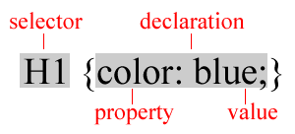
1. CSS properties…
A rule consists of
A selector: element or elements the declaration applies to
Declaration: how the elements referred to in the selector should be styled
property: which is the property of the selected element
value: which is a specification for this property

Slide 8
1. CSS properties…
To control the presentation of an element, you need to know the corresponding properties
Properties with related functionalities are grouped together
Example:
Properties to control the presentation of text

Slide 9
2. Font properties
When text is displayed in a browser it appears in a default font face, size, style, and color.
Most browsers use the Times New Roman font face at approximately 12-point size and rendered in black.
CSS settings permit you to change these default settings to bring a different look to your pages.
Several properties allow you to control the appearance of text in your documents
These properties directly affect the font and its appearance

Slide 10
2. Font properties…
Common font properties:
font-family
font-size
font-weight
font-style
font-variant

Slide 11
2.1 font-family
A generic description of a range of font types all having a similar design supported by all CSS capable browsers
The font-family property needs to be specified to change the browser's default setting from Times New Roman.
Five generic font families are supported by Cascading Style Sheets:
Serif (e.g., Times)
Sans-serif (e.g., Arial or Helvetica)
Cursive (e.g., Zapf-Chancery)
Fantasy (e.g., Western)
Monospace (e.g., Courier)

Slide 12
2.1 font-family
A computer may provide additional font families that supplement generic font families
You cannot assume these additional families will be available
So if used specify a generic font to use if the specific font family is not available
The following font faces are typical on a Windows-based PC:
arial
arial narrow
comic sans ms
courier new
georgia
impact
tahoma
times new roman
verdana

Slide 13
2.1 font-family (Example)
Example:
h1, h2, h3, h4, h5, h6 {font-family: Arial Helvetica sans-serif}
As with the <font> tag proceed from the most unlikely to the most likely font family
Similar to <font face=“face”> attribute

Slide 14
2.2 font-size
The font-size property is used to change the browser's default 12-point size.
You can use pixels to set letter heights for special styling.
In pixels (12px,20px etc.)
Absolute size (small, medium, lage, x-large etc.)
Two ways to specify:
Absolute
Relative
Using a Keyword description
As a percent of the default font size for a tag

Slide 15
2.2 font-size (Absolute Font)
millimeters (use mm)
inches (use in)
points (72 points per inch; use pt)
pica (6 picas per inch; use pc)
pixel (use px)
Smallest display element on computer monitor
Can specify decimal units:
h1 {font-size: 0.5in}

Slide 16
2.2 font-size (Relative Font)
Specify according to relationship to the standard character
Standard characters: em and ex
EM Unit
Equal to width of capital letter “M” in the default font
EX Unit
Equal to the height of a lower case “x” in the default font

Slide 17
2.2.1 Advantages of relative unit.
Allows for scalable fonts
Monitors vary in size of display and screen resolution
Specifying a relative unit ensures a uniform viewing experience across the variety of monitors rendering your page
As a scalable font:
body {font-size: 150%}
Use descriptive keywords: xx-small through xx-large:
b {font-size: xx-large}

Slide 18
2.3 font-style
Specifies appearance of font
Browser default is the normal style.
Syntax: font-style: style_type
Style Types:
normal
italic
oblique (similar to italic)
Example:
p {font-style: italic}

Slide 19
2.3 font-weight
Specifies the degree of “boldness” of the type
Specifies whether the font should be bold or normal
Specified from 100-900 in intervals of 100
100 is lightest
900 is heaviest
Example:
p {font-weight: 300}

Slide 20
2.3 font-variant
Specifies whether the font should be normal or small-caps (smaller version of upper case)
Attribute values:
normal
small-caps (EXAMPLE)
Uppercases but reduces font size
Specifying normal returns the text to standard display.
Example:
H1{font-variant:small-caps}

Slide 21
2.3 font Property
Pools together a variety of text and font attributes
Attribute values are positional: font-style specified first, font-variant second, font-weight last
Example:
h2 {font: italic small-caps bold}
(instead of)
h2 {font-style:italic; font-variant:small-caps; font-weight:bold}

Slide 22
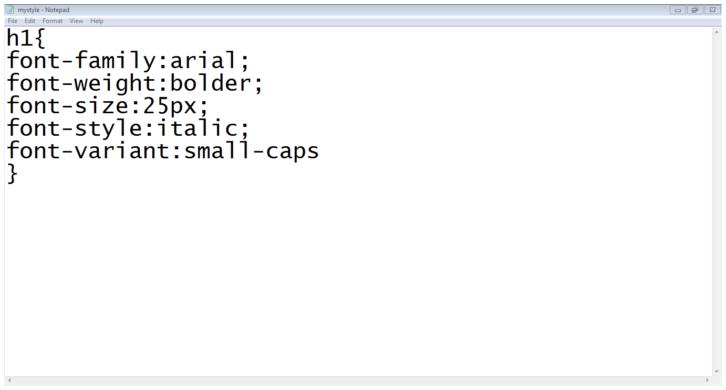
2. Font properties… (Example)
selector
Font properties
End of CSS rule

Slide 23
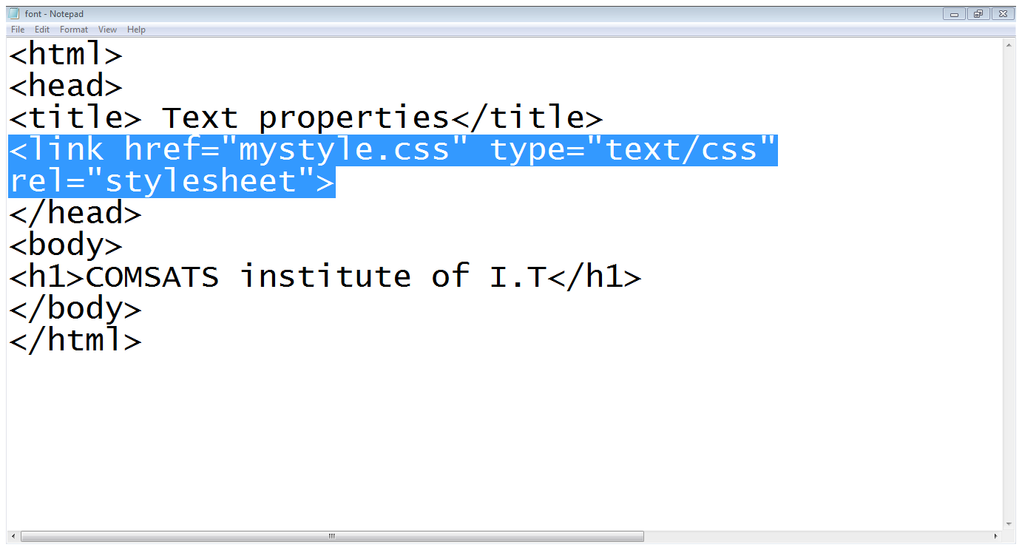
2. Font properties… (Example)
Including stylesheet
Using h1 tag

Slide 24

2. Font properties… (Example)

Slide 25
3. Text properties
Font settings can be paired with other style sheet properties to apply additional formatting to strings of text.
The following text properties can be paired with font settings to bring more variety to text displays.
word-spacing
letter-spacing
line-height
text-align
vertical-align
text-indent
text-decoration
text-transformation

Slide 26
3. Text properties
Word, letter and line spacing specify amount of white space to leave between words, letters and lines
Syntax:
word-spacing: size
letter-spacing: size
line-height: size
Size can be expressed as “normal” (browser determines spacing) or a specific unit

Slide 27
3. Text properties
p {letter-spacing: 1 em}
Might render: L e t t e r
p {word-spacing: 2 em}
Might render: This is an example
p {line-height: 2}
Indicates line height is twice the font size height
Default is 1.2

Slide 28
3. Text properties
color
text-align
vertical-align
text-decoration
text-transform
word-spacing
letter-spacing

Slide 29
3. Text properties
color:
specifies the color of the text
P{color : green}
text-align:
horizontal alignment of the text
Left, right, center or justify
vertical-align:
Vertical alignment of the text
Sub, super, top, middle, bottom

Slide 30
3. Text properties
text-decoration:
specifies the whether the text should be underline, overline, line-through or blinking
text-transform:
text should be lowercase, uppercase or capitalized
letter-spacing:
Specifies the space between letters
H1{letter-spacing:3px}

Slide 31
3. Text properties
word-spacing:
Specifies the space between words
H1{word-spacing:4px}

Slide 32
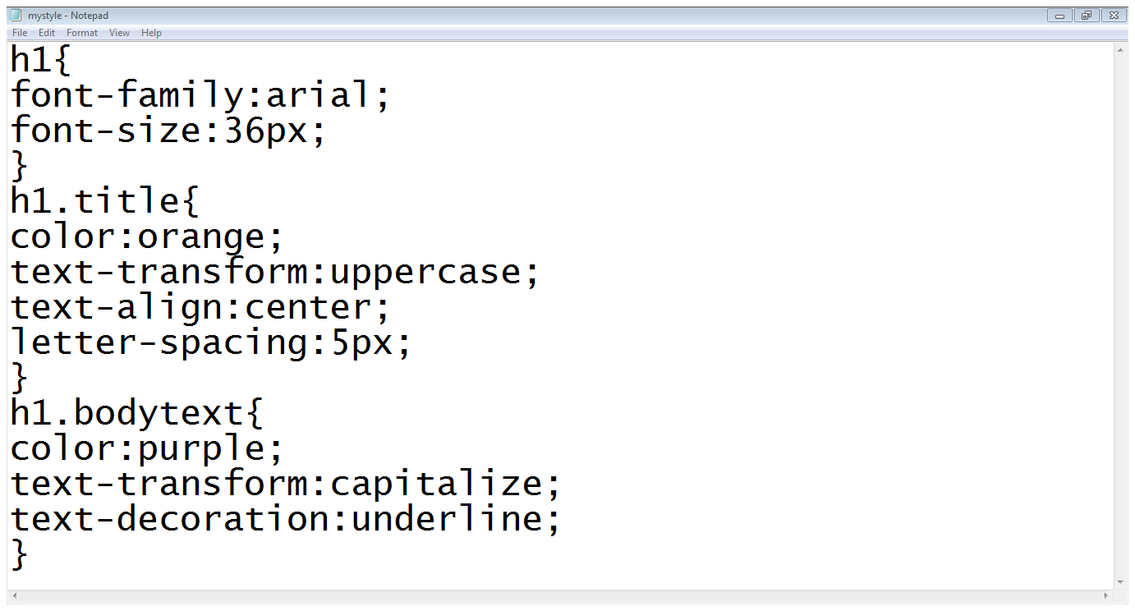
3. Text properties
Basic properties
Class declaration
Class properties
Second class properties

Slide 33
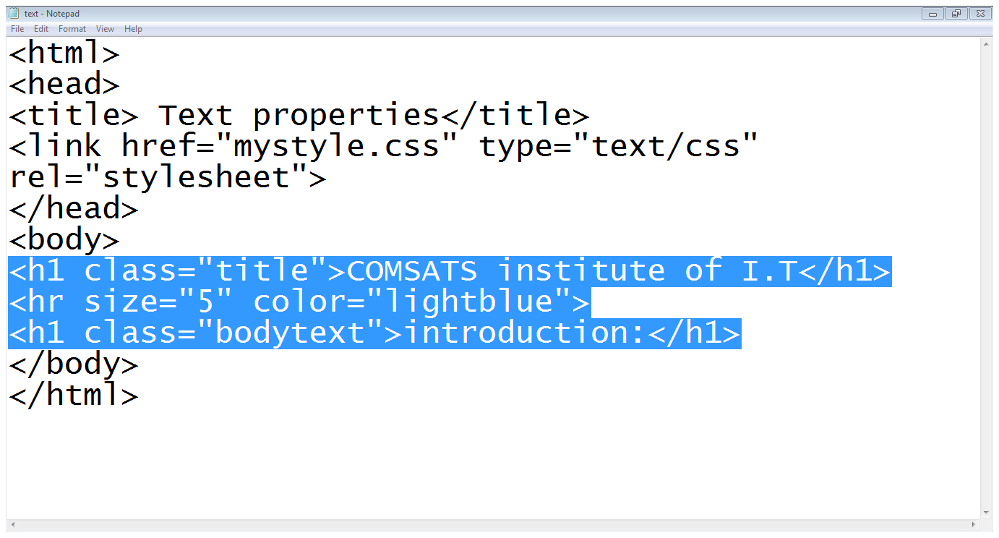
3. Text properties
Title class
Bodytext class
Horizontal line

Slide 34

3. Text properties

Slide 35
3. Styling Links
color :
Changes the color of the links
background-color :
Highlights the link, as if it had been highlighted with a highlighter pen
text-decoration :
Underline, strike through, over-line, blink

Slide 36
3. Styling links…
Pseudo-classes of links:
Link:
Styles for links in general
Visited:
Styles the links which are already visited
Hover:
Styles when some on hovering over a link
Active:
Styles the links when a links is being clicked

Slide 37
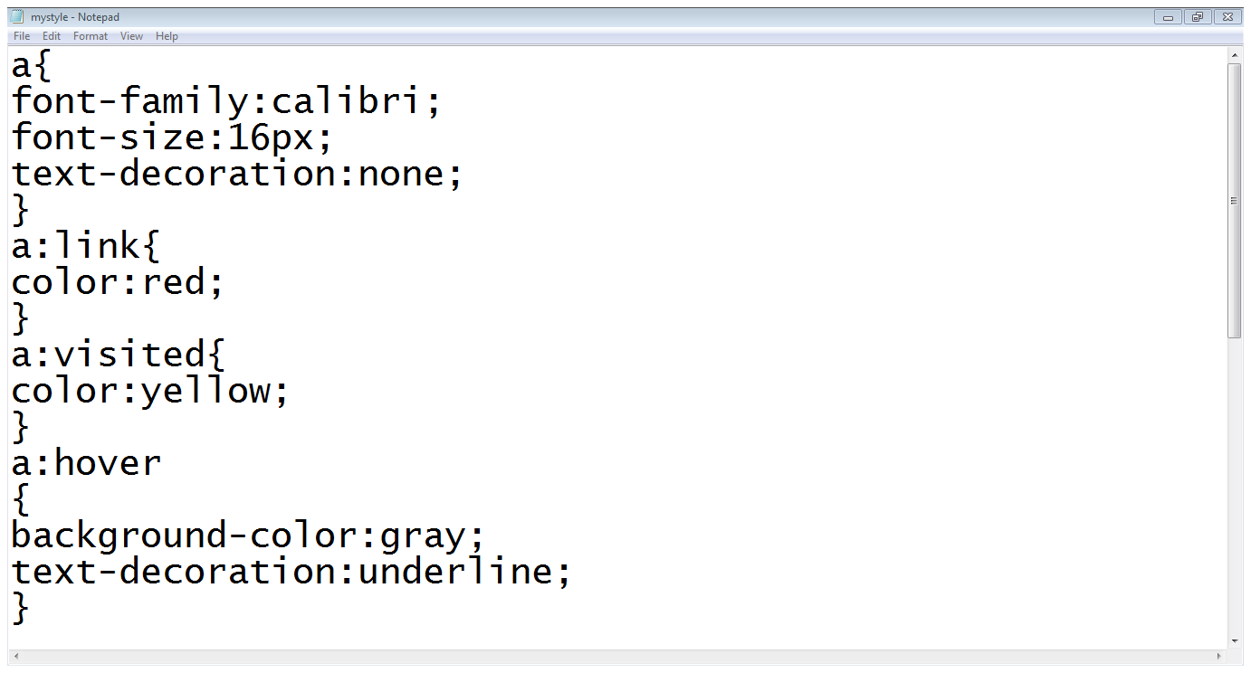
3. Styling links…
a tag style
Link settings
Visited settings
Hover settings

Slide 38
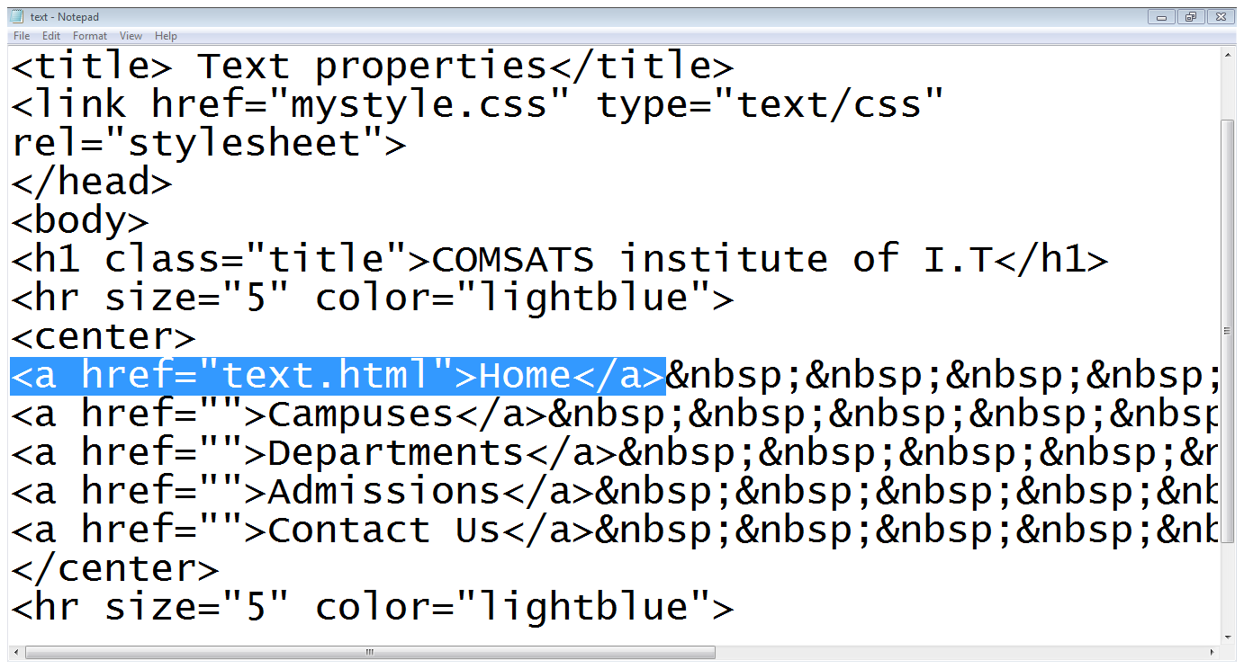
3. Styling links…
Link added

Slide 39
4. Styling Background
background-color:
Specifies the background color
background-image:
Specifies the background image
background-repeat:
Specifies whether the image should repeat or not
background-position:
Where an image should be positioned

Slide 40
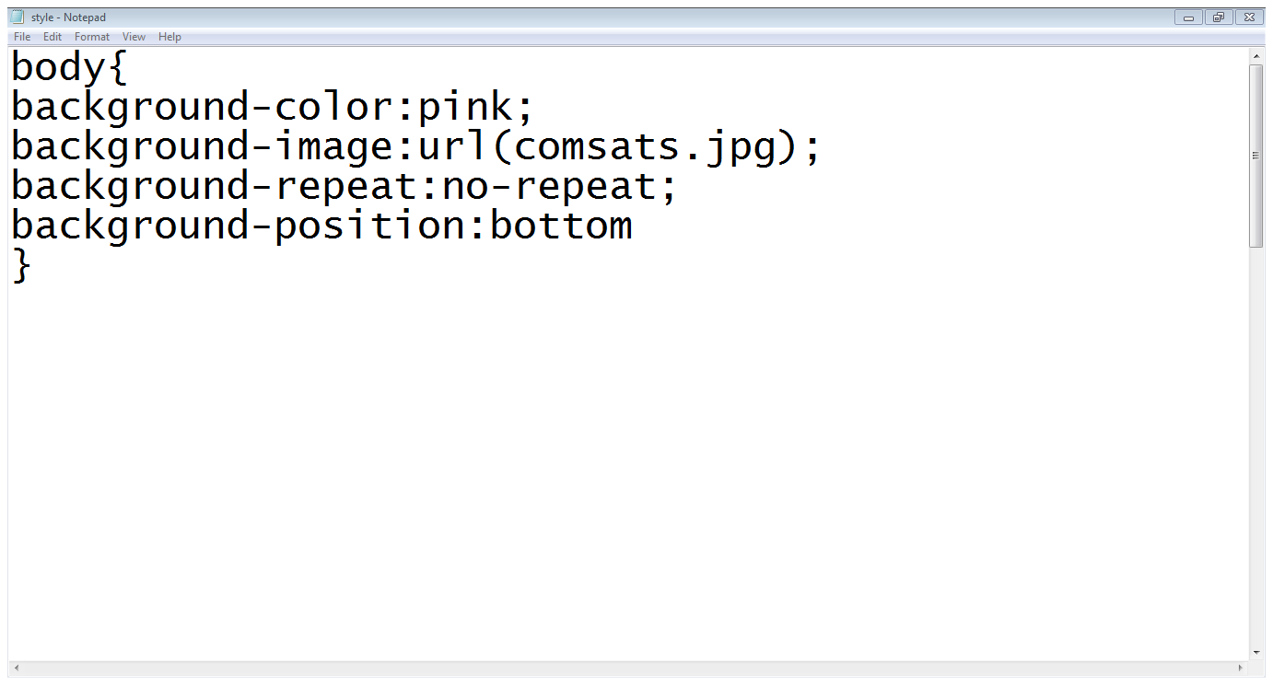
4. Styling Background…

Slide 41
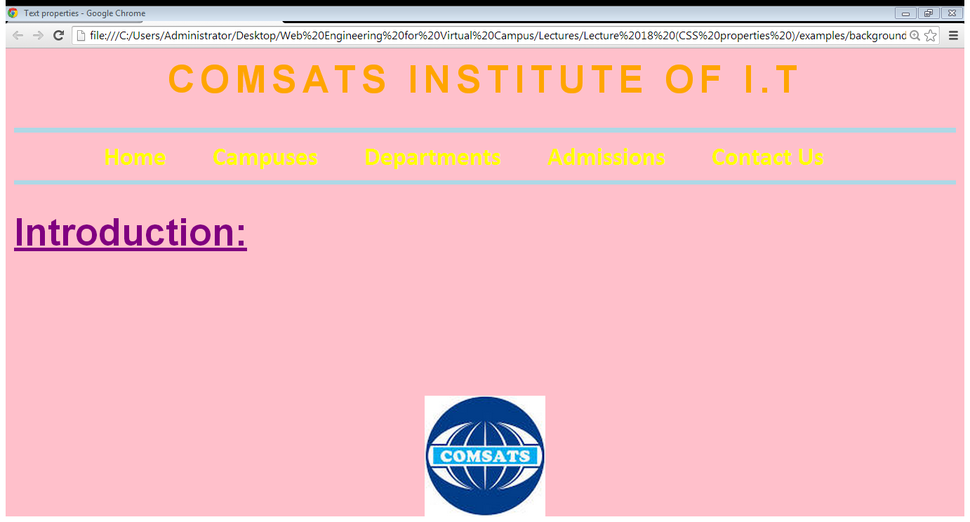
4. Styling Background…

Slide 42
5. Styling tables
text and font
vertical – align
width
height
background - color
background - image

Slide 43
5. Styling tables
border :
border-style (solid, dashed, doted, double etc.)
border-color
border-bottom (solid, dashed, doted, double etc.)
padding
Padding-left
Padding-right
Padding-top
padding-bottom

Slide 44
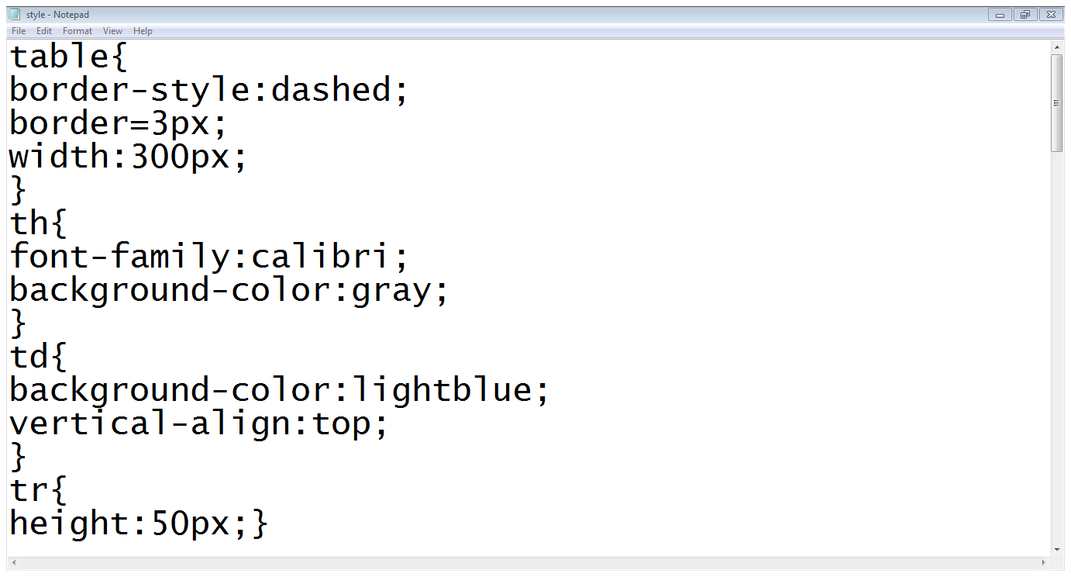
5. Styling tables…
Table settings
Th settings
Td settings
Tr settings

Slide 45
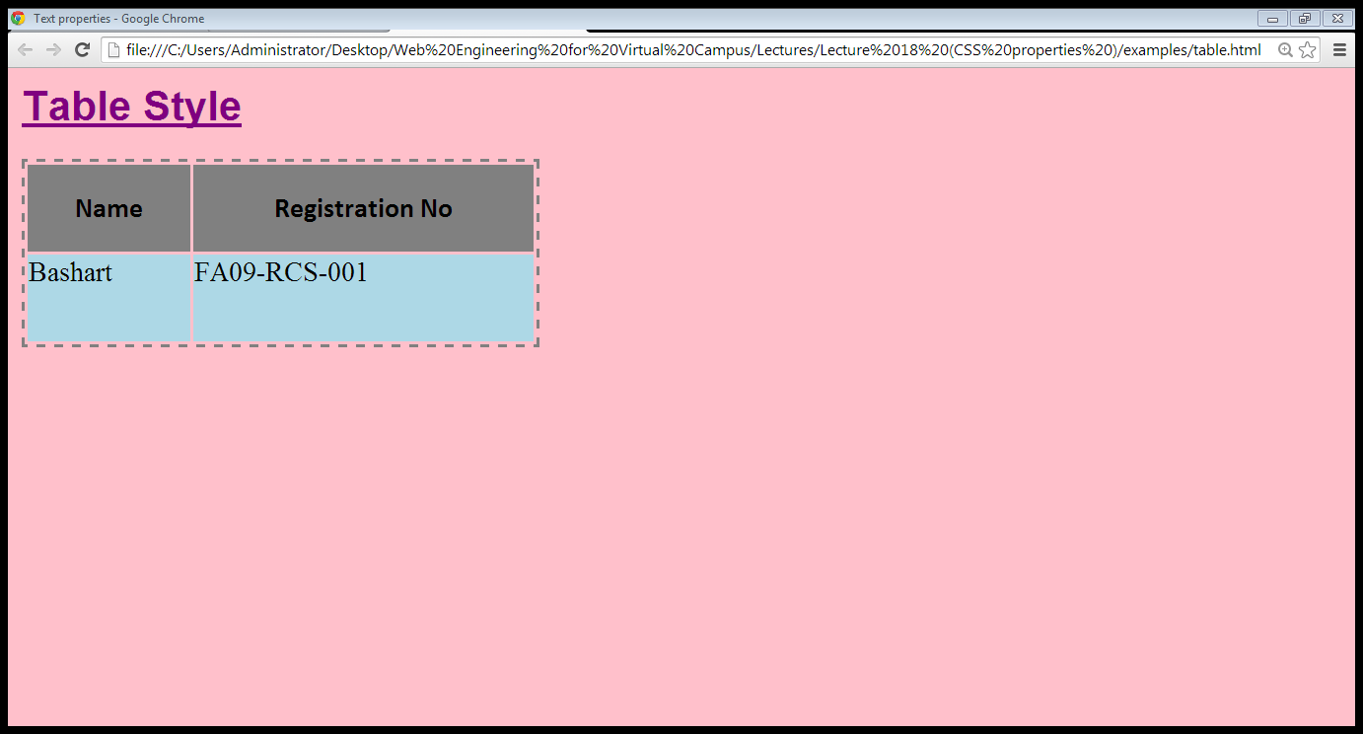
5. Styling tables…

Slide 46
Summary
Font properties
font-family
font-size
font-weight
font-style
font-variant
Controlling text with CSS
word-spacing
letter-spacing
line-height
text-align
vertical-align
text-indent
text-decoration
text-transformation

Slide 47
Summary
Styling links
Styling background
background-color
background-image
background-repeat
background-position
Styling tables
text and font
vertical – align
width
height
background - color
background - image

Slide 48
THANK YOU

