Slide 1


Slide 2
Web Technologies and Programming
Lecture 14

Slide 3
Page Layout

Slide 4
Summary of the previous lecture
Font properties
font-family
font-size
font-weight
font-style
font-variant
Controlling text with CSS
word-spacing
letter-spacing
line-height
text-align
vertical-align
text-indent
text-decoration
text-transformation

Slide 5
Summary of the previous lecture
Styling links
Styling background
background-color
background-image
background-repeat
background-position
Styling tables
text and font
vertical – align
width
height
background - color
background - image

Slide 6
Outline
The process to design a page layout
div tag
Coding a page using divs and CSS
Styling divs and positioning it.

Slide 7
Consider a web application to develop
CONNECTIONS: a smaller version of social web
Users can register themselves
After registration they can send a text message to anybody who is registered with the website
User’s can view the received messages

Slide 8
1. The process
Determine the requirements of the site
Group the required information
Make a site map
Identify key elements for each page
Decide about the arrangement of information on each page
Translate the design into code

Slide 9
1.1 Determining requirements
Under standing the audience
Who? Who will visit the site?
You can create fictional visitors
Men and women of 20 to 50 years of age
Why? Why have they come to your site?
Send messages
View received messages

Slide 10
1.1 Determining requirements…
What? What does a visitor need to achieve a goal?
Will they be familiar with your product?
How often? How often can you realistically expect them to visit?
In-order to make changes

Slide 11
1.1 Determining requirements…
Things You Want the Site to Do
Determining the requirement of the owner of the site which are not already listed
User must register themselves in-order to send and receive messages

Slide 12
1.2 Grouping and categorization
Group related information/sections
Home page: login form, registration form
User page: user’s information, recent messages
Inbox: Received messages
Outbox: Sent messages
Send a message: Send message form

Slide 13
1.3 Make a site map…
Site map shows how many pages you need and how they relate
Usually look like either a family tree or folder list

Slide 14
1.3 Make a site map
Home page
User page
Inbox
Outbox
Send a message

Slide 15
1.4 Key element for each page
Common sections (header, navigation, footer etc.)
Page specific sections
Common Sections (header, footer)
Page specific sections
Home page: login form, registration form
User page: user’s information, recent messages

Slide 16
1.4 Key element for each page…
Inbox page: received messages
Outbox page: messages sent by the user
Send message page: form to send a message

Slide 17
1.5 Arranging elements on pages
header
Logo
Web Page
Login form
Sign-In form
Footer

Slide 18
1.5 Arranging elements on pages…
User Info
User data
User Picture
Message
Actions
Recent Messages

Slide 19
2. Translating design into code
Liquid vs Fixed design
The Div tag
Coding the design

Slide 20
2.1 Liquid vs Fixed design
Liquid Design
designs automatically fits to the screen
Use percentage values to declare height and width of sections
Fixed design
Designs remain fixed width
Use fixed values to declare height and width of sections

Slide 21
2.2 The <div> Tag
Use DIVs to create the skeleton of the page.
There should be no display-specific information in the XHTML
The Goal: separate the information from the layout / presentation of the page
Layout is entirely controlled by CSS

Slide 22
2.2 The <div> Tag
The <div> tag defines a division or a section in an HTML document.
The <div> tag is used to group block-elements to format them with CSS.
Tip: The <div> element is very often used together with CSS, to layout a web page.
Note: By default, browsers always place a line break before and after the <div> element. However, this can be changed with CSS.

Slide 23
2.2 The <div> Tag
Identify major sections of the page
Masthead (Logo and Title)
Menu
Content
Search
Footer
Don’t overuse the DIVs!
Don’t worry about positioning in the XHTML!

Slide 24
2.2 The <div> tag
Defines a division or section in an HTML document
Visually, allows us to make containers that can be formatted
Does not format by itself
Used to logically group a sequence of block level tags
Don’t try to use it to use it to group tags that are not block level, like <b>
Can be declared as
<div>……</div>

Slide 25
2.2 The <div> tag
Any block level tag can have its width and height set
Be careful especially with height because if text exceeds the size of the area allocated unpredictable things might occur
Example: Keep the <body> to 75% of the width of the browser window
body {width:75%}

Slide 26
2.2 The <div> tag
Use the float attribute:
float:right|left
Text is aligned around the block level tag
clear:right|left|both
Prevents a floating element from appearing along-side a block level element

Slide 27
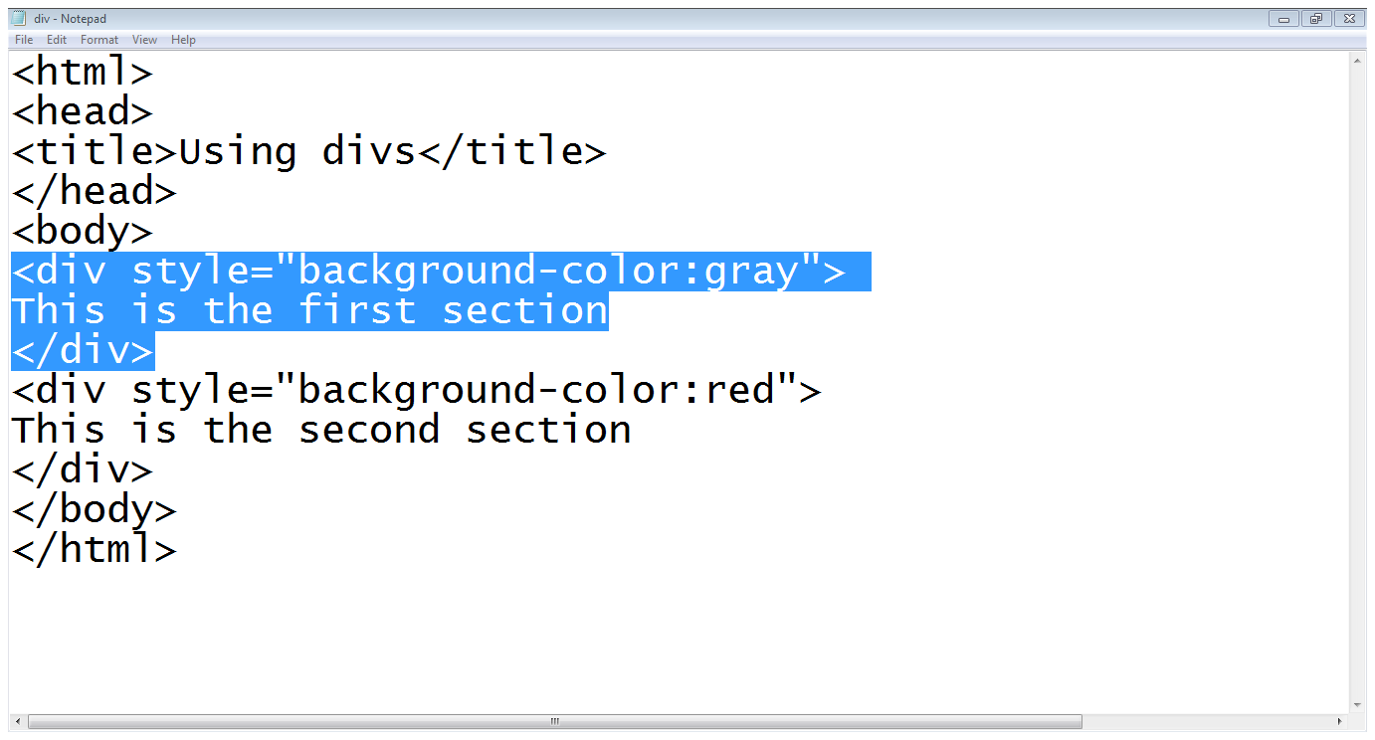
2.2 The <div> tag (Example)
Div style
Starts a div
Div contents
Div ends
Second div

Slide 28
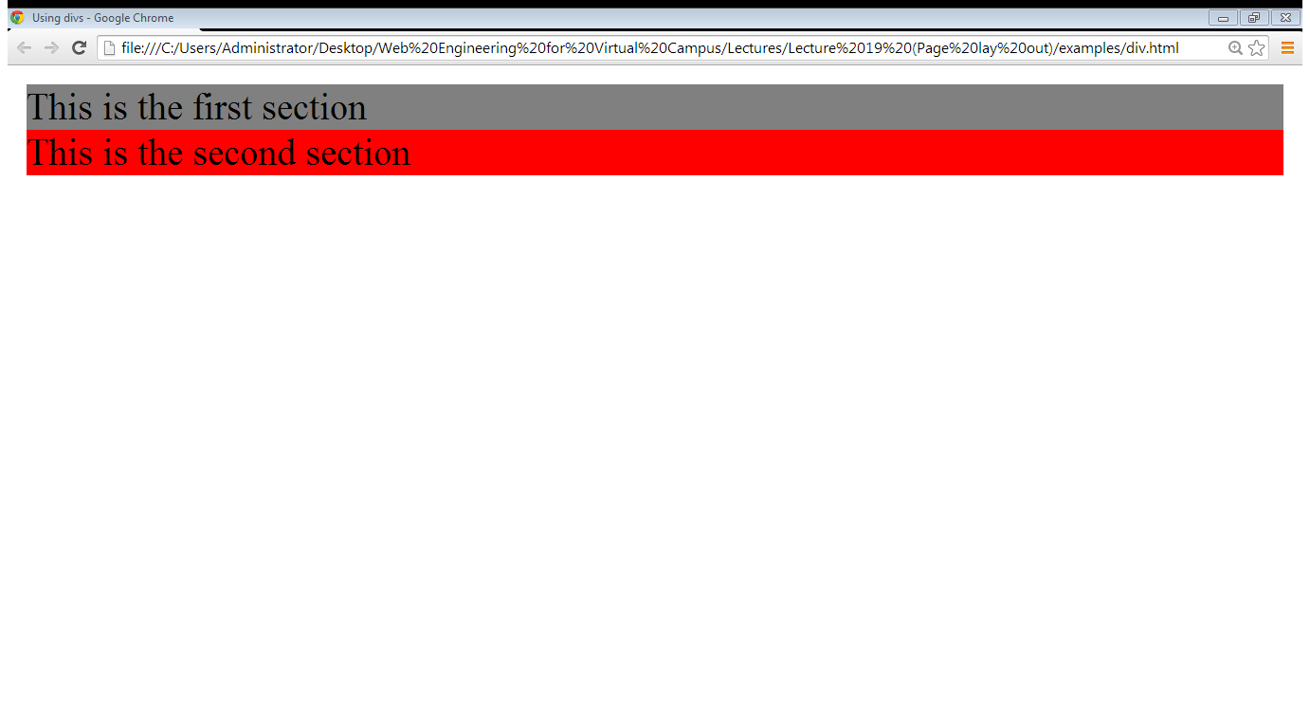
2.2 The <div> tag (Example)
First div
Second div

Slide 29
2.3 Coding the design
<div id=“container”>
<div id=“header”>
<div id=“logo”></div>
</div> //header div ends
</div> //container div ends

Slide 30
2.3 Coding the design…
<div id=“container”>
Header and logo divs
<div id=“center-content”>
<div id=“form-containter”>
<div class=“form-heading”>
Heading text </div>
<div class=“form-rows”>
Form element </div>
</div> //form container ends
</div> //end of center content
</div> //container div ends

Slide 31
2.3 Coding the design…
<div id=“container”>
Header and logo divs
<div id=“center-content”>
Login form div’s
<div id=“form-containter”>
<div class=“form-heading”>
Heading text </div>
<div class=“form-rows”>
Form element </div>
</div> //form container ends
</div> //end of center content
</div> //container div ends

Slide 32
2.3 Coding the design…
<div id=“container”>
Header and logo divs
<div id=“center-content”>
Login form div’s
Registration form div’s
</div> //end of center content
<div id=“footer”>
</div>
</div> //container div ends

Slide 33
2.3 Coding the design…
Divs required to make the structure:
Main container
Header
Logo
Center container
Form container
Form heading
Form row

Slide 34
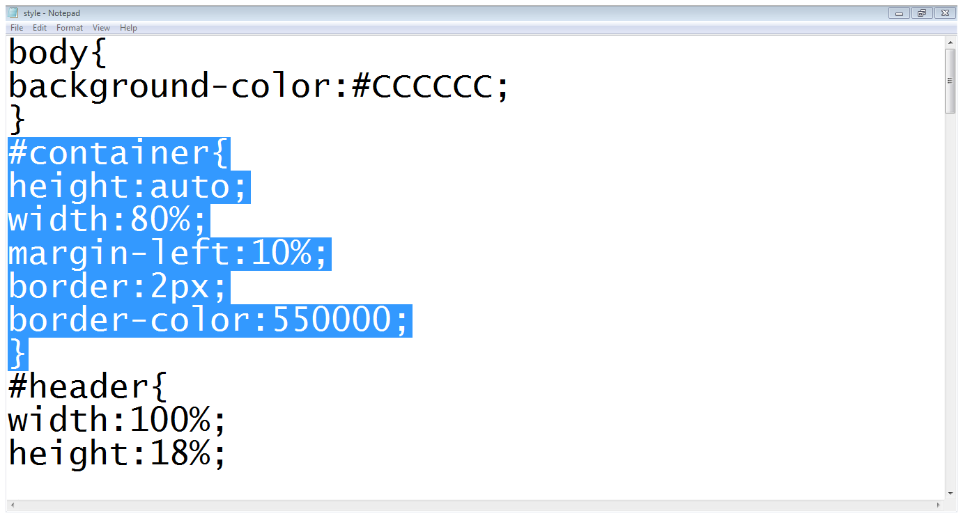
2.3 Coding the design…
Main container

Slide 35
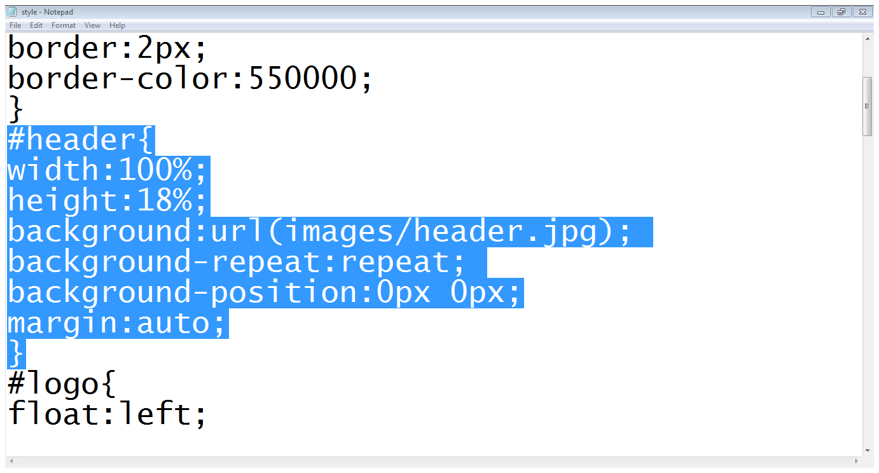
2.3 Coding the design…
Header div

Slide 36
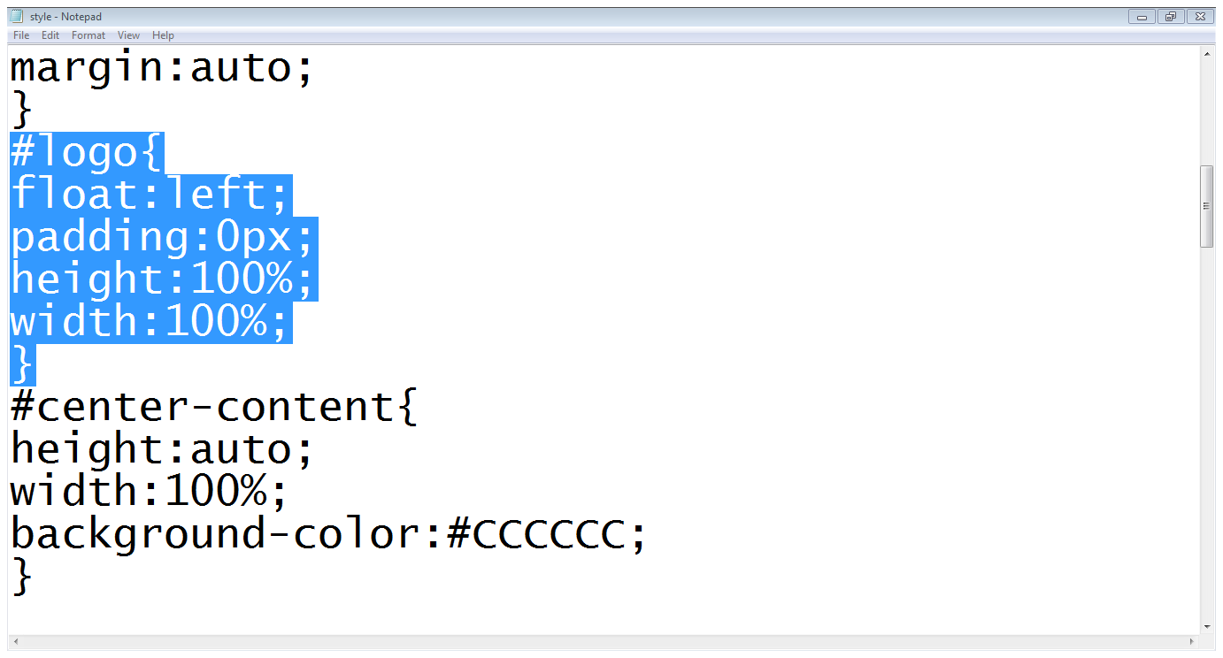
2.3 Coding the design…
Logo div
Center content

Slide 37
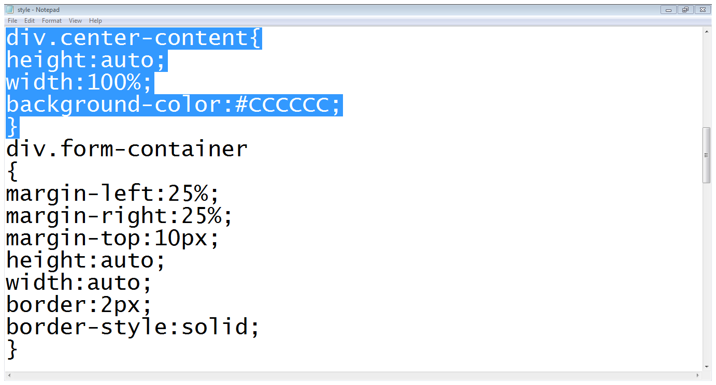
2.3 Coding the design…
Center content
Form container

Slide 38
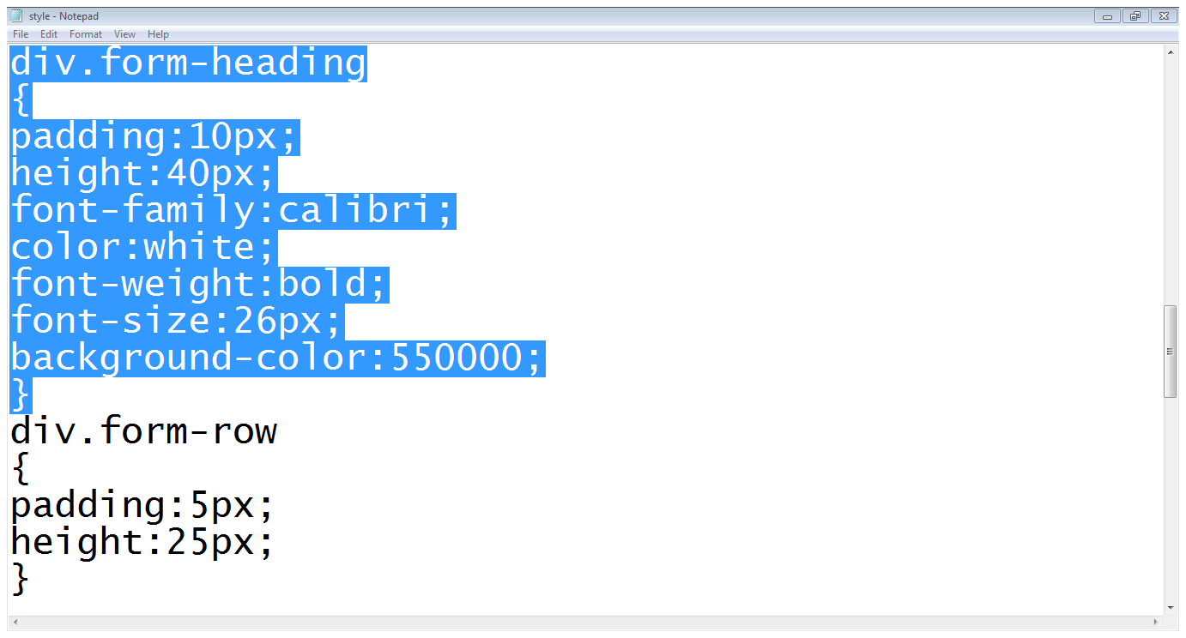
2.3 Coding the design…
Form heading
Form row

Slide 39
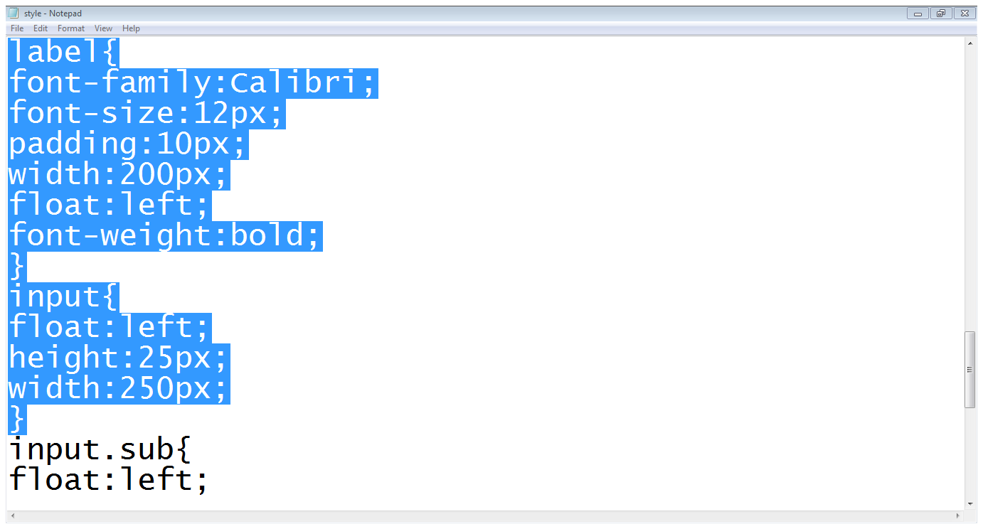
2.3 Coding the design…
Styling label
Styling input field

Slide 40
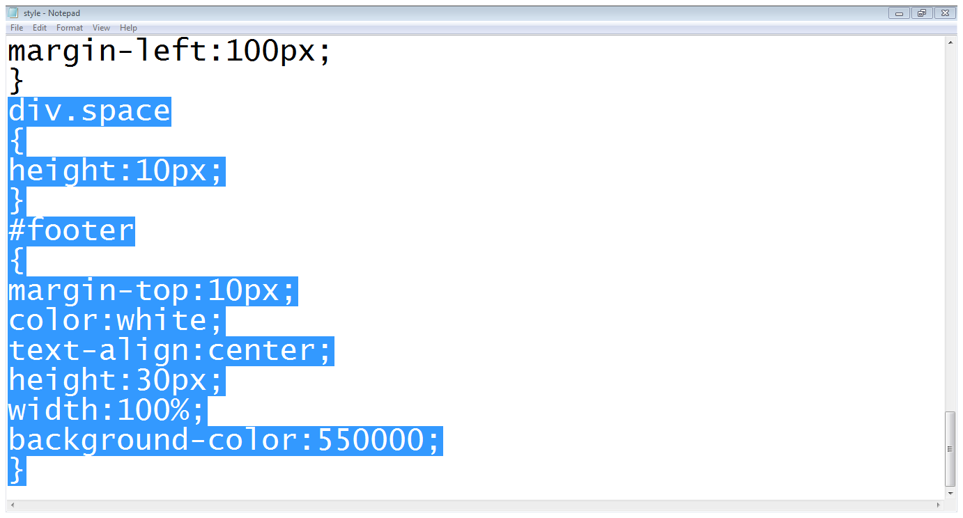
2.3 Coding the design…
Div adding space
Footer div

Slide 41
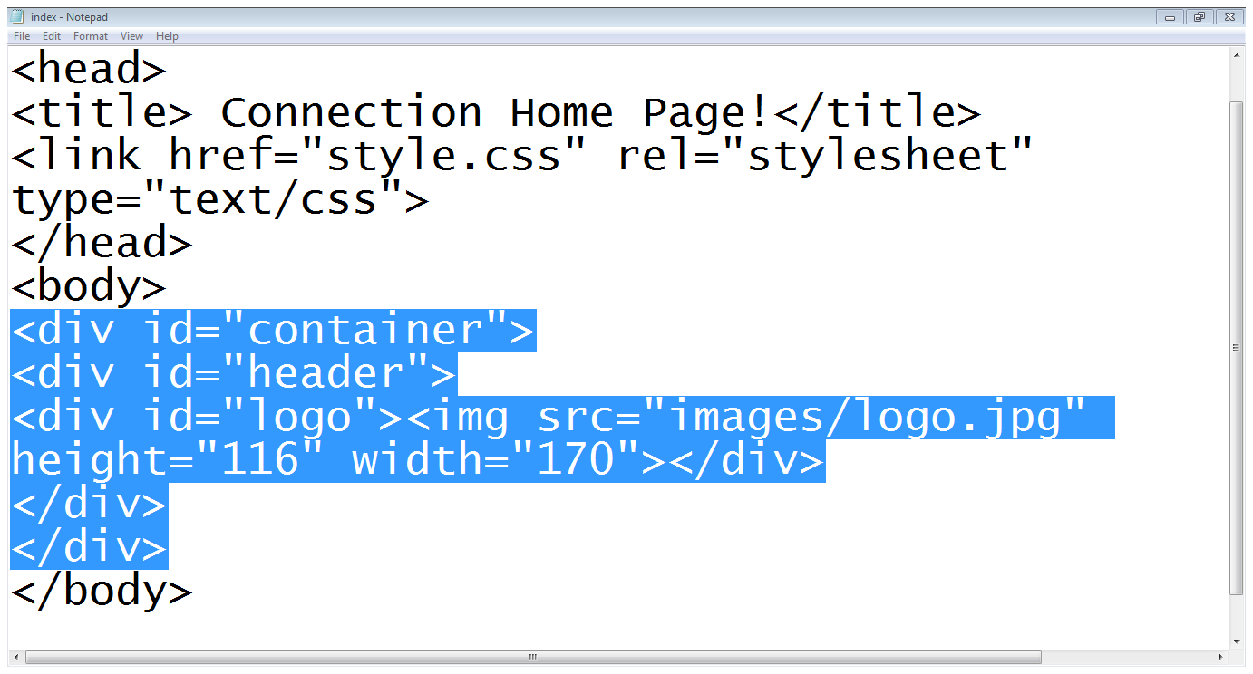
2.3 Coding the design…
Container div
Header div
Header ends
Logo div
Container ends

Slide 42
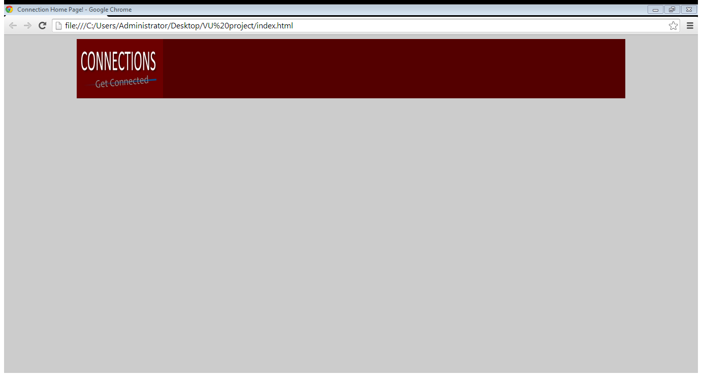
2.3 Coding the design…

Slide 43
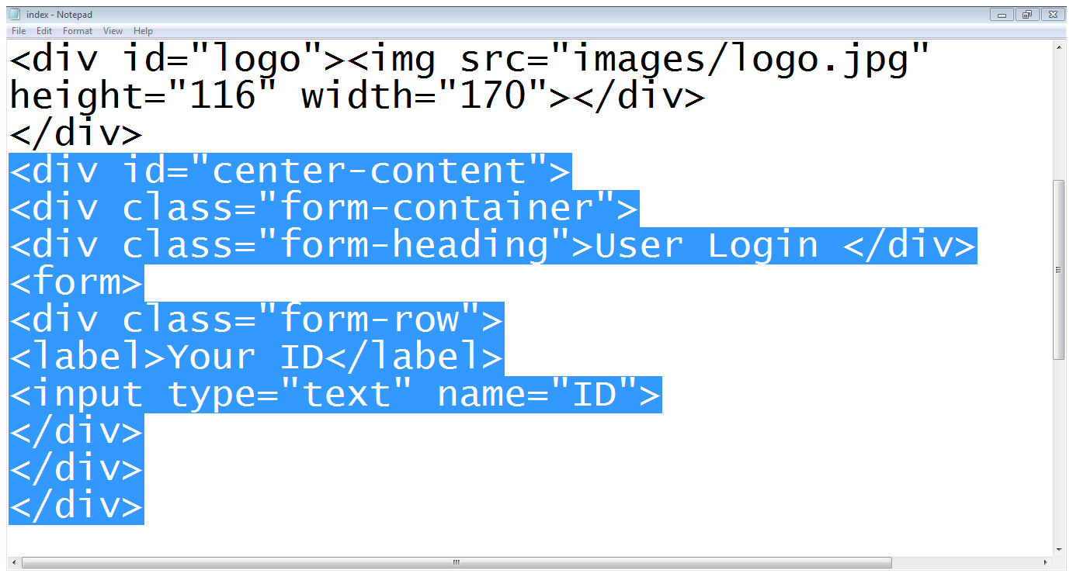
2.3 Coding the design…
Center content starts
Form container start
Form starts
Form heading
Row starts
Label
Input field
Row ends
Form container end
Center content ends

Slide 44
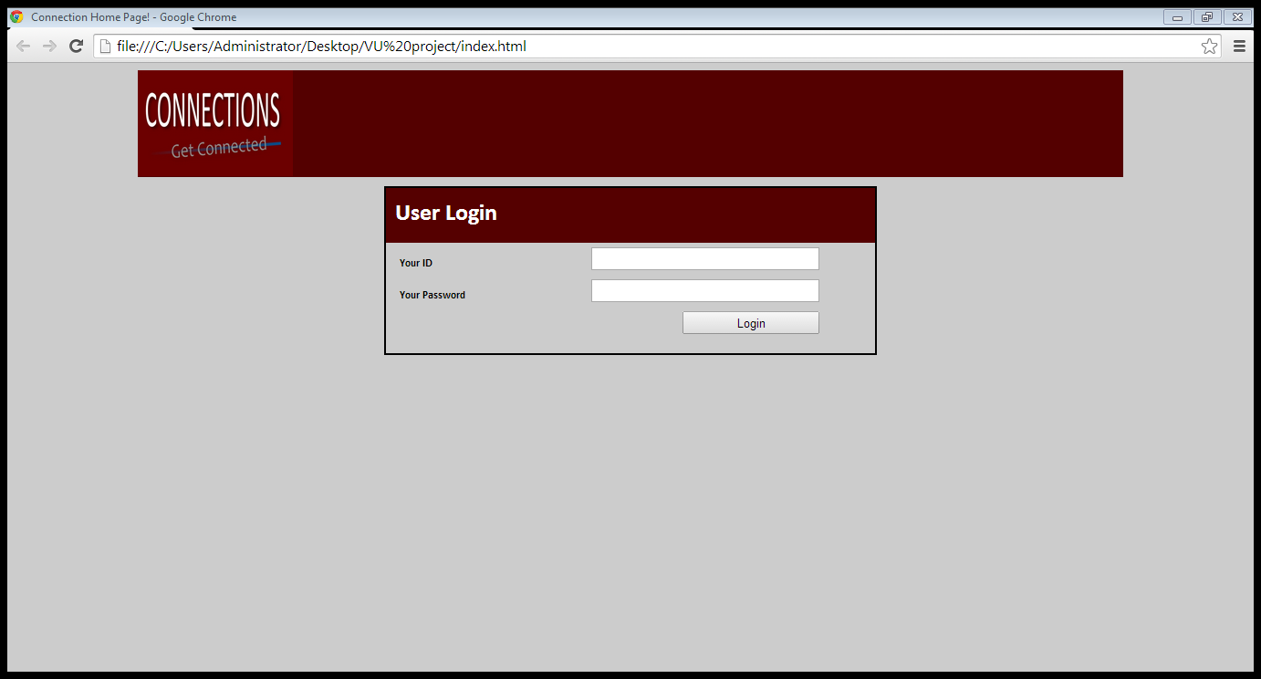
2.3 Coding the design…

Slide 45
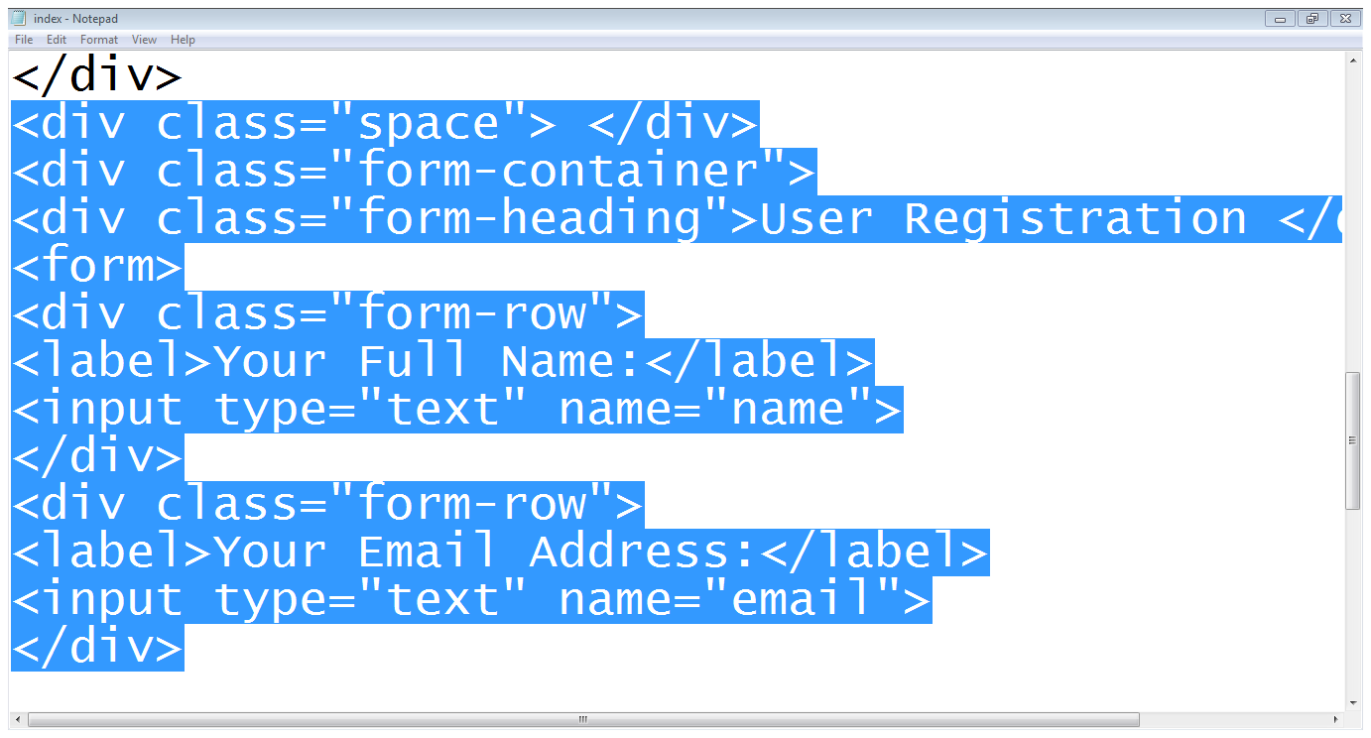
2.3 Coding the design…
Space is added
Form container
heading
Form row
Second row

Slide 46
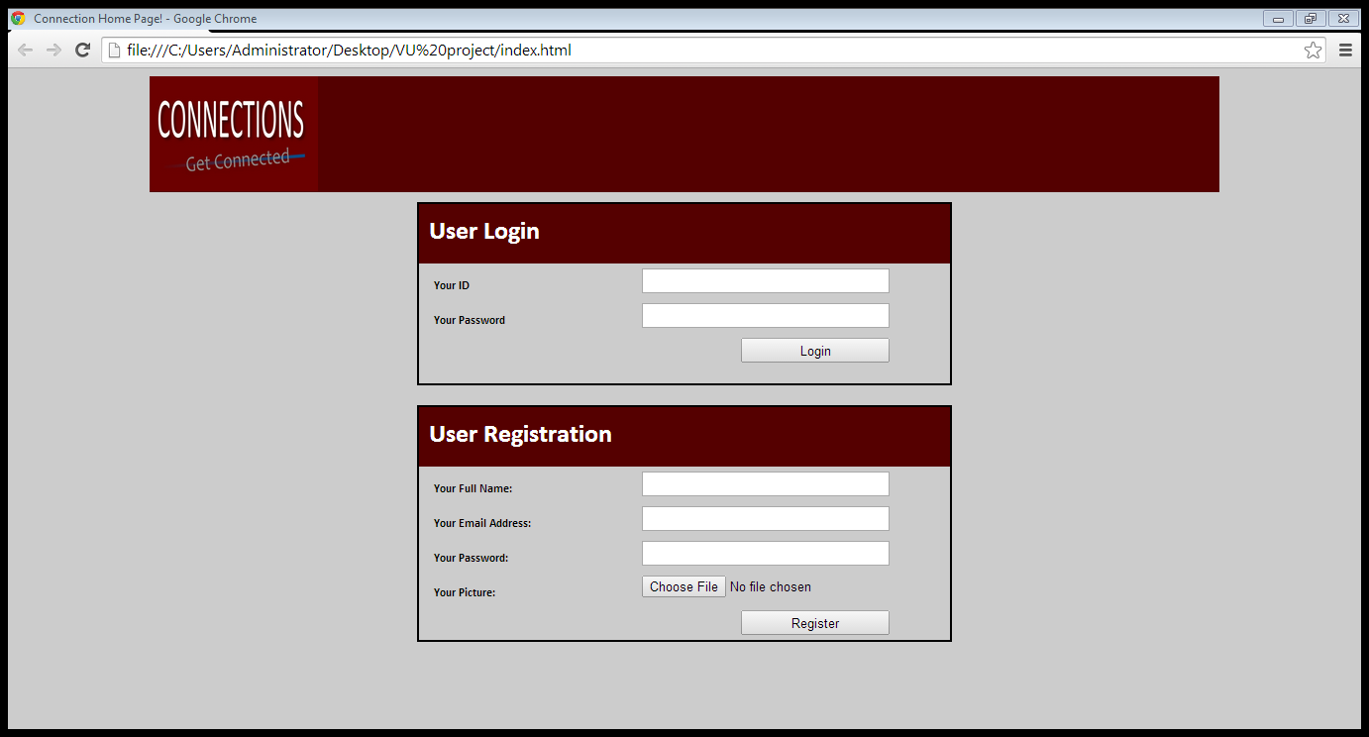
2.3 Coding the design…

Slide 47
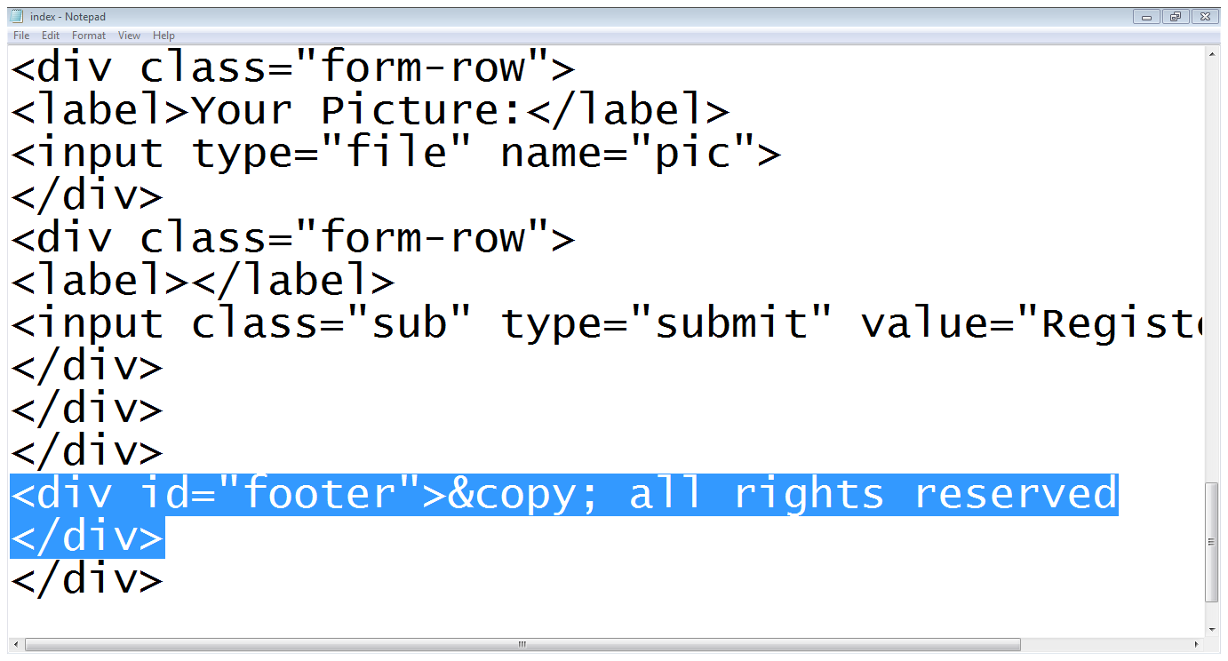
2.3 Coding the design…
Footer div

Slide 48
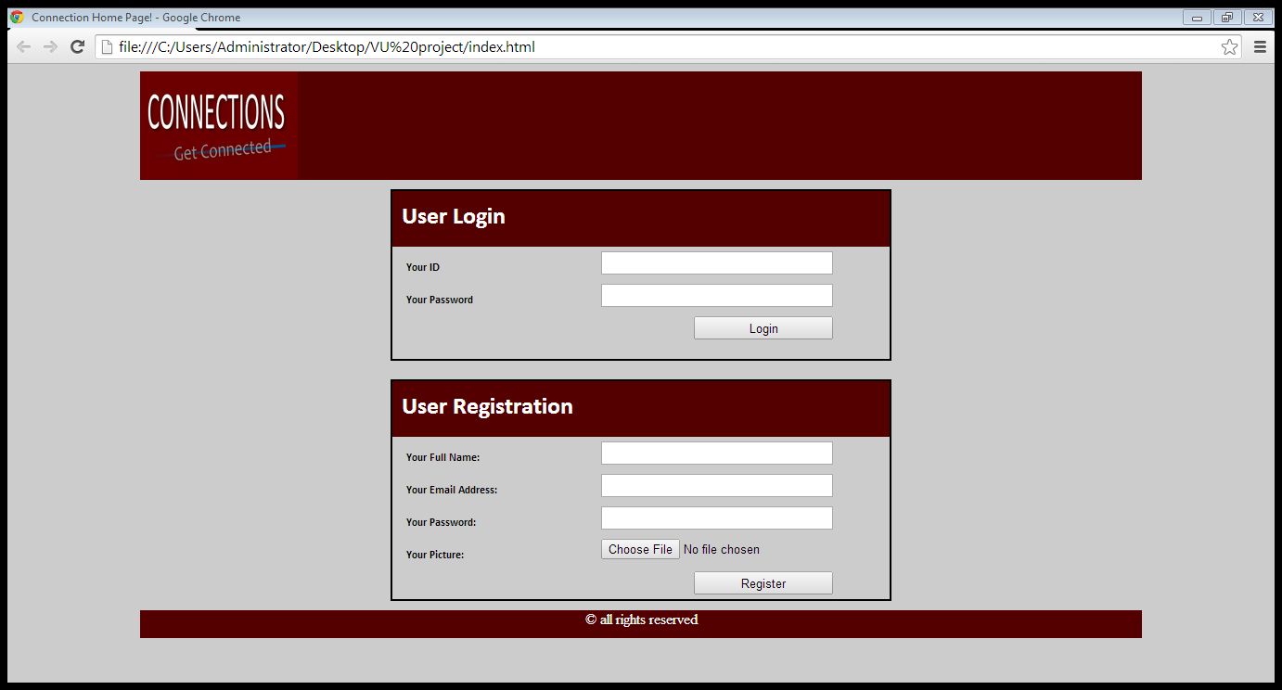
2.3 Coding the design…

Slide 49
Summary
The process to design a page layout
Determining requirements
Grouping and categorization
Key element for each page
Translating design into code
Liquid vs Fixed design
The Div tag
Coding the design
Coding a page using divs and CSS
Positioning and resizing divs.

Slide 50
THANK YOU

