Slide 1


Slide 2
Web Technologies and Programming
Lecture 15

Slide 3
CSS 3

Slide 4
Summary of the previous lecture
The process to design a page layout
Determining requirements
Grouping and categorization
Key element for each page
Translating design into code
Liquid vs Fixed design
The Div tag
Coding the design
Coding a page using divs and CSS
Positioning and resizing divs.

Slide 5
Outline
Introduction to CSS3.
CSS3 Properties.
Rounded Corners, Box Shadows.
CSS3 Transformations.
CSS3 Media Queries.

Slide 6
1. Introduction to CSS 3
Draft Published in 1999, Released in 2012.
Backward Compatible with CSS2 and CSS1.
CSS3 has been split into different modules.
It also contains Old CSS Specification. But some old CSS tags has been removed in this version.
Fully Supported in only modern browsers like Google Chrome, Internet Explorer 11 etc.

Slide 7
1. Introduction to CSS 3
Designed to be smaller and faster than other CSS frameworks.
Designed to be easier to learn, and easier to use than other CSS frameworks.
Designed to provide CSS equality for all devices: PC, laptop, tablet, and mobile.
Designed to use standard CSS only
Designed to speed up mobile HTML apps.

Slide 8
1. Introduction to CSS 3
CSS3 is split up into "modules". Some of the most important CSS3 modules are
Selectors
Box Model
Backgrounds and Borders
Text Effects
2D/3D Transformations
Animations
Multiple Column Layout
User Interface

Slide 9
1.1 CSS3 Rounded Corners.
With CSS3, you can give any element "rounded corners", by using the border-radius property.
You can specify each corner separately if you wish. Here are the rules:
Four values: first value applies to top-left, second value applies to top-right, third value applies to bottom-right, and fourth value applies to bottom-left corner
Three values: first value applies to top-left, second value applies to top-right and bottom-left, and third value applies to bottom-right
Two values: first value applies to top-left and bottom-right corner, and the second value applies to top-right and bottom-left corner
One value: all four corners are rounded equally

Slide 10
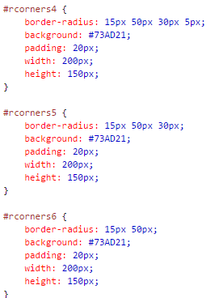
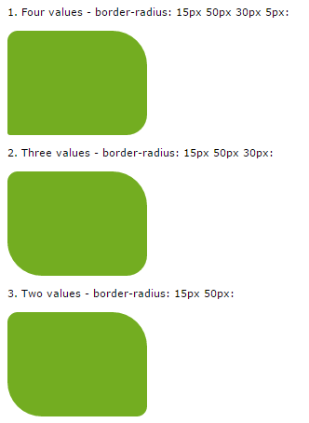
1.1 CSS3 Rounded Corners.

Slide 11
1.2 CSS3 Border Images.
The CSS3 border-image property allows you to specify an image to be used instead of the normal border around an element.
The property has three parts:
The image to use as the border
Where to slice the image
Define whether the middle sections should be repeated or stretched

Slide 12
1.2 CSS3 Border Images.
The border-image property takes the image and slices it into nine sections, like a tic-tac-toe board. It then places the corners at the corners, and the middle sections are repeated or stretched as you specify.
Note: For border-image to work, the element also needs the border property set!

Slide 13
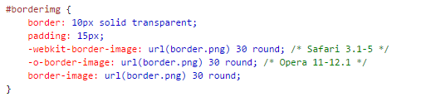
1.2 CSS3 Border Images.

Slide 14
1.3 CSS3 Background.
CSS3 allows you to add multiple background images for an element, through the background-image property.
The different background images are separated by commas, and the images are stacked on top of each other, where the first image is closest to the viewer.

Slide 15
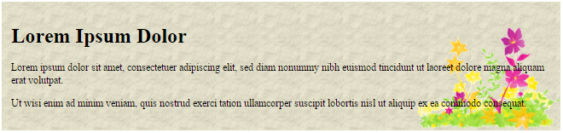

1.3 CSS3 Background.

Slide 16
1.3 CSS3 Background.
Background-size:
The CSS3 background-size property allows you to specify the size of background images.
Before CSS3, the size of a background image was the actual size of the image. CSS3 allows us to re-use background images in different contexts.
The size can be specified in lengths, percentages, or by using one of the two keywords: contain or cover.
Example:
background-size: 100px 80px;
background-size: contain;
background-size: cover;

Slide 17
1.3 CSS3 Background.
Background-origin:
The CSS3 background-origin property specifies where the background image is positioned.
The property takes three different values:
border-box - the background image starts from the upper left corner of the border
padding-box - (default) the background image starts from the upper left corner of the padding edge
content-box - the background image starts from the upper left corner of the content
Example:
background-origin: content-box;

Slide 18
1.4 CSS3 Gradients.
CSS3 gradients let you display smooth transitions between two or more specified colors.
Elements with gradients look better when zoomed, because the gradient is generated by the browser.
CSS3 defines two types of gradients:
Linear Gradients (goes down/up/left/right/diagonally)
Radial Gradients (defined by their center)

Slide 19
1.4.1 CSS3 Linear Gradients.
To create a linear gradient you must define at least two color stops. Color stops are the colors you want to render smooth transitions among.
You can also set a starting point and a direction (or an angle) along with the gradient effect.
Syntax:
background:linear-gradient(direction,color-stop1, color-stop2, ...);

Slide 20

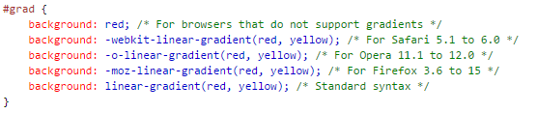
1.4.1 CSS3 Linear Gradients. (Top to bottom)

Slide 21

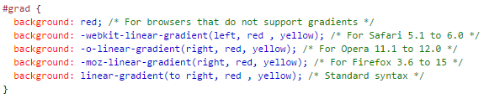
1.4.1 CSS3 Linear Gradients. (Left to Right)

Slide 22

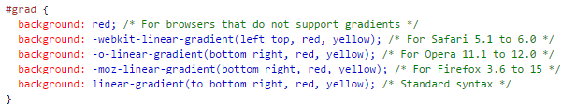
1.4.1 CSS3 Linear Gradients. (Diagonal)

Slide 23

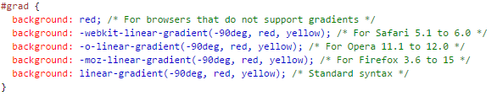
1.4.1 CSS3 Linear Gradients. (Using Angles)

Slide 24
1.4.2 CSS3 Radial Gradients.
A radial gradient is defined by its center.
To create a radial gradient you must also define at least two color stops.
Syntax:
background: radial-gradient(shape size at position, start-color, ..., last-color);

Slide 25

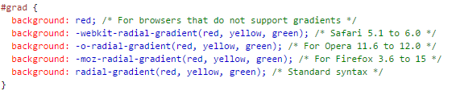
1.4.2 CSS3 Radial Gradients. (Evenly Spaced Color Stops)

Slide 26

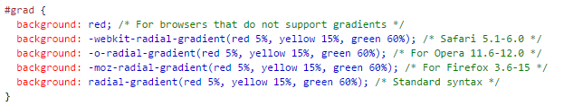
1.4.2 CSS3 Radial Gradients. (Differently Spaced Color Stops)

Slide 27
1.5 CSS3 Shadows Effects.
We can add shadows to your content using CSS3 Shadow effects.
There are two types of shadows we can use:
Text-shadow
Box-shadow

Slide 28




1.5.1 CSS3 text-shadow.

Slide 29


1.5.2 CSS3 box-shadow.

Slide 30
1.6 CSS3 text-overflow.

Slide 31
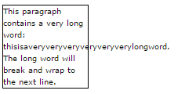
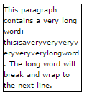
1.6 CSS3 word-wrapping.
Without word wrap

Slide 32
1.7 CSS3 2-D Transforms.
CSS3 transforms allow you to translate, rotate, scale, and skew elements.
A transformation is an effect that lets an element change shape, size and position.
Following are some css properties to apply 2-D Transforms
translate()
rotate()
scale()
skewX()
skewY()
matrix()

Slide 33

1.7.1 CSS3 2-D Transforms (Translate).
The translate() method moves an element from its current position (according to the parameters given for the X-axis and the Y-axis).

Slide 34

1.7.2 CSS3 2-D Transforms (Rotate).
The rotate() method rotates an element clockwise or counter-clockwise according to a given degree.

Slide 35

1.7.3 CSS3 2-D Transforms (Scale).
The scale() method increases or decreases the size of an element (according to the parameters given for the width and height).

Slide 36
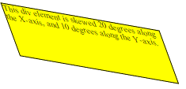
1.7.4 CSS3 2-D Transforms (Skew).
The skew() method skews an element along the X and Y-axis by the given angles.

Slide 37

1.7.5 CSS3 2-D Transforms (Matrix).
The matrix() method combines all the 2D transform methods into one.

Slide 38
1.8 CSS3 3-D Transforms.
CSS3 allows you to format your elements using 3D transformations.
Following are some css properties to apply 3-D Transforms
rotateX()
rotateY()
rotateZ()

Slide 39

1.8.1 CSS3 3-D Transforms (rotateX).
The rotateX() method rotates an element around its X-axis at a given degree:

Slide 40

1.8.2 CSS3 3-D Transitions (rotateY)
The rotateY() method rotates an element around its Y-axis at a given degree:

Slide 41
1.9 CSS3 Media Queries
In CSS2, “@media” property made it possible to define different style rules for different media types.
For example, You could have one set of style rules for computer screens, one for printers, one for handheld devices, one for television-type devices, and so on.

Slide 42
1.9 CSS3 Media Queries
Media queries can be used to check many things, such as:
width and height of the viewport
width and height of the device
orientation (is the tablet/phone in landscape or portrait mode?)
resolution

Slide 43

1.9 CSS3 Media Queries
A media query consists of a media type and can contain one or more expressions, which resolve to either true or false.

Slide 44
1.9 CSS3 Media Queries
The result of the query is true if the specified media type matches the type of device the document is being displayed on and all expressions in the media query are true.
When a media query is true, the corresponding style sheet or style rules are applied, following the normal cascading rules.
Unless you use the not or only operators, the media type is optional and the all type will be implied.

Slide 45
1.9 CSS3 Media Queries
We can have different style sheets for different screen types.
We can specify this condition in <link> tag, when we are associating our external style sheet. media="mediatype and|not|only (expressions)"
<link rel="stylesheet" href=“sample.css">

Slide 46
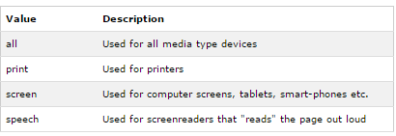
1.9 CSS3 Media Queries (Media Types)

Slide 47
Summary
Introduction to CSS3.
CSS3 modules
Selectors
Box Model
Backgrounds and Borders
Text Effects
2D/3D Transformations
Animations
Multiple Column Layout
User Interface
CSS3 Rounded Corners
CSS3 Properties.
CSS3 border-image property
CSS3 Border Images

Slide 48
Summary
CSS3 Gradients
CSS3 Linear Gradients
CSS3 Radial Gradients
CSS3 text-shadow
CSS3 text-overflow
CSS3 word-wrapping
CSS3 2-D Transforms
translate()
rotate()
scale()
skewX()
CSS3 3-D Transforms
rotateX()
rotateY()
rotateZ()
CSS3 Media Queries

Slide 49
THANK YOU

