Slide 1


Slide 2
Web Technologies and Programming
Lecture 16

Slide 3
Style Guidelines For Interface Design
(Elements of Visual Design)

Slide 4
Summary of Previous Lecture
Introduction to CSS3.
CSS3 modules
Selectors
Box Model
Backgrounds and Borders
Text Effects
2D/3D Transformations
CSS3 Rounded Corners
CSS3 Properties.
CSS3 border-image property
CSS3 Border Images

Slide 5
Summary of Previous Lecture
CSS3 Gradients
CSS3 Linear Gradients
CSS3 Radial Gradients
CSS3 text-shadow
CSS3 text-overflow
CSS3 word-wrapping
CSS3 2-D Transforms (translate(), rotate(), scale(), skewX() )
CSS3 3-D Transforms(rotateX(), rotateY(), rotateZ() )
CSS3 Media Queries

Slide 6
Outline
Why User Interface should look Good?
Guidelines and Principles of User Interface Design
Principles of Screen Design
Interface Design Goals
Interaction Styles
Types of Interfaces
What are the Advantages of Style Guidelines?
What are Advantages of Good Interface?
What are Disadvantages of Bad Interface?

Slide 7
Today’s Lecture Outline
What are the Elements of Visual Design?
Font
Six Typographic Terms
Font Size
Types of Fonts
Proportional Vs. Fixed width Fonts
Case of Text
Layout
Color
Guidelines for Color Use
Labels

Slide 8
1. User Interface
“The user interface is the most important part of any computer system.” (Galitz, 2002, p. 1)
“The best interface is the one that is not noticed, one that permits the user to focus on the information and task at hand, not the mechanisms used to present the information and perform the task.” (Galitz, 2002, p. 4)

Slide 9
1.1 Benefits of Good Design
Higher task completion rates
More efficient task completion rates
Reduced training costs
Improved customer service

Slide 10
1.2 Guidelines for Interface Design Process
Know your user or client
Understand the basic business function
Understand the principles of good screen design
Develop system menus and navigation schemes
Select the proper kinds of windows
Select the proper device-based controls
Choose the proper screen-based controls

Slide 11
1.2 Guidelines for Interface Design Process…
Write clear text and messages
Provide effective feedback and guidance and assistance
Provide effective internationalization and accessibility
Create meaningful graphics, icons and images
Choose the proper colors
Organize and layout windows and pages
Test, test and retest

Slide 12
1.2 Principles of User Interface Design
“An interface must really be just an extension of a person. This means that the system and its software must reflect a person’s capabilities and respond to his or her specific needs. It should be useful, accomplishing some business objectives faster and more efficiently than the previously used method or tool did. It must also be easy and fun to use, evoking a sense of pleasure and accomplishment, not tedium and frustration.” (Galitz, 2002, p. 40)

Slide 13
1.3 General Principles of User Interface Design
Aesthetically pleasing
Clarity
Compatibility
Comprehensibility
Configurability
Consistency
Control
Directness
Efficiency

Slide 14
1.3 General Principles of User Interface Design…
Familiarity
Flexibility
Forgiveness
Predictability
Recovery
Responsiveness
Simplicity
Transparency
Trade-offs

Slide 15
1.4 Principles of Good Screen Design
A well-designed screen:
Reflects the capabilities, needs and tasks of its users
Is developed within the physical constraints imposed by the hardware on which it is displayed
Effectively utilizes the capabilities of its controlling software
Achieves the business objectives of the system for which it is designed

Slide 16
1.5 Interface Design Goals
Reduce visual work
Reduce intellectual work
Reduce memory work
Reduce motor work
Minimize or eliminate any burdens or obstructions imposed by technology

Slide 17
1.6 Characteristics for Web Based Application
Clear navigation aids
No dead-end pages
Direct access
Simplicity and consistency
Design integrity and stability
Feedback and dialog
Bandwidth and interaction
Interface design conventions
What goes in the header area?

Slide 18
1.7 Interaction Style
Direct manipulation
Menu selection
Form fill-in
Natural language
Command language

Slide 19
1.8 Types of Interfaces
Command Line Interface (CLI)
Graphical User Interface (GUI)
Menu Driven Interface
Natural Language Interface

Slide 20
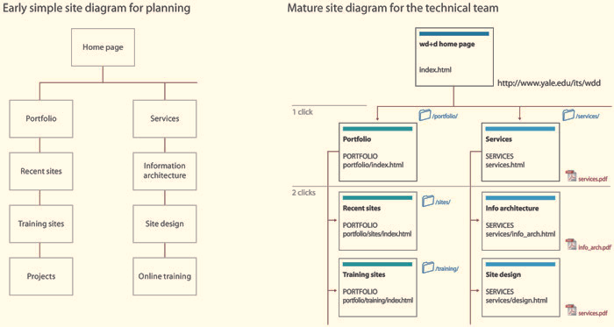
1.9 Web Based Application - Comparison

Slide 21
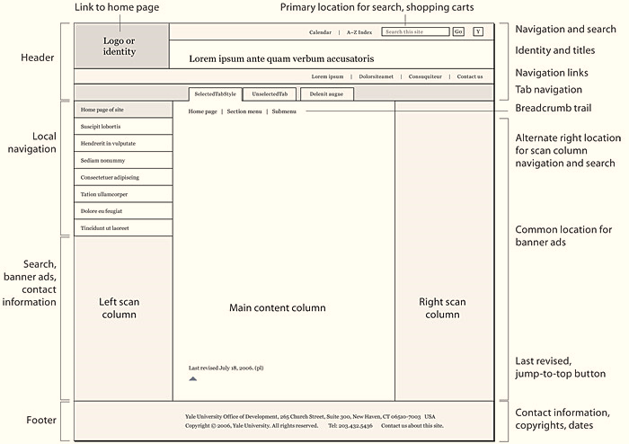
1.10 Interface Design Convention (Web Based Application)

Slide 22
1.11 Advantages of Style Guidelines
It helps you focus on design issues early in the development process
The customized style guide can steer decision making throughout the design process
It can also serve as a record of the design decisions that have been taken and of the design constraints that have been identified, so that the design team can refer back to them

Slide 23
1.11 Advantages of Style Guidelines…
The customized style guide will help ensure consistency across the user interface. This should help improve the usability of the User Interface.
One can check against the customized style guide during the evaluation.
If it is used across the organization, it will help to give a corporate look to all the User Interfaces.

Slide 24
1.12 Good Interface Vs. Bad Interface
Good Interface
Saves money
Convinces user to use product
Keeps existing users and bring in new ones
Achieves usability
Bad Interface
Leads to User Frustration and Dissatisfaction
Loss of Productivity
Less Efficiency
More Money

Slide 25
1.13 Conclusion
It’s also common that beautiful interfaces don’t stay beautiful.
Interface style guides are extremely best practices for design and development. However, keeping that information updated and functional is imperative

Slide 26
2. Elements of Visual Design
Principles
Principles of Design describe the methods of arranging and assembling elements.
Balance, Unity, Variety, Proportion, Rhythm and Grids
Elements
Elements of Design are the graphic items that are the building blocks of all design
Line, Shape, Space, Color, Value, Texture, Movement and Type

Slide 27
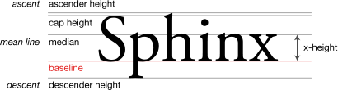
2.1 Fonts
Font Metrics

Slide 28
2.1.1 Typography
Typography is the style and appearance of words
We can present words in many fonts
and in many different sizes
We see how it effects the user

Slide 29
2.1.1 Typography…
Typography has huge effects on how people see and interact with your content. Type, although often invisible to most people, has an enormous effect on how your content is communicated.
For example: consider the letter “R” as done in Gill Sans. In this letterform, there is a perception that the weight of the letter is uniform throughout. However, when examined closely, there is a difference in the weights at different parts of the letter. If you look at the bottom of the letter, you see a different thickness than in other parts of the letter. This is an example that shows that in graphic design, it is important to design things to be perceptually balanced and perceptually uniform.

Slide 30

2.1.1 Typography…

Slide 31
2.1.1 Typography…
Here are six typographic terms to know
Point Size
Leading
X-height
Ascenders and Descenders
Weight
Serifs

Slide 32
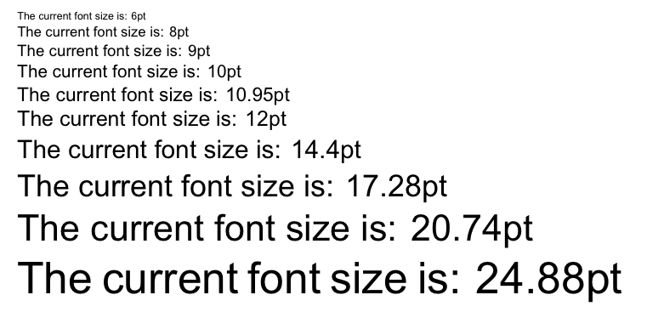
2.1.1.1 Point Size
The point size of the font is simply the size of the font on the page. Note that although point sizes specify the height of the font in points, a 12 point size in one font will not always be exactly identical to 12 points in another font.

Slide 33
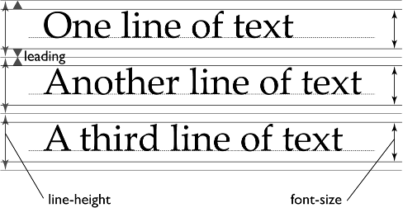
2.1.1.2 Leading
Leading refers to the height of the line, with greater leading meaning greater space between each line of the content. It’s customary to have 20% of your font size as your leading.

Slide 34
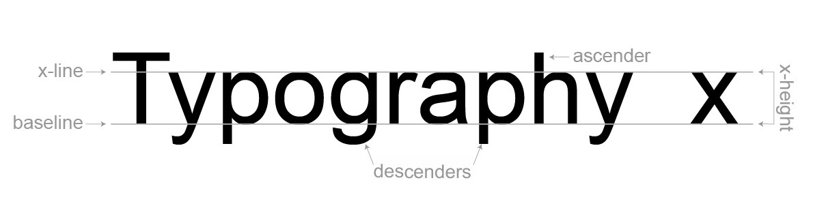
2.1.1.3 X-height
The height of the lowercase letters is known as the x-height of the font, which has an effect on the readability of the font. In general, fonts with greater x-heights are easier to read at small font sizes than fonts with smaller x-heights.

Slide 35
2.1.1.4 Ascenders and Descenders
These are the parts of the letters that extend above or below the lines of the font, such as the part of the letter “y” that extends below the bottom, or the part of the letter “l” that extends above the top.

Slide 36
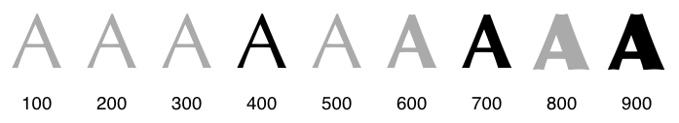
2.1.1.5 Weight
The weight of a font refers to the thickness of the letters, and can range from thin or light to bold and heavy. The weight of a font also can provide a good contrast to what the content is trying to convey.

Slide 37
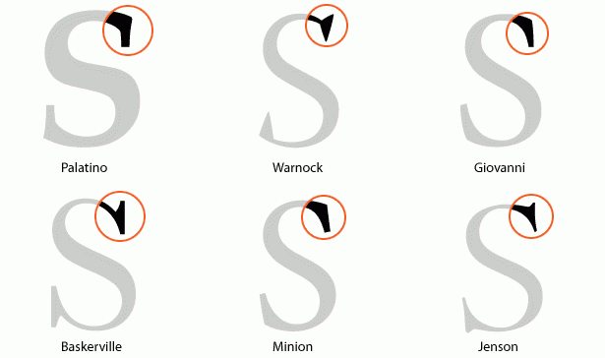
2.1.1.6 Serifs
Fonts can be divided into two main categories: serif fonts and sans-serif fonts. Serif fonts are the ones with the little serifs coming out of the edges of the font, giving it a more traditional look, while sans-serifs don’t have these additional markings, making them look more modern. Historically, serif fonts are considered easier to read, even though there’s no way to quantitatively prove that statement.

Slide 38
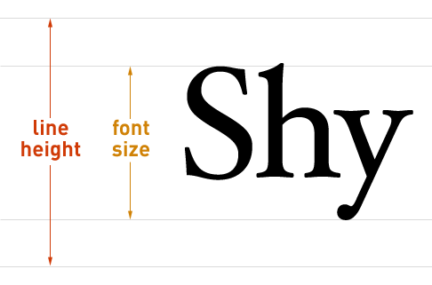
2.1.2 Font Size
Font sizes are traditionally expressed in printers’ points (pt)
1 pt = 1/72 inch = 0.35mm

Slide 39
2.1.2 Font Size…
10 pt is legible, 11 or 12 pt is better
The distinction between two fonts should be min of 2 pts.
Human eye cannot detect smaller difference
For Example:
If you use 12 pt for text
14 pt for header
10 pt for foot note
16 pt or larger for tiltes.

Slide 40
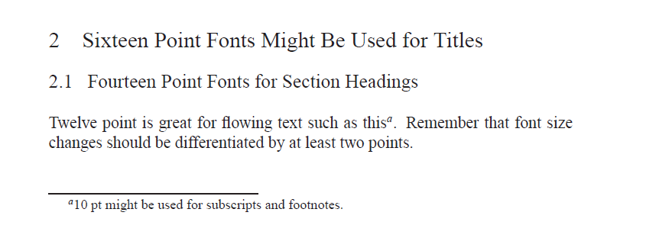
2.1.2 Font Size…

Slide 41
2.1.3 Types of Fonts
Serif is a slight extra line at the end of a letter stroke
Times Roman and Georgia
Sans Serif (French = without serif) font does not have such embellishments
Arial, Helvetica and Verdana

Slide 42
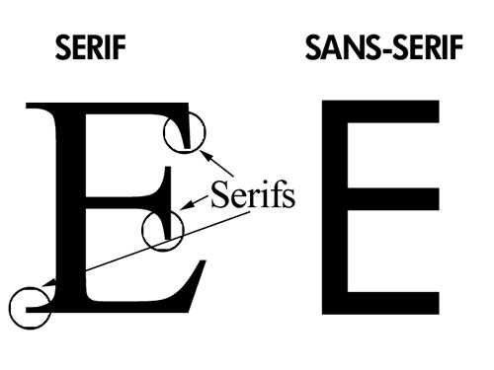
2.1.3 Types of Fonts…

Slide 43
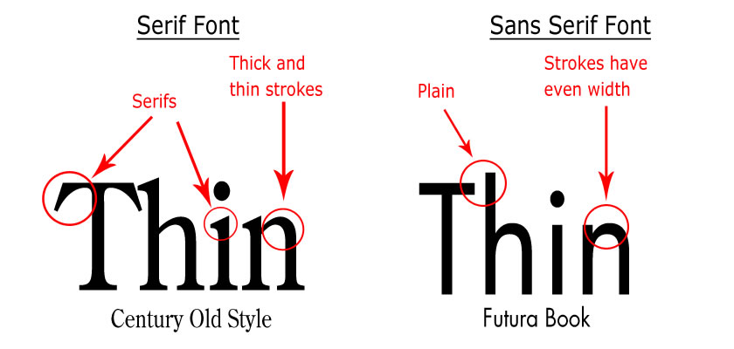
2.1.3 Types of Fonts…

Slide 44
2.1.3 Types of Fonts…
Serif or Sans Serif?
When reading passages of text serif text may be easier to read than san serif, but the evidence is not conclusive
Ultimately, picking a typeface depends primarily on application of the content being used. When choosing a font for a logo, the font should be something that stands out, is clear, and makes a statement. But when choosing a font for a book, the font should be chosen to maximize readability of the content.

Slide 45
2.2 Layout
The next tool for creating a visual hierarchy that is clear and distinguishable is to consider the layout of your content. By grouping things and putting them on a grid, we can visually guide the user into a design.
The first example of a grid comes from the Java grid systems. As you can see, all of the elements in this dialog box have been arranged in a grid, or a set of invisible lines that all elements in the dialog box snap to.

Slide 46
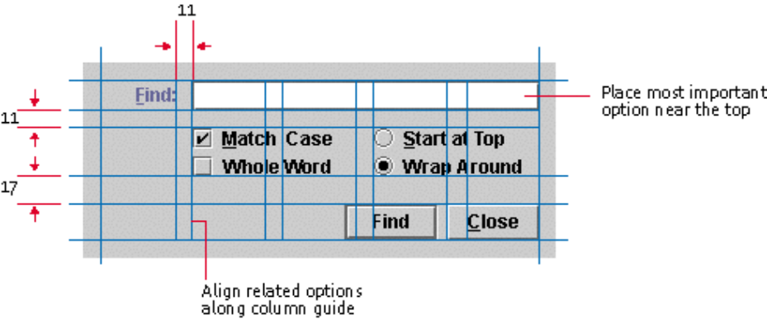
2.2 Layout…

Slide 47
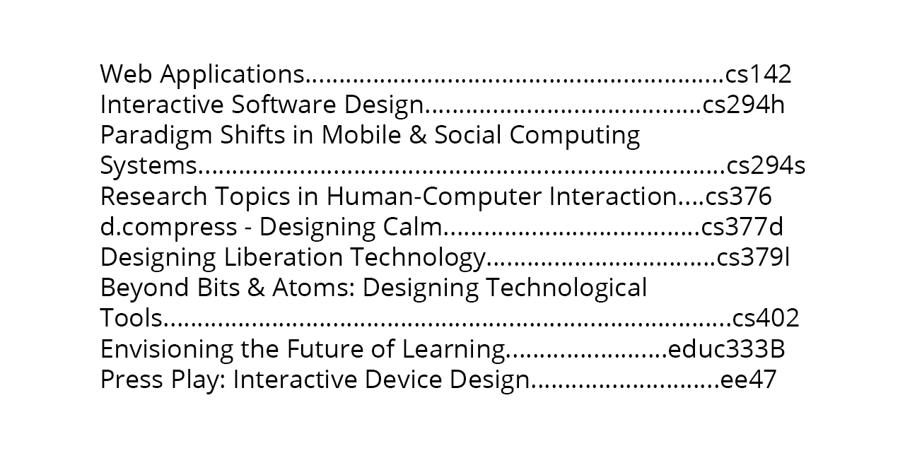
2.2 Layout…
Consider the table of contents of a book as another example of the difference a good layout can make. One layout of the contents that you are likely familiar with is spacing content out with periods or spaces, like we see in this example.

Slide 48
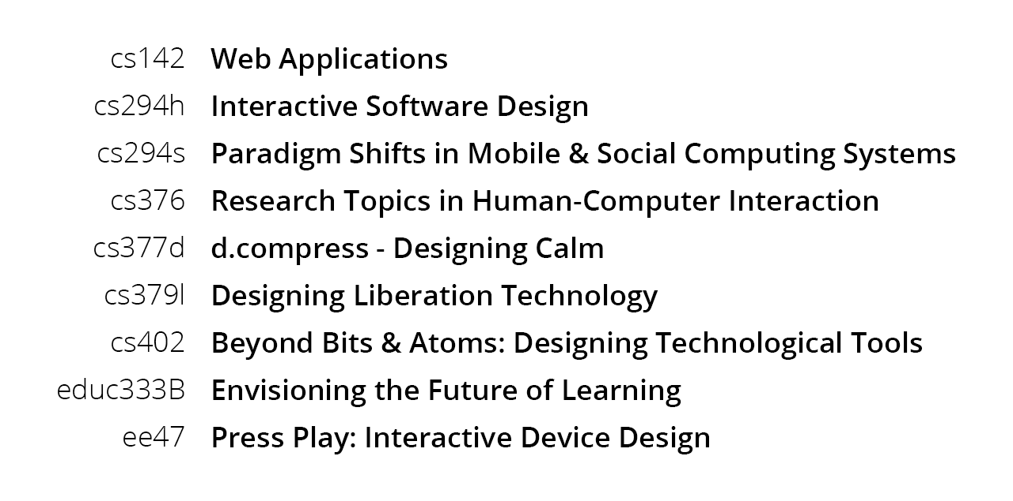
2.2 Layout…
However, by simply moving things around a little bit and applying some typographic variation, we can improve this layout dramatically. By putting the course titles in a smaller column that is right aligned with the course names in a larger, left aligned column, we can provide a much clearer layout of the information.

Slide 49
2.3 Color
The last tool to utilize when working on a visual design is color.
The best designs often only use a couple of colors.
In fact, it is usually helpful to design in grayscale first, using layouts and typography as the main methods of creating visual hierarchy, and adding color to strengthen and highlight other elements. Then, when moving from grayscale to color, be sure to keep the luminance values of the grayscale mockup that you created.

Slide 50

2.3 Color…
Color is used to compliment all objects and tie them together
Color can create emotion and leave a lasting impression
Use colors that create harmony in your design.

Slide 51
2.3.1 Guidelines for Color Use
Don’t use too many colors
Use color coding to support use tasks
Allow users to control color coding
Design for monochrome then add color
Use color coding consistently
Avoid color pairings which clash
Use color change to show status change
Be aware that color displays are usually lower resolution

Slide 52
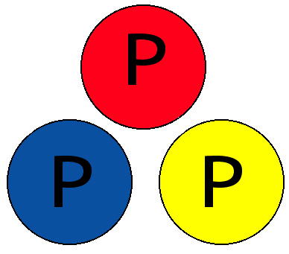
2.3.2 Primary Colors
Red, Blue and Yellow
They are the building blocks to create all other colors.

Slide 53
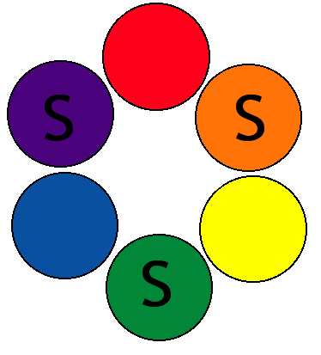
2.3.3 Secondary Colors
Violet, Green and Orange
When two of the primary colors are mixed together, a secondary color is made

Slide 54
2.4 Lables
Labeled data fields
Left-align labels, fields, columns in tables
Use meaningful, unambiguous labels
For Beginners, searching n size menu:
If label unknown, examine all items, S ~ n
If label known, search linearly or randomly, S ~ n
Textual labels help beginners, infrequent users.

Slide 55
Summary of Today’s Lecture
Why User Interface should look Good?
Guidelines and Principles of User Interface Design
Principles of Screen Design
Interface Design Goals
Interaction Styles
Types of Interfaces
What are the Advantages of Style Guidelines?
What are Advantages of Good Interface?
What are Disadvantages of Bad Interface?

Slide 56
Summary of Today’s Lecture
What are the Elements of Visual Design?
Font
Six Typographic Terms
Font Size
Types of Fonts
Proportional Vs. Fixed width Fonts
Case of Text
Layout
Color
Guidelines for Color Use
Labels

Slide 57
THANK YOU

