Slide 1


Slide 2
Web Technologies
Lecture 17
Introduction to JavaScript

Slide 3
Summary of Previous Lecture
Why User Interface should look Good?
Guidelines and Principles of User Interface Design
Principles of Screen Design
Interface Design Goals
Interaction Styles
Types of Interfaces
What are the Advantages of Style Guidelines?
What are Advantages of Good Interface?
What are Disadvantages of Bad Interface?

Slide 4
Summary of Previous Lecture
What are the Elements of Visual Design?
Font
Six Typographic Terms
Font Size
Types of Fonts
Proportional Vs. Fixed width Fonts
Case of Text
Layout
Color
Guidelines for Color Use
Labels

Slide 5
Today’s Lecture Outline
What is JavaScript?
Embedding JavaScript with HTML
JavaScript conventions
Variables in JavaScript
JavaScript operators
Input output in JavaScript
JavaScript functions
Conditional Statements
Looping Statements

Slide 6
1. JavaScript
JavaScript is a client-side scripting language
JavaScript was designed to add interactivity to HTML pages
JavaScript is used in millions of Web pages to improve the design, validate forms, detect browsers, create cookies, and much more

Slide 7
1. JavaScript….
JavaScript is an interpreted language (means that scripts execute without preliminary compilation)
JavaScript is usually embedded directly into HTML pages
Everyone can use JavaScript without purchasing a license

Slide 8
1. JavaScript….
JavaScript is the programming language of HTML and the Web.
JavaScript is the most popular scripting language on the internet, and works in all major browsers, such as Internet Explorer, Mozilla, Firefox, Netscape, Opera

Slide 9
1.1 JavaScript: Common Uses
JavaScript gives HTML designers a programming tool
HTML authors are normally not programmers, but JavaScript is a scripting language with a very simple syntax!
Almost anyone can put small "snippets" of code into their HTML pages
JavaScript can react to events
A JavaScript can be set to execute when something happens, like when a page has finished loading or when a user clicks on an HTML element
JavaScript can read and write HTML elements
A JavaScript can read and change the content of an HTML element

Slide 10
1.1 JavaScript: Common Uses
JavaScript can be used to validate data
A JavaScript can be used to validate form data before it is submitted to a server. This saves the server from extra processing
JavaScript can be used to detect the visitor's browser
JavaScript can be used to create cookies
A JavaScript can be used to store and retrieve information on the visitor's computer

Slide 11
1.1 JavaScript: Common Uses
Cookie
A message given to a Web browser by a Web server. The browser stores the message in a text file. The message is then sent back to the server each time the browser requests a page from the server.

Slide 12
2. Embedding JavaScript in HTML
There are two methods to embed JavaScript in to HTML code
Internal Script: directly written in HTML code
External Script: written in separate file
<script> tag is used to tell the browser that a script follows

Slide 13
2.1 Internal Scripts
The <SCRIPT> tag is used to embed JavaScript code in HTML documents
<SCRIPT LANGUAGE="JavaScript">
// JavaScript Statements...
</SCRIPT>
JavaScript can be placed anywhere between <HTML> and </HTML> tags
two possibilities are the <HEAD>…</HEAD>
portion and the <BODY>…</BODY> portion

Slide 14
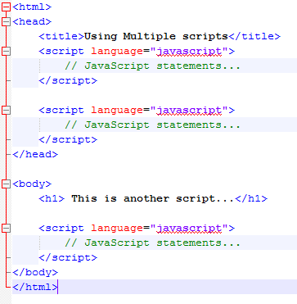
2.1 Internal Scripts…
Example:

Slide 15
2.2 External Script
We place script in a separate file and include this in HTML code
SRC attribute of the <SCRIPT> is used to include the external JavaScript file in HTML
<script src="myscripts.js">…</script>
External Scripts are useful when you have lengthy scripts
External Scripts improves the readability

Slide 16
2.2 External Script
External JavaScript Advantages
Placing JavaScripts in external files has some advantages:
It separates HTML and code
It makes HTML and JavaScript easier to read and maintain
Cached JavaScript files can speed up page loads

Slide 17
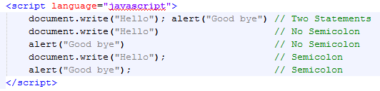
3. JavaScript Conventions
Using the Semicolon
With traditional programming languages, like C, C++ and Java, each code statement has to end with a semicolon (;).
Many programmers continue this habit when writing JavaScript, but in general, semicolons are optional! However, semicolons are required if you want to put more than one statement on a single line.

Slide 18
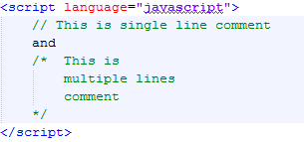
3. JavaScript Conventions
Case Sensitivity
JavaScript is a case sensitive language
Variable names lastname and LastName are different.
Comments
Single Line: //
Multiple lines: /* */

Slide 19
3. JavaScript Conventions
Using Quotes
You can use both type of quotes that is:
Single quotes: ‘something inside single quotes’
Double quotes: “something inside double quotes”
For Example:
document.write(“<font color=“red”>Hello World</font>”)
document.write(“<font color=‘red’>Hello World</font>”)

Slide 20
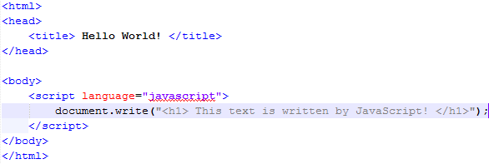
4. Writing JavaScript
Start of JavaScript
HTML code in JavaScript
Writing on webpage
End of JavaScript

Slide 21
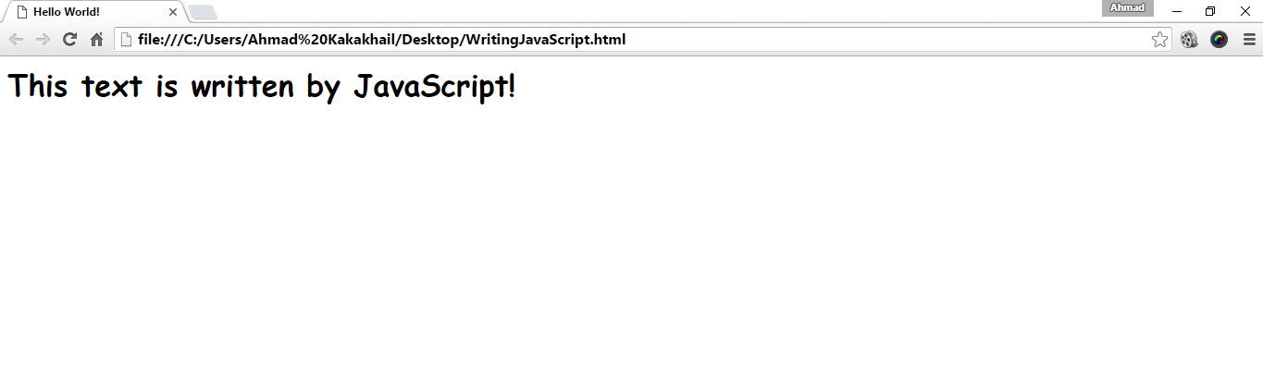
4. Writing JavaScript…
Output of JavaScirpt

Slide 22
4.1 Variables in JavaScript
Variable is the name of a memory location which holds the data of a certain type (data types)
There are four common data types in JavaScript
Numbers
Strings
Boolean
null values
JavaScript is a loosely typed language which means you do not have to explicitly write the datatype, it can pick the datatype by itself.

Slide 23
4.1 Variables in JavaScript…
The word “var” is used to declare a variable
var LastName = “Smith”
var AccountNumber = 1111
Variable Naming
First character can not be a digit
Other characters may be digits, letters or underscore
Reserved words can not be used
Case Sensitive

Slide 24
4.1 Variables in JavaScript…
Variable Initialization
var variableName = initialValue
var variableName1 = initialValue1, variableName2 = initialValue2, …
Local & Global Variables:
A variable declared within a JavaScript function becomes Local and can only be accessed within that function.
Variables declared outside a function become Global, and all scripts and functions on the web page can access it.

Slide 25
5. JavaScript Operators
An operator is simply a symbol that tells the compiler (or interpreter) to perform a certain action
Assignment Operator: =
Arithmetic Operators: +, - , *, /, %, ++, --
Logical Operators: &&, ||, !
Comparison Operators: ==, ===, !=, !==, <, >, <=, >=

Slide 26
6. Input Output in JavaScript
write();
It is used to write on browser
document.write(“hello world”)
document.write(a)
prompt();
It is used to take input from users
var num = prompt(“Please Enter a Number”, 0)

Slide 27
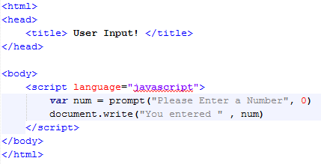
6. Input Out put in JavaScript…
Start of JavaScript
User input
Writing on browser
End of Script

Slide 28
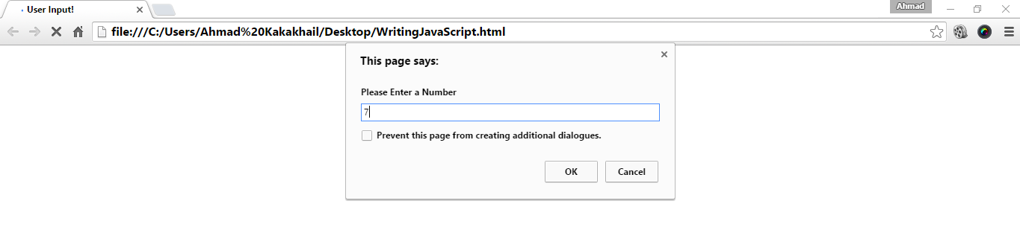
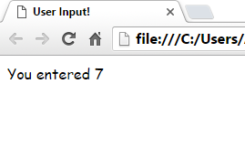
6. Input Out put in JavaScript…

Slide 29
7. JavaScript Function
A JavaScript function is a block of JavaScript code, that can be executed when "asked" for.
For example, a function can be executed when an event occurs, like when the user clicks a button.

Slide 30
7. JavaScript Function
Functions are used in JavaScript to perform various actions such as writing something, alerting users and taking input from users.
There are two types of functions:
User defined functions: the functions made by the user to perform some actions:
Predefined functions: the functions that are defined previously and compiler uses it, user do not know about what is going on behind the code, but he should know how to call the function.

Slide 31
7. JavaScript Function…
Functions are defined using the keyword function, followed by the name of the function and list of parameters
function functionName([parameters])
{
// some statements
}
Calling a function
The syntax of a function call is:
functionName([arguments])

Slide 32
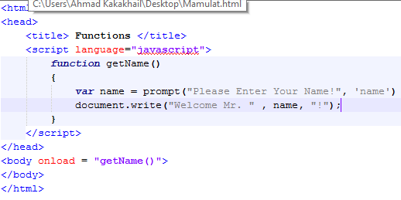
7. JavaScript Function…
Start of the function
Asks user to enter name
Writes name on the webpage
Calling a function

Slide 33
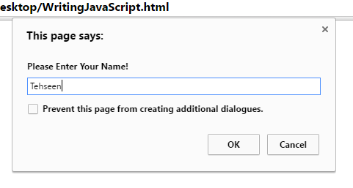
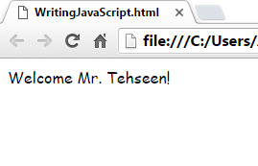
7. JavaScript Function…

Slide 34
7. JavaScript Function…
Common events
onClick()
onDblClick()
onChange()
onFocus()
onMouseOver()
onMouseOut()
onSubmit()
onLoad()

Slide 35
7. JavaScript Function…
Some common predefined math functions
Math.Sqrt (to calculate square root)
Math.Pow (to calculate power of number)
Math.Abs (to calculate absolute value)
Math.Max (to calculate maximum value)
Math.Min (to calculate minimum value)
Math.Floor (to calculate back rounded value)
Math.Ceil (to calculate forward rounded value)
Math.Round (to calculate rounded value)
Math.Random (to pick up some random value)

Slide 36
8. Conditional Statements
If statement
if (condition) // statement
If (condition) { // statements }
If-else statement
If (condition) { // statement } else { // statement }

Slide 37
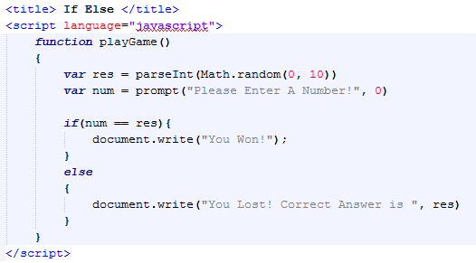
8. Conditional Statements…
Random Number Generator
User’s Input
If Condition

Slide 38

8. Conditional Statements…
Text
On Click Event

Slide 39
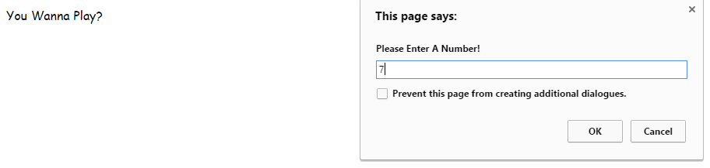
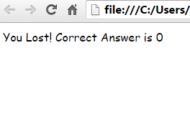
8. Conditional Statements…

Slide 40
9. Loops
For loop
for(var i=1; i==10; i==) { // statements }
While loop
While(condition) { // statements
}

Slide 41
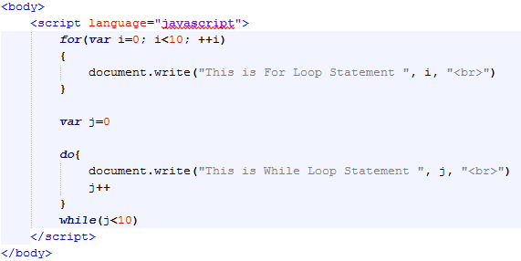
9. Loops
For Loop
Do-While Loop

Slide 42
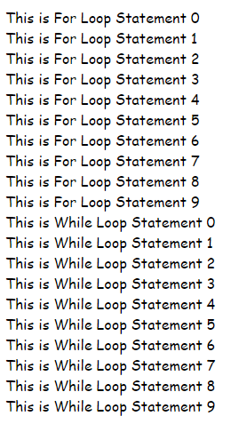
9. Loops
Output of For Loop
Output of Do-While Loop

Slide 43
10. JavaScript Output
JavaScript can "display" data in different ways:
Writing into an alert box, using window.alert()
<script> window.alert(5 + 6); </script>.
Writing into the HTML output using document.write().
<script> document.write(5 + 6); </script>

Slide 44
10. JavaScript Output
Writing into an HTML element, using innerHTML.
<script> document.getElementById("demo").innerHTML = 5 + 6; </script>
Writing into the browser console, using console.log().
<script> console.log(5 + 6); </script>

Slide 45
Summary of Today’s Lecture
What is JavaScript?
Embedding JavaScript with HTML
JavaScript conventions
Variables in JavaScript
JavaScript operators
Input output in JavaScript
JavaScript functions
Conditional Statements
Looping Statements

Slide 46
THANK YOU

