Slide 1


Slide 2
Web Technologies and Programming
Lecture 18

Slide 3
Summary of Previous Lecture
What is JavaScript?
Embedding JavaScript with HTML
JavaScript conventions
Variables in JavaScript
JavaScript operators
Input output in JavaScript
JavaScript functions
Conditional Statements
Looping Statements

Slide 4
Today’s Lecture Outline
Dialog boxes in JavaScript
HTML Document Object Model (DOM)

Slide 5
1. Dialog boxes in JavaScript
JavaScript provides the ability to pickup user input or display small amounts of text to the user by using dialog boxes
These dialog boxes appear as separate windows and their content depends on the information provided by the user

Slide 6
1. Dialog boxes in JavaScript
JavaScript has three kind of popup boxes:
Alert box
Prompt box
Confirm box

Slide 7
1.1 Alert Box
An alert box is simply a small message box that pops up and gives the user some information
An alert dialog box is mostly used to give a warning message to the users
When an alert box pops up, the user will have to click "OK" to proceed
Syntax:
alert(“message”)

Slide 8
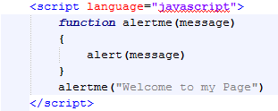
1.1 Alert Box…
Start of Function
Displays an Alert Box
Calling the Function

Slide 9
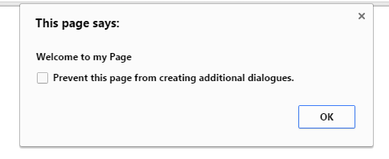
1.1 Alert Box…
Alert Box

Slide 10
1.2 Prompt box
A prompt box is often used if you want the user to input a value before entering a page
When a prompt box pops up, the user will have to click either "OK" or "Cancel" to proceed after entering an input value
If the user clicks "OK" the box returns the input value
If the user clicks "Cancel" the box returns null

Slide 11
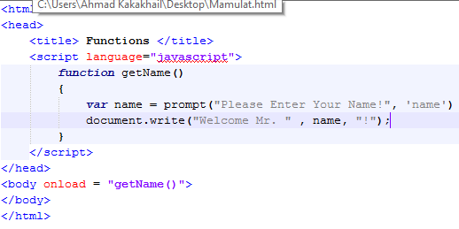
1.2. Prompt box…
Start of the function
Asks user to enter name
Writes name on the webpage
Calling a function

Slide 12
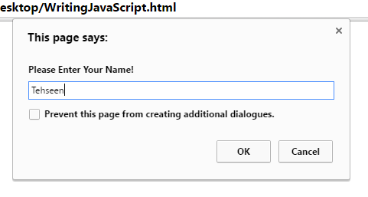
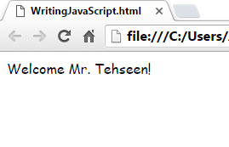
1.2. Prompt box…
Prompt Box
Output

Slide 13
1.3 Confirm box
A confirm box is often used if you want the user to verify or accept something
When a confirm box pops up, the user will have to click either "OK" or "Cancel" to proceed
If the user clicks "OK", the box returns true
If the user clicks "Cancel", the box returns false

Slide 14
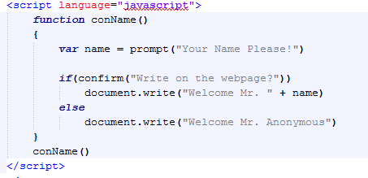
1.3 Confirm box
User Input
Confirmation
Not Confirmed

Slide 15
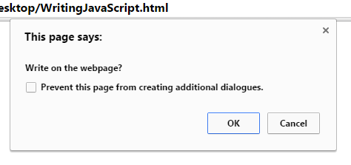
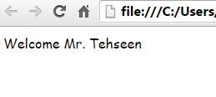
1.3 Confirm box

Slide 16
2. Document Object Model (DOM)
What is the DOM?
The DOM is a W3C (World Wide Web Consortium) standard.
The DOM defines a standard for accessing documents:
"The W3C Document Object Model (DOM) is a platform and language-neutral interface that allows programs and scripts to dynamically access and update the content, structure, and style of a document.”

Slide 17
2. Document Object Model (DOM)
The W3C DOM standard is separated into 3 different parts:
Core DOM - standard model for all document types
XML DOM - standard model for XML documents
HTML DOM - standard model for HTML documents

Slide 18
2. HTML Document Object Model (DOM)
Once html element are rendered (painted) in the browser window, browser can not recognize them
To create interactive web pages it is vital that the browser continues to recognize HTML elements
JavaScript enabled browsers do this because they recognize and uses DOM

Slide 19
2. HTML Document Object Model (DOM)…
The HTML DOM defines a standard set of objects for HTML, and a standard way to access and manipulate HTML documents
All HTML elements, along with their containing text and attributes, can be accessed through the DOM
The contents can be modified or deleted, and new elements can be created

Slide 20
2. HTML Document Object Model (DOM)…
The HTML DOM is platform and language Independent
It can be used by any programming language like Java, JavaScript, and VBScript
The HTML DOM can be thought of as a hierarchy moving from the most general object to the most specific

Slide 21
2. Document Object Model (DOM)…
Window
Navigator
Document
History
Location
Forms[ ]
Array of forms
Images[]
Array of images
links[]
Array of links
anchors[]
Array of anchors
Options[]
li
Element[ ] Array of element of forms
Textboxes buttons select list
Reset
files

Slide 22
2. Document Object Model (DOM)…
When a web page is loaded, the browser creates a Document Object Model of the page.
With the object model, JavaScript gets all the power it needs to create dynamic HTML:
JavaScript can change all the HTML elements in the page
JavaScript can change all the HTML attributes in the page
JavaScript can change all the CSS styles in the page
JavaScript can remove existing HTML elements and attributes

Slide 23
2. Document Object Model (DOM)…
JavaScript can add new HTML elements and attributes
JavaScript can react to all existing HTML events in the page
JavaScript can create new HTML events in the page

Slide 24
2. Html Document Object Model (DOM)…
HTML DOM methods are actions you can perform (on HTML Elements).
HTML DOM properties are values (of HTML Elements) that you can set or change.
In the DOM, all HTML elements are defined as objects.
The programming interface is the properties and methods of each object.
A property is a value that you can get or set (like changing the content of an HTML element).
A method is an action you can do (like add or deleting an HTML element).

Slide 25
2. Document Object Model (DOM)…
document.forms[0].elements[0].value
document.images[0].src
document.links[0].href

Slide 26
2.1 Retrieving HTML elements
The getElementById() method is a workhorse method of the DOM
It retrieves a specified element of the HTML document and returns a reference to it
To retrieve an element, it must have an unique id
document.getElementById(“element-id”)

Slide 27
2.1 Retrieving HTML elements…
The returned reference can be used to retrieve element attributes
document.getElementById(“element-id”).attribute
document.getElementById(“pic”).src
document.getElementById(“pic”).height

Slide 28
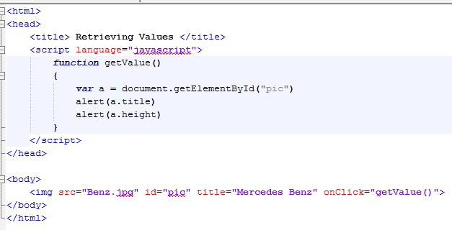
2.1 Retrieving HTML elements…
Function Starts
Getting Reference to “pic”
Accessing Attributes
Setting id
Image Tag
Calling Function

Slide 29
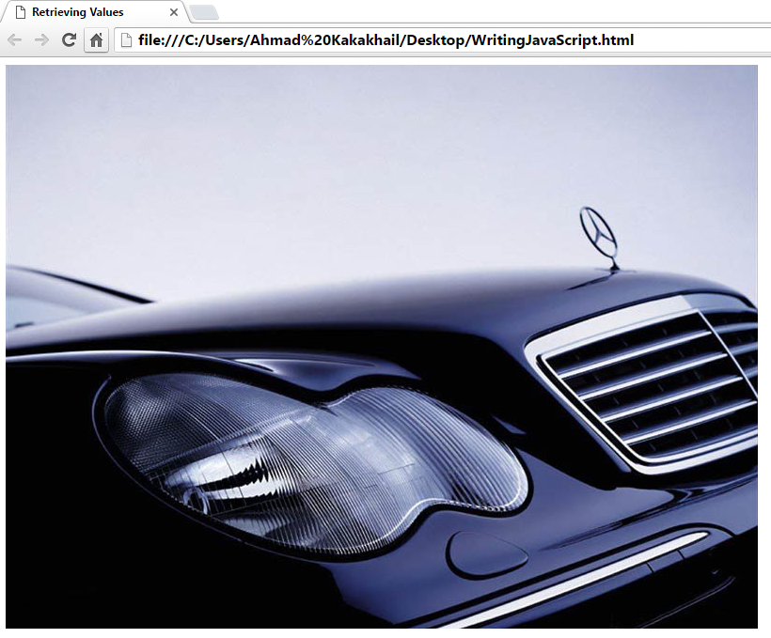
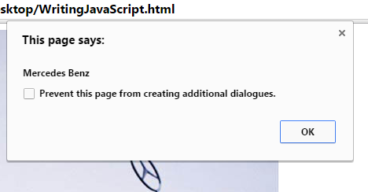
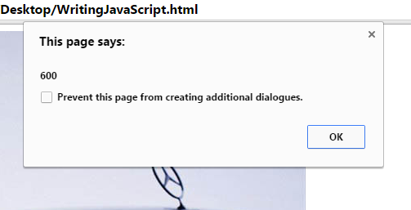
2.1 Retrieving HTML elements…
Image
Title Alert
Height Alert

Slide 30
2.2 Retrieving the text of an element…
innerHTML property defines both the HTML code and the text that occurs between that element's opening and closing
document.getElementById(“element-id”).innerHTML

Slide 31
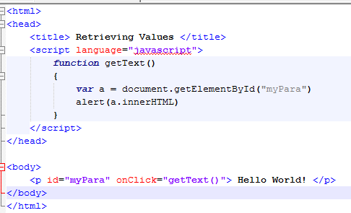
2.2 Retrieving the text of an element…
Getting Element Reference
Getting Text
Paragraph id
Calling Function
Paragraph Text

Slide 32
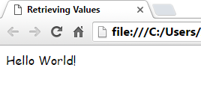
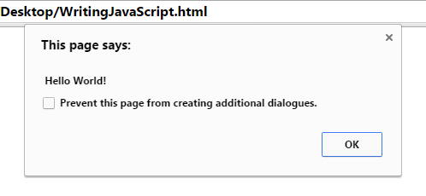
2.2 Retrieving the text of an element
Paragraph Text
Text Alert

Slide 33
2.3 Getting value of attributes
getAttribute() method is used to retrieve values of attributes
document.getElementById(“element-id”).getAttribute(“attribute-name”)
document.getElementById(“pic”).getAttribute(“src”)

Slide 34
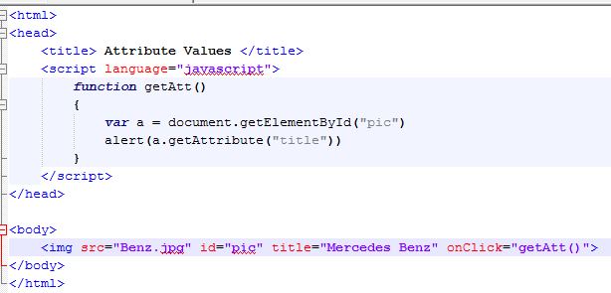
2.3 Getting value of attributes…
Getting Element Reference
Using getAttribute() Function

Slide 35
2.3 Getting value of attributes…
Image
Title Attribute Alert

Slide 36
2.4 Setting value of attributes
setAttribute() method is used to set values of attributes
document.getElementById(“element-id”).setAttribute(“attribute-name”, ”Value”)
document.getElementById(“pic”).setAttribute(“src”, ”abc.jpg”)

Slide 37
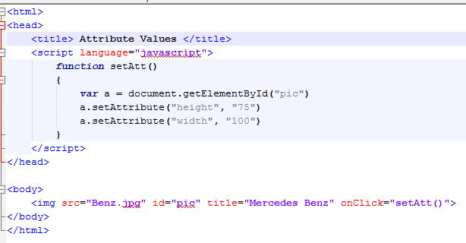
2.4 Setting value of attributes…
Getting Reference Element
Changing Attribute Values

Slide 38
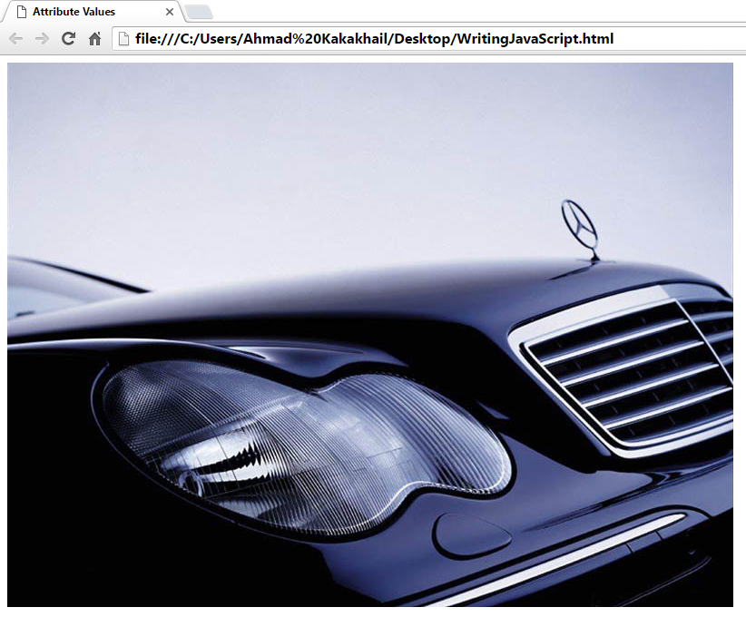
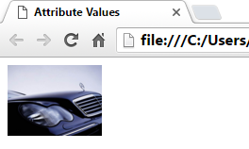
2.4 Setting value of attributes…
Before Setting Attribute Values
After Setting Attribute Values

Slide 39
3.0 HTML DOM Elements
Finding HTML Elements
To do so, you have to find the elements first. There are a couple of ways to do this:
Finding HTML elements by id
Finding HTML elements by tag name
Finding HTML elements by class name
Finding HTML elements by CSS selectors
Finding HTML elements by HTML object collections

Slide 40
3.1 HTML DOM Elements
Finding HTML Element by Id
The easiest way to find an HTML element in the DOM, is by using the element id.
This example finds the element with id="intro":
Example:
var myElement = document.getElementById("intro");

Slide 41
3.2 HTML DOM Elements
Finding HTML Elements by Tag Name
This example finds all <p> elements:
Example
var x = document.getElementsByTagName("p");

Slide 42
3.3 HTML DOM Elements
Finding HTML Elements by Class Name
If you want to find all HTML elements with the same class name, use getElementsByClassName(). This example returns a list of all elements with class="intro".
Example
var x = document.getElementsByClassName("intro");

Slide 43
3.4 HTML DOM Elements
Finding HTML Elements
Methods
Descriptiondocument.getElementById(id)
Find an element by element
iddocument.getElementsByTagName(name)
Find elements by tag namedocument.getElementsByClassName(name)
Find elements by class name

Slide 44
Summary of Today’s Lecture
Dialog boxes in JavaScript
Alert box
Prompt box
Confirm box
What is DOM?
HTML DOM
Retrieving HTML elements
getElementById()
innerHTML
getAttribute()
setAttribute()

Slide 45
Summary of Today’s Lecture
HTML DOM Elements
Finding HTML Elements
Find an element by element
Find elements by tag
Find elements by class name

Slide 46
THANK YOU

