Slide 1


Slide 2
Web Technologies and Programming
Lecture 20

Slide 3
History, Navigator, Screen and Form Objects

Slide 4
Summary of Previous Lecture
Controlling the background dynamically
Bgcolor
SET For a document
SET For a specific <div>
SET the Text Color
Return background color of a specific <div> element
Return background color of a document:
Background
background color for a document
background image for a document
Set a background-image to no-repeat
Set the background-image to be fixed
Change the position of a background-image

Slide 5
Summary of Previous Lecture
Working with images
Access an Image Object
On MouseOut
On MouseOver
Image Rollover
Image Preview
Image Slide Show
Date object
Digital Clock

Slide 6
Today’s Lecture Outline
History object
Navigator object
Screen object
Form object

Slide 7
1. The History object
The history object contains the URLs visited by the user (within a browser window)
The history object is part of the window object and is accessed through the window.history property
Used to move forward and backward through the visitor’s browsing history
All major browsers support it.

Slide 8
1. The History object…
History object properties:
Length: Returns the number of URLs in the history list
History object methods:
back(): Loads the previous URL in the history list
forward(): Loads the next URL in the history list
go(): Loads a specific URL from the history list
The window.history object can be written without the window prefix.

Slide 9
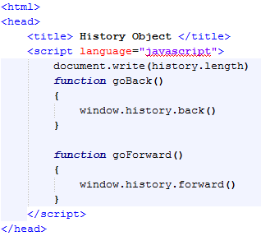
1. The History object…
Writes History Length on Webpage
Go Back Function
Go Forward Function

Slide 10
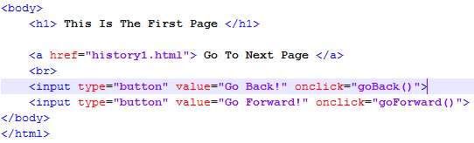
1. The History object…
Body Contents
Call to Go Back Function
Call to Go Forward Function

Slide 11
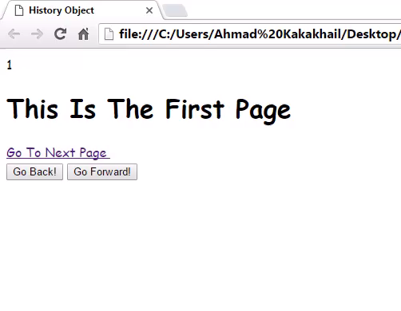
1. The History object…

Slide 12
2. The Navigator object
The navigator object contains information about the visitor's browser
It also provides several properties that assist in the detection of various elements of the visitor’s browser and environment

Slide 13
2. The Navigator object…
Navigator object properties:
appCodeName: Returns the code name of the browser
appName: Returns the name of the browser
appVersion: Returns the version information of the browser
The properties appName and appCodeName return the name of the browse
Navigator object methods:
javaEnabled(): Specifies whether or not the browser has Java enabled

Slide 14
2.1 Detecting Users browser
Used to write browser specific code
Can also be used to restrict users to use a specific browser

Slide 15
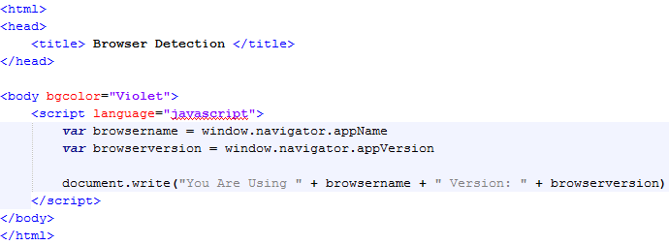
2.1 Detecting Users browser…
Finding Browser Name
Finding Browser Version
Writing Browser Information

Slide 16
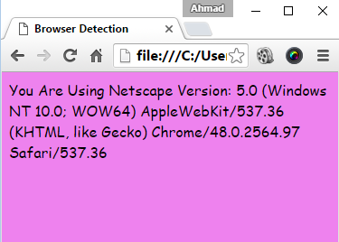
2.1 Detecting Users browser…

Slide 17
2.2 The Browser Engine…
The property product returns the engine name of the browser:
Example
<p id="demo"></p> <script> document.getElementById("demo").innerHTML = navigator.product; </script>

Slide 18
2.3 The Browser Platform
The property platform returns the browser platform (operating system):
Example
<p id="demo"></p> <script> document.getElementById("demo").innerHTML = navigator.platform; </script>

Slide 19
2.3 The Browser Language
The property language returns the browser's language:
Example
<p id="demo"></p> <script> document.getElementById("demo").innerHTML = navigator.language; </script>

Slide 20
3. The Screen object
The screen object contains information about the visitor's screen
You might need this information to determine which images to display or how large the page can be

Slide 21
3. The Screen object…
The screen object properties:
availHeight
Returns the height of the screen (excluding the Windows Taskbar)
availWidth
Returns the width of the screen (excluding the Windows Taskbar)
colorDepth
Returns the bit depth of the color palette for displaying images

Slide 22
3. The Screen object…
Height
Returns the total height of the screen
Width
Returns the total width of the screen

Slide 23
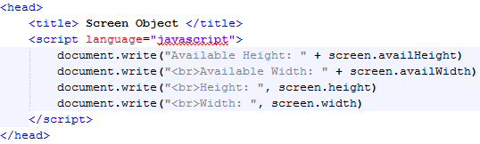
3. The Screen object…
Finding Available Height
Finding Available Width
Finding Actual Height
Finding Actual Width

Slide 24
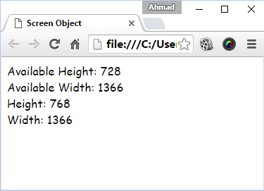
3. The Screen object…

Slide 25
4. Form Object
The Form object represents an HTML form
For each <form> tag in an HTML document, a Form object is created
The browser crates a ‘forms array’ which keeps the number of form objects in the HTML program
The first form object in the HTML file being held as array index [0], the second as index [1] and so on

Slide 26
4. Form Object…
The ‘forms array’ also holds information about each element used within <form> and </form> tags
elements array keeps information about form elements

Slide 27
4. Form Object…
Create a Form Object
You can create a <form> element by using the document.createElement() method:
var x = document.createElement("FORM");

Slide 28
4. Form Object…
<body>
<form name=“form1”>
</form>
<form name=“form2”>
</form>
</body>
forms
0
1
form1
form2

Slide 29
4.1 Accessing Form Elements
Let’s see, how to access the elements of the following form:
<body>
<form name=“form1”>
<input type=“text” name=“name”>
<input type=“text” name=“email”>
</form>
</body>

Slide 30
4.1 Accessing Form Elements…
Accessing Name Element
document.forms[0].name.value
document.form1.elements[0].value
Accessing Email Element
document.forms[0].email.value
document.form1.elements[1].value

Slide 31
4.2 Setting Form Elements
Let’s see, how to set the elements of the following form
<body>
<form name=“form1”>
<input type=“text” name=“name”>
<input type=“text” name=“email”>
</form>
</body>

Slide 32
4.2 Setting Form Elements…
Setting Name Element
document.forms[0].name.value = “Ali”
document.form1.elements[0].value = “Ali”
Setting Email Element
document.forms[0].email.value = “ali@gmail.com”
document.form1.elements[1].value = “ali@gmail.com”

Slide 33
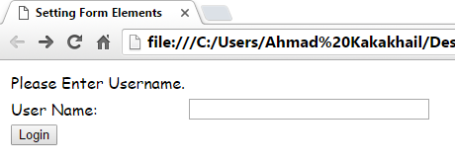
4.2 Setting Form Elements…
No User Name Entered
Let’s Write The User Name By Pressing Login Button, not by Actually Writing It

Slide 34
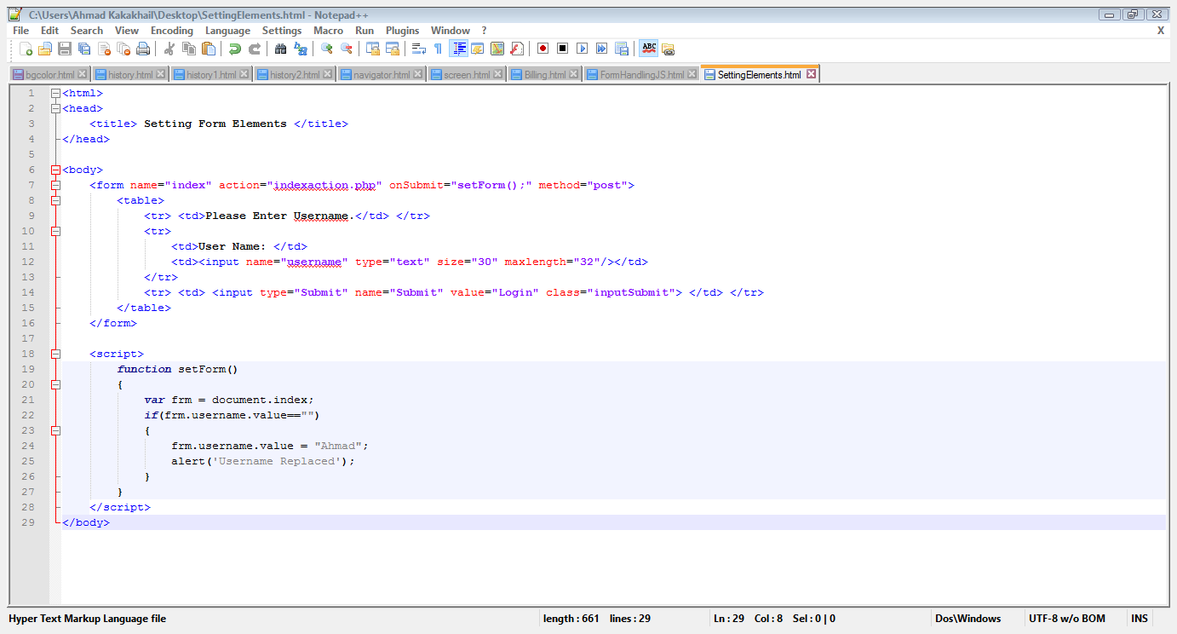
4.2 Setting Form Elements…
Set Form Function Call

Slide 35
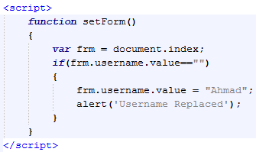
4.2 Setting Form Elements…
Getting Form Elements
Checking The Null Condition
Alert of User Name Replacement

Slide 36
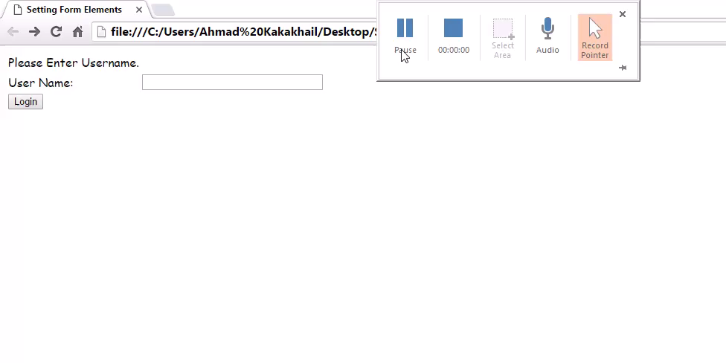
4.2 Setting Form Elements…

Slide 37
4.3 Validating Form Data
JavaScript can be useful in validating the form submission that is:
All required fields are filled with data?
For Example: If name is required, the textbox should not be empty on the time of submission.
All fields have valid data?
For Example: If email is required, it should not have invalid data like tra731, it must contain “@” and “.”

Slide 38
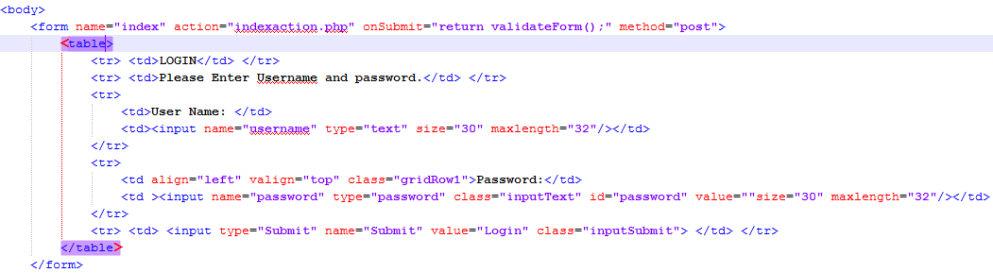
4.3 Validating Form Data…
Validate Form Function Call

Slide 39
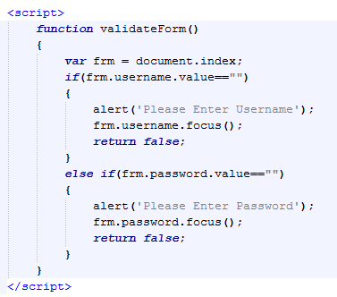
4.3 Validating Form Data…
Getting Form Elements
Checking For Emptiness
Alerts When The Field is Empty

Slide 40
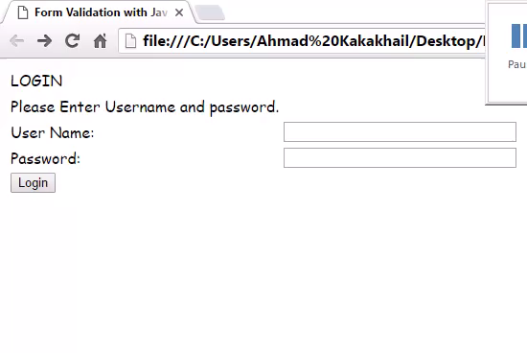
4.3 Validating Form Data…

Slide 41
5.0 Data Validation
Data validation is the process of ensuring that computer input is clean, correct, and useful.
Typical validation tasks are:
has the user filled in all required fields?
has the user entered a valid date?
has the user entered text in a numeric field?

Slide 42
5.0 Data Validation
Most often, the purpose of data validation is to ensure correct input to a computer application.
Validation can be defined by many different methods, and deployed in many different ways.
Server side validation is performed by a web server, after input has been sent to the server.
Client side validation is performed by a web browser, before input is sent to a web server.

Slide 43
Summary of Today’s Lecture
The history object
The navigator object
The user browser
The browser Engine
The browser platform
The browser language
The screen object
The form object
Accessing from element
Setting form element

Slide 44
Summary of Today’s Lecture
Validating form data
DATA Validation

Slide 45
THANK YOU

