Slide 1


Slide 2
Web Technologies and Programming
Lecture 21

Slide 3
jQuery, Data Description and Transformation, XML, DOM

Slide 4
Summary of the previous lecture
The history object
The navigator object
The user browser
The browser Engine
The browser platform
The browser language
The screen object
The form object
Accessing from element
Setting form element

Slide 5
Summary of the previous lecture
Validating form data
DATA Validation

Slide 6
Outline
Introduction to jQuery
DOM and jQuery
jQuery Selectors and events
DOM Objects
XML
Components of XML

Slide 7
1. Introduction to jQuery
“jQuery is a lightweight JavaScript library that emphasizes interaction between JavaScript and HTML.”
Developed by John Resig at Rochester Institute of Technology
“jQuery is free, open source software Dual-licensed under the MIT License and the GNU General Public License.”
“It’s all about simplicity. Why should web developers be forced to write long, complex, book-length pieces of code when they want to create simple pieces of interaction?”

Slide 8
1.1 Why use jQuery?
Rich Internet Applications (RIA)
Dynamic HTML (DHTML)
“Unobtrusive” JavaScript – separation of behavior from structure
Allows adding JavaScript to your web pages
Much easier to use
Eliminates cross-browser problems
Mobile First Web Development

Slide 9
1.1 Why use jQuery?
jQuery also simplifies a lot of the complicated things from JavaScript, like AJAX calls and DOM manipulation.
The jQuery library contains the following features:
HTML/DOM manipulation
CSS manipulation
HTML event methods
Effects and animations
AJAX (Asynchronous JavaScript and XML.

Slide 10
2. jQuery and DOM
DOM stands for Document Object Model
“The Document Object Model (DOM) is a cross-platform and language-independent convention for representing and interacting with objects in HTML, XHTML and XML documents.
Aspects of the DOM (such as its "Elements") may be addressed and manipulated within the syntax of the programming language in use.”

Slide 11
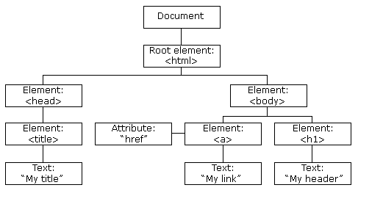
2. jQuery and DOM

Slide 12
2. jQuery and DOM
jQuery is “DOM scripting”
Hierarchal structure of a web page
You can add and subtract DOM elements on the fly
You can change the properties and contents of DOM elements on the fly
jQuery uses DOM elements to manipulate a web page.

Slide 13
3. jQuery Syntax
The jQuery syntax is tailor made for selecting HTML elements and performing some action on the element(s).
Basic syntax is: $(selector).action()
A $ sign to define/access jQuery
A (selector) to "query (or find)" HTML elements
A jQuery action() to be performed on the element(s)
Examples:
$(this).hide() - hides the current element.
$("p").hide() - hides all <p> elements.
$(".test").hide() - hides all elements with class="test".
$("#test").hide() - hides the element with id="test".

Slide 14
3.1 jQuery Selectors
Query selectors allow you to select and manipulate HTML element(s).
jQuery selectors are used to "find" (or select) HTML elements based on their id, classes, types, attributes, values of attributes and much more.
Majorly there are three types of selectors:
Element selector
Id selector
Class selector
All selectors in jQuery start with the dollar sign and parentheses: $().

Slide 15
3.1.1 jQuery element Selectors
The jQuery element selector selects elements based on the element name.
Example:
$("p")
Using this all <p> tags from a webpage will be selected.

Slide 16
3.1.2 jQuery id Selectors
The jQuery #id selector uses the id attribute of an HTML tag to find the specific element.
An id should be unique within a page, so you should use the #id selector when you want to find a single, unique element.
Example:
$("#test")
Using this tag with id of “text” from a webpage will be selected.

Slide 17
3.1.3 jQuery class Selectors
The jQuery class selector finds elements with a specific class.
Example:
$(".test")
Using this, tags with class of “text” from a webpage will be selected.

Slide 18
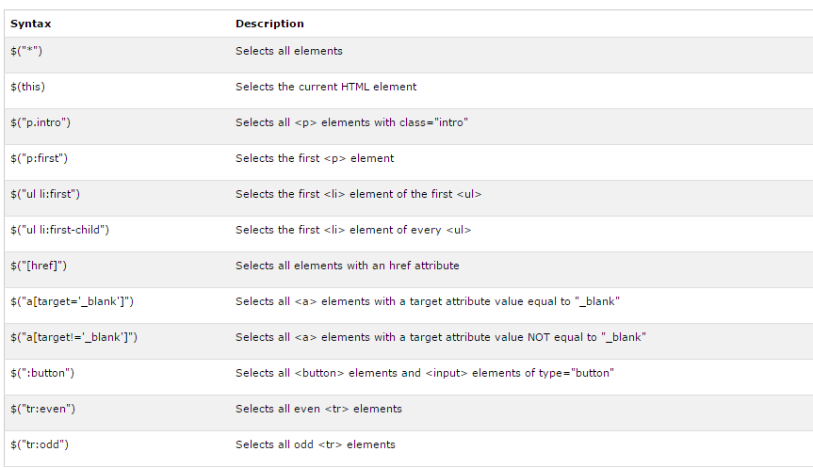
3.1.3 jQuery class Selectors

Slide 19
3.2 jQuery events
All the different visitor's actions that a web page can respond to are called events.
An event represents the precise moment when something happens.
Mouse Events | Keyboard Events | Form Events | Document/Window Events
click | keypress | submit | load
dblclick | keydown | change | resize
mouseenter | keyup | focus | scroll
mouseleave |  | blur | unload

Slide 20
3.2.1 jQuery events syntax
To assign a click event to all paragraphs on a page, you can do this:
$("p").click();
The next step is to define what should happen when the event fires. You must pass a function to the event:
$("p").click(function(){ // action goes here!! });

Slide 21
3.2.2 Commonly used events
$(document).ready()
The method allows us to execute a function when the document is fully loaded.
click()
The function is executed when the user clicks on the HTML element.
dblclick()
he function is executed when the user double-clicks on the HTML element
hover()
The hover() method takes two functions and is a combination of the mouseenter() and mouseleave() methods.
The first function is executed when the mouse enters the HTML element, and the second function is executed when the mouse leaves the HTML element
blur()
The function is executed when the form field loses focus.

Slide 22
3.2.3 The on() method
The on() method attaches one or more event handlers for the selected elements.
Example:
$("p").on({ mouseenter: function(){ $(this).css("background-color", "lightgray"); }, mouseleave: function(){ $(this).css("background-color", "lightblue"); }, click: function(){ $(this).css("background-color", "yellow"); } });

Slide 23
3.3 jQuery Effects
We can apply some commonly used effects to our HTML elements by just calling a simple jQuery function.
Some Common Effects are:
Hide() / show()
$("p").hide();
$("p").show();
fadeIn() / fadeOut()
slideDown() / slideUp()

Slide 24
4. DOM ( Document Object Model )
A Web page is made dynamic by applying JavaScript processing to the XHTML elements on that page
XHTML tags are also software objects , having properties and methods that can be programmed
These objects are programmed through JavaScript processing routines to make Web pages dynamic
The DOM is the programming interface to the XHTML objects appearing on a Web page
All XHTML elements, along with their containing text and attributes, can be accessed through the DOM.
The contents can be modified or deleted, and new elements can be created.
The XHTML DOM is platform and language independent.
It can be used by any programming language like Java, JavaScript, and VBScript.

Slide 25
4. DOM ( Document Object Model )
DOM stands for Document Object Model
“The Document Object Model (DOM) is a cross-platform and language-independent convention for representing and interacting with objects in HTML, XHTML and XML documents.
Aspects of the DOM (such as its "Elements") may be addressed and manipulated within the syntax of the programming language in use.”

Slide 26
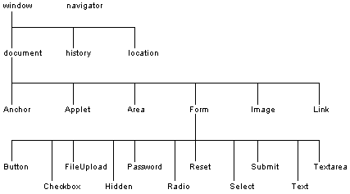
4. DOM ( Document Object Model ) The Hierarchy

Slide 27
4.1 DOM ( Document Object Model ) Objects
There are majorly 5 types of DOM Objects:
Window
Navigator
Location
History
Document

Slide 28
4.1.1 Window Object
The window object is the “master” DOM object at the top of the DOM hierarchy
Useful properties:
length: number of frames in window
frames: an array of window objects, one for each frame
parent: Since frames are window objects, sometimes parent window is needed
Examples:
window.document : if frameless, accesses the top level document. If frames, accesses the top frame’s document
window.frame[1].document : Access the document contained in the first frame
frame[1].parent.document : Access the document contained in the parent frame

Slide 29
4.1.2 Navigator Object
Contains information about the browser
Can be accessed as window.navigator or just navigator
Useful properties:
appName: name of browser used
appVersion: version of browser used
platform: operating system in use
cookieEnabled: can the browser store cookies?

Slide 30
4.1.3 Location Object
Contains information about the current URL
Can be accessed as window.location or just location
Useful properties:
href: retrieves entire URL
host: retrieves just the domain name (ex: yahoo.com)
pathname: retrieves just the path inside the domain (page name is at end)
hash: retrieves the anchor

Slide 31
4.1.4 History Object
Contains information on the URLs that the browser has visited in this session within a window
Can be accessed as window.history or just history
Useful properties: next, previous (tells you the URL, but won’t direct you there)
Useful methods:
back: same as pressing the back arrow button
forward: same as pressing the forward arrow button
go: go back or forward a given number of pages; to go back 3 pages:
history.go(-3);

Slide 32
4.1.5 Document Object
This is the typically the most accessed object
You can access all items in the document window through the document object
Forms, tables, paragraphs, lists, images, etc.
Consult a reference for properties and methods
Frameless document: Access a
window.document or document
Document contained in a frame:
window.frame[x].document, where x is the number or name of the frame

Slide 33
5. XML (Background)
SGML (Standard Generalized Markup Language)
ISO Standard, 1986, for data storage & exchange
Metalanguage for defining languages (through DTDs)
A famous SGML language: HTML
Separation of content and display
Used in U.S. gvt. & contractors, large manufacturing companies, technical info. Publishers,...
SGML reference is 600 pages long
XML
W3C recommendation in 1998
Simple subset (80/20 rule) of SGML: “ASCII of the Web”, “Semantic Web”
XML specification is 26 pages long

Slide 34
5. XML
XML stands for EXtensible Markup Language
A meta-language for descriptive markup: you invent your own tags
XML uses a Document Type Definition (DTD) or an XML Schema to describe the data
XML with a DTD or XML Schema is designed to be self-descriptive
Built-in internationalization via Unicode
Built-in error-handling
A forgotten tag, or an attribute without quotes renders an XML document unusable
Tons of support from the big IT companies

Slide 35
5.1 Why we use XML ?
Much of shareable data reside in computer systems and databases in incompatible formats
use conflicting hardware and/or software.
One of the most time-consuming challenges for developers has been to exchange data between such systems over the Internet
Converting the data to XML can greatly reduce the complexity and create data that can be read by many different applications
XML data is stored in plain text format – hardware and software independent
XML can be used to create new languages
Allows us to define our own markup languages

Slide 36
5.2 HTML and XML.
XML is not a replacement for HTML
In future Web development, XML is likely to be used to describe data while HTML will be used to format and display the same data (one interpretation of XML)
XML and HTML were designed with different goals
XML was designed to describe data and to focus on what data is
XML describes only content, or “meaning”
HTML was designed to display data and to focus on how data looks.
HTML describes both structure (e.g. <p>, <h2>, <em>) and appearance (e.g. <br>, <font>, <i>)
XML is for computers while HTML is for humans
XML is used to mark up data so it can be processed by computers
HTML is used to mark up text so it can be displayed to users

Slide 37
5.3 Benefits of XML.
Open W3C standard – non-proprietary
Representation of data across heterogeneous environments
Cross platform
Allows for high degree of interoperability
E.g., ability to exchange data between incompatible applications with incompatible data formats
Strict rules that make it relatively easy to write XML parsers
Syntax
Structure
Case sensitive
XML can make data more useful
s/w, h/w and application independence of XML makes data available to more users not only HTML browsers

Slide 38
5.3 Benefits of XML….
XML tags are not predefined
You must "invent" your own tags
The tags used to mark up HTML documents and the structure of HTML documents are predefined
The author of HTML documents can only use tags that are defined in the HTML standard
XML allows the author to define his own tags and his own document structure

Slide 39
5.4 Components of XML.
XML declaration
Processing instructions
Encoding specification (Unicode by default)
Namespace declaration
Schema declaration
Elements
Each element has a beginning and ending tag
<TAG_NAME>...</TAG_NAME>
Elements can be empty (<TAG_NAME />)
Attributes
Describes an element; e.g. data type, data range, etc.
Can only appear on beginning tag

Slide 40
5.4 Components of XML.
<?xml version="1.0" ?>
<?xml-stylesheet type="text/xsl" href="template.xsl"?>
<ROOT>
<ELEMENT1><SUBELEMENT1 /><SUBELEMENT2 /></ELEMENT1>
<ELEMENT2> </ELEMENT2>
<ELEMENT3 type='string'> </ELEMENT3>
<ELEMENT4 type='integer' value='9.3'> </ELEMENT4>
</ROOT>
Elements with Attributes
Elements
Processing Instructions

Slide 41
5.5 XML Declaration.
The XML declaration looks like this: <?xml version="1.0" encoding="UTF-8" standalone="yes"?>
The XML declaration is not required by browsers, but is required by most XML processors (so include it!)
If present, the XML declaration must be first--not even whitespace should precede it
Note that the brackets are <? and ?>
The version attribute is required
encoding can be "UTF-8" (ASCII) or "UTF-16" (Unicode), or something else, or it can be omitted
An XML document is standalone if it makes use of no external markup (DTD) declarations
Default value for this attribute is no

Slide 42
5.6 XML Elements.
An XML element is everything from the element's start tag to the element's end tag
XML Elements are extensible and they have relationships
Related as parents and children
XML Elements have simple naming rules
Names can contain letters, numbers, and other characters
Names must not start with a number or punctuation character
Names must not start with the letters xml (or XML or Xml ..)
Names cannot contain spaces

Slide 43
5.7 XML Attributes.
XML elements can have attributes
Data can be stored in child elements or in attributes
Should you avoid using attributes?
Here are some of the problems using attributes:
attributes cannot contain multiple values (child elements can)
attributes are not easily expandable (for future changes)
attributes cannot describe structures (child elements can)
attributes are more difficult to manipulate by program code
attribute values are not easy to test against a Document Type Definition (DTD) - which is used to define the legal elements of an XML document
Experience shows that attributes are handy in HTML but child elements should be used in their place in XML
Use attributes only to provide information that is not relevant to the data

Slide 44
5.8 XML Validation.
There is a difference between a well-formed XML document and a valid XML document
A well-formed XML document is one with correct XML syntax
XML syntax is constrained by a grammar (DTD or Schema) that governs the permitted tag names, attachment of attributes to tags, and so on.
A well-formed XML document that also conforms to a given DTD (Data type defination) or schema is said to be valid.
Every valid XML document is well-formed but the reverse is not necessarily the case

Slide 45
5.9 Sample XML Document.
<?xml version='1.0'?>
<bookstore>
<book genre='autobiography' publicationdate='1981'
ISBN='1-861003-11-0'>
<title>The Autobiography of Benjamin Franklin</title>
<author>
<first-name>Benjamin</first-name>
<last-name>Franklin</last-name>
</author>
<price>8.99</price>
</book>
<book genre='novel' publicationdate='1967' ISBN='0-201-63361-2'>
<title>The Confidence Man</title>
<author>
<first-name>Herman</first-name>
<last-name>Melville</last-name>
</author>
<price>11.99</price>
</book>
</bookstore>

Slide 46
5.9 XML Writing Rules.
There must be one, and only one, root element
All XML elements must have a closing tag
Sub-elements must be properly nested
Attributes are optional
Defined by an optional schema
Attribute values must be enclosed in “” or ‘’
Processing instructions are optional
XML is case-sensitive

Slide 47
5.10 XML Browser Support
Netscape 6 supports XML
Internet Explorer 5.0 supports the XML 1.0 standard
Internet Explorer 5.0 and greater has the following XML support:
Viewing of XML documents
Displaying XML with CSS
Transforming and displaying XML with XSL
XML embedded in HTML as Data Islands
Binding XML data to HTML elements
Access to the XML DOM
Full support for W3C DTD standards

Slide 48
Summary
Introduction to jQuery
Why use jQuery
Jquery:
Syntax
Selectors
element Selectors
class Selectors
events
Effects

Slide 49
Summary
DOM
DOM Objects
Window
Navigator
Location
History
Document
XML
Components of XML

Slide 50
THANK YOU

