Slide 1


Slide 2
Web Technologies and Programming
Lecture 22
Introduction to PHP (Part-1)

Slide 3
Summary of Previous Lecture
Introduction to jQuery
Why use jQuery
Jquery:
Syntax
Selectors
Element Selectors
Class Selectors
Events
Effects

Slide 4
Summary of Previous Lecture
DOM
DOM Objects
Window
Navigator
Location
History
Document
XML
Components of XML

Slide 5
Outline
Setting the environment
Overview of PHP
Constants and Variables in PHP
PHP strings
PHP is loose typed language

Slide 6
1. Setting The Environment
A Web Server
PHP
MySql
http://www.wampserver.com/en/
Editor
Macromedia Dreamweaver
Adobe Dreamweaver
Notepad / Notepad++
WAMP Server
Windows, Apache, MySQL, PHP

Slide 7
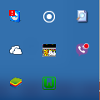
1. Setting The Environment…
Checking WAMP status:
If this Icon is Red or Orange, it means it is not working properly.
MSVCR100.dll is missing
Install Microsoft Visual C++ 2010 SP1 Redistributable Package
Port conflict with Skype
Port conflict with IIS Express (if Visual Studio is installed)
WAMP Is Working Properly

Slide 8
1. Setting The Environment…
Resolving Port Issues (If there is port issue):
Click the icon of WAMP Server
Expand Apache section
Open httpd.conf file in Notepad
Press Ctrl+F and type 80
Wherever you find occurrence of 80, change it to 81
Save the file
Click the icon of WAMP Server and Select Start All Services
Open Your Browser, type localhost:81 and it should display homepage of WampServer

Slide 9
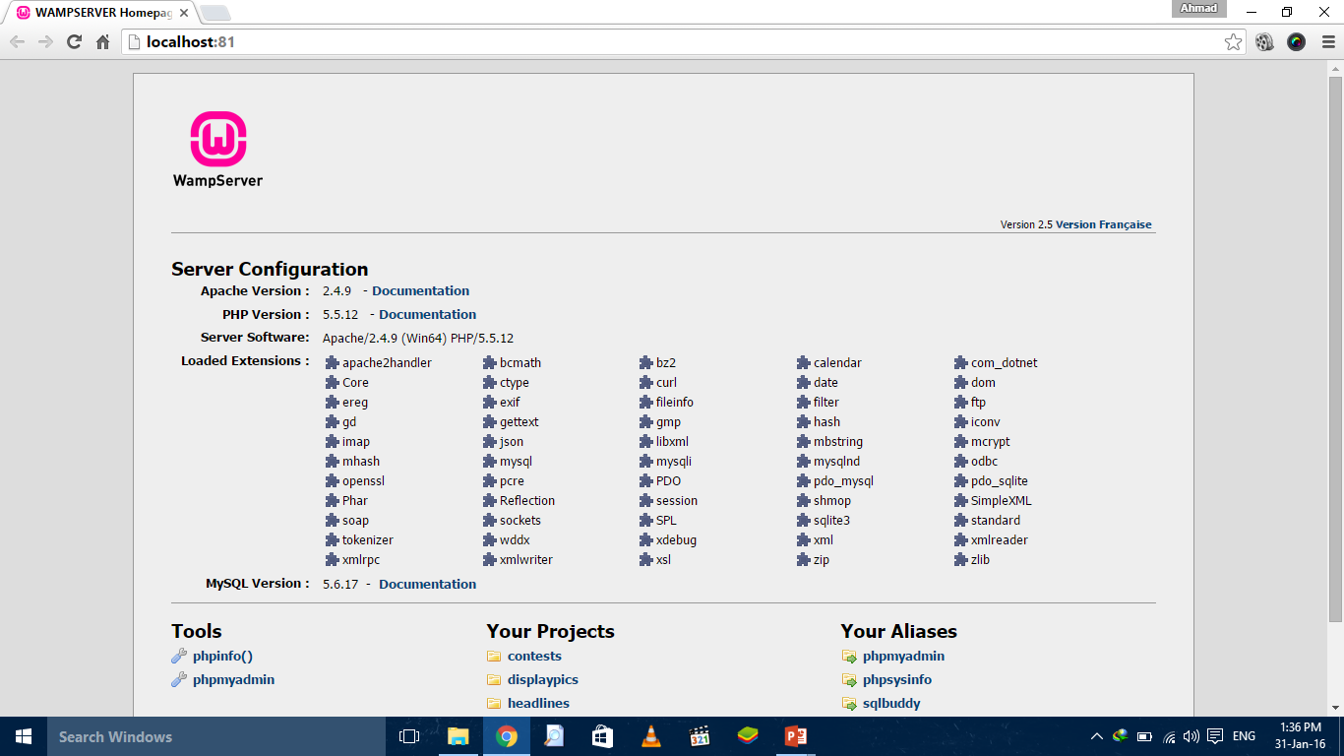
1. Setting The Environment…

Slide 10
2. PHP: an Overview
PHP: Hypertext Preprocessor
Originally called “Personal Home Page Tools”
Used to create dynamic web pages
Popular server-side scripting technology
Open-source
Anyone may view, modify and redistribute source code
Platform independent
PHP is a widely-used scripting language

Slide 11
2. PHP: an Overview
What is a PHP File?
PHP files can contain text, HTML, CSS, JavaScript, and PHP code
PHP code are executed on the server, and the result is returned to the browser as plain HTML
PHP files have extension ".php“
PHP scripts are executed on the server.

Slide 12
2. PHP: an Overview…
PHP:
Interpreted language, scripts are parsed at run-time rather than compiled beforehand
Compatible with many popular databases
Popular server-side scripting technology
Structurally similar to C/C++
Supports procedural and object-oriented paradigm

Slide 13
2. PHP: What Can PHP Do?
PHP:
PHP can generate dynamic page content
PHP can create, open, read, write, delete, and close files on the server
PHP can collect form data
PHP can send and receive cookies
PHP can add, delete, modify data in your database
PHP can be used to control user-access
PHP can encrypt data

Slide 14
2. PHP: Why PHP?
PHP:
PHP runs on various platforms (Windows, Linux, Unix, Mac OS X, etc.)
PHP is compatible with almost all servers used today (Apache, IIS, etc.)
PHP supports a wide range of databases
PHP is free. Download it from the official PHP resource: www.php.net
PHP is easy to learn and runs efficiently on the server side

Slide 15
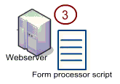

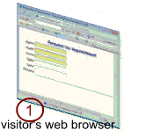
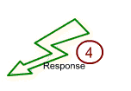
2. PHP: an Overview…

Slide 16
2. PHP: Basic PHP Syntax
PHP:
A PHP script can be placed anywhere in the document.
A PHP script starts with <?php and ends with ?>:
Syntax:
<?php // PHP code goes here ?>

Slide 17
2.1 How PHP Fits with HTML
Embedding PHP in HTML code
HTML can also be written inside the PHP code
PHP can also be written as a standalone program with no HTML at all

Slide 18
2.2 Basic Rules of PHP Syntax
PHP code is denoted in the page with opening and closing tags, as follows:
<?php and ?>
<? or ?>
<script language=“PHP”>…… </script>
PHP statements end with a semicolon
Comments can be added as
// for one line comment
/* and */ for multiple lines comment

Slide 19
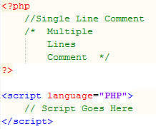
2.2 Basic Rules of PHP Syntax

Slide 20
2.3 Writing and Executing PHP Code
Open a Notepad/Notepad++ or Dreamweaver File
Write PHP Code
Save file with .php extension
Save all the files in one directory
Copy this directory in
C:\wamp\www\
This is the directory from where wampserver access files

Slide 21
2.3 Writing and executing PHP code…
Start WAMP server
Go to localhost either by typing localhost in address bar of the browser or by clicking the WAMP sever icon in the toolbar and selecting localhost
Select your web directory from the list of project on the WAMP server home page
Select the file to execute

Slide 22
2.3 COMMENTS IN PHP code…
A comment in PHP code is a line that is not read/executed as part of the program. Its only purpose is to be read by someone who is looking at the code.
Comments can be used to:
Let others understand what you are doing
Remind yourself of what you did - Most programmers have experienced coming back to their own work a year or two later and having to re-figure out what they did. Comments can remind you of what you were thinking when you wrote the code
PHP supports several ways of commenting:

Slide 23
2.3 COMMENTS IN PHP code…
Example
<!DOCTYPE html> <html> <body> <?php // This is a single-line comment # This is also a single-line comment /* This is a multiple-lines comment block that spans over multiple lines */ // You can also use comments to leave out parts of a code line $x = 5 /* + 15 */ + 5; echo $x; ?> </body> </html>

Slide 24
2.4 Writing output to the browser
echo(): is used to write output on the browser
echo(“Welcome to PHP”);
echo “Welcome to PHP”;
print(): can also be used to write out put on the browser
print(“Welcome to PHP”);
print “Welcome to PHP”;
printf(): can also be used for writing output

Slide 25

2.5 First PHP program
PHP Block Starts
Writing on Browser
Ending PHP Block

Slide 26
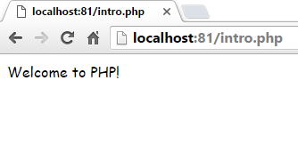
2.5 First PHP program…
Output from PHP Code

Slide 27
2.6 Integrating HTML with PHP
echo statement outputs whatever it’s told to the browser
It can output not only plain text but also HTML tags
echo “<h1> Welcome to the PHP</h1>”;

Slide 28
2.6 Integrating HTML with PHP…
Using quotation marks:
echo “<h1 style=“color:red”> Welcome to PHP</h1>”;
echo “<h1 style=‘color:red’> Welcome to PHP</h1>”;
echo “<h1 style=\“color:red\”> Welcome to PHP</h1>”;

Slide 29
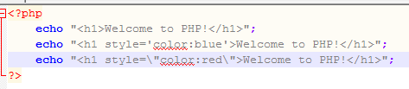
2.6 Integrating HTML with PHP…
Arranging Quotations
Using Heading Tag
Using Escape Character

Slide 30
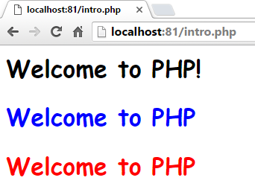
2.6 Integrating HTML with PHP…

Slide 31
3. Using CONSTANTS and Variables

Slide 32
3.1 Constants
A constant is a placeholder for a value that you reference within your code that is formally defined before using it
must begin with a letter or an underscore
are case sensitive
typically they are named using all capital letters
PHP function define() is used to assign a value to a constant

Slide 33
3.1 Constants
Parameters:
name: Specifies the name of the constant
value: Specifies the value of the constant
case-insensitive: Specifies whether the constant name should be case-insensitive. Default is false

Slide 34
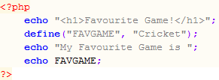
3.1 Constants…
Constant Name
Value of Constant
Displaying The Value

Slide 35
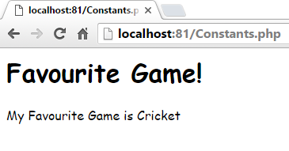
3.1 Constants…

Slide 36
3.2 Constants are Global
Constants are automatically global and can be used across the entire script.
The example below uses a constant inside a function, even if it is defined outside the function:
Example:
<?php define("GREETING", "Welcome to W3Schools.com!"); function myTest() { echo GREETING; } myTest(); ?>

Slide 37
3.2 Variables
Variables are "containers" for storing information.
Variables can store data of different types, and different data types can do different things.

Slide 38
3.2 Variables
Begin with $ sign
First character must be a letter or underscore
Remaining characters may be letters, numbers or underscores
Don’t need to declare or initialize
Case Sensitive ( $age and $AGE)
A variable name can only contain alpha-numeric characters and underscores (A-z, 0-9, and _ )
Data types does not require to be declare explicitly
Supports
Float, Integer, Boolean, String, Array, Object

Slide 39
3.2 Variables
PHP has three different variable scopes:
Local
A variable declared within a function has a LOCAL SCOPE and can only be accessed within that function
Global
A variable declared outside a function has a GLOBAL SCOPE and can only be accessed outside a function
Static
when a function is completed/executed, all of its variables are deleted. However, sometimes we want a local variable NOT to be deleted. We need it for a further job.
To do this, use the static keyword when you first declare the variable

Slide 40
3.2 Variables
Data Types Supported by PHP
Float (floating point numbers - also called double)
Integer ( -2,147,483,648 and 2,147,483,647)
Boolean ( TRUE or FALSE.)
String
Array (An array stores multiple values in one single variable ) .
Object (An object is a data type which stores data and information on how to process that data. an object must be explicitly declared an object must be explicitly declared ).

Slide 41
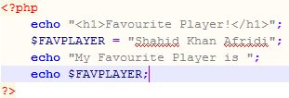
3.2 Variables…
Variable Declared
Initial Value
Displaying Variable’s Value

Slide 42
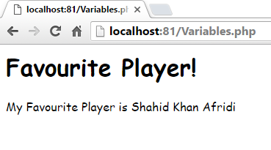
3.2 Variables…

Slide 43
3.2 Variables…
The gettype() Function
returns the type of Provided Variable
The settype() Function
converts a variable to the type specified by type

Slide 44
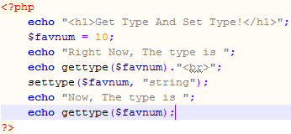
3.2 Variables…
Get Type Function
Set Type Function
Get Type Function

Slide 45
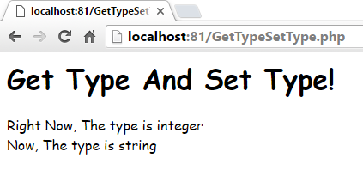
2.2 Variables…

Slide 46
2.2.1 Type Determination
A number of functions are available for determining a variable’s type
It will return 1 if conditions satisfies so these are Boolean functions.
Syntax:
is_name($variable_name)

Slide 47
2.2.1 Type Determination
Some of the common functions are:
is_array()
is_bool()
is_float()
is_integer()
is_null()
is_numeric()
is_string()

Slide 48
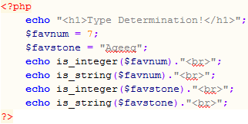
2.2.1 Type determination…

Slide 49
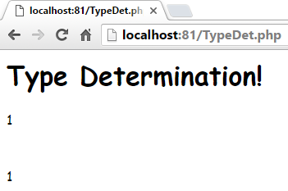
2.2.1 Type determination…

Slide 50
3. PHP Strings
A string is a sequence of characters, like "Hello world!".
PHP String Functions
Now, we will look at some commonly used functions to manipulate strings.
Get The Length of a String
The PHP strlen() function returns the length of a string.
The example below returns the length of the string "Hello world!":
<?php echo strlen("Hello world!"); // outputs 12 ?>

Slide 51
3. PHP Strings
Count The Number of Words in a String
The PHP str_word_count() function counts the number of words in a string:
<?php echo str_word_count("Hello world!"); // outputs 2 ?>
Reverse a String
The PHP strrev() function reverses a string:
<?php echo strrev("Hello world!"); // outputs !dlrow olleH ?>

Slide 52
4. PHP is a Loosely Typed Language…
In the example below, notice that we did not have to tell PHP which data type the variable is.
PHP automatically converts the variable to the correct data type, depending on its value.
In other languages such as C, C++, and Java, the programmer must declare the name and type of the variable before using it.
Example
<?php $x = 5; $y = 4; echo $x + $y; ?>

Slide 53
Summary of Today’s Lecture
Setting the environment
PHP overview
What is a PHP File
Open-source
Platform independent
What Can PHP Do?
Why PHP?
Basic PHP Syntax
Writing and Executing PHP Code
PHP constants
Constants are Global
PHP variables
Local
Global
Static
Type Determination

Slide 54
Summary of Today’s Lecture
PHP Strings
PHP is a Loosely Typed Language

Slide 55
THANK YOU

