Slide 1


Slide 2
Web Technologies and Programming
Lecture 23
Introduction to PHP (Part-2)

Slide 3
Summary of Previous Lecture
Setting the environment
PHP overview
What is a PHP File
Open-source
Platform independent
What Can PHP Do?
Why PHP?
Basic PHP Syntax
Writing and Executing PHP Code
PHP constants
Constants are Global
PHP variables
Local
Global
Static
Type Determination
PHP Strings
PHP is a Loosely Typed Language

Slide 4
Today’s Lecture Outline
Operators in PHP
Conditional Statements in PHP
Looping Statements
Arrays in PHP

Slide 5
1. Operators in PHP
Operators are used to perform operations on variables and values.
PHP divides the operators in the following groups:
Arithmetic operators
Assignment operators
String operators
Increment/Decrement operators
Logical operators
Comparison operators
Equality Operators
Array operators

Slide 6
1. Operators in PHP
Arithmetic Operators:
The PHP arithmetic operators are used with numeric values to perform common arithmetical operations, such as addition, subtraction, multiplication etc.
+, - ,*, /, %, **

Slide 7
1. Operators in PHP
Assignment Operators:
The PHP assignment operators are used with numeric values to write a value to a variable.
The basic assignment operator in PHP is "=". It means that the left operand gets set to the value of the assignment expression on the right.
=
+= ($a +=$b ), *= , /=
.= ($a .= $b)

Slide 8
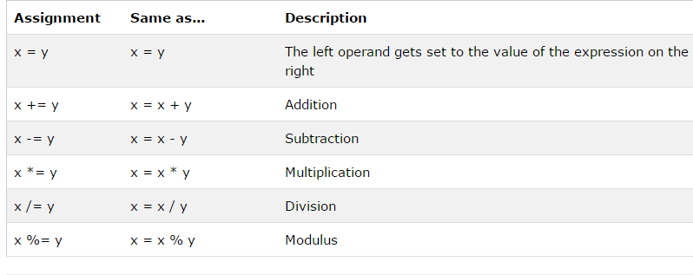
1. Operators in PHP

Slide 9
1. Operators in PHP…
String Operators:
PHP has two operators that are specially designed for strings.
. , .=
$a=“abcd”.”efgh”; $a=abcdefgh
$a.=“ijk”; $a=abcdefghijk

Slide 10
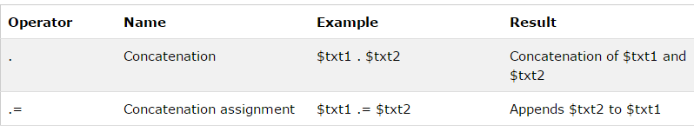
1. Operators in PHP…
String Operators:

Slide 11
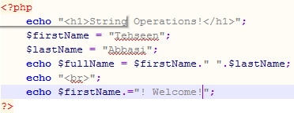
1. Operators in PHP…
First Variable
Second Variable
Concatenation
Using .=

Slide 12
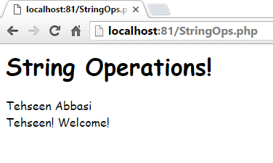
1. Operators in PHP…

Slide 13
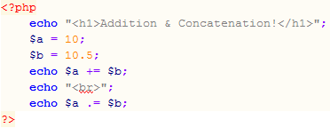
1. Operators in PHP…
Adds $b in $a
Concatenates $b with $a

Slide 14
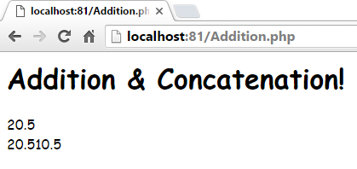
1. Operators in PHP…

Slide 15
1. Operators in PHP…
Increment/decrement Operators:
The PHP increment operators are used to increment a variable's value.
The PHP decrement operators are used to decrement a variable's value.
++ , --
$b=$a++
$b=++$a

Slide 16
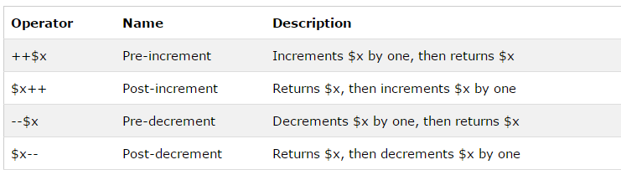
1. Operators in PHP…
Increment/decrement Operators:

Slide 17
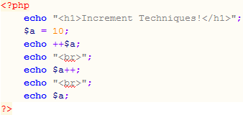
1. Operators in PHP…
Variable Declared
Incremented Before Display
Incremented After Display
Displaying Incremented Value

Slide 18
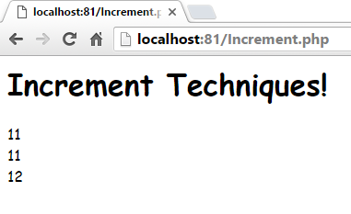
1. Operators in PHP…

Slide 19
1. Operators in PHP…
Logical Operators:
The PHP logical operators are used to combine conditional statements.
AND, OR, NOT, XOR
&&, ||, !

Slide 20
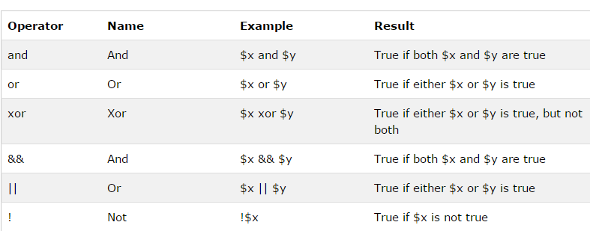
1. Operators in PHP…
Logical Operators:

Slide 21
1. Operators in PHP…
Comparison Operators:
The PHP comparison operators are used to compare two values (number or string):
>, <, <=, >=

Slide 22
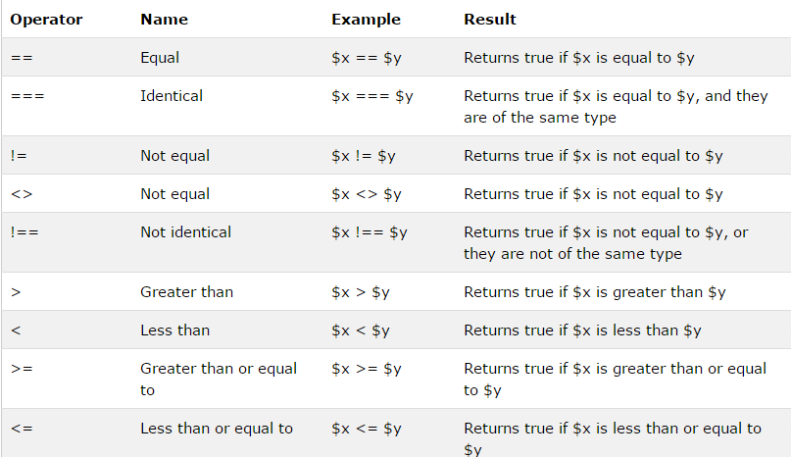
1. Operators in PHP…
Comparison Operators:

Slide 23
1. Operators in PHP…
Equality Operators:
==, !=, ===

Slide 24
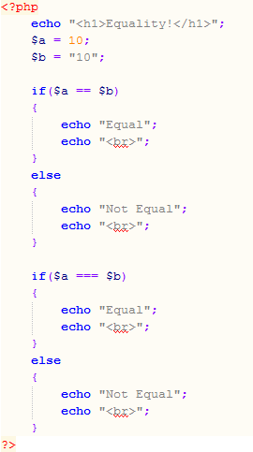
1. Operators in PHP…
Integer Value
String Value
Compares Only Values
Strict Comparison, Data Types Should Also Match

Slide 25
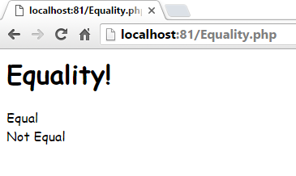
1. Operators in PHP…

Slide 26
2. Conditional Statements
When you want to perform different actions for different conditions. You can use conditional statements in your code to do this.
In PHP we have the following conditional statements:
if statement - executes some code if one condition is true
if...else statement - executes some code if a condition is true and another code if that condition is false
if...elseif....else statement - executes different codes for more than two conditions
switch statement - selects one of many blocks of code to be executed

Slide 27
2. Conditional Statements
if statement:
The if statement executes some code if one condition is true.
if(condition)
{
code to be executed if condition is true;
}

Slide 28

2. Conditional Statements
if statement Example:
<?php $t = date("H"); if ($t < "20")
{ echo "Have a good day!"; } ?>\

Slide 29
2. Conditional Statements
if-else statement:
The if....else statement executes some code if a condition is true and another code if that condition is false.
if (condition) { code to be executed if condition is true; } else { code to be executed if condition is false; }

Slide 30

2. Conditional Statements
if-else statement Example:
<?php $t = date("H"); if ($t < "20") { echo "Have a good day!"; }
else
{ echo "Have a good night!"; } ?>

Slide 31
2. Conditional Statements
The if...elseif....else Statement:
The if....elseif...else statement executes different codes for more than two conditions..
if (condition)
{ code to be executed if this condition is true; }
elseif (condition)
{ code to be executed if this condition is true; }
else
{ code to be executed if all conditions are false; }

Slide 32
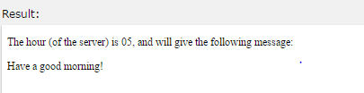
2. Conditional Statements
The if...elseif....else statement Example:
<?php $t = date("H"); if ($t < "10") { echo "Have a good morning!"; } elseif ($t < "20") { echo "Have a good day!"; } else { echo "Have a good night!"; } ?>

Slide 33
2. Conditional Statements…
switch statement:
Use the switch statement to select one of many blocks of code to be executed
switch(variable)
{
case option:
action
break;
.
.
}

Slide 34
2. Conditional Statements…
switch (n) { case label1: code to be executed if n=label1; break; case label2: code to be executed if n=label2; break; case label3: code to be executed if n=label3; break; ... default: code to be executed if n is different from all labels; }

Slide 35
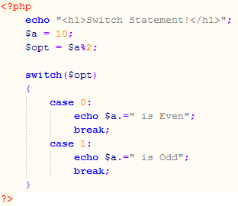
2. Conditional Statements…
Switch Starts
Case 0
Case 1

Slide 36
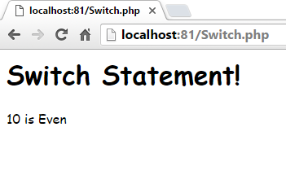
2. Conditional Statements…

Slide 37
3. Looping Statements
For Loop
While Loop
Do-While Loop
ForEach Loop

Slide 38
3. Looping Statements
for loop
The for loop is used when you know in advance how many times the script should run.
Syntax:
for (init counter; test counter; increment counter) { code to be executed; }
………………………………………………………………………….
for($a=0; $a<10; $a++)
{
//statements
}

Slide 39
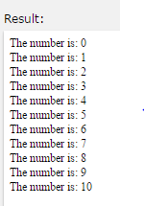
3. Looping Statements
for loop Example:
<!DOCTYPE html> <html> <body> <?php for ($x = 0; $x <= 10; $x++) { echo "The number is: $x <br>"; } ?> </body> </html>

Slide 40
3. Looping Statements
while loop
The while loop executes a block of code as long as the specified condition is true.
while(condition is true)
{
//Statements
//Increment/decrement
}

Slide 41
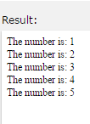
3. Looping Statements
while loop Example:
<?php $x = 1; while($x <= 5) { echo "The number is: $x <br>"; $x++; } ?>

Slide 42
3. Looping Statements…
do-while loop
The do...while loop will always execute the block of code once, it will then check the condition, and repeat the loop while the specified condition is true.
do
{
//Statements
//Increment/decrement
}
While(condition is true);

Slide 43
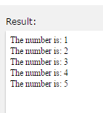
3. Looping Statements…
do-while loop Example:
<?php $x = 1; do { echo "The number is: $x <br>"; $x++; } while ($x <= 5); ?>

Slide 44
3. Looping Statements…
foreach loop
The foreach loop works only on arrays, and is used to loop through each key/value pair in an array
is used to read an entire array
foreach ($array as $value)
{ code to be executed; }

Slide 45
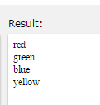
3. Looping Statements…
foreach loop example:
<?php $colors = array("red", "green", "blue", "yellow"); foreach ($colors as $value) { echo "$value <br>"; } ?>

Slide 46
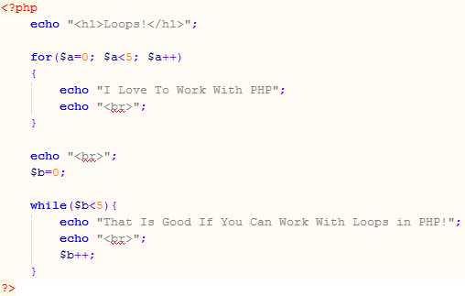
3. Looping Statements…
For Loop
While Loop

Slide 47
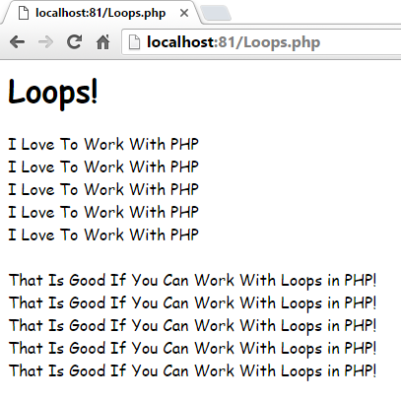
3. Looping Statements…
Output From For Loop
Output From While Loop

Slide 48
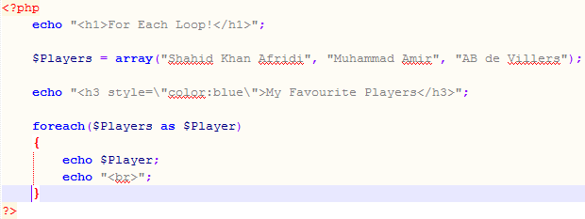
3. Looping Statements…
Array Declaration
ForEach Loop Starts
Using Obtained Value

Slide 49
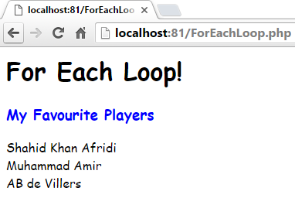
3. Looping Statements…

Slide 50
4. Arrays in PHP
An array stores multiple values in one single variable
An array is a special variable, which can hold more than one value at a time.
An array is traditionally defined as a group of items that share certain characteristics
Each item consists of two components:
Key
Value
PHP doesn’t require that you assign a size to an array at creation time

Slide 51
4. Arrays in PHP…
Declaring an array:
$array_name[key] = value;
$players[0] = “Shahid Khan Afridi”;
Adding element in an array:
$players[1] = “Muhammad Amir”;
Accessing element in an array
echo $players[0];

Slide 52
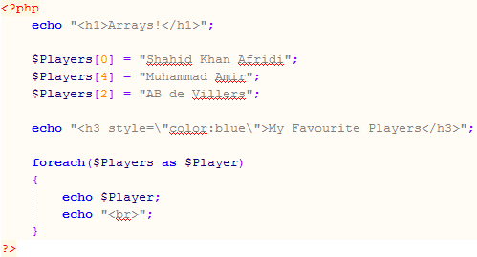
4. Arrays in PHP…
Declaring Array
Adding Elements
ForEach Loop

Slide 53
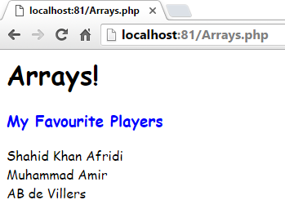
4. Arrays in PHP…

Slide 54
4. Arrays in PHP…
Associative arrays: Arrays with named keys
$array_name[‘element-name’] = value;
$players[‘shahid’] = “Shahid Khan Afridi”;
Adding element in an array:
$players[‘amir’] = “Muhammad Amir”;
Accessing element in an array:
echo $players[‘shahid’];

Slide 55
4. Arrays in PHP…
The array(); can also be used to create an array
$array_name = array(item_1, item_2, …, item_n);
$players = array(“Shahid Khan Afridi”, ”Muhammad Amir”);
$players = array(“shahid”=>“Shahid Khan Afridi”, ”amir”=>”Muhammad Amir”);

Slide 56
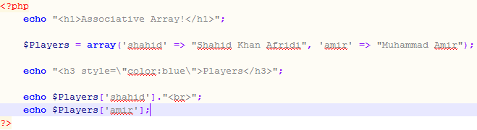
4. Arrays in PHP…
Associative Array Declared Using array()
Accessing Elements by Name

Slide 57
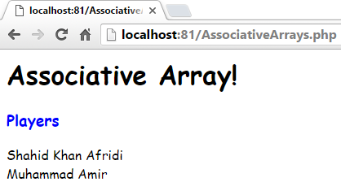
4. Arrays in PHP…

Slide 58
4. Arrays in PHP…
Sorting arrays:
sort()
Sorts the array in ascending order
rsort()
Sorts the array in descending order

Slide 59
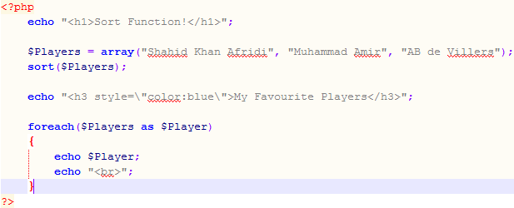
4. Arrays in PHP…
Array Declaration
Sorting Array
ForEach Loop for Displaying Arrays

Slide 60
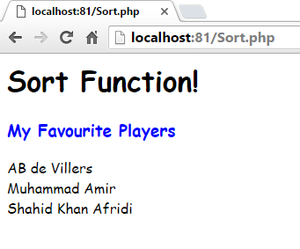
4. Arrays in PHP…

Slide 61
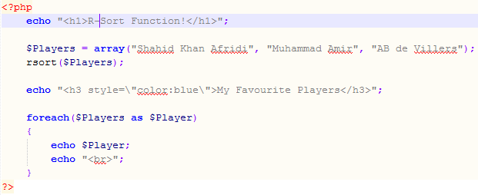
4. Arrays in PHP…
Reverse Sorting

Slide 62
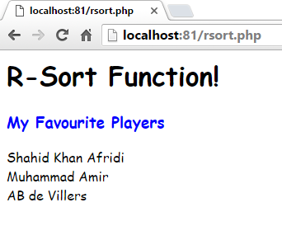
4. Arrays in PHP…

Slide 63
Summary of Today’s Lecture
Operators in PHP
Arithmetic Operators: +, - ,*, /, %, **
Assignment Operators: =
String Operators: . , .=
Increment/decrement Operators: ++ , --
Logical Operators: AND, OR, NOT, XOR, &&, ||, !
Comparison Operators: >, <, <=, >=
Equality Operators: ==, !=, ===
Conditional statements
if statement - executes some code if one condition is true
if...else statement - executes some code if a condition is true and another code if that condition is false
if...elseif....else statement - executes different codes for more than two conditions
switch statement - selects one of many blocks of code to be executed

Slide 64
Summary of Today’s Lecture
Looping statements
For Loop
While Loop
Do-While Loop
ForEach Loop
Arrays in PHP
Associative arrays
Sorting arrays

Slide 65
THANK YOU

