Slide 1


Slide 2
Web Technologies and Programming
Lecture 24

Slide 3
Passing Data Between Pages

Slide 4
Summary of Previous Lecture
Operators in PHP
Arithmetic Operators: +, - ,*, /, %, **
Assignment Operators: =
String Operators: . , .=
Increment/decrement Operators: ++ , --
Logical Operators: AND, OR, NOT, XOR, &&, ||, !
Comparison Operators: >, <, <=, >=
Equality Operators: ==, !=, ===
Conditional statements
if statement - executes some code if one condition is true
if...else statement - executes some code if a condition is true and another code if that condition is false
if...elseif....else statement - executes different codes for more than two conditions
switch statement - selects one of many blocks of code to be executed

Slide 5
Summary of Previous Lecture
Looping statements
For Loop
While Loop
Do-While Loop
ForEach Loop
Arrays in PHP
Associative arrays
Sorting arrays

Slide 6
Today’s Lecture Outline
Super Global variables
Passing form data
Passing data with sessions

Slide 7
1. Passing Form Data
Forms provide a mean of submitting information from the client to the server.
We can create HTML forms using <form> tag
Method and action are the most common attributes of <form>

Slide 8
1. Passing Form Data…
action
gives the URL of the application that is to receive and process the forms data
method
sets the HTTP method that the browser uses to send the form's data to the server for processing
most common methods are POST or GET

Slide 9
1. Passing Form Data…
When to Use GET?
You can use GET (the default method):
If the form submission is passive (like a search engine query), and without sensitive information.

Slide 10
1. Passing Form Data…
When to Use GET?
When you use GET, the form data will be visible in the page address:
action_page.php?firstname=Mickey&lastname=Mouse

Slide 11
1. Passing Form Data…
Get Method:
all Form Data is encoded into the URL, appended the action URL as query string parameters
Information is visible to everyone
It has the amount limit
Get method should only be used when the data is not sensitive
Get should not be used when sending passwords or sensitive data

Slide 12
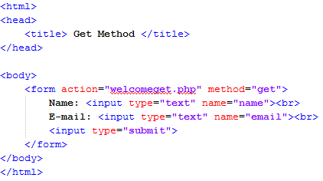
1. Passing Form Data…
URL where Information is to be submitted
Get Method

Slide 13
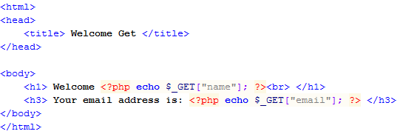
1. Passing Form Data…
Getting Name
Getting Email

Slide 14
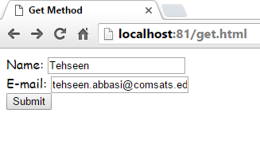
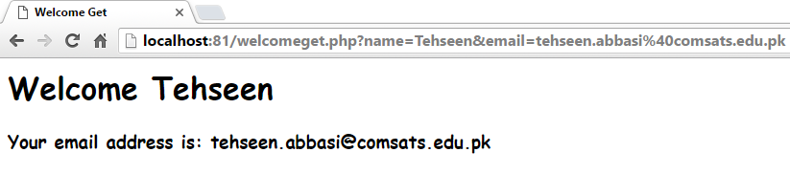
1. Passing Form Data…
Information to be Sent
URL contains all Data that was sent from previous page

Slide 15
1. Passing Form Data…
When to Use POST?
You should use POST:
If the form is updating data, or includes sensitive information (password).
POST offers better security because the submitted data is not visible in the page address.

Slide 16
1. Passing form data…
Post method:
Form Data appears within the message body of the HTTP request
Information sent will be invisible to others
No limit on data amount
When using sensitive data such as passwords, use Post Method.

Slide 17
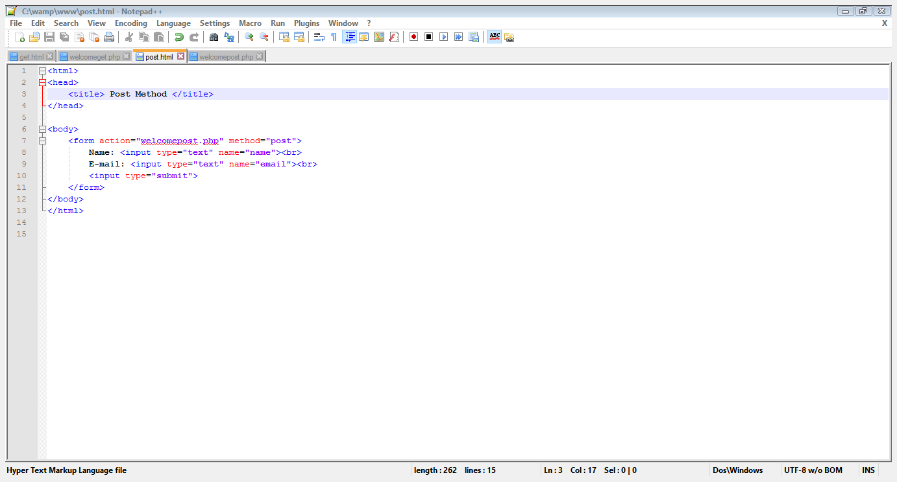
1. Passing Form Data…
URL where Information is to be submitted
Get Method

Slide 18
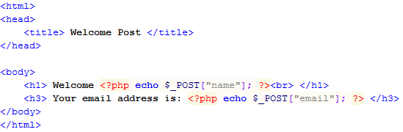
1. Passing Form Data…
Getting Posted Name
Getting Posted Email

Slide 19
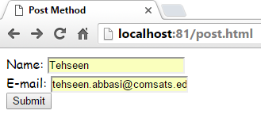
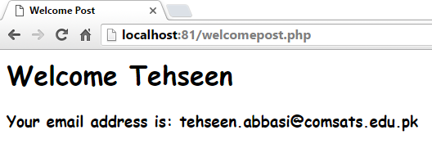
1. Passing Form Data…
Information to be Sent
URL contains no Data that was sent from previous page

Slide 20
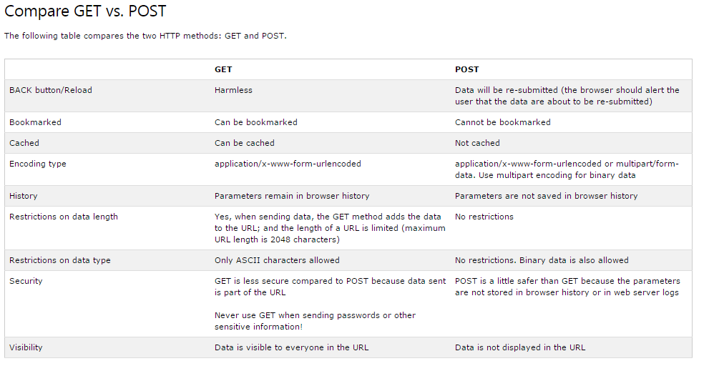
1. Compare GET vs. POST

Slide 21
1.1 Super Global Variables
Several predefined variables in PHP are "superglobals", which means that they are always accessible, regardless of scope - and you can access them from any function, class or file without having to do anything special.

Slide 22
1.1 Super Global Variables
PHP automatically makes few variables available in your program
These are array variables and can be accessed by name
These variables are called super-global variables because they can be accessed without regard to scope

Slide 23
1.1 Super Global Variables…
$_GET:
contains all the query string variables that were attached to the URL
$_POST:
contains all the submitted form variables and their data

Slide 24


1.1 Super Global Variables…
$_GET:
<html> <body> <a href="test_get.php?subject=PHP&web=W3schools.com">Test $GET</a> </body> </html>

Slide 25

1.1 Super Global Variables…
$_POST:
<html> <body> <form method="post" action="<?php echo $_SERVER['PHP_SELF'];?>"> Name: <input type="text" name="fname"> <input type="submit"> </form> <?php if ($_SERVER["REQUEST_METHOD"] == "POST") { // collect value of input field $name = $_POST['fname']; if (empty($name)) { echo "Name is empty"; } else { echo $name; } } ?> </body> </html>

Slide 26
1.1 Super Global Variables…
name
email
$_GET
Tehseen
tehseen.abbasi@comsats.edu.pk

Slide 27
1.1 Super Global Variables…
$_POST
Tehseen
tehseen.abbasi@comsats.edu.pk
name
email

Slide 28
1.2 Accessing Form Data on Action Page
name
email
$_GET
Tehseen
tehseen.abbasi@comsats.edu.pk

Slide 29
1.2 Accessing Form Data on Action Page
name
email
$_POST
Tehseen
tehseen.abbasi@comsats.edu.pk

Slide 30
2. Passing Text Field Data
Post Method
Text Field
Text Field Name

Slide 31
2. Passing Text Field Data…
Display A Message
Data Received

Slide 32
2. Passing Text Field Data…
Form Page
Action Page

Slide 33
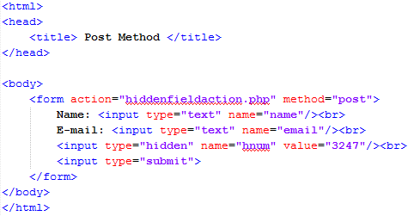
2. Passing Hidden Field Data…
Hidden Value
Hidden Field
Field Name

Slide 34
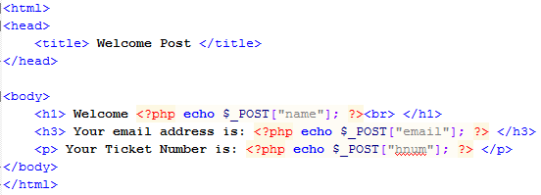
2. Passing Hidden Field Data…
Accessing Hidden Value

Slide 35
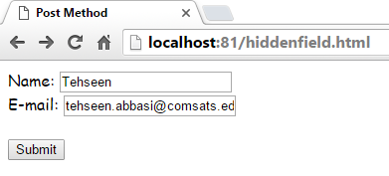
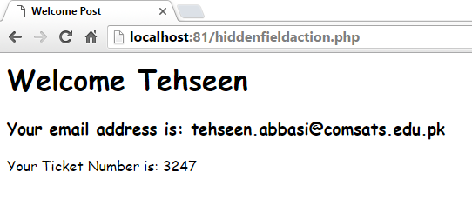
2. Passing Hidden Field Data…
No Third Entry
Hidden Field Data

Slide 36
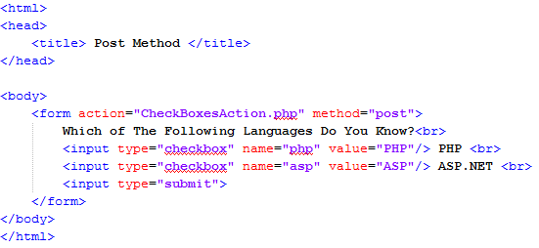
2.3 Getting Value From Checkbox
CheckBox
Name
Value

Slide 37
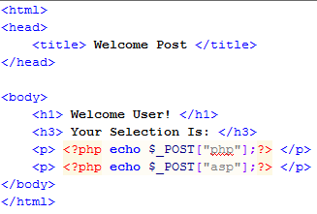
2.3 Getting Value From Checkbox
PHP Value
ASP Value

Slide 38
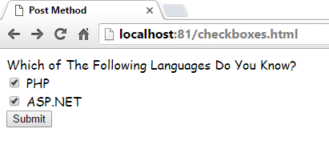
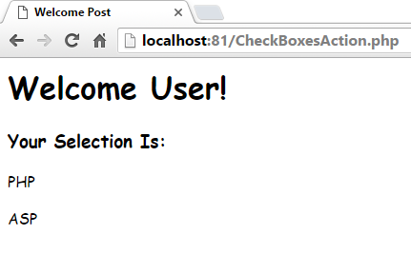
2.3 Getting Value From Checkbox…

Slide 39
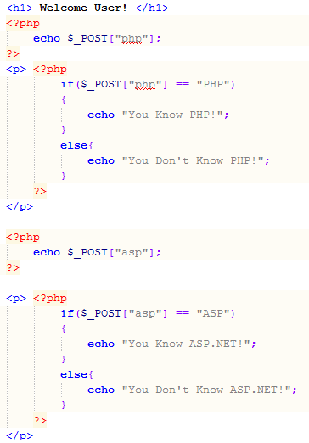
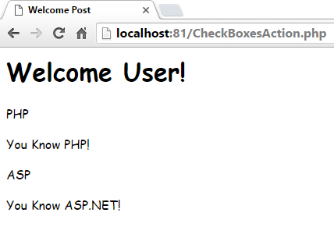
2.3 Getting Value From Checkbox…
Checking for Value of PHP

Slide 40
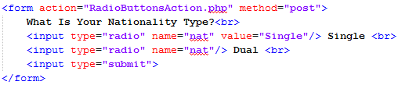

2.4 Getting Value From Radio Button
Same Name
Value Set
Value Not Set
Getting Value from Radio Button

Slide 41
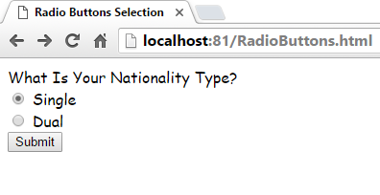
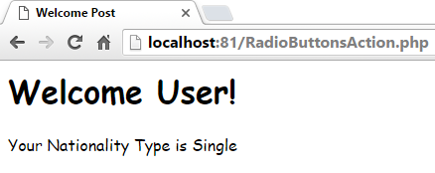
2.4 Getting Value From Radio Button…

Slide 42
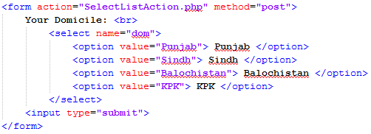

2.5 Getting Value From Select List
Name of List
Option and Value
Getting Value of List

Slide 43
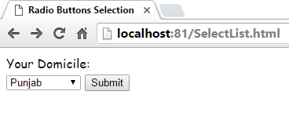
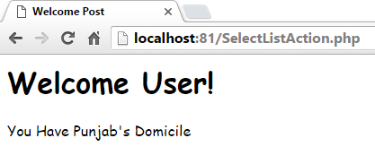
2.5 Getting Value From Select List…

Slide 44
3. Passing Variables Using Sessions
A session is basically a temporary set of variables that exists only until the browser has shut down
$_SESSION:
represents data available to a PHP script that has previously been stored in a session

Slide 45
3. Passing Variables Using Sessions…
name
email
$_SESSION
Tehseen
Tehseen.abbasi@comsats.edu.pk
First Page
<?php
$_SESSION[‘name ‘] =‘Tehseen’;
?>
2nd Page
<?php
echo $_SESSION[‘name ‘];
$_SESSION[‘email ‘] = ‘tehseen.abbasi@comsats.edu.pk’;
?>
n^{th} page
<?php
echo $_SESSION[‘name ‘];
echo $_SESSION[‘email ‘];
?>
……..

Slide 46
3. Passing Variables Using Sessions
session_start()
is used to start a session
$_SESSION[‘variable_name’]
is used to store data in session variable
session_destroy()
is used to destroy a session
unset($_SESSION[‘variable_name’])
is used to unset a specific variable

Slide 47
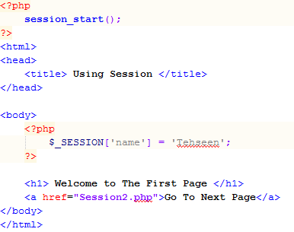
3. Passing Variables Using Sessions…
Session Starts
Session Variable Created
Link to Next Page

Slide 48
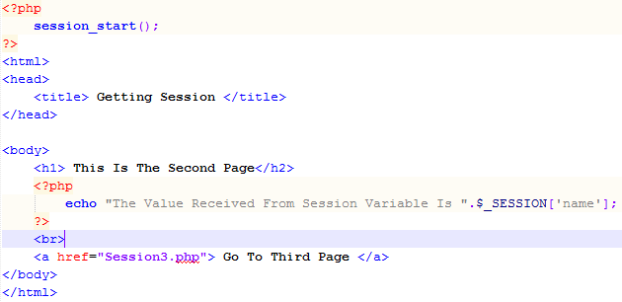
3. Passing Variables Using Sessions…
Session Starts
Session Variable Created
Link Page

Slide 49
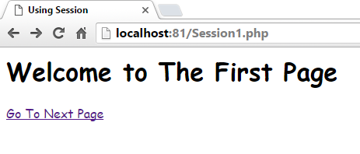
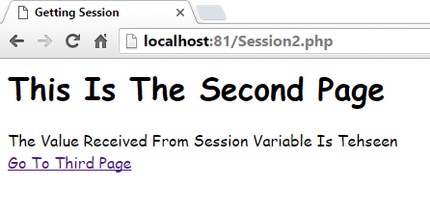
3. Passing variables using sessions…
Session Variable’s Value

Slide 50
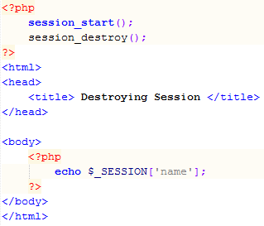
3. Passing variables using sessions…
Destroying Session
Accessing Session

Slide 51
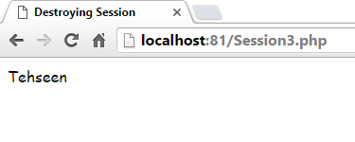
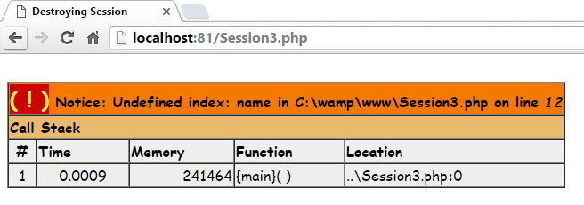
3. Passing variables using sessions…
Session Accessed
Session Destroyed

Slide 52
Summary of Today’s Lecture
Passing Form Data
action
method (POST or GET)
When to Use GET?
When to Use POST?
Compare GET vs. POST
Super Global Variables

Slide 53
Summary of Today’s Lecture
Passing data with forms
Passing Text Field Data
Passing Hidden Field Data
Getting Value From Checkbox
Getting Value From Radio Button
Getting Value From Select List
Using session Variables

Slide 54
THANK YOU

