Slide 1


Slide 2
Web Technologies and Programming
Lecture 26

Slide 3
Database Connectivity, File Upload in PHP

Slide 4
Summary of the previous lecture
Writing regular expression in PHP
Brackets []
Quantifiers +, *, ?, {int. range}, and $
Sub-patterns
Predefined character ranges\d:\D:\w:
Validating User’s Input
Validating name:
Validating Password:
Validating date:
Validating CNIC:
Validating Email:
Validating user’s input

Slide 5
Summary of the previous lecture
Defined functions.
preg_match():
preg_match_all():
preg_grep():
String Functions in PHP
strlen():
strcmp():
strcasecmp():
strtolower():
strtoupper():
ucfirst():
ucwords():
strpos():
strrpos():
substr_count():

Slide 6
Outline
Intro to MySQL
Creating database in MySQL using WAMP
Connecting PHP with MySQL
Inserting data in database
CONNECTIONS: user registration
FILES super global variable
File uploading in PHP
Storing reference of uploaded file in database
User registration in CONNECTIONS web application with file upload

Slide 7
1. MySQL DATABASE
With PHP, you can connect to and manipulate databases.
MySQL is the most popular database system used with PHP.

Slide 8
1. Creating database in MySQL using WAMP
What is MySQL?
MySQL is named after co-founder Monty Widenius's daughter: My
MySQL is a database system used on the web
MySQL is a database system that runs on a server
MySQL is ideal for both small and large applications
MySQL is very fast, reliable, and easy to use
MySQL uses standard SQL
MySQL compiles on a number of platforms
MySQL is free to download and use
The data in a MySQL database are stored in tables. A table is a collection of related data, and it consists of columns and rows.

Slide 9
1. Creating database in MySQL using WAMP
Go to home page of WAMP server
Select PHP myadmin
Login to MySql
Enter database name and click create database button

Slide 10
1. Creating database in MySQL using WAMP…
Creating a table in a database:
Select database from the list of databases
Enter table name and number of columns
Enter name, data-type and other required properties for columns
Click create table button

Slide 11
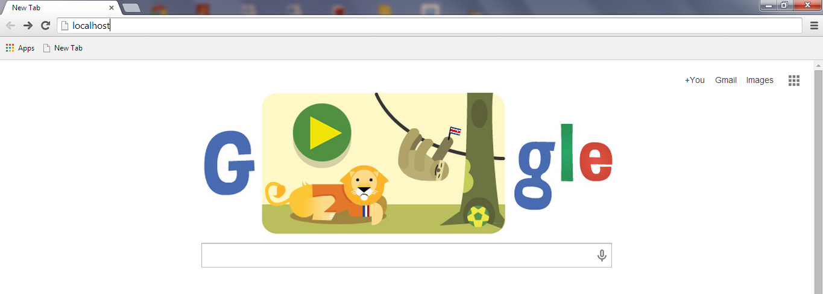
1. Creating database in MySQL using WAMP…
localhost

Slide 12
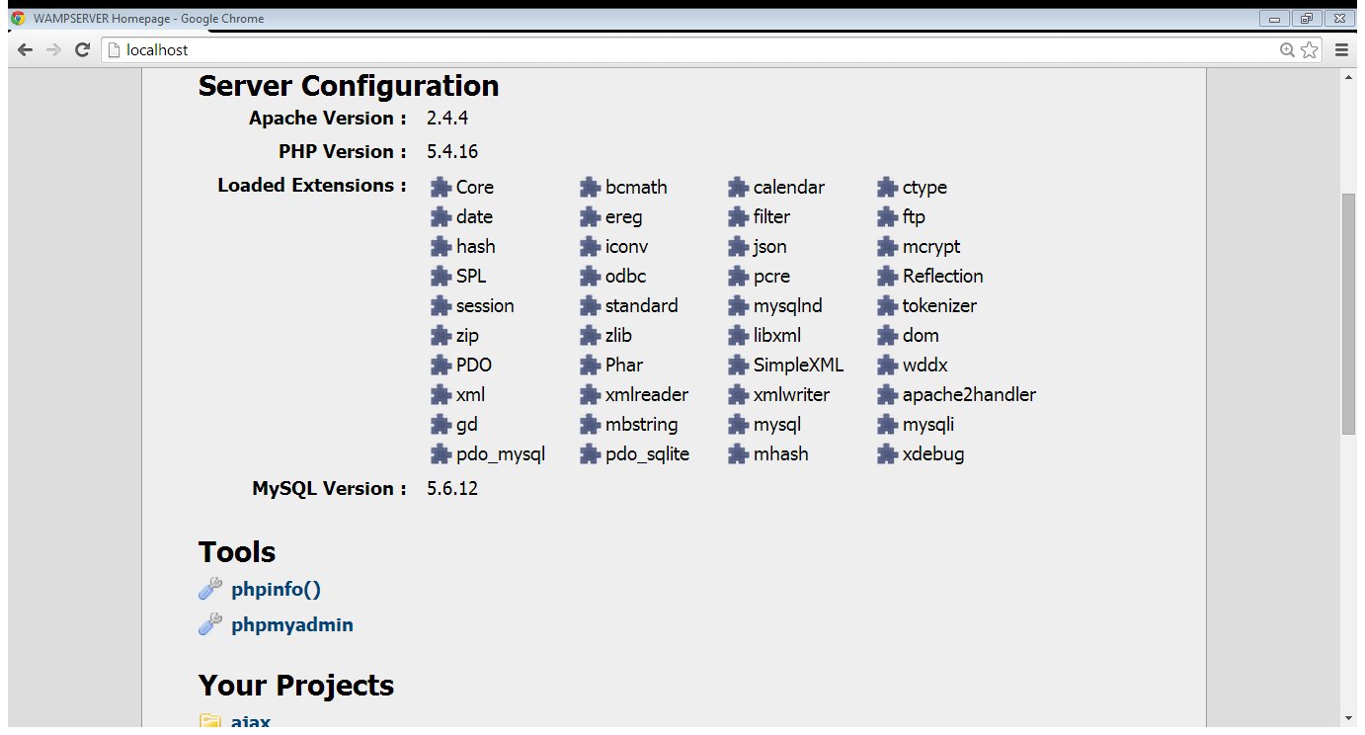
1. Creating database in MySQL using WAMP…
Select phpmyadmin

Slide 13
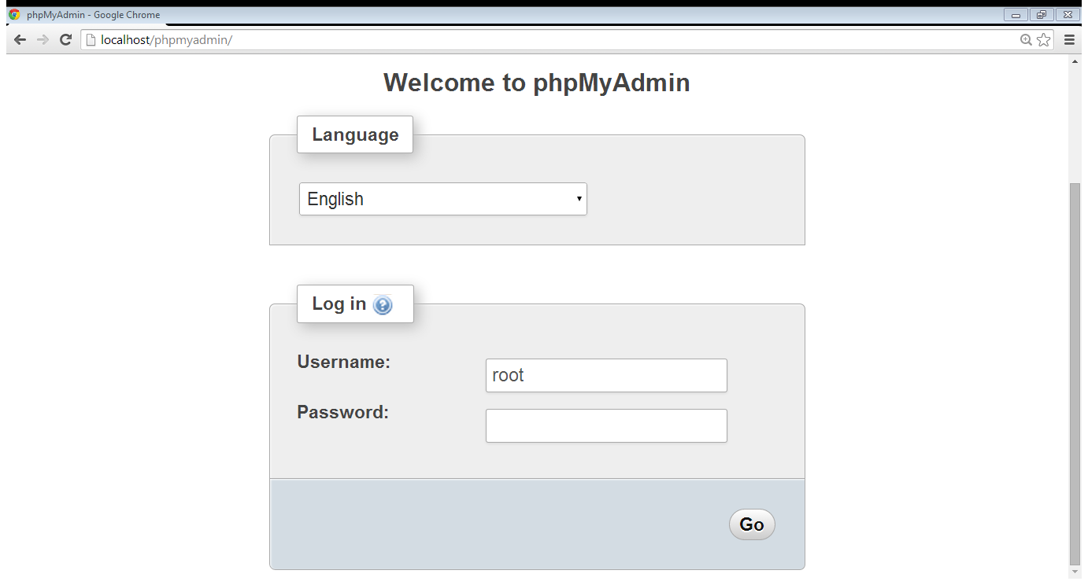
1. Creating database in MySQL using WAMP…
User name is root
Empty password

Slide 14
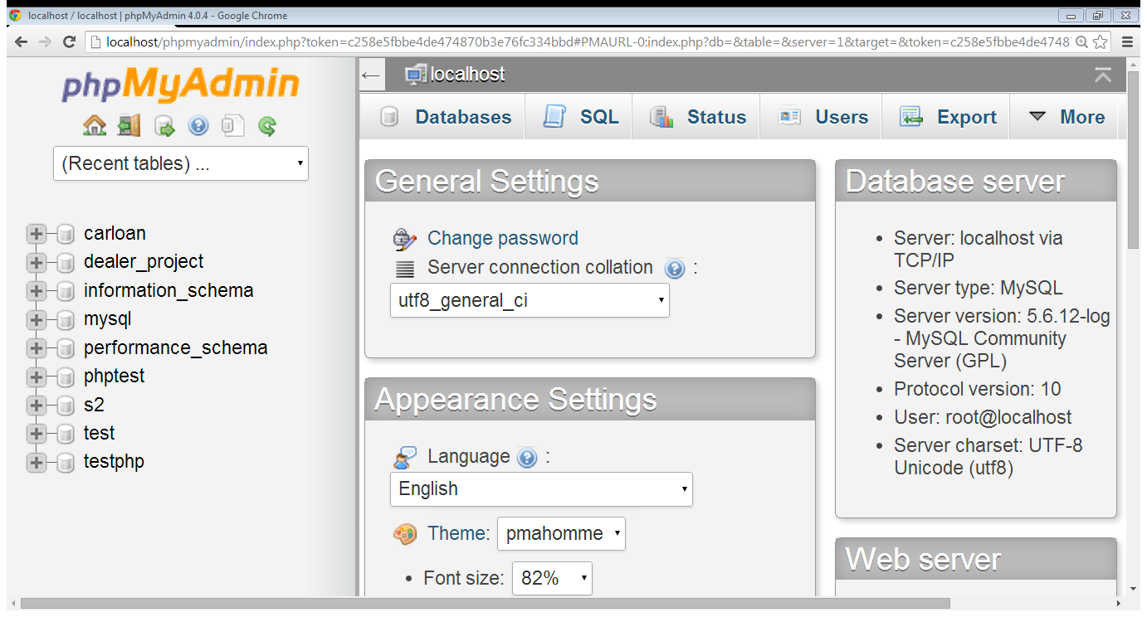
1. Creating database in MySQL using WAMP…
Select databases

Slide 15
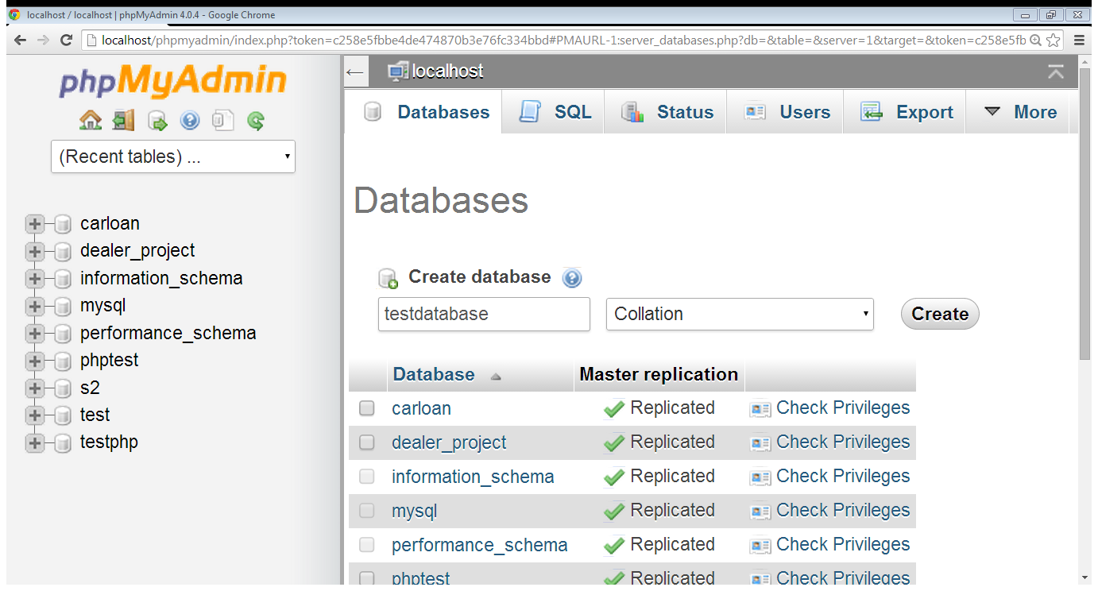
1. Creating database in MySQL using WAMP…
Enter database name
Select create

Slide 16
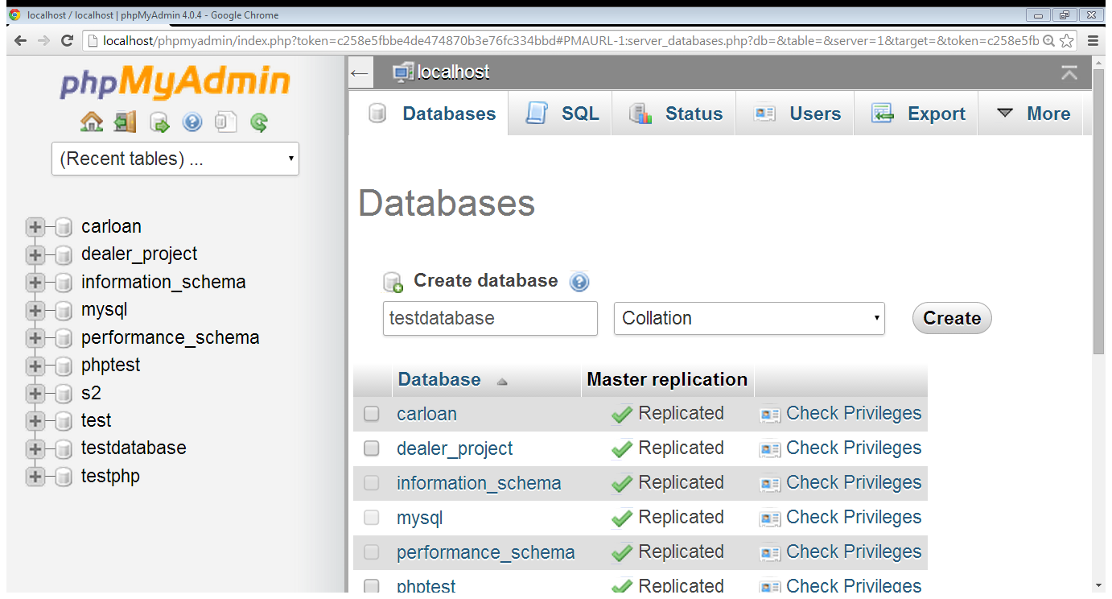
1. Creating database in MySQL using WAMP…
Select database

Slide 17
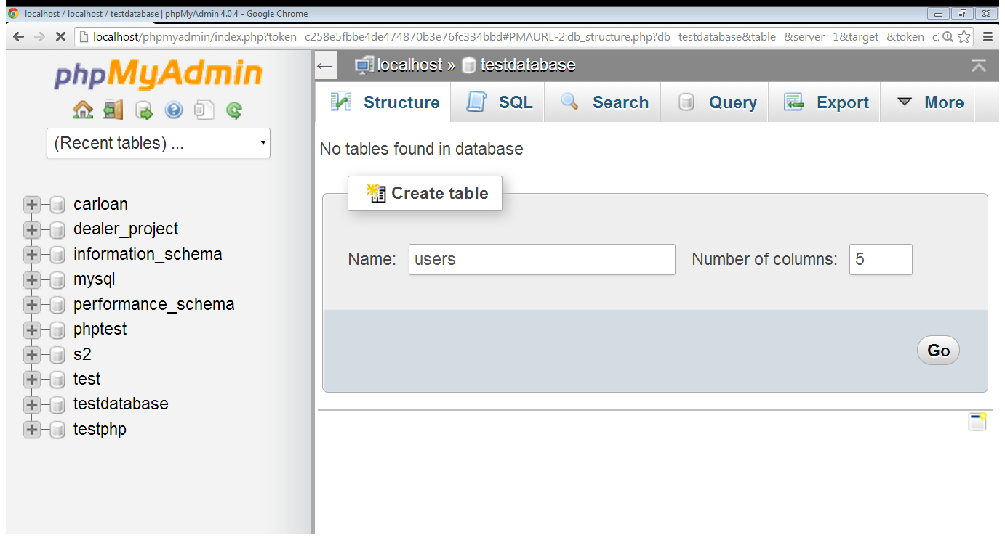
1. Creating database in MySQL using WAMP…
Enter no. of columns
Table name
Click go

Slide 18
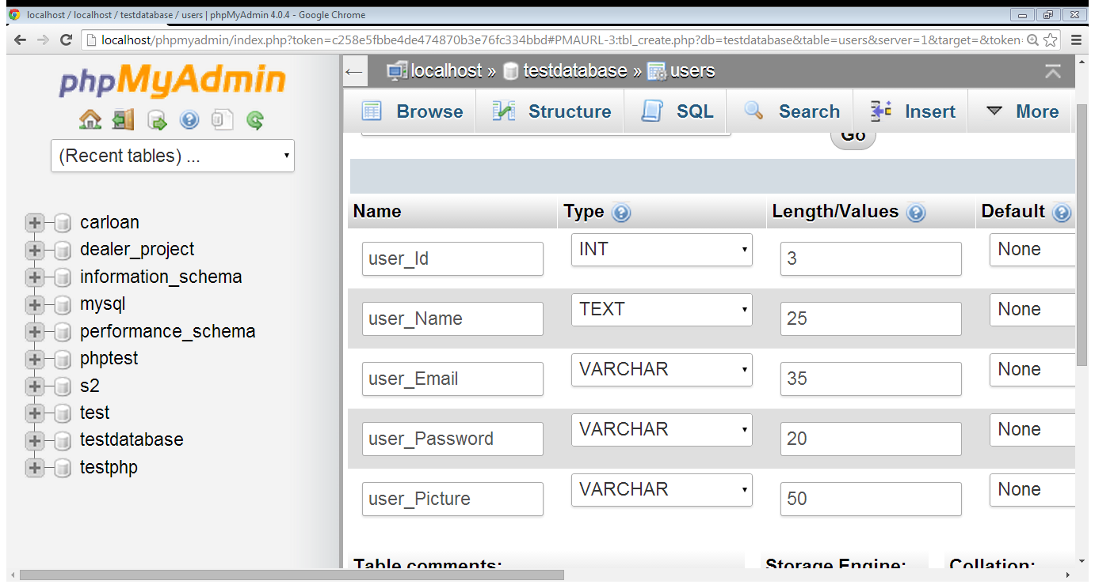
1. Creating database in MySQL using WAMP…
Column name
Data-type
Max length

Slide 19
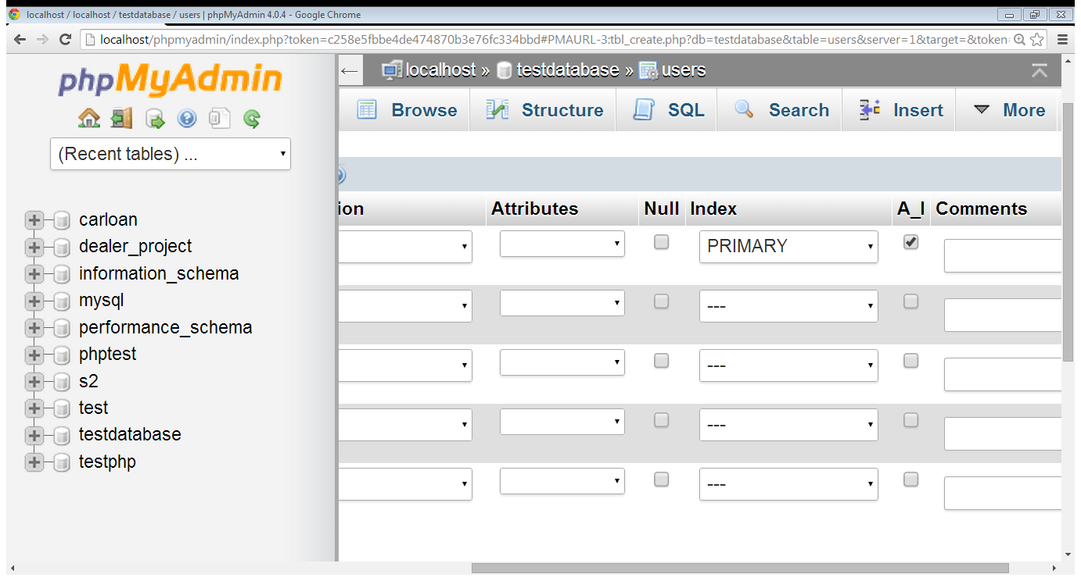
1. Creating database in MySQL using WAMP…
Primary key
Auto increment

Slide 20
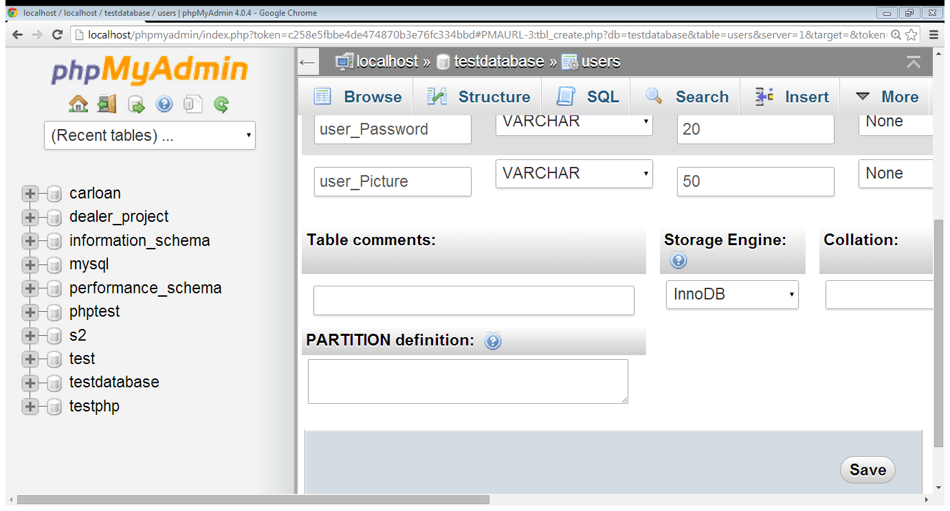
1. Creating database in MySQL using WAMP…
Click to create table

Slide 21
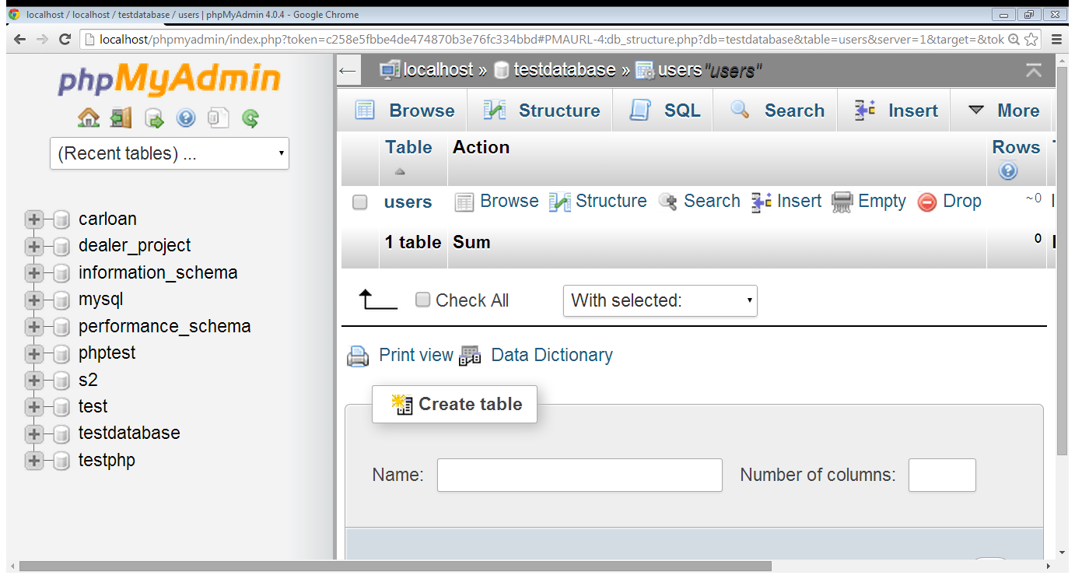
1. Creating database in MySQL using WAMP…
name

Slide 22
2. Connecting PHP with MySQL
Before we can access data in the MySQL database, we need to be able to connect to the server:
<?php $servername = "localhost"; $username = "username"; $password = "password"; // Create connection $conn = new mysqli($servername, $username, $password); // Check connection if ($conn->connect_error) { die("Connection failed: " . $conn->connect_error); } echo "Connected successfully"; ?>

Slide 23
2. Connecting PHP with MySQL
Our MYSQL connection:
mysql_connect(“hostname” ,”username”, ”password”)
mysql_connect(“localhost”,”root”,””)
mysql_select_db(“database name”)
mysql_select_db(“testdatabase”)

Slide 24
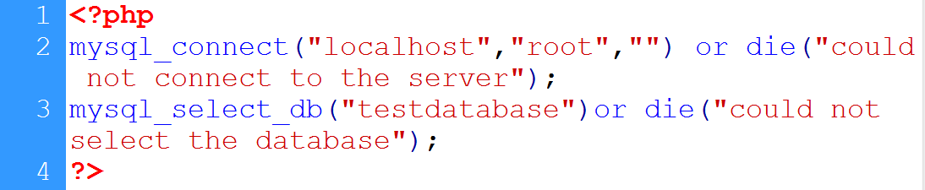
2. Connecting PHP with MySQL…
Connect with server
Empty password
Error message
Host name
username
Select database
Database name

Slide 25
3. Inserting data in database
After a database and a table have been created, we can start adding data in them.
Here are some syntax rules to follow:
The SQL query must be quoted in PHP
String values inside the SQL query must be quoted
Numeric values must not be quoted
The word NULL must not be quoted
The INSERT INTO statement is used to add new records to a MySQL table:
INSERT INTO table_name (column1, column2, column3,...) VALUES (value1, value2, value3,...)

Slide 26
3. Inserting data in database for user input
Create form to receive input from user
On action page
Retrieve user’s input
Validate user’s input (optional)
Establish connection with database
Write insert command
Execute command

Slide 27
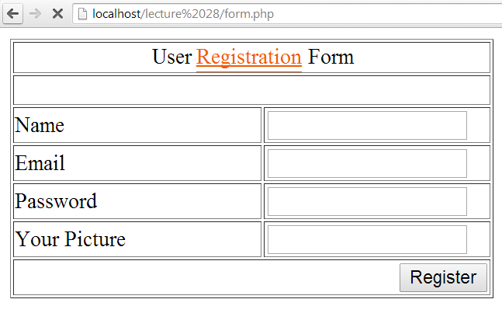
3. Inserting data in database…
post
reg_action.php
for later use
name
email
password

Slide 28
3. Inserting data in database…
Insert SQL command:
INSERT INTO `table_name`
(list of columns)
VALUES (list of values)
INSERT INTO users
(‘user_Name’,’user_Email’,’user_Password’)
VALUES (‘$name’,’$email’,’$password’)
mysql_query(query to execute)

Slide 29
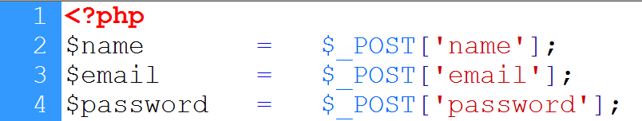
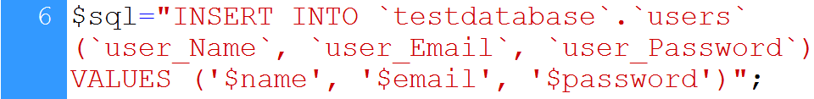

3. Inserting data in database…
User’s input is retrieved
Database connection
Insert command
Command is executed

Slide 30
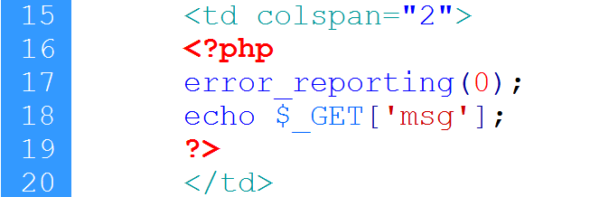
3. Inserting data in database…
Header function
location
message
Close warnings
Message is displayed

Slide 31
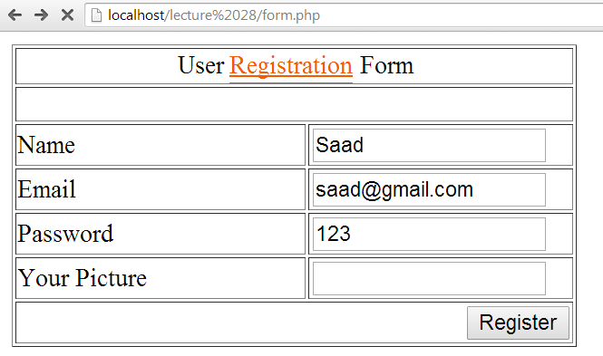
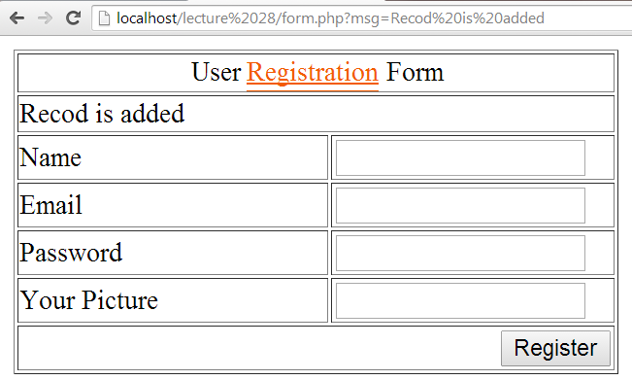
3. Inserting data in database…
message

Slide 32
4. CONNECTIONS: user registration
Create database
Database name: connections
Table name: users
Table columns:
user_Id int 4
User_Name text 25
User_Email varchar 35
User_Password varchar 20
User_Picture varchar 50

Slide 33
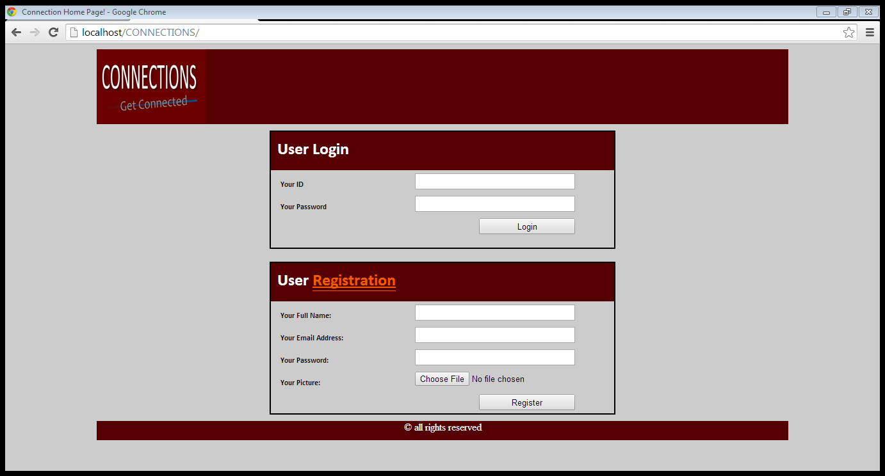
4. CONNECTIONS: user registration…
post
name
email
password

Slide 34
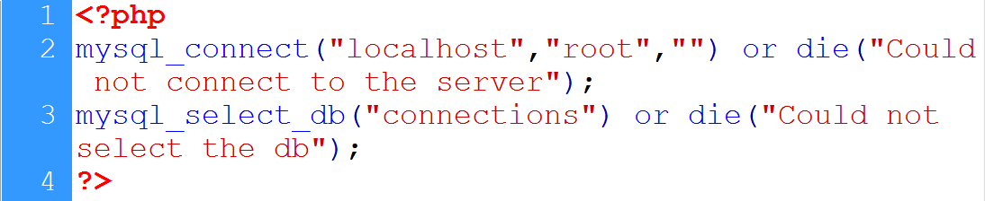
4. CONNECTIONS: user registration…
Connection to the server
Database name
Database selection

Slide 35
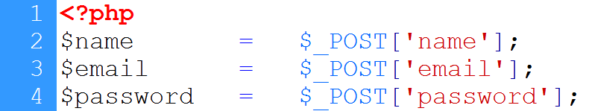
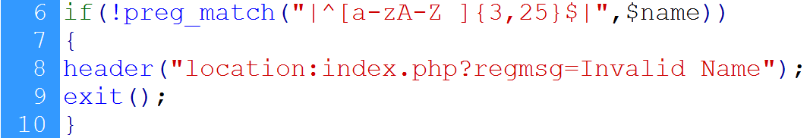
4. CONNECTIONS: user registration…
User’s input is retrieved
Database connection
Name validation

Slide 36
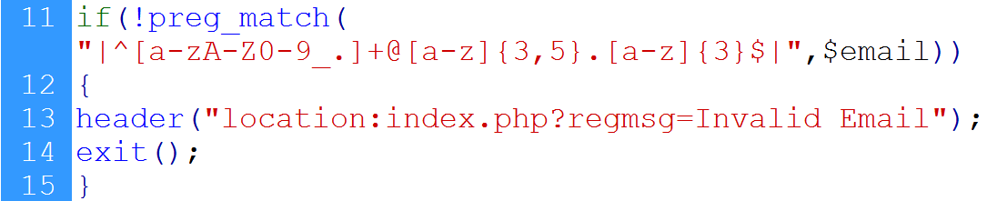
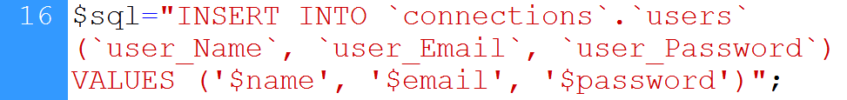
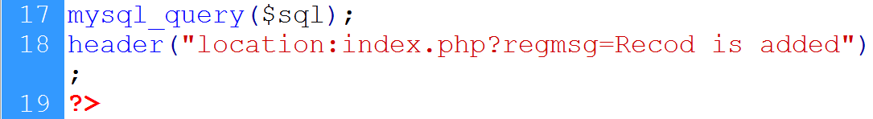
4. CONNECTIONS: user registration…
Email validation
Insert command
Command is executed

Slide 37
5. $_FILES: super-global variable
$_FILES: contains any item uploaded to the server when the post method is used
an array type variable
Created automatically
Can be accessed on other pages

Slide 38
5. $_FILES: super-global variable…
Keeps information about
Name
Size
Type
Tmp_name

Slide 39
5. $_FILES: super-global variable…
FORM attributes required:
Method should be post
Enctype should be multipart/form-data
<form enctype=“multipart/form-data” method=“post” action=“upload.php”>

Slide 40
5. $_FILES: super-global variable…
<body>
<form method=“post” enctype=“multipart/form-data” action=“action.php”>
<input type=“text” name=“name”>
<input type=“file” name=“pic”>
<input type=“submit”>
</form></body>
Asad
File type
Choose File
No File Chosen
Mypci.jpg
submit
name
$_POST
Asad
name
$_FILES
[name]
=>file name
[type]
=>file type
[size]
=>file size
[tmp_name]
=>tmp name
pic

Slide 41
5. $_FILES: super-global variable…
Accessing file information
$_FILES[‘input-field name’][‘name’];
$_FILES[‘picture’][‘name’];
$_FILES[‘input-field name’][‘type’];
$_FILES[‘picture’][‘type’];
$_FILES[‘input-field name’][‘size’];
$_FILES[‘picture’][‘size’];

Slide 42
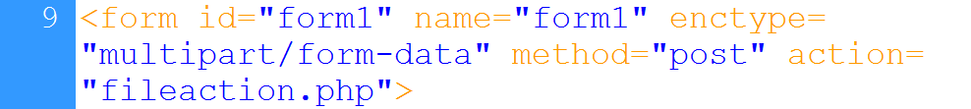
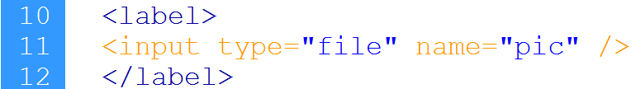
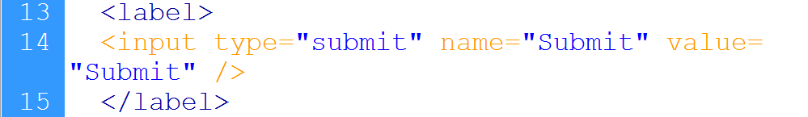

5. $_FILES: super-global variable…
enctype
method
Input field
Submit button

Slide 43
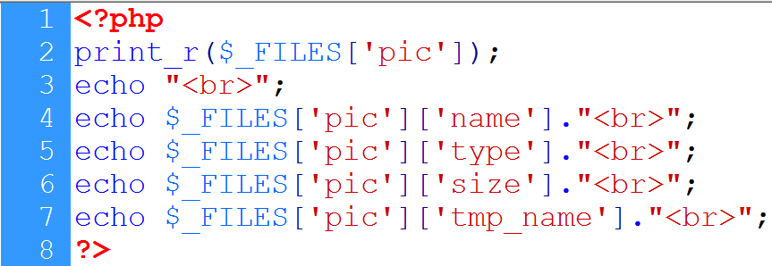
5. $_FILES: super-global variable…
Display files array
File name
File type
tmp name
File size

Slide 44
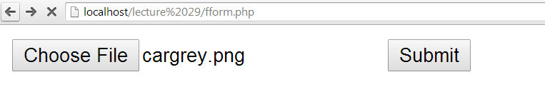
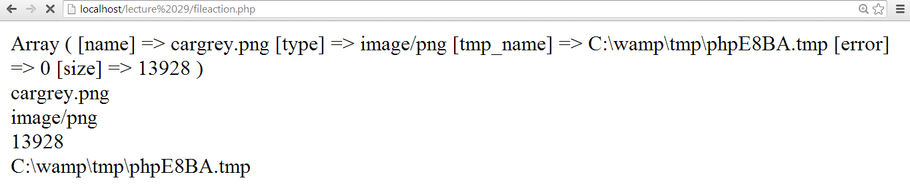
5. $_FILES: super-global variable…
Selected file
File name
File type
Files array
File size
Temp name

Slide 45
6. Uploading file
move_uploaded_file():
bool move_uploaded_file ( string $filename , string $destination );
This function checks to ensure that the file designated by filename is a valid upload file (meaning that it was uploaded via PHP's HTTP POST upload mechanism)
If the file is valid, it will be moved to the filename given by destination

Slide 46
6. Uploading file…
basename():
returns the filename from a path
Example:
<?PHP
echo basename("/home/httpd/html/index.php");
?>
retutns index.php

Slide 47
6. Uploading file…
File upload steps:
Identify the file to be uploaded
tmp_name is used
Define destination
Location + file name
Upload the file

Slide 48
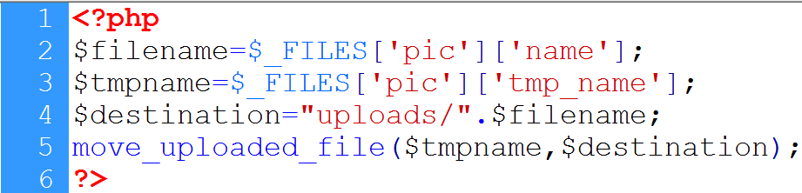
6. Uploading file…
File name
File tmp name
Folder + filename
File uploaded

Slide 49
6. Uploading file…
Restricting Users:
Size restriction
Type restriction
File rename

Slide 50
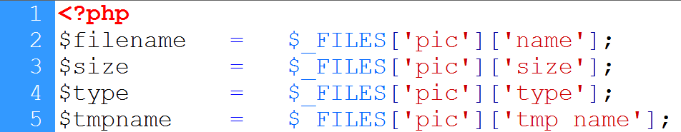
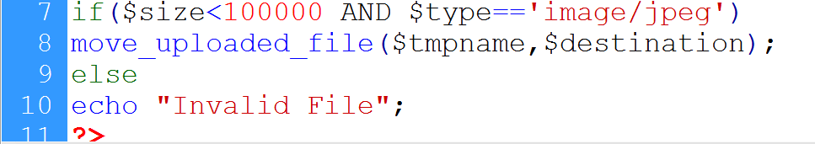
7. Uploading file…
Retrieving file attributes
File rename
Size and type
File uploaded

Slide 51
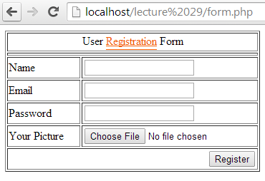
7. Storing reference to database
Method is post
Enctype=“multipart/form-data”
name
email
password
picture

Slide 52
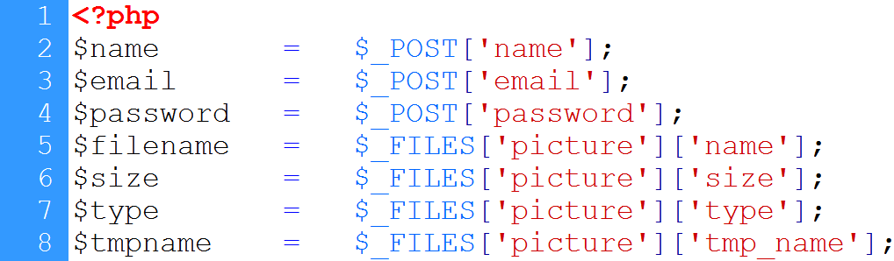
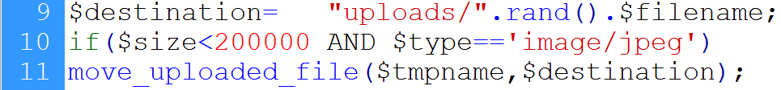
7. Storing reference to database…

Slide 53
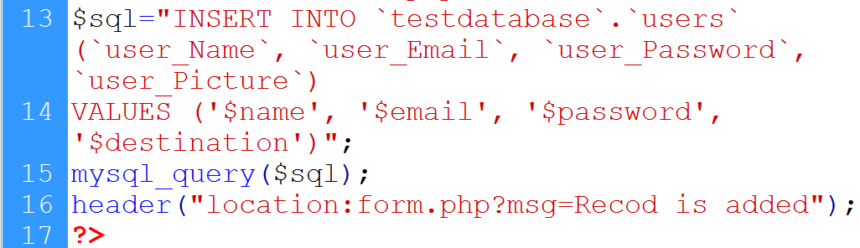
7. Storing reference to database…
DB connection
Insert query
Executing query
redirection

Slide 54
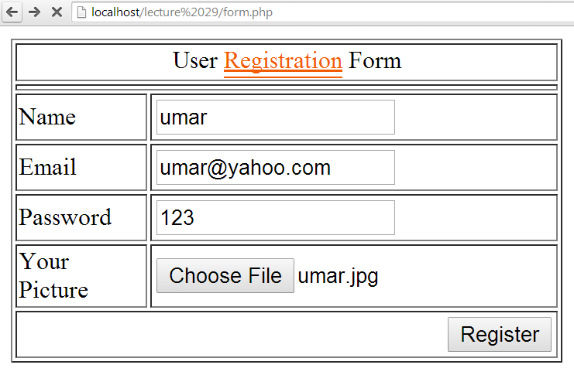
7. Storing reference to database…

Slide 55
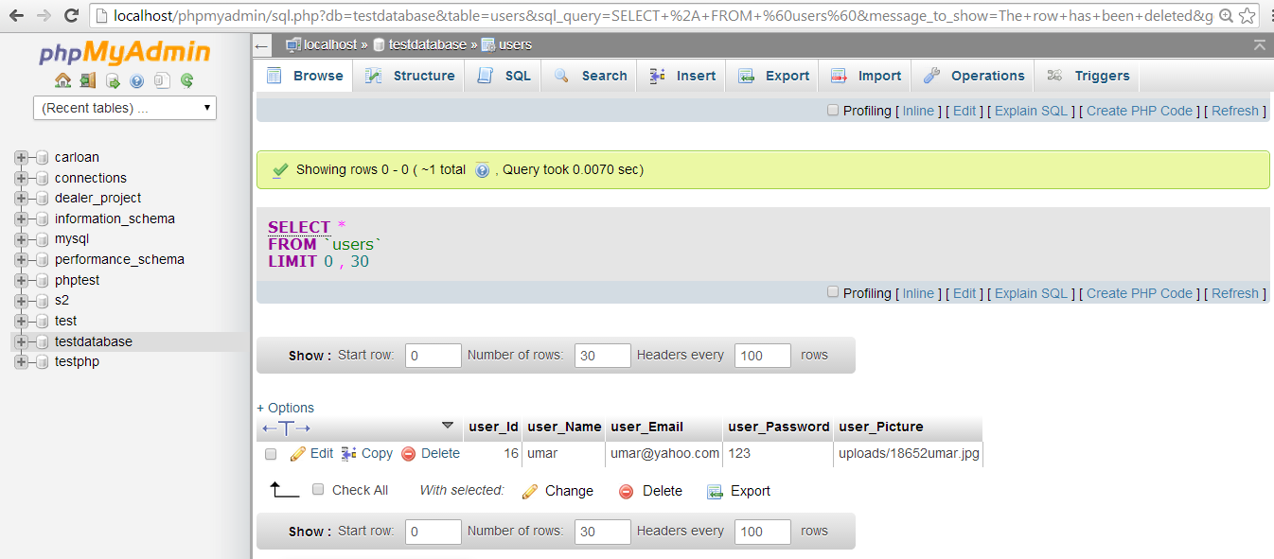
7. Storing reference to database…
Record is added

Slide 56
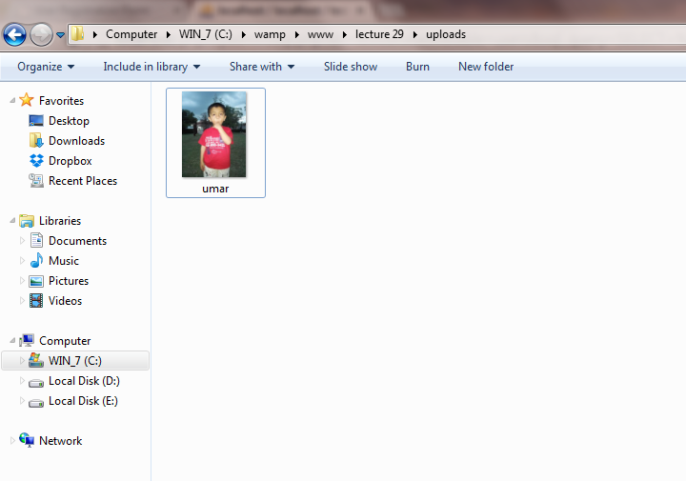
7. Storing reference to database…

Slide 57
8. CONNECTIONS: registration action
post
name
email
password
pic

Slide 58
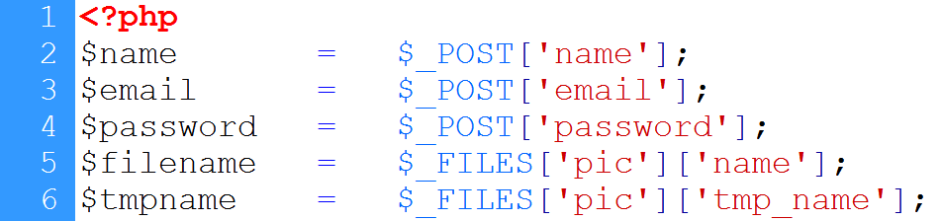
8. CONNECTIONS: registration action…
Input is retrieved
File is uploaded
DB connection

Slide 59
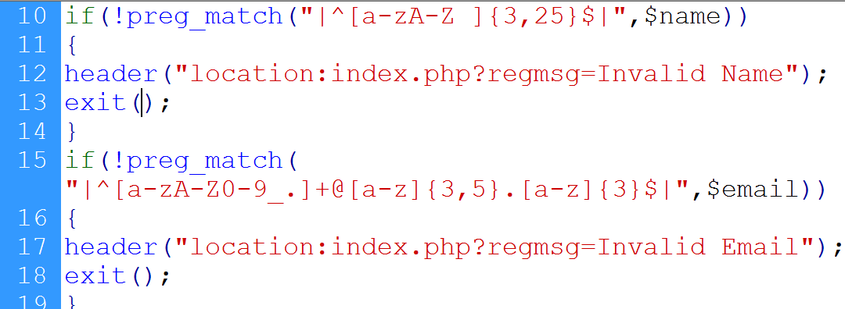
8. CONNECTIONS: registration action…
Input is validated

Slide 60
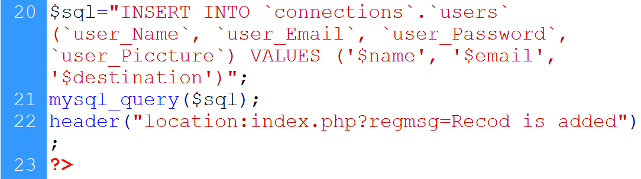
8. CONNECTIONS: registration action…
Data is inserted

Slide 61
Summary
Intro to MySQL
Creating database in MySQL using WAMP
Connecting PHP with MySQL
Inserting data in database
CONNECTIONS: user registration
FILES super global variable
File uploading in PHP
Storing reference of uploaded file in database
User registration in CONNECTIONS web application with file upload

Slide 62
THANK YOU

