Slide 1


Slide 2
Web Technologies and Programming
Lecture 27

Slide 3
Retrieving Data, Delete, Update from Database

Slide 4
Summary of the previous lecture
Creating database in MySQL using WAMP
Connecting PHP with MySQL
Inserting data in database
CONNECTIONS: user registration
FILES super global variable
File uploading in PHP
Storing reference of uploaded file in database
User registration in CONNECTIONS web application with file upload

Slide 5
Outline
Retrieving data from MySQL using PHP
CONNECTIONS: login functionality
Deleting records in MySQL using PHP
Updating records in MySQL using PHP

Slide 6
1. Retrieving data from MySQL using PHP
Connection with database
Execute Select SQL command
Make display structure
Write data

Slide 7
1.1 Connection with database
<?php
mysql_connect(“localhost”,”root”,””) or die(“Error in connection”);
mysql_select_db(“testdatabase”) or die(“Error in Selection”);
?>

Slide 8
1.2 Selecting data
The SELECT statement is used to select data from one or more tables:
SELECT command in SQL:
SELECT column-name
FROM table-name
SELECT user_Name
FROM users
SELECT *
FROM users

Slide 9
1.2 Selecting data…
Condition selection:
SELECT column-name
FROM table-name
WHERE condition
SELECT *
FROM users
WHERE user_Id>4

Slide 10
1.2 Selecting data…
<?php
include(‘connection.php’);
$sql = ‘select * from users’;
$result = mysql_query($sql);
?>

Slide 11
1.2 Selecting data…
Counting rows:
mysql_num_rows(variable);
<?php
include(‘connection.php’);
$sql = ‘select * from users’;
$result = mysql_query($sql);
$users = mysql_num_rows($result);
echo “There are total ”. $users .”users found”;
?>

Slide 12
1.3 Display structure
<table border=‘1’>
<tr>
<th> User Name</th>
<th> User Email</th>
<th> User Password</th>
<th> User Picture</th>
</tr>
<tr>
<td> &nbsp;</td>
<td> &nbsp;</td>
<td> &nbsp;</td>
<td> &nbsp;</td>
</tr>
</table>

Slide 13
1.4 Writing data
mysql_fetch_array(result-resource);
mysql_fetch_array($result);

Slide 14
1.4 Writing data…
$result=
1 | Ali | ali@yahoo.com | 123 | upload/123ali.jpg
2 | Umar | umar@yahoo.com | 123 | upload/123umar.jpg
$row = mysql_fetch_array($result);
0
1
2
3
4
1 | Ali | ali@yahoo.com | 123 | upload/123ali.jpg
$row=
user_Id
user_Name
user_Email
user_Password
user_Picture
echo $row [1];
echo $row[‘user_Name’];

Slide 15
1.4 Writing data…
User Name | User Email | User Password | User Picture
Ali | ali@yahoo.com | 123
<table border=‘1’>
<tr>
<th> User Name</th>
<th> User Email</th>
<th> User Password</th>
<th> User Picture</th>
</tr>
<tr>
<td> <?php echo $row[1]; ?> </td>
<td> <?php echo $row[2]; ?> </td>
<td> <?php echo $row[3]; ?> </td>
<td> <img src= “<?php echo $row[4]; ?>”> </td>
</tr>
</table>

Slide 16
1.4 Writing data…
<table border=‘1’>
Heading Row
<?php
while($rows = mysql_fetch_array($result))
{
?>
<tr>
<td> <?php echo $row[1]; ?> </td>
<td> <?php echo $row[2]; ?> </td>
<td> <?php echo $row[3]; ?> </td>
<td> <img src= “<?php echo $row[3]; ?>”> </td>
</tr>
<?php } ?>
</table>
User Name | User Email | User Password | User Picture
Ali | ali@yahoo.com | 123
Umar | umar@yahoo.com | 123

Slide 17
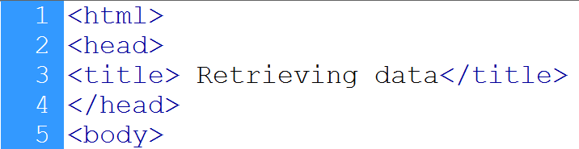


1.5 Example
Starts a HTML page
Connection to database
Select command
Query executed
Counting number of rows

Slide 18
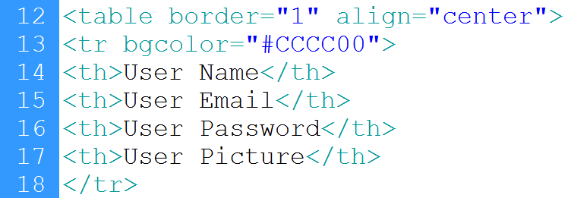
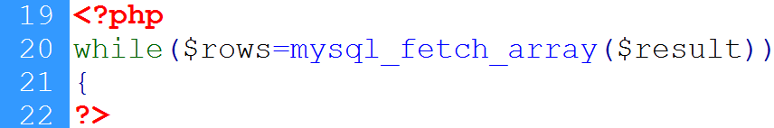
1.5 Example…
Heading row
Loop starts
Keeps row

Slide 19
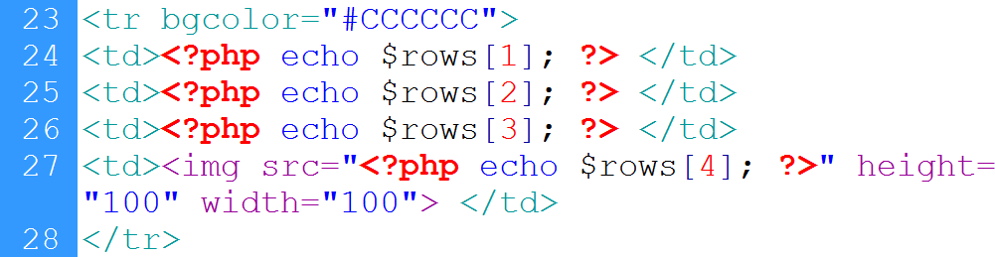
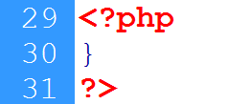
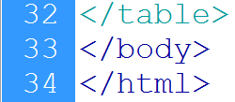
1.5 Example…
Displays name
Displays email
Displays password
Displays image
Sets source
Ends loop
Ends table

Slide 20
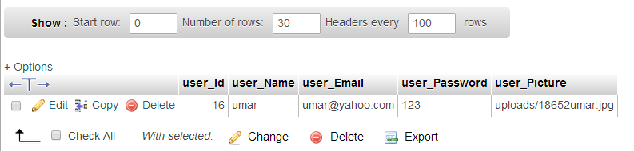
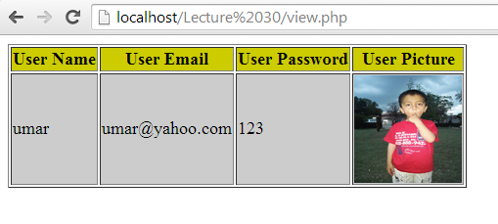
1.5 Example…
Records in user’s table
Output from the table

Slide 21
2. CONNECTIONS: User login
Form for user’s input
Login action page:
Connection with database
Retrieve user’s input
Select a record from user’s table with same email and password
Count the number of row in result
If one row is selected then fetch its values and store in session variable, otherwise send an error message on main page

Slide 22
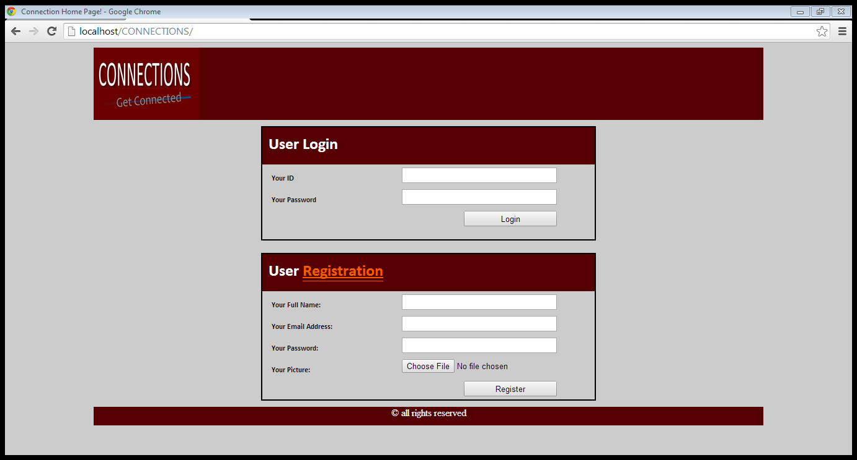
2.1 CONNECTIONS: User login form
Post method
email
Password

Slide 23
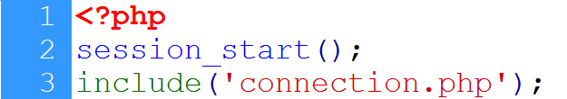
2.2 CONNECTIONS: database connection
<?php
mysql_connect(“localhost”,”root”,””) or die(“Error in connection”);
mysql_select_db(“testdatabase”) or die(“Error in Selection”);
?>

Slide 24
2.3 CONNECTIONS: Retrieve user’s input

Slide 25
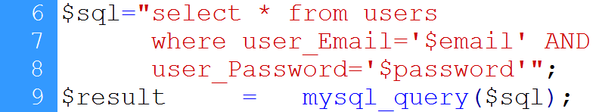
2.4 CONNECTIONS: Select record

Slide 26
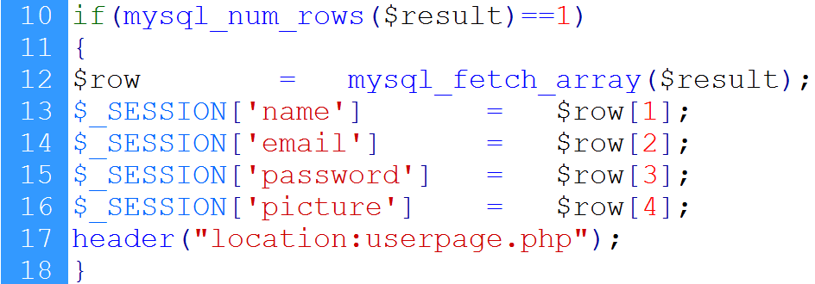
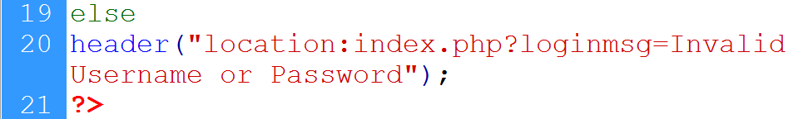
2.5 CONNECTIONS: Redirect
No. of rows selected
Fetch user information
Register session variables
redirect
If user’s input is invalid

Slide 27
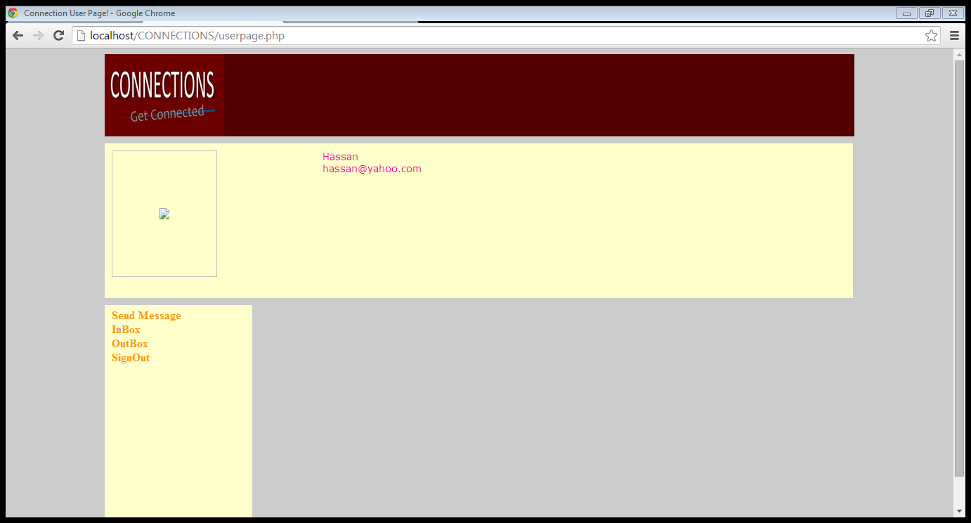
2.6 CONNECTIONS: user page
User’s pic
User profile
User’s information
actions

Slide 28
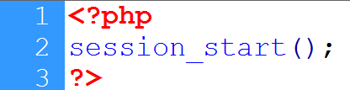
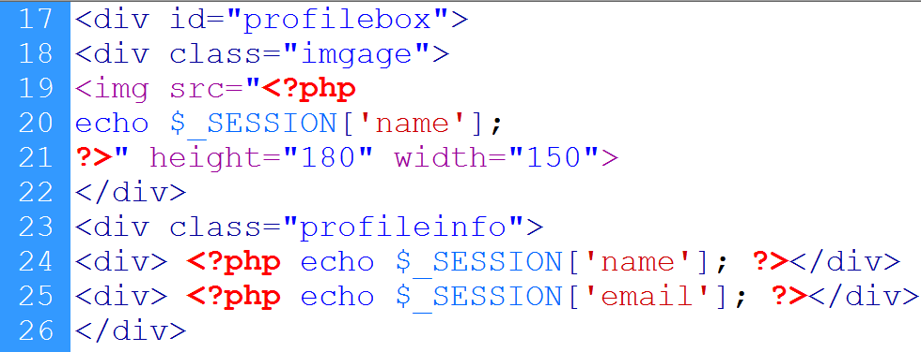
2.6 CONNECTIONS: user page…
Image div
Profile div
User’s info

Slide 29
3. Deleting record in MySQL using PHP
Connection with database
Delete the record

Slide 30
3.1 Connection with database
<?php
mysql_connect(‘localhost’,’root’,’’) or die(“error in connection”);
mysql_select_db(‘testdatabase’) or die(“error in selection”);
?>

Slide 31
3.2 Delete the record
Delete SQL instruction:
DELETE FROM table-name
WHERE condition
DELETE FROM users
WHERE user_Id =5
DELETE FROM users
WHERE user_Id >5

Slide 32
3.2 Delete the record…
<?php
include(‘connection.php’);
$sql=“DELETE FROM users
WHERE user_Id=5”;
mysql_query($sql);
?>

Slide 33
3.3 Example
Display data from database in a table
Add actions column
In each record, add a delete button
When delete button in clicked, delete that record

Slide 34
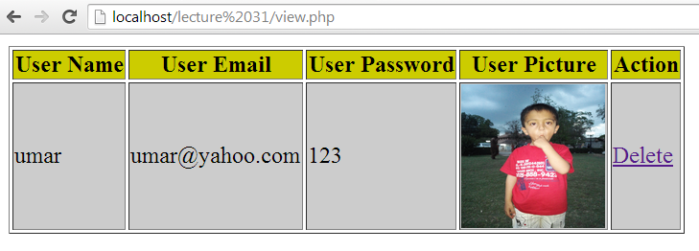
1.3 Example…
Delete

Slide 35
3.3 Example…
<?php
Connection with database
Select data
<table border=‘1’>
<tr>
<th> User Name</th>
<th> User Email</th>
<th> User Password</th>
<th> User Picture</th>
<th> Actions </th>
</tr>

Slide 36
3.3 Example…
<?php
while($rows = mysql_fetch_array($result))
{
?>
<tr>
<td> <?php echo $row[1]; ?> </td>
<td> <?php echo $row[2]; ?> </td>
<td> <?php echo $row[3]; ?> </td>
<td> <img src= “<?php echo $row[4]; ?>”> </td>
<td><a href=“delet.php?id=<?php echo $rows[0];?>”>Delete</a>
</tr>
<?php } ?>
</table>

Slide 37
3.3 Example…
<a href=“delet.php?id=<?php echo $rows[0];?>”> Delete</a>
Id name
Link starts
Page name
Assigning the id of current record
End of link
Link text

Slide 38
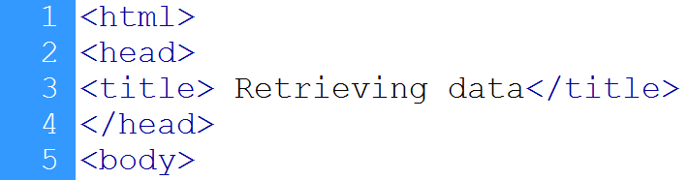

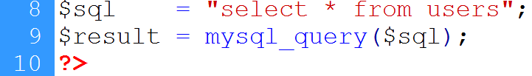
3.3 Example…
Starts HTML page
Connection to database
Selecting data

Slide 39
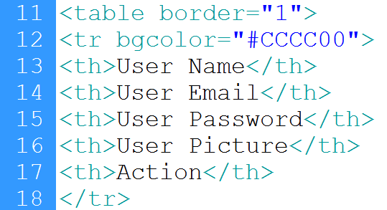
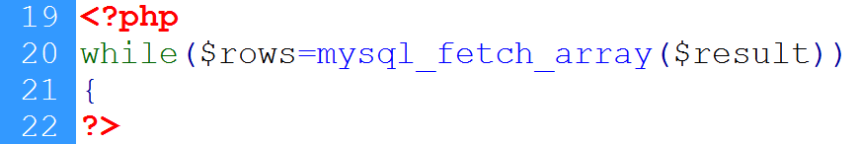
3.3 Example…
Heading row
Loop starts

Slide 40
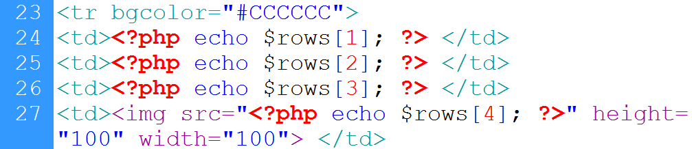
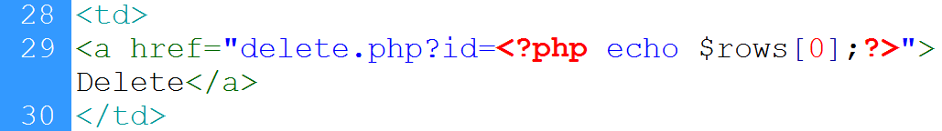
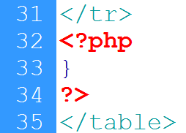
3.3 Example…
Writing user’s record
Link to the delete.php
Ends loop

Slide 41



3.3 Example…
Getting record id
DB connection
Delete instruction
Executing instruction

Slide 42
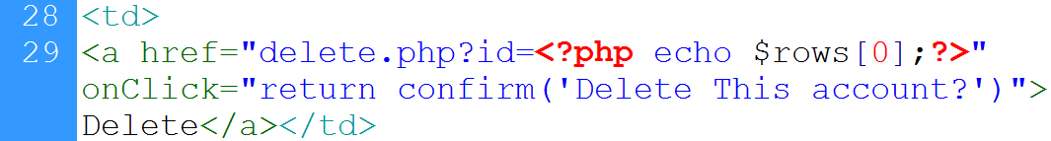
3.3 Example…
Confirmation before delete:
Link to page
On-click event
Confirm box

Slide 43
4. Updating records in MySQL using PHP
Connection with database
Update the record

Slide 44
4. Updating records in MySQL using PHP…
Update SQL instruction:
UPDATE table-name
SET column-names = values
WHERE condition
UPDATE users
SET user_Name = ‘Ali’,
user_Email = ‘ali@yahoo.com’,
user_Password=‘123’
WHERE user_Id=1

Slide 45
4. Updating records in MySQL using PHP…
<?php
Include(‘connection.php’);
$sql =“UPDATE users
SET user_Name = ‘Ali’,
user_Email = ‘ali@yahoo.com’,
user_Password=‘123
Where user_Id=1’’;
mysql_query($sql);
?>

Slide 46
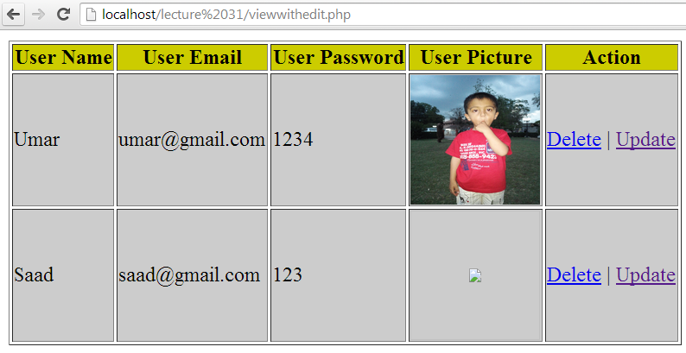
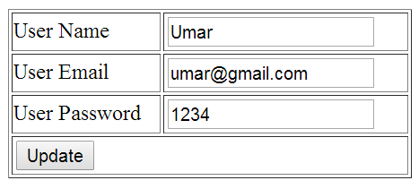
4.1 Example
Selects update
Form with previous values

Slide 47
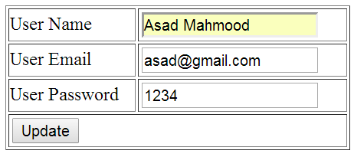
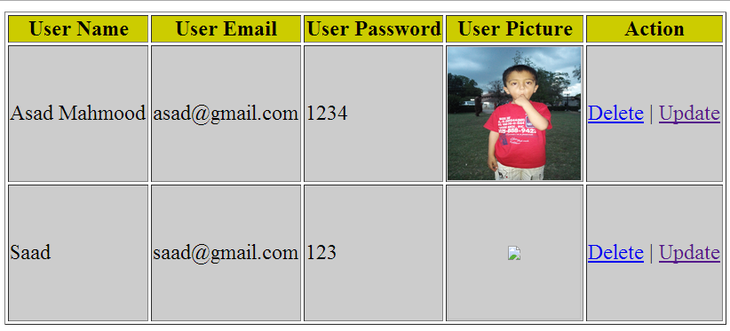
4.1 Example…
Values are updated
Updated record

Slide 48
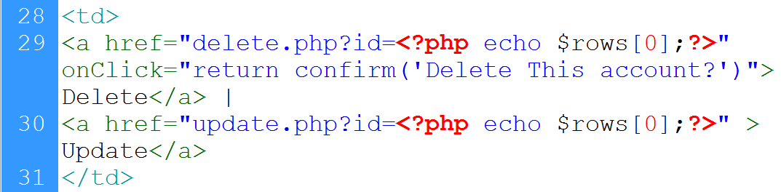
4.1 Example…
View page:
Link to update.php, record id is passed with link

Slide 49
4.1 Example…
Get id of the record
Connect to database
Retrieve record from database against the id
Start form
Set retrieved values as value of the input fields

Slide 50
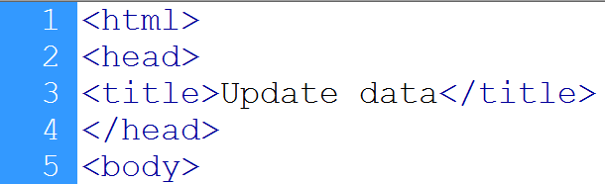

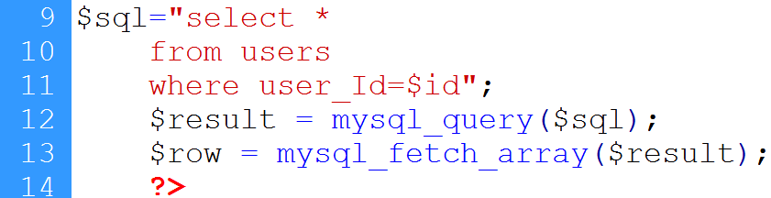
4.1 Example…
HTML page start
Gets record’s id
DB connection
Data selection
Query execution
Record is retrieved

Slide 51
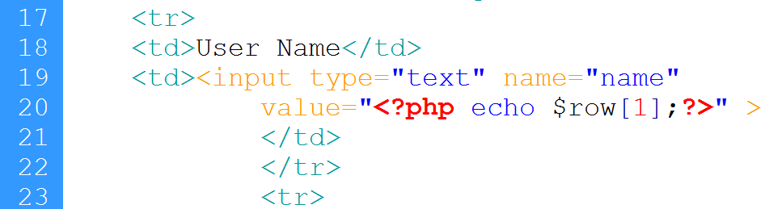
4.1 Example…
Form starts
Table starts
Id is sent as hidden value
label
Value is set to user’s current name

Slide 52
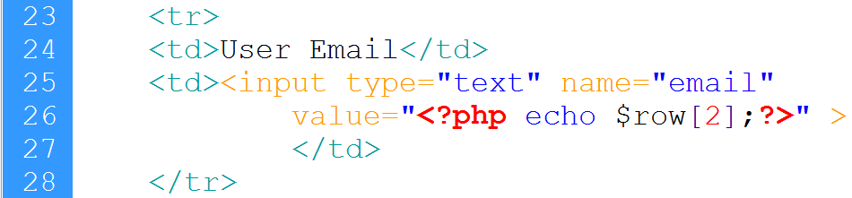
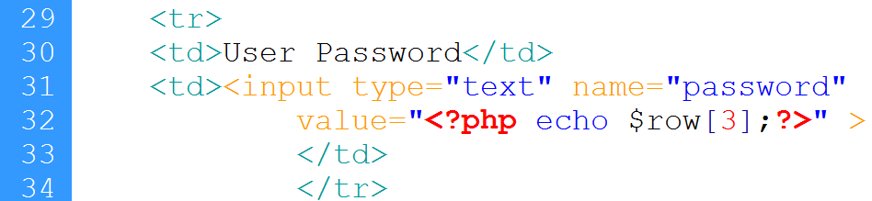
4.1 Example…
Email
password

Slide 53
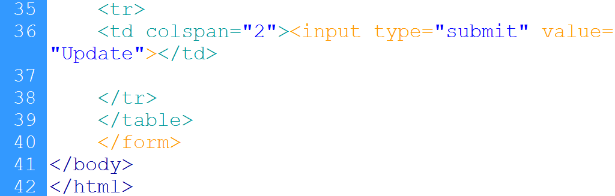
4.1 Example…
Submit button

Slide 54
4.1 Example…
Up_action.php page:
Retrieve users input
Connect with database
Execute update instruction
Redirect to view page

Slide 55
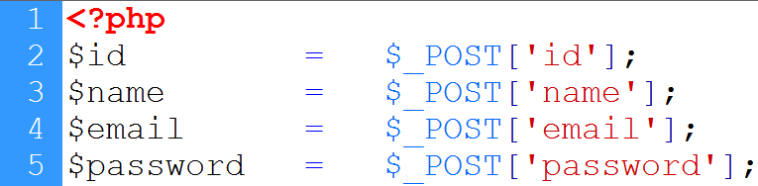
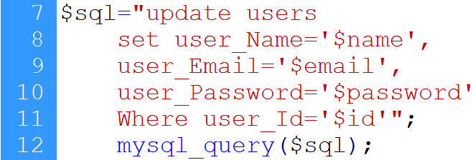
4.1 Example…
User’s input
Connection to database
Update instruction
redirection

Slide 56
5. Limit Data Selections From a MySQL Database
MySQL provides a LIMIT clause that is used to specify the number of records to return.
The LIMIT clause makes it easy to code multi page results or pagination with SQL, and is very useful on large tables. Returning a large number of records can impact on performance.

Slide 57
5. Limit Data Selections From a MySQL Database
Assume we wish to select all records from 1 - 30 (inclusive) from a table called “users". The SQL query would then look like this:
$sql = "SELECT * FROM Users LIMIT 30";
When the SQL query above is run, it will return the first 30 records.

Slide 58
Summary of MYSQL DATABASE
Intro to MySQL
Creating database in MySQL using WAMP
Connecting PHP with MySQL
Inserting data in database
CONNECTIONS: user registration
FILES super global variable
File uploading in PHP
Storing reference of uploaded file in database
User registration in CONNECTIONS web application with file upload

Slide 59
Summary
Retrieving data from MySQL using PHP
Connection with database
Execute Select SQL command
Make display structure
Selecting Command
Counting rows
Write data
CONNECTIONS: login page
Deleting record in MySQL using PHP
Connection with database
Delete the record
Delete Command

Slide 60
Summary
Updating records in MySQL using PHP
Connection with database
Update the record
Update Command
Limit Data Selections

Slide 61
THANK YOU

