Slide 1


Slide 2
Web Technologies and Programming
Lecture 28

Slide 3
Introduction to ASP.NET

Slide 4
Summary of Previous Lecture
Retrieving data from MySQL using PHP
Connection with database
Execute Select SQL command
Make display structure
Selecting Command
Counting rows
Write data
CONNECTIONS: login page
Deleting record in MySQL using PHP
Connection with database
Delete the record
Delete Command

Slide 5
Summary of Previous Lecture
Updating records in MySQL using PHP
Connection with database
Update the record
Update Command
Limit Data Selections

Slide 6
Today’s Lecture Outline
What is ASP.NET
ASP.NET Web Forms Model
Components of .NET Framework
Setting the Environment
ASP.NET: An Example
Event Handling in ASP.NET
Application and Session Events

Slide 7
Today’s Lecture Outline…
Page and Control Events
Event Handling using Controls
Common Control Events
PostBack and NonPostBack Events
Controls with Default Events

Slide 8
1. What Is ASP.NET
ASP.
ASP stands for Active Server Pages
ASP is a program that runs inside IIS
IIS stands for Internet Information Service
.NET
A programming infrastructure created by Microsoft for building, deploying, and running applications and services that use .NETtechnologies, such as desktop applications and Web services.

Slide 9
1. What Is ASP.NET
What is an ASP File?
An ASP file is just the same as an HTML file
An ASP file can contain text, HTML, XML, and scripts
Scripts in an ASP file are executed on the server
An ASP file has the file extension ".asp"

Slide 10
1. What Is ASP.NET
ASP.NET is a web application framework developed and marketed by Microsoft to allow programmers to build dynamic web sites. It allows you to use a full featured programming language such as C# or VB.NET to build web applications easily.
The ASP.NET application codes can be written in any of the following languages:
C#
Visual Basic.Net
Jscript
J#

Slide 11
1. What Is ASP.NET
ASP.NET is a web development platform, which provides
A programming model
A comprehensive software infrastructure
Various services required to build up robust web applications for PC as well as mobile devices.
ASP.NET works on top of the HTTP protocol, and uses the HTTP commands and policies to set a browser-to-server bilateral communication and cooperation.
ASP.NET is a part of Microsoft .Net platform.
ASP.NET applications are compiled codes, written using the extensible and reusable components or objects present in .Net framework. These codes can use the entire hierarchy of classes in .Net framework.

Slide 12
1. What Is ASP.NET…
ASP.NET application codes can be written in any of the following languages:
C#
Visual Basic.Net
Jscript
J#
ASP.NET is used to produce interactive, data-driven web applications over the internet.
It consists of a large number of controls such as text boxes, buttons, and labels for assembling, configuring, and manipulating code to create HTML pages.

Slide 13
2. ASP.NET Web Forms Model
ASP.NET web forms extend the event-driven model of interaction to the web applications.
The browser submits a web form to the web server and the server returns a full markup page or HTML page in response.
All client side user activities are forwarded to the server for stateful processing.
The server processes the output of the client actions and triggers the reactions.
HTTP is a stateless protocol.
ASP.NET framework helps in storing the information regarding the state of the application, which consists of:
Page state
Session state

Slide 14
2. ASP.NET Web Forms Model…
The page state is the state of the client, i.e., the content of various input fields in the web form.
The session state is the collective information obtained from various pages the user visited and worked with, i.e., the overall session state (Just as we discussed in PHP Lectures).

Slide 15
2. ASP.NET Web Forms Model…
Example:
Let us take an example of a shopping cart:
User adds items to a shopping cart.
Items are selected from a page, say the items page
The total collected items and price are shown on a different page, say the cart page.
Only HTTP cannot keep track of all the information coming from various pages. ASP.NET session state and server side infrastructure keeps track of the information collected globally over a session.

Slide 16
2. ASP.NET Web Forms Model…
ASP.NET runtime carries the page state to and from the server across page requests while generating ASP.NET runtime codes, and incorporates the state of the server side components in hidden fields.
This way, the server becomes aware of the overall application state and operates in a two-tiered connected way.

Slide 17
3. Components of .NET Framework
Common Language Runtime (CLR)
Performs Memory Management
Exception Handling
Debugging
Security Checking
Thread Execution
Code Execution
Code Safety
Verification
Compilation.
The code that is directly managed by the CLR is called the managed code.
When the managed code is compiled, the compiler converts the source code into a CPU independent intermediate language (IL) code. A Just-In-Time (JIT) compiler compiles the IL code into native code, which is CPU specific.

Slide 18
3. Components of .NET Framework…
.NET Framework Class Library
It contains a huge library of reusable types, classes, interfaces, structures, and enumerated values, which are collectively called types.
ASP.NET & ASP.NET AJAX
ASP.NET is the web development model and AJAX is an extension of ASP.NET for developing and implementing AJAX functionality.
ASP.NET AJAX contains the components that allow the developer to update data on a website without a complete reload of the page.

Slide 19
3. Components of .NET Framework…
ADO.NET
It is the technology used for working with data and databases. It provides access to data sources like SQL server, OLE DB, XML etc.
The ADO.NET allows connection to data sources for retrieving, manipulating, and updating data.
LINQ
It imparts data querying capabilities to .Net languages using a syntax which is similar to the tradition query language SQL.

Slide 20
4. Setting The Environment
Visual Studio IDE
Can be download from microsoft.com
You can get Express Edition because it is free
It allows you to write code, compile it, debug it and run it in the browser
It has variety of templates for multiple languages which supports .NET framework

Slide 21
4. Setting The Environment…
How to Work With ASP.NET:
Open Visual Studio
From the File Menu, Click on New then Click on Website
Select ASP.NET Empty Website
Name It
The Website Will Be Created

Slide 22
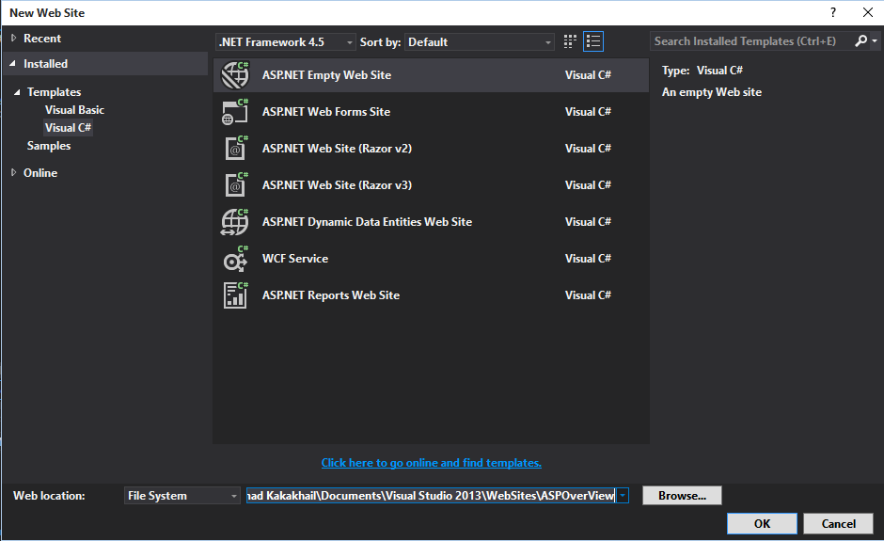
4. Setting The Environment…
ASP.NET Empty Website
Name It

Slide 23
4. Setting The Environment…
Now
Right click on ASPOverView in Solution Explorer
Expand Add Section
Select Add New Item
Select Web Form
Name It
Click Add

Slide 24
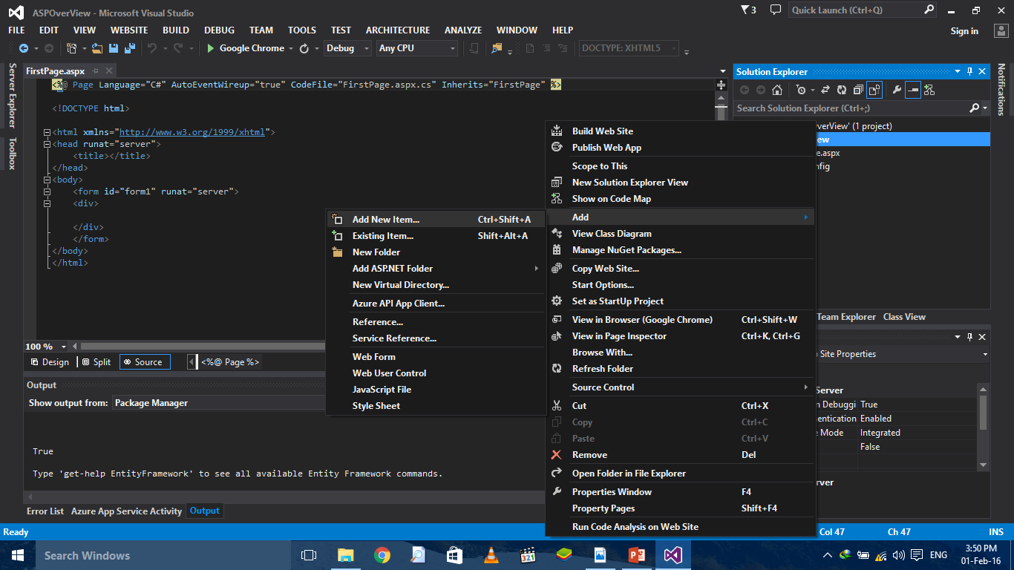
4. Setting The Environment…
Add New Item
Add Section

Slide 25
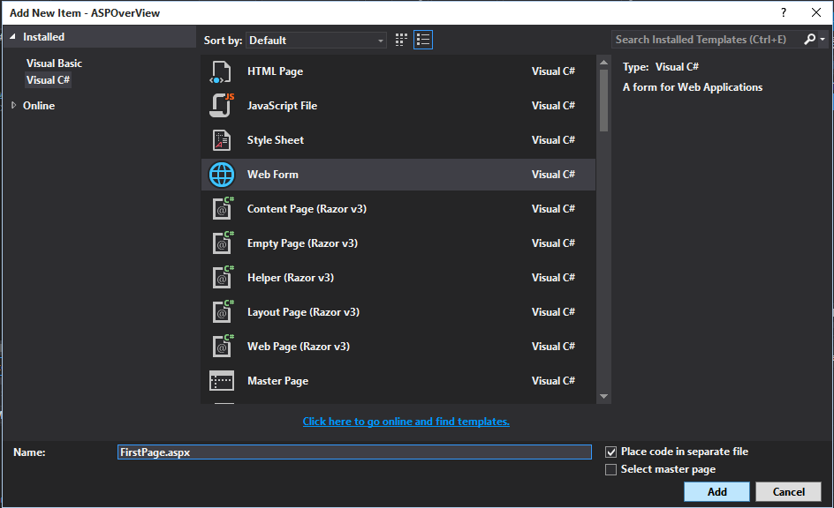
4. Setting The Environment…
Select Web Form
Name It
Click Add

Slide 26
5. ASP.NET: an Example
Now, Let’s Add Some Code in our first ASP.NET Web Site
You can see the Web Form As an .aspx file in the Solution Explorer
Click on FirstPage.aspx and you can see the HTML code.
You can also see that there is a small arrow with FirstPage.aspx in Solution Explorer
Expand it, and you will see FirstPage.aspx.cs file
That’s the file whre Code Behind is written
.aspx file contains HTML and Scripting Code while .aspx.cs contains C# code

Slide 27
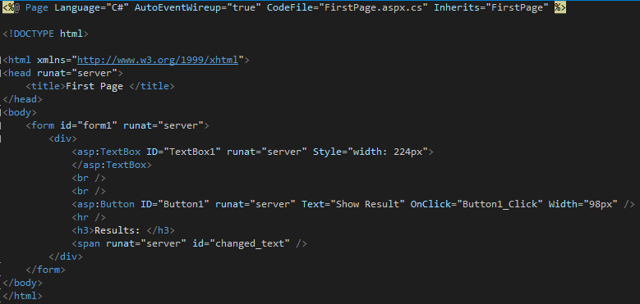
5. ASP.NET: an Example…
Page Directives

Slide 28
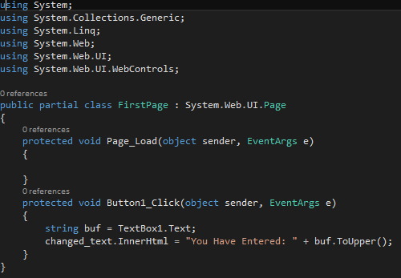
5. ASP.NET: an Example…
Button Click Event

Slide 29
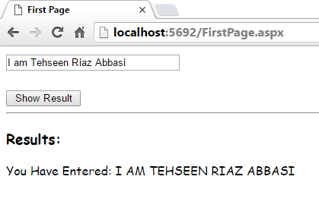
5. ASP.NET: an Example…
TextBox
Button
Results

Slide 30
6. Event Handling in ASP.NET
An event is an action or occurrence such as a mouse click, a key press, mouse movements, or any system-generated notification.
A process communicates through events.
For example, interrupts are system-generated events. When events occur, the application should be able to respond to it and manage it.
Events in ASP.NET are raised at the client machine and handled at the server machine.
For example, a user clicks a button displayed in the browser. A Click event is raised. The browser handles this client-side event by posting it to the server.

Slide 31
6. Event Handling in ASP.NET…
The server has a subroutine describing what to do when the event is raised; it is called the event-handler.
When the event message is transmitted to the server, it checks whether the Click event has an associated event handler. If it has, the event handler is executed.
ASP.NET event handlers generally take two parameters and return void. The first parameter represents the object raising the event and the second parameter is event argument.
private void EventName (object sender, EventArgs e);

Slide 32
7. Application and Session Events
Application_Start:
It is raised when the application/website is started
Application_End:
It is raised when the application/website is stopped.
Session_Start:
It is raised when a user first requests a page from the application.
Session_End:
It is raised when the session ends.

Slide 33
8. Page and Control Events
DataBinding
It is raised when a control binds to a data source
Disposed
It is raised when the page or the control is released
Error
It is a page event, occurs when an unhandled exception is thrown
Init
It is raised when the page or the control is initialized

Slide 34
8. Page and Control Events…
Load
It is raised when a page or control is loaded
PreRender
It is raised when the page or the control is to be rendered
Unload
It is a raised when a page or control is unloaded from memory

Slide 35
9. Event Handling Using Controls
All ASP.NET controls are implemented as classes, and they have events which are fired when a user performs a certain action on them.
For example, when a user clicks a button the 'Click' event is generated.
For handling events, there are in-built attributes and event handlers.
Event handler is coded to respond to an event and take appropriate action on it.

Slide 36
9. Event Handling Using Controls…
The ASP tag for a button control:
<asp:Button ID="btnCancel" runat="server" Text="Cancel" />
The event handler for click event:
protected void btnCancel_Click(object sender, EventArgs e) { // Handles Event }

Slide 37
10. Common Control Events
Click
Attribute: OnClick
Associated Controls: Button, ImageButton, LinkButton, ImageMap
Command
Attribute: OnCommand
Associated Controls: Button, ImageButton, LinkButton
TextChanged
Attribute: OnTextChanged
Associated Controls: TextBox

Slide 38
10. Common Control Events…
SelectedIndexChanged
Attribute: OnSelectedIndexChanged
Associated Controls: DropDownList, ListBox, RadioButton, CheckBoxList
CheckedChanged
Attribute: OnCheckedChanged
Associated Controls: RadioButton, CheckBox

Slide 39
11. PostBack Events & Non-PostBack Events
Some events cause the form to be posted back to the server immediately, these are called the postback events.
For example, the click event such as Button.Click.
Some events are not posted back to the server immediately, these are called non-postback events.
For example, the change events or selection events such as TextBox.TextChanged or CheckBox.CheckedChanged.
The nonpostback events could be made to post back immediately by setting their AutoPostBack property to true.

Slide 40
12. Controls with Default Events
AdRotator
Default Event: Ad Created
BulletedList
Default Event: Click
Button
Default Event: Click
Calendar
Default Event: SelectionChanged
CheckBox
Default Event: CheckedChanged

Slide 41
12. Controls with Default Events…
CheckBoxList
Default Event: SelectedIndexChanged
DataGrid
Default Event: SelectedIndexChanged
DataList
Default Event: SelectedIndexChanged
DropDownList
Default Event: SelectedIndexChanged
HyperLink
Default Event: Click

Slide 42
12. Controls with Default Events…
ImageButton
Default Event: Click
ImageMap
Default Event: Click
LinkButton
Default Event: Click
ListBox
Default Event: SelectedIndexChanged
Menu
Default Event: MenuItemClick

Slide 43
12. Controls with Default Events…
RadioButton
Default Event: CheckedChanged
RadioButtonList
Default Event: SelectedIndexChanged

Slide 44
Summary of Today’s Lecture
What is ASP.NET
ASP.NET Web Forms Model
Components of .NET Framework
Setting the Environment
ASP.NET: An Example
Event Handling in ASP.NET
Application and Session Events

Slide 45
Summary of Today’s Lecture…
Page and Control Events
Event Handling using Controls
Common Control Events
PostBack and NonPostBack Events
Controls with Default Events
Good Link: http://www.tutorialspoint.com/asp.net/asp.net_quick_guide.htm

Slide 46
THANK YOU

