Slide 1


Slide 2
Web Technologies and Programming
Lecture 29

Slide 3
Web Services, Intro to Web Hosting

Slide 4
Summary of Previous Lecture
What is ASP.NET
ASP.NET Web Forms Model
Components of .NET Framework
Setting the Environment
ASP.NET: An Example
Event Handling in ASP.NET
Application and Session Events

Slide 5
Summary of Previous Lecture
Page and Control Events
Event Handling using Controls
Common Control Events
PostBack and NonPostBack Events
Controls with Default Events

Slide 6
Outline
Web Services
History of web services
Model of web services
Components of web services
Web Hosting
Types of Web Hosting

Slide 7
1. Web Services
Web services are XML-based information exchange systems that use the Internet for direct application-to-application interaction. These systems can include programs, objects, messages, or documents.
A web service is any piece of software that makes itself available over the internet and uses a standardized XML messaging system. XML is used to encode all communications to a web service

Slide 8
1. Web Services
Web Service Example:
A client invokes a web service by sending an XML message, then waits for a corresponding XML response. As all communication is in XML, web services are not tied to any one operating system or programming language--Java can talk with Perl; Windows applications can talk with Unix applications.

Slide 9
1. Web Services
To summarize, a complete web service is, therefore, any service that:
Is available over the Internet or private (intranet) networks
Uses a standardized XML messaging system
Is not tied to any one operating system or programming language
Is self-describing via a common XML grammar
Is discoverable via a simple find mechanism

Slide 10
1. History of Web Services
Web services evolved from previous technologies that served the same purpose such as RPC, ORPC (DCOM, CORBA and JAVA RMI).
Web Services were intended to solve three main problems:
Interoperability
Firewall traversal
Complexity

Slide 11
1.1 Interoperability
Earlier distributed systems suffered from interoperability issues because each vendor implemented its own on-wire format for distributed object messaging.
Development of DCOM apps strictly bound to Windows Operating system.
Development of RMI bound to Java programming language.

Slide 12
1.2 Firewall Traversal
Collaboration across corporations was an issue because distributed systems such as CORBA and DCOM used non-standard ports.
Web Services use HTTP as a transport protocol and most of the firewalls allow access though port 80 (HTTP), leading to easier and dynamic collaboration.

Slide 13
1.3 Complexity
Web Services is a developer-friendly service system.
Most of the above-mentioned technologies such as RMI, COM, and CORBA involve a whole learning curve.
New technologies and languages have to be learnt to implement these services.

Slide 14
2. Web Services
Web services serves as a component that:
Communicates via open protocols (HTTP, SMTP, etc.)
Processes XML messages framed using SOAP
Describes its messages using XML Schema
Provides an endpoint description using WSDL
Can be discovered using UDDI

Slide 15
2. Web Services
The basic web services platform is XML + HTTP. All the standard web services work using the following components
SOAP (Simple Object Access Protocol)
UDDI (Universal Description, Discovery and Integration)
WSDL (Web Services Description Language)

Slide 16
2. Web Services Advantages
Web services has the following advantages:
Open, text-based standards
Modular approach
Inexpensive to implement (relatively)
Reduce the cost of enterprise application integration
Incremental implementation
Interoperability: Web services allow various applications to talk to each other and share data and services among themselves

Slide 17
2. Web Services
How Does a Web Service Work?
A web service enables communication among various applications by using open standards such as HTML, XML, WSDL, and SOAP. A web service takes the help of:
XML to tag the data
SOAP to transfer a message
WSDL to describe the availability of service.

Slide 18
3. Model of Web Services
The Web Services architecture is based upon the interactions between three roles:
Service provider
Service registry
Service requestor
Service Provider
This is the provider of the web service. The service provider implements the service and makes it available on the Internet.

Slide 19
3. Model of Web Services
Service Requestor
This is any consumer of the web service. The requestor utilizes an existing web service by opening a network connection and sending an XML request.
Service Registry
This is a logically centralized directory of services. The registry provides a central place where developers can publish new services or find existing ones. It therefore serves as a centralized clearing house for companies and their services.

Slide 20
3. Model of Web Services
Service provider
Service registry
Service requestor
Web Service
Registry
1. publish
2. find
Web Service
Provider
Web Service
Client
3. bind/invoke

Slide 21
4. Components of Web Services
XML – eXtensible Markup Language – A uniform data representation and exchange mechanism.
SOAP – Simple Object Access Protocol – A standard way for communication.
UDDI – Universal Description, Discovery and Integration specification – A mechanism to register and locate WS based application.
WSDL – Web Services Description Language – A standard meta language to described the services offered.

Slide 22
4.1 XML
This is the simplest XML-based protocol for exchanging information between computers.
XML-RPC is a simple protocol that uses XML messages to perform RPCs.
Requests are encoded in XML and sent via HTTP POST.
XML responses are embedded in the body of the HTTP response.
XML-RPC is platform-independent.
XML-RPC allows diverse applications to communicate.
A Java client can speak XML-RPC to a Perl server.
XML-RPC is the easiest way to get started with web services.

Slide 23
4.1 XML
XML stands for EXtensible Markup Language.
XML is a markup language much like HTML.
XML was designed to describe data.
XML tags are not predefined. You must define your own tags.
The prefect choice for enabling cross-platform data communication in Web Services.

Slide 24
4.1 XML (Example)
<?xml version=1.0?>
<contact>
<name>John Doe</name>
<address>2 Backroads Lane</address>
<country>New York</country>
<phone>045935435</phone>
<email>john.doe@gmail.com</email>
</contact>

Slide 25
4.2 SOAP
SOAP
SOAP is an XML-based protocol for exchanging information between computers.
SOAP is a communication protocol.
SOAP is for communication between applications.
SOAP is a format for sending messages.
SOAP is designed to communicate via Internet.
SOAP is platform independent.
SOAP is language independent.
SOAP is simple and extensible.
SOAP allows you to get around firewalls.
SOAP will be developed as a W3C standard.

Slide 26
4.2 SOAP
SOAP originally stood for "Simple Object Access Protocol" .
Web Services expose useful functionality to Web users through a standard Web protocol called SOAP.
Soap is an XML vocabulary standard to enable programs on separate computers to interact across any network. SOAP is a simple markup language for describing messages between applications.
Soap uses mainly HTTP as a transport protocol. That is, HTTP message contains a SOAP message as its payload section.

Slide 27
4.2 SOAP
SOAP has three major characteristics:
Extensibility – security and WS-routing are among the extensions under development.
Neutrality - SOAP can be used over any transport protocol such as HTTP, SMTP or even TCP.
Independent - SOAP allows for any programming model .

Slide 28
4.2 SOAP
A SOAP message is an ordinary XML document containing the following elements:
A required Envelope element that identifies the XML document as a SOAP message.
An optional Header element that contains header information.
A required Body element that contains call and response information.
An optional Fault element that provides information about errors that occurred while processing the message.

Slide 29
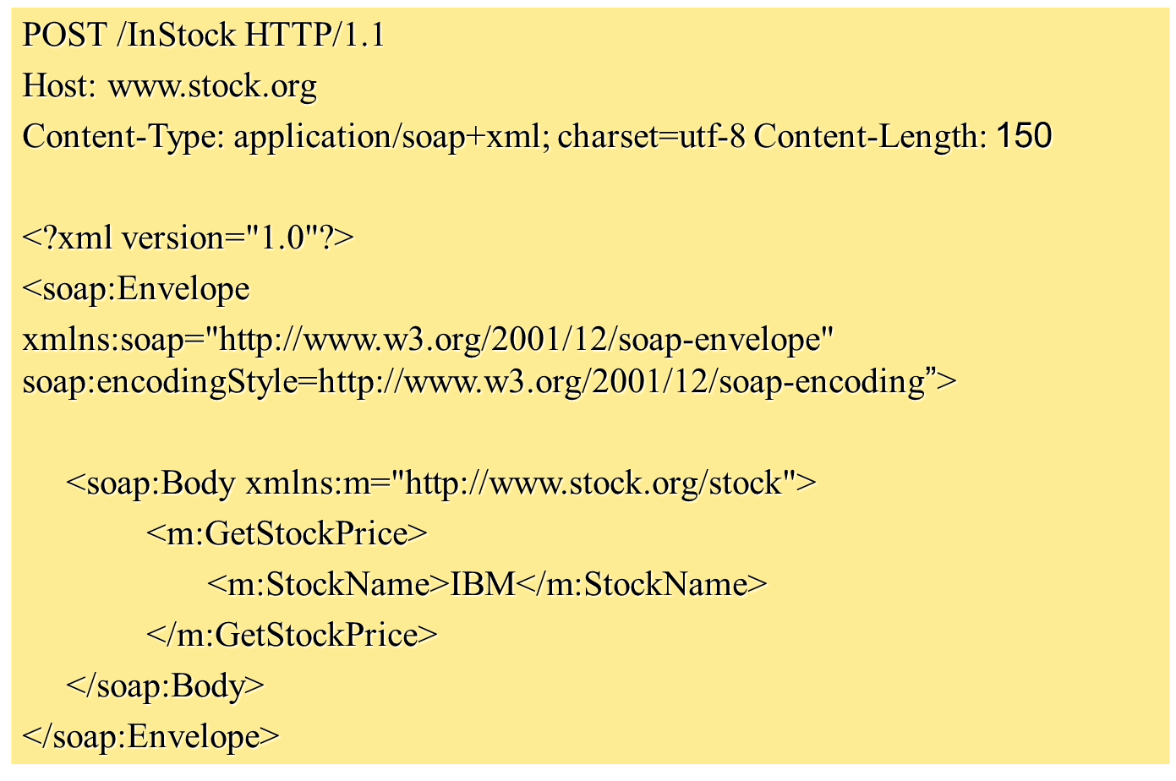
4.2 SOAP (A Request)

Slide 30
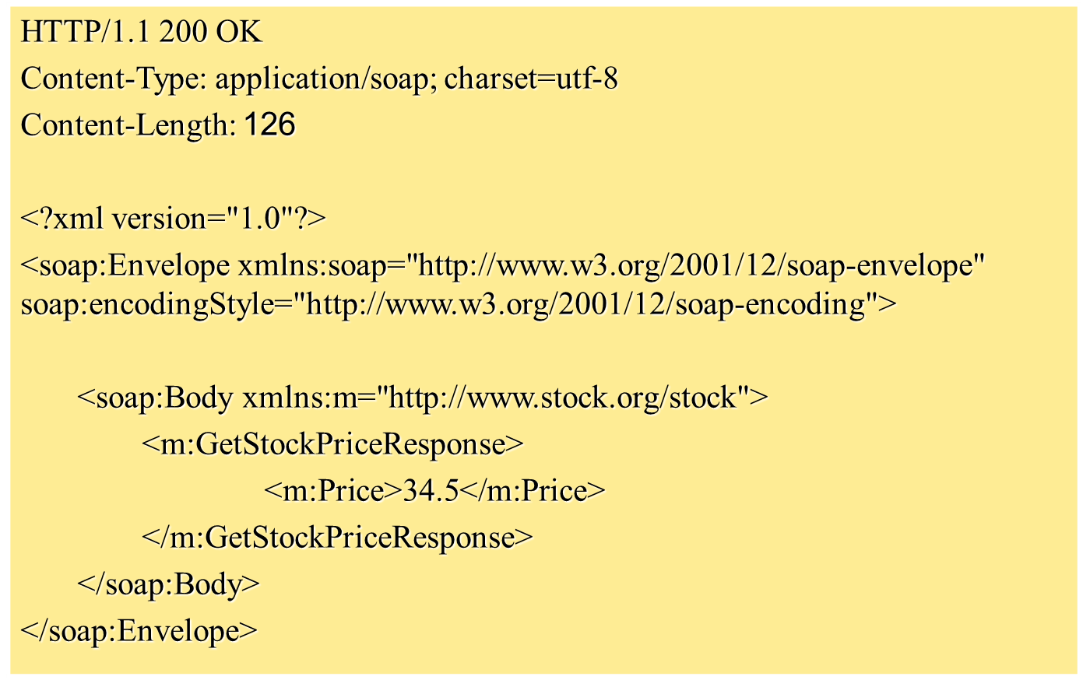
4.2 SOAP (A Response)

Slide 31
4.2 SOAP (Security Issue)
SOAP uses HTTP as a transport protocol and hence can use HTTP security mainly HTTP over SSL.
But, since SOAP can run over a number of application protocols (such as SMTP) security had to be considered.

Slide 32
4.3 WSDL
WSDL stands for Web Services Description Language.
WSDL is an XML vocabulary for describing Web services. It allows developers to describe Web Services and their capabilities, in a standard manner.
WSDL specifies what a request message must contain and what the response message will look like in unambiguous notation. In other words, it is a contract between the XML Web service and the client who wishes to use this service.
In addition to describing message contents, WSDL defines where the service is available and what communications protocol is used to talk to the service.

Slide 33
4.3 WSDL
WSDL is pronounced as 'wiz-dull' and spelled out as 'W-S-D-L'.
WSDL stands for Web Services Description Language.
WSDL was developed jointly by Microsoft and IBM.
WSDL is the standard format for describing a web service.
WSDL definition describes how to access a web service and what operations it will perform.
WSDL is an XML based protocol for information exchange in decentralized and distributed environments.
WSDL is a language for describing how to interface with XML-based services.
WSDL is an integral part of UDDI, an XML-based worldwide business registry.
WSDL is the language that UDDI uses.

Slide 34
4.3 WSDL
A WSDL document is just a simple XML document.
It defines a web service using these major elements:
port type - The operations performed by the web service.
message - The messages used by the web service.
types - The data types used by the web service.
binding - The communication protocols used by the web service

Slide 35
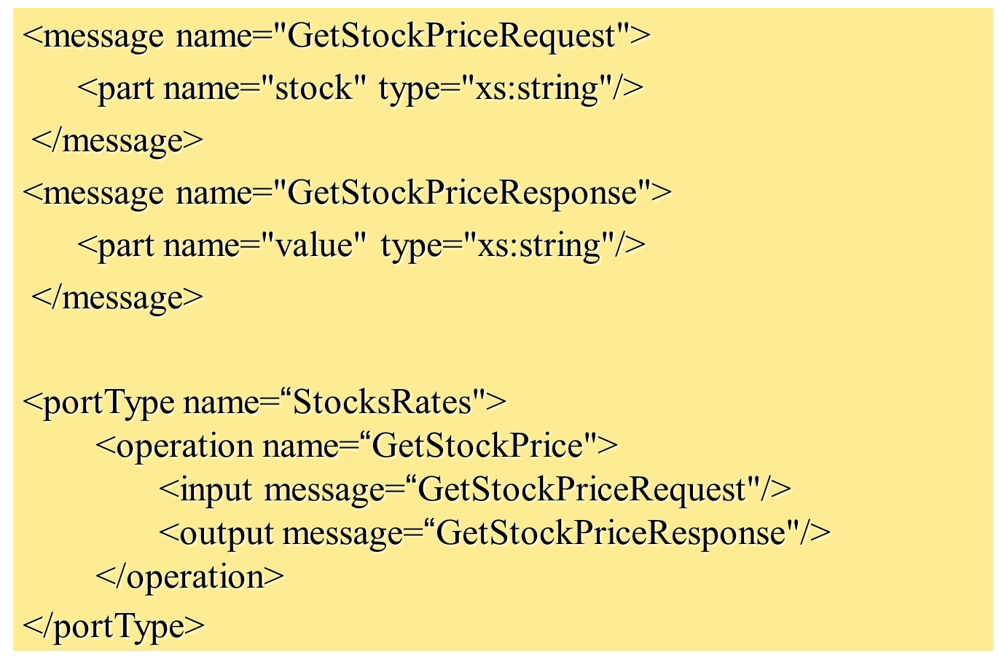
4.3 WSDL

Slide 36
4.4 UDDI
UDDI stands for Universal Description, Discovery and Integration.
UDDI is a directory for storing information about web services , like yellow pages.
UDDI is a directory of web service interfaces described by WSDL.

Slide 37
4.4 UDDI
UDDI is platform independent, open framework.
UDDI can communicate via SOAP, CORBA, and Java RMI Protocol.
UDDI uses WSDL to describe interfaces to web services.
UDDI is seen with SOAP and WSDL as one of the three foundation standards of web services.
UDDI is an open industry initiative enabling businesses to discover each other and define how they interact over the Internet.

Slide 38
5. Introduction to Web Hosting
Web hosting is a service of providing online space for storage of web pages. These web pages are made available via World Wide Web. The companies which offer website hosting are known as Web hosts.
It is not possible to host your website on your local computer, to do so you would have to leave your computer on 24 hours a day. This is not practical and cheaper as well. This is where web hosting companies comes in

Slide 39
5. Introduction to Web Hosting
The total costs of setting up your own in-house Web commerce site are expensive.
Web hosting services allow businesses to start electronic commerce inexpensively.
Web hosting services provide all the services that an ISP does.

Slide 40
5. Types of Web Hosting
Self-hosting
Shared hosting
Dedicated hosting
Grid Hosting
Collocated hosting

Slide 41
5.1 Self-Hosting
The online business owns and maintains the server and all its software.
It implies full control, instant hardware access, and complete flexibility.
Business must have additional staff, Web expertise, expensive equipment, and a high-speed direct Internet connection.

Slide 42
5.2 Shared-Hosting
Your Web or commerce site resides on the same physical server as several other sites.
It is inexpensive, requires very little of an online store’s time to maintain.
It has a very high-speed connection to the Internet.
It may lose direct control from online stores.
Security concerns arise from unrelated online businesses sharing the same server.

Slide 43
5.3 Dedicated-Hosting
In this kind of hosting, single dedicated server is setup for just one customer
A Web host provides a server for your Web site alone.
More Web and commerce software options, a good high-speed connection, more control to site’s design become available.
Higher software costs and maintenance costs can be incurred.

Slide 44
5.4 Grid Hosting
Instead of utilizing one server, Grid Hosting spreads resources over a large number of servers.
It is quite stable and flexible.
The servers can be added or taken away from the grid without crashing the system

Slide 45
5.5 Collocated-Hosting
The server is owned by the online store but is located at the Web host’s site.
The Web host provides maintenance based on the level of service the online business requires.
Maintenance costs are higher than self-hosting.
“ValueWeb” is an example of a Web hosting service. It provides services of shared hosting, dedicated hosting, and collocation services.

Slide 46
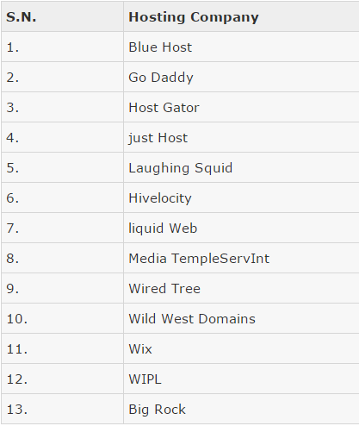
5.2 Web Hosting Companies
These are
the several
companies
offering
web hosting
service:

Slide 47
6. Selecting a Host
Usage limitations
Most hosting plans limit how much data you can transfer to and from their servers in a given month. Once you reach 500MB or 1GB of data transfer, most companies charge you by the megabyte for any additional traffic
Script and extension support
If your Web site uses or will soon use:
SQL databases
CGI scripts
FrontPage 2000 extensions
PHP
Active Server Pages.

Slide 48
6. Selecting a Host
File-transfer options
You'll need to upload your site from your local machine to the server it lives on, and you may want people to be able to download files directly from your site. Look for a host that offers unlimited password-protected FTP uploads to get your site online
Mail options
How much e-mail will you need for your domain? Estimate the number of mailboxes you'll want. You might pick one for each employee, for example, and add some for functions such as sales, info, complaints, and feedback

Slide 49
6. Selecting a Host
Site statistics
You may not think much about hit rates and browser versions and types now, but once you get the site off the ground, you might want site statistic tools so that you can evaluate traffic and plan future site development.

Slide 50
Summary
Web Services - Introduction
History of Web Services
Web services serves as a component
Web Services Advantages
How Does a Web Service Work?
Web Services architecture
Service provider
Service registry
Service requestor

Slide 51
Summary
Components of Web Services
XML – eXtensible Markup Language
SOAP – Simple Object Access Protocol
UDDI – Universal Description, Discovery and Integration specification
WSDL – Web Services Description Language
Introduction to Web Hosting
Types of Web Hosting
Self-hosting
Shared hosting
Dedicated hosting
Grid Hosting
Collocated hosting
Web Hosting Companies
Selecting a Host

Slide 52
THANK YOU

