Slide 1


Slide 2
Web Technologies and Programming
Lecture 30

Slide 3
Search Engine Optimization (SEO)

Slide 4
Summary of Previous Lecture
Web Services - Introduction
History of Web Services
Web services serves as a component
Web Services Advantages
How Does a Web Service Work?
Web Services architecture
Service provider
Service registry
Service requestor

Slide 5
Summary of Previous Lecture
Components of Web Services
XML – eXtensible Markup Language
SOAP – Simple Object Access Protocol
UDDI – Universal Description, Discovery and Integration specification
WSDL – Web Services Description Language
Introduction to Web Hosting
Types of Web Hosting
Self-hosting
Shared hosting
Dedicated hosting
Grid Hosting
Collocated hosting
Web Hosting Companies
Selecting a Host

Slide 6
Outline
What is SEO?
What are Organic Results?
Why SEO?
How does a Search Engine works?
Conceptual Categories
SEO Tactics and Methods
Mobile SEO
What is Mobile SEO
Techniques of Mobile SEO
Tools for Mobile SEO

Slide 7
1. What is SEO?
Search Engine Optimization (SEO) is the activity of optimizing web pages or whole sites in order to make them search engine friendly, thus getting higher positions in search results.
Notes:
The process of improving web pages so they rank higher in search engines for your targeted keywords.

Slide 8
1. What is SEO?
SEO stands for Search Engine Optimization.
SEO is all about optimizing a website for growing visibility in organic (non-paid, natural) search engine results.
Notes:
The process of improving web pages so they rank higher in search engines for your targeted keywords.

Slide 9
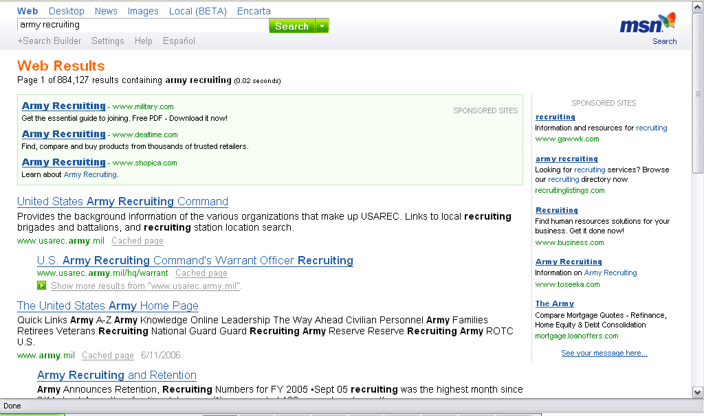
1.1 What are Organic Results?
Pay Per Click
Pay Per Click
Organic

Slide 10
1.2 Why SEO?
To rank a website well in search engine results.
To improve the volume and quality of traffic of a website from search engines.
To market by understanding how search algorithms work, and what human visitors might search.

Slide 11
1.3 How does a Search Engine Work?
For better learning of SEO, it is essential that you understand how search engines works.
These are the activities a search engine perform to build result
Crawling
Indexing
Processing
Calculating Relevancy
Retrieving Results

Slide 12
1.3 How does a Search Engine Work?...
Crawling
Process of fetching all the web pages linked to a website. This task is performed by a software called a crawler or a spider (or Googlebot, in case of Google).

Slide 13
1.3 How does a Search Engine Work?...
Indexing
Process of creating index for all the fetched web pages and keeping them into a giant database from where it can later be retrieved.
Essentially, the process of indexing is identifying the words and expressions that best describe the page and assigning the page to particular keywords.

Slide 14
1.3 How does a Search Engine Work?...
Processing
This is the process which compares the search string in the search request with the indexed pages in the database.

Slide 15
1.3 How does a Search Engine Work?...
Calculating Relevancy
It is likely that more than one page contains the search string, so the search engine starts calculating the relevancy of each of the pages in its index to the search string.

Slide 16
1.3 How does a Search Engine Work?...
Retrieving Results
The last step in search engine activities is retrieving the best matched results. Basically, it is nothing more than simply displaying them in the browser.

Slide 17
1.4 Conceptual categories
Conceptually, there are two ways of optimization:
On-Page SEO:
It includes providing good content, good keywords selection, putting keywords on correct places, giving appropriate title to every page, etc.
Off-Page SEO:
It includes link building, increasing link popularity by submitting open directories, search engines, link exchange, etc.

Slide 18
1.5 SEO TACTICS AND METHODS
SEO techniques are classified into two broad categories:
White Hat SEO:
Techniques that search engines recommend as part of a good design.
Black Hat SEO:
Techniques that search engines do not approve and attempt to minimize the effect of. These techniques are also known as spamdexing.

Slide 19
1.5 SEO TACTICS AND METHODS
White Hat SEO?
An SEO tactic is considered as White Hat if it has the following features:
It conforms to the search engine's guidelines.
It does not involve in any deception.
It ensures that the content a search engine indexes, and subsequently ranks, is the same content a user will see.
It ensures that a web page content should have been created for the users and not just for the search engines.
It ensures good quality of the web pages.
It ensures availability of useful content on the web pages.

Slide 20
1.5 SEO TACTICS AND METHODS…
Note: We will discuss only white Hat techniques.
Selecting appropriate Website domain:
Before you choose a domain name, you should consider the following:
Who would be your target audience?
What you intend to sell to them. Is it a tangible item or just text content?
What will make your business idea unique or different from everything else that is already available in the market?

Slide 21
1.5 SEO TACTICS AND METHODS…
Selecting appropriate Website domain:
Using keywords in your domain name gives you a strong competitive advantage.
Keep two to three words in your domain name that will be easy to memorize.
Buy your domain name that is catchy, memorable, and relevant to your business.

Slide 22
1.5 SEO TACTICS AND METHODS…
Using Relevant FILENAMES:
One of the simplest methods to improve your search engine optimization is to look at the way you name your files.
Search engines like Google give too much importance to filenames.

Slide 23
1.5 SEO TACTICS AND METHODS…
Using Relevant FILENAMES:
The filename should preferably be short and descriptive.
It is always good to use same keywords in a filename as well as in page title.
Do not use generic filenames such as service.htm or job.htm.
Do not use more than 3–4 words in file names.
Separate the keywords with hyphens rather than underscore.
Try to use 2 keywords if possible.

Slide 24
1.5 SEO TACTICS AND METHODS…
Design and Layout:
The website design and layout gives the first impression about your site.
If you make your site too complicated, then the search engine would not be able to parse the content

Slide 25
1.5 SEO TACTICS AND METHODS…
Design and Layout:
Follow the following guideline for better Design and Layout.
You should have more text content than HTML elements.
No frames as they are the enemies of search engines, and search engines are enemies of frames.
No ads if possible because most of the ads use JavaScript which is not advised to be used.

Slide 26
1.5 SEO TACTICS AND METHODS…
Design and Layout:
No internal JavaScript. If you need JavaScript, call it from an external file rather than dumping the code in the HTML file.
Do not put anything in the page topic that does not fit perfectly.
No unnecessary directories. Keep your files as close to the root as possible.
No fancy stuff (Flash, Splash, Animated Gifs, Rollovers, etc.) unless absolutely necessary.

Slide 27
1.5 SEO TACTICS AND METHODS…
Optimized Keywords:
A keyword is a term that is used to match with the query a person enters into a search engine to find specific information.
Most people enter search phrases that consist of two to five words. Such phrases may be called search phrases, keyword phrases, query phrases, or just keywords. Good keyword phrases are specific and descriptive.

Slide 28
1.5 SEO TACTICS AND METHODS…
Optimized Keywords:
Following are methods for keyword optimization:
Repeat your keyword in the document as many times as you can get away with, and up to 3-7 times in your list of metatags.
One technique that often works well is to create some smaller pages is by keeping the overall number of words to a minimum, you can increase the "weight" of the keyword you are emphasizing.

Slide 29
1.5 SEO TACTICS AND METHODS…
Optimized Keywords:
Having keywords in the first heading and in the first paragraph (first 20 words or so) on a page are best.
Where your keywords are placed on a page is very important. For example, in most engines, placing the keywords in the Title of the page, or in the Heading tags will give it more relevancy.

Slide 30
1.5 SEO TACTICS AND METHODS…
Content is Important:
Content basically includes what you see on the site: the text, graphics, and even links to other websites.
Creating, editing, and promoting unique high-quality content is difficult and time consuming. But in the end, the golden rule of SEO is that Content is the King. It is not because of a search engine, but it is for your site visitors.

Slide 31
1.5 SEO TACTICS AND METHODS…
Link building:
Link building is the SEO practice of obtaining links from external websites to your own to improve both direct referrals (i.e., people clicking on the links), and search engine ranking. Link building is all about increasing your site link popularity.

Slide 32
1.5 SEO TACTICS AND METHODS…
Link building:
Following are the methods to do link building.
Submit your site in popular search engines manually. Do not go for automated submission.
Get your site listed in Open Directory Projects like dmog.org, yahoo.com. Getting listed in these directories gives a boost in link popularity and improve search engine ranking in other search engines.

Slide 33
1.5 SEO TACTICS AND METHODS…
Link building:
Participate in Link Exchange Programs. Find top 20 sites doing the same business and contact them for reciprocal links.
Get your site listed in Open Directory Projects like dmog.org, yahoo.com. Getting listed in these directories gives a boost in link popularity and improve search engine ranking in other search engines.

Slide 34
1.5 SEO TACTICS AND METHODS…
Link building:
Buy a place on high-rank website where you can put your link.
Subscribe for Google's AdWords program to drive traffic towards your site.

Slide 35
1.6 SEO TACTICS AND METHODS…
Verifying Web Site:
You design and develop a website but how would you know if you have put all the HTML syntax in a correct way. Most browsers do not complain against your wrong syntax, but wrong is wrong.
There are many SEO experts who claim that SEO is not dependent on site HTML/XHTML verification. But still your site should be as per W3C Compliance.

Slide 36
2. Mobile SEO
Millions of users these days access the web using smartphones running on Android, iOS, or Windows.
Hence, it has become imperative that websites adapt themselves to this changing environment and make suitable changes in their website design to attract more viewership.

Slide 37
2.1 What is Mobile SEO?
Mobile Search Engine Optimization is the process of designing a website to make it suitable for viewing on mobile devices of different screen sizes and load times.

Slide 38
2.1 What is Mobile SEO?...
A website is mobile friendly if it has the following attributes:
Its contents are easy to read on a mobile device without having to zoom the screen.
It should be easy to navigate through the site on a small screen.
Most important of all, it should show up in Google search results.

Slide 39
2.2 Techniques of Mobile SEO?
If your site is already optimized for search engines, then it should not be too difficult to optimize it for mobile devices. We can categorize the steps into two broad categories:
Select a Mobile Configuration
Avoid Common Mistakes

Slide 40
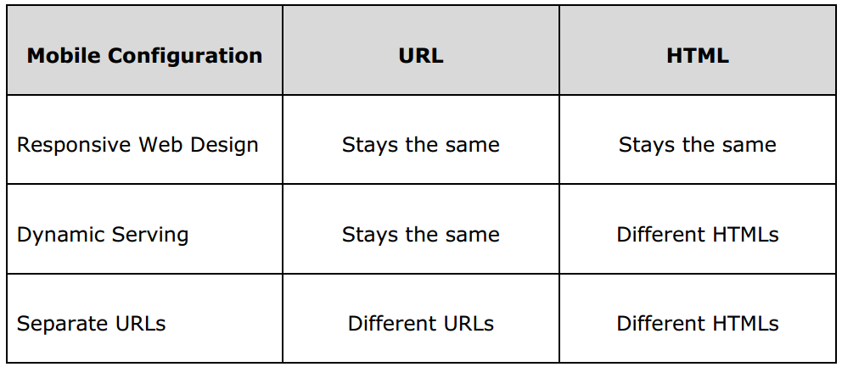
2.2 Techniques of Mobile SEO?...
Select a Mobile Configuration

Slide 41
2.2 Techniques of Mobile SEO?...
Avoid Common Mistakes
Avoid slow Mobile Pages.
Don't Block CSS, JavaScript, or Image Files.
Avoid popups.

Slide 42
2.3 Tools for Mobile SEO?
Here is a list of some useful tools that you can use to find out how mobile friendly your site is:
Mobile Emulator
Moz Local
Responsive Web Design Testing Tool
Screaming Frog

Slide 43
3. SEO - Miscellaneous Techniques
To-Don't List
Don't keep hidden text on your webpages.
Don't create alternate image spamming by putting wrong keywords.
Don't use meta tags stuffing.
Don't use frames and flash on your site.
Don't exchange your links with black listed sites.
Don't try to fool your site visitors by using misspelled keyword.
Don't send spam emails to thousands of email IDs.
Don't use too much graphics on your site.
Don't create too many doorway pages.

Slide 44
3. SEO - Miscellaneous Techniques
To-Don't List
Don't try to create duplicate content of pages.
Don't submit your website many times in a single search engine.
Don't use sub-directory depth more than 1-2.
Don't create too many dynamic pages. Try to convert them into static pages.
Don't bloat your pages with code.
Don't nest your pages.

Slide 45
3. SEO - Miscellaneous Techniques
To-Do List
Create logs of pages and each page should however contain a minimum of about 200 visible words of text to maximize relevance with Google.
Create a Sitemap, Help, FAQ, About Us, Link to Us, Copyright, Disclaimer, Privacy Policy pages on mandatory basis.

Slide 46
3. SEO - Miscellaneous Techniques
To-Do List
Create a homepage link to each and every webpage and provide easy navigation through all the pages.
Pay attention to your dynamic page URLs. Google can crawl and index dynamic pages as long as you don't have more than 2 parameters in the URL.
Check your complete site for broken links. Broken links will reduce your other pages rank as well.

Slide 47
For Review
We have covered almost all major concepts related to Search Engine Optimization.
Now you are familiar with most frequently used SEO related terminologies as well.
Learn keywords and layout optimization techniques.
Learn all the ethical strategies to enhance your website ranking.

Slide 48
Summary
What is SEO?
What are Organic Results?
Why SEO?
How does a Search Engine works?
Crawling
Indexing
Processing
Calculating Relevancy
Retrieving Results
Conceptual Categories
On-Page SEO:
Off-Page SEO:

Slide 49
Summary
SEO Tactics and Methods
Black Hat SEO?
White Hat SEO?
Selecting appropriate Website domain
Using Relevant FILENAMES
Design and Layout
Optimized Keywords
Link building:
Verifying Web Site
Mobile SEO
What is Mobile SEO
Techniques of Mobile SEO
Tools for Mobile SEO

Slide 50
Summary
SEO - Miscellaneous Techniques
To-Don't List
To-Do List

Slide 51
THANK YOU

