Slide 1


Slide 2
Web Technologies and Programming
Lecture 31

Slide 3
Summary of Lecture 1 - 15

Slide 4
Outline
Introduction to Web Technologies
The web application development process
Web Project Management
Requirement Engineering
Modeling web applications
Implementing and testing web applications
Web application architecture

Slide 5
Outline
Introduction to HTML
HTML Links and navigation
Adding Image, audio and video files to web pages
Tables in HTML
HTML FORMS
HTML 5 Form elments

Slide 6
Outline
Introduction to Cascading Style-sheets (CSS)
Page Layout
CSS Properties
CSS 3

Slide 7
1. Introduction to Web Technologies
What is web?
Web applications
The case for web engineering
Categories of web applications
Document-centric web
Interactive and transactional web applications
Workflow-based web applications
Collaborative and social web applications
Portal-oriented web applications
Ubiquitous web applications
Characteristics of web applications
(Product, Usage, Development)

Slide 8
1. Introduction to Web Technologies
Web engineering extends Software Engineering to Web applications
Why web engineering?
Web applications
Integration:
Internal: with existing legacy systems
External: with Web services
Integration issues: correct interaction

Slide 9
2. The web application development process
Development Process model
software development process activities
Requirement for a web development process model
Rational unified process model (RUP)
A modern process model derived from the work on the UML and associated process.
RUP is a heavyweight, phase oriented, incremental and iterative process
suitability for web application development

Slide 10
2. The web application development process
Software specification:
The functionality of the software and constraints on its operation must be defined
critical stage (can lead to problems in design and implementation)
Activities:
Feasibility study
Requirement elicitation and analysis
Requirement specification
Requirement validation

Slide 11
3. Web Project Management
Project management is the process of planning, organizing, motivating and controlling resources and procedures to develop a software/web project
Projects need to be managed
to ensure budget and time constraints
Project manager: tasks/responsibilities
Traditional vs. web project management

Slide 12
3. Web Project Management
Project Managers Tasks
Project planning
Risk management
People management
Reporting
Proposal writing

Slide 13
4. Requirement Engineering
Requirements Engineering: the principles, methods, & tools for drawing, describing, validating, and managing project goals and needs
It may range from a high-level abstract statement of a service or of a system constraint to a detailed mathematical functional specification.
The processes used for RE vary widely depending on the application domain, the people involved and the organisation developing the requirements.
Functional requirements
Non-functional requirements
However, there are a number of generic activities common to all processes
Requirements elicitation;
Requirements analysis;
Requirements validation;
Requirements management

Slide 14
4. Requirement Engineering
The requirements engineering process

Slide 15
5. Modeling web applications
Process of developing abstract models of a system
Representing system using graphical notation - UML
Requirement modeling
use-case diagram
activity diagram
Content modeling
class diagram
Navigational modeling
to model nodes and navigational structure among them
Presentation modeling
model user interface, page-layout

Slide 16
5. Modeling web applications
Presentation Modelling
<<page>>
User registration page
<<presentationUnit>>
Logo
<<image>>
logo
<<text>>
title
<<presentationUnit>>
<<textinput>>
name
<<textinput>>
email
<<textinput>>
password
<<button>>
submit

Slide 17
6. Implementing and testing web applications
When we have decided the ‘What’ of the web application i.e.
requirements are defined
system architecture is decided
system model and design is ready
We are ready for ‘how’ i.e. to implementation phase

Slide 18
6. Implementing and testing web applications
Testing is an activity conducted to evaluate the quality of a product and to improve it by identifying defects and problems
If we run a program with the intent to find errors, then we talk about testing
By testing we determine the quality state of the system
which provides a basis for improvement

Slide 19
6. Implementing and testing web applications
Technologies for web development
Protocol
client-side technologies
server-side technologies
Testing web applications
Objectives
Levels
Web application specifics
challenges

Slide 20
7. Web application architecture
Software system architecture
The architecture of a computer system is the high-level (most general) design on which the system is based
Architectural features include:
Components (a Component is a part of a program)
It contains one or several routines
Connectors (how components communicate)
Collaborations (how components interact)

Slide 21
7. 1 Components of a web application architecture
Client
Firewall
proxy
Web-server
CGI support
Browser
HTML, XML
Plug -In
Database server
Application server
Media server
Legacy application

Slide 22
7. Web application architecture
Specifics of web application architecture
Layered web architecture
2-layered architecture
3-layered architecture
N-layered architecture

Slide 23
8. Introduction to HTML
Introduction to HTML
HTML – Hyper-Text Markup Language – The Language of Web Pages on the World Wide Web
Hypertext:
Allows for non-linear linking to other documents
Markup Language:
Content is “marked up” or tagged to tell the browser how to display it

Slide 24
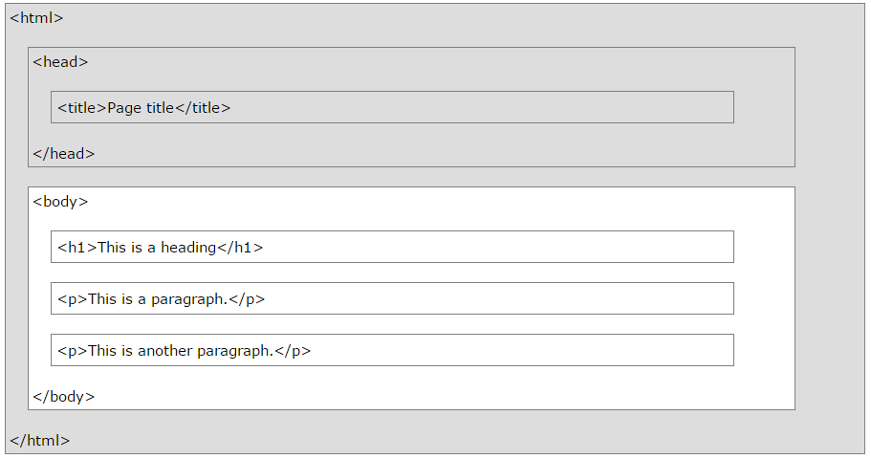
8. HTML Links and navigation
Basic Structure of a HTML page

Slide 25
8. HTML
Basic Structure of HTML page
Body tag attributes
Text formatting tags
Lists

Slide 26
9. HTML Links and navigation
How to link between pages of your site (internal links)
Anything between the opening <a> tag and the closing </a> tag becomes part of the link that users can click in a browser
A Local link uses a page name (including sub-directories if needed) as the target. It is “local” to the current server.

Slide 27
9. Introduction to Web Technologies
How to link to other sites (external)
To link the page of another website, again the href attribute of opening tag of <a> is used
the value of the href attribute is the full web address for the page you want to link to rather than just the filename
<a href="https://www.google.com.pk"> Click here </a>

Slide 28
10. Adding Image, audio and video files to web pages
Use the HTML <img> element (inside <a>) to use an image as a link
Images can be added as follows
We can add an image by
<img src=“image-name”>
<img src=“abc.jpg”>
<img src="url" alt="some_text">

Slide 29
10. Adding Image, audio and video files to web pages
The <video> tag is used to add a video to a web page
This tag is provided in HTML5
The src attribute of the <video> tag is used to indicate the source of the video
We can add a video to our page as
<video src=“abc.mp4”>
<video width="320" height="240" controls>

Slide 30
10. Adding Image, audio and video files to web pages
The <audio> tab is used to add a audio to a web page
This tag is provided in HTML5
The src attribute of the <audio> tag is used to indicate the source of the audio
We can add a audio to our page as
<audio src=“abc.mp3”>

Slide 31
11. Tables in HTML
Tables display information in rows and columns
Tables are commonly used to display all manner of data that fits in a grid such as train schedules, television listings, financial reports etc.

Slide 32
1. Creating HTML tables
An HTML table consists of the <table> element and one or more elements like
<tr>
<th>
<td>
Tables are divided into table rows with the <tr> tag.
Table rows are divided into table data with the <td> tag.
A table row can also be divided into table headings with the <th> tag.
Table level attributes
Row level attributes
Cell level attributes

Slide 33
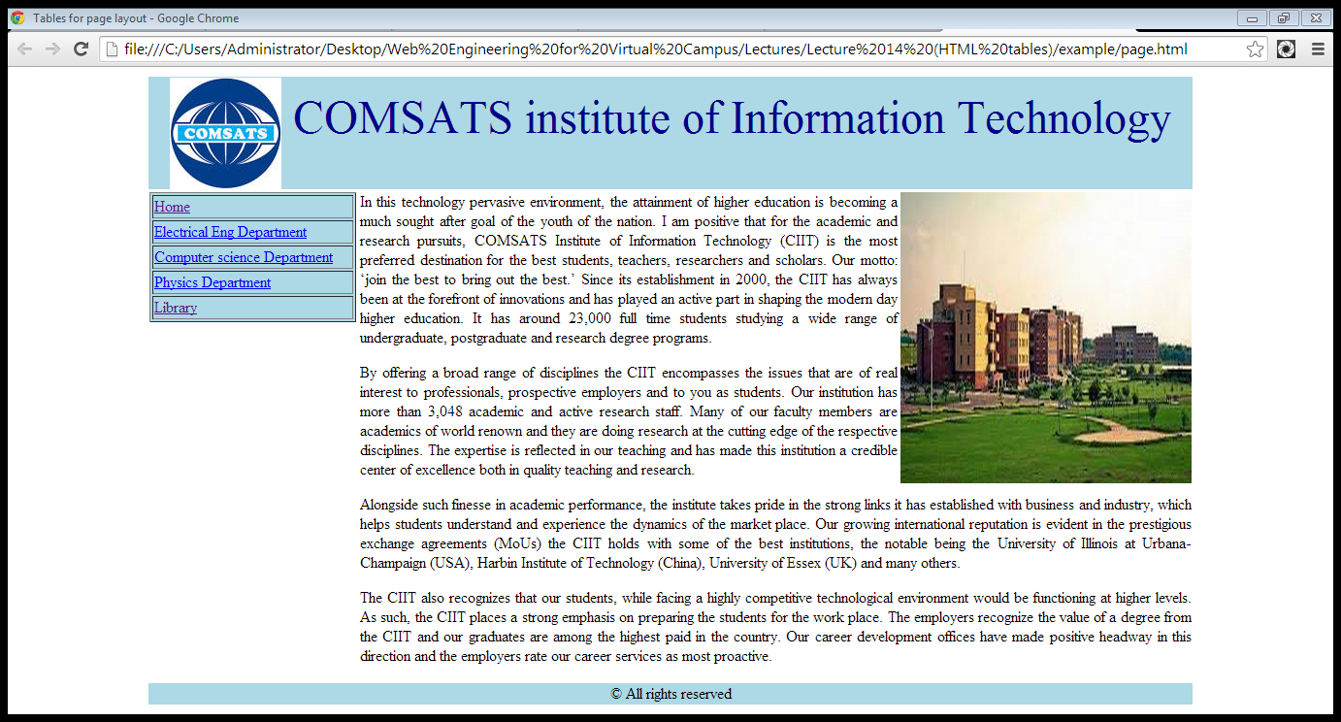
11. Page Layout using Tables
Layout using Table

Slide 34
12. HTML Form
HTML forms are used to collect user input.
HTML forms contain form elements.
Form elements are different types of input elements, checkboxes, radio buttons, submit buttons, and more.
The <form> element defines an HTML form:
<form> . form elements . </form>

Slide 35
12. HTML Form
Forms provide a means of submitting information from the client to the server
HTML supports tags for creating forms, however, it does not process the information
Use server-side script to process form information
Server-side script runs on the Web server and receives data from a form and uses it to perform a set of tasks

Slide 36
12. HTML FORMS…
Common Form Attributes:
action - gives the URL of the application that is to receive and process the forms data
method - sets the HTTP method that the browser uses to send the form's data to the server for processing; Either POST or GET
name – name of the form

Slide 37
13. HTML 5 Form elements
New Attributes
Required
Placeholder
Autocomplete
Pattern
Disable
Read only

Slide 38
13. HTML 5 Form elements
HTML Elements
Textbox
Password Field
Hidden Field
Checkbox
Radio Button
Text Area
Select List
Submit Button
Reset Button
New Elements
Email element
Date element
Number element
Color element

Slide 39
13. HTML 5 Form elements
XHTML
EXtensible HyperText Markup Language
XHTML is almost identical to HTML
Stricter version than HTML
XHTML is HTML defined as an XML application
XHTML is supported by all major browsers

Slide 40
14. Introduction to Cascading Style-sheets (CSS)
Understand the basics of CSS
CSS ( Cascading Style Sheets ) is a style sheet language that describes the presentation style of an HTML Page.
It describes how HTML elements must be rendered/displayed on screen.
Enforce standards and uniformity
Create dynamic effects
Works by allowing you to specify rules

Slide 41
14. Introduction to Cascading Style-sheets (CSS)
Understand the differences among inline, internal and external style sheets
Understand the difference between ids and classes.
Understand how to declare a style.

Slide 42
14. CSS - Font properties…
Common font properties:
font-family
font-size
font-weight
font-style
font-variant

Slide 43
15. Page Layout
Group related information/sections
Home page: login form, registration form
User page: user’s information, recent messages
Inbox: Received messages
Outbox: Sent messages
Send a message: Send message form
Liquid vs Fixed design
The Div tag
Coding the design

Slide 44
15. Page Layout
Create site map
Home page
User page
Inbox
Outbox
Send a message

Slide 45
16. CSS Properties
To control the presentation of an element, you need to know the corresponding properties
Properties with related functionalities are grouped together
Example:
Properties to control the presentation of text

Slide 46
16. CSS Properties
Allows for scalable fonts
Monitors vary in size of display and screen resolution
Specifying a relative unit ensures a uniform viewing experience across the variety of monitors rendering your page
As a scalable font:
body {font-size: 150%}
Use descriptive keywords: xx-small through xx-large:
b {font-size: xx-large}

Slide 47
17. CSS 3
Introduction to CSS3.
CSS3 Properties.
Rounded Corners, Box Shadows.
CSS3 Transformations.
CSS3 Media Queries.

Slide 48
17. CSS3
CSS3 is split up into "modules". Some of the most important CSS3 modules are
Selectors
Box Model
Backgrounds and Borders
Text Effects
2D/3D Transformations
Animations
Multiple Column Layout
User Interface

Slide 49
17. CSS 3
A media query consists of a media type and can contain one or more expressions, which resolve to either true or false.
Media queries can be used to check many things, such as:
width and height of the viewport
width and height of the device
orientation (is the tablet/phone in landscape or portrait mode?)
resolution

Slide 50
Summary
Introduction to Web Technologies
The web application development process
Web Project Management
Requirement Engineering
Modeling web applications
Implementing and testing web applications
Web application architecture

Slide 51
Summary
Introduction to HTML
HTML Links and navigation
Adding Image, audio and video files to web pages
Tables in HTML
HTML FORMS
HTML 5 Form elments

Slide 52
Summary
Introduction to Cascading Style-sheets (CSS)
Page Layout
CSS Properties
CSS 3

Slide 53
THANK YOU

