Slide 1


Slide 2
Web Technologies and Programming
Lecture 02

Slide 3
The web application development
process
Web Project Management

Slide 4
Summary of the last lecture
Web engineering extends Software Engineering to Web applications
Why web engineering?
Web applications
Categories of web applications
Characteristics of web applications

Slide 5
Outline
Development Process model
software development process activities
Requirement for a web development process model
Rational unified process model (RUP)
A modern process model derived from the work on the UML and associated process.
suitability for web application development

Slide 6
1. Process model
A set of related activities that leads to the production of a software product
development of software from scratch
extending and modifying existing systems
Common activities
Software specification
Designing and implementation
System validation
System evolution

Slide 7
1.1 Process activities
Software specification:
The functionality of the software and constraints on its operation must be defined
critical stage (can lead to problems in design and implementation)
Activities:
Feasibility study
Requirement elicitation and analysis
Requirement specification
Requirement validation

Slide 8
1.1 Process activities…
Software design and implementation:
Design is the description of
System structure
Data models
Interface between components
Implementation: Converting a system specification into an executable system

Slide 9
1.1 Process activities…
System validation:
Intended to show that the system
confirms its specification
meets customer’s expectations
Development testing
tested by the people developed the components
System testing
finding component integration errors
Acceptance testing
System is tested by the customer’s provided data

Slide 10
1.1 Process activities…
Software evolution:
Software is flexible as compared to hardware
Changes can be made to the system during development or after the development

Slide 11
1.2 Common approaches
The waterfall approach
(complete each process step before beginning the next)
Iterative approach
(Go quickly through all process steps to create a rough system, then repeat them to improve the system)
Reuse oriented approach
(systems are integrated from existing components )

Slide 12
2. Requirements for a web application development process
Evolving from informational medium to application medium
Existing approaches are over-pragmatic
lead to short development time
Web engineering does not have its own mature development process model
SE development process models are adopted

Slide 13
2. Requirements for a web application development process…
Handling Short development cycles
Development time is short
Normally does not exceed six month
Immediate delivery mechanism
Capture share in the market
Leaves less freedom for systematic development process

Slide 14
2. Requirements for a web application development process…
Handling changing requirement
Requirements often emerge during development
as developer understand the unknown business
Integrate changes rapidly to remain in competition
User involvement is more critical
due to emerging and unstable requirements

Slide 15
2. Requirements for a web application development process…
Releases with fixed deadlines and flexible contents
Due to rapid changes in requirements, disposable releases are required
To detail and validate customer’s requirements
Release intervals are very short
Time plan for releases is more important than planning requirements for releases

Slide 16
2. Requirements for a web application development process…
Parallel development of different releases
To meet time constraints, parallel and overlapping development is required
Several small teams work on similar tasks
Communication overhead is extensive in web application development

Slide 17
2. Requirements for a web application development process…
Reuse and integration
to meet time constraints developer try to reuse components
Leads to integration issues
Development can not be isolated from the development of other applications within the organization

Slide 18
2. Requirements for a web application development process…
Adapting to web application’s complexity level
process depends upon the level of complexity
process is adapted dynamically
for low complexity, it should be like lightweight process
for high complexity, it should be like heavyweight process

Slide 19
3. Rational unified process
RUP is a heavyweight, phase oriented, incremental and iterative process
Described in three perspectives
Dynamic perspective: phases over time
Static perspective: activities in process
Practice perspective: good engineering practices

Slide 20
3. Rational unified process
RUP phases:
Inception
Establish the business case for the system.
Elaboration
Develop an understanding of the problem domain and the system architecture.
Construction
System design, programming and testing.
Transition
Deploy the system in its operating environment

Slide 21
3. Rational unified process
RUP phases:
Inception: Define the business case for the project
Goals:
Business case
Identify and interact with external entities
Asses the business contribution
Artifacts:
business case

Slide 22
3. Rational unified process
RUP phases:
Elaboration: establish understanding with the problem
Goals:
Establish software scope
Discriminating critical use-cases
Estimating cost, schedules and risks
Artifacts:
development plan, use-case model, architectural description

Slide 23
3. Rational unified process
RUP phases:
Construction: involves system design, programming and testing
Goals:
Develop the design
Implement the design
Validate the system
Artifacts:
System, training material

Slide 24
3. Rational unified process
RUP phases:
Transition: Installing the system in real environment
Goals:
Testing in real environment
training
Bug fixing, performance enhancements
Artifacts:
A documented system working correctly

Slide 25
3. Rational unified process
RUP phases:

Slide 26
3. Rational unified process
RUP activities (workflows):
Requirements
analysis
design
implementation
test

Slide 27
3. Rational unified process
RUP good practices:
Develop software iteratively
Manage requirements
Use component-based architectures
Visually model software-using UML
Verify software quality
Control changes to software

Slide 28
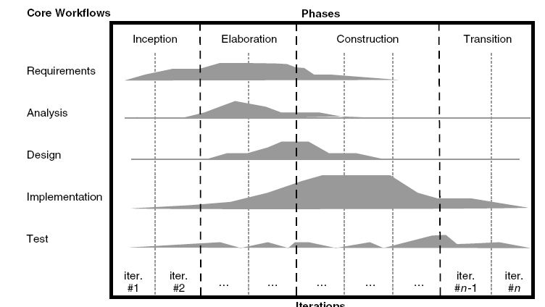
3. Rational unified process…
phases
activities

Slide 29
3.1 RUP for web application
Inception phase:
Definition is problematic for web application
no concrete view of the system at beginning
has target group but needs are unknown
Elaboration phase:
due to short development time, first version has priority over clearly defined end-product

Slide 30
3.1 RUP for web application…
Construction phase:
exists in web development process
Transition phase:
is meaningful for web application development

Slide 31
3.1 RUP for web application…
Handling short development cycles:
Conflicting
short cycle means concession in modeling and documentation while RUP is heavyweight
Handling changing requirements:
Conflicting with time constraints
require concrete vision at the end of inception phase which require more time in web application due to evolving requirements

Slide 32
3.1 RUP for web application…
Parallel development of different releases:
can be met with RUP
RUP only allow parallel development in construction phase
Reuse and integration:
Conflicting
It requires coordination with development processes of other applications RUP does not describe this

Slide 33
3.1 RUP for web application…
Adapting to a Web application’s complexity level:
RUP can be adopted for later stages when complexity of web application is understood

Slide 34
Web Project Management

Slide 35
Outline
Project management
Project manager: tasks/responsibilities
Traditional vs. web project management

Slide 36
1. Project Management
Project management is the process of planning, organizing, motivating and controlling resources and procedures to develop a software/web project
Is essential part of software/web engineering
Projects need to be managed
to ensure budget and time constraints

Slide 37
1. Project Management…
Project manager’s job is to ensure
project meets budget and timing constraints
high quality product is delivered
Good management does not guarantee the project success
Bad management usually results in project failure
schedule delays
budget overrun
low customer’s acceptance

Slide 38
1. Aim of Project Management…
To complete a project:
• On Time
• On Budget
• With required functionality
• To the satisfaction of the client
• Without exhausting the team
To provide visibility about the progress of a project

Slide 39
1. Project Management…
Project management goals are
deliver software on time
meet budget constraints
fulfill customer’s expectation
maintain a happy and well-functioning team

Slide 40
1. Aspects of Project Management…
Planning
Outline schedule during feasibility study
Fuller schedule for each part of a project (e.g., each process step, iteration, or sprint)
Contingency planning
Anticipation of possible problems (risk management)
Progress tracking
Regular comparison of progress against plan
Regular modification of the plan
Changes of scope, etc. made jointly by client and developers
Final analysis
Analysis of project for improvements during next project

Slide 41
2. Project Manager’s tasks
Project planning
Risk management
People management
Reporting
Proposal writing

Slide 42
2. Project Manager’s tasks…
Project planning:
Project managers are responsible for
cost estimation
project scheduling
resource allocation
Monitoring
work is carried out according to standards
progress is according to budget and schedule

Slide 43
2. Project Manager’s tasks…
Project planning:
At proposal stage:
are resources available to complete the project
what price to ask (effort, s/w,h/w, travelling)
At startup stage:
start‐up time is typically three to six months
who will work
decide about the increments and allocate resources
refine estimates as more information is available

Slide 44
2. Project Manager’s tasks…
Project planning:
During development process:
when project plan needs to be changed
can make more accurate estimates about time and cost

Slide 45
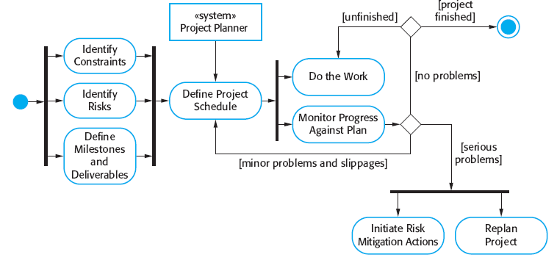
2. Project Manager’s tasks…
Project planning:
Source: ‘software engineering’ by Sommerville

Slide 46
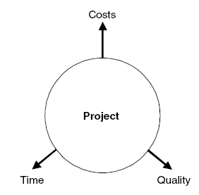
2. Project Manager’s tasks…
Conflicting areas:
Project requires to have a well balanced between budget, time and quality
change in one can influence others
time
quality
cost
Source: Web Engineering – Kappel et al.

Slide 47
2. Project Manager’s tasks…
Risk management:
Project managers are responsible for
anticipation of risks
can affect schedule or quality
taking actions to avoid these risks

Slide 48
2. Project Manager’s tasks…
Risk management:
Risk categories:
Project risks: affect the project schedule or resources
experienced developer leaves the job
Product risks: affect the quality and performance of the product
a purchased component does not work as expected

Slide 49
2. Project Manager’s tasks…
Risk management:
Risk categories:
Business risks: affect the organization developing or procuring the product
a competitor introduced a new product

Slide 50
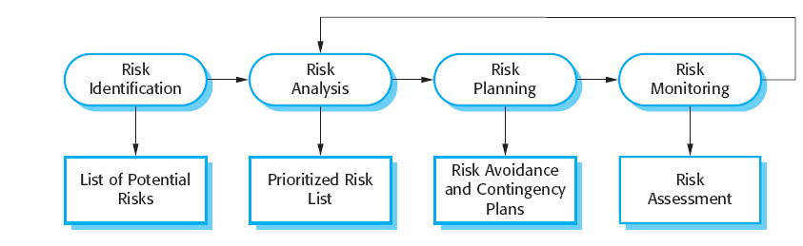
2. Project Manager’s tasks…
Risk management:
Source: ‘software engineering’ by Sommerville

Slide 51
2. Project Manager’s tasks…
People management:
Project managers responsible for
choosing people
establishing ways of working
Characteristics of web development team
multidisciplinary: experts from diverse fields
Parallelism: parallel work on large task
Small size: due to budget constraints/short development cycles

Slide 52
2. Project Manager’s tasks…
People management:
PM solves conflicts if members are working as group
must be solved early to meet time constraints
due to short development time, even suboptimal solution is acceptable

Slide 53
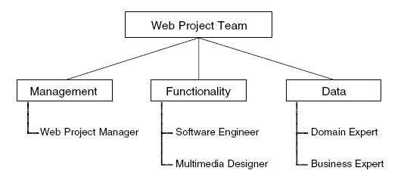
2. Project Manager’s tasks…
People management:
Web team composition
roles
people
Source: Web Engineering – Kappel et al.

Slide 54
2. Project Manager’s tasks…
Reporting:
Project mangers are responsible for reporting
on progress of a project to customers and managers of the company
Proposal writing:
write proposal to win a project
critical task

Slide 55
2. Project Manager’s tasks…
Golden rules for Web project managers:
Take care of ethics in the team
Stress the importance of different application knowledge for the project
Solve conflicts quickly. Make sure no team member is a winner or a loser all the time
Explain to each team member his or her roles and responsibilities continuously
Identify parallel developments

Slide 56
2. Project Manager’s tasks…
Golden rules for Web project managers:
Distribute documentation tasks to team members fairly according to their scope
Promote and coordinate the continuous use of tools from the very beginning of the project
Translate costs and values into different project areas
Promote the continuous involvement of the customer in the project
Always keep an eye on the project progress and the project objective

Slide 57
3. Traditional vs. web project management
Main objective:
Create a quality product at lowest possible cost!
Create a usable product in shortest possible time!
Project size:
Medium to large (10 to 100 people and more)
Usually small (6 +/− 3 people)
Duration:
12 to 18 months on average
3 to 6 months on average

Slide 58
3. Traditional vs. web project management
Cost
several million dollars
several thousand dollars
Development approach
based on requirements; structured into phases; incremental; documentation-driven
Agile methods
Technologies
OO methods
web technologies

Slide 59
3. Traditional vs. web project management
Product
Code-based; poor reusability; complex applications
High reusability; standard components; many standard applications
Staff profile
Professional software developers with several years of experience
Multimedia designers; Web programmers (Java, etc.); PR/marketing people

Slide 60
Summary
Development Process model
software development process activities
conventional software development approaches
Requirement for a web development process model
Rational unified process model (RUP)
suitability for web application development

Slide 61
Summary
Project management
Responsibilities/tasks of a Project manager
Planning
Risk management
People management
Reporting
Proposal writing
Traditional vs. web engineering

Slide 62
THANK YOU

