Slide 1


Slide 2
Web Technologies and Programming
Lecture 04
Modeling web applications

Slide 3
Modeling web applications
Implementing and testing web applications

Slide 4
Summary of the previous lecture
Introduction to RE
RE basics
Requirements specification
RE process
RE specifics in web engineering
System modeling
Requirement Modeling
use-case diagram
activity diagram

Slide 5
Outline
Requirement modeling
use-case diagram
activity diagram
Content modeling
Navigation modeling
Presentation modeling
Technologies for web applications
Testing web applications

Slide 6
1. Content modeling
The information provided by a web application is one of the most important factors for the success of that application
Content modeling aims at modeling the information requirements of a web application
diagraming the structural and behavioral aspects of the information
ignores the navigational information

Slide 7
1. Content modeling
Key models
Class diagram: to model the structural aspects of information
State machine diagram: to model behavioral aspects of information

Slide 8
1.1 Class diagram
Class diagram describes the structure of a system by
system’s classes
class attributes
operations (methods)
relationship among objects

Slide 9
1.1 Class diagram…
Elements of a class diagram:
class:
class is represented by a rectangle with three compartments
name
attributes
methods
Class name
Attributes
Methods

Slide 10
1.1 Class diagram…
Elements of a class diagram:
Adding attributes:
an attribute describes a piece of information that an object owns
specified by name
kind (data type)
visibility (+, - , #)
default value
visibility name : type= default value
+ name : string = ‘ali’ {maximum 25 characters}
users
+ name : String
+ email : String
+ password : String
methods

Slide 11
1.1 Class diagram…
Elements of a class diagram:
Adding methods (functions):
behaviors (things objects can do or can be done with them)
name
arguments
visibility (+, - , #)
return value
visibility name (argument_name:type): return_value
+ userLogin(email:string, password:string):null
users
attributes
- register(name:string, email:string,password:string):bool
- login(email:string, password:string):bool

Slide 12
1.1 Class diagram…
Elements of a class diagram:
Association
relationship between classes
name of relationship
direction of relationship
person
owns
car

Slide 13
1.1 Class diagram…
Elements of a class diagram:
Association multiplicity
How many objects participating in the relation
person
1 .. 1
owns
0..*
car

Slide 14

1.1 Class diagram…
Elements of a class diagram:
Aggregation relation
class has features of another class plus some own features

Slide 15

1.1 Class diagram…
Elements of a class diagram:
Composition relation

Slide 16
1.1 Class diagram…
users
1..1
Video Sharing
0..*
- name : string
-email : string
-password : string
-introduction : string
1..1
-register
-login
0..*
user
uploads
0..*
Register user
video
-videoID : int
+videoTITLE : string
+videoDES : string
+upload()
+search()
0..*

Slide 17
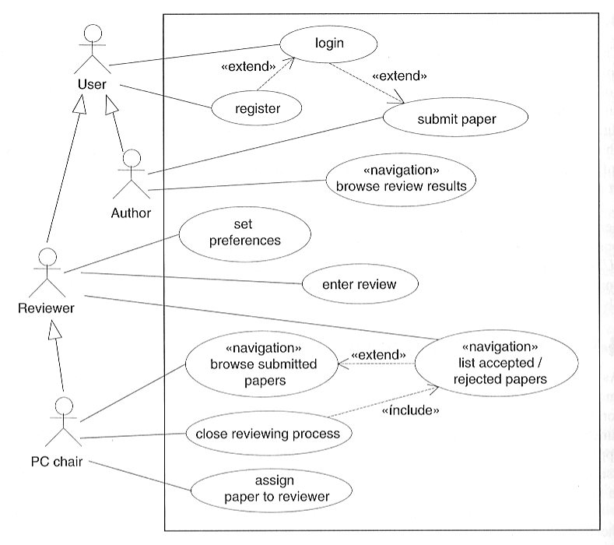
1.1 Class diagram…
Use-case diagram : Conference Paper Submission System
Source: Web Engineering – Kappel et al.

Slide 18
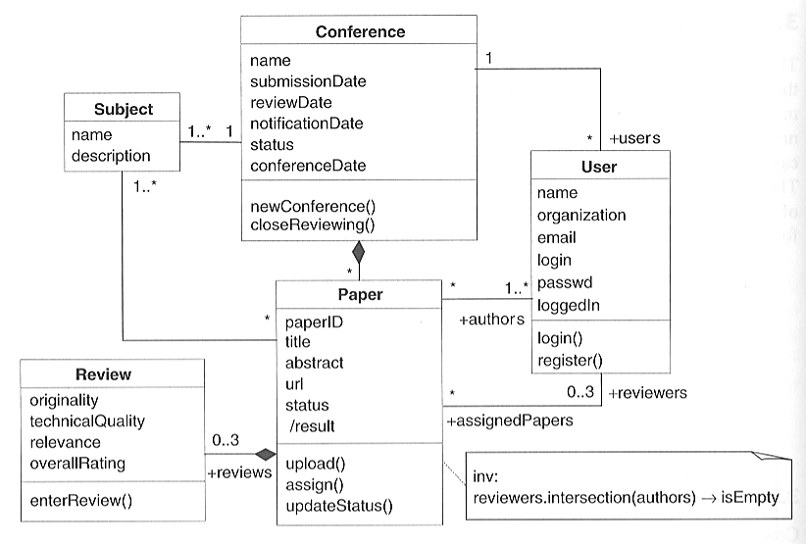
1.1 Class diagram…
Conference Paper Submission System
Source: Web Engineering – Kappel et al.

Slide 19
2. Navigation Modeling
Models how web-pages are linked together
defines the structure of the hypertext
Which classes of the content model can be visited by navigation
Content to navigation
http://uwe.pst.ifi.lmu.de/teachingTutorialNavigation.html

Slide 20
2. Navigation Modeling…
UWE navigation modeling
navigationClass
menu
Index
query
processClass
Processlink
Navigation link
External link

Slide 21
2. Navigation Modeling
Online video sharing:
Home page
video list
search video
upload video
register
login
upload

Slide 22
2. Navigation modeling…
<<navigationClass>>
Video Sharing
<<processlink>>
<<menu>>
mainMenu
<<navigationlink>>
<<query>>
searchVideo
<<navigationLink>>
<<navigationClass>>
uploadVideo
<<processLink>>
<<index>>
videolist
<<processlink>>
<<processlink>>
<<navigationlink>>
<<processClass>>
register
<<processClass>>
login
<<processClass>>
upload
<<processlink>>

Slide 23
3. Presentation Modeling
Purpose: To model the look & feel of the Web application at the page level
The design should aim for simplicity and self-explanation
Describes presentation structure:
Composition & design of each page

Slide 24
3. Presentation Modeling…
Levels:
Presentation Page
page container
Presentation Unit
A fragment of the page logically defined by grouping related elements

Slide 25
3. Presentation Modeling…
Levels:
Presentation Element
A unit’s informational components
Text, images, buttons, fields

Slide 26
3. Presentation Modeling…
<<page>>
User registration page
<<presentationUnit>>
Logo
<<image>>
logo
<<text>>
title
<<presentationUnit>>
<<textinput>>
name
<<textinput>>
email
<<textinput>>
password
<<button>>
submit

Slide 27
Implementing and testing web applications

Slide 28
1. Technologies for web applications
When we have decided the ‘What’ of the web application i.e.
requirements are defined
system architecture is decided
system model and design is ready
We are ready for ‘how’ i.e. to implementation phase

Slide 29
1. Technologies for web applications…
The implementation phase begins with deciding the technologies for development
Technologies for web application development concerns within three ‘views’
request (client)
response (server)
rules for communication between them(protocols)

Slide 30
1.1 client/server communication on the web
Client/server paradigm forms the backbone between the user and the application
This communication model is based on two-layer architecture
How ever the web server integrates additional systems i.e. database server, application server etc.
Several protocols play an important role to guide this communication

Slide 31
1.1 client/server communication on the web
SMTP- simple mail transfer protocol:
SMTP along with POP3(post office protocol) or IMAP (internet message access protocol) allows us to send email
RTSP- real-time streaming protocol:
Designed to facilitate delivery of multimedia data in real time
allows transmission in timely manner instead of whole

Slide 32
1.1 client/server communication on the web
HTTP- hyper text transfer protocol:
Most popular transport protocol for web contents
a text based stateless protocol
controls how resources are accessed
resources are addressed by URL
URL is used with domain name system to find the server where the resource is located

Slide 33
1.1 client/server communication on the web
Session tracking:
Web applications must be able to distinguish requests by multiple simultaneous users
also need to identify request from the same user
The term session is used to define a sequence of HTTP requests between a specific user and the server
Whenever a user sends a request to the server, it identify itself with session id

Slide 34
1.2 Client-side technologies
Helper program and plug-in:
Applications that can add functionality to browsers
When the browser receives a media type included in the helper program or plugin list, the media file is forwarded to external program
Installed by the user

Slide 35
1.2 Client-side technologies
Java applets:
Java applets are programs written in Java that are loaded dynamically into the browser
have controlled access to system resources after checking security policies
Applets are loaded by server and executed in browser within JVM
Can run on all platforms with a JVM

Slide 36
1.2 Client-side technologies
Client side scripting:
Refers to the class of computer programs on the web that are executed at client-side, by the user's web browser
Usually embedded in HTML code
Browser interpret several client side scripting
Used to add dynamic affects in HTML page

Slide 37
1.3 Document specific technologies
HTML- hypertext markup language
HTML describes the element
to mark contents
Hypertext
Defines a large number of tags to denote different semantics

Slide 38
1.4 Server side technologies
URL handlers:
special applications used to process HTTP requests and to deliver a requested resource
Client request for a resource by URL
takes the request and forwards it for execution
result of this execution is then returned to the web server

Slide 39
1.4 Server side technologies…
Server side scripting:
Are executed by the web server when the user requests a document
Usually embedded in HTML code
Server-side scripts require that their language's interpreter be installed on the server

Slide 40
2. Testing web applications
Testing is an activity conducted to evaluate the quality of a product and to improve it by identifying defects and problems
If we run a program with the intent to find errors, then we talk about testing
By testing we determine the quality state of the system
which provides a basis for improvement

Slide 41
2. Testing web applications…
We say that an error is present if the actual result from a test run does not comply with the expected result
each deviation from the requirements definition is an error

Slide 42
2. Testing web applications…
Objectives:
Finding error instead of showing their absence (defect testing)
if no error is found it does not mean that there is no error
a test run is successful if errors are detected
To demonstrate to the developer and the customer that the software meets its requirements (validation testing)

Slide 43
2. Testing web applications…
Testing Levels:
Unit tests: test the smallest testable units (Web pages, etc.), independently of one another
Unit testing is done by the developer during implementation

Slide 44
2. Testing web applications…
Testing Levels:
Integration tests: evaluate the interaction between distinct and separately tested units once they have been integrated
Integration tests are performed by a tester, a developer, or both jointly

Slide 45
2. Testing web applications…
Testing Levels:
System tests: test the complete, integrated system
System tests are typically performed by a specialized test team

Slide 46
2. Testing web applications…
Testing Levels:
Acceptance tests: evaluate the system in cooperation with the client
Acceptance tests use real conditions and real data
The client will test it, in their place, in a near-real-time or simulated environment.
Beta tests: let users work with early versions of a product with the goal to provide early feedback

Slide 47
2. Testing web applications…
Web application testing:
Link testing
Browser testing
Usability testing
Load, stress and continuous testing
Security testing
Content testing

Slide 48
2. Testing web applications…
Link testing:
Goals:
broken links (linked document does not exist)
orphan pages (page does not link any other page)
Strategy:
All links are systematically visited

Slide 49
2. Testing web applications…
Browser testing:
Goals:
Try to find errors in web application due to incompatibilities between different Web browsers
Strategy:
Test application on all popular combinations (browser, version, operating system)

Slide 50
2. Testing web applications…
Usability testing:
Goals:
Evaluate ease-of-use, lay-out and navigation structure
Strategy:
By a set of representative users
By one or more HCI specialists

Slide 51
2. Testing web applications…
Load testing:
Goals:
system meets response time requirements
Strategy:
Identify load profile
Identify response time
Perform the test

Slide 52
2. Testing web applications…
Stress testing:
Goals:
system reaches the required response times and the required throughput under stress
Continuous testing:
Goals:
Testing system behavior over a period of time

Slide 53
2. Testing web applications…
Security testing:
Goals:
Regulate access to information, to verify user identities, and to encrypt confidential information
Strategy:
A systematic test scheme

Slide 54
2. Testing web applications…
Content testing:
Goals:
Test the quality of contents
Strategy:
Proofreading

Slide 55
2. Testing web applications…
Challenges in web testing:
Content testing requires costly manual measures
Usability is difficult to measure
Divers platforms (devices, operating environment)
Globality (understanding cultural differences)
Dominance of change makes is more challenging

Slide 56
Summary
Content modeling
class diagram
state machine diagram
Navigation modeling
Presentation modeling

Slide 57
Summary
Technologies for web development
Protocol
client-side technologies
server-side technologies
Testing web applications
Objectives
Levels
Web application specifics
challenges

Slide 58
THANK YOU

