Slide 1


Slide 2
Web Technologies and Programming
Lecture 06
Modeling web applications

Slide 3
Introduction to HTML

Slide 4
Summary of Previous Lecture
Software system architecture
Specifics of web application architecture
Layered web architecture
2-layered architecture
3-layered architecture
N-layered architecture

Slide 5
Outline
Introduction to HTML
Basic Structure of a HTML page
Text formatting tags in HTML
Lists in HTML

Slide 6
1. Introduction to HTML…
HTML – Hyper-Text Markup Language – The Language of Web Pages on the World Wide Web
Hypertext:
Allows for non-linear linking to other documents
Markup Language:
Content is “marked up” or tagged to tell the browser how to display it

Slide 7
1. Introduction to HTML…
It is called markup language because it contains a set of markup tags
HTML is a text formatting language
HTML standards are developed under the authority of the World Wide Web Consortium (W3C), headed by Tim Lee
http://www.w3c.org

Slide 8
1. Introduction to HTML…
It defines the structure of webpages and determines how data is displayed online
It has a set of special instructions that can be added in the text to add formatting and linking information
It is directly interpreted by the browser
HTML is described by different HTML tags
Each HTML tag describes different document content

Slide 9
1. Introduction to HTML…
HTML was created in 1991 by Tim Berners-Lee at CERN in Switzerland
It was designed to allow scientists to display and share their research
1995- HTML 2
lots of browsers had added their own bits to HTML
Dan Connolly and colleagues collected all the HTML tags that were widely used and collated them into a draft document

Slide 10
1. Introduction to HTML…
1997- HTML 3.2
It was the first version developed and standardized exclusively by the W3C
HTML 3.2 included the support for applets, text flow around images, subscripts and superscripts etc
1999 – HTML 4.1
extends HTML with mechanisms for style sheets, scripting, frames etc.
HTML5

Slide 11
1. Introduction to HTML…
HTML Tags:
Tags are instruction that are directly embedded into the text of the document
Is a signal to a browser to do something before just throwing text on the screen
Begin with open angle bracket < and ends with close angle bracket >
For example <HTML>

Slide 12
1. Introduction to HTML…
HTML Tags:
HTML tags normally come in pairs like <p> and </p>
The first tag in a pair is the start tag, the second tag is the end tag
The end tag is written like the start tag, but with a slash before the tag name
Paired Tags : <HTML> </HTML>
Singular Tags: <BR>

Slide 13
1. Introduction to HTML…
HTML is not case-sensitive
Blank and new lines are ignored
Comment can be added as
<!-- comments -- >
HTML files have .html extension

Slide 14
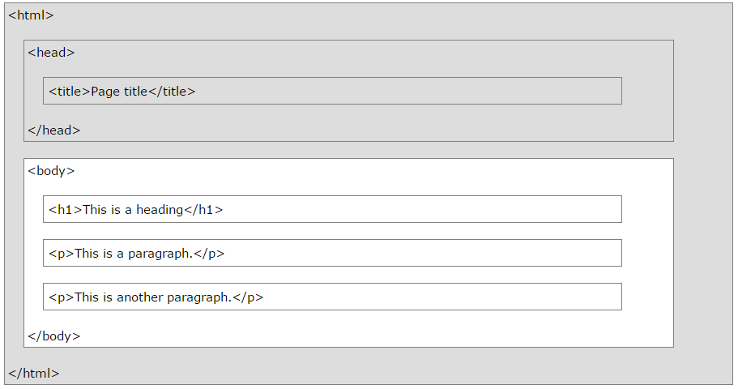
2. Structure of HTML Page

Slide 15
2. Structure of HTML Page
The entire web page is enclosed within <HTML> and </HTML>
Within these tags two distinct sections are created head and body
Head: <HEAD>
<TITLE> …… </TITLE>
</HEAD>
<TITLE> shows the title of the webpage

Slide 16
2. Structure of HTML Page
. Body: indicate the start and end of main body of textual information
<BODY>
</BODY>
Body is the part of html page which is displayed by web browser.

Slide 17
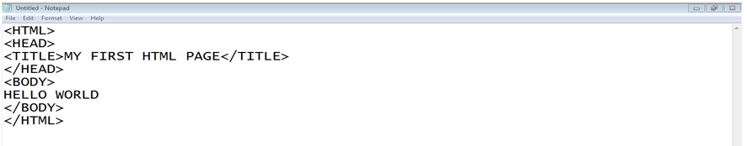
2. Structure of HTML Page…
Example - First HTML page:

Slide 18
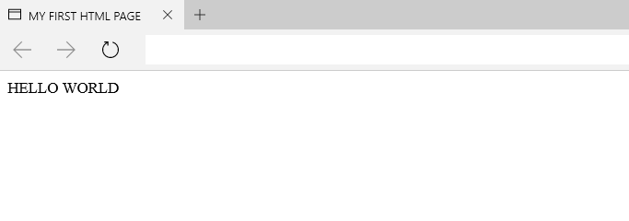
2. Structure of HTML Page…
Example Output- First HTML page:

Slide 19
2. Structure of HTML Page
<!DOCTYPE> Declaration
The <!DOCTYPE> declaration helps the browser to display a web page correctly depending on doctype.
To display a document correctly, the browser must know both type and version.
The doctype declaration is not case sensitive.

Slide 20
2. Structure of HTML Page
Common DOCTYPE Declaration
HTML5
<!DOCTYPE html>
HTML 4.01
<!DOCTYPE HTML PUBLIC "-//W3C//DTD HTML 4.01 Transitional//EN" "http://www.w3.org/TR/html4/loose.dtd">
XHTML 1.0
<!DOCTYPE html PUBLIC "-//W3C//DTD XHTML 1.0 Transitional//EN" "http://www.w3.org/TR/xhtml1/DTD/xhtml1-transitional.dtd">

Slide 21
3. The BODY Tag
Attributes:
BGCOLOR: Change the background color
BACKGROUND: Place an image at background
TEXT: Change the color of the body text
Example:
<BODY BGCOLOR=123345 TEXT=Red>
<BODY BACKGROUND=“img.jpg” TEXT=Red>

Slide 22
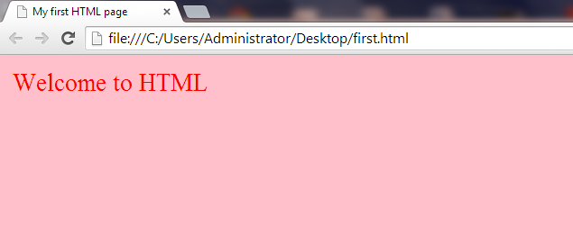
3. The BODY Tag
Contents of the body
Text=“red”
bgcolor=“pink”

Slide 23
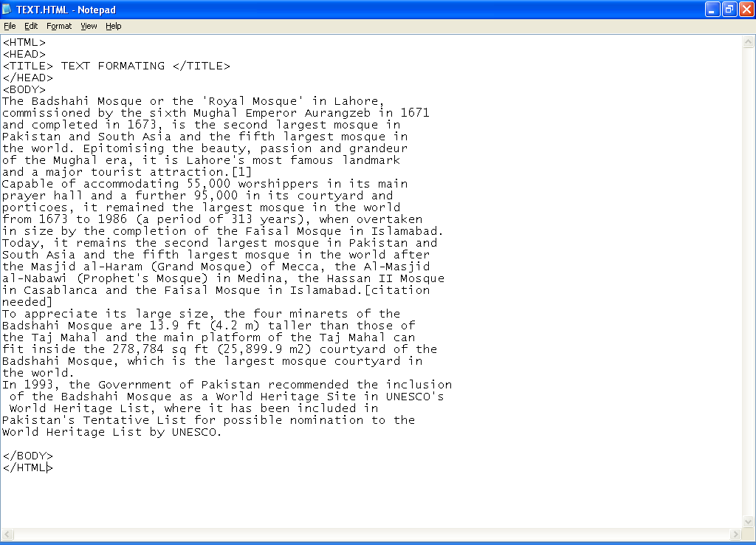
4. Formatting text

Slide 24
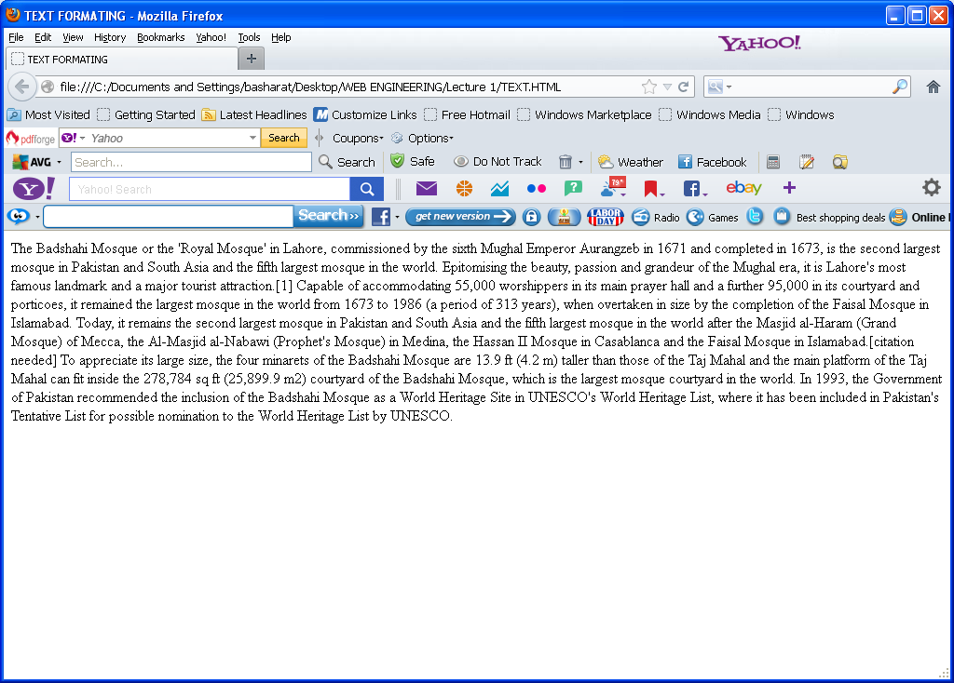
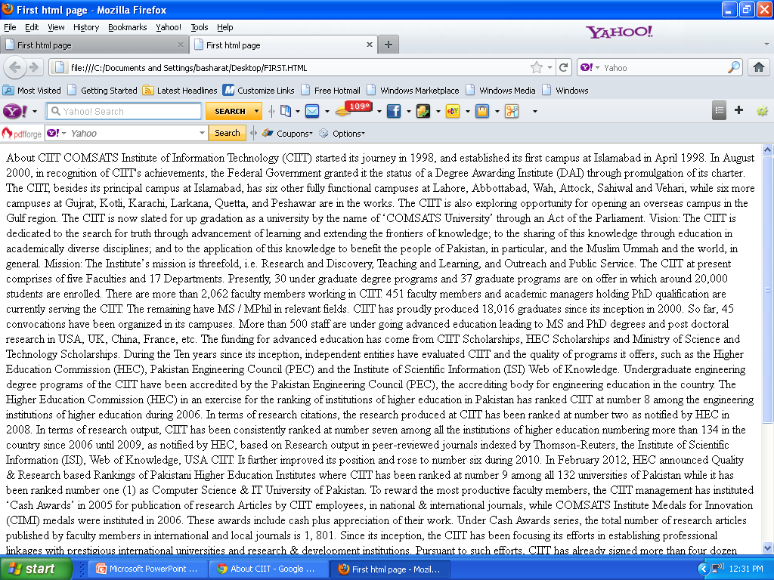
Formatting Text…...

Slide 25
4. Formatting text…
<P>….. </p>: starts a new paragraph
Attributes of paragraph (values)
Align (left, right, center and justify)
<BR>: gives an one line break. After this, tag start from next line
Text Styles:
<B> …. </B> , <I> …. </I>, <U> …. </U>
<HR>: draws horizontal line
Attibutes
ALIGN (LEFT,CENTER,RIGHT)
SIZE=2
WIDTH=100%
color

Slide 26
4. Formatting text…
Headings (6 sizes)
<H1> ….. </H1>
<H2> ….. </H2>
<H3> ….. </H3>
<H4> ….. </H4>
<H5> ….. </H5>
<H6> ….. </H6>

Slide 27
4. Formatting text…
<CENTER>….</CENTER>
<FONT>……</FONT>
FONTFACE: Sets the specified font name
SIZE: Size of the text (between 1 and 7)
COLOR: Set the color of the text
Example:
<FONT FONTFACE=“COMIC SANS MS” SIZE=6 COLOR=RED> Welcome</FONT>

Slide 28




4. Formatting text…
<pre>…… </pre>:
Spaces and line breaks are supported
Text is displayed in mono-spaced format
Text is shown in same format as written in editor
Without <pre>… </pre>
With <pre>… </pre>

Slide 29
4. Formatting text…
<Strike>……</Strike>:
DEL is also used in modern browsers
<SUB>……</SUB>:
<SUP>……</SUP>:

Slide 30
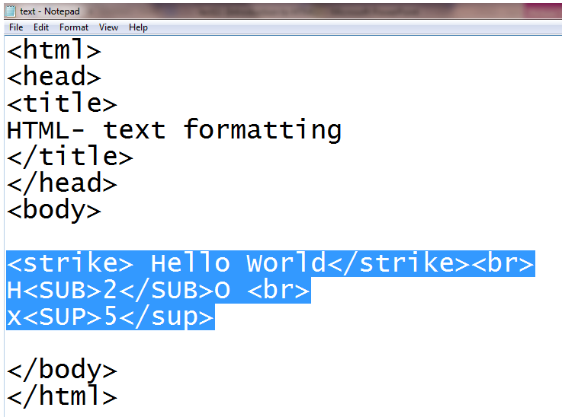
4. Formatting text…

Slide 31
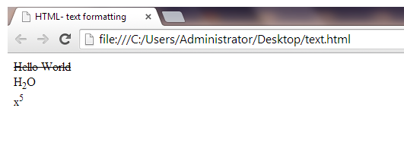
4. Formatting text…

Slide 32
4. Formatting text…
Special Characters:
Non-breaking space: &nbsp;
Copyright: &copy; ©
Registration mark: &reg; ®
Fraction one qtr: &frac14; ¼
Greater-than sign: &gt; >
Less-than sign: &lt; <
Trademark sign: &trade; ™

Slide 33
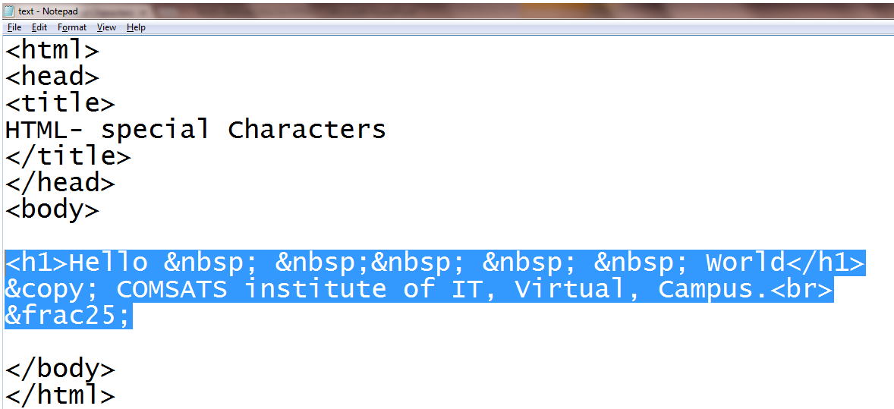
4. Formatting text…

Slide 34
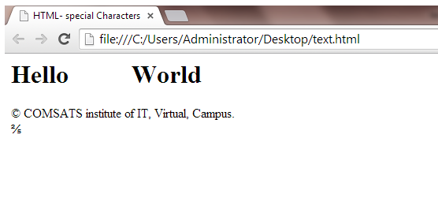
4. Formatting text…

Slide 35
5. Lists in HTML
Two type of list
Un-ordered Lists:
Starting Tag <UL>, Ending Tag </UL>
List Items <LI>
Type (FILLROUND, SQUARE)
Ordered Lists:
Starting Tag <OL>, Ending Tag </OL>
List Items <LI>
Type (“1”, “A”, ‘”a”, ”I”, ”i”)
Start (Alerts the numbering Sequence)
Value (Changes the number sequence in the middle of an ordered list)

Slide 36
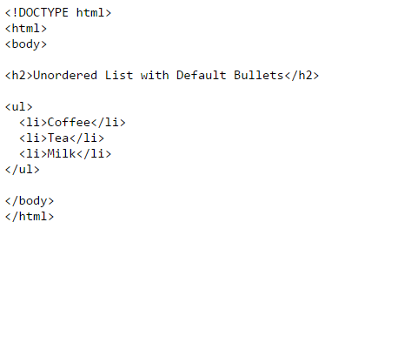
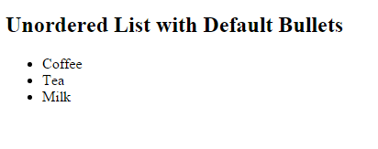
5. Lists in HTML
Un-ordered Lists Example:

Slide 37
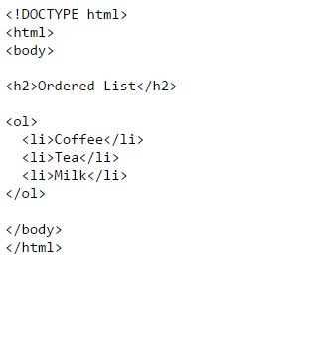
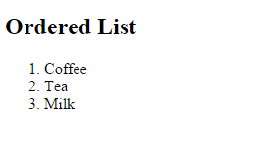
5. Lists in HTML
Ordered Lists Example:

Slide 38
5. Lists in HTML…
Definition Lists:
Starting Tag<DL>
Ending Tag </DL>
Definition Term <DT>
Definition Description <DD>

Slide 39
5. Lists in HTML…
Differences Between HTML 4.01 and HTML5
In HTML 4.01, the <dl> tag defines a definition list.
In HTML 5, the <dl> tag defines a description list.

Slide 40
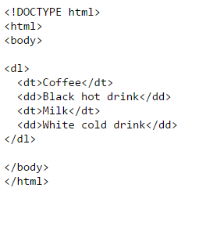
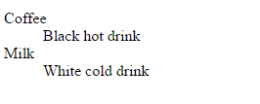
5. Lists in HTML…
Definition Lists Example:

Slide 41
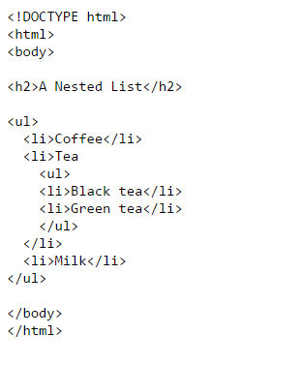
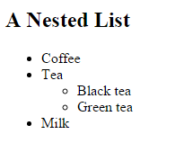
5. Lists in HTML…
Nested List:
We can nest multiple list to make sub-lists

Slide 42
5. Lists in HTML…
Nested List:
We can nest multiple list to make sub-list

Slide 43
Summary
What is HTML?
Basic Structure of HTML page
Body tag attributes
Text formatting tags
Lists

Slide 44
THANK YOU

