Slide 1


Slide 2
Web Technologies and Programming
Lecture 07
Modeling web applications

Slide 3
HTML Links and navigation

Slide 4
Summary of Previous Lecture
What is HTML?
Basic Structure of HTML page
Body tag attributes
Text formatting tags
Lists

Slide 5
Outline
How to link between pages of your site (internal links)
How to link to other sites (external)
How to structure the folders on your web site
Internal document references
Link attributes
Other Type of links

Slide 6
1. HTML links
HTML links are hyperlinks.
A hyperlink is a text or an image you can click on, and jump to another document.

Slide 7
1. HTML links
HTML Links - Syntax
In HTML, links are defined with the <a> tag:
<a href="url">link text</a>
The href attribute specifies the destination address .
The link text is the visible part

Slide 8
1. HTML links
HTML Links – Example
<a href="http://www.w3schools.com/html/">Visit our HTML tutorial</a>

Slide 9
1. HTML links
The crux of HTML is its capability to reference countless other pieces of information easily on the internet
A hyperlink is a text or an image you can click on, and jump to another document.
In HTML, links are defined with the <a></a> tag

Slide 10
1. HTML links - Colors
When you move the mouse over a link, two things will normally happen:
The mouse arrow will turn into a little hand
The color of the link element will change

Slide 11
1. HTML links
By default, links will appear as follows in all browsers:
An unvisited link is underlined and blue
A visited link is underlined and purple
An active link is underlined and red

Slide 12
1. HTML links
For visited link
<body vlink=“red”>
For active link
<body alink=“pink">
For color of link
<body link=“ebl">

Slide 13
1. HTML links
Example
<style> a:link {color:green; background-color:transparent; text-decoration:none} a:visited {color:pink; background-color:transparent; text-decoration:none} a:hover {color:red; background-color:transparent; text-decoration:underline} a:active color:yellow; background-color:transparent; text-decoration:underline} </style>

Slide 14
1. HTML links
When you link to another page in your own web site, the link is known as an internal link
When you link to a different site, it is known as an external link
Some other form of links are also discuss in this lecture.

Slide 15
1.1 Internal links
Anything between the opening <a> tag and the closing </a> tag becomes part of the link that users can click in a browser
A Local link uses a page name (including sub-directories if needed) as the target. It is “local” to the current server.

Slide 16
1.1 Internal links…
Href
href attribute specifies the URL of the page the link goes to.
If the href attribute is not present, the <a> tag is not a hyperlink.

Slide 17
1.1 Internal links…
Href
URL used in Href can be
The URL of the link. Possible values:
An absolute URL (external)
points to another web site (like href="http://www.example.com/default.htm")
A relative URL (local) –
points to a file within a web site (like href="default.html")

Slide 18
1.1 Internal links…
Href
URL used in Href can be
Link to an element with a specified id within the page (like href="#top")
A script (like href="javascript:alert('Hello');")

Slide 19
1.1 Internal links…
To link another page, href attribute of opening tag of <a> is used
the value of the href attribute is the name of the file you are linking to
For example:
<a href=“abc.html”> Click here </a>

Slide 20
1.1 Internal links…
The A stands for Anchor.
The anchor tag tells the browser to anchor or to attach to something else. Every Anchor tag must have a closing or end tag (</A>) to signal the end of the anchor.
HREF stands for Hypertext REFerence. It means that “this is where the link is going to.

Slide 21
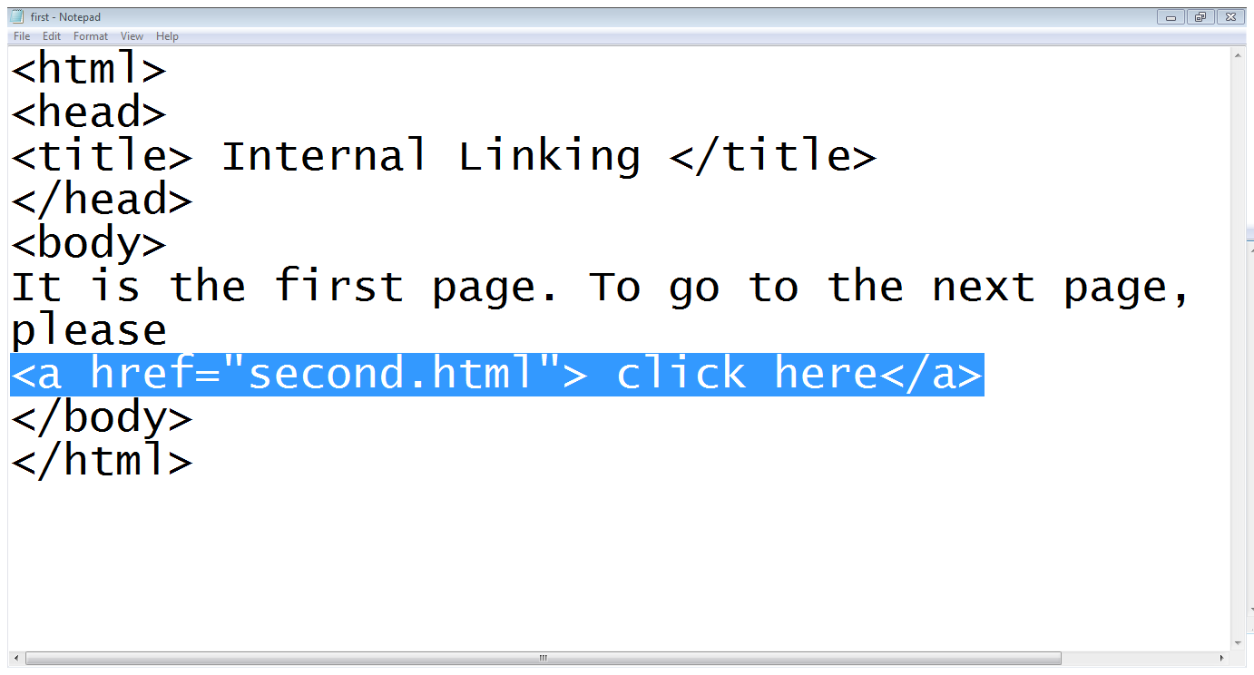
1.1 Internal links…

Slide 22
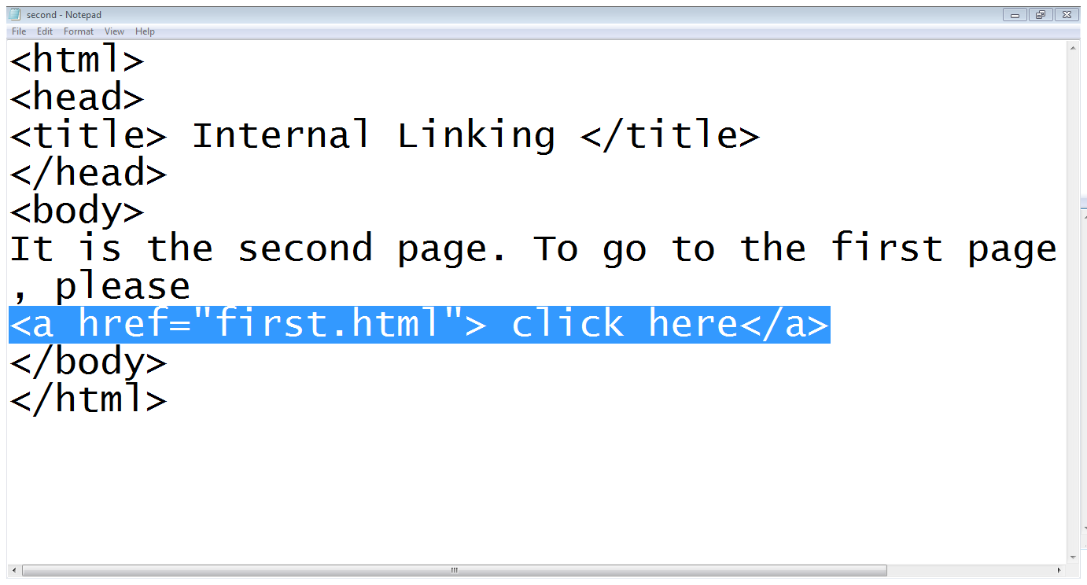
1.1 Internal links…

Slide 23
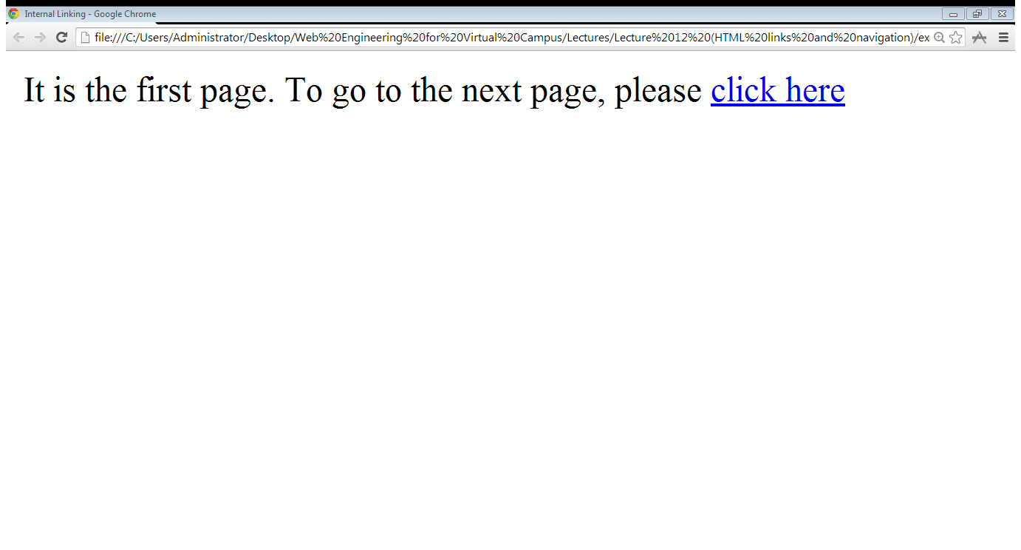
1.1 Internal links…

Slide 24
1.2 External links
To link the page of another website, again the href attribute of opening tag of <a> is used
the value of the href attribute is the full web address for the page you want to link to rather than just the filename
<a href="https://www.google.com.pk"> Click here </a>

Slide 25
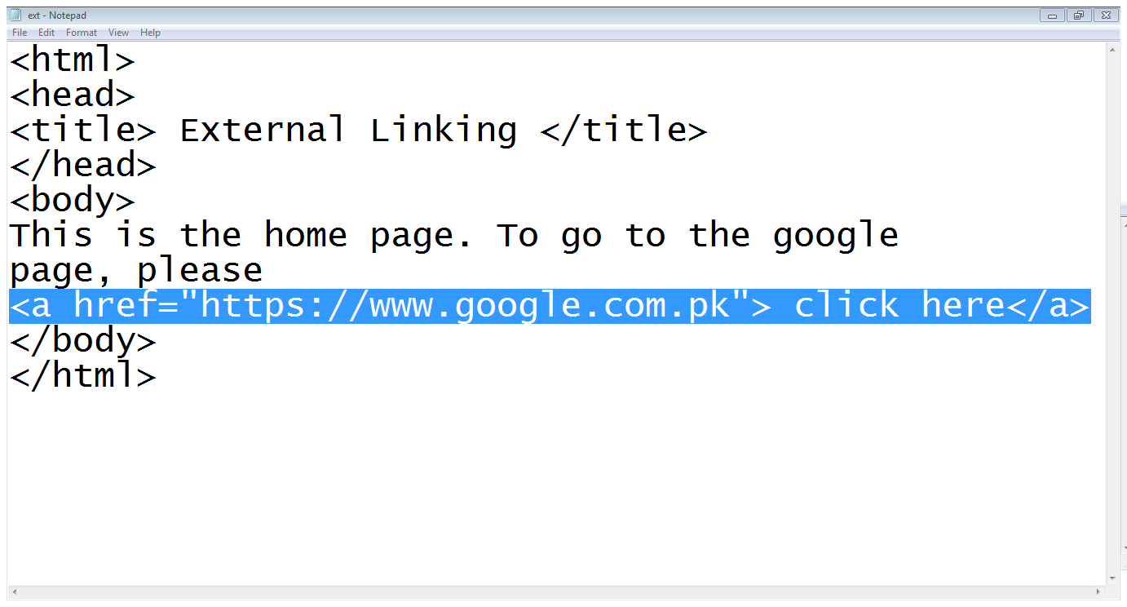
1.2 External links …

Slide 26
2. Directory Structures
A directory is simply another name for a folder on a web site
The root directory (or root folder) is the main directory that holds the whole of your web site
A subdirectory is a directory that is within another directory
A parent directory is a directory that contains another directory

Slide 27
2. Directory Structures…
Entertainment
index.html
Songs
audio.html
video.html
Videos
videos.html
Films
englishfilms.html
urdufilms.html

Slide 28
2.1 Referencing a web page
Same Directory: When you want to link to, or include, a resource from the same directory, you can just use the name of that file
Subdirectory:
sub-directory/…/file-name
Parent directory:
../file-name

Slide 29
2.1 Referencing a web page…
Entertainment
index.html
<a href=“englishfilms.html”>…..</a>
<a href=“Videos/Films/englishfilms.html”>….</a>
<a href=“../../Songs/audio.html”>….</a>
Songs
audio.html
video.html
Videos
videos.html
Films
englishfilms.html
urdufilms.html

Slide 30
3. Internal document references
Also be called page jump, u can make this jump with two simple steps
Step 1
Assign a name to the link you want to reference
E.g. <A NAME=”your bookmark name“></A>

Slide 31
3. Internal document references
Step 2
add a link in anyplace in your page to let the user move to your bookmark point from it
E.g. <A HREF=”# your bookmark name “> Add the text to be displayed and clicked by the user</A>

Slide 32
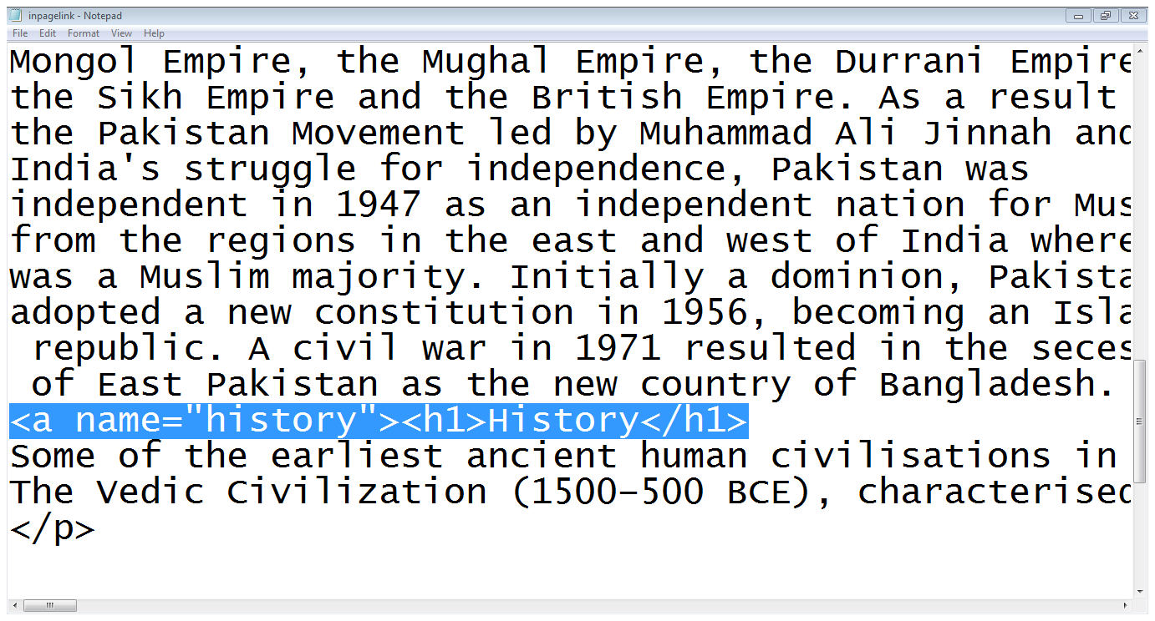
3. Internal document references

Slide 33
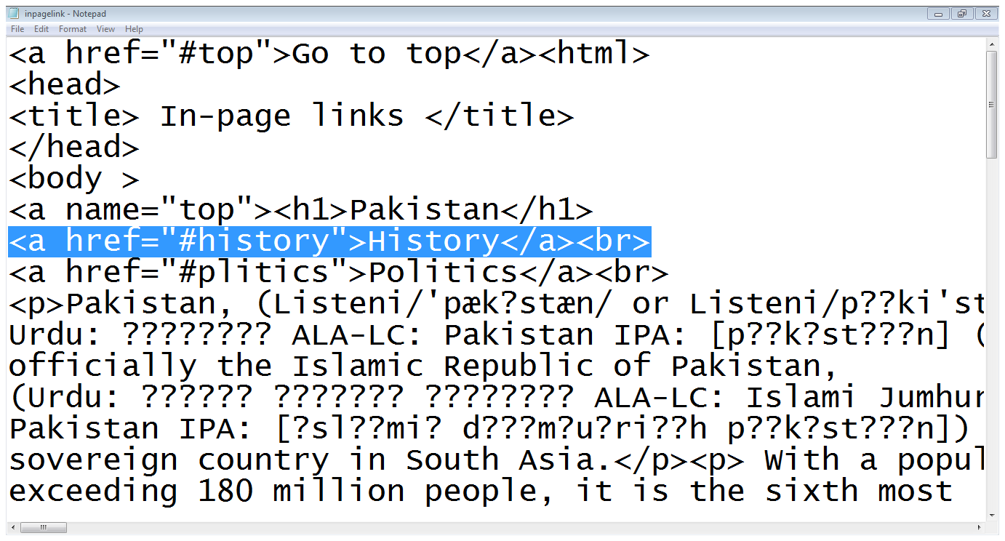
3. Internal document references

Slide 34
4. Referencing another page at specific location
Referring other pages also involves 2 steps
Step 1: Assign a name to the link
e.g.
<a name=“location-name”>
Step 2: Link to that page
<a href=“pagename#location-name”>….</a>

Slide 35
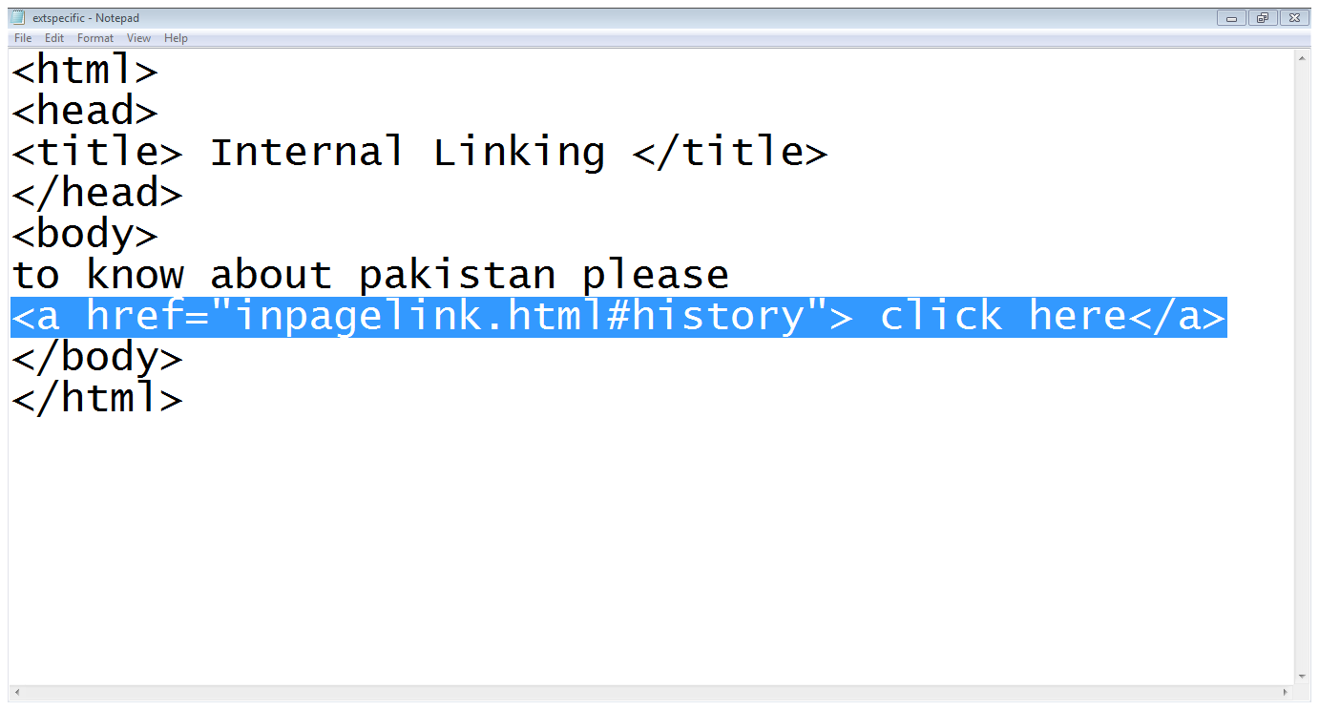
4. Referencing another page at specific location

Slide 36
4. Referencing another page at specific location

Slide 37
5. More attribute for <a>
target:
The target attribute specifies where to open the linked document.
This example will open the linked document in a new browser window or in a new tab:
<a href=“abc.html” target=“_blank”>….</a>

Slide 38
5. More attribute for <a>
target:
Other values of target are:
_blank | Opens the linked document in a new window or tab
_self | Opens the linked document in the same frame as it was clicked (this is default)
_parent | Opens the linked document in the parent frame
_top | Opens the linked document in the full body of the window
framename | Opens the linked document in a named frame

Slide 39
5. More attribute for <a>
accesskey:
To access the link
<a href=“abc.html” accesskey=“a”>…..</a>
tabindex:
Which index shall be selected
<a href=“abc.html” tabindex=“1”>….</a>
title:
Show title of link
<a href=“abc.html” title=“it,s a link”>….</a>

Slide 40
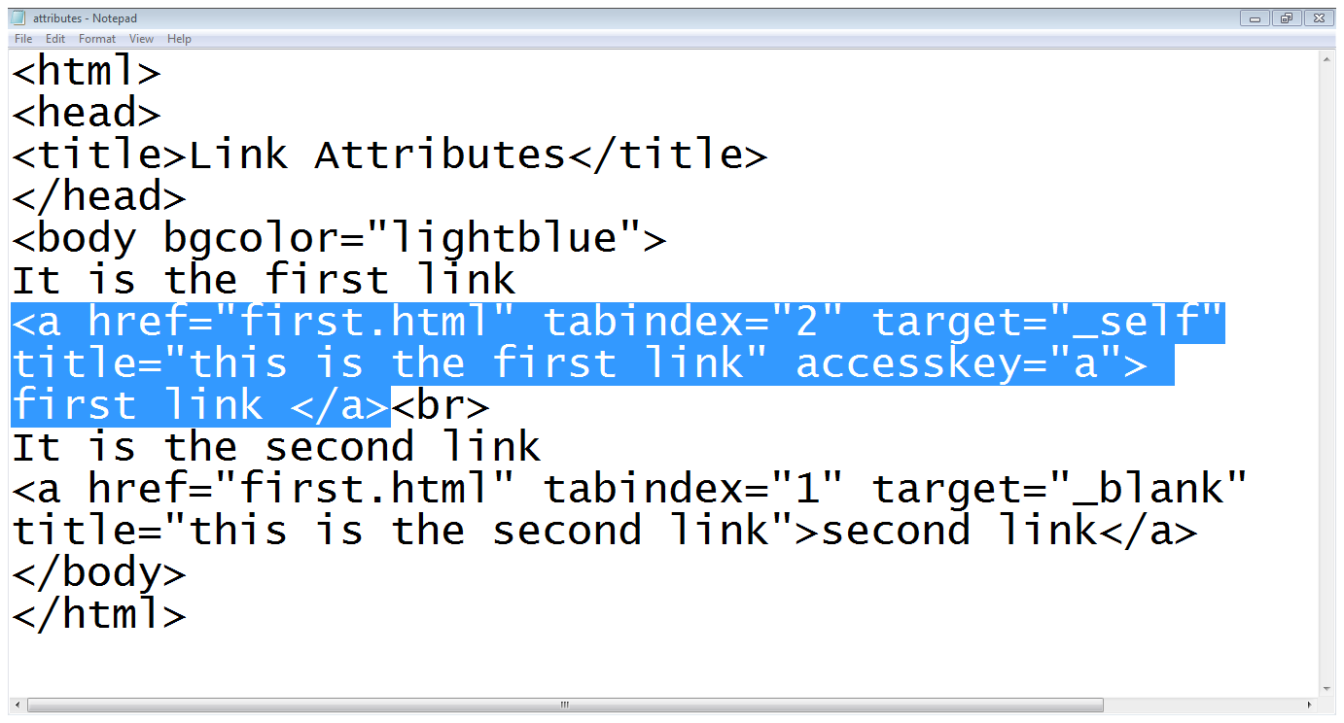
5. More attribute for <a>…

Slide 41
Other type of links
Download Link
The download attribute specifies that the target will be downloaded when a user clicks on the hyperlink.
This attribute is only used if the href attribute is set.
There are no restrictions on allowed values

Slide 42
Other type of links
Download Link
This link is not supported in Internet explorer and Safari browser
E.g.
<a href="/images/myw3schoolsimage.jpg" download>
It can also be written as
<a download="filename">

Slide 43
Other type of links
Mailto:
Is used to send email
E.g.
<a href="mailto:webmaster@example.com">Jon Doe</a>

Slide 44
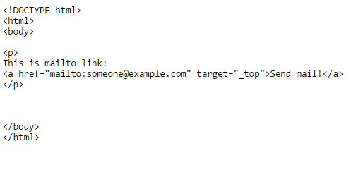

Other type of links
Mailto Example:

Slide 45
Summary
Use the HTML <a> element to define a link
Use the HTML href attribute to define the link address
Use the HTML target attribute to define where to open the linked document
Use the HTML <img> element (inside <a>) to use an image as a link

Slide 46
Summary
Internal links
External links
Directory Structure
Internal document reference
Some attributes of <a>
Other types of links

Slide 47
THANK YOU

