Slide 1


Slide 2
Web Technologies and Programming
Lecture 08

Slide 3
Adding Image, audio and video files to web pages

Slide 4
Summary of the previous lecture
Internal links
External links
Directory Structure
Internal document reference
Some attributes of <a>
Other type of links

Slide 5
Outline
Adding images to web pages
Using images as links
Image map
Adding video to web pages
Adding audio to web pages

Slide 6
1. Adding images to web pages
<img> tag is used to add images to web pages
SRC attribute of the <img> tag is used to indicate the source of the image
The <img> tag is empty, it contains attributes only, and does not have a closing tag.

Slide 7
1. Adding images to web pages
Images can be added as follows
We can add an image by
<img src=“image-name”>
<img src=“abc.jpg”>

Slide 8
1. Adding images to web pages
HTML Images Syntax
In HTML, images are defined with the <img> tag.
The <img> tag is empty, it contains attributes only, and does not have a closing tag.
The src attribute specifies the URL (web address) of the image:
<img src="url" alt="some_text">

Slide 9
1. Adding images to web pages
The alt Attribute
The alt attribute specifies an alternate text for an image, if the image cannot be displayed.
The alt attribute provides alternative information for an image if a user for some reason cannot view it (because of slow connection, an error in the src attribute, or if the user uses a screen reader).
If a browser cannot find an image, it will display the alt text

Slide 10
1. Adding images to web pages
Images can be added as follows
IMG stands for "image." It announces to the browser that an image will go here on the page.
SRC stands for "source." This again is an attribute. It's telling the browser where to go to find the image.

Slide 11
1. Adding images to web pages
Images supported by web
.jpg
.gif
.png
.jpeg
.bmp

Slide 12
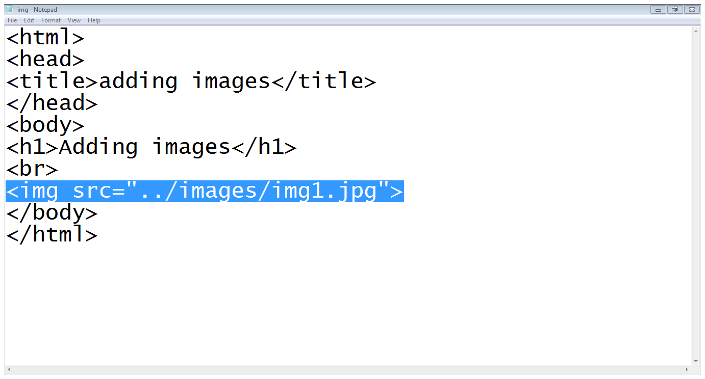
1. Adding images to web pages...
Image path and name
Root Directory
examples
images
ex.html
img1.jpg
Image tag
Src attribute

Slide 13
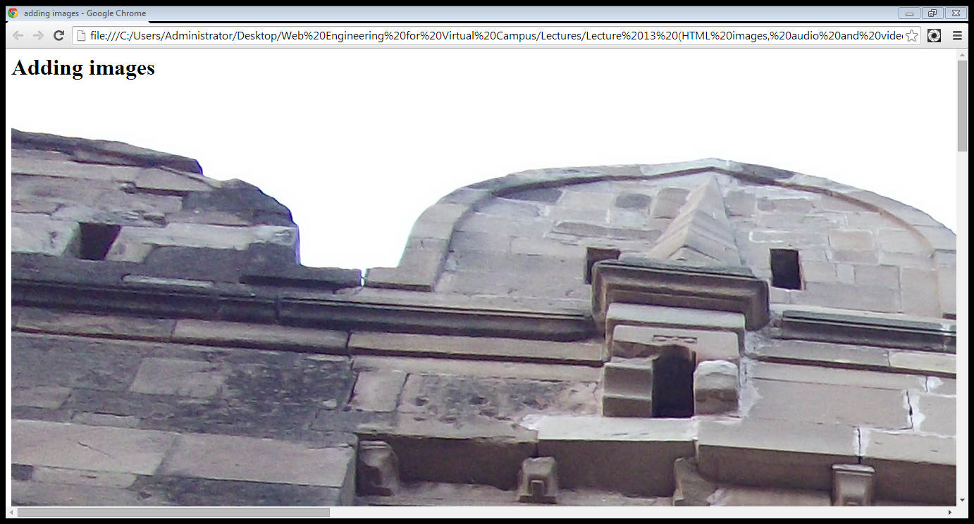
1. Adding images to web pages...

Slide 14
1.1 Attributes of <img> tag
Height and width:
You can use the style attribute to specify the width and height of an image.
The values are specified in pixels (use px after the value):
Specifies the height and width of an image
<img src=“image-name” height=“100” width=“100”>

Slide 15
1.1 Attributes of <img> tag
Alt attribute:
Shows alternate text when an image is not available
<img src=“image-name” alt=“image description”>

Slide 16
1.1 Attributes of <img> tag
Align attribute:
Align the image as desired
<img src=“image-name” align=“left”>

Slide 17
1.1 Attributes of <img> tag
Align attribute:
Some values for aligned are
Value | Description
left | Align the image to the left
right | Align the image to the right
middle | Align the image in the middle
top | Align the image at the top
bottom | Align the image at the bottom

Slide 18
1.1 Images in Another Folder
If not specified, the browser expects to find the image in the same folder as the web page.
However, it is common to store images in a sub-folder. You must then include the folder name in the src attribute:
Example
<img src="/images/html5.gif" alt="HTML5 Icon“>

Slide 19
1.1 Animated Images
The GIF standard allows animated images:
Example
<img src="programming.gif" alt="Computer Man“ >

Slide 20
1.1 Attributes of <img> tag …
Border attribute:
Add border around the image
<img src=“image-name” border=“2”>

Slide 21
1.1 Attributes of <img> tag …
Differences Between HTML 4.01 and HTML5
The following attributes: align, border, hspace, and vspace are not supported in HTML5.

Slide 22
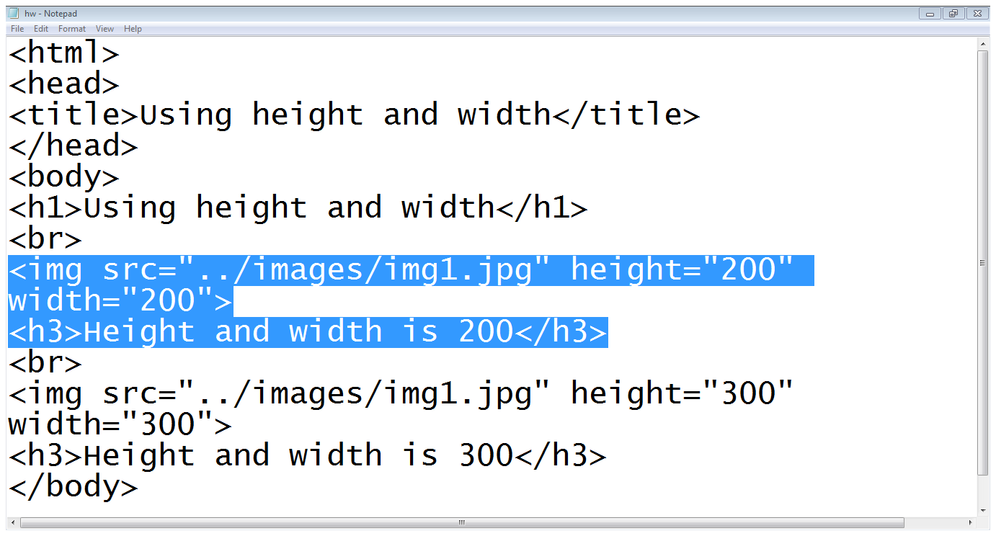
1.1 Attributes of <img> tag …

Slide 23
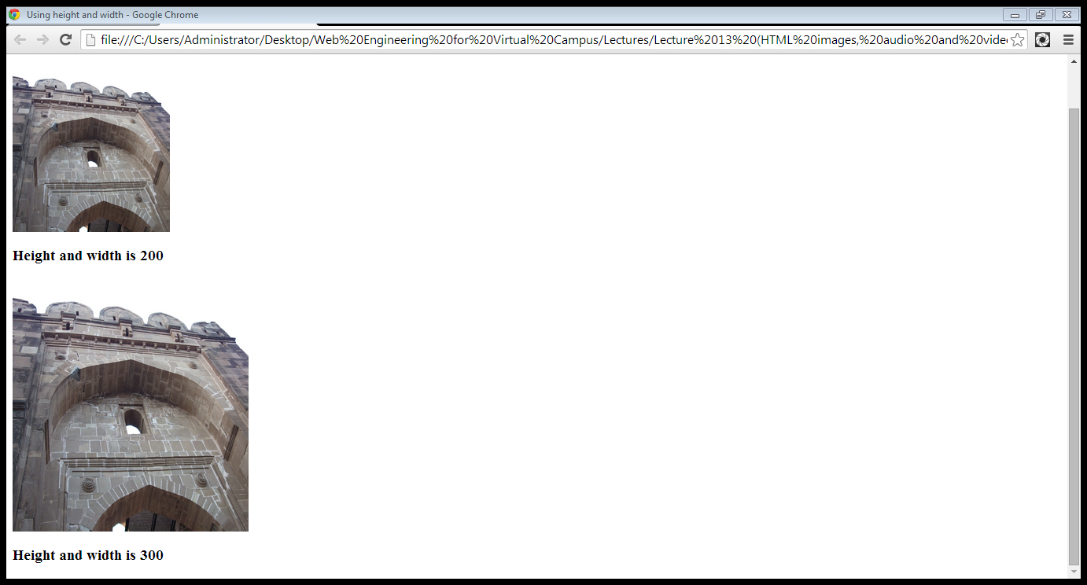
1.1 Attributes of <img> tag …

Slide 24
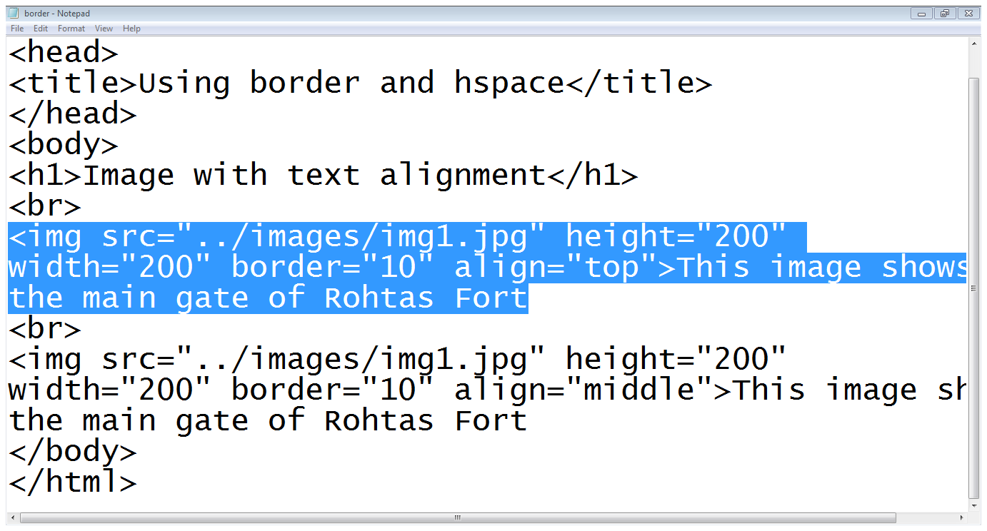
1.1 Attributes of <img> tag …

Slide 25
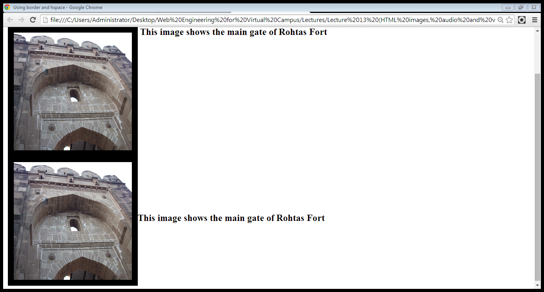
1.1 Attributes of <img> tag …
Align top
Align middle

Slide 26
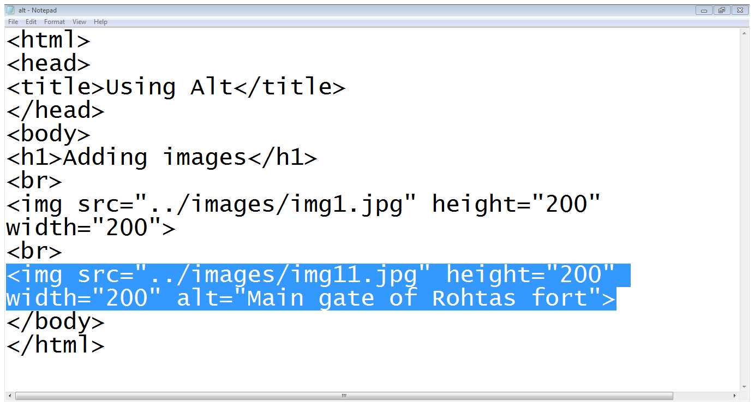
1.1 Attributes of <img> tag …
Wrong image name

Slide 27
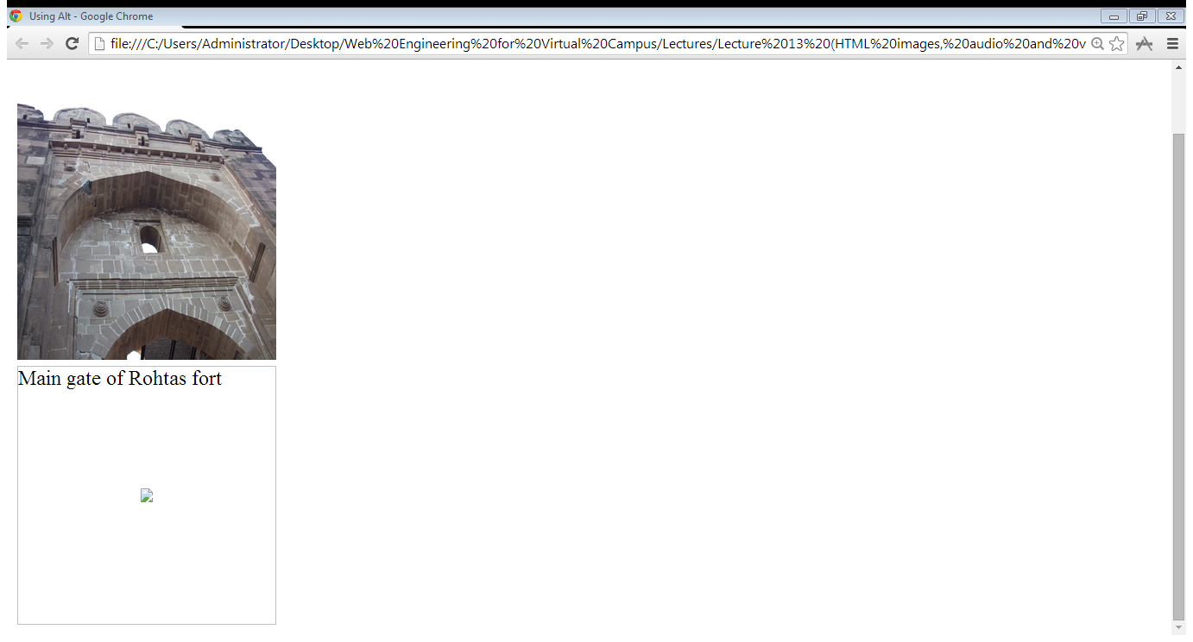
1.1 Attributes of <img> tag …
Image is found
Image not found

Slide 28
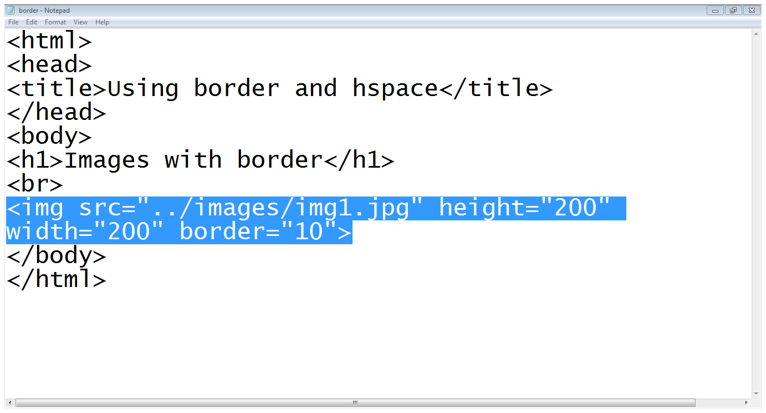
1.1 Attributes of <img> tag …

Slide 29
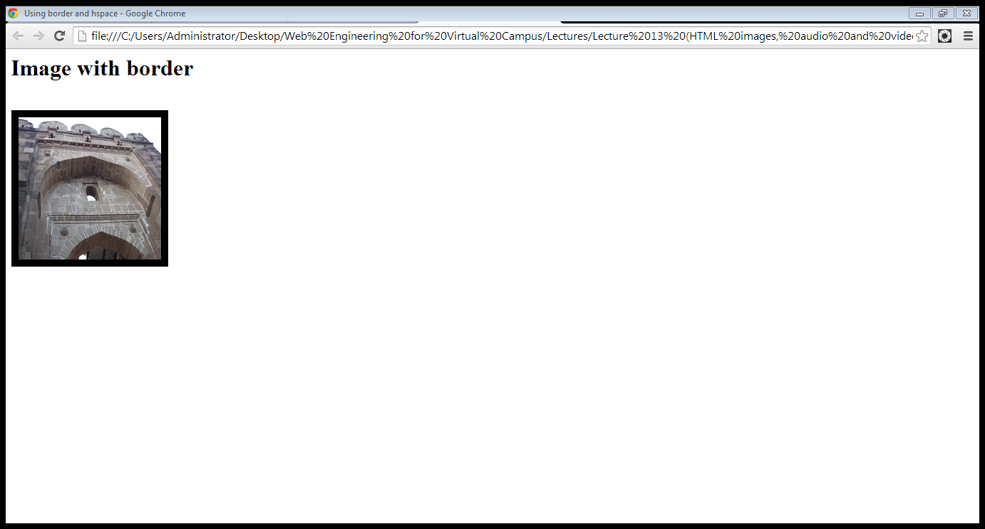
1.1 Attributes of <img> tag …

Slide 30
2. Using images for linking
We can put images between <a> and </a > tags instead of text to link other documents or portions of the page
<a href=“page-reference”> <img src=“image-srource”></a>
<a href=“abc.html”> <img src=“img.jpg”></a>

Slide 31
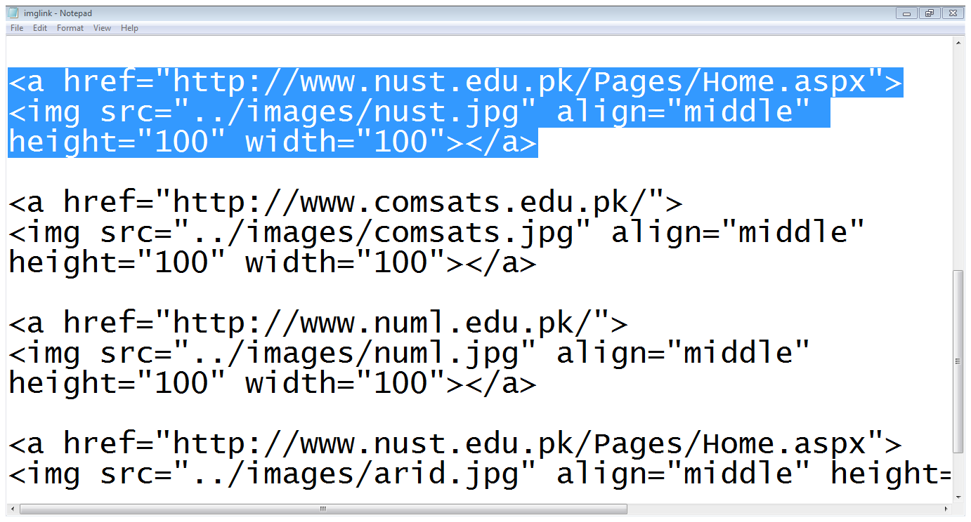
2. Using images for linking…
Link
Image

Slide 32
3. Image maps
Image maps allow you to add multiple links to the same image
Each link can point to a different page
Each of these clickable areas is known as a hotspot

Slide 33
3. Image maps…
Defining a map:
Step1 (Define a map):
<map name=“map name”>
<area shape=“link-shape” coords=“coordinates of link area” href=“page-reference”>
</map>

Slide 34
3. Image maps…
Defining a map:
Area can contain following values
Rect
Circle
coord

Slide 35
3. Image maps…
Defining a map:
Step2(using the map):
Applying map on an image
<img src=“image-title” usermap=“#map-name”>

Slide 36
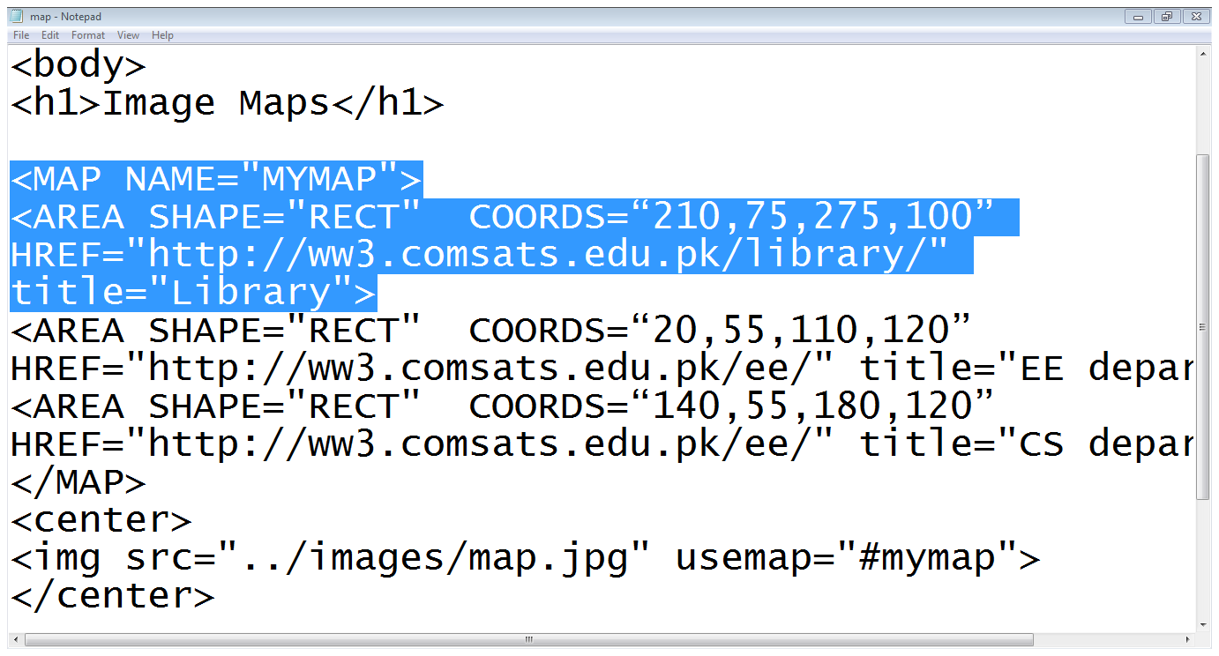
3. Image maps…
Map name
Shape
Coordinates
Map
Area tag
Link
End of Map
Using a map
Adding an Image

Slide 37
4. Adding videos to web pages
The <video> tag is used to add a video to a web page
This tag is provided in HTML5
The src attribute of the <video> tag is used to indicate the source of the video
We can add a video to our page as
<video src=“abc.mp4”>

Slide 38
4. Adding videos to web pages
Videos can also be added as
<video width="320" height="240" controls>
<source src="movie.mp4" type="video/mp4"> <source src="movie.ogg" type="video/ogg"> Your browser does not support the video tag.
</video>

Slide 39
4. Adding videos to web pages
It supports following video formats
File Format | Media Type
MP4 | video/mp4
WebM | video/webm
Ogg | video/ogg

Slide 40
4. Adding videos to web pages…
Attributes of <video> tag:
Auto-play
Controls
Height
Loop

Slide 41
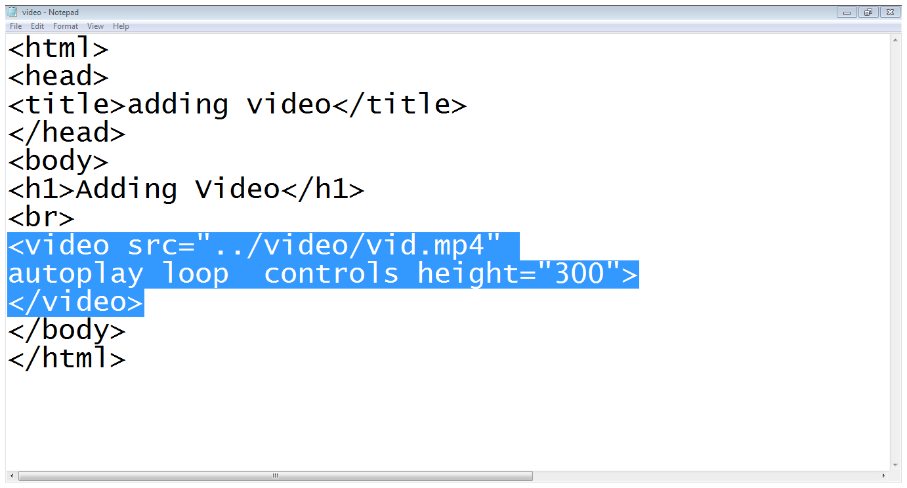
4. Adding videos to web pages…
Video tag
Source of the video
Controls attribute
Loop attribute
Auto-play attribute

Slide 42
5. Adding audio to web pages…
The <audio> tab is used to add a audio to a web page
This tag is provided in HTML5
The src attribute of the <audio> tag is used to indicate the source of the audio
We can add a audio to our page as
<audio src=“abc.mp3”>

Slide 43
5. Adding audio to web pages…
Audio can also be added as
<audio controls>
<source src="horse.ogg" type="audio/ogg">
<source src="horse.mp3" type="audio/mpeg"> Your browser does not support the audio tag.
</audio>

Slide 44
5. Adding audio to web pages…
Audio formats supported by audio tag are
File Format | Media Type
MP3 | audio/mpeg
Ogg | audio/ogg
Wav | audio/wav

Slide 45
5. Adding audio to web pages…
Attributes of <audio> tag:
Auto-play
Controls
Loop

Slide 46
5. Adding audio to web pages…
Control In audio
The controls attribute is a boolean attribute.
Audio controls include:
Play
Pause
Seeking
Volume

Slide 47
Summary
Adding images to web page
Using images as links
Image map
Adding audio and video to web page

Slide 48
Summary
Use the HTML <img> element to define an image
Use the HTML src attribute to define the URL of the image
Use the HTML alt attribute to define an alternate text for an image, if it cannot be displayed
Use the HTML width and height attributes to define the size of the image
Use the HTML <map> element to define an image-map
Use the HTML <area> element to define the clickable areas in the image-map

Slide 49
THANK YOU

