Slide 1


Slide 2
Web Technologies and Programming
Lecture 09

Slide 3
Tables in HTML

Slide 4
Summary of the previous lecture
Adding images to web page
Using images as links
Image map
Adding video to web page
Adding audio o web page

Slide 5
Outline
How to create tables
Page lay-out using tables

Slide 6
1. Creating HTML tables
Tables display information in rows and columns
Tables are commonly used to display all manner of data that fits in a grid such as train schedules, television listings, financial reports etc.

Slide 7
1. Creating HTML tables
An HTML table consists of the <table> element and one or more elements like
<tr>
<th>
<td>
Tables are divided into table rows with the <tr> tag.
Table rows are divided into table data with the <td> tag.
A table row can also be divided into table headings with the <th> tag.

Slide 8
1. Creating HTML tables…
In HTML <table> tag is used to start a table while </table> tag indicates the end of the table
<table>
Table Structure
</table>
<tr> tag starts a row of the table and </tr> ends the row
<td> is used to create a cell inside the row while </td> ends the cell

Slide 9
1. Creating HTML tables…
The contents of the cell are written between <td> and </td> tags
<th> tag is used to declare the cell of the heading row of the table

Slide 10
1. Creating HTML tables…
An HTML Table with a Border Attribute
If you do not specify a border for the table, it will be displayed without borders.
A border can be added using the border attribute:
<table border="1“>

Slide 11
1. Creating HTML tables…
<table border=“1”>
<tr>
<td> Name </td>
<td> Registration No. </td>
</tr>
<tr>
<td>Ali</td>
<td>FA13-BCS-001</td>
</tr>
</table>
Name
Registration No.
Ali
FA13-BCS-001

Slide 12
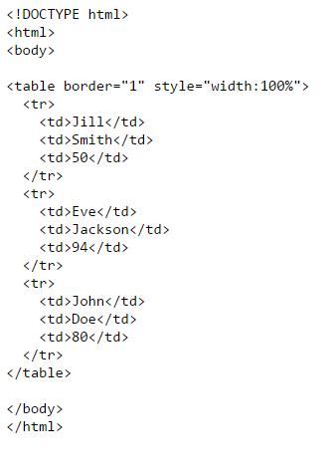
1. Creating HTML tables…

Slide 13

1. Creating HTML tables…

Slide 14
1.1 Table Attributes
Table level attributes
Row level attributes
Cell level attributes

Slide 15
1.1.1 Table Attributes
The Border Attribute: Indicates the presence of the border around the table
<table border=“1”>
The align Attribute:
<table align= “center”>
Other values for align are
Center
Left
right

Slide 16
1.1.1 Table Attributes
The bgcolor Attribute: sets the background color of the table
<table bgcolor=“gray”>
The background Attribute: sets the specified
image at the background of the table
<table background=“image-title”>

Slide 17
1.1.1 Table Attributes…
The height and width Attributes:
The cellpadding Attribute:
The cell padding attribute is used to create a gap between the edges of a cell and its contents
<table cellpadding=“50”>

Slide 18
1.1.1 Table Attributes…
The height and width Attributes:
The cellspacing Attribute:
The cellspacing attribute is used to create a space between the borders of each cell

Slide 19
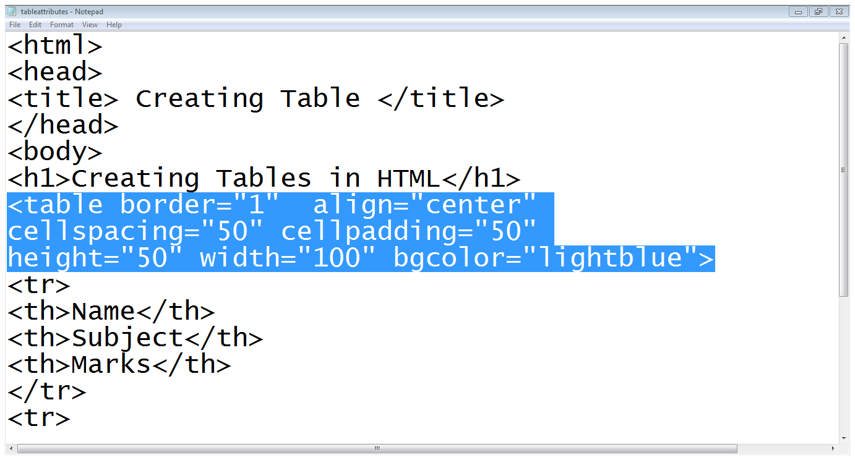
1.1.1 Table Attributes…

Slide 20
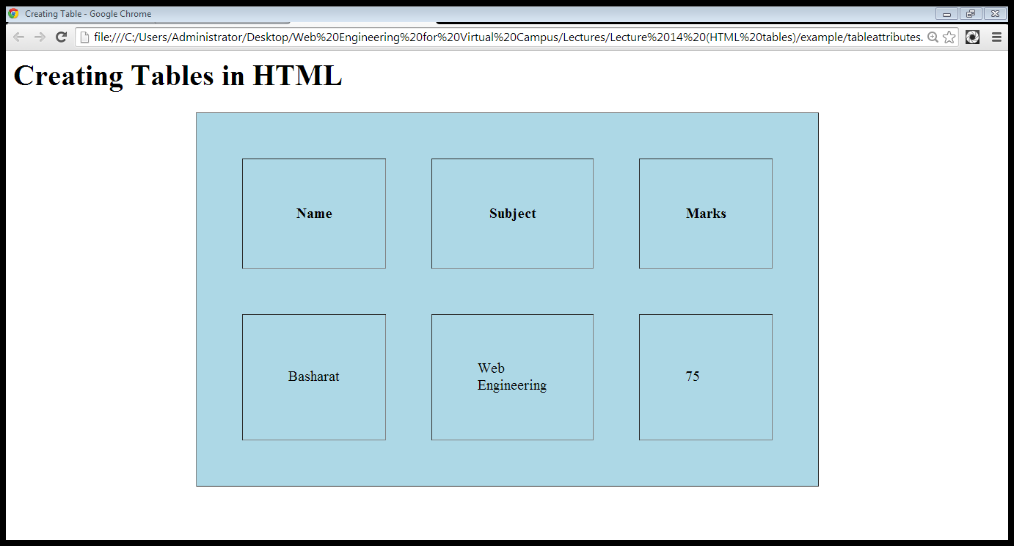
1.1.1 Table Attributes…
cell spacing
cell padding
Height
Width

Slide 21
1.1.1 Table Attributes…
Differences Between HTML 4.01 and HTML5
The "align", "bgcolor", "cellpadding", "cellspacing", "frame", "rules", "summary", and "width" attributes are not supported in HTML5.

Slide 22
1.1.2 Row level attributes
The align Attribute:
Aligns content of the row
<tr align=“center, right or left”>
The bgcolor Attribute:
Apply background color to row
<tr bgcolor=“gray”>
The background Attribute:
Adds image as the background of row
<tr background=“image-name”>

Slide 23
1.1.2 Row level attributes
The height Attributes:
Change height on table row
<tr height=“20” >
The width Attributes:
Change width of the row
<tr widht=“20”>
The valign Attributes:
Changes row vertical alignment
<tr valign=“top, middle or bottom”>

Slide 24
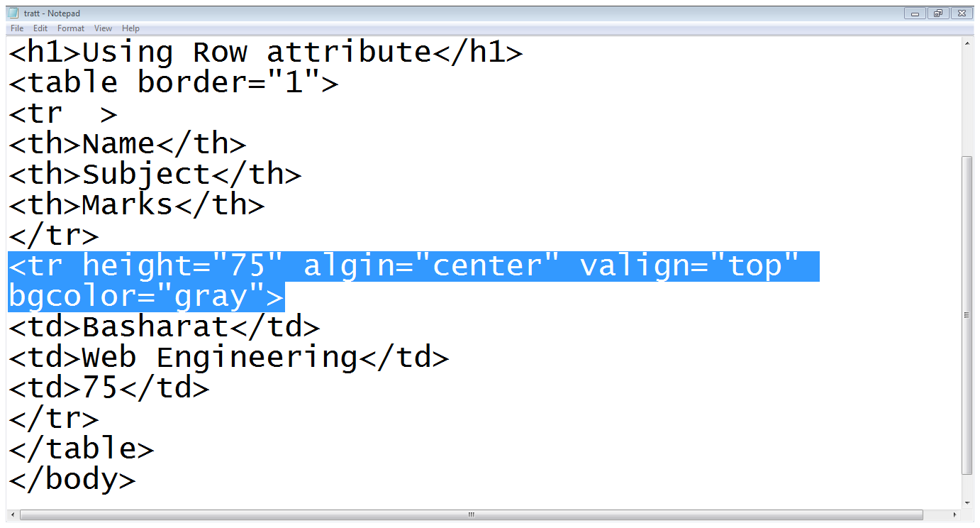
1.1.2 Row level attributes…

Slide 25
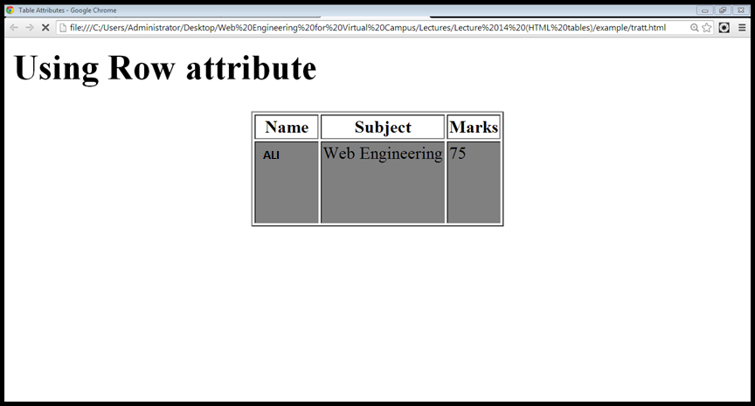
1.1.2 Row level attributes…
Vertical Align
Row Height

Slide 26
1.1.3 Cell level attributes
The align Attribute:
<td align=“center, right or left”>
The bgcolor Attribute:
The height and width Attributes:
The valign Attributes:

Slide 27
1.1.3 Cell level attributes
The rowspan Attributes:
used when a cell should span across more than one rows
The colspan Attribute:
used when a cell should span across more than one column

Slide 28
1.1.3 Cell level attributes…
<table border=“1”>
<tr>
<td rowspan=“2”>Name</td>
<td colspan=“2”>Subjects</td>
</tr>
<tr>
<td >OOP</td>
<td >DB</td>
</tr>
<tr>
<td >ALi</td>
<td >75</td>
<td >80</td>
</tr>
</table>
Name
Subjects
OOP
DB
ALi
75
80

Slide 29
1.2 Creating HTML tables Caption
An HTML Table With a Caption
To add a caption to a table, use the <caption> tag:

Slide 30
1.2 Adding caption to the table
<caption> tag is used to add a caption of the table
We usually add caption before the first row of the table

Slide 31
1.2 Creating HTML table caption
An HTML Table With a Caption
To add a caption to a table, use the <caption> tag:

Slide 32
1.2 Creating HTML tables Caption
Example
<table style="width:100%"> <caption>Monthly savings</caption> <tr> <th>Month</th> </tr> <tr> <td>January</td> </tr> </table>

Slide 33
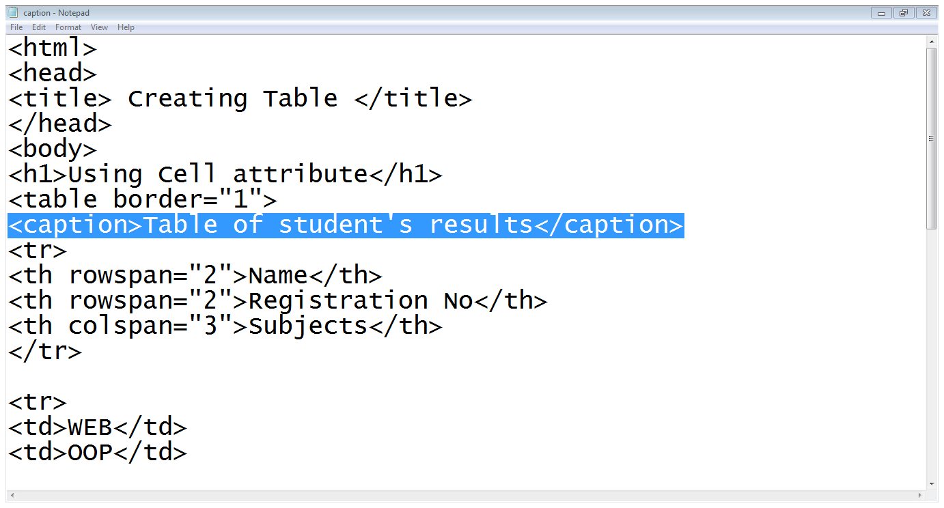
1.2 Adding caption to the table…

Slide 34
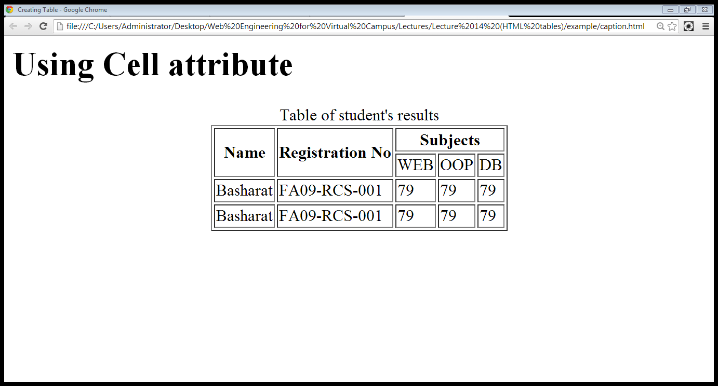
1.2 Adding caption to the table…
Caption

Slide 35
1.3 Creating HTML tables - id attribute
A Special Style for One Table
To define a special style for a special table, add an id attribute to the table:

Slide 36
1.3 Creating HTML tables - id attribute
A Special Style for One Table
Example
<table id="t01"> <tr> <th>Firstname</th> <th>Lastname</th> <th>Points</th> </tr> <tr> <td>Eve</td> <td>Jackson</td> <td>94</td> </tr> </table>

Slide 37
2. Page Layout using Tables
We can use tables to define the structure of the web page

Slide 38

2. Page Layout using Tables
Header
Links
Body
Footer

Slide 39
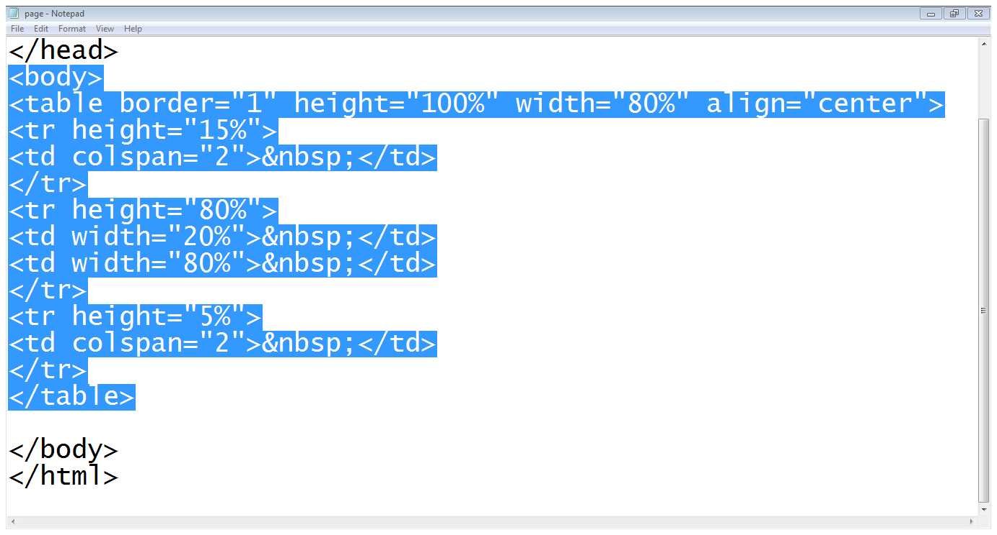
2. Page Layout using Tables…
Header
Footer
Body and links
Example: Step 1 (Structure of the page)

Slide 40
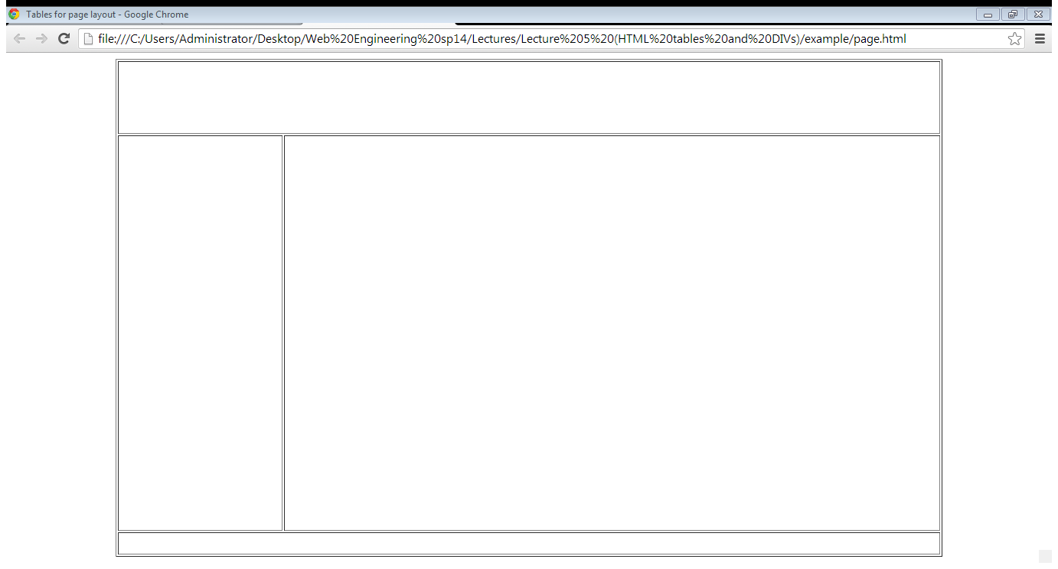
2. Page Layout using Tables…
Example: Step 1 (Structure of the page)

Slide 41
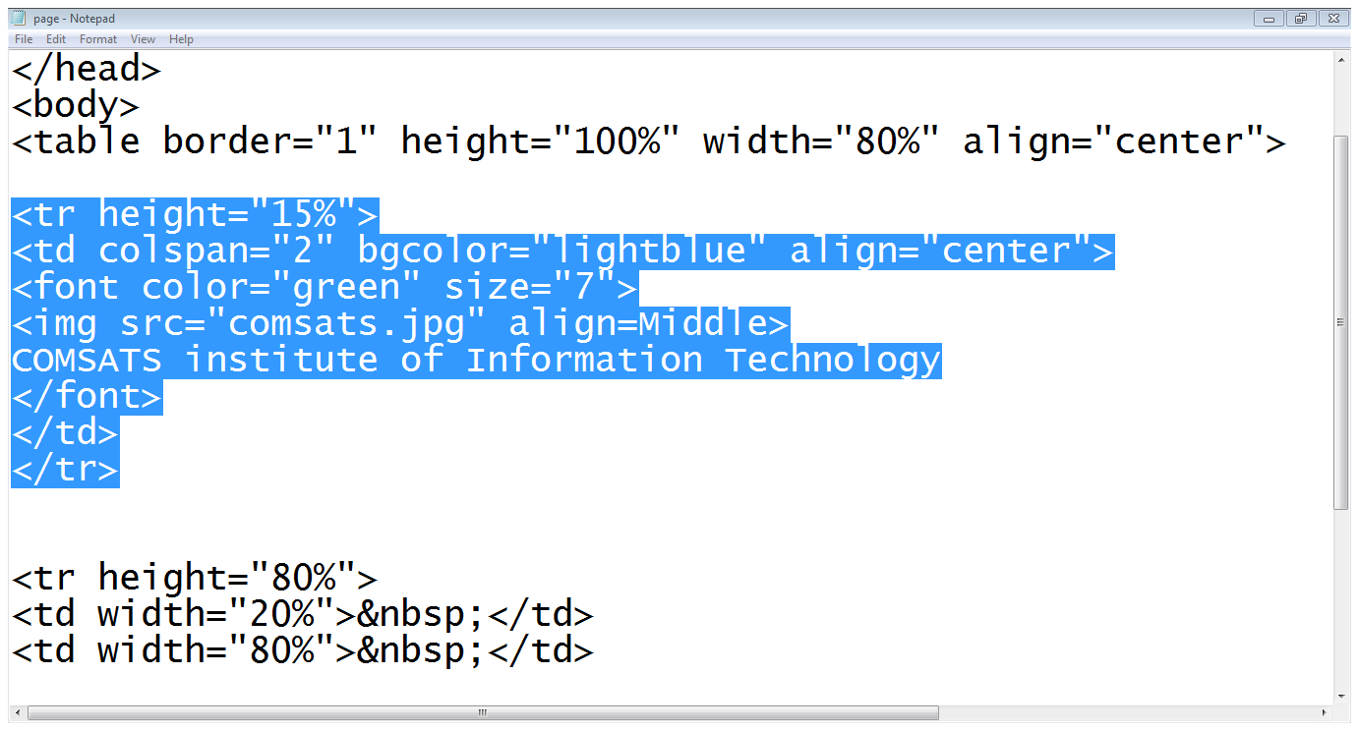
2. Page Layout using Tables…
Example: Step 2 (Header section)
Adding Logo
Title

Slide 42
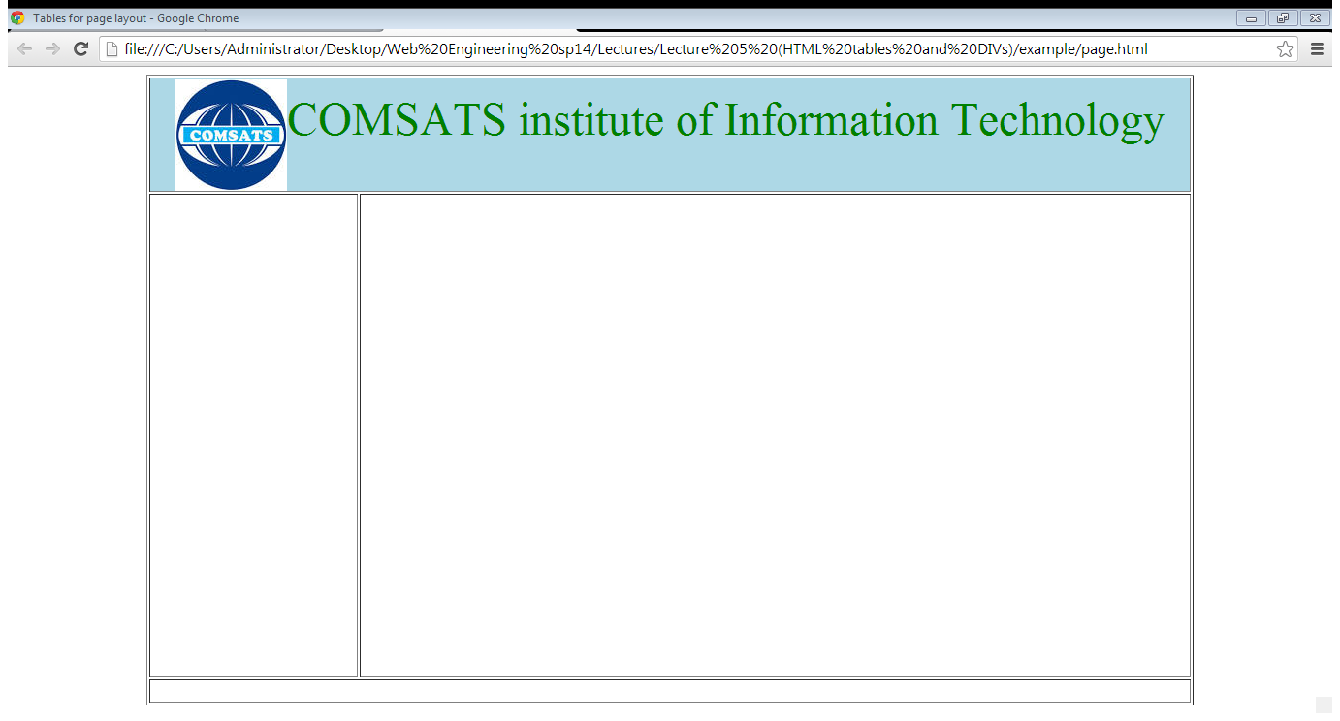
1.5. Page Layout using Tables…
Example: Step 2 (Header section)

Slide 43
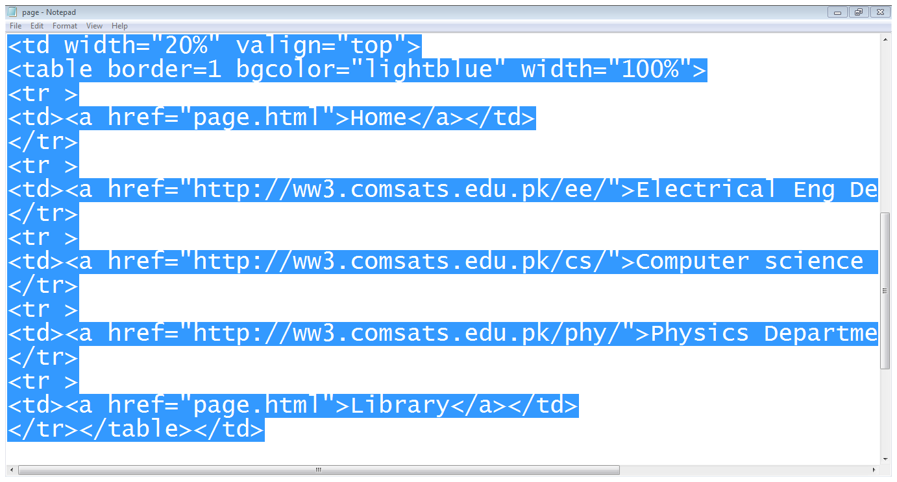
2. Page Layout using Tables…
Links table
Example: Step 3 (Links section)

Slide 44
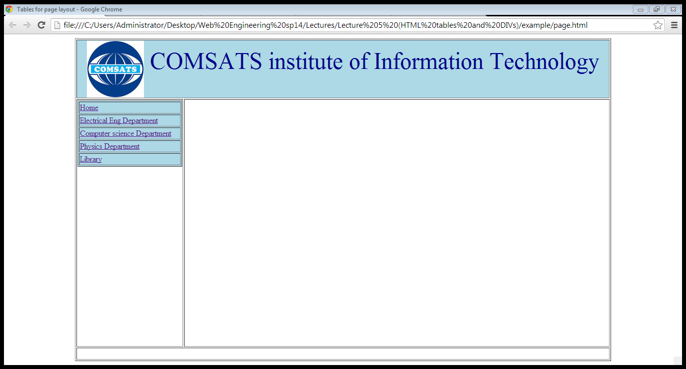
2. Page Layout using Tables…
Example: Step 3 (Links section)

Slide 45
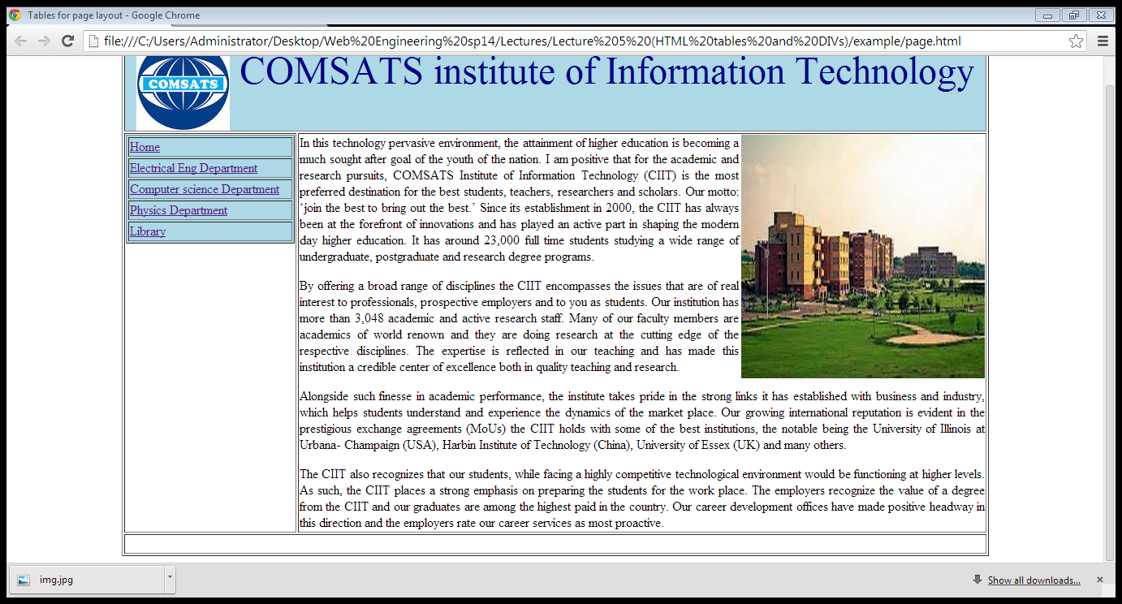
2. Page Layout using Tables…
Example: Step 4 (body section)

Slide 46
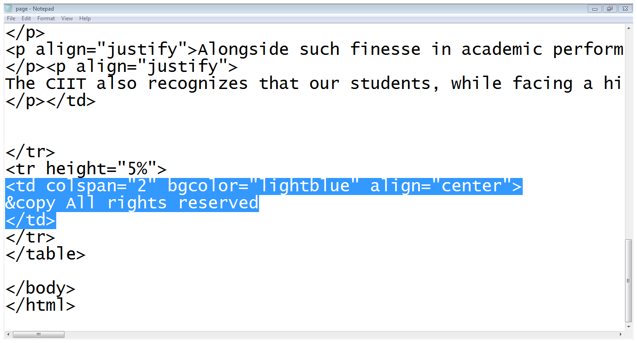
2. Page Layout using Tables…
Footer
Example: Step 5 (footer section)

Slide 47
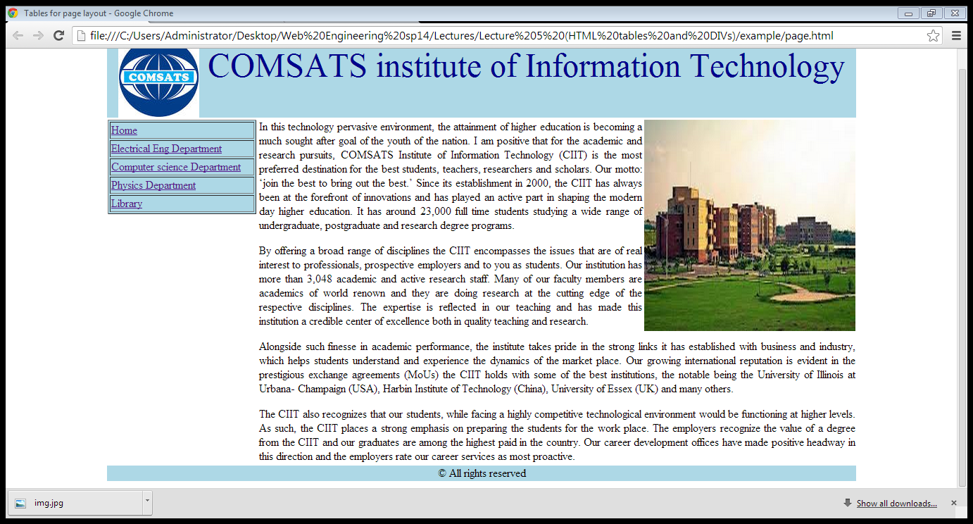
2. Page Layout using Tables…
Example: Step 5 (footer section)

Slide 48
Summary
Use the HTML <table> element to define a table
Use the HTML <tr> element to define a table row
Use the HTML <td> element to define a table data
Use the HTML <th> element to define a table heading
Use the HTML <caption> element to define a table caption
Use the CSS border property to define a border
Use the CSS padding property to add padding to cells
Use the CSS text-align property to align cell text
Use the CSS border-spacing property to set the spacing between cells
Use the colspan attribute to make a cell span many columns
Use the rowspan attribute to make a cell span many rows
Use the id attribute to uniquely define one table

Slide 49
Summary
Creating tables in HTML
Table attributes
Table level attributes
Row level attributes
Cell level attributes
Page lay-out using tables

Slide 50
THANK YOU

