Slide 1


Slide 2
Web Technologies and Programming
Lecture 10

Slide 3
HTML FORMS

Slide 4
Summary of the previous lecture
Creating tables in HTML
Table attributes
Table level attributes
Row level attributes
Cell level attributes
Page lay-out using tables

Slide 5
Outline
HTML FORMS
HTML FORM elements

Slide 6
1. HTML FORMS
HTML forms are used to collect user input.
HTML forms contain form elements.
Form elements are different types of input elements, checkboxes, radio buttons, submit buttons, and more.

Slide 7
1. HTML FORMS
The <form> element defines an HTML form:
<form> . form elements . </form>

Slide 8
1. HTML FORMS
Forms provide a means of submitting information from the client to the server
HTML supports tags for creating forms, however, it does not process the information
Use server-side script to process form information
Server-side script runs on the Web server and receives data from a form and uses it to perform a set of tasks

Slide 9
1. HTML FORMS…
This figure shows how a Web page form interacts with a CGI script.

Slide 10
1. HTML FORMS…
<form> tag is used to start a form
</form> tag is used to end a form
Between <form> and </form>, form elements are placed
We can declare a form as:
<form attributes>
form elements and layout tags
</form>
A single page can include several different
forms, but you cannot nest one form
inside another

Slide 11
1. HTML FORMS…
Common Form Attributes:
action - gives the URL of the application that is to receive and process the forms data
method - sets the HTTP method that the browser uses to send the form's data to the server for processing; Either POST or GET
name – name of the form

Slide 12
1. HTML FORMS…
When to Use GET?
You can use GET (the default method):
If the form submission is passive (like a search engine query), and without sensitive information.
When you use GET, the form data will be visible in the page address.

Slide 13
1. HTML FORMS…
When to Use POST?
You should use POST:
If the form is updating data, or includes sensitive information (password).
POST offers better security because the submitted data is not visible in the page address.

Slide 14
1. HTML FORMS…
GET
Requests data from a specified resource
GET requests can be cached
GET requests remain in the browser history
GET requests can be bookmarked
GET requests should never be used when dealing with sensitive data
GET requests have length restrictions
GET requests should be used only to retrieve data

Slide 15
1. HTML FORMS…
POST
Submits data to be processed to a specified resource
POST requests are never cached
POST requests do not remain in the browser history
POST requests cannot be bookmarked
POST requests have no restrictions on data length

Slide 16
2. Form Elements
Textbox
Password Field
Hidden Field
Checkbox
Radio Button
Text Area
Select List
Submit Button
Reset Button

Slide 17
2.1 Text box
<INPUT TYPE=“TEXT” >
NAME
SIZE
VALUE
MAXLENGTH
<INPUT TYPE=“TEXT” NAME=NAME SIZE=30 VALUE=“ALI” MAXLENGTH=15>

Slide 18
2.1 Text box
<input type="submit"> defines a button for submitting a form to a form-handler.
The form-handler is typically a server page with a script for processing input data.

Slide 19
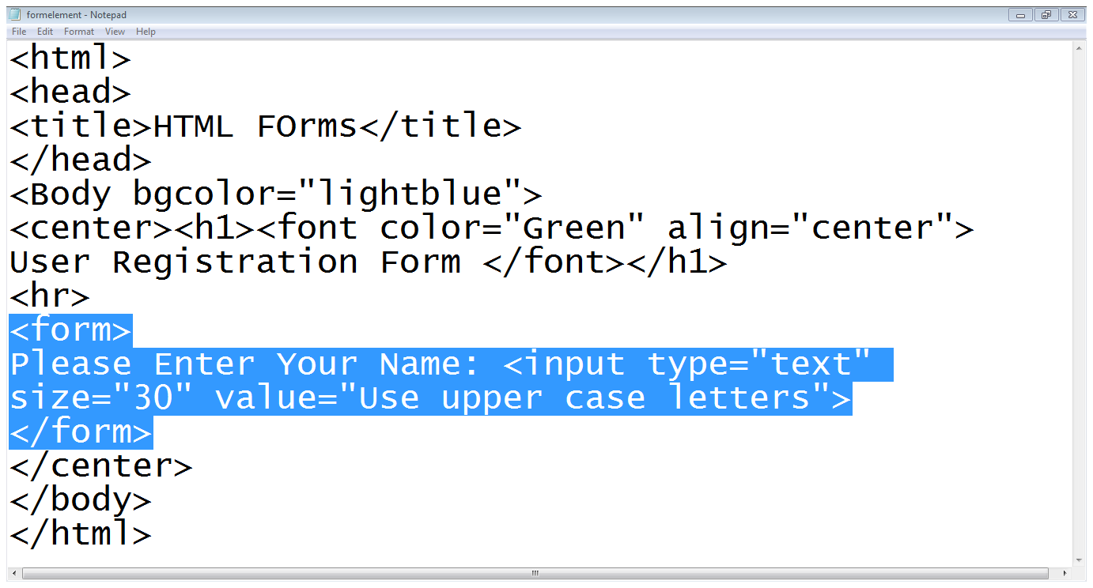
2.1 Text box…
Start of the form
label
Text box

Slide 20
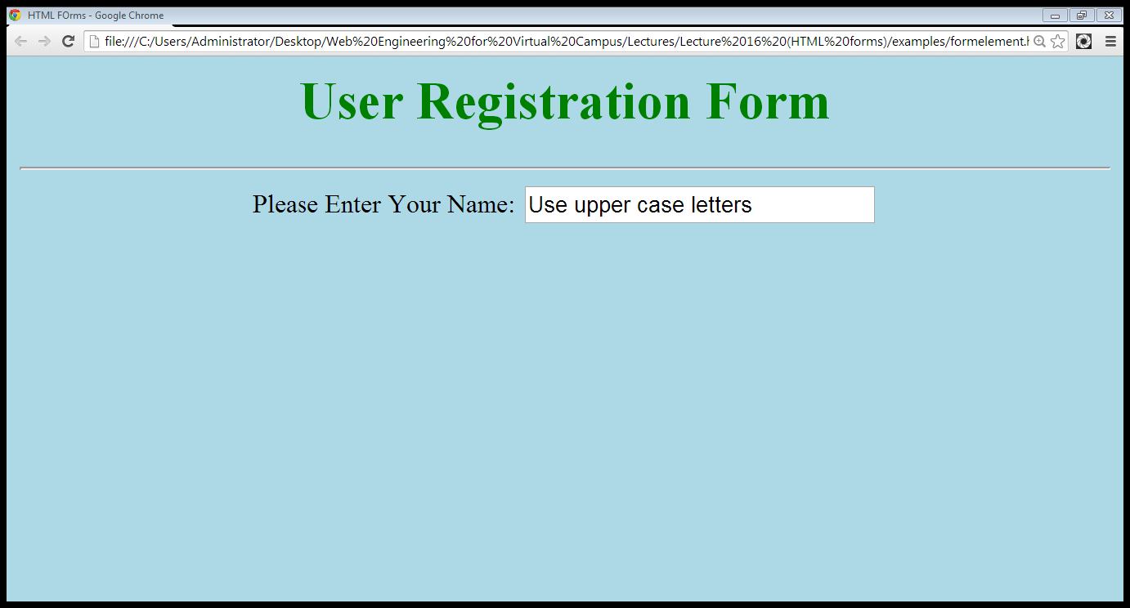
2.1 Text box…
value
label
Text box

Slide 21
2.2 Password Field
<INPUT TYPE=“PASSWORD”>
NAME
SIZE
VALUE
MAXLENGTH
<INPUT TYPE=“PASSWORD” NAME=NAME SIZE=30 VALUE=“ALI” MAXLENGTH=15>
Note: The characters in a password field are masked (shown as asterisks or circles).

Slide 22
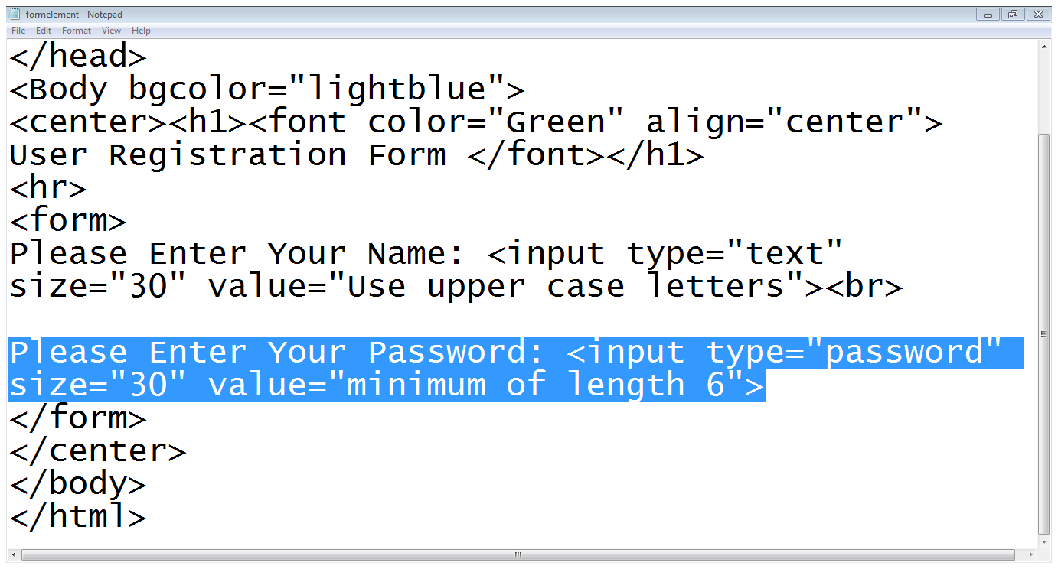
2.2 Password Field…
Type is password

Slide 23
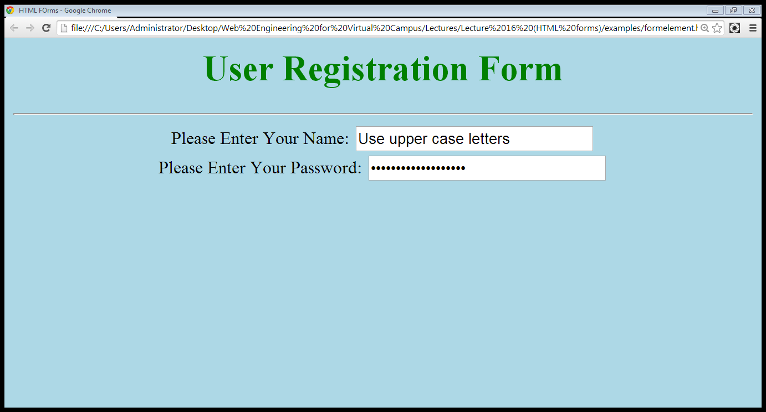
2.2 Password Field…
Typed characters are hidden

Slide 24
2.3 Hidden Text Field
<INPUT TYPE=“HIDDEN”>
NAME
VALUE
<INPUT TYPE=“HIDDEN” NAME=NAME VALUE=“ALI” >

Slide 25
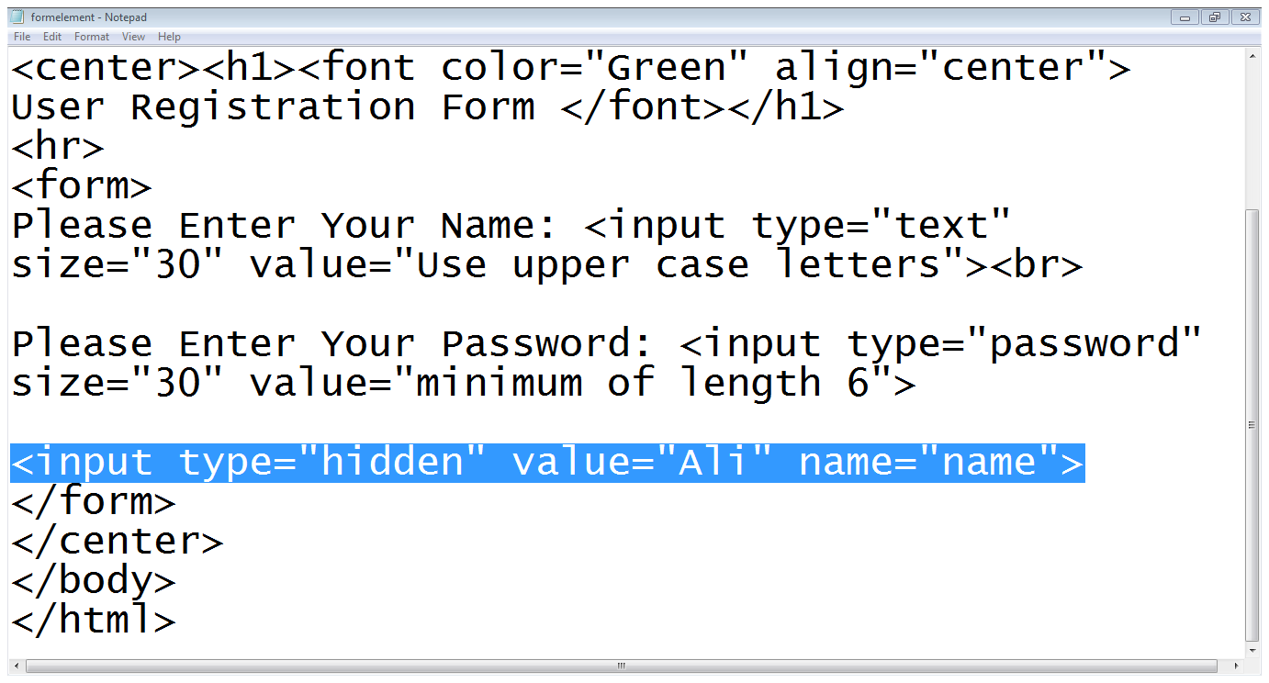
2.3 Hidden Text Field…
Type is hidden

Slide 26

2.3 Hidden Text Field…
Hidden field is not visible

Slide 27
2.4 Checkbox
<INPUT TYPE=“CHECKBOX”>
CHECKED
NAME
VALUE
<INPUT TYPE=“CHECKBOX” NAME=“CHECK” VALUE=“ CHECKED”>
Checkboxes let a user select ZERO or MORE options of a limited number of choices.

Slide 28
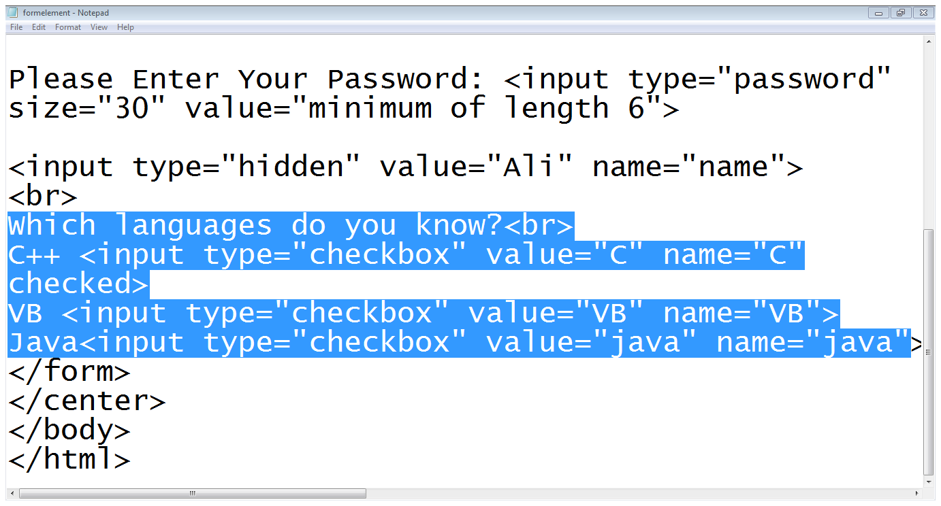
2.4 Checkbox…
label
Type
option
value
checked

Slide 29
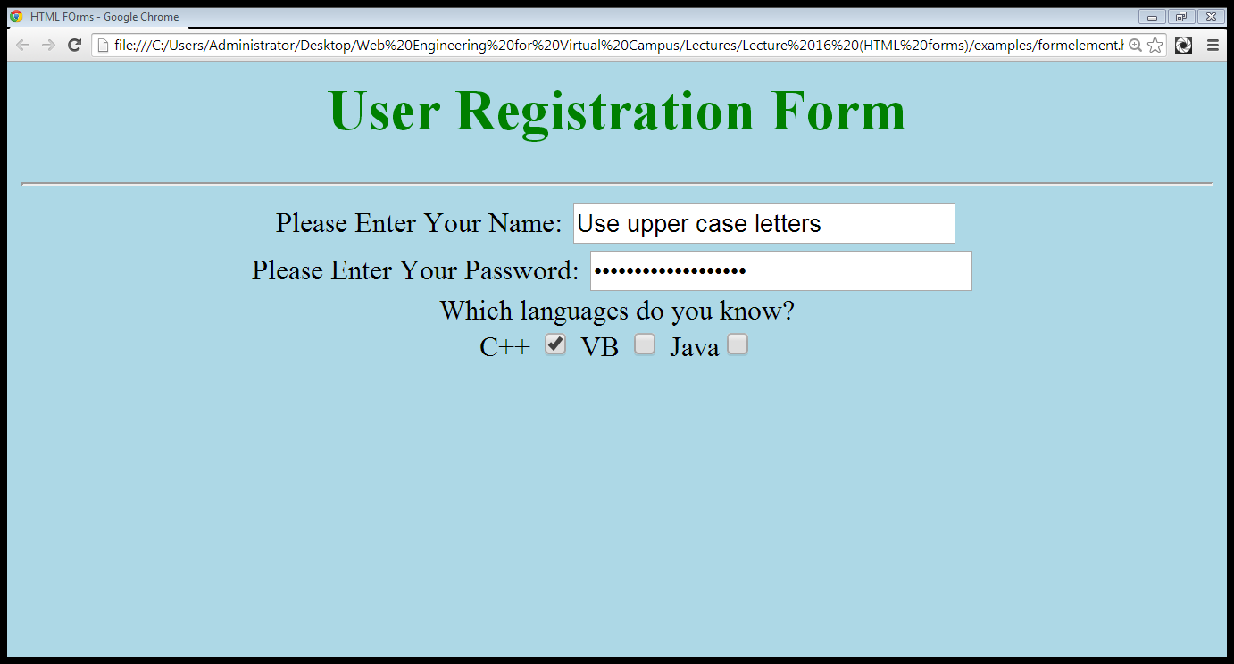
2.4 Checkbox…
label
Already checked
Options

Slide 30
2.5 Radio Buttons
<INPUT TYPE=“RADIO”>
CHECKED
NAME
VALUE
<INPUT TYPE=“RADIO” NAME=“RADIO” VALUE=“” CHECKED>MALE
<INPUT TYPE=“RADIO” NAME=“RADIO” VALUE=“” >FEMALE
Radio buttons let a user select ONLY ONE of a limited number of choices:

Slide 31
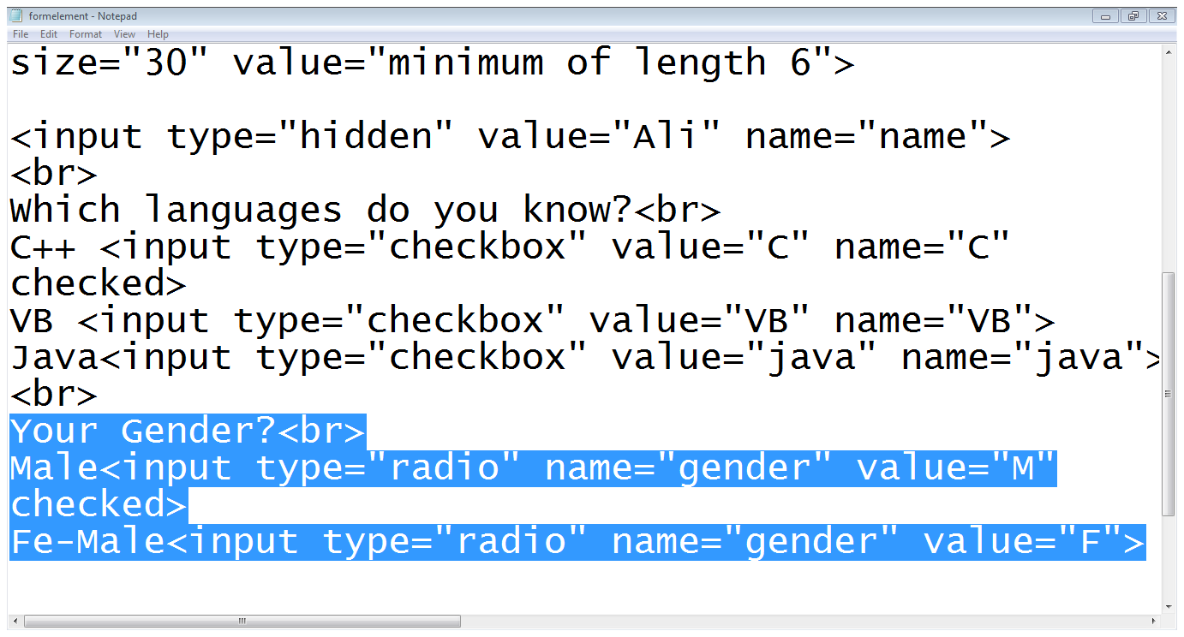
2.5 Radio Buttons…
label
Option
type
Same name

Slide 32
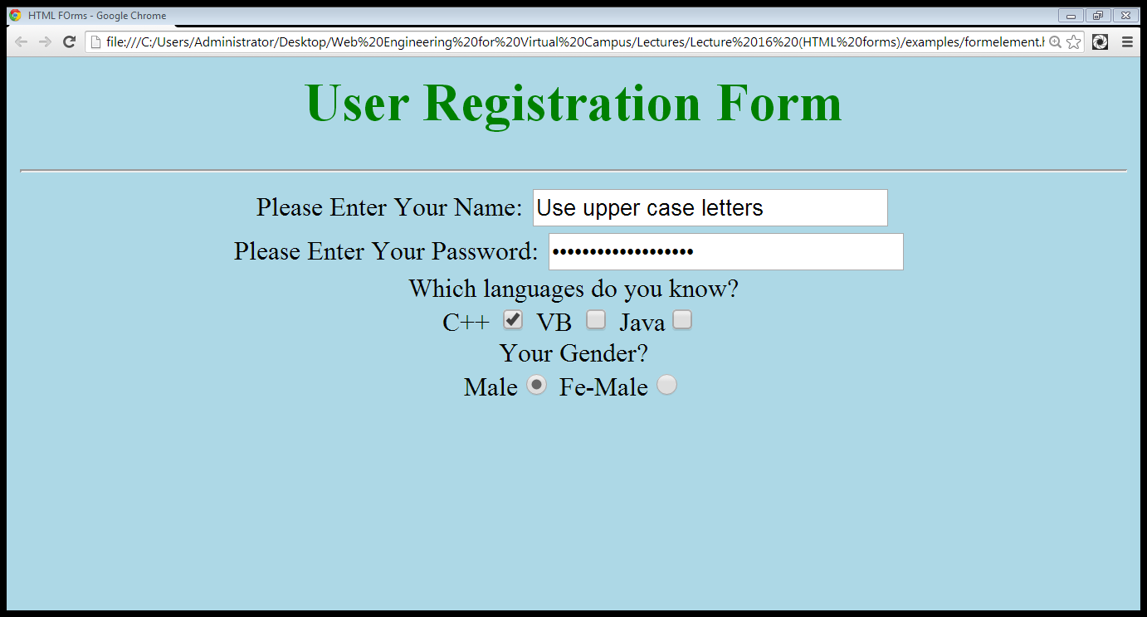
2.5 Radio Buttons…
Radio Button
Already checked

Slide 33
2.6 Select list
Drop down list:
Select
Name, size
Option
<SELECT name=“name” size=“size”>
<OPTION value=“lahore”>LAHORE</option>
<OPTION value=“karachi”>KARACH</option>
<OPTION value=“islamabad”>ISLAMABAD</option>
</SELECT>

Slide 34
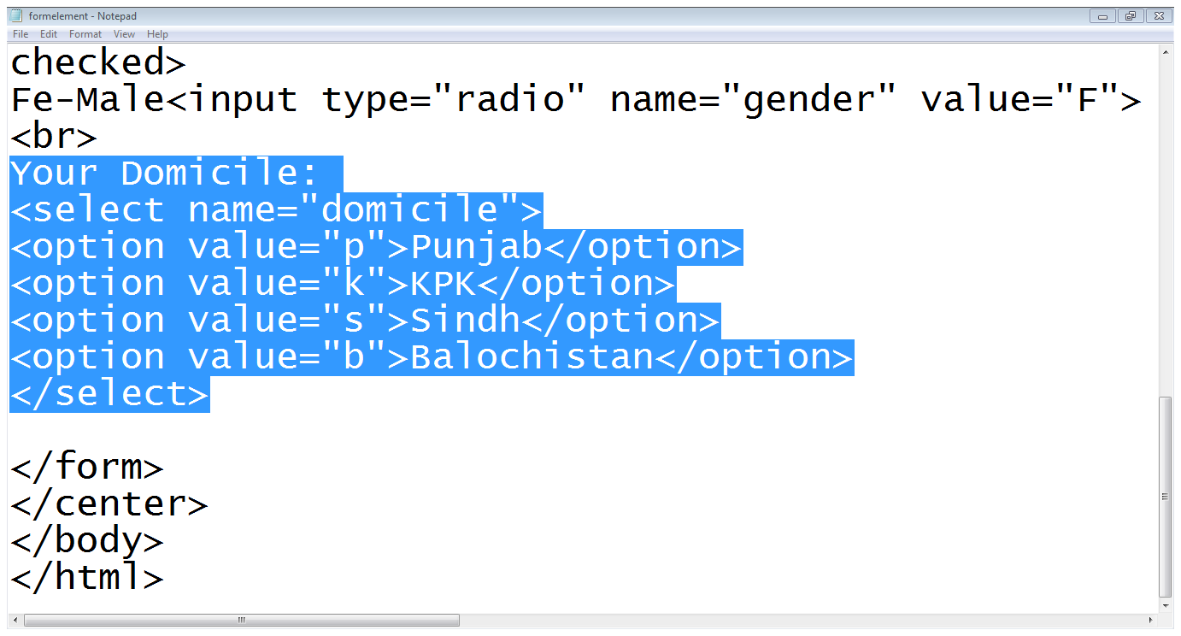
2.6 Select list…
List starts
options
Select ends

Slide 35
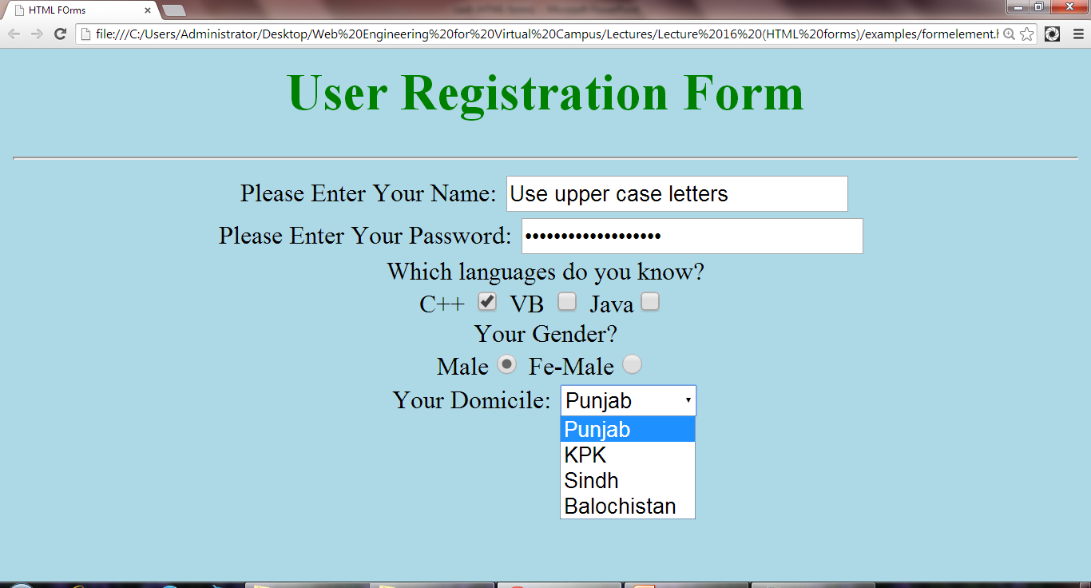
2.6 Select list…
Select list with options

Slide 36
2.6.1 Creating scrolling select list
To create scrolling select list, we use the size attribute of the <select>
The value of the size attribute is the number of options you want to be visible at any one time

Slide 37
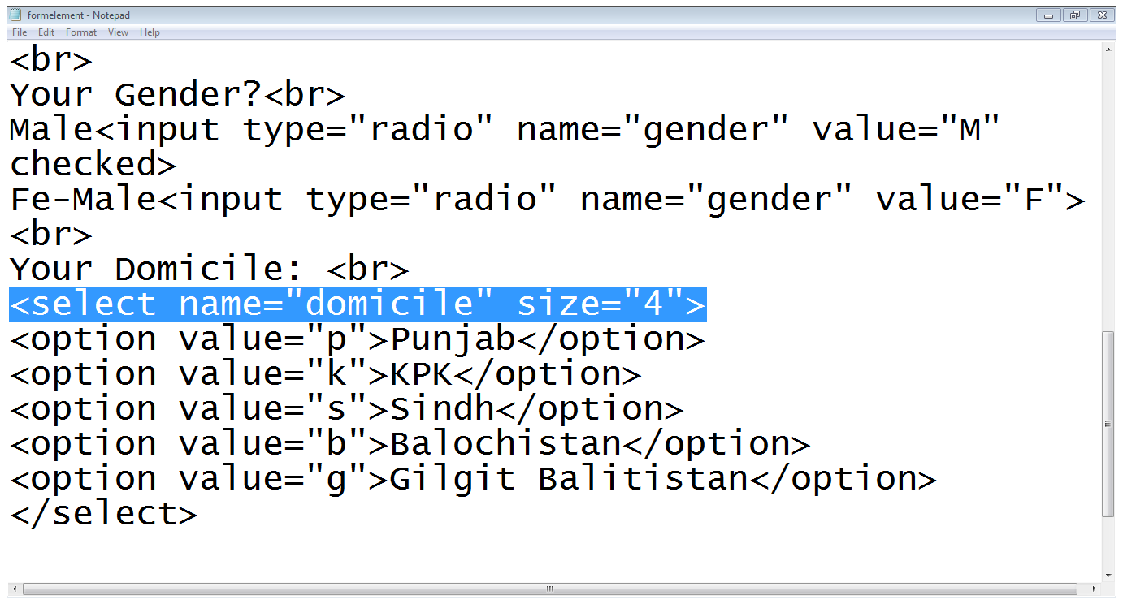
2.6.1 Creating scrolling select list
Size attribute

Slide 38
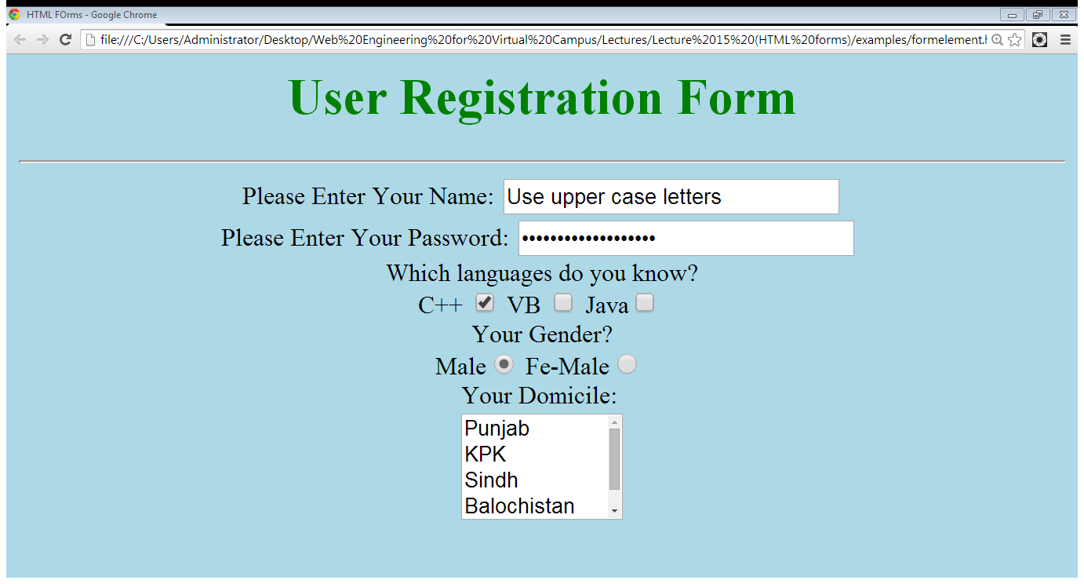
2.6.1 Creating scrolling select list
Scrolling Option
Visible Options

Slide 39
2.7 Text area
Text-area
The <textarea> element defines a multi-line input field (a text area):
Rows
Cols
Name
<TEXTAREA rows=“5” cols=“5”>
Default text
</TEXTAREA>

Slide 40
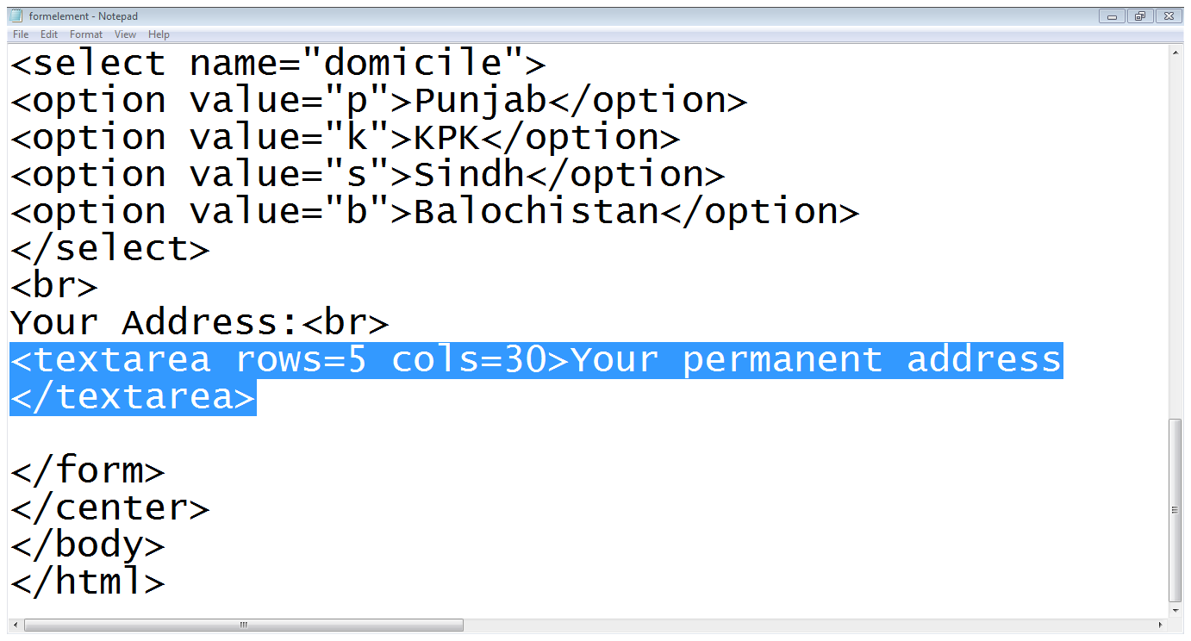
2.7 Text area…

Slide 41
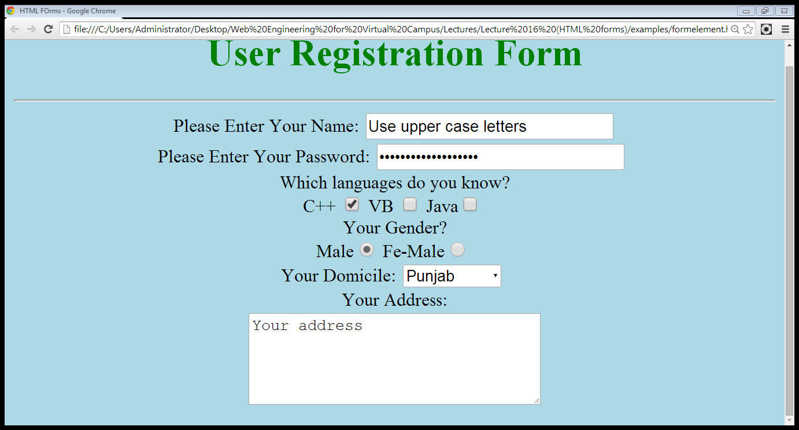
2.7 Text area…
Text area

Slide 42
2.8 File field
File-field
<input type=“file” name=“file-name”>

Slide 43
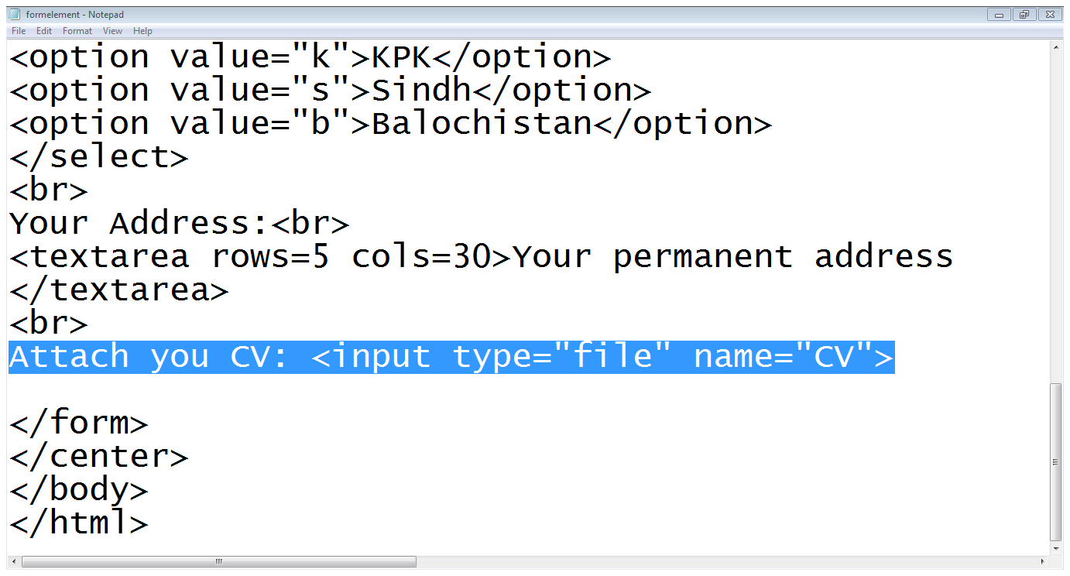
2.8 File field…

Slide 44
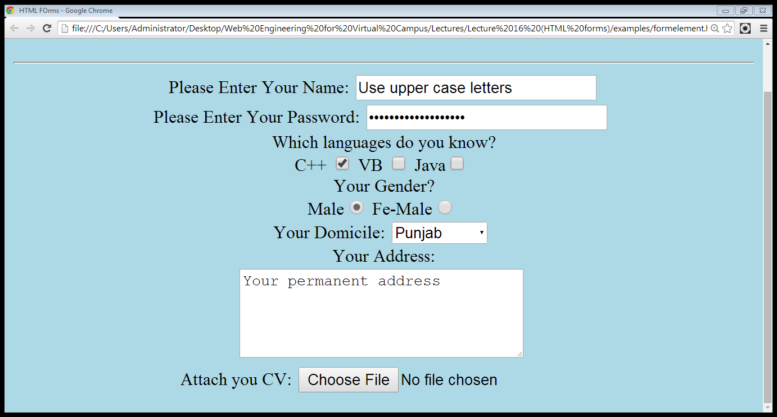
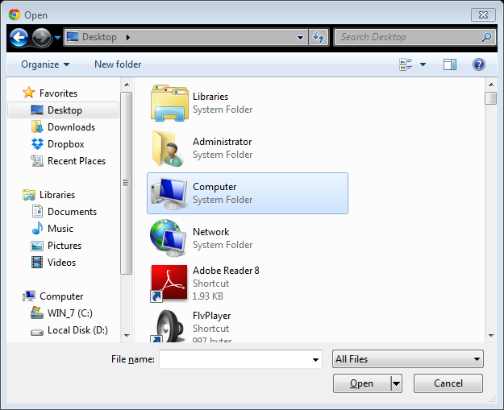
2.8 File field…

Slide 45
2.9 Submit and Reset buttons
Submit and Reset Buttons
<INPUT TYPE=“SUBMIT” VALUE=“SAVE”>
<INPUT TYPE=“RESET” VALUE=“RESET”>
<input type="submit"> defines a button for submitting form input to a form-handler.
The form-handler is typically a server page with a script for processing input data.

Slide 46
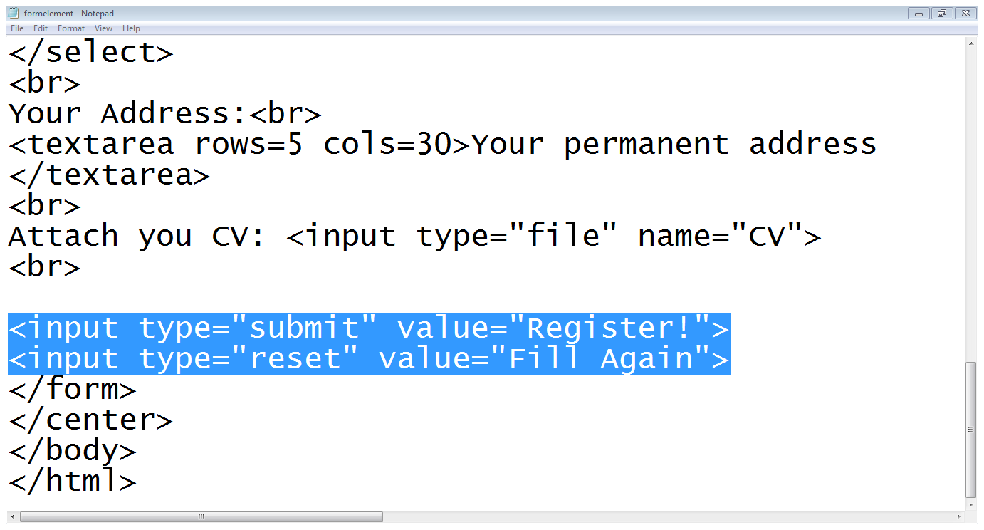
2.9 Submit and Reset buttons…
Submit button
Reset button

Slide 47
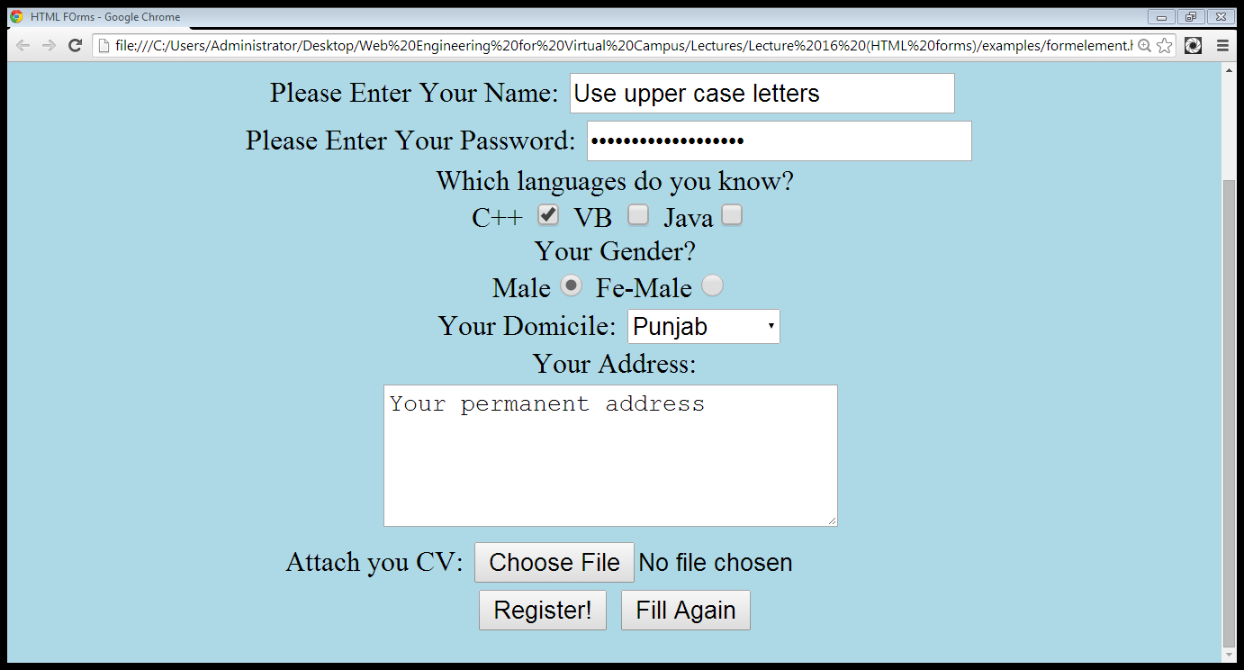
2.9 Submit and Reset buttons…
Submit
Reset

Slide 48
Summary
HTML5 added several new input types:
color
date
Datetime
email
month
number
range
search
tel
time
url
week

Slide 49
Summary - input
HTML5 added the following attributes for <input>:
autocomplete
autofocus
form
formaction
formenctype
formmethod
formnovalidate
formtarget
height and width
list
min and max
multiple
pattern (regexp)
placeholder
required

Slide 50
Summary - attributes for input
HTML5 added the following attributes for <input>:
the following attributes for <form>:
autocomplete
novalidate

Slide 51
Summary
Creating forms in HTML
Adding form elements

Slide 52
THANK YOU

