Slide 1

ENGINEERING PROJECT NAME: ACCESSAI
নাগরিক সাথী
প্রত্যেক নাগরিকের জন্য একজন এআই সহকারী।
One AI assistant that tells a citizen exactly what they qualify for and why — then makes sure the money and the promises around it can be checked, too.
Built for
Bangladesh
1 / 55

Slide 2
A TRUE-TO-LIFE SCENARIO
Her husband just died. She has three children, no income, and no idea what she is owed.
Somewhere, right now, a government office has an allowance with her name on it — on paper. She doesn’t know it exists. Nobody is going to tell her. That gap is not a technology problem first. It’s a trust problem. This is what we built to close it.
2 / 55

Slide 3
THE PROBLEM, PART ONE
Bangladesh doesn’t lack welfare programmes. It lacks a way to find them.
JUST IN OUR OWN SAMPLE CORPUS
11
10
7
7
7
Allowances for widows, the elderly, students, farmers, disabled citizens, disaster survivors — dozens of real schemes, run by different ministries, departments and NGOs, each with its own eligibility rules, its own office, its own form. There is no single place that asks “what happened to you” and answers “here’s what you’re entitled to.”
Welfare
Education
Health
Livelihood
Support
3 / 55

Slide 4
THE PROBLEM, PART TWO
The cost isn’t paperwork. It’s a lost day, spent standing in the wrong queue.
She asks a neighbour, who heard something from a cousin. She travels to the Union Parishad office. They send her to the Upazila Social Services office. That office needs a certificate she doesn’t have. She comes back another day.
Multiply that by every citizen who doesn’t know a scheme exists, every officer who can’t hold 42 rule sets in their head, and every family that gives up after the second wrong office. That is the real, everyday cost — not an abstraction.
4 / 55

Slide 5
THE PROBLEM, PART THREE
A generic solution quietly assumes the wrong Bangladesh.
Most digital benefit tools are designed for a smartphone on fast data, in a language its author already reads comfortably. Our own product decisions — the ones judges will see in a moment — were made for the opposite assumption on every count: a 2G connection, a cracked screen in direct sun, a citizen who may not read fluently, and a phone that might not even be a smartphone at all.
📶 2G / cheap Android, not fibre and flagships
🗣 Bangla first — not Bangla translated later
📵 Millions still reachable only by feature phone
🏛 Local government (Union Parishad) is where trust is actually won or lost
5 / 55

Slide 6
THE TRAP EVERYONE ELSE FALLS INTO
A chatbot that guesses is worse than no chatbot at all.
Point a general-purpose language model at “am I eligible for this allowance” and it will answer fluently — and it will sometimes invent a threshold, forget a citation, or state an unverified number as settled fact. For a scholarship, that’s annoying. For a widow’s allowance, a confidently wrong answer is a real harm. So the question we actually had to answer wasn’t “how good is our AI” — it was “how do we stop the AI from ever being the one who decides.”
6 / 55

Slide 7
THE INSIGHT THAT SHAPED EVERYTHING
Separate the decision from the explanation.
A rule engine decides what a citizen qualifies for — deterministic, traceable, boring in the best way. An AI model is only ever allowed to take a decision that has already been made and say it warmly, in Bangla or English. It cannot add a fact. It cannot invent a number. If it has nothing grounded to say, it is not called at all.
7 / 55

Slide 8
THE SECOND INSIGHT
Access without accountability just digitises the same broken trust.
Telling a citizen what they can get is only half the promise. If the same phone in her hand can’t also show her where her union’s budget went, or give her a real channel when a tube well breaks, we’ve built a nicer front door onto the same opaque system. So we built both halves as one platform, not two products.
8 / 55

Slide 9
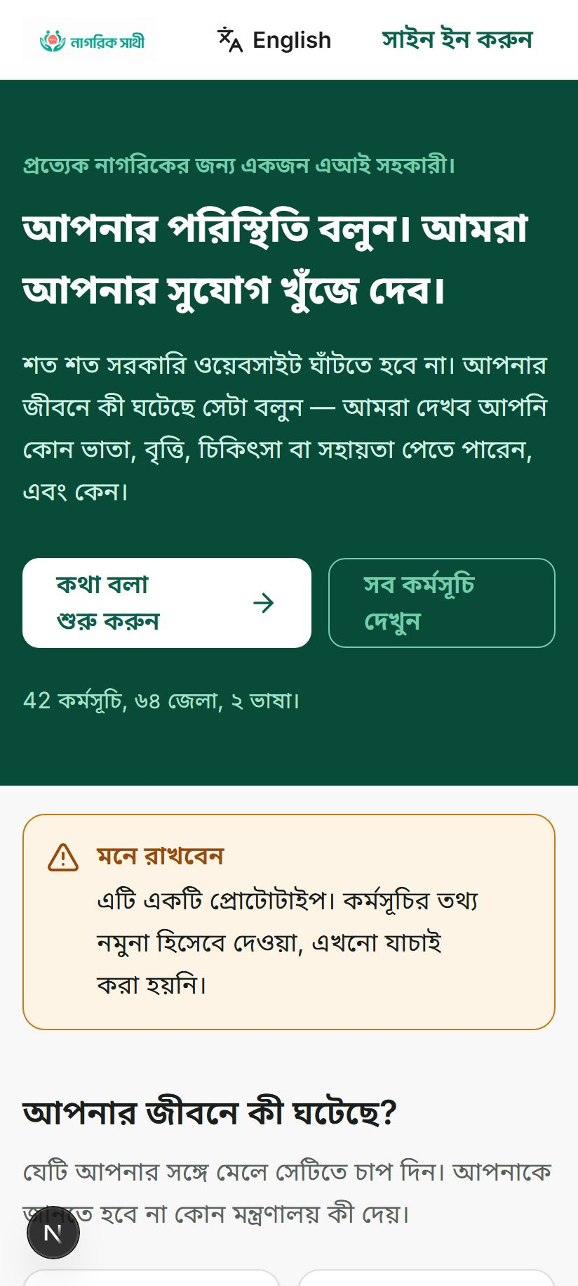
MEET THE PRODUCT
This is what she would actually open.
Real screen, real running system — not a mockup. A life-event grid, not a form. She doesn’t pick a ministry or a scheme name; she says what happened, in her own words, in Bangla.
42 programmes
64 districts
2 languages
9 / 55

Slide 10
THE MENTAL MODEL, IN ONE LINE
Describe → Decide → Explain → Act.
01
02
03
04
She describes her situation — voice or text.
A rule engine decides — never a guess.
The reason is shown, in plain language.
She saves it, and gets a real checklist.
10 / 55

Slide 11
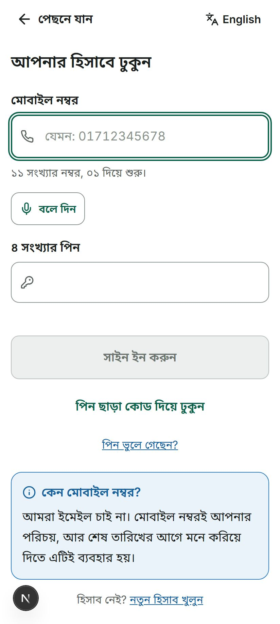
HOW IT WORKS — STEP 1
Getting in needs a phone number, not an email address.
A phone number plus a 4–6 digit PIN. No email, no strong-password rules, no CAPTCHA, no “Sign in with Google.” Real screen, right down to the info panel explaining, in Bangla, why a phone number is enough: most people this app is for don’t use email, and a phone number is already their identity.
11 / 55

Slide 12
HOW IT WORKS — STEP 2
She types — or speaks — exactly what happened. No form.
“আমার স্বামী মারা গেছেন, আমার তিনিথি সন্তান আছে। আমি কী সহায়তা পেতে পারি?”
“My husband has died, and I have three children. What help can I get?” — the exact message, typed into the real running app.
12 / 55

Slide 13
HOW IT WORKS — STEP 3
Behind the scenes, a rule engine decides — and it is allowed to say “I don’t know.”
Every decision has exactly four possible outcomes: eligible, partially eligible, not eligible, or unknown. A missing answer is never quietly treated as a “no” — that would silently deny someone a benefit they may actually be entitled to. Instead, the system asks one more question, the single most useful one, and waits.
13 / 55

Slide 14
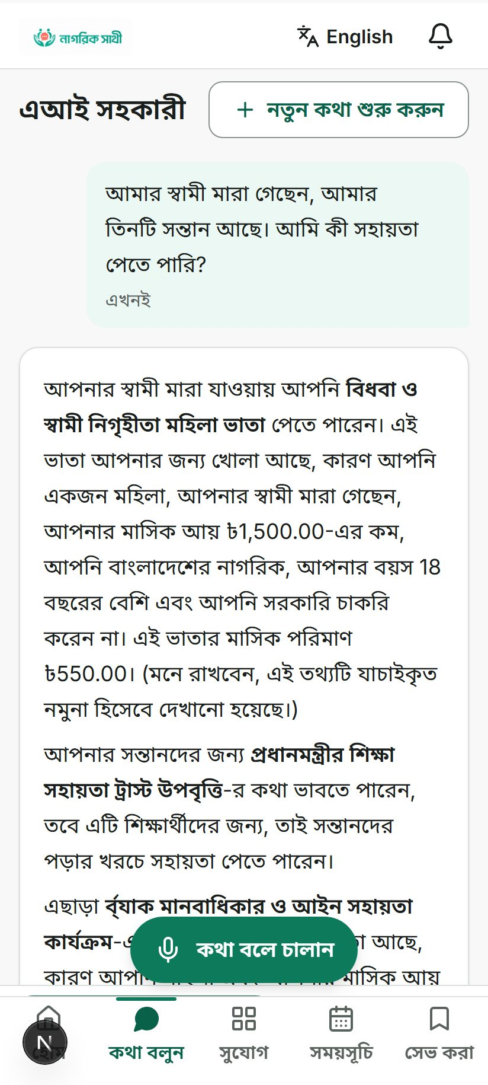
This exact answer,
live, right now
HOW IT WORKS — STEP 4
Live. Right now. Real AI, rendering a decision it did not make.
Widow allowance: eligible. Every reason named — her gender, her income, her age, her citizenship, her job status — each one traced back to something she actually said. The amount, in taka. And the model itself admits the record behind it is unverified sample data. Nothing here is a screenshot from a slide template — this is the running app answering, in Bangla, in real time.
14 / 55

Slide 15
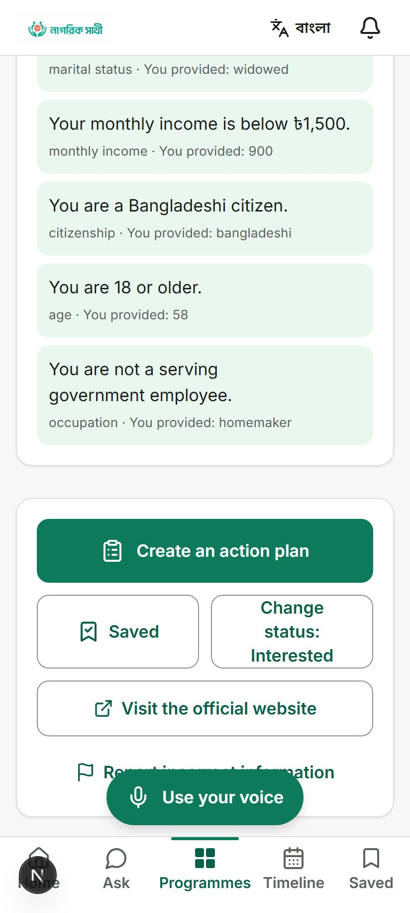
CORE CAPABILITY
Never a black-box “yes.” Always every reason.
Tap into any recommendation and see the full trace: which conditions she met, which she failed, and exactly what value she gave for each one — “monthly income · you provided: 900.” This is the same reasoning the engine actually used, shown, not summarised. A citizen — or a journalist, or an auditor — can check the app’s homework on every single answer.
15 / 55

Slide 16
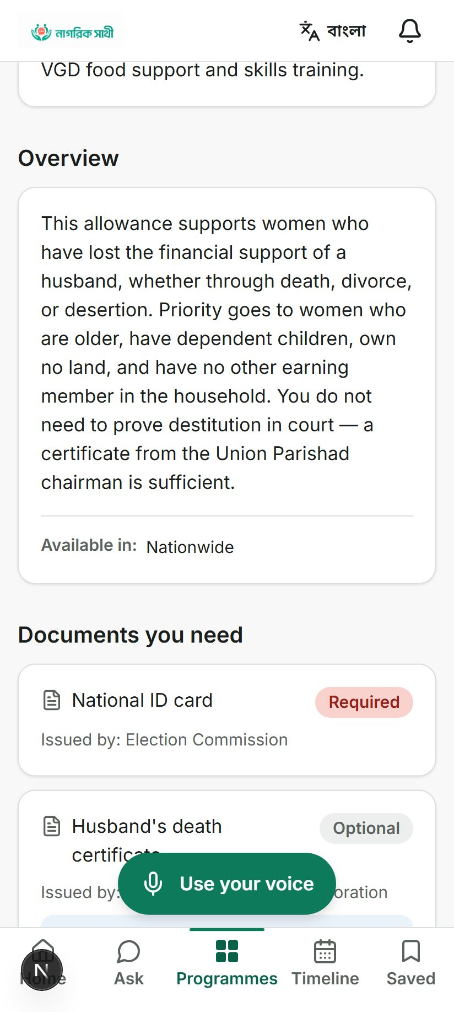
CORE CAPABILITY
“Eligible” becomes a checklist, not a dead end.
One tap turns a decision into an action plan — built from that programme’s own real application steps and its own real document list, in order, with the documents that unlock everything else scheduled first. Nothing here is generic homework; it’s assembled from the same record that decided she qualifies.
16 / 55

Slide 17
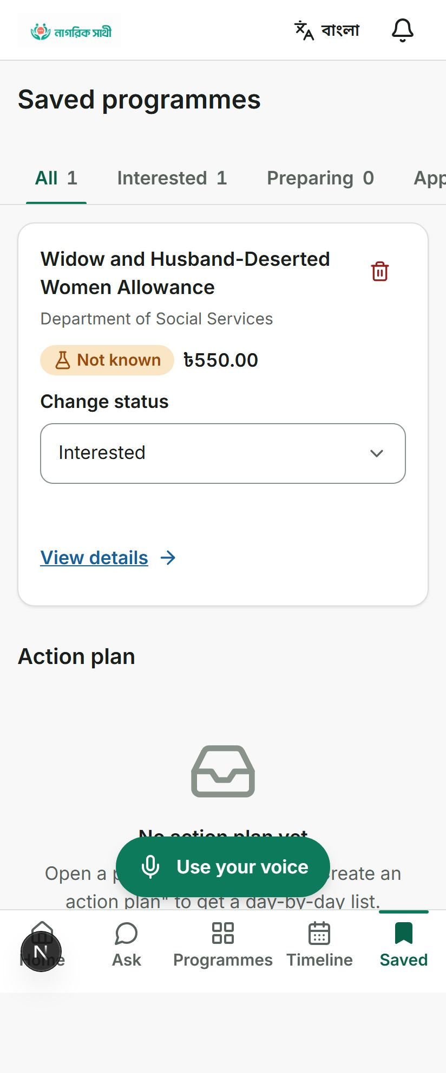
CORE CAPABILITY
A tracker for the part everyone forgets: follow-through.
Save a programme, move it through interested → preparing → applied → approved, and every deadline attached to it lands on her Timeline automatically. Applying for a benefit in Bangladesh is rarely one visit — it’s a small project. We treated it like one.
17 / 55

Slide 18
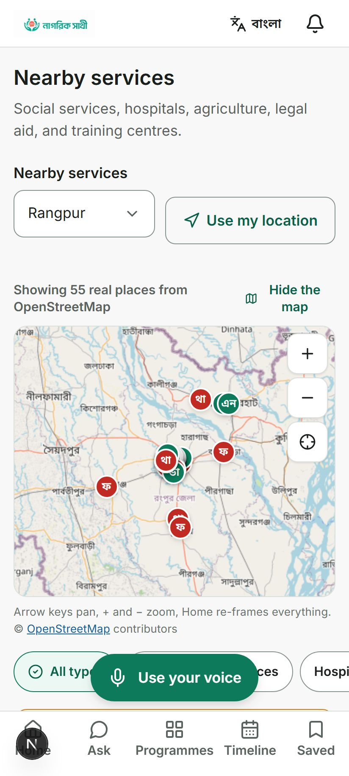
CORE CAPABILITY
A real, accessible map — built to survive 2G, not just look good on a demo Wi-Fi.
No Google Maps, no Mapbox, no 45-kilobyte map library. A hand-built, keyboard-operable map, blending real OpenStreetMap data — hospitals, police stations, legal aid, banks — with our own seeded office directory, each one honestly labelled as what it is. 55 real places, found near Rangpur, on this exact screen.
18 / 55

Slide 19
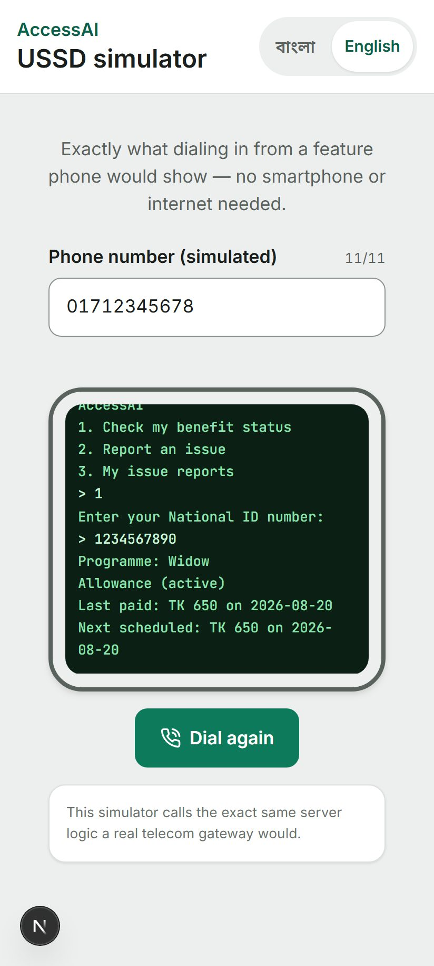
Zero smartphone.
Zero data plan.
CORE CAPABILITY
She doesn’t even need this app to use this app.
Dial a short code from any phone — no smartphone, no internet, no data cost — and check a real benefit status by National ID. This is the identical server logic a telecom aggregator would call, shown here as a working simulator so it can actually be demonstrated, not just described in a slide.
19 / 55

Slide 20
NOW, THE HALF NOBODY ELSE BUILDS
Knowing what you’re owed means nothing if nobody can see where the money went.
Union Parishads — Bangladesh’s lowest tier of elected local government — allocate real budgets for real projects. We built the citizen-facing accountability layer for that: report a problem, watch a budget, flag what looks wrong, and let anyone — with no account at all — check that the record hasn’t been quietly edited.
20 / 55

Slide 21
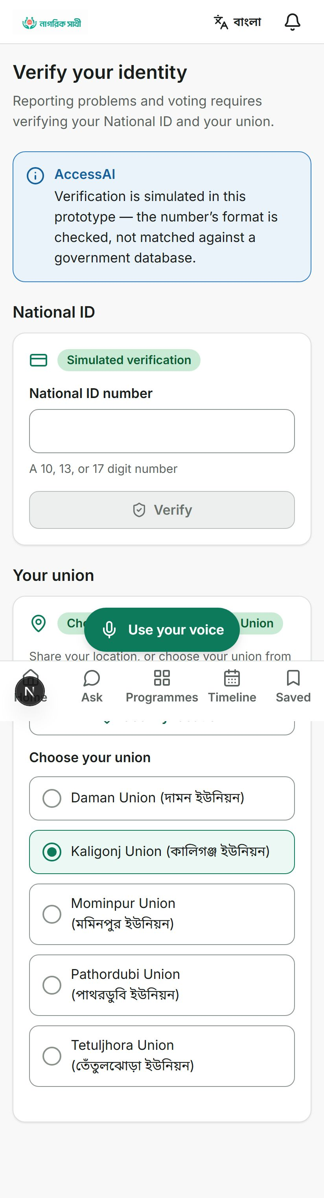
CIVIC LAYER — THE GATE
Every civic feature starts with proving who and where you are.
A National ID check and a residency check — matched, where possible, against a real GPS location inside her union’s actual boundary. And the app says, in the interface itself, exactly how far that verification really goes today: format-checked, not yet matched against a government database. No feature here pretends to be more certain than it is.
21 / 55

Slide 22
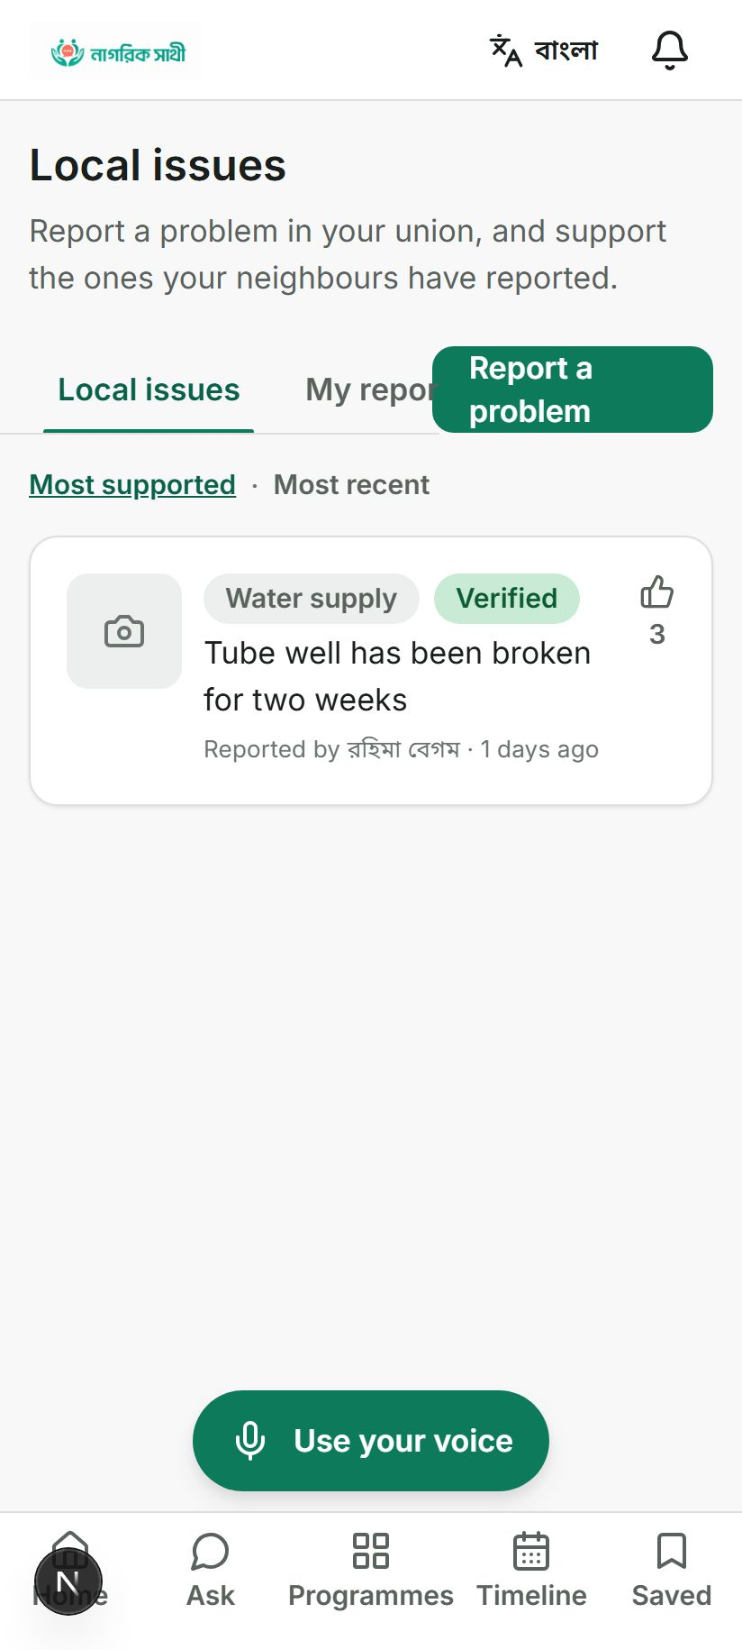
CIVIC LAYER — VOICE
A broken tube well shouldn’t need a favour to get fixed.
Report it, with a photo and a location. Neighbours can support it. Staff move it through a real, enforced lifecycle — under review → verified → in progress → completed — and it can’t skip a step. The report shown here is real: filed, verified, and backed by three of her neighbours.
22 / 55

Slide 23
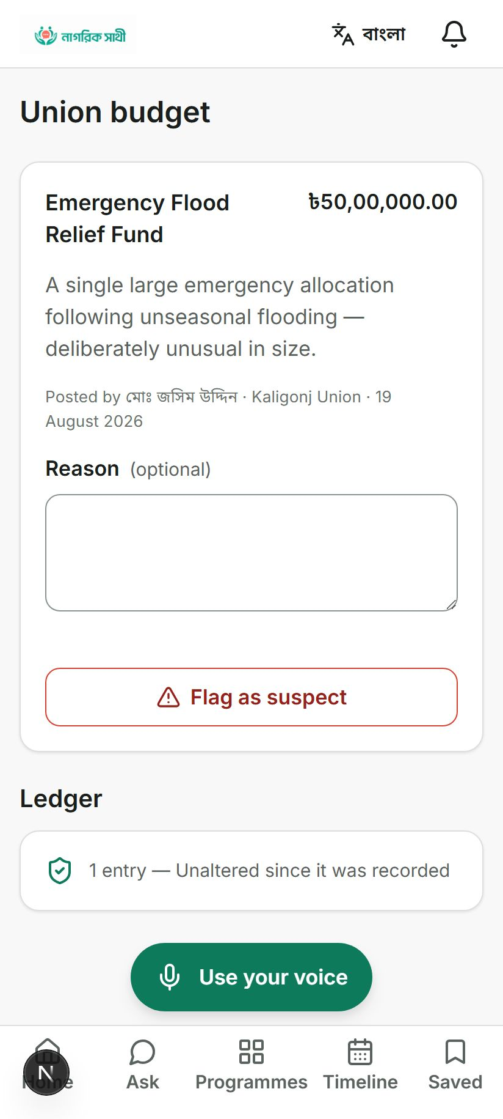
CIVIC LAYER — THE MONEY
See the allocation. Flag it if it looks wrong.
A ৳50,00,000 emergency flood fund, posted by the union chairman, visible to every verified resident — with a one-tap way to flag it as suspect. Enough flags from enough verified residents automatically escalate it to a district official’s queue. No petition drive required.
23 / 55

Slide 24
CIVIC LAYER — THE MECHANISM
How “unaltered since it was recorded” is actually proven.
Every allocation and every disbursement is chained: each new record’s fingerprint is built from the record before it. Change one figure after the fact, anywhere in the chain, and every fingerprint after it stops matching. It’s the digital version of a wax seal on a stack of letters — break one seal, and every seal after it visibly fails too.
We are exactly as honest about the limits: this proves nobody edited a record after it was written. It does not — and cannot — prove the first entry was truthful. That is what citizen flagging and anomaly detection are for, and they run alongside it, not instead of it.
24 / 55

Slide 25
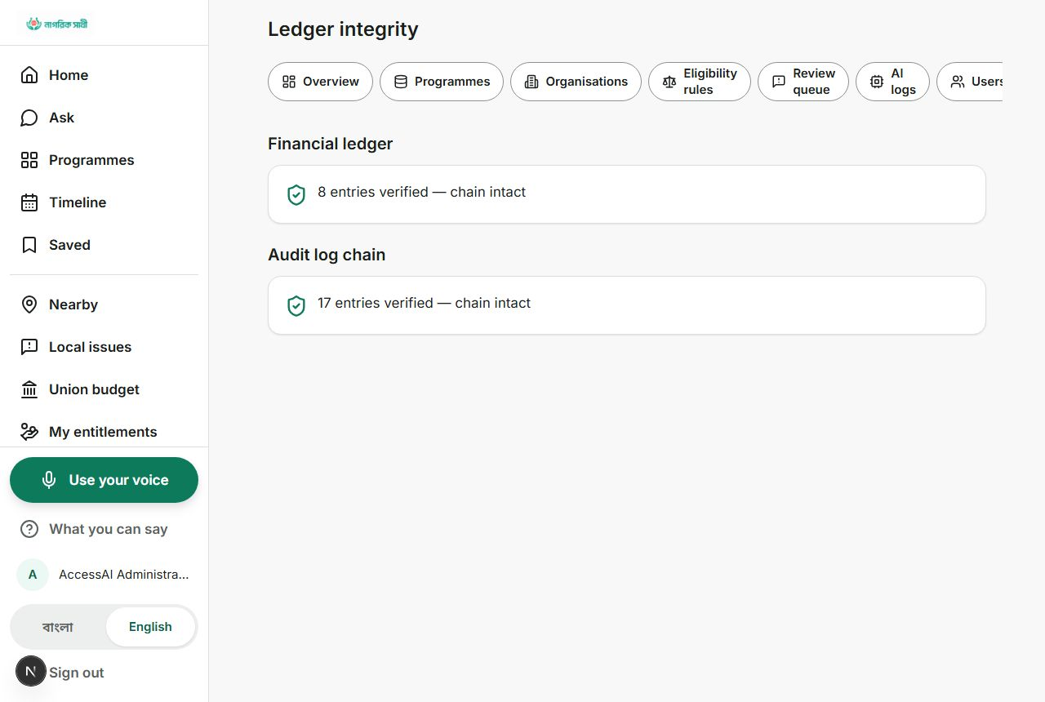
CIVIC LAYER — CHECK OUR WORK
A staff page that just... verifies the math. Out loud.
“8 entries verified — chain intact.” “17 entries verified — chain intact.” No opinion, no marketing language — a real recomputation of every record’s fingerprint, run against the live database. The same check ships as a stand-alone script that needs no login and no running server at all, so an outside auditor never has to trust our word for it.
25 / 55

Slide 26
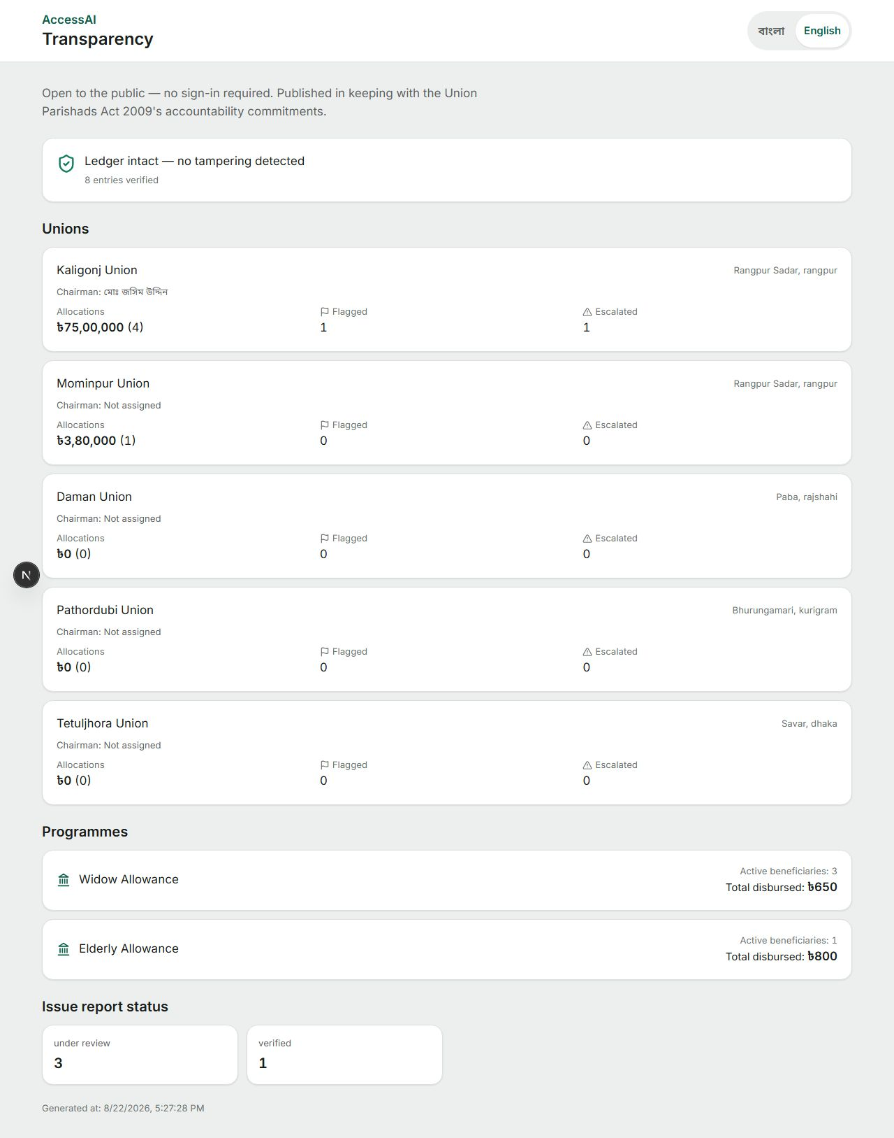
CIVIC LAYER — THE PUBLIC HALF
A page that needs no account at all.
Union names, chairmen’s names, allocation totals, flag counts, escalation counts, programme disbursement totals — and a live, real-time re-check of the ledger’s integrity. Open to any citizen, any journalist, any anti-corruption office, published in the spirit of the Union Parishads Act 2009’s own accountability commitments. No login screen stands between the public and this page.
26 / 55

Slide 27
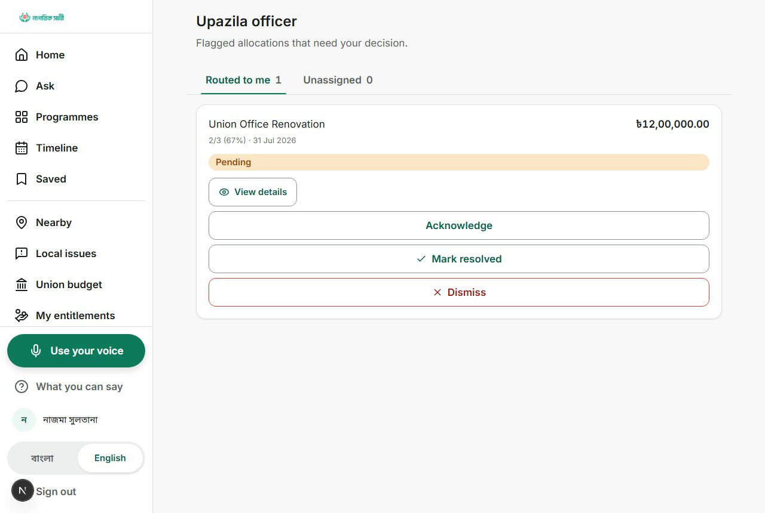
CIVIC LAYER — FOR OFFICIALS
A flag doesn’t vanish into a suggestion box. It becomes a real queue.
The upazila officer responsible for this union sees exactly one thing that needs a decision: a ৳12,00,000 renovation, flagged by two-thirds of a small resident base, routed to them by name. Acknowledge, resolve, or dismiss — every action logged. And if no officer is assigned yet, the escalation stays visibly “unassigned” rather than quietly disappearing.
27 / 55

Slide 28
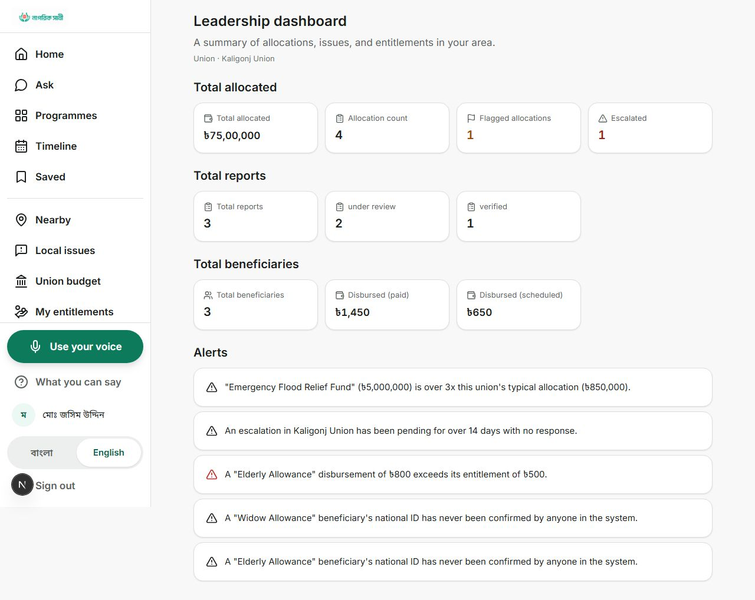
CIVIC LAYER — PATTERN DETECTION
Fraud doesn’t announce itself. Patterns do.
Five plain, explainable rules run automatically — no black-box machine learning, nothing that can’t be justified in one sentence: an allocation far above its union’s own usual size, the same National ID enrolled as a beneficiary in two unions at once, a payment that exceeds what someone was actually entitled to, an escalation that’s sat untouched for two weeks, a beneficiary nobody has ever identity-checked. Every single one on this real screen fired on real seeded data.
28 / 55

Slide 29
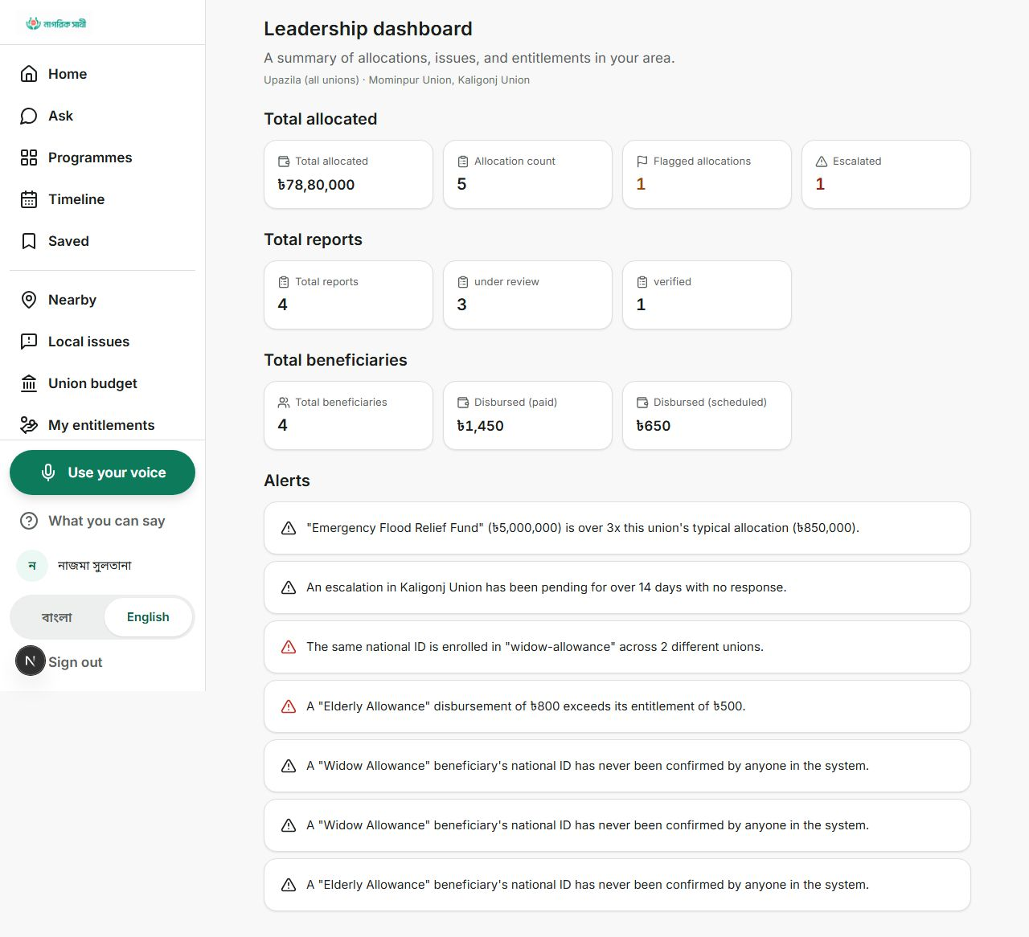
CIVIC LAYER — SAME CODE, WIDER LENS
One dashboard. It just changes scope, not code.
A union chairman sees their own union. An upazila officer sees every union in their upazila, automatically rolled up. A district officer would see their whole district. It’s the same screen, the same query — just widened. Proven here across two real unions in Rangpur Sadar.
29 / 55

Slide 30
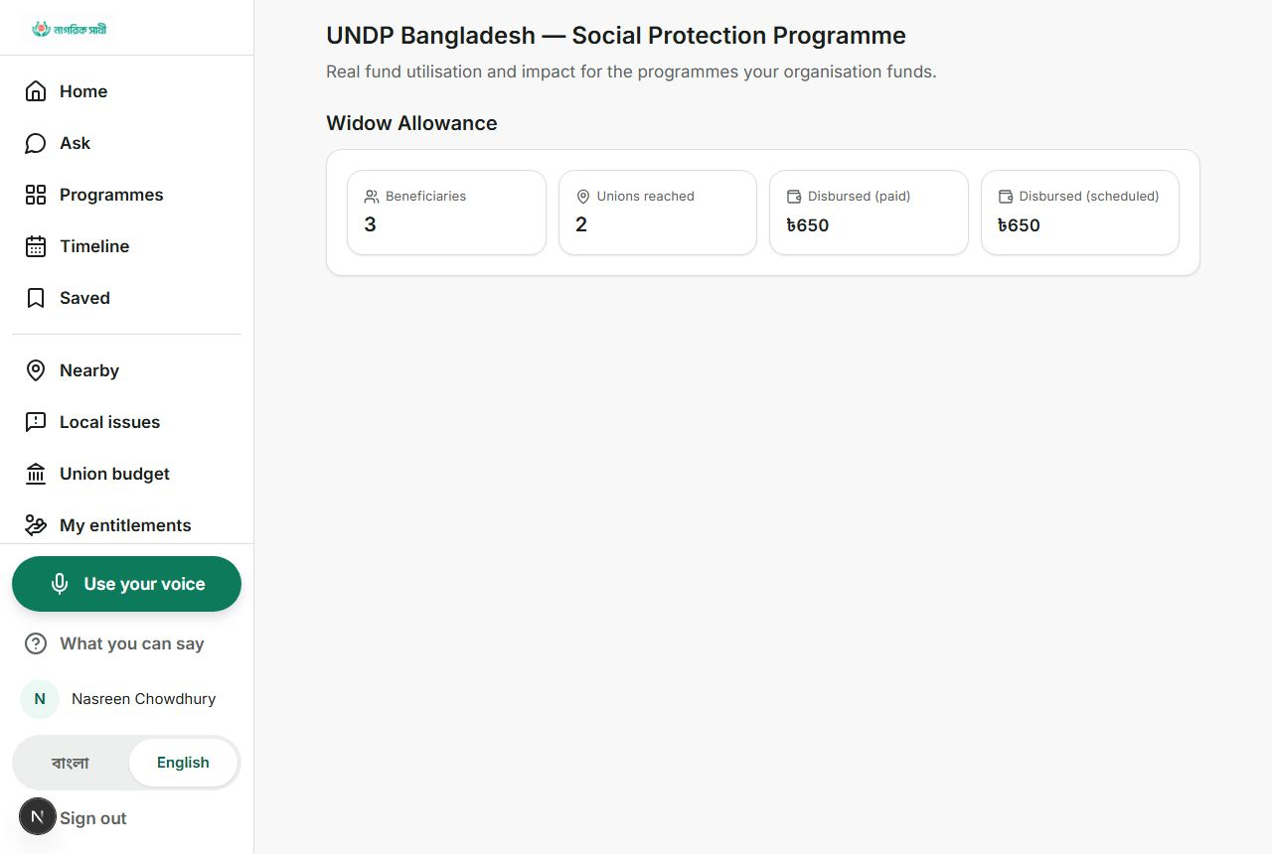
CIVIC LAYER — FOR FUNDERS
A donor sees exactly the money they gave. Nothing else.
A development partner funding the Widow Allowance sees real beneficiary counts, unions reached, and disbursed amounts — for that programme only. Never the whole ledger, never another funder’s numbers. Transparency for a donor doesn’t have to mean handing over everyone’s data to get it.
30 / 55

Slide 31
PRODUCT EXPERIENCE
We named the design system after Bhorosha — trust — and then built to it.
A confidence score is never allowed to overstate what the system actually knows:
Unverified sample
65%
Pending review
75%
Verified
100%
Outdated
45%
Disputed
25%
31 / 55

Slide 32
FOR THE TECHNICAL JUDGES — CONCEPT FIRST
The architecture exists to enforce one rule.
Citizen’s
message
→
Rules engine
decides
→
AI model
only explains
→
Citizen
reads the reply
If the middle step finds nothing, the last box before the citizen is never reached by a model at all — it’s rendered by a template instead. That’s not a fallback bolted on afterward; it’s the same code path every single time.
32 / 55

Slide 33
FOR THE TECHNICAL JUDGES — HOW IT’S ACTUALLY BUILT
One application. No Docker, no Redis, no separate backend to babysit.
Thin adapters
All the logic
One database
API routes and pages just parse, guard, and call one function.
Lives in plain functions that know nothing about the web framework.
A single SQLite file today, with one file that would need to change to move to Postgres.
This is a real, deliberate trade-off, not a shortcut we’re hiding: it means the whole system starts from a fresh clone with two commands, which is exactly what let every flow here be verified before you ever saw it.
33 / 55

Slide 34
FOR THE TECHNICAL JUDGES — WHY IT MATTERS HERE
Every infrastructure choice was made against a 2G phone, not a demo laptop.
Choice | Why it matters on the ground
No map library, tiles proxied by our own server | No third-party origin ever sees a citizen’s location just for looking up a legal aid office
OpenStreetMap, not a paid map API | No per-request billing risk as usage grows across a whole country
Server-side voice transcription | Works identically on Firefox and old Android WebViews, not just Chrome
SQLite today, Postgres-ready | Runs with zero installed services, so a partner’s team can actually stand it up
Deployed on Cloudflare’s edge network | Affordable at scale, and fast from wherever in Bangladesh someone opens it
34 / 55

Slide 35
BUILT FOR BANGLADESH — LANGUAGE
Bangla first. Not Bangla bolted on.
Every string in the product exists as a matched Bangla/English pair — a translation that’s missing its other half fails to even compile. Bangla text gets its own type rules: taller line spacing, larger sizing, no forced italics (Bangla script doesn’t really have one), and the exact OpenType features that let conjunct letters render correctly. This isn’t a checkbox; it’s structural.
35 / 55

Slide 36
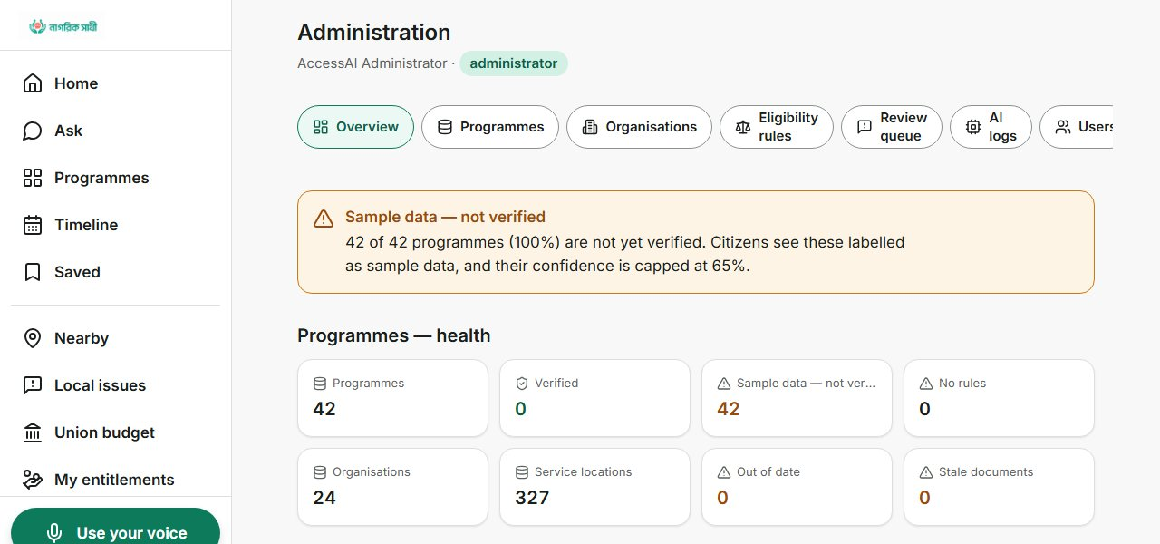
BUILT FOR BANGLADESH — GOVERNANCE
Modelled on the government structure that already exists.
Union Parishad, Upazila, Zila — the civic layer’s roles map onto Bangladesh’s real local government tiers, not an invented hierarchy. And the back office is just as honest as the citizen side: this real screen states plainly that 42 of 42 sample programmes aren’t yet verified, and their confidence is capped accordingly — nothing here is presented as more certain than it is.
36 / 55

Slide 37
WHAT ACTUALLY CHANGES
Before this exists. After it does.
BEFORE
AFTER
No idea what she qualifies for, or why A “no” with no reason and no next step A benefit application that quietly stalls A budget she has no way to see A complaint with nowhere real to go
A clear yes / partial / no / not yet — always with a reason The nearest programmes she actually does qualify for A checklist and deadlines that follow her A union budget she can see and flag A report that moves through a real, visible process
37 / 55

Slide 38
IS THIS REAL, OR A PITCH?
Every screen in this deck came from the running app. Nothing was drawn.
47
~44
58
2
database tables
bilingual pages
API route files
independent tamper-evident ledgers
38 / 55

Slide 39
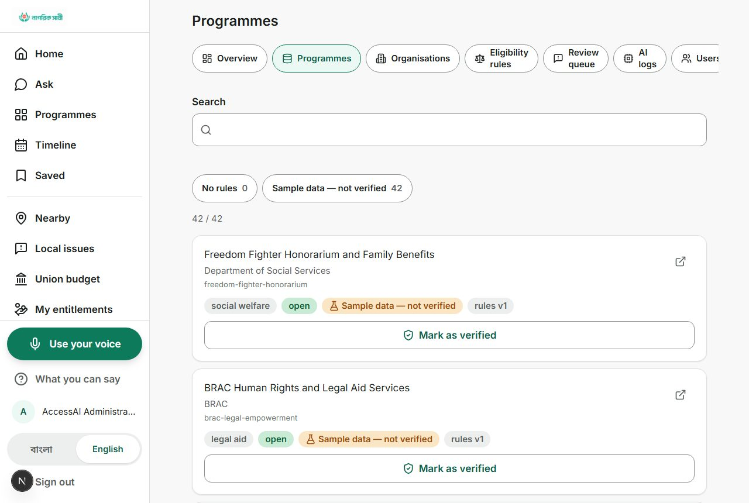
FEASIBILITY — VERIFY IT YOURSELF
We wrote down our own gaps before a judge could find them.
A ledger-audit script that runs with no login and no server. Automated tests that compute real contrast ratios instead of trusting a design document’s claim. And a document, shipped in the same repository, that says outright which integrations are real, which are simulated, and why — including one genuine bug we found and fixed while writing it. That habit of self-checking is itself the evidence this is engineered, not staged.
39 / 55

Slide 40
HOW THIS SUSTAINS ITSELF
A public-interest platform doesn’t monetise citizens. It monetises trust.
Ministry & local-government partnership
Donor-funded verification
Union Parishad accountability tier
Licensed as the digital front door for verified programmes — the verification workflow already exists; it just needs an institutional owner.
A development partner pays to have their own programmes verified and lifted out of the 65% ceiling — and gets the Donor Portal you just saw, for free, as proof.
A light support fee for unions that want the budget-transparency and issue-tracking module — the feature that builds a chairman’s own credibility.
No fee ever sits between a citizen and finding out what they’re owed. That line doesn’t move.
40 / 55

Slide 41
THE SIZE OF THE OPPORTUNITY
This pilot proves the model at 5 unions.
5
~4,500
→
unions running today
Union Parishads nationwide
No rewrite required. The leader dashboard already rolls a union up to an upazila by resolving a list of union IDs — the same query, wider scope. Growth here is a matter of onboarding, not engineering.
41 / 55

Slide 42
WHAT’S OUT THERE TODAY
Nothing else on the market does both halves of this.
 | Paper & word-of-mouth | Generic AI chatbot | Single-purpose NGO app | Nagorik Sathi
Explains why you qualify | No | Not reliably | Rarely | Every time
Cannot hallucinate a benefit | N/A | No safeguard | Depends | By construction
Works with no smartphone | Yes | No | No | USSD + SMS
Shows where local budgets go | No | No | Not usually | Public, no login
Tamper-evident financial records | No | No | No | Two independent chains
42 / 55

Slide 43
RISKS, NAMED HONESTLY
We’d rather you hear these from us.
Sample data isn’t verified yet
→ capped at 65% confidence, labelled everywhere, verification workflow already built
A single database is one writer
→ collisions fail loudly, not silently; a documented, deliberate limit at pilot scale
Real SMS / vision credentials aren’t live here
→ real vendor-shaped code, degrades to a stated fallback, never a silent fake success
Adoption needs institutional buy-in
→ every civic feature already mirrors Bangladesh’s real government tiers, so there’s no re-org required to use it
43 / 55

Slide 44
WHAT’S NEXT
Three honest steps, in order.
Next
Then
After
Verify the corpus with a real institutional partner — the single highest-leverage step there is.
Light up real SMS and vision-moderation credentials, and expand past 5 pilot unions.
Ship document capture with a confirm-what-we-read step, and a district-officer rollup dashboard.
44 / 55

Slide 45
WHY THIS SCALES
Adding the next union costs onboarding, not rewriting.
One codebase already answers “what can I get,” “where did the money go,” and “who’s watching” for a citizen, a chairman, an upazila officer, a donor, and the public — each from the exact same data, scoped differently. Any ministry’s next programme joins the same rule engine. Any union joins the same ledger. That is what makes this a platform, not a pilot.
45 / 55

Slide 46
JUDGING CRITERION — ORIGINALITY
The new idea isn’t the chatbot. It’s the wall we built around it.
Benefits chatbots already exist. What’s genuinely new is refusing to let a model decide anything — a rule engine owns the verdict, the AI only narrates it — and pairing that with a citizen-facing accountability ledger on the same platform, so “what can I get” and “where did the money go” are one product, not two.
46 / 55

Slide 47
JUDGING CRITERION — PRACTICAL IMPACT
It changes what a citizen learns, and what an official can’t hide.
A citizen gets a clear yes / partially / not eligible / not yet, always with a reason, instead of silence. A union chairman gets a legitimate channel to build trust. An upazila officer gets a real queue instead of rumours. None of it requires a citizen to already know the programme exists — the life-event grid finds it for them.
47 / 55

Slide 48
JUDGING CRITERION — COMMERCIALIZATION POTENTIAL
The buyers aren’t citizens — they’re the institutions that need to be trusted.
Ministries license it as a verified front door. Donors already want fund-tracking, and pay to have their own programmes verified. Union Parishads pay a light fee for the accountability tier that builds a chairman’s own credibility. The leader dashboard already scales from 5 pilot unions to any of Bangladesh’s ~4,500 with no rewrite — adoption is the constraint, not engineering.
48 / 55

Slide 49
JUDGING CRITERION — TECHNICAL CAPABILITY
Not a prototype pretending to work. A working system that says so.
47 database tables, 58 API route files, a deterministic rule engine with its own test suite, and two independent tamper-evident ledgers checkable with a script that needs no login. Every screenshot in this deck came from that running system, not a mockup.
49 / 55

Slide 50
JUDGING CRITERION — SUSTAINABLE DEVELOPMENT CONTRIBUTION
Four SDGs we can point to inside the product, not just in a slide.
SDG 1 — No Poverty
SDG 5 — Gender Equality
SDG 10 — Reduced Inequalities
SDG 16 — Strong Institutions
Connects citizens to welfare allowances they qualify for but didn’t know existed.
The flagship programme in this deck is a widow’s allowance; verification is open to every citizen equally.
Voice-first, USSD and SMS reach citizens with no smartphone, no data plan, or low literacy.
A tamper-evident public ledger and an enforced citizen complaint channel.
50 / 55

Slide 51
JUDGING CRITERION — INNOVATIVE LEADERSHIP
The evidence is in the discipline, not a slogan.
We documented our own gaps in the same repository before anyone else could find them, fixed a real audit-chain bug we found while building the ledger, and layered five civic phases onto an existing platform without breaking what already worked. That’s what initiative looks like in the artifact itself, not just in a claim about it.
51 / 55

Slide 52
JUDGING CRITERION — SOCIAL INCLUSION
Designed for the person least likely to be reached by a typical app.
Voice-first for citizens who don’t read fluently. No smartphone required — USSD and SMS reach the feature phone already in someone’s pocket. The flagship allowance in this deck serves widows specifically. And civic participation — flagging a budget, filing a report — is open to every verified resident, not just the already-connected few.
52 / 55

Slide 53
JUDGING CRITERION — ETHICS AND SAFETY
The AI is never allowed to decide anything that could hurt someone.
Never a fabricated verdict — an unconfigured check says “unavailable,” not a guessed pass.
Sensitive health data is encrypted at rest; audit logs redact it.
Confidence is capped, never inflated, on unverified information.
Conversations and AI logs are deleted on a real schedule — the accountability ledger never is.
53 / 55

Slide 54
JUDGING CRITERION — MARKET DEMAND
The demand already shaped the product, before we pitched anyone.
The Donor Portal exists because funders already want proof of impact. The verification workflow exists because institutions already need a trust gate before standing behind data. Nothing else on the market answers both “what can I get” and “where did the money go” — that gap is the demand.
54 / 55

Slide 55
ONE MORE TIME, ALL THE WAY THROUGH
A widow asks a question in her own words. A rule decides. A ledger remembers.
We didn’t build a chatbot with a benefits skin, and we didn’t build a transparency dashboard nobody outside an office will ever open. We built the thing a citizen actually opens first — and made sure everything behind it can be checked, by her, by an official, and by you. Every screen in this deck was real. That was the whole point.
নাগরিক সাথী
55 / 55

