Slide 1

FIELD SNAPSHOT •
Software is already
inside the pharmacy
What 16 pharmacy visits reveal about software, ordering and the human workflow
13 of 16 had some form of software
Small directional sample — not a market-share estimate
Notes:
[Sources]
- User-provided field-survey brief: 16 pharmacies; 13 had some software.
- OpenAI-generated clay-morphism asset: pharmacy-owner-hero.png.

Slide 2
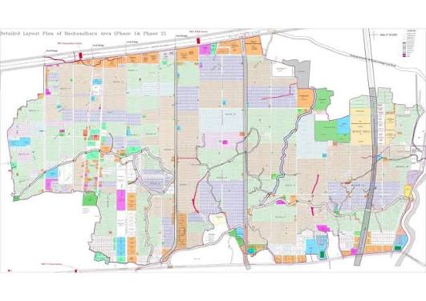
Location Bashundhara
Notes:
[Sources]
- User-provided field-survey brief: 16 pharmacies; 13 had some software.
- OpenAI-generated clay-morphism asset: pharmacy-owner-hero.png.

Slide 3
PHARMACY SURVEY
13 of 16 pharmacies use some software
13
/ 16
Software penetration looks high in this small, urban sample.
The next question is not adoption. It is what the software actually changes.
13 software-enabled
3 without
Directional field snapshot • 16 pharmacies •
02
Notes:
[Sources]
- User-provided field-survey brief: 13 of 16 visited pharmacies had some form of software.
- Interpretation is directional because the sample is small and localized.

Slide 4


PHARMACY SURVEY
BONIK leads — at a higher price
IQRASYS
BONIK
MEDIASOFT
Observed as more popular
70,000
3,000
30,000
2,000
INITIAL
MONTHLY
INITIAL
MONTHLY
Reported price points from pharmacy visits; currency/unit should be reconfirmed before external use.
Directional field snapshot • 16 pharmacies •
03
Notes:
[Sources]
- User-provided field-survey brief: BONIK observed as more popular; BONIK initial 70,000 / monthly 3,000; Mediasoft initial 30,000 / monthly 2,000; IQRASYS annotation.

Slide 5
PHARMACY SURVEY
The real order flow still starts with a shelf visit
1
2
3
4
5
6
SR arrives
Shelves
Reminders
Big khata
Delivery
Hard cash
at night
checked
+ order
records it
next day
settles
Entry specialists work across 3–4 pharmacies in parallel
Directional field snapshot • 16 pharmacies •
04
Notes:
[Sources]
- User-provided field-survey brief: SR visits at night, checks shelves, gives reminders and takes orders; order is recorded in a large khata; delivery arrives next day; settlement is hard cash; entry specialists cover 3–4 pharmacies in parallel.

Slide 6
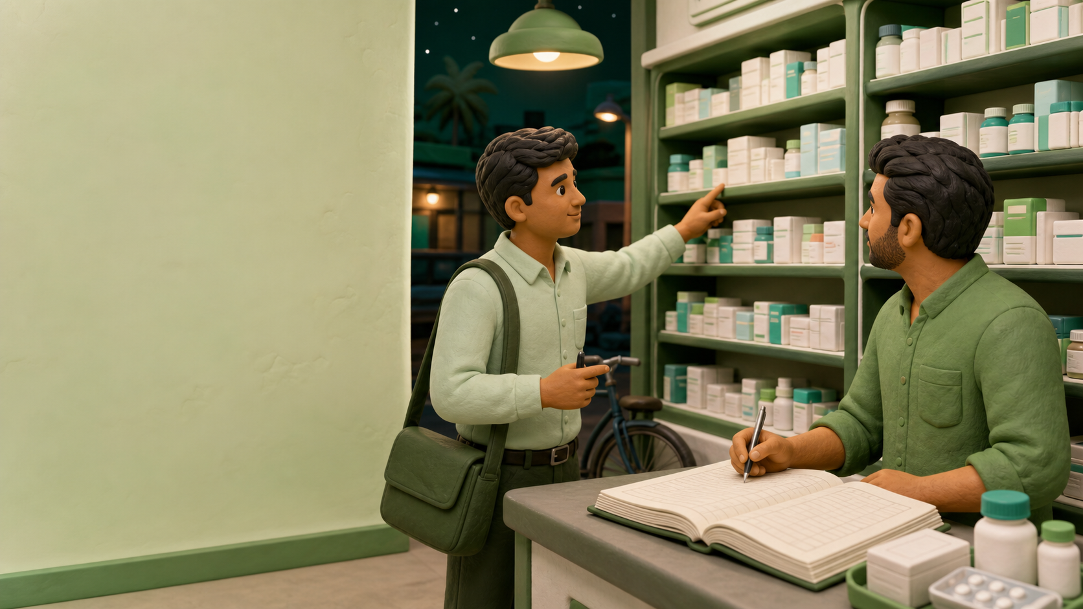
THE HUMAN LAYER
The SR is the
night-time procurement interface
1
Sees the shelves
2
Gives reminders
3
Takes the order
Software sits inside a relationship-led buying process.
05
Notes:
[Sources]
- User-provided field-survey brief: SR visits at night, sees shelves, gives reminders and takes orders.
- OpenAI-generated clay-morphism asset: night-sr-ordering.png.

Slide 7

THE OPERATING SYSTEM
Khata + software + cash
01
Khata captures the order
02
Software records the business
03
Cash closes the transaction
Digitization has not removed the analogue workflow — it sits beside it.
06
Notes:
[Sources]
- User-provided field-survey brief: large khata, pharmacy software and hard-cash settlement coexist.
- OpenAI-generated clay-morphism asset: khata-software-cash.png.

Slide 8
PHARMACY SURVEY
BONIK extends from POS into B2B ordering
IQRASYS
ORDER
ORDER
ANCHOR /
PHARMACY
BONIK
MANUFACTURER
places the order
B2B ordering layer
DELIVERY IS DONE BY ANCHOR
Settlement mechanism was not confirmed in the field note.
Directional field snapshot • 16 pharmacies •
07
Notes:
[Sources]
- User-provided field-survey brief: Bonik lets pharmacies order from Anchor/manufacturer; delivery is performed by Anchor. Settlement mechanism was explicitly not confirmed.
- IQRASYS annotation supplied by the user.

Slide 9
PHARMACY SURVEY
Adoption is not explained by price alone
2.3×
1.5×
higher initial price
higher monthly price
70,000 vs 30,000
3,000 vs 2,000
BONIK was still observed as more popular — workflow, support or distribution access may matter more than price.
Directional field snapshot • 16 pharmacies •
08
Notes:
[Sources]
- User-provided price points: BONIK 70,000 initial and 3,000 monthly; Mediasoft 30,000 initial and 2,000 monthly.
- Derived ratios: 70,000 / 30,000 = 2.33x; 3,000 / 2,000 = 1.5x.
- User-provided observation: BONIK is more popular in the visited set.

Slide 10
PHARMACY SURVEY
Design for the workflow that already exists
Human-assisted ordering
01
Support the SR and entry specialist instead of assuming self-serve.
Khata-to-system continuity
02
Make order capture and reconciliation work across paper and software.
Anchor fulfilment visibility
03
Show what was ordered, delivered and paid — clearly.
NEXT RESEARCH • active users • purchasing share • settlement flow
Directional field snapshot • 16 pharmacies •
09
Notes:
[Sources]
- Strategic interpretation based only on the user-provided 16-pharmacy field survey.
- Recommended next validations: active usage, purchasing wallet share and settlement flow.

Slide 11
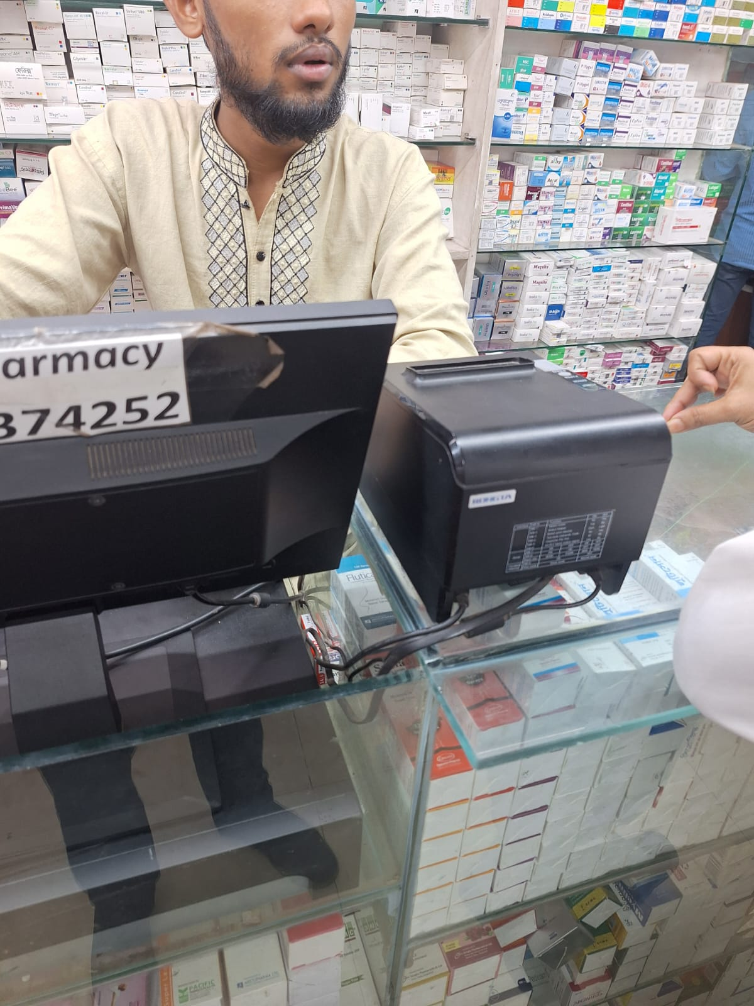
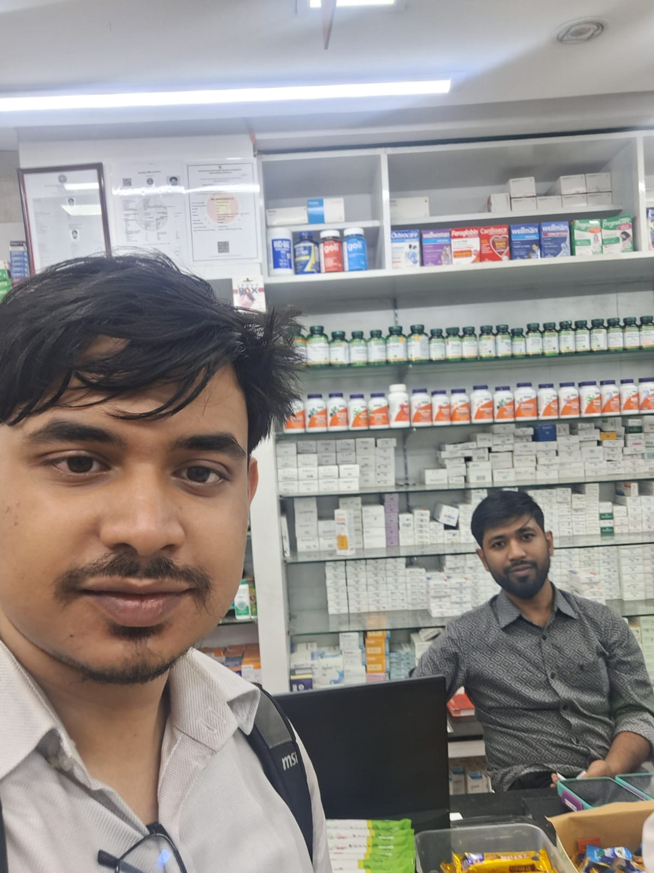
Notes:
[Sources]
- User-provided field-survey brief: 16 pharmacies; 13 had some software.
- OpenAI-generated clay-morphism asset: pharmacy-owner-hero.png.

Slide 12
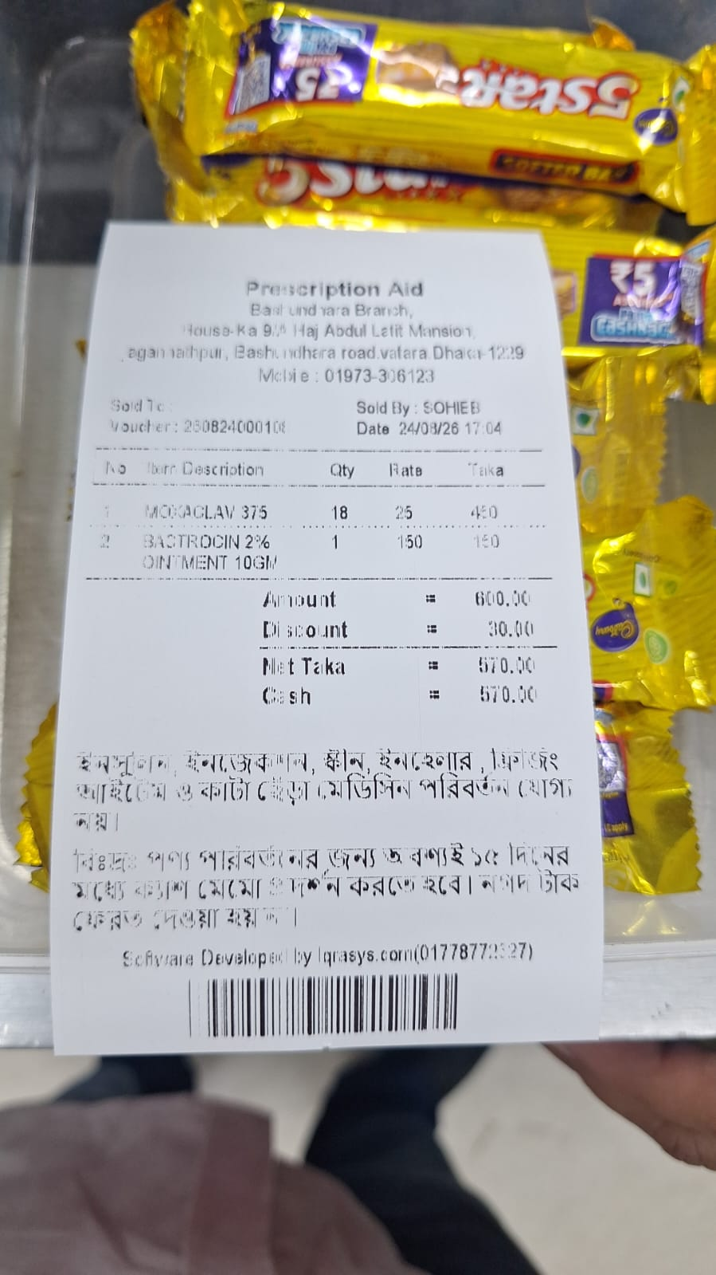
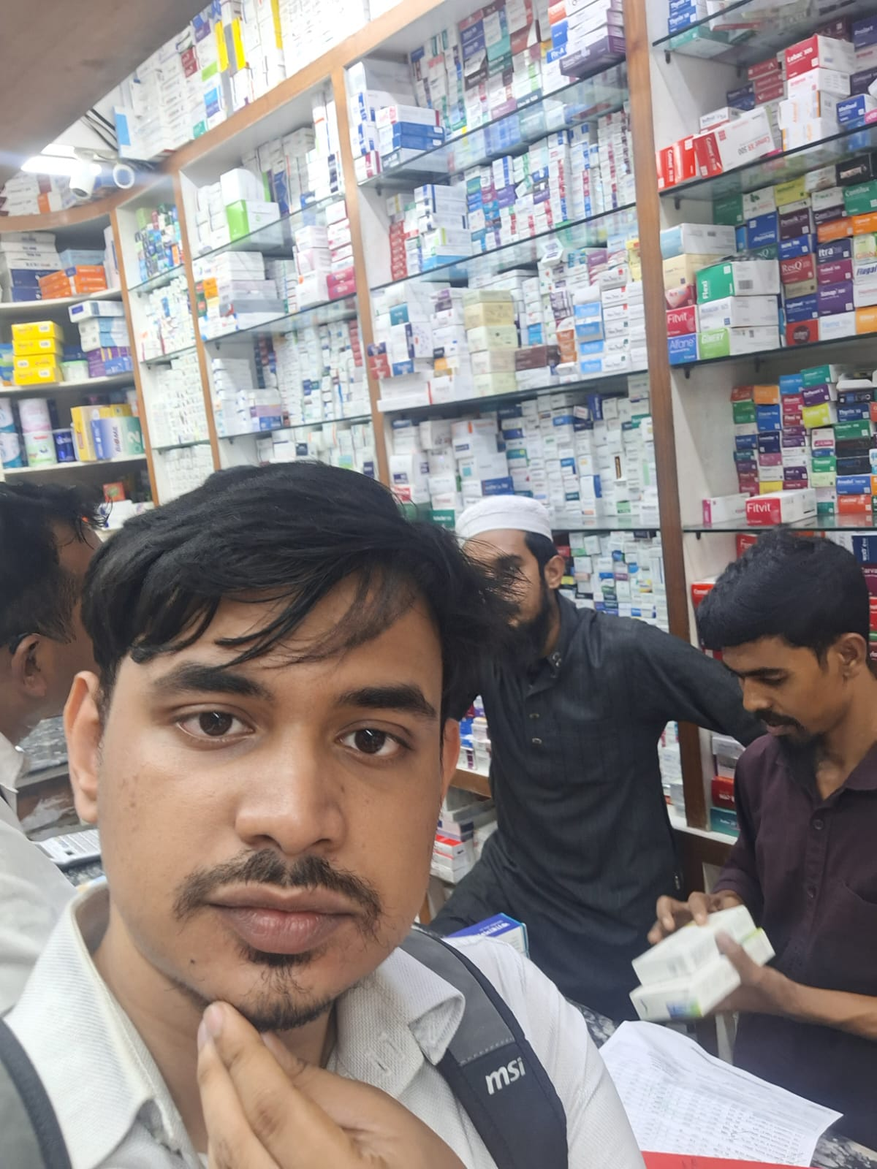
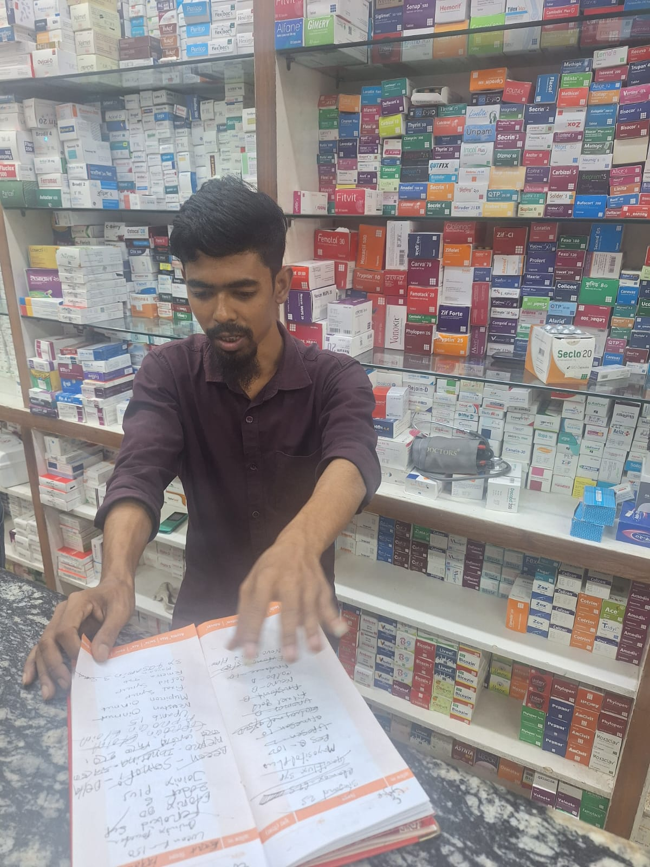
FIELD SNAPSHOT •
Notes:
[Sources]
- User-provided field-survey brief: 16 pharmacies; 13 had some software.
- OpenAI-generated clay-morphism asset: pharmacy-owner-hero.png.

