Slide 1
Peptide Detectability
Getting Started
16

Slide 2
Peptide detectability: Background
18
Protein sequence coverage rarely exceeds 25%
Protein presence is inferred by mapping peptides to database sequences.
Some peptides are more detectable than others.
Observed
peptides
Inferred
proteins
Notes:
>> Signature peptides versus ambiguous peptides
>> If we want to be sure of the existence of variants at protein level, we need a peptide that covers the variant region.

Slide 3

Differentiating potential isoforms
20
Gene:
1
2
3
Isoform A
Isoform B
Proteins:
1
2
3
OR
1
3
Peptide coverage observed in three different samples:
Sample X:
1
2
3
1
3
B present
Sample Y:
1
2
3
1
3
A present
Sample Z:
1
2
3
1
3
Ambiguous
If peptide is more detectable than , B is more likely in the ambiguous case.

Slide 4
Predicting peptide detectability
22
Published methods work by summing amino acid characteristics.
  Very poor predictive performance in practice.
We’ve tried two solutions:
Use deep learning (LSTM and Transformers) and random forests.
  Considers amino acid composition and order. Good results to date.
Train a new model to predict detectability from peptide structure.
  Need to predict peptide structures first. Limited success so far.
Notes:
AA Index
LSTM – works well for structural prediction

Slide 5
Plenty of training data in every sample
23
100s of inferred proteins in any sample:
= undetected tryptic peptides
= detected tryptic peptides

Slide 6
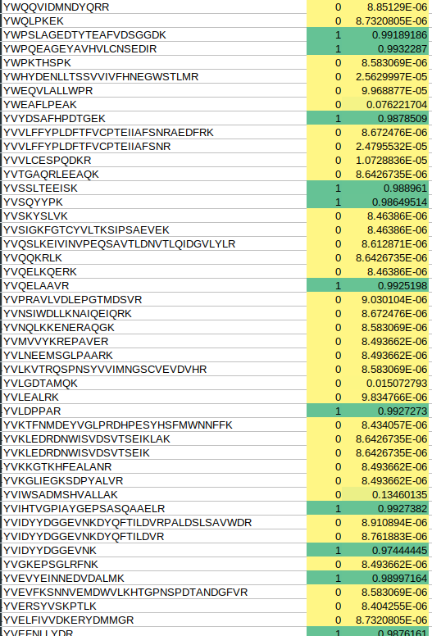
Predicting peptide detectability
23
We have achieved good predictive accuracy so far.
Quantitative predictability score reported for each peptide.
Biggest source of error is incomplete tryptic digestion affecting which peptides enter the mass spectrometer.

Slide 7
Digestion of proteins by trypsin
A cleavage enzyme (typically trypsin) is used to cut proteins in shorter peptides.
ALEWLGADRNEGRRHAAVLVLRELAISVPTFFFQQVQPFFDNIFVAVWDPKQAIREGAVAALRACLILTTQREPKEMQKPQW
ALEWLGADRNEGRRHAAVLVLRELAISVPTFFFQQVQPFFDNIFVAVWDPKQAIREGAVAALRACLILTTQREPKEMQKPQW
Length: 5 10 15 20 25
| | | | |
R
EPK
NEGR
QAIR
EMQKPQW
EGAVAALR
HAAVLVLR
ALEWLGADR
ACLILTTQR
ELAISVPTFFFQQVQPFFDNIFVAVWDPK
| | | | |
Trypsin cuts after K and R, unless they’re followed by P (Keil Rule).
BUT, sometimes digestion is incomplete so longer peptides are produced, e.g. QAIREGAVAALR
Notes:
Hopefully, after doing the coding module, you can see how easy it would be to predict the peptides that would be generated by tryptic digestion of any given protein sequence.

Slide 8
Effect of missed cleavage on detectabiliy
missed cleavage site
ALEWLGADRNEGRRHAAVLVLRELAISVPTFFFQQVQPFFDNIFVAVWDPKQAIREGAVAALRACLILTTQREPKEMQKPQW
Length: 5 10 15 20 25
| | | | |
R
EPK
NEGR
QAIREGAVAALR ← gained peptide
EMQKPQW
HAAVLVLR
ALEWLGADR
ACLILTTQR
ELAISVPTFFFQQVQPFFDNIFVAVWDPK
| | | | |
Length: 5 10 15 20 25
| | | | |
R
EPK
NEGR
QAIR ← lost peptide
EMQKPQW
EGAVAALR ← lost peptide
HAAVLVLR
ALEWLGADR
ACLILTTQR
ELAISVPTFFFQQVQPFFDNIFVAVWDPK
| | | | |

Slide 9
Proposal for predicting missed cleavage
Predicting missed cleavage from sequence has been tried – does not work very well (e.g. https://www.liebertpub.com/doi/10.1089/omi.2011.0156)
New idea: Locate potential cleavage sites on the protein structure and use neighborhood structure properties to predict likelihood of site being missed.
3D structures of all human proteins now available thanks to Alphafold, at https://alphafold.ebi.ac.uk/.

Slide 10
Proposed pipeline

Slide 11

Proposed pipeline
Protein identification software*
Spectrum counting
Mass spec data from sample
† Protein abundance is the main determinant of detectability of peptides from that protein
Protein identified in sample
Name | Sequence | Peptide evidence for each protein
MTOR | MLGTGPAAAT… | MEAARTCSR; LVPER; …
TP53 | MDPTGSQLDS... | GDGNSGFNEHLK; VDVSCEPLEGVE; …
~5,000 proteins; 10,000+ peptides | ~20,000 proteins
All human proteins
Name | Sequence
MTOR | MLGTGPAAAT…
TP53 | MDPTGSQLDS...
~20,000 proteins | ~20,000 proteins
Protein abundance†
5.672
3.108
All possible tryptic peptides (allowing up to N missed cleavages per peptide)
Name | Sequence | All possible peptides for each protein
MTOR | MLGTGPAAAT… | MLGTGPAAATTAATTSSNVSVLQQFASGLKSR; NEETR; …
TP53 | MDPTGSQLDS... | MDPTGSQLDSDFSQQDTPCLIIEDSQPESQVLEDDSGSHFSMLSR …
~20,000 proteins; >100,000 peptides | ~20,000 proteins
In silico tryptic digestion
Only keep peptides belonging to proteins identified in our sample
All potentially observable tryptic peptides (allowing up to N missed cleavages per peptide)
Name | Sequence | All potentially observable peptides for each protein
MTOR | MLGTGPAAAT… | NEETR; NEETRAK; NEETRAKAAK; ELQHYVTMELR; …
TP53 | MDPTGSQLDS... | HLPNLQTHKENPVLDVVSNPEQTAGEER; GDGNSGFNEHLK; …
~5,000 proteins; ~100,000 peptides | ~20,000 proteins
Drop peptides outside detectable mass range
WARNING: This slide is a work in progress! May contain errors!
*allowed missed cleavages per peptide = N

Slide 12
Proposed pipeline
Protein abundance
5.672
3.108
All potentially observable tryptic peptides (allowing up to N missed cleavages per peptide)
Name | Sequence | All potentially observable peptides for each protein
MTOR | MLGTGPAAAT… | NEETR; NEETRAK; NEETRAKAAK; ELQHYVTMELR; …
TP53 | MDPTGSQLDS... | HLPNLQTHKENPVLDVVSNPEQTAGEER; GDGNSGFNEHLK; …
~5,000 proteins; ~100,000 peptides | ~20,000 proteins
WARNING: This slide is a work in progress! May contain errors!

Slide 13
Proposed pipeline
All potentially observable tryptic peptides (allowing up to N missed cleavages per peptide)
Name | Sequence | All potentially observable peptides for each protein
MTOR | MLGTGPAAAT… | NEETR; NEETRAK; NEETRAKAAK; ELQHYVTMELR; …
TP53 | MDPTGSQLDS... | HLPNLQTHKENPVLDVVSNPEQTAGEER; GDGNSGFNEHLK; …
~5,000 proteins; ~100,000 peptides | ~20,000 proteins
Protein abundance
5.672
3.108
WARNING: This slide is a work in progress! May contain errors!

Slide 14
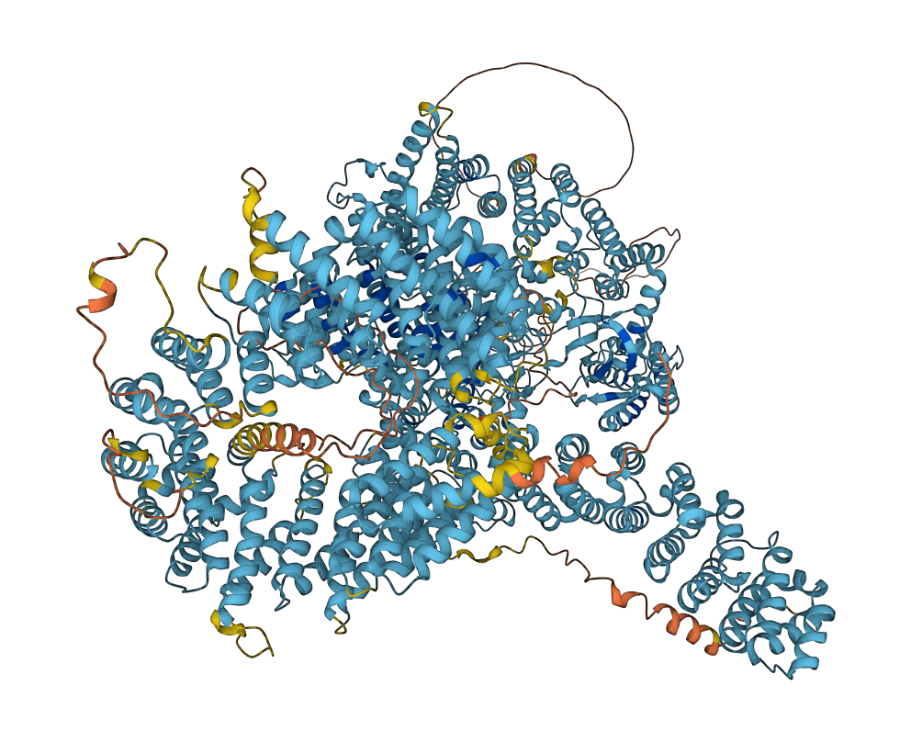
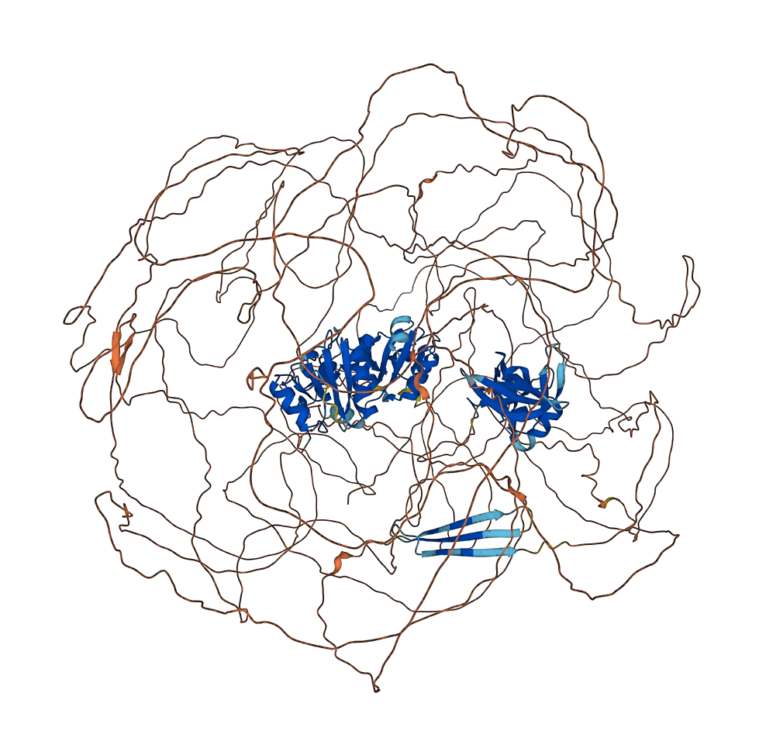
Proposed pipeline
All potentially observable tryptic peptides (allowing up to N missed cleavages per peptide)
Name | Sequence | All potentially observable peptides for each protein
MTOR | MLGTGPAAAT… | NEETR; NEETRAK; NEETRAKAAK; ELQHYVTMELR; …
TP53 | MDPTGSQLDS... | HLPNLQTHKENPVLDVVSNPEQTAGEER; GDGNSGFNEHLK; …
~5,000 proteins; ~100,000 peptides | ~20,000 proteins
Protein abundance
5.672
3.108
Prediction of likelihood of tryptic cleavage at each site
Refined list of potentially observable tryptic peptides (allowing up to N missed cleavages)
Name | Sequence | All potentially observable peptides for each protein
MTOR | MLGTGPAAAT… | NEETR; NEETRAKAAK; ELQHYVTMELR; …
TP53 | MDPTGSQLDS... | HLPNLQTHKENPVLDVVSNPEQTAGEER; GDGNSGFNEHLK; …
~5,000 proteins; <~100,000 peptides | ~20,000 proteins
Protein abundance
5.672
3.108
Structures from Alphafold2
Peptide detectability scores
Name | Peptide | Detectability score
MTOR | NEETR | 0.568
MTOR | NEETRAKAAK | 0.601
MTOR | ELQHYVTMELR | 0.954
TP53 | HLPNLQTHKENPVLDVVSNPEQTAGEER | 0.808
<~100,000 peptides | ~20,000 proteins
Machine learning model
WARNING: This slide is a work in progress! May contain errors!

Slide 15
Training & testing the machine learning model
All potentially observable tryptic peptides (allowing up to N missed cleavages per peptide)
Name | Sequence | All potentially observable peptides for each protein
MTOR | MLGTGPAAAT… | NEETR; NEETRAK; NEETRAKAAK; ELQHYVTMELR; …
TP53 | MDPTGSQLDS... | HLPNLQTHKENPVLDVVSNPEQTAGEER; GDGNSGFNEHLK; …
~5,000 proteins; ~100,000 peptides | ~20,000 proteins
Protein abundance
5.672
3.108
Prediction of likelihood of tryptic cleavage at each site
Refined list of potentially observable tryptic peptides (allowing up to N missed cleavages)
Name | Sequence | All potentially observable peptides for each protein
MTOR | MLGTGPAAAT… | NEETR; NEETRAKAAK; ELQHYVTMELR; …
TP53 | MDPTGSQLDS... | HLPNLQTHKENPVLDVVSNPEQTAGEER; GDGNSGFNEHLK; …
~5,000 proteins; <~100,000 peptides | ~20,000 proteins
Protein abundance
5.672
3.108
Structures from Alphafold2
Peptide detectability scores
Name | Peptide | Detectability score
MTOR | NEETR | 0.568
MTOR | NEETRAKAAK | 0.601
MTOR | ELQHYVTMELR | 0.954
TP53 | HLPNLQTHKENPVLDVVSNPEQTAGEER | 0.808
<~100,000 peptides | ~20,000 proteins
Machine learning model
WARNING: This slide is a work in progress! May contain errors!

Slide 16
Quantitation
Detectability is not really a binary thing.
Some peptides are intrinsically more detectable than others.
This is why we can’t quantify peptides from MS peak areas alone.
Ideally, we what a quantitative measure of detectability (see F-Factor paper for one attempt).

