Slide 1

MAJOR PROJECT
MUSIC ANALYSIS USING COMPUTATIONAL METHODS
Supervisor : Dr. Anurag Sahay
Name : Shashank Sinha
Roll no. : 1810002
Dept. : Integrated M.Sc. Physics

Slide 2
DATA COLLECTION
For this project I have used midi files datasets, having piano music from the following sources :
http://www.piano-midi.de/midi_files.htm
https://abc.sourceforge.net/NMD/
TECHNIQUES USED
time series forecasting
LSTM, dropout, and dense layer in neural network model.
music21 and numpy modules for data preparation
keras for sequential LSTM modeling
matplotlib for data visualization

Slide 3
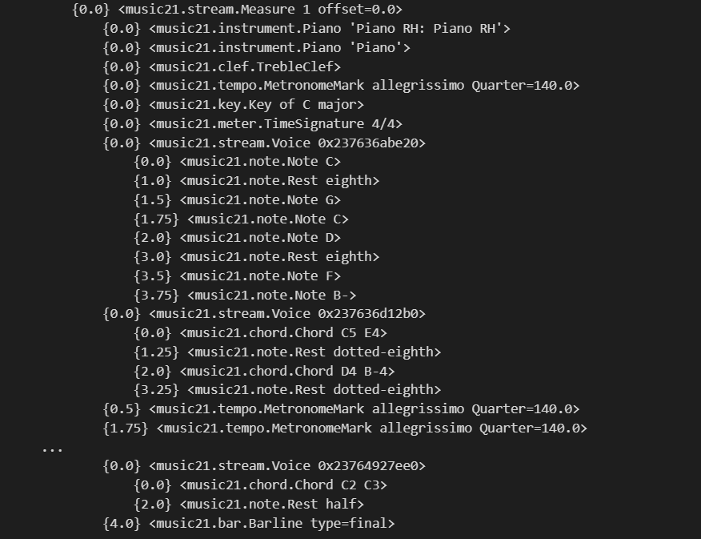
Midi dataset (in text form)

Slide 4
MODELS USED
LSTM
Long Short Term Memory networks – usually just called “LSTMs” – are a special kind of RNN, capable of learning long-term dependencies. LSTMs are explicitly designed to avoid the long-term dependency (Vanishing gradient) problem. Remembering information for long periods of time is practically their default behavior.
In RNN :
a1 = A[(Wxa)*(x1) + (Waa)*(a0) + ba] , y1 = A’[(Way)*(a1) + by] …
=> an = A[(Wxa)*(xn) + (Waa)*(an-1) + ba] , yn = A’[(Way)*(an) + by]
where, A : Activation function ,
Waa : gradients (weights) for correlation coefficients (a0, a1,..)
Waa > 1 : Exploding Gradient problem
Waa < 1 : Vanishing Gradient problem

Slide 5
MODELS USED
Dropout Layer
Used to drop some fraction of previous layer’s output, to discard some random noise created in middle of neural network.
Dense Layer
In Music, there might be deep correlation, with previous music elements, therefore used dense layer in model.
In final layer of neural network, predicted output in terms of probability-distribution using softmax activation function.

Slide 6
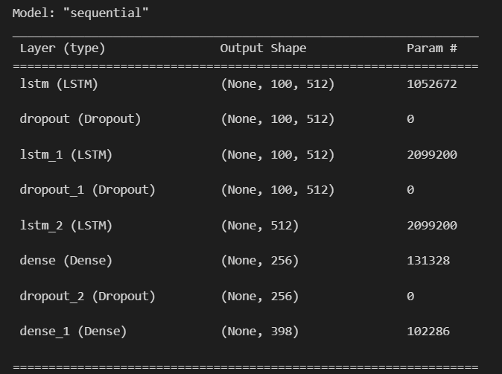
Sequential model (summary)

Slide 7
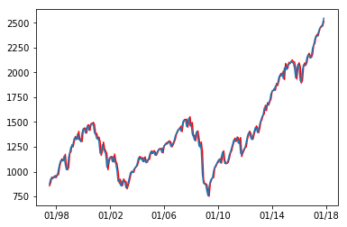
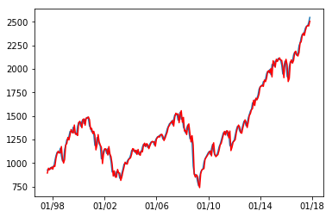
S&P 500 ARIMA model
The ARIMA predictions below have an average RMSE value of 45.5 (with the range of actual values being from ~800 to 2500). One differencing period and log transformation was used.
S&P 500 LSTM model
The LSTM model below also uses log transformation and differencing, with 5 training epochs to update model weights. It has a very similar average RMSE error of 46.7.

Slide 8
RESULT
Data Set | ARIMA (test RMSE) | LSTM (test RMSE) | Gaussian ARIMA (RMSE) | Gaussian LSTM (RMSE)
S&P 500 | 45.495 | 46.671 | 24.570 | 24.751
LeBron James | 20.009 | 27.175 | 9.816 | 13.743
Cold Brew | 9.157 | 8.597 | 3.025 | 4.543
Kentucky Perby | 30.935 | 30.224 | 15.232 | 15.232
Gilmore Girls | 12.026 | 13.885 | 6.517 | 7.592
Olympics | 17.420 | 18.506 | 9.146 | 11.078
Zika Virus | 16.771 | 16.040 | 8.543 | 8.586

Slide 9
CONCLUSION
Overall, the results demonstrate that both ARIMA and LSTM are quality algorithms for forecasting time series data. In general, the ARIMA model provided slightly lower errors, but also can suffer from convergence errors for series with sharp gradients. The LSTM series can train and make predictions on any series—though the accuracy must be evaluated.
Further, Gaussian filtering of the dataset improved predictions in every case, even when comparing the filtered predictions to the original, un-filtered dataset.

