Slide 1

I-V Characteristics of Linear Circuits
Department of Computer Science and Engineering (CSE)
BRAC University
Fall 2023
CSE250 – Circuits and Electronics
Purbayan Das, Lecturer
Department of Computer Science and Engineering (CSE)
BRAC University

Slide 2
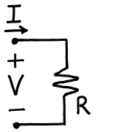
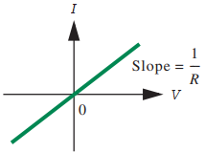
I-V Characteristics
[PDS] Purbayan Das
CSE250 – Circuits and Electronics
Department of CSE, BracU
2

Slide 3
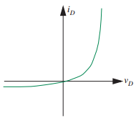


Linear and non-linear elements
A linear element
A non-linear element
[PDS] Purbayan Das
CSE250 – Circuits and Electronics
Department of CSE, BracU
3

Slide 4
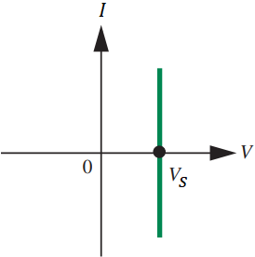
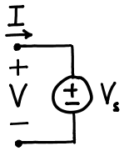
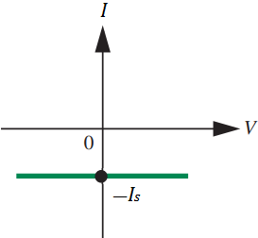
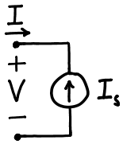
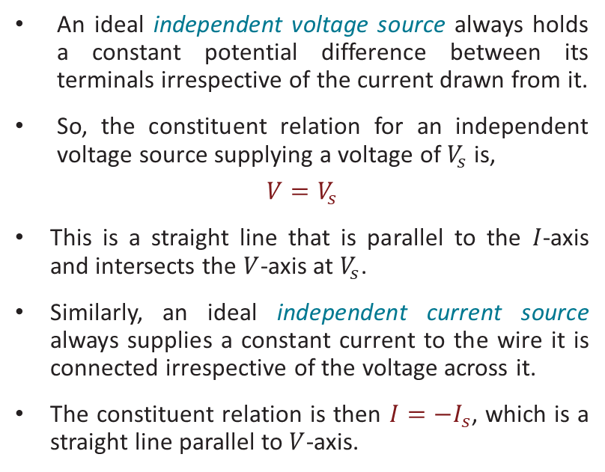
I-V of Voltage and Current Source
An ideal independent voltage source always holds a constant potential difference between its terminals irrespective of the current drawn from it.
So, the constituent relation for an independent voltage source supplying a voltage of $V_{s}$ is,
$$V=V_{s}$$
This is a straight line that is parallel to the $I$-axis and intersects the $V$-axis at $V_{s}$.
Similarly, an ideal independent current source always supplies a constant current to the wire it is connected irrespective of the voltage across it.
The constituent relation is then $I={−I}_{s}$, which is a straight line parallel to $V$-axis.
[PDS] Purbayan Das
CSE250 – Circuits and Electronics
Department of CSE, BracU
4

Slide 5
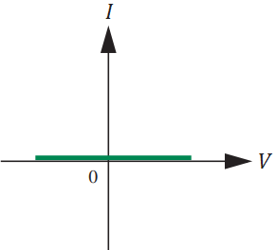
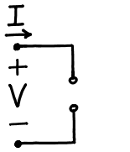
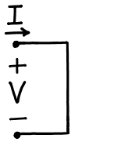
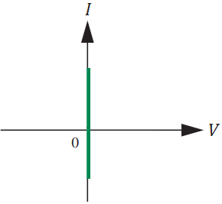
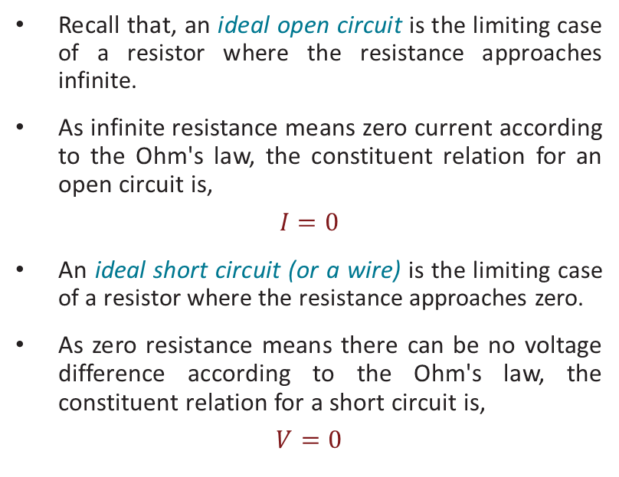
I-V of Open and Short Circuits
Recall that, an ideal open circuit is the limiting case of a resistor where the resistance approaches infinite.
As infinite resistance means zero current according to the Ohm's law, the constituent relation for an open circuit is,
$$I=0$$
An ideal short circuit (or a wire) is the limiting case of a resistor where the resistance approaches zero.
As zero resistance means there can be no voltage difference according to the Ohm's law, the constituent relation for a short circuit is,
$$V=0$$
[PDS] Purbayan Das
CSE250 – Circuits and Electronics
Department of CSE, BracU
5

Slide 6
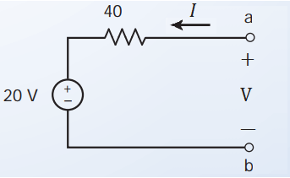
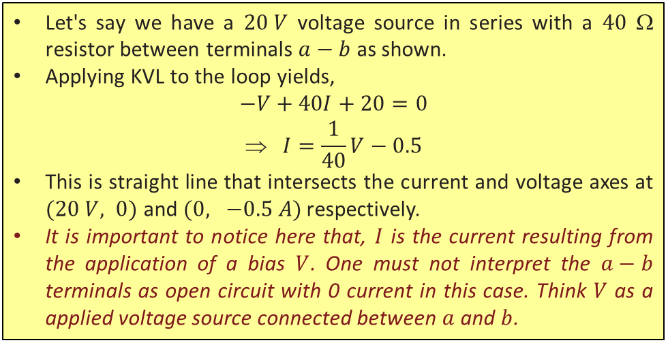


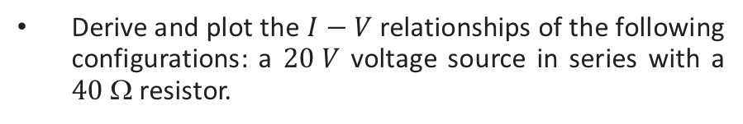


Example 1
Derive and plot the $I−V$ relationships of the following configurations: a $20 V$ voltage source in series with a $40$ Ω resistor.
Let's say we have a $20 V$ voltage source in series with a $40$ Ω resistor between terminals $a−b$ as shown.
Applying KVL to the loop yields,
$$−V+40I+20=0$$
$$ I=\frac{1}{40}V−0.5$$
This is straight line that intersects the current and voltage axes at $(20 V, 0)$ and $(0, −0.5 A)$ respectively.
It is important to notice here that, $I$ is the current resulting from the application of a bias $V$. One must not interpret the $a−b$ terminals as open circuit with 0 current in this case. Think $V$ as a applied voltage source connected between $a$ and $b$.
$$I$$
$$20 V$$
$$V$$
$$−0.5 A$$
[PDS] Purbayan Das
CSE250 – Circuits and Electronics
Department of CSE, BracU
6

Slide 7
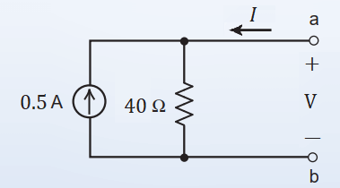

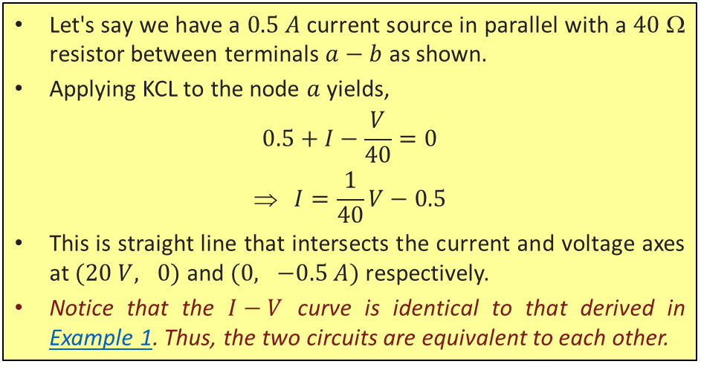

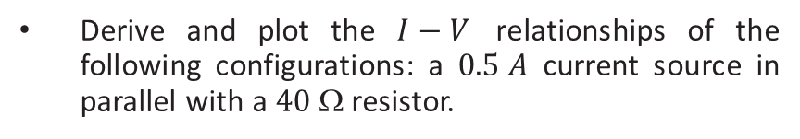


Example 2
Derive and plot the $I−V$ relationships of the following configurations: a $0.5 A$ current source in parallel with a $40$ Ω resistor.
Let's say we have a $0.5 A$ current source in parallel with a $40$ Ω resistor between terminals $a−b$ as shown.
Applying KCL to the node $a$ yields,
$$0.5+I−\frac{V}{40}=0$$
$$ I=\frac{1}{40}V−0.5$$
This is straight line that intersects the current and voltage axes at $(20 V, 0)$ and $(0, −0.5 A)$ respectively.
Notice that the $I−V$ curve is identical to that derived in Example 1. Thus, the two circuits are equivalent to each other.
$$I$$
$$20 V$$
$$V$$
$$−0.5 A$$
[PDS] Purbayan Das
CSE250 – Circuits and Electronics
Department of CSE, BracU
7

Slide 8
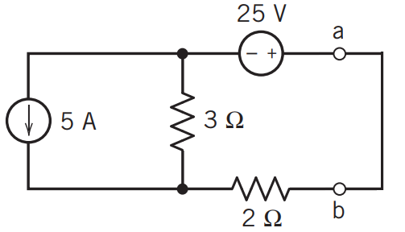
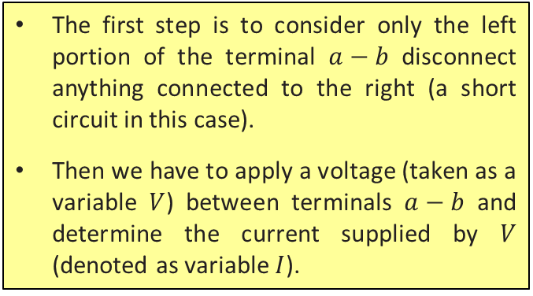
Example 3
Derive and plot the $I−V$ relationship of the left portion of $a−b$ in the following circuit.
The first step is to consider only the left portion of the terminal $a−b$ disconnect anything connected to the right (a short circuit in this case).
Then we have to apply a voltage (taken as a variable $V$) between terminals $a−b$ and determine the current supplied by $V$ (denoted as variable $I$).
[PDS] Purbayan Das
CSE250 – Circuits and Electronics
Department of CSE, BracU
8

Slide 9
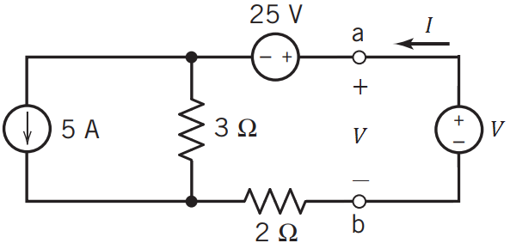

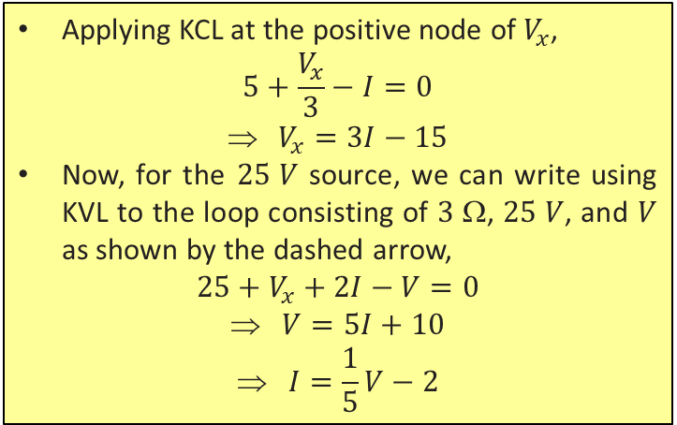
Example 3: solution
Applying KCL at the positive node of $V_{x}$,
$$5+\frac{V_{x}}{3}−I=0$$
$$ V_{x}=3I−15$$
Now, for the $25 V$ source, we can write using KVL to the loop consisting of $3$ Ω, $25 V$, and $V$ as shown by the dashed arrow,
$$25+V_{x}+2I−V=0$$
$$ V=5I+10$$
$$ I=\frac{1}{5}V−2$$
$$+$$ $$V_{x}$$ $$−$$
[PDS] Purbayan Das
CSE250 – Circuits and Electronics
Department of CSE, BracU
9

Slide 10
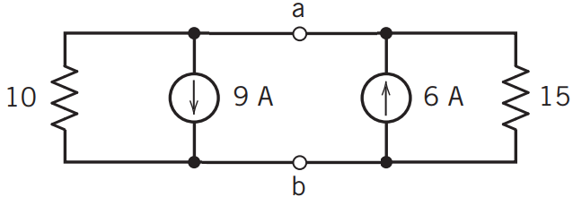


Problem 1
Derive the $I−V$ characteristics of the following circuit with respect to the terminals $a−b$.
Ans: $I=\frac{1}{6}V+3$
[PDS] Purbayan Das
CSE250 – Circuits and Electronics
Department of CSE, BracU
10

Slide 11
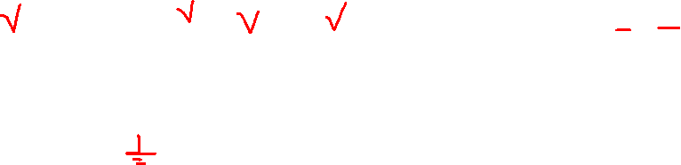


Problem 1
Derive the $I−V$ characteristics of the following circuit with respect to the terminals $a−b$.
$$\frac{V}{15}+\frac{V}{10}+9=I+6$$
$$or, I=\frac{V}{6}+3$$
Ans: $I=\frac{1}{6}V+3$
[PDS] Purbayan Das
CSE250 – Circuits and Electronics
Department of CSE, BracU
11

Slide 12
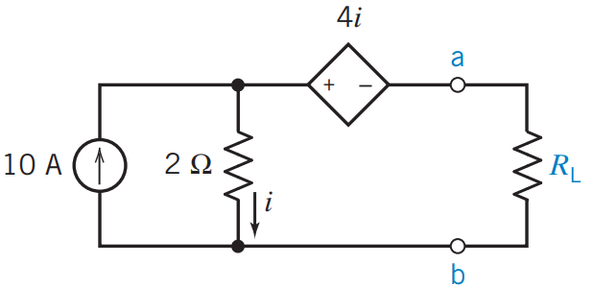


Problem 2
Derive the $I−V$ characteristics of the following circuit with respect to the terminals $a−b$.
Ans: $I=−\frac{1}{2}V−10$
[PDS] Purbayan Das
CSE250 – Circuits and Electronics
Department of CSE, BracU
12

Slide 13
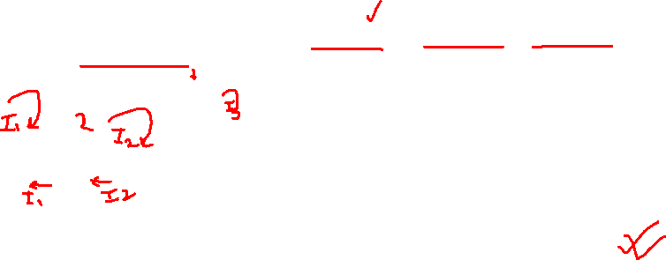

Problem 2
Derive the $I−V$ characteristics of the following circuit with respect to the terminals $a−b$.
$$I_{1}=10 i=I_{1}−I_{2} I=−I_{2}$$
$$4i+V+2(I_{2}−I_{1})=0$$
$$or, 4(I_{1}−I_{2})+V+2(I_{2}−I_{1})=0$$
$$or, 2I_{1}−{2I}_{2}+V=0$$
$$or, 2I_{1}+2I+V=0$$
$$or, I=−\frac{V}{2}−10$$
Ans: $I=−\frac{1}{2}V−10$
[PDS] Purbayan Das
CSE250 – Circuits and Electronics
Department of CSE, BracU
13

Slide 14
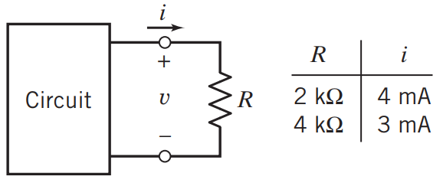

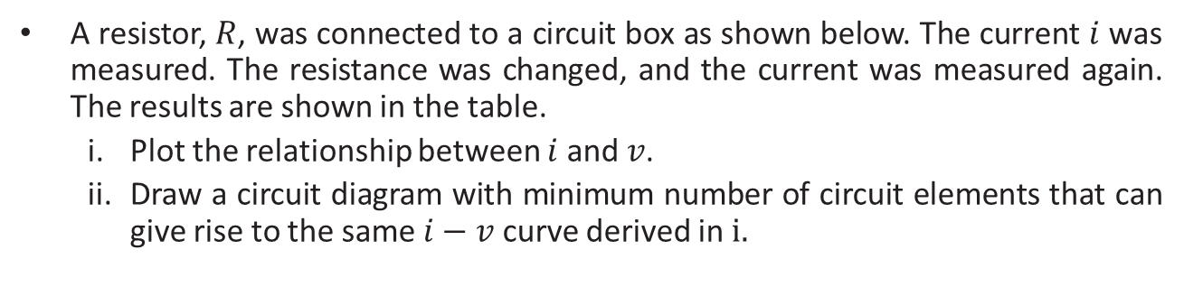
Problem 4
A resistor, $R$, was connected to a circuit box as shown below. The current $i$ was measured. The resistance was changed, and the current was measured again. The results are shown in the table.
Plot the relationship between $i$ and $v$.
Draw a circuit diagram with minimum number of circuit elements that can give rise to the same $i−v$ curve derived in $i.$
Ans: $i=−\frac{1}{4}v+6$
[PDS] Purbayan Das
CSE250 – Circuits and Electronics
Department of CSE, BracU
14

Slide 15




Problem 4
$$\frac{v−12}{12−8}=\frac{i−3}{3−4}$$
$$or, \frac{v−12}{4}=\frac{i−3}{−1}$$
$$or, 12−v=4i−12$$
$$or, i=−\frac{v}{4}+6$$
$$When R=2 kΩ, V=2×{10}^{3}×4×{10}^{−3}=8V$$
$$When R=4 kΩ, V=4×{10}^{3}×3×{10}^{−3}=12V$$
Ans: $i=−\frac{1}{4}v+6$
[PDS] Purbayan Das
CSE250 – Circuits and Electronics
Department of CSE, BracU
15

Slide 16
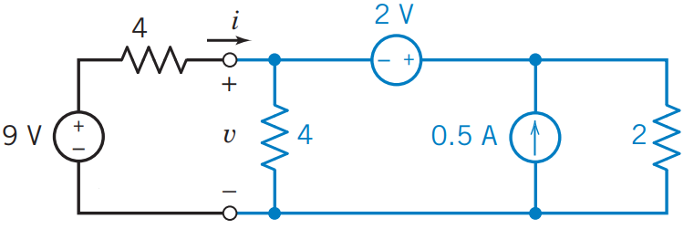
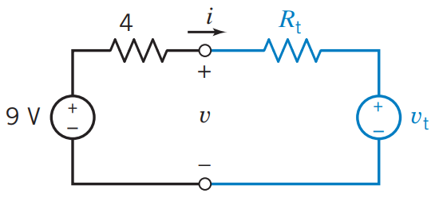
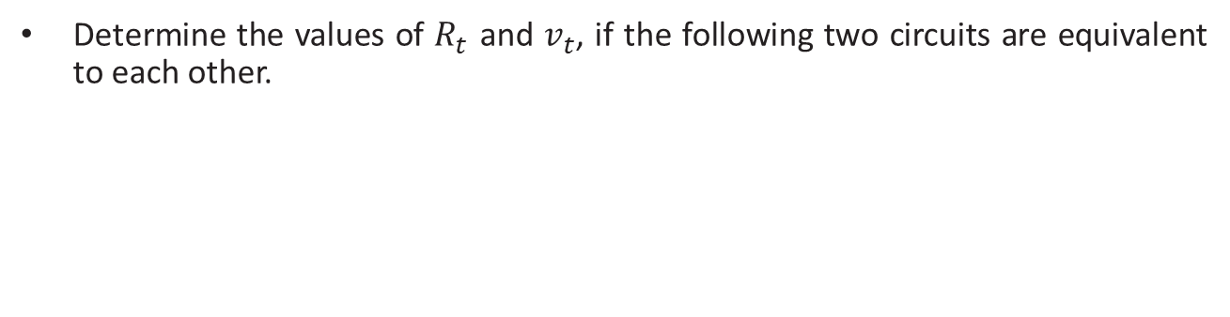
Problem 5
Determine the values of $R_{t}$ and $v_{t}$, if the following two circuits are equivalent to each other.
[PDS] Purbayan Das
CSE250 – Circuits and Electronics
Department of CSE, BracU
16

Slide 17
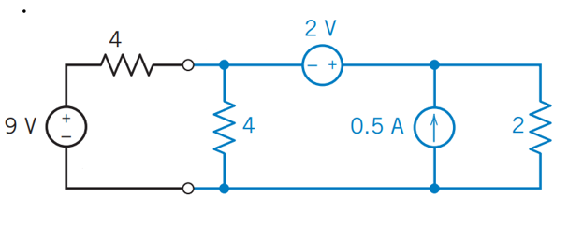

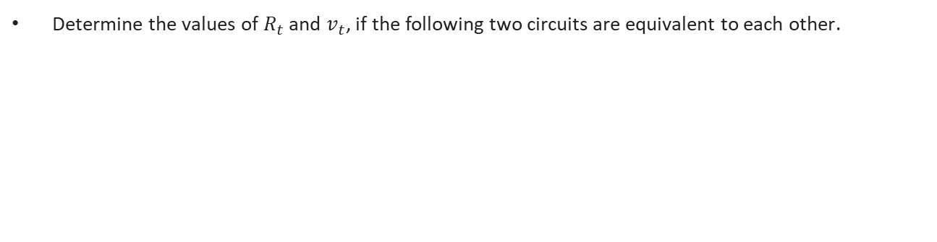


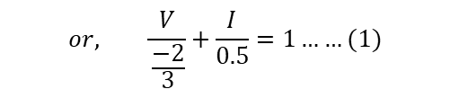

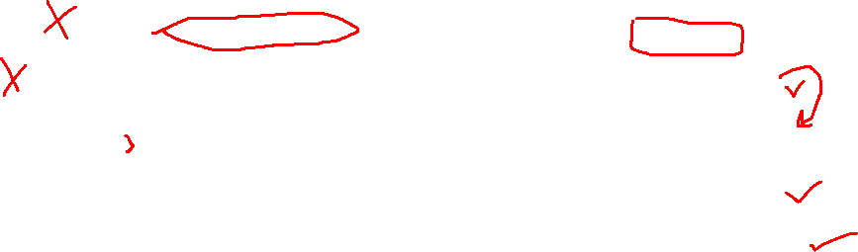
Problem 5
Determine the values of $R_{t}$ and $v_{t}$, if the following two circuits are equivalent to each other.
$$V_{1}−V=2$$
$$or, V_{1}=V+2$$
KCL at Supernode, $0.5+I=\frac{V}{4}+\frac{V_{1}}{2}$
$$or, 0.5+I=\frac{V}{4}+\frac{V+2}{2}$$
$$or, \frac{3V}{4}−I=−0.5$$
$$or, \frac{V}{\frac{−2}{3}}+\frac{I}{0.5}=1……(1)$$
[PDS] Purbayan Das
CSE250 – Circuits and Electronics
Department of CSE, BracU
17

Slide 18
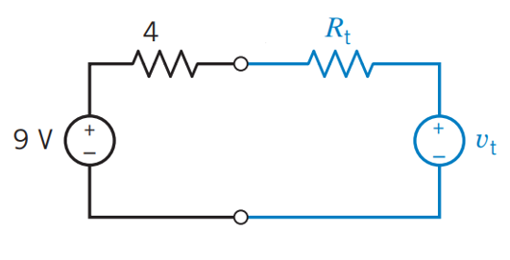

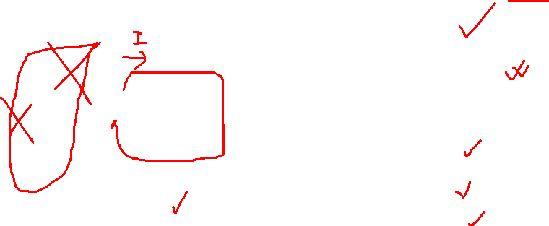


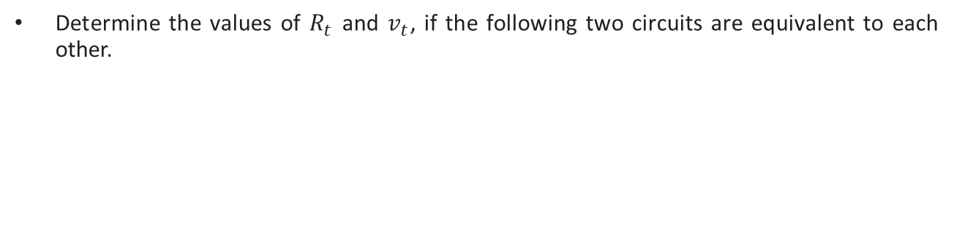
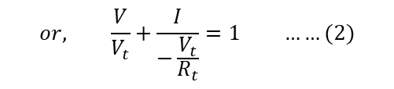

Problem 5
Determine the values of $R_{t}$ and $v_{t}$, if the following two circuits are equivalent to each other.
$$V={IR_{t}+V}_{t}$$
$$or, \frac{V}{V_{t}}+\frac{I}{−\frac{V_{t}}{R_{t}}}=1 ……(2)$$
Comparing Equation (1) & (2)
$$V_{t}=−\frac{2}{3}$$
$$−\frac{V_{t}}{R_{t}}=0.5 V$$
$$\frac{V}{\frac{−2}{3}}+\frac{I}{0.5}=1……(1)$$
$$or, R_{t}=\frac{4}{3} Ω$$
[PDS] Purbayan Das
CSE250 – Circuits and Electronics
Department of CSE, BracU
18

Slide 19
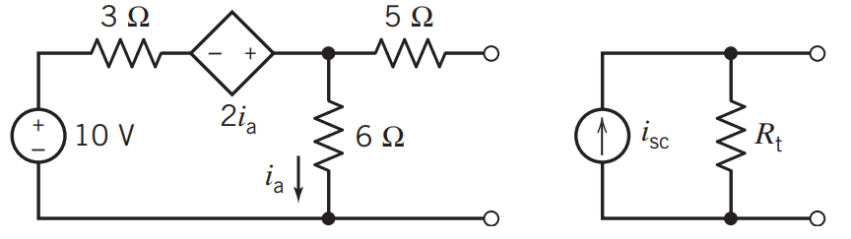

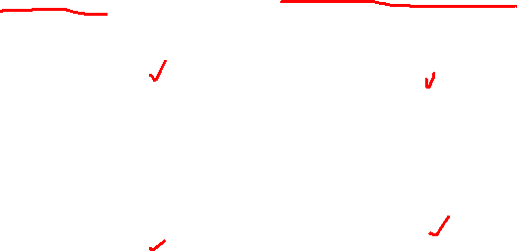

Problem 6
Determine the values of $R_{t}$ and $i_{sc}$, if the following two circuits are equivalent to each other.
Ans: $i_{sc}=1.13 A, R_{t}=7.57 $
[PDS] Purbayan Das
CSE250 – Circuits and Electronics
Department of CSE, BracU
19

Slide 20
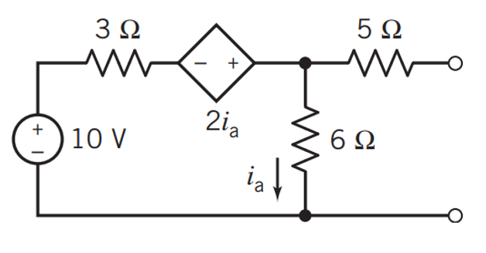

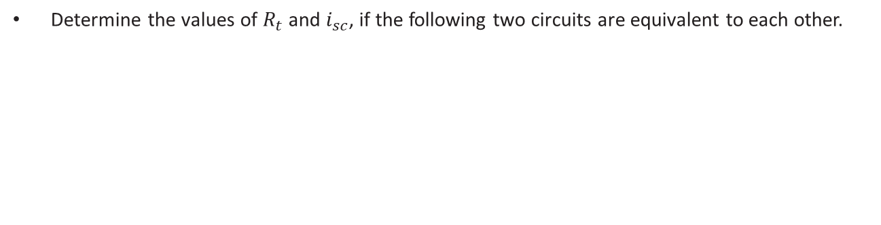



Problem 6
Determine the values of $R_{t}$ and $i_{sc}$, if the following two circuits are equivalent to each other.
$$i_{a}=I_{1}−I_{2}$$
KVL at loop-1
$$3I_{1}−2i_{a}+6\left(I_{1}−I_{2}\right)=10$$
$$or, 3I_{1}−2(I_{1}−I_{2})+6\left(I_{1}−I_{2}\right)=10$$
$$or, 7I_{1}−4I_{2}=10$$
$${or, I}_{1}=\frac{4}{7}I_{2}+\frac{10}{7} ……(1)$$
KVL at loop-2
$$5I_{2}+V+6(I_{2}−I_{1})=0$$
$$or, \frac{53}{7}I_{2}+V=\frac{60}{7}$$
$$or, −6I_{1}+11I_{2}+V=0$$
$$or, −6(\frac{4}{7}I_{2}+\frac{10}{7})+11I_{2}+V=0$$
[PDS] Purbayan Das
CSE250 – Circuits and Electronics
Department of CSE, BracU
20

Slide 21


Problem 6
Determine the values of $R_{t}$ and $i_{sc}$, if the following two circuits are equivalent to each other.
$$or, \frac{53}{7}I_{2}+V=\frac{60}{7}$$
$$or, 53I_{2}+7V=60$$
$$or, 7V−53I=60$$
$$or, \frac{V}{\frac{60}{7}}+\frac{I}{\frac{−60}{53}}=1 ……(1)$$
[PDS] Purbayan Das
CSE250 – Circuits and Electronics
Department of CSE, BracU
21

Slide 22
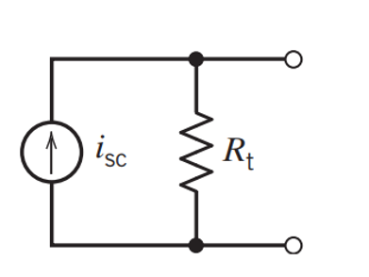

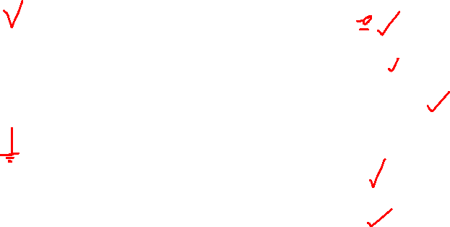


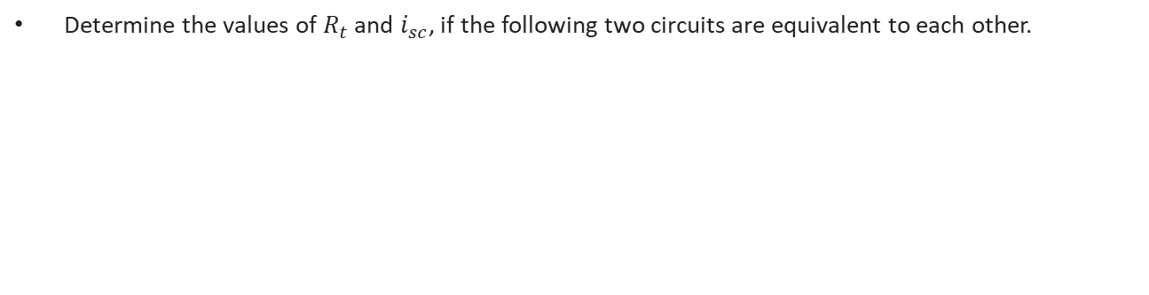



Problem 6
Determine the values of $R_{t}$ and $i_{sc}$, if the following two circuits are equivalent to each other.
$$I+I_{SC}=\frac{V}{R_{t}}$$
$$or, \frac{V}{R_{t}}−I=I_{SC}$$
$$or, \frac{V}{R_{t}I_{SC}}+\frac{I}{−I_{SC}}=1 ……(2)$$
Comparing Equation (1) & (2)
$${−I}_{SC}=−\frac{60}{53}$$
$$\frac{V}{\frac{60}{7}}+\frac{I}{\frac{−60}{53}}=1 ……(1)$$
$${R_{t}I}_{SC}=\frac{60}{7}$$
[PDS] Purbayan Das
CSE250 – Circuits and Electronics
Department of CSE, BracU
22

Slide 23
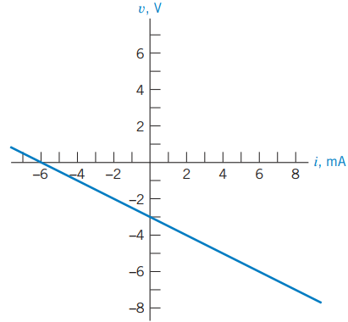



Problem 7
If the voltage $v$ vs. current $i$ has the following relationship expressed graphically, determine the value of $R_{3}$.
Ans: $1 k$
[PDS] Purbayan Das
CSE250 – Circuits and Electronics
Department of CSE, BracU
23

Slide 24







Problem 7
If the voltage $v$ vs. current $i$ has the following relationship expressed graphically, determine the value of $R_{3}$.
$$\frac{V_{x}}{0.6}+10+\frac{V_{x}−V}{0.6}=0$$
$$or, V_{x}=\frac{V}{2}−3$$
$$\frac{V}{R_{3}}+i+\frac{V−V_{x}}{0.6}=0$$
$$or, \frac{V}{R_{3}}+i+\frac{V−\frac{V}{2}+3}{0.6}=0$$
$$or, \frac{V}{\frac{−5}{\frac{1}{R_{3}}+\frac{5}{6}}}+\frac{i}{−5}=1 ……(1)$$
$$or, \left(\frac{1}{R_{3}}+\frac{5}{6}\right)V+i=−5$$
[PDS] Purbayan Das
CSE250 – Circuits and Electronics
Department of CSE, BracU
24

Slide 25




Problem 7
If the voltage $v$ vs. current $i$ has the following relationship expressed graphically, determine the value of $R_{3}$.
$$\frac{v}{−3}+\frac{i}{−5}=1……(2)$$
$$\frac{−5}{\frac{1}{R_{3}}+\frac{5}{6}}=−3$$
$$R_{3}=1.2 kΩ$$
[PDS] Purbayan Das
CSE250 – Circuits and Electronics
Department of CSE, BracU
25

Slide 26
Thank you for your attention
[PDS] Purbayan Das
CSE250 – Circuits and Electronics
Department of CSE, BracU
26

