Slide 1
CNN

Slide 2
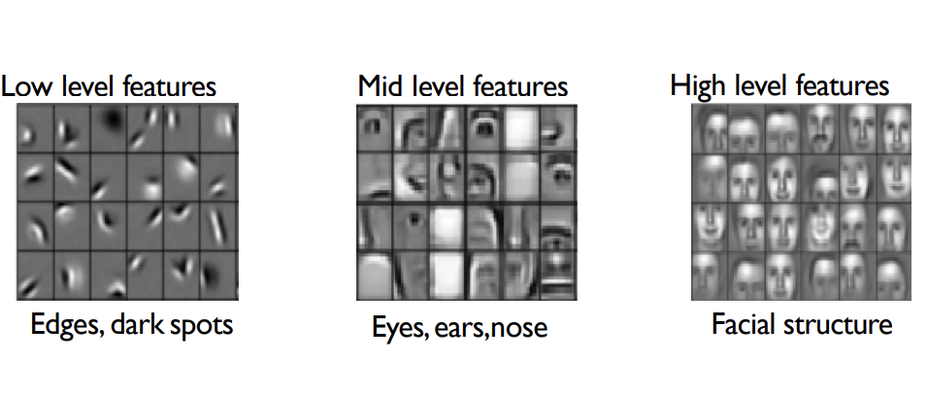

Slide 3
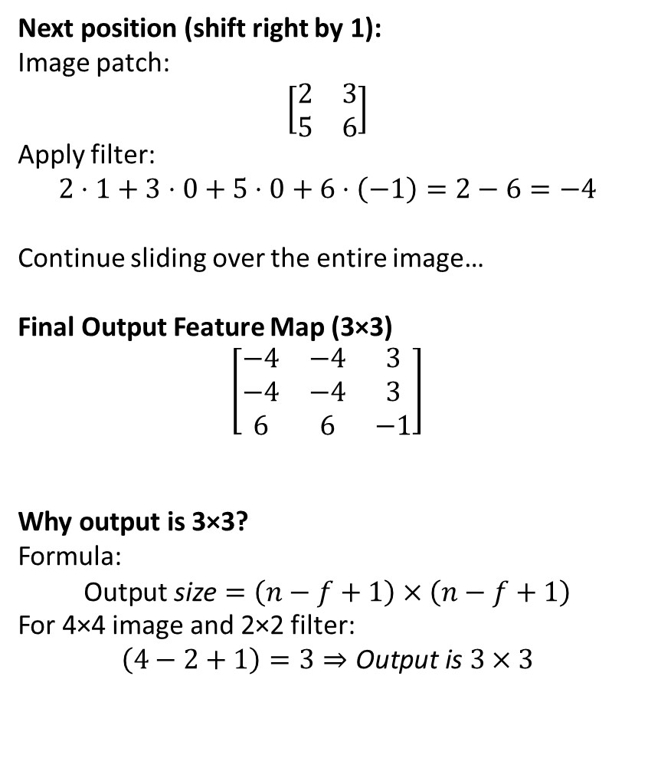
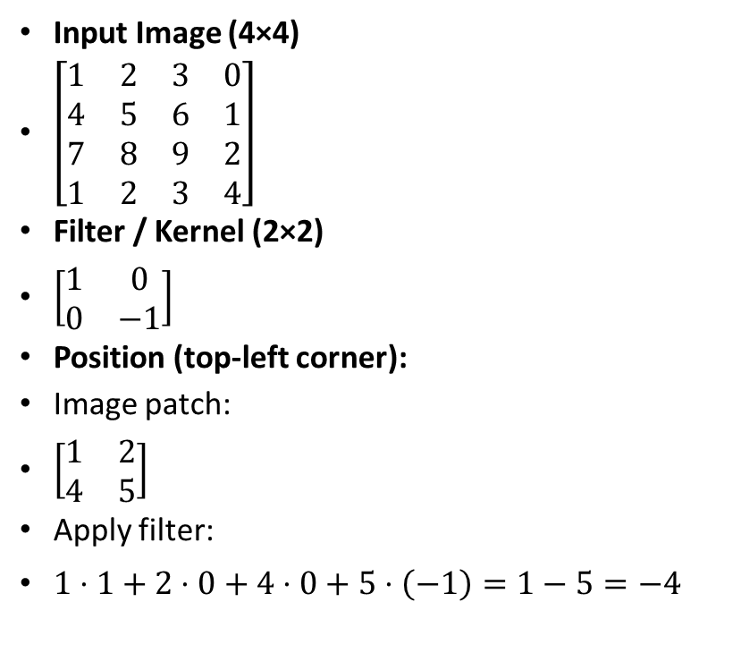
Example of convolution
Next position (shift right by 1):
Image patch:
$$\left[\begin{matrix}2 & 3 \\ 5 & 6\end{matrix}\right]$$
Apply filter:
$$2⋅1+3⋅0+5⋅0+6⋅\left(−1\right)=2−6=−4$$
Continue sliding over the entire image…
Final Output Feature Map (3×3)
$$\left[\begin{matrix}−4 & −4 & 3 \\ −4 & −4 & 3 \\ 6 & 6 & −1\end{matrix}\right]$$
Why output is 3×3?
Formula:
$$\text{Output} \text{size}=\left(n−f+1\right)×\left(n−f+1\right)$$
For 4×4 image and 2×2 filter:
$$\left(4−2+1\right)=3⇒\text{Output} \text{is} 3×3$$
Input Image (4×4)
$\left[\begin{matrix}1 & 2 & 3 & 0 \\ 4 & 5 & 6 & 1 \\ 7 & 8 & 9 & 2 \\ 1 & 2 & 3 & 4\end{matrix}\right]$
Filter / Kernel (2×2)
$\left[\begin{matrix}1 & 0 \\ 0 & −1\end{matrix}\right]$
Position (top-left corner):
Image patch:
$\left[\begin{matrix}1 & 2 \\ 4 & 5\end{matrix}\right]$
Apply filter:
$1⋅1+2⋅0+4⋅0+5⋅\left(−1\right)=1−5=−4$

Slide 4
Model | Year | Purpose
LeNet-5 | 1998 | Handwritten digit recognition (MNIST)
AlexNet | 2012 | Large-scale ImageNet classification (1.2M images)
VGG-16/19 | 2014 | Deeper CNN for ImageNet with simple 3×3 convolution rule

Slide 5
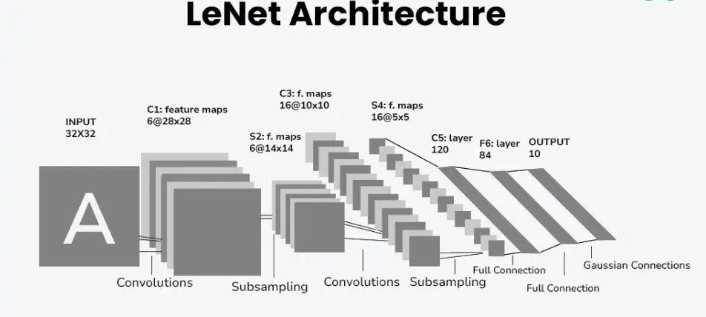
LeNet-5
Very small and simple network.
Helped establish how we use CNNs today •
Replaced manual feature extraction
Designed for 28×28 grayscale images.
Architecture:
  Conv → Pool → Conv → Pool → FC → FC → Softmax
Convolution kernels: 5×5
Total parameters: ~60,000

Slide 6
LeNet
Layer | Feature Map | Size | Kernel Size | Stride | Activation
Input - Image | 1 | 32 X 32 | - | - | -
1 - Convolution | 6 | 28 X 28 | 5 X 5 | 1 | tanh
2 - Average Pooling | 6 | 14 X 14 | 2 X 2 | 2 | tanh
3 - Convolution | 16 | 10 X 10 | 5 X 5 | 1 | tanh
4 - Avergae Pooling | 16 | 5 X 5 | 2 X 2 | 2 | tanh
5 - Convolution | 120 | 1 X 1 | 5 X 5 | 1 | tanh
6 - FC | - | 84 | - | - | tanh
Output - FC | - | 10 | - | - | softmax

Slide 7
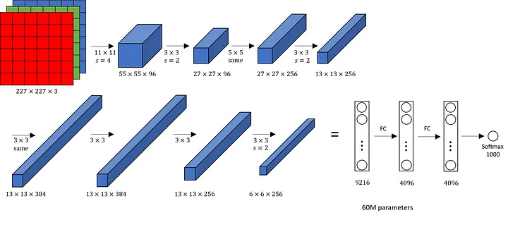
AlexNet
Much deeper and wider than LeNet.
Designed for 224×224 RGB images.
Architecture:
  5 Conv layers → 3 FC layers
Introduced ReLU, Dropout, Data Augmentation.
In AlexNet, data augmentation refers to artificially increasing the size and diversity of the training dataset by applying label-preserving transformations to the input images.
Used overlapping max-pool, large filters (11×11, 5×5).
First CNN to win ImageNet with a big margin.
Parameters: ~60 million.

Slide 8
Key Features: AlexNet
‘ReLU’ is used as an activation function rather than ‘tanh’
Batch size of 128
SGD Momentum is used as a learning algorithm
Data Augmentation is been carried out like flipping, jittering, cropping, colour normalization, etc.
AlexNet was trained on a GTX 580 GPU with only 3 GB of memory which couldn’t fit the entire network. So the network was split across 2 GPUs, with half of the neurons(feature maps) on each GPU.

Slide 9
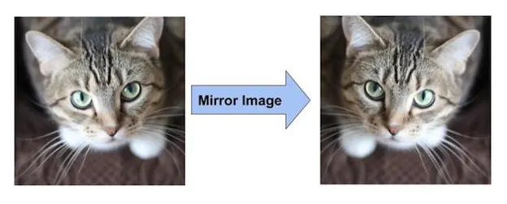
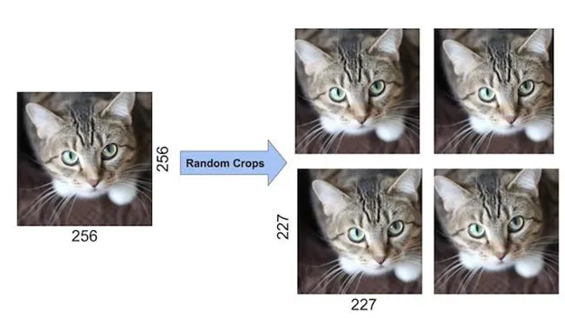
Data Augumentation
For the network’s inputs, the creators of AlexNet selected random crops with dimensions of 227 by 227 from within the 256 by 256 image boundary. They multiplied the size of the data by 2048 using this technique.

Slide 10
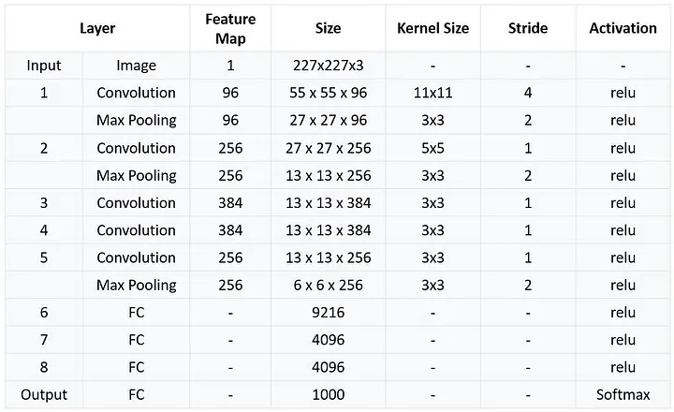
AlexNet: Summary

Slide 11
VGG (VGG-16, VGG-19)
Much deeper than AlexNet.
Key idea: Use only 3×3 convolutions
Architecture:
  Many (11–19) convolution layers
  Conv → Conv → Pool repeating blocks
  3 dense layers at the end
Highly uniform design.
Parameters: ~138 million (very large)
Strong feature extractor for transfer learning.

Slide 12
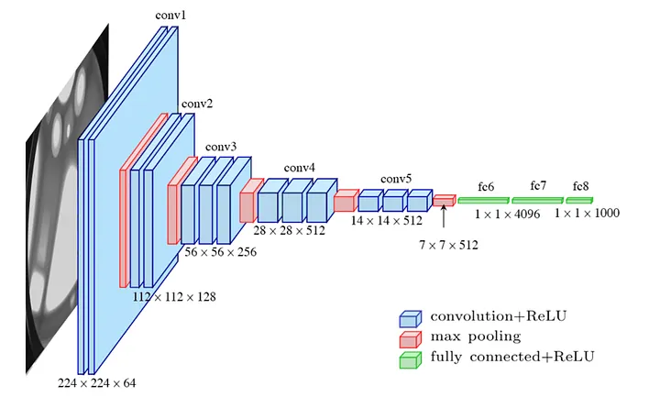
VGGNet

Slide 13
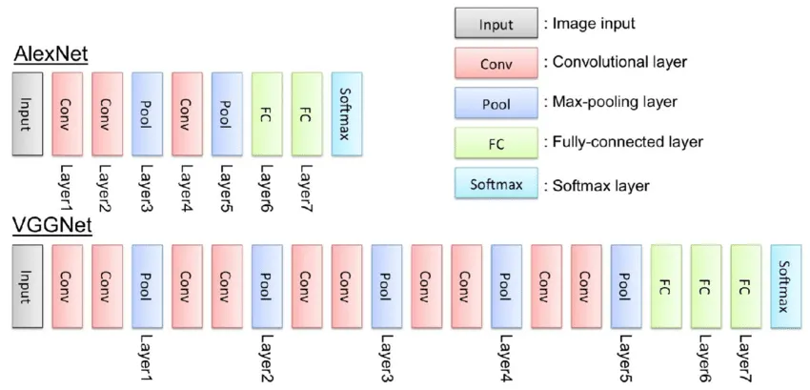
VGGNet Vs. AlexNet

Slide 14
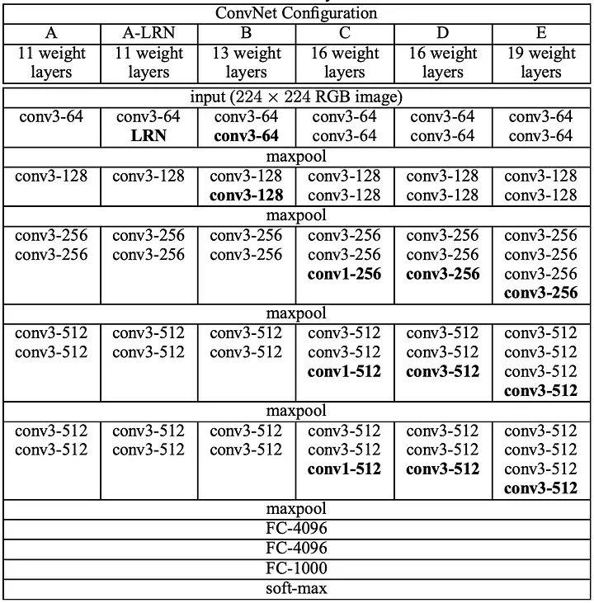
VGGNet Summary

Slide 15
Detailed Comparisson
Feature | LeNet-5 | AlexNet | VGG-16/19
Year | 1998 | 2012 | 2014
Depth | 5–7 layers | 8 layers | 16/19 layers
Image Input | 28×28 grayscale | 224×224 RGB | 224×224 RGB
Convolution Filters | 5×5 | 11×11, 5×5, 3×3 | Only 3×3
Activation | tanh | ReLU | ReLU
Pooling | Avg pooling | Overlapping max-pool | Max-pool
Innovations | Early CNN; low-compute | ReLU, GPU training, dropout | Deep + simple design, strong transfer learning
Parameters | ~60K | ~60M | ~138M
Use Case | MNIST | ImageNet | ImageNet & feature extraction

Slide 16
Evolution
LeNet:
  First structured CNN; very small; suited for small images.
AlexNet:
  Huge jump in scale.
  Introduced ReLU → solved vanishing gradient.
  Effective use of GPUs.
VGG:
  Showed that depth + small filters = better accuracy.
  Extremely clean architecture, widely used for transfer learning.

