Slide 1

ARTIFICIAL INTELLIGENCE
ASSIGNMENT-2
CS22B051 - JAIMIN VIRAMGAMA
CS22B016 - CHATSE SIDDHANT

Slide 2


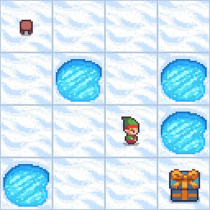
Branch and Bound
(Frozen Lake)
01
Heuristic Used:
No explicit heuristic function used
Explanation :
Branch and Bound prioritizes exploring paths with the lowest cumulative cost (path length).
It uses a priority queue, sorted by path cost (g(n)), but does not estimate future cost (h(n)).
This makes it a uniform-cost search, not an informed search.
Implication :
Guarantees optimality if costs are accurate.
Slower than heuristic-based methods due to lack of direction toward the goal.

Slide 3
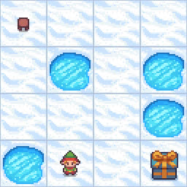
IDA-Frozen Lake
(Iterative Deepening A*)
02
Heuristic Used:
Manhattan Distance (Grid-based heuristic)
h(state) = |row_s - row_g| + |col_s - col_g|
Explanation :
Estimates how far the current tile is from the goal tile on a 4x4 grid.
Assumes only horizontal and vertical moves (which fits Frozen Lake).
Guides the search towards the goal while maintaining optimality.
Properties :
Admissible (never overestimates)
Consistent (triangle inequality holds)

Slide 4
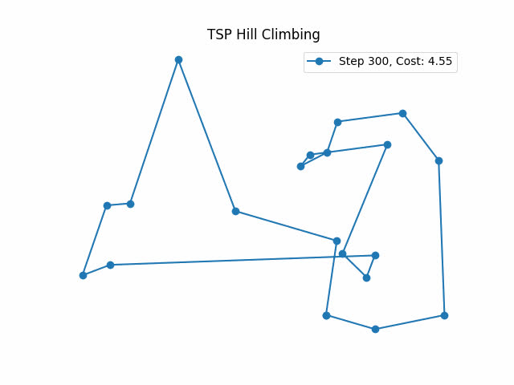
Hill Climbing
(TSP)
03
Heuristic Used:
Total Distance of Tour
h(route) = Σ distance between consecutive cities in the route
Explanation :
The cost function itself acts as the heuristic.
Chooses neighbor solutions that reduce the total route distance.
Greedy local search: always accepts better solutions.
Limitations :
Can get stuck in local optima.
No "look ahead" or backtracking unless randomness is introduced.
Note : For the Travelling Salesman Problem, the environment as well as the grpah is used and implemented from other repository :
Github Link

Slide 5
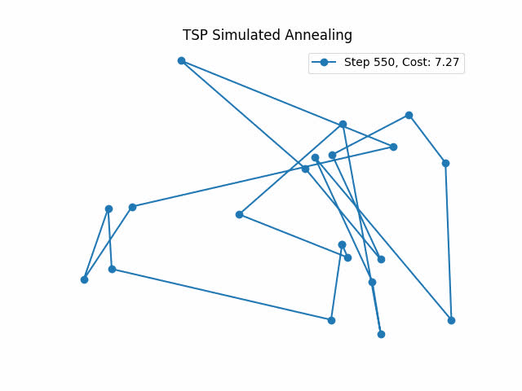
Simulated Annealing
(TSP)
04
Heuristic Used:
Tour Distance of Tour (Same as Hill Climbing)
h(route) = Σ distance between consecutive cities in the route
Explanation :
Like Hill Climbing, it uses tour cost as a guide.
However, it occasionally accepts worse solutions with probability:
P = exp(-(Δcost) / T)
This helps escape local optima by simulating thermal fluctuations.
Key Difference from HC :
Exploratory due to probabilistic acceptance.
Cooling schedule (temperature) is crucial to performance.
Note : For the Travelling Salesman Problem, the environment as well as the grpah is used and implemented from other repository :
Github Link

Slide 6


06
Algorithm | Cost/Reward | Path
BnB | 1.0 | [1, 1, 2, 2, 1, 2]
IDA* | 6 | [1, 1, 2, 1, 2, 2]
HC | 4.25 | [10, 15, 5, 18, 8, 1, 7, 6, 19, 11, 3, 4, 14, 0, 13, 9, 12, 17, 16, 2]
SA | 6.87 | [11, 3, 15, 10, 0, 13, 6, 7, 1, 16, 12, 9, 4, 19, 5, 18, 8, 14, 17, 2]

