Slide 1
Exploring Wildfire Distribution of Alberta: The Role of Human Activity and Fire Class Classification Models
Archana Senthil

Slide 2
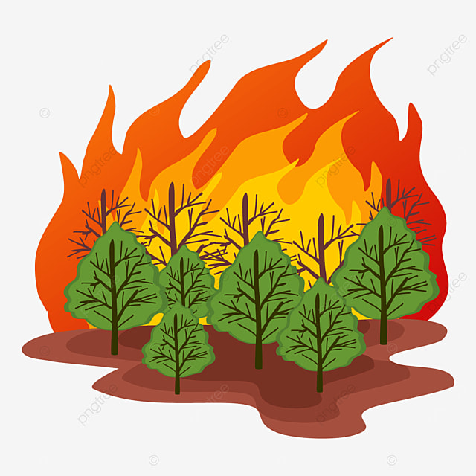
Introduction
Alarming Wildfire Threat
More frequent and severe
Long-term ecological impacts.
Need for Analysis
Identifying causes and impact
Developing classification model
Alberta Wildfire Dataset (2006–2023)
26,552 wildfire records from the Government of Alberta.
50 features covering wildfire class, key dates, environmental conditions, geographic location, and ignition causes

Slide 3
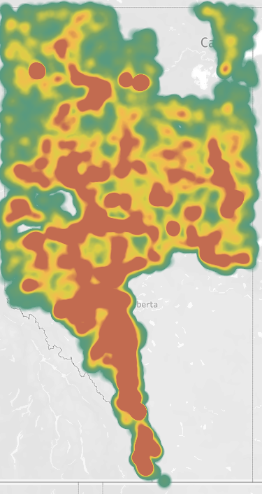
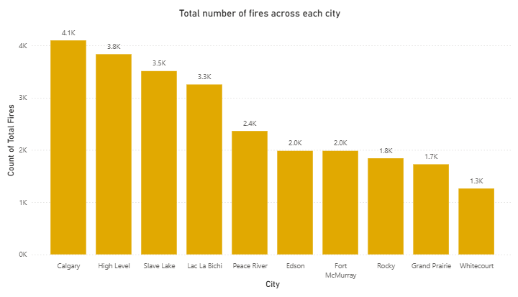
Objective 1: Understanding Wildfire Distribution Guiding Question: How are wildfires distributed across Alberta?
Findings: - More wildfires in the west and central Alberta - Calgary and High Level has most wildfires
Tools used: - Python - Tableau

Slide 4
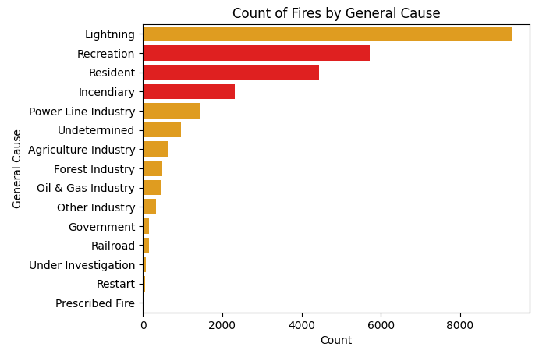
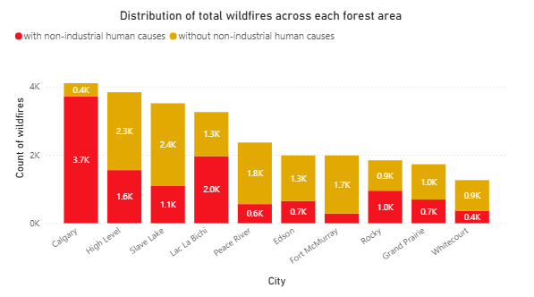
Objective 2: Assessing Human Impact on Wildfires Guiding Question: What are the primary causes of wildfires? To what extent do non-industrial human activities contribute to wildfire incidents?
47% of wildfires are due to recreation, resident and incendiary.
12,482 out of 26,552 fires.
In Calgary, Lac La Bichi and Rocky, most wildfires are due to these causes.
In Calgary alone, wildfires are 9 times more likely due to them.

Slide 5
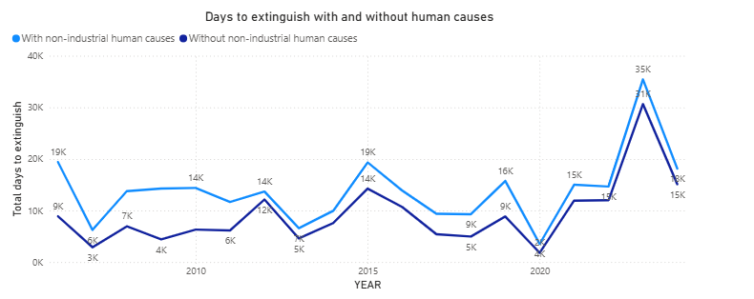
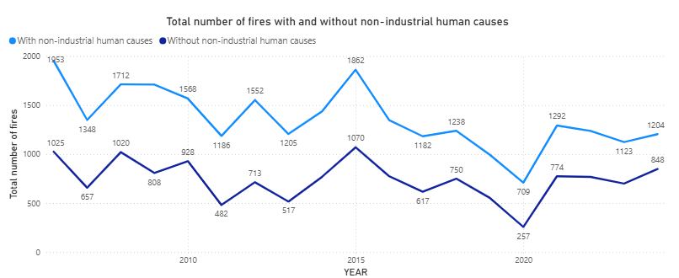
Objective 2: Assessing Human Impact on Wildfires
Findings:
Year over year trend shows the total number of fires and the total number of days taken to extinguish would be lower without the recreation, resident and incendiary causes.
Tools Used:
Python
Power BI

Slide 6
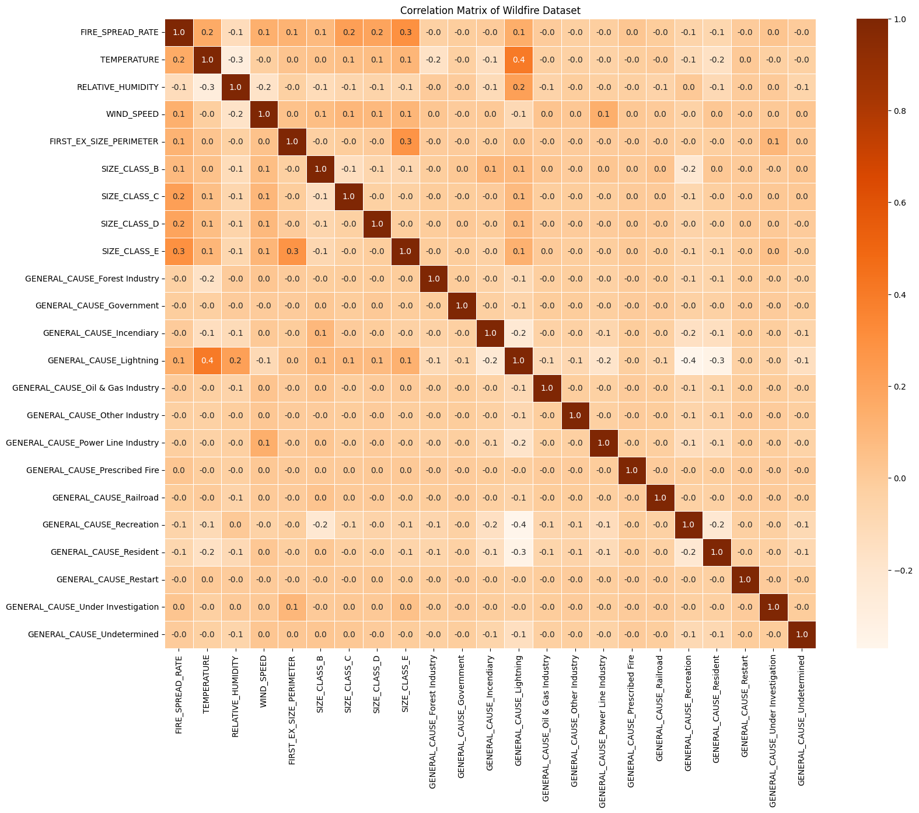
Objective 3: Analyzing Relationships Between Features Guiding Question: What are the key relationships between wildfire spread, environmental conditions, and general causes, and how do they impact wildfire behavior?
Findings:
No strong correlation
Moderate Positive Correlation
Temperature and Lightning
Fire Spread Rate and Size Class E
Perimeter Size and size Class E
Moderate Negative Correlation
Temperature and Relative Humidity
Lightning and Recreation
Lightning and Resident
Tools Used:
Python

Slide 7
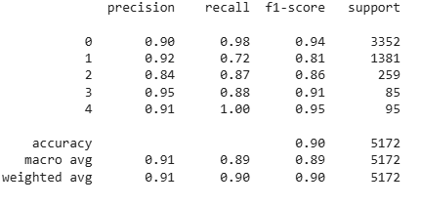
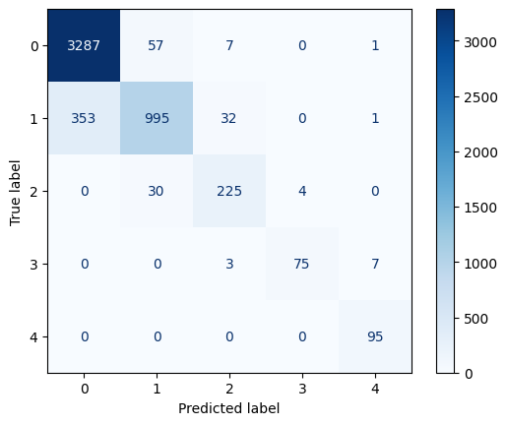
Objective 4: Predicting the wildfire size class based on various features Guiding Question: How accurately can multinomial logistic regression classify the size of a wildfire?
Findings:
Accuracy of 90.43%
Limitations in classifying smaller size class
Tools Used:
Python

Slide 8
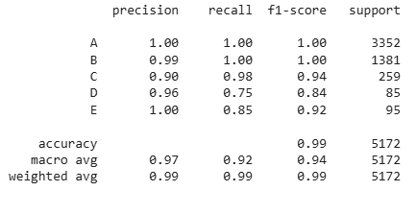
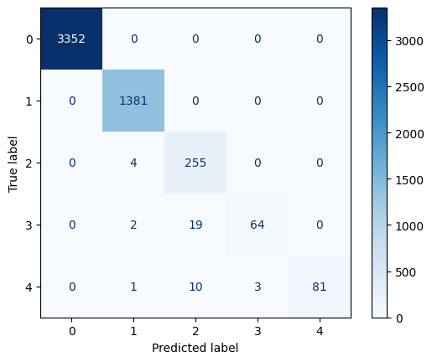
Objective 5: Enhancing the Accuracy of the Prediction Model Guiding Question: How accurately can multinomial logistic regression classify the size of a wildfire?
Findings:
Accuracy of 99.25%
ROC-AUC score of 0.9958
Limitations in classifying larger size class
Tools Used:
Python

Slide 9
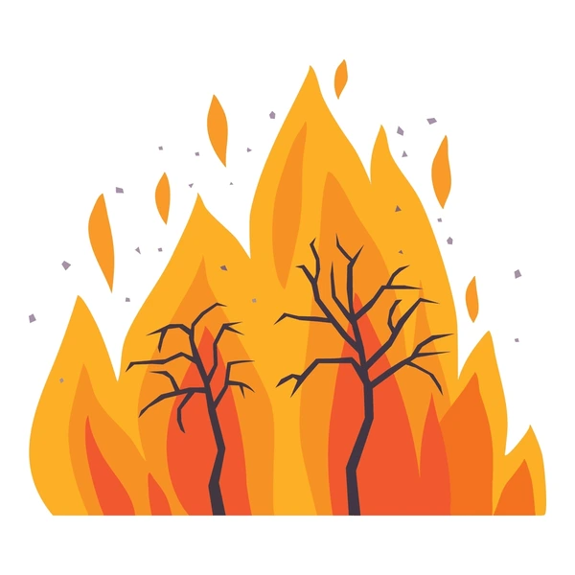
Conclusion
Wildfire Distribution and Human Impact
Predominant in Western and Central regions
47% of fires are due to non-industrial human activity
Environmental Factors and Fire Behavior
Temperature and wind speed influence wildfire spread while, humidity has inverse correlation
Predictive Modeling for Classification
Multinomial logistic regression accuracy is 90.43%
Random forest model accuracy is 99.25%
Future Works
Hyper parameter tuning to improving the accuracy of the classification model.
More awareness, stricter fire regulation needs to be emphasised.
Incorporating real-time data weather condition can help enhance wildfire forecasting.

Slide 10
Thank you

