Slide 1
Microsoft Azure: Infrastructure as a Service (IaaS)

Slide 2
How to View This Presentation
All slides have two styles of PDF documents:
Full View – full page view per slide
Notes View – 3 slides per page with ruled lines used to take notes
Use Adobe Reader or other PDF viewing tools to review the PDF slides
All PDF slides are located in your AzureIaaSWS.zip file

Slide 3
Introduction and Logistics
Your trainer
You
Your role
Your company
Your experience in this technology area
Your goals for this workshop
Start and end times
Facilities (bathrooms, smoking)
Meals
Computers, phones, tablets, etc.
Please set to vibrate
What’s on your desk?

Slide 4
Module 4: IaaS Virtual Networking
Azure Networking
Notes:
After this lesson, you will be able to:
Objective
Objective
Why should you learn this material?
<Insert a paragraph explaining why it is useful to learn this material.>
[EDITOR] Zain Ahmed:
Thursday, October 03, 2013 Please update the placeholder

Slide 5
Microsoft Azure Virtual Networks
Your virtual branch office/data center in the cloud
Allows customers to extend their Enterprise Networks into Microsoft Azure
Networking on-ramp for migrating existing apps and services to Microsoft Azure
Allows customers to run hybrid apps that span the cloud and their on-premises setup
A protected private virtual network in the cloud
Allows customers to set up secure private IPv4 networks fully contained within Microsoft Azure
IP address persistence capability
Inter-service (Dynamic IP address) DIP-to-DIP communication ~ PaaS/IaaS communication
Notes:
Slide Objective
Provide an overview of Microsoft Azure Virtual Network
Notes
Microsoft Azure Virtual Network is our solution to providing:
Hybrid solutions
Solutions that require advanced connectivity in the cloud
Hybrid (on-premises to cloud) connectivity is enabled by using the Virtual Private Network (VPN) solution that allows site<->site connectivity allowing machines on-premises and machines in the cloud to appear on the same network
Advanced connectivity solutions are enabled because Microsoft Azure applications that are deployed to a virtual network will have persistent IP addresses. This is a requirement for solutions like Active Directory
Other solutions enabled by virtual networks in the cloud are mixing VMs and web/worker role solutions in the same Microsoft Azure network. This allows for scenarios such as web/worker roles communicating back to VMs running applications such as SQL server.
[EDITOR] Zain Ahmed:
Thursday, October 03, 2013 Can this be changed to 'site-to-site‘ or “inter-site”?

Slide 6
Virtual Network Features
Customer-managed private virtual networks within Microsoft Azure
“Bring your own IPv4 addresses”
Provides control over placement of Microsoft Azure VMs and roles within the network
Stable IPv4 addresses for VMs
Hosted VPN Gateway that enables site-to-site connectivity
Automated provisioning and management
Support existing on-premises VPN devices
Use on-premises DNS servers for name resolution or Azure DNS
Allows you to use your own on-premises DNS servers for name resolution
Allows VMs running in Microsoft Azure to be joined to corporate domains running on-premises (use your on-premises Active Directory)
Can provide internal static IP addresses (via PowerShell) [DIP]
Can provide public reserved IP addresses (via PowerShell) [VIP]
Multiple virtual IP addresses per VM [ILPIP]
Notes:
Slide Objective
VNET feature overview
Notes
BYO IPv4 space. Only provide IPs in a VNET
Carve out IP subnets with a virtual network
No overlapping subnets
IP address stays with the VM for its lifetime
We manage the software gateway. Run in active/passive mode for high availability
DNS + IP address persistence is the key to enabling many new scenarios (AD, DNs, etc.)
Multiple virtual IP addresses per machine in a virtual network - You can get more than one load-balanced public IP address (also called Virtual IP address) assigned to a set of virtual machines (VMs), enabling high-availability and high-scale scenarios. This enables scenarios such as hosting of multiple secure websites in a web app or allow multiple SQL Server AlwaysOn Availability Group listeners access to the same set of VMs. With ARM, you can have multiple public IP addresses per machine
* Azure DNS covered in a later slide
[EDITOR] TWB_Trevor:
09 October 2013 “the software” was originally “SW”. Is the change correct?

Slide 7
How to Setup Virtual Networks
Portal
Wizard to create, and update virtual networks
Manage Gateway Lifecycle
APIs and Scripting
REST APIs
PowerShell cmdlets
Network Configuration
Operations on Network Configuration
Set Network Configuration
Get Network Configuration
Azure Resource Manager (ARM) scripting/deployment
Notes:
Slide Objective
Explain entry points.

Slide 8


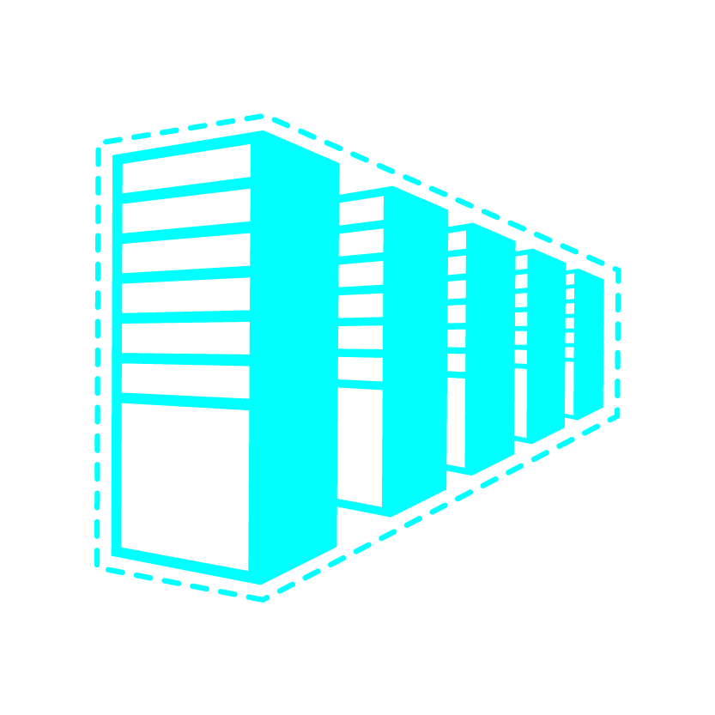
Configuring Virtual Networks
Microsoft Azure Portal (API)
Network Admin
Network configuration
CorpOffice
Deployment package
IT Admin
ContosoCorpOffice (10.0.0.0/16)
ContosoVNet (10.1.0.0/16)
FEndSubnet
(10.1.1.0/24)
ADSubnet
(10.1.2.0/24)
GWSubnet
(10.1.5.0/24)
DNS Server
(10.1.2.101)
Cisco ASA GW 131.57.23.45
SQLSubnet
(10.1.3.0/24)
BESubnet
(10.1.4.0/24)
GW IP
65.57.23.45
DNS2 10.0.0.21
DNS1 10.0.0.20
Notes:
Slide Objective
Overview - Steps of deploying a VNET from what you would normally see in a production environment
<click> A network administrator deploys a virtual network configuration file to Azure
<click><click> The virtual network plus subnets are created in Azure (no machines yet)
<click> The on-premises environment is shown. Notice that the overall network address space here 10.0.0.0/16 does not overlap with ContosoVNet
<click> A Cisco ASA VPN device is setup as a gateway device for site-to-site VPN. Notice that for the Cisco device it has a public IP address
<click><click> Within Azure, the admin creates a VPN gateway (this is not part of the imported configuration file)
<click> After the gateway is established, the gateway machines are created by Azure
<click> And then given a public IP address for the gateway
<click> Within the portal, the user downloads a VPN device setup script
<click> A VPN connection is made between the Cisco device and the Azure gateway
<click><click> Now for the IT Administrator
<click> IT Administrator creates a deployment package (PowerShell) to create the machines in Azure
<click><click> Machines are created in Azure in the appropriate subnets
Notes
Network admin sets up network (logically)
IP ranges of premises and VNET(s)
Subnet specification
DNS server specification
IP of VPN GW
Microsoft provides sample VPN configuration scripts for popular device families
Services can be easily deployed in a virtual network
[EDITOR] TWB_Trevor:
09 October 2013 Does “GW” stand for “Gateway”?
[EDITOR] TWB_Trevor:
09 October 2013 Should the content in yellow be “on-premises and virtual networks”?

Slide 9
Demonstration: Deploying a Virtual Network
Notes:
Slide Objective
Demonstrate how to deploy a virtual network. Most typically, you can just demonstrate setting up a P2S network because that is the student lab. If you do have access to an on-premises VPN device, it is also good to show how to set that up.

Slide 10
Module 4: IaaS Virtual Networking
Azure Connectivity
Notes:
After this lesson, you will be able to:
Objective
Objective
Why should you learn this material?
<Insert a paragraph explaining why it is useful to learn this material.>
[EDITOR] Zain Ahmed:
Thursday, October 03, 2013 Please update the placeholder

Slide 11
Glossary for Network basic components
VIP (Virtual IP address)
A public IP address belongs to the a machine in a virtual network. It also serves as an Azure Load Balancer which tells how network traffic should be directed before being routed to the VM.
It is possible to reserve an IP from the Microsoft pool
DIP (Dynamic IP address):
An internal IP assigned by Microsoft Azure DHCP to the VM
Associated automatically with the VM when created
It is released when VM is deleted or deallocated (default)
It is possible to configure and static IP address
You can have more than one DIP per VM (Multi-NIC support)
ILPIP (Instance Level Public IP)
A ILPIP is associated with the VM in addition to the VIP. Traffic to the ILPIP goes directly to the VM and is not routed through the Azure Load Balancer
Notes:
VIP: The VIP is allocated at random from a pool of IP addresses managed by Microsoft. However, it is possible to reserve an IP address from the Microsoft pool and allocate that reserved IP address as a VIP. There is a limit of 5 reserved IPs for a subscription. Unless a reserved IP address is used, the VIP is given up and returned to the Microsoft pool once the last VM with that VIP is deallocated or deleted. Internet-bound traffic coming from the VM is SNATted to have the VIP be its source address.
DIP: This IP address is associated automatically with the VM when it is created and remains associated with it while it is deployed. The DIP survives system reboots as well as service healing migration of the VM. If the VM is deleted or changed into a stopped/deallocated state it loses its DIP, which may then be allocated to another VM. Alternatively, the DIP can be a static IP address allocated to the VM on creation. This address comes from the range configured for the subnet the VM is deployed into. It is a good practice to use a distinct subnet for statically-allocated DIPs to avoid the possibility of collision between a dynamically and statically allocated DIP.
PIP: A PIP is a public instance-level IP address associated with the VM in addition to the VIP. Traffic to the PIP goes directly to the VM and is not routed through the Azure Load Balancer. Internet-bound traffic from a VM with a configured PIP is also sent over the PIP rather than going through the VIP. The PIP must be appropriately firewalled to restrict traffic to only that desired. A PIP is useful for workloads such as passive FTP that require a large number of ports to be opened, which is impractical when using the VIP which supports only a limited number of endpoints.

Slide 12
Glossary for Network basic components (con’t)
Azure Load Balancer (External LB)
All inbound traffic to the VIP is routed through the ELB which firewalls and distributes it. Allows only inbound TCP or UDP traffic. This is a software load balancer (SLB)
Internal Load Balancer (ILB):
It is configured to port-forward or load-balance traffic inside a VNET to different VMs.
Inbound Security Rule
Associated with a network security group. Associates a VIP/DIP + port combination on a VM with a port on either the Azure Load Balancer for public-facing traffic or the Internal Load Balancer for traffic inside a VNET
Notes:
LB: The Azure Load Balancer supports only the TCP and UDP protocols, all other internet protocols are denied. The Azure Load Balancer supports all three methods of distributing load-balanced traffic: default, sourceIP and sourceIPProtocol.
ILB:The Internal Load Balancer only supports the default mechanism for distributing load-balanced traffic – i.e., source IP, source port, destination IP, destination port and protocol.

Slide 13
Microsoft Azure Provided DNS – Within a Virtual Network
TestVM1
TestVM2
Who is TestVM2?
10.1.1.1
Who is TestVM2?
Who is TestVM2?
Notes:
Slide Objective
Overview of Microsoft Azure provided DNS.
Notes
No need to deploy a DNS server. Name resolution within the deployment boundary works
A malicious tenant cannot detect VMs in a deployment by name or IP address
The name resolution boundary is the same as the deployment boundary
Discovery is currently not supported
[EDITOR] TWB_Trevor:
09 October 2013 Kindly validate the factual accuracy of the last bullet, since it contains a reference to time.

Slide 14
Overview: Basic Connectivity in Microsoft Azure
Optional DNS Namespace & public IP
(yourDNSname.region.cloudapp.azure.com)
LB
VNet in Resource Group
Access via internal IP address – same VNet
Notes:
To understand how Microsoft Azure virtual networks work, you first need to understand the concept of how the machines can be accessed via the DNS namespace address. Although you have multiple machines that are load balanced, by referencing the DNS address from outside, the load balancer will take care of finding a machine to call.
Inside of the Resource Group, machines can reference each other by internal IP addresses if they are in the same Vnet and across subnets within a Vnet

Slide 15
Overview: Existing Connectivity in Microsoft Azure
DNS Address
Optional load balanced endpoint. Stable VIP per service deployment. You can choose not to have a VIP
Single port per inbound security rule with protocols HTTP, HTTPS, TCP
Each individual VM can reserve a separate public IP address
VIP: DNS Address
LB
Internal IP Addresses
Instance-to-instance communication in same VNet
Supported Protocols: TCP
Port ranges supported
Communication boundary = Deployment boundary
Name Resolution
Internal IP Addresses
Microsoft Azure-provided DNS service for VMs in the same virtual network/resource group
Dnsname.region.cloudapp.azure.com 🡪 VIP
Notes:
Slide Objective
This slide discusses connectivity options supported as of SDK 2.7.1. This slide does not include information on any of the new features.
Notes
The VM is optionally assigned a VIP for when deployed, or later—Production in the case of a VM (IaaS)
Only RDP port is open by default
Need to define endpoints to open ports
Each individual VM can have a reserved public IP address (10/2/14) https://azure.microsoft.com/en-in/documentation/articles/virtual-networks-reserved-public-ip/
Input endpoint is a port
Can be load balanced
Port mapping is supported
Internal endpoint enables inter-role-instance communication
Ports for inter-VM communication are closed by default—firewall rules need to be set up to open them
An internal endpoint needs to be defined for communication
Internal endpoints can be port ranges
DNS resolution is only
Only service-level name resolution is supported
Runtime APIs need to be used for instance name resolution
[EDITOR] TWB_Trevor:
08 October 2013 This bullet seems incomplete. Kindly update if required.

Slide 16
Internal IP Addresses
Open by default with VMs (Firewalls are not)
Allows all IP traffic to flow
Open ICMPv4 port to ping
Can be used across VMs within a single virtual network
Virtual Network
Resource Group\Single Vnet
Subnet 1
Subnet 2
IP Traffic
Notes:
Slide Objective
Understand how and explain why internal endpoints are open by default.
Notes
Internal endpoints are an overhead for VMs and within a virtual network, you can reference each machine by name, therefore using internal ip addresses is an open if you need it
All ports need to be open for all IP-based protocols
This has been done by default for VMs
Same can be done for PaaS by defining an internal endpoint with protocol = any
Allows all IP-based traffic to flow
Notable exceptions: UDP MCAST, Broadcast; GRE and IP-inIP encap traffic
[EDITOR] TWB_Trevor:
08 October 2013 The content on this slide has been repeated- same as Notes Page 09. Kindly delete this content and replace it with information specific to this slide.

Slide 17
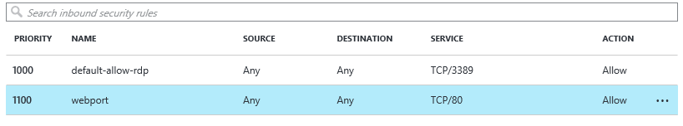
Virtual Machine Inbound Security Rules
VMs can automatically communicate with other VMs in the same virtual network
Inbound security rules are required to direct Internet or other virtual networks inbound network traffic to a VM
In the Azure Management Portal, endpoints are automatically created for:
Remote Desktop
Each inbound security rule has a source and destination port range:
Source port range: used by the Azure to listen for incoming traffic to the VM
Destination port range: used by the VM to listen for incoming traffic to an application or service running on the VM
ACLs on an endpoint can restrict traffic based upon source IP address range
Inbound or outbound security rules can allow or deny traffic from specific IPs and known IP address ranges
Rules are evaluated based on priority number. The lower the number, the higher the priority
Inbound and Outbound Security rules are part of a Network Security group
Notes:
All virtual machines that you create in Azure can automatically communicate using a private network channel with other virtual machines in the same virtual network in a resource group. However, other resources on the Internet or other virtual networks require endpoints to handle the inbound network traffic to the virtual machine.
When you create a virtual machine in the Management Portal, you can create these inbound security rules, such as for Remote Desktop, Windows PowerShell Remoting, or Secure Shell (SSH). After you create the virtual machine, if you have a network security group, you can create additional inbound security rules as needed. You also can manage incoming traffic to the inbound security rule. This article shows you how to do both of those tasks.
Each inbound security rule has a source and destination port range:
Source port range: used by the Azure to listen for incoming traffic to the VM
Destination port range: used by the VM to listen for incoming traffic to an application or service running on the VM
ACLs on an endpoint can restrict traffic based upon source IP address range
Inbound or outbound security rules can allow or deny traffic from specific IPs and known IP address ranges
Rules are evaluated based on priority number. The lower the number, the higher the priority
Inbound and Outbound Security rules are part of a Network Security group

Slide 18


Microsoft Azure External Connectivity Options
ENTERPRISE
CLOUD
Data Synchronization
Azure Data Factory
Application Layer
Connectivity and Messaging
Service Bus
Secure Machine-to-Machine Network Connectivity Point-to-Site
Secure Site-to-Site
Network Connectivity
Microsoft Azure Virtual Network
Secure Site-to-Site
Network Connectivity
Microsoft Azure Virtual Network
Private Site-to-Site Connectivity
Express Route
Notes:
Slide Objective
Microsoft stack to provide connectivity between on-premises and cloud.
Notes
Servicebus vs connect: Servicebus requires changes to application code; Connect/Virtual Networks do not require changes.
Virtual Networks are the net new here. They provide site-to-site connectivity where Connect provided server-to-server connectivity
Virtual Networks are the more flexible and powerful option
ExpressRoute picture depicts a partner supplied data connection with high-powered router going to Azure. Guaranteed bandwidth
NOTE: Currently for ARM, P2S is only available via PowerShell
[EDITOR] Zain Ahmed:
Thursday, October 03, 2013 Stack is a technical term but, in this context, seems to refer to a layered collection of services and/or features (based on the image on the slide). Is the word “stack” still applicable here, based on more than just the appearance of the image? If not, kindly replace with a more appropriate word.
[EDITOR] TWB_Trevor:
08 October 2013 Does Servicebus here refer to Microsoft Azure Service Bus? If so, it should be two words, and used as “Microsoft Azure Service Bus” since this is the first occurrence of the word.
Also, what does “connect” refer to here? The context of the word is not clear. It is a reference to “Microsoft Azure Connect”? If so, kindly note that the feature was deprecated on 7/3/2013 and may not be acceptable to reference in content.
Finally, are “Microsoft Azure Connect” and “Microsoft Azure Virtual Network” interchangeable? They have been separated by a slash, here, which implies “or”. If the message should be “and”, the actual word should be used instead of the slash.

Slide 19
Point-to-Site
The Corp. HQ
Virtual Network
SQL Server
WA Web Role
VPN Tunnel
Client 1
Certificate
VPN Client Package
Notes:
Slide Objective
Enable customers to extend individual existing machines in their Enterprise Networks into Microsoft Azure:
Replacement for Microsoft Azure Connect
Support for “hybrid” apps that span the cloud and on-premises
Notes
You will create a virtual network in Azure
This virtual network is identical to virtual networks you have been building in the past, except that you will select Point-To-Site in the Wizard
You still need a VPN gateway device or Windows Server 2012 with Routing and Remote Access Service (RRAS) setup
Install a certificate on both sides
Install the VPM client package
[EDITOR] TWB_Trevor:
09 October 2013 Kindly provide some context to “sides” here.

Slide 20


Site-to-Site Connectivity
Windows Azure
Extend your on-premises to the cloud securely
On-ramp for migrating services to the cloud
Use your on-premises resources in Azure (monitoring, AD, …)
<subnet 1>
<subnet 2>
<subnet 3>
Virtual Network
DNS Server
Site-to-Site VPN
On-premises
VPN Gateway
VPN Gateway
Hardware VPN or Windows RRAS
Your datacenter

Slide 21
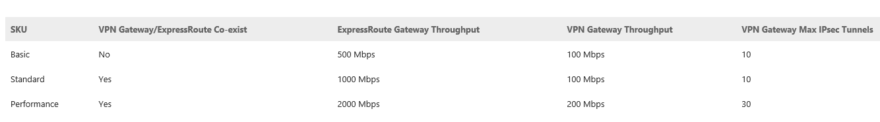
VPN Gateways
Notes:
https://msdn.microsoft.com/en-us/library/azure/jj156075.aspx
Static and Dynamic routing gateways
When you create a site-to-site VPN, you’ll specify either a static, or dynamic gateway. Select the gateway type that is supported by your router and for the type of IPSec parameters and configuration that you require. The tables below show the supported configurations for both static and dynamic VPNs. If you plan to use a site-to-site configuration concurrently with a point-to-site configuration, you’ll need to configure a dynamic routing VPN gateway.
Static routing VPNs – Static routing VPNs are also referred to as policy-based VPNs. Policy-based VPNs encrypt and route packets through an interface based on a customer-defined policy. The policy is usually defined as an access list. Static routing VPNs require a static routing VPN gateway. Note - Multi-Site VPN, VNet to VNet, and Point-to-Site are not supported with static routing VPN gateways.
Dynamic routing VPNs – Dynamic routing VPNs are also referred to as route-based VPNs. Route-based VPNs depend on a tunnel interface specifically created for forwarding packets. Any packet arriving on the tunnel interface will be forwarded through the VPN connection. Dynamic routing VPNs require a dynamic routing VPN gateway. Note - A dynamic routing VPN gateway is required for Multi-Site VPN, VNet to VNet, and Point-to-Site.

Slide 22
The Virtual Branch Office
The Branch Office
The Corp. HQ
SQL Servers
IIS Servers
S2S VPN tunnel
S2S VPN Device
The Virtual Network
in Microsoft Azure
AD / DNS
S2S VPN Device
S2S VPN tunnel
Exchange Server
BRK Gateway
Notes:
Slide Objective
Understand how Virtual Network is just like your branch office.
<click> Outline of the corporate network appears
<click><click> Shows external users using the IIS servers on-premises
<click> Branch office and Azure Cloud appears
<click> S2S VPN devices appear on premise and on-premises in the Branch office
<click> Setup S2S VPN tunnel between branch office and Corp HQ
<click> Create the Azure Vnet
<click> Create a Gateway on the Vnet
<click> Create a VPN between the CorpNet and Azure Vnet
<click> IIS servers are moved to Azure
<click> SQL Servers are moved to Azure
<click> AD/DNS is moved to Azure
<click> <click> Users are now authenticated through the Azure AD/DNS and will begin using the IIS servers there
Allows branch office to access Azure resource via connection to the on-premises VPN device. Allows customer to control who accesses Azure resources. Picture depicts direct connection from clients outside Azure also for public sites.
[EDITOR] TWB_Trevor:
08 October 2013 Original: “Vnet is just like your branch office”.

Slide 23
Multi-Site VPN
Create a multi-site VPN in order to connect multiple on-premises sites to a single virtual network gateway
Requires dynamic routing configured on the VNet gateway
Can change the gateway type without needing to rebuild the virtual network to accommodate multi-site
Need to ensure on-premises VPN gateway supports dynamic routing VPN.
Add configuration settings to the network configuration file
Changes to the VNet won’t be available through the Management Portal
Can use it for everything else except making configuration changes to this particular virtual network.
Notes:
Create your multi-site VPN
Create a site-to-site VPN with a dynamic routing gateway
Export the virtual network configuration settings
Open your network configuration file
Add multiple site references to the network configuration file
Save the network configuration file and import it
Download the pre-shared keys for the VPN tunnels
Check the multi-site tunnel status
Configure a Multi-Site VPN
https://azure.microsoft.com/en-in/documentation/articles/vpn-gateway-multi-site/

Slide 24
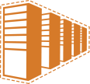
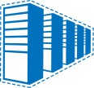
Example: Contoso’s Deployment
Contoso Production VNET in Microsoft Azure (10.1.0.0/16)
The Corp. HQ (10.0.0.0/16)
10.1.2.0/24
10.1.3.0/24
SQL Farm
IIS Servers
131.57.23.120
65.52.249.22
10.1.0.4
10.1.1.4
10.0.0.10
10.0.0.11
S2S VPN tunnels
Contoso Test in Microsoft Azure (10.2.0.0/16)
AD / DNS
S2S VPN Device
Exchange Server
BRK Gateway
10.2.2.0/24
10.2.3.0/24
Multiple S2S VPNs allowed to a single VNet
Notes:
Slide Objective
Illustrate virtual networks with an example.
Notes
A customer can have more than one VNET per subscription
VNETs communicating with the same site must not have overlapping IP ranges, pay close attention to the IP address ranges shown, they do not overlap
Gateway addresses (top right) are 65.52.249.22 ~gateway and 10.1.0.5 & 1.1.4 are IP addresses of gateway to S2S network. It is these gateway addresses that cannot overlap on-premises IP
Multiple S2S VPNs are also allowed, connecting to the same VNet
[EDITOR] TWB_Trevor:
09 October 2013 Kindly validate the suggested modification. Original: “Example”.

Slide 25
VNet to VNet Connectivity
Cross region geo-redundancy and geo-presence
You can set up your own geo-replication or synchronization with secure connectivity without going over internet-facing endpoints
With Azure Load Balancer and Microsoft or third party clustering technologies, you can setup highly available workloads with geo-redundancy across multiple Azure regions
Regional multi-tier applications with strong isolation boundary
Within the same region, you can setup multi-tier applications with multiple virtual networks connected together with strong isolation and secure inter-tier communication
Cross subscription, inter-organization communication in Azure
Connect workloads from different subscriptions together securely between virtual networks
Enable cross organization communication with secure VPN technology within Azure.
Notes:
https://azure.microsoft.com/en-us/blog/vnet-to-vnet-connecting-virtual-networks-in-azure-across-different-regions/

Slide 26
VNet to VNet Connectivity Considerations
VNet to VNet requires Azure for site-to-site VPN gateways with dynamic routing VPNs – static routing is not supported
Virtual network connectivity can be used simultaneously with multi-site VPNs, with a maximum of 10 VPN tunnels
The address spaces of the virtual networks and on-premises local network sites MUST NOT overlap.
Virtual networks can be in the same or different subscriptions or Azure regions
Redundant tunnels between a pair of virtual networks are not supported
Although a Resource Group can span regions, load balancing endpoints cannot span regions
All VPN tunnels of the virtual network, including P2S VPNs, share the available bandwidth on the Azure VPN gateway and the same VPN gateway uptime SLA in Azure
Notes:
VNet to VNet requires Azure VPN gateways with dynamic routing VPNs – static routing is not supported: When setting up a Site-to-Site VPN, you have two choices, dynamic and static routing. To do dynamic routing, you need a device that can handle dynamic routing. Also, dynamic routing is preferred since it implies that the internal routing tables do not need to be manually set up, they auto adjust based on routing changes as they happen on the network. For Azure, we need to have dynamic routing because Azure keeps track of routing changes and we do not have the option to make these changes.
Virtual network connectivity can be used simultaneously with multi-site VPNs, with a maximum of 10 VPN tunnels for a virtual network VPN gateway connecting to either other virtual networks or on-premises sites – Some customers have VPN devices that connect to multiple Azure regions. The maximum mixture of connections in a subscription would be 10 VPN tunnels, regardless of whether that is from on-premises to the Cloud, Cloud to Cloud etc.
The address spaces of the virtual networks and on-premises local network sites MUST NOT overlap – this condition is no different than what we have had with P2S or S2S previously.
Virtual networks can be in the same or different subscriptions
Virtual networks can be in the same or different Azure regions
Redundant tunnels between a pair of virtual networks are not supported – some networks are able to provide master/slave redundancy in case there is a failure in the tunnel. Vnet does not support this.
PaaS load balancing endpoint CANNOT span across virtual networks even though the virtual networks are connected together
All VPN tunnels of the virtual network, including P2S VPNs, share the available bandwidth on the Azure VPN gateway and the same VPN gateway uptime SLA in Azure – a virtual network can have multiple connections to other networks, hence multiple VPN tunnels. They all share the same bandwidth, meaning the more tunnels you have, the slower the throughput.

Slide 27
What is ExpressRoute?
ExpressRoute provides organizations a private, dedicated, high-throughput network connection between Windows Azure datacenters and their on-premises IT environment.
Predictable performance
Security
High throughput
Lower cost
Notes:
1. With ExpessRoute, you can choose the network performance you desire. Your can design apps to meet QoS and SLA requirements
2. ExpessRoute provides a private dedicated connection between Azure and your datacenter, so don’t have to rely on the shared network infrastructure of the Internet
3. With up to 10Gps dedicated connection, you have a extremely high bandwidth connection between Azure datacenters and your IT environment
4. For transferring large datasets in and out of Azure datacenters, ExpessRoute provides an economically cheaper alternative.

Slide 28
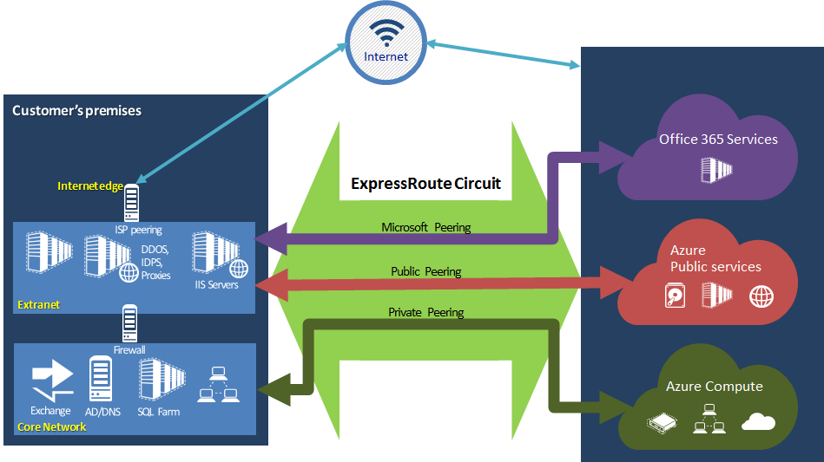
Public, Private and Microsoft peering
Make shapes consistent and icons throughout deck similar
DNS Server
Notes:
http://azure.microsoft.com/en-us/documentation/articles/expressroute-introduction/
Private Peering
Azure compute services, namely virtual machines (IaaS) deployed within a virtual network can be connected through the private peering domain. The private peering domain is considered to be a trusted extension of your core network into Microsoft Azure. You can setup bidirectional connectivity between your core network and Azure virtual networks (VNets). This will enable you to connect to virtual machines directly on their private IP addresses.
You can connect more than one virtual network to the private peering domain. Review the FAQ page for information on limits and limitations.
Public Peering
Services such as Azure Storage, SQL databases and Websites are offered on public IP addresses. You can privately connect to services hosted on public IP addresses (including VIPs of your VMs) through the public peering routing domain. You can connect the public peering domain to your extranet and connect to all Azure services on their public IP addresses from your WAN without having to connect through the internet. Connectivity is always initiated from your WAN to Microsoft Azure services. Microsoft Azure services will not be able to initiate connections into your network through this routing domain. Once public peering is enabled, you will be able to connect to all Azure services (we do not allow you to selectively pick services for which we advertise routes to). You can review the list of prefixes we advertise to you through this peering at Microsoft Azure Datacenter IP Ranges page. You can define custom route filters within your network to consume only the routes you need.
Review the FAQ page for more information on services supported through the public peering routing domain.
Microsoft Peering
Connectivity to all other Microsoft online services (such as Office 365 services) will be through the Microsoft peering. We enable bidirectional connectivity between your WAN and Microsoft through the Microsoft peering routing domain. You must connect to Microsoft only over public IP addresses that are owned by you or your connectivity provider and must adhere to all the rules we define. Review the ExpressRoute prerequisites page for more information.
Review the FAQ page for more information on services supported, costs and configuration details. Review the ExpressRoute Locations page for information on the list of connectivity providers offering Microsoft peering support.
NOTES
You have complete control over how you want to route packets between Azure and on-premises
If you were concerned about security and monitoring, you could have all traffic sent back on premises and then back out to Azure (Orange line). There will be a performance penalty
If you want to only extend your backend infrastructure into the Cloud application ,concern is that cloud is open entity, but what we do is forced tunneling, where you publish default routes to us to say that you want all traffic going back and forth from backend to Cloud. There is no danger of traffic leaking out to the internet (red)
Blue line represents anything internet bound, again you can setup your routing to do this

Slide 29
Virtual Network and ExpressRoute
Scenario 1: IPSec VPN over internet
Scenario 2: Exchange Provider
Scenario 3: Network Service Provider
Public
internet
Public
internet
Customer site 3
Windows Azure
Windows Azure
Customer site 2
WAN
Customer DC
Windows Azure
Customer site
ExpressRoute
partner location
Customer site 1
Public
internet
Connect via an encrypted link over public internet
Peer at an ExpressRoute location, an Exchange Provider facility
Connection from a WAN provided by Network Service Provider.
Azure becomes another site on the customer’s WAN network.
Virtual Network - Compute only.
ExpressRoute - Provides customer choice and include access to compute, storage, and other Azure services.
Notes:
Scenario 1 – this is the typical situation for a site-to-site connection where you have a VPN device. Although you can connect your internal network to the Azure network, you are still going out over the internet
Scenario 2 – this is called an Exchange provider. Here, you can put your hardware devices at the vendor
Customer already using co-location facility; or wants to meet Azure at Exchange Provider location for a simple point to point connection
Connect to Windows Azure directly through a virtual cross connection
Higher flexibility
Control over routing
Place your hardware in the Exchange Provider’s datacenter
Tiers and Pricing
Throughput based tiers, data charges separate
Upto 10 GBps
Scenario 3 – Network service provider (WAN provider) see’s Azure as another site on your WAN network Customer already getting managed WAN services (like MPLS VPN)
Connect to Windows Azure through VPN provider
Easy to onboard
Use your existing VPN to connect to Azure
Access from any site Tiers and pricing
Throughput based tiers (with unlimited data)
Connection speeds of up to 1 GBps
Notes: Need to find industry terms for this.
“Private VPN” = frame relay, ATM, MPLS | MPLS is the king

Slide 30
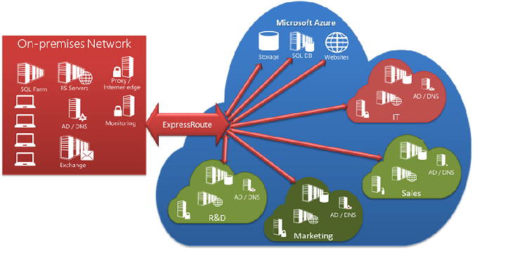
ExpressRoute Shared Connections
A single ExpressRoute circuit can be shared across subscriptions
Subscription administrators/co-admins can authorize admins from other subscriptions to use dedicated circuit
ExpressRoute and S2S VPN can now co-exist
Notes:
https://azure.microsoft.com/en-in/documentation/articles/expressroute-introduction/
Each of the smaller clouds within the large cloud is used to represent subscriptions belonging to different departments within an organization. Each of the departments within the organization can use their own subscription for deploying their services but can share a single ExpressRoute dedicated circuit to connect back to the corporate network. A single department (in this example: IT) can own the ExpressRoute dedicated circuit. Connectivity and bandwidth charges for the dedicated circuit will be applied to the dedicated circuit owner. Other subscriptions within the organization can use the ExpressRoute circuit.

Slide 31
ExpressRoute Premium Add-on Package
Used for large numbers of Border Gateway Protocol (BGP) routes
Global connectivity – VNets across regions can be accessed through circuit
More Azure virtual network links per circuit
Increases public and private peering from 4,000 to 10,000 routes
More than 10 VNet links per ExpressRoute circuit (limit depends on circuit bandwidth)
Notes:
For Azure ExpressRoute customers who require a large number of Border Gateway Protocol (BGP) routes, global connectivity, or more Azure Virtual Network (VNet) links per circuit, starting today we’re introducing the ExpressRoute Premium add-on package – a set of capabilities that no other public cloud provider offers. This add-on can be applied over the ExpressRoute Network Service Provider or Exchange Provider circuits, increasing the limit for public and private peering from 4,000 to 10,000 routes. In addition, the ExpressRoute Premium add-on provides global connectivity (for example, a VNet created in West Europe can be accessed through an ExpressRoute circuit provisioned in the West US region), while now allowing more than 10 VNet links per ExpressRoute circuit, with the exact limit depending on circuit bandwidth.

Slide 32
Enhanced VPN Gateway Features
Used for both Site-to-Site and ExpressRoute VPN
High performance gateways options allows more tunnels for hybrid scenarios
Operations and audit logs can be generated for VNet gateways
Advanced gateway policies now allow you to control encryption for tunnels between virtual networks
Encryption types available - 3DES, AES128, AES256 and Null Encryption
Enable Perfect Forward Secrecy (PFS) for IPsec/IKE gateways
Notes:
New VPN Gateway Sizes
To cater to the growing hybrid connectivity throughput needs and the number of cross premise sites, we are announcing the availability of a higher performance Azure VPN gateway. This will enable a faster ExpressRoute and Site-to-Site VPN gateways with more tunnels.
Operations and audit logs for VNet Gateways and ExpressRoute
You can now view operations logs for Virtual Network Gateways and ExpressRoute circuits. The Azure portal will now show operations logs and information on all API calls you make and important infrastructure changes made such as scheduled updates to gateways.
https://azure.microsoft.com/en-in/documentation/articles/expressroute-howto-vnet-portal-classic/
Advanced Virtual Network Gateway policies
We now enable the ability for you to control encryption for the tunnel between Virtual Networks. You now have a choice between 3DES, AES128, AES256 and Null encryption, and you can also enable Perfect Forward Secrecy (PFS) for IPsec/IKE gateways.
PowerShell
For an EXISTING gateway, you can “resize” it using:
Resize-AzureVNetGateway [-VNetName] <string> [-GatewaySKU] <GatewaySKU> {Default | HighPerformance}
So either use “Default” or “HighPerformance”.
If you create a NEW gateway:
New-AzureVNetGateway [-VNetName] <string> [[-GatewayType] <GatewayType> {StaticRouting | DynamicRouting}] [[-Gatewa
ySKU] <GatewaySKU> {Default | HighPerformance}]

Slide 33
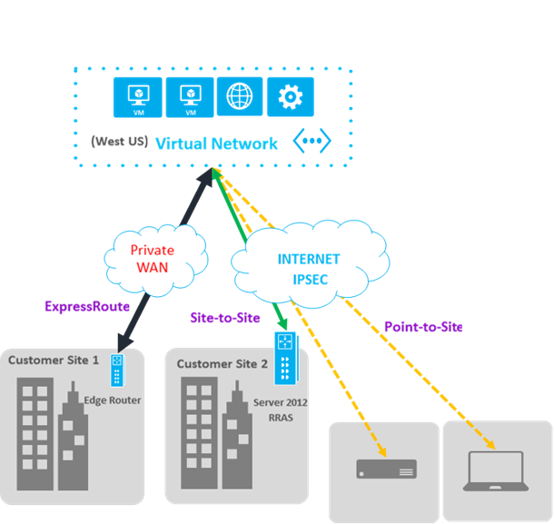
VPN GW S2S and ExpressRoute coexistence
VPN gateway allows you to have Site-to-Site (S2S) VPN connectivity to a Virtual Network that also has a gateway connected to an ExpressRoute circuit.
This enables new connectivity scenarios:
You can now use S2S VPN tunnel as a backup for your ExpressRoute connection.
You can connect branch offices that aren’t part of your WAN to your Azure virtual networks that are also connected via ExpressRoute.
You can have Point-to-Site connections to the same Virtual Network that is also connected via ExpressRoute enabling dev/test and mobile worker scenarios.
Notes:
http://azure.microsoft.com/blog/2015/05/05/new-networking-capabilities-for-a-consistent-connected-and-hybrid-cloud/

Slide 34
Module 4: IaaS Virtual Networking
Networking Scenarios

Slide 35
Virtual Network Scenarios
Hybrid Public/Private Cloud
Enterprise app in Microsoft Azure requiring connectivity to on-premises resources
Enterprise Identity and Access Control
Manage identity and access control with on-premises resources (on-premises Active Directory)
Monitoring and Management
Remote monitoring and troubleshooting of resources running in Microsoft Azure (SCOM)
Advanced Connectivity Requirements
Cloud deployments requiring persistent IP addresses and direct connectivity across services
Notes:
Slide Objective
Review and understand some Use Cases related to virtual networks.

Slide 36
Application Migration
The Corp. HQ
WA Web Role
SQL Farm
IIS Servers
VPN Tunnel
App Servers
AD / DNS
Notes:
Slide Objective
Explain how customers can extend their Enterprise Networks into Microsoft Azure. Discuss:
Networking on-ramp for migrating existing apps to Microsoft Azure
Support for hybrid apps that span the cloud and on-premises
Notes
Customer-managed private virtual networks within Microsoft Azure
“Bring your own IPv4 addresses”
Offers control over placement of Microsoft Azure Roles within the network
Ensures stable IPv4 addresses for VMs
Hosted VPN Gateway that enables site-to-site connectivity
Automated provisioning and management
Support existing on-premises VPN devices
BYO on-premises DNS servers
Allows you to use your on-premises DNS servers for name resolution
Allows VMs running in Microsoft Azure to be joined to corporate domains running on-premises (use your on-premises Active Directory)

Slide 37
Monitoring
The Corp. HQ
WA Web Role
SQL Farm
IIS Servers
VPN Tunnel
Monitoring Service
AD / DNS
Notes:
Slide Objective
Explain how customers can extend their Enterprise Networks into Microsoft Azure. Discuss:
Networking on-ramp for migrating existing apps to Microsoft Azure
Support for hybrid apps that span the cloud and on-premises
Notes
Customer-managed private virtual networks within Microsoft Azure
“Bring your own IPv4 addresses”
Offers control over placement of Microsoft Azure Roles within the network
Ensures stable IPv4 addresses for VMs
Hosted VPN Gateway that enables site-to-site connectivity
Automated provisioning and management
Support existing on-premises VPN devices
BYO on-premises DNS servers
Allows you to use your on-premises DNS servers for name resolution
Allows VMs running in Microsoft Azure to be joined to corporate domains running on-premises (use your on-premises Active Directory)
[EDITOR] TWB_Trevor:
09 October 2013 The content on this slide is the same as that of the previous slide. Kindly delete if required.

Slide 38
SharePoint in Microsoft Azure
On Premises
Microsoft Azure Virtual Network
IaaS VM
DC
DNS
Local DNS
10.8.8.x
Use Accounts
IaaS VM
SharePoint FrontEnd
DC
DNS
Server Account
Persistent VM Role
SQL
LB
SQL Mirroring
IaaS VM
SharePoint Front-End
IaaS VM
IaaS VM
SQL
Search and Index
Persistent Desk
Internet
Domain Joined to On-Premises Network
Notes:
Slide Objective
Just have a general discussion of how SharePoint, when deployed via IaaS, requires a Windows domain. This windows domain is in Azure but uses a VPN for AD/DNS on-premises

Slide 39
Mixed Mode with Virtual Network
PaaS
IaaS
IaaS VM
IaaS VM
Business Components & Entities
SQL
Web Role
Persistent Disk
LB
SQL AlwaysOn
IaaS VM
Business Components & Entities
Web Role
IaaS VM
Persistent Disk
SQL
Notes:
Slide Objective
Show how using a virtual network could allow multiple deployment types (IaaS and PaaS) to co-exist on the same network.

Slide 40
Module 4: IaaS Virtual Networking
High Availability

Slide 41
Azure Load Balancer
Load Balancer
Virtual Network
VM
VM
VM
VM
Notes:
Slide Objective
Explain the Load Balancer and health probes.
Notes
Required for load balancing VMs based on health
If probes are not responded to, the instance will be taken out of load balancer rotation
This is not desirable in some cases as it does not take the app’s health into account
Custom probes offers the ability to probe an app directly for health. Custom probes are supported for TCP and HTTP
By using a custom health probe, you can keep the network load balancer from putting the machine into load balancer rotation until it is ready (by returning a non-200 http code)
For PaaS role instances running in a VM, we have a guest agent that performs many tasks, including responding to probes from the load balancer
[EDITOR] TWB_Trevor:
08 October 2013 The context of the last bullet is not clear. Are default probes or custom probes required to load balance VMs based on health? The bullet needs to be rephrased for clarity.

Slide 42
Load Balancer: Default Health Probe for Load Balanced Sets
Load Balancer
VM
VM
Microsoft Azure
Agent
Microsoft Azure
Agent
Role Status
Role Status
Customer
Application
Customer
Application
Notes:
Slide Objective
Explain the default health probe.
Notes
PaaS role instances run in a VM. We have a guest agent that performs many tasks, including responding to probes from the load balancer
If probes are not responded to, the instance will be taken out of load balancer rotation
This is not desirable in some cases as it does not take the app’s health into account
Custom probes offers the ability to probe an app directly for health. Custom probes are supported for TCP and HTTP
Also required for load balancing VMs based on health
[EDITOR] TWB_Trevor:
08 October 2013 The context of the last bullet is not clear. Are default probes or custom probes required to load balance VMs based on health? The bullet needs to be rephrased for clarity.

Slide 43
Load Balancer: Custom Health Probe for Load Balanced Sets
Load Balancer
VM
VM
Microsoft Azure
Agent
Microsoft Azure
Agent
Role Status
Role Status
Customer
Application
Customer
Application
Notes:
Slide Objective
Explain that you can specify a custom health probe.
Notes
Currently, this is only possible through Windows PowerShell
By using a custom health probe, you can keep the network load balancer from putting the machine into load balancer rotation until it is ready (by returning a non-200 http code)

Slide 44
Azure Internal Load Balancer - ILB
Provides load balancing for machines inside of a Virtual network
Within a virtual network, from virtual machines in a virtual network to a set of virtual machines that reside within the same virtual network.
For a cross-premises virtual network, from on-premises computers to a set of virtual machines that reside within the same virtual network
Between virtual machines in a virtual network
Using ILB
Internet-facing, multi-tier applications in which the back-end tiers are not Internet-facing but require load balancing for traffic from the Internet-facing tier.
Load balancing for line-of-business (LOB) applications hosted in Azure without requiring additional load balancer hardware or software.
ILB Setup
PowerShell Only
Add-AzureRMLoadBalancerFrontendIPConfig
Add-AzureRMLoadBalancerBackendAddressPoolConfig
Notes:
All virtual networks created now are regional and do not require affinity groups.
Azure Internal Load Balancer
https://azure.microsoft.com/en-us/documentation/articles/load-balancer-internal-overview/
Configure an internal load balanced set
https://azure.microsoft.com/en-in/documentation/articles/load-balancer-get-started-ilb-arm-ps/

Slide 45
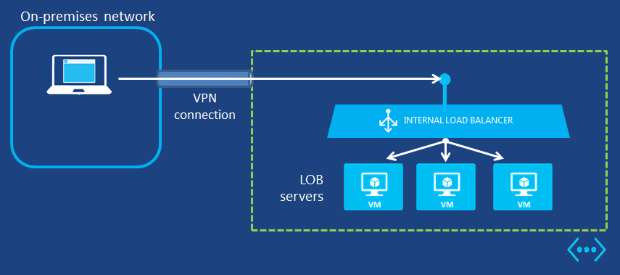
ILB Scenario
Intranet app running on Azure IaaS
Cross-premises Azure virtual network
Load balance not internet facing machines

Slide 46

Internet IP Addresses and Load Balancing
Public IP Addresses in Azure
Can be used for instance (VM) level access or load balancing
Instance-level IP (ILPIP)
Internet IP assigned exclusively to single VM Entire port range accessible by default
Primarily for targeting a specific VM
Load balanced IP (VIP)
Internet IP load balanced among one or more VM instances
Allows port redirection
Primarily for load balanced, highly available, or auto-scale scenarios
Internet
151.2.3.4 (VIP)
LB
131.3.3.3
(Instance-level IP)
131.3.4.4
(Instance-level IP)
VM1
VM2
IP1
IP2
Microsoft Azure
Notes:
This slide is used to discuss the combination of both the public IP addresses that Azure can provide to individual VMs + load balancing between them.
http://azure.microsoft.com/blog/2014/10/22/instance-level-public-ip-address/
You can now have Azure provide public IP addresses to individual VMs, maybe so you can use the machine as an FTP server
An instance level public IP is not load balanced
The entire port range is accessible by default. Typically, to be able to send traffic to an Azure VM from an external source, the destination port must be declared as an Endpoint in the VM, but with Instance-Level Public IPs this restriction is removed. An external source can send traffic to any port on the Instance-Level Public IP Address as long the firewall in the VM allows it. This is particularly useful when the VM needs to receive traffic on dynamic ports, a good use case being FTP servers implementing passive mode

Slide 47
Azure DNS Services
Azure DNS
Traffic Manager
Preview
DNS
Host your DNS domains in Azure
Integrate your Web and Domain hosting
Globally route user traffic with flexible policies
Enable best-of-class end to end user experience
Notes:
As of 7/31/15 we now have Azure DNS (Preview) that can be offered to customers as a DNS service http://azure.microsoft.com/en-us/updates/preview-azure-dns/
Azure Domain Name System (DNS) allows you to host your domains with your Azure apps. By hosting your domains in Azure, you can manage your DNS records by using your existing Azure subscription. The global Microsoft network of servers has the reach, scale, and redundancy needed to ensure ultra-fast DNS responses and ultra-high availability for your domains.
Traffic Manager has been around for a while. It is a DNS service, no traffic flows through it

Slide 48
Traffic Manager
Traffic Management Policies
Latency – Direct to “closest” service
Round Robin – Distribute across all services
Failover – Direct to “backup” if primary fails
Nested – Flexible multi-level policies
www.contoso.com
Notes:
Microsoft Azure Traffic Manager allows you to control the distribution of user traffic to your specified endpoints, which can include Azure websites, and other endpoints. Traffic Manager works by applying an intelligent policy engine to Domain Name System (DNS) queries for the domain names of your Internet resources. Your Azure websites can be running in different datacenters across the world.
There are three load balancing methods available in Traffic Manager. Each Traffic Manager profile can use only one load balancing method at a time, although you can select a different load balancing method for your profile at any time.
It’s important to note that all load balancing methods include endpoint monitoring. After you configure your Traffic Manager profile to specify the load balancing method that best fits your requirements, configure your monitoring settings. When monitoring is correctly configured, Traffic Manager will monitor the state of your endpoints, consisting of websites, and won’t send traffic to endpoints it thinks are unavailable. For information about Traffic Manager monitoring, see About Traffic Manager Monitoring. For information about configuring your monitoring settings, see Configure Traffic Manager Monitoring.
The three Traffic Manager load balancing methods are:
Failover: Select Failover when you have endpoints in the same or different Azure datacenters (known as regions in the Management Portal) and want to use a primary endpoint for all traffic, but provide backups in case the primary or the backup endpoints are unavailable. For more information, see Failover load balancing method.
Round Robin: Select Round Robin when you want to distribute load across a set of endpoints in the same datacenter or across different datacenters. For more information, see Round Robin load balancing method.
Performance: Select Performance when you have endpoints in different geographic locations and you want requesting clients to use the "closest" endpoint in terms of the lowest latency. For more information, see Performance load balancing method.
Note that Azure Websites already provides failover and round-robin load balancing functionality for websites within a datacenter, regardless of the website mode. Traffic Manager allows you to specify failover and round-robin load balancing for websites in different datacenters.
Note: The DNS Time-to-Live (TTL) informs DNS clients and resolvers on DNS servers how long to cache the resolved names. Clients will continue to use a given endpoint when resolving its domain name until the local DNS cache entry for the name expires.

Slide 49
Module 04: IaaS Virtual Networking
Other Features

Slide 50
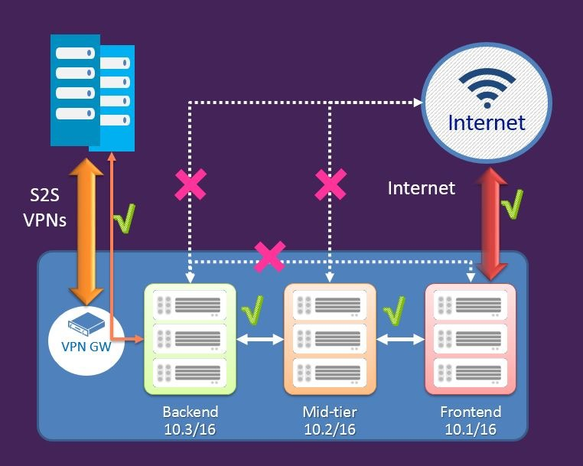
Network Security Groups (NSG)
Define access control rules for inbound/outbound traffic to a VM or group of VMs in a subnet
NSG rules can be changed at any time and apply to all instances
NSG can be associated with:
A single VM in a VNet
A subnet in a VNet
A VM and a Subnet together for added security
Rules are processed in order of priority
Rules are based on 5-tuple (source/dest IP/port, protocol)
Notes:
You can now create Network Security groups to define access control rules for inbound and outbound traffic to a Virtual machine or a group of virtual machines in a subnet. The security groups and the rules can be managed and updated independent of the life cycle of the VM.
http://azure.microsoft.com/blog/2014/10/29/networking-enterprise/
https://anderseideblog.wordpress.com/2014/10/30/network-security-groups-in-azure/
https://azure.microsoft.com/en-in/documentation/articles/virtual-networks-nsg/
added note that rules are based on the 5-tuple (source/dest IP/port, protocol)

Slide 51
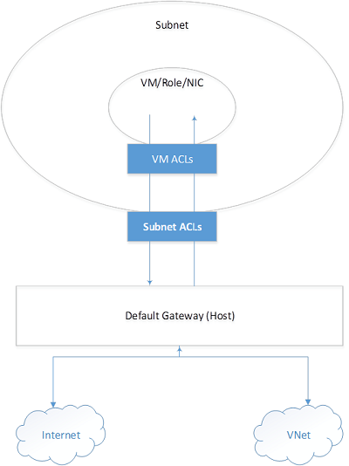
Network Security Groups (continued)
Two different ACL groups, one for individual VM, one for Subnet
Rules are applied to inbound traffic for subnet followed by rules for the VM
Outbound rules are applied for VM first and then followed by subnet rules
Example PowerShell:
New-AzureNetworkSecurityGroup -Name "MyVNetSG" -Location uswest -Label "Security group for my Vnet in West US“
Get-AzureNetworkSecurityGroup -Name "MyVNetSG" | Set-AzureNetworkSecurityRule -Name WEB -Type Inbound -Priority 100 -Action Allow -SourceAddressPrefix 'INTERNET' -SourcePortRange '*' -DestinationAddressPrefix '*' -DestinationPortRange '*' -Protocol TCP
Notes:
Associating an NSG to a Subnet and a VM - It is possible that you can associate a NSG to a VM and a different NSG to the subnet where the VM resides. This is supported and in this case the VM gets two layers of protection. On the Inbound traffic the packet goes through the access rules specified in the subnet followed by rules in the VM and in the Outbound case it goes through the rules specified in the VM first before going through the rules specified in the subnet, as illustrated in the diagram above.
When an NSG is associated with a VM or subnet, the network access control rules becomes very explicit. The platform will not insert any implicit rule to allow traffic to a particular port. In this case, if you create an endpoint in the VM, you also have to create a rule to allow traffic from the Internet. If you don’t do this, the VIP:<Port> will not be accessible from outside.
For example:You create a new VM and also create a new NSG. You associate the NSG to the VM. The VM can communicate to other VMs in the virtual network through the ALLOW VNET INBOUND rule. The VM can also make outbound connections to the Internet using the ALLOW INTERNET OUTBOUND rule. Later, you create an endpoint on port 80 to receive traffic to your website running in the VM. Packets destined to port 80 on the VIP (public Virtual IP address) from the Internet will not reach the VM until you add a rule similar to the following (below) to the NSG.

Slide 52
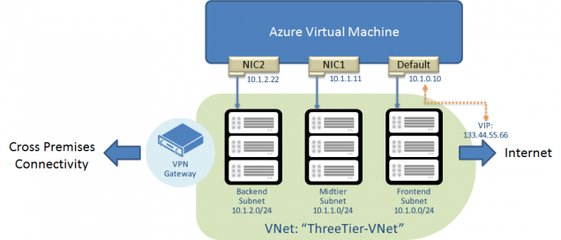
Multi-NIC Support
Using multiple NICs on your VM allows you to manage network traffic better (max ~ 8)
Isolate traffic between front-end NICs and backend NICs
Cannot add or remove NICs once VM is created
Can have multiple NICs on any VM except for Basic SKU
VMs must be in an Azure Virtual Network
Additional NICs cannot be used in a load balanced set
On-premise VM’s with multiple NIC’s migrated to Azure won’t work – VM must be built in Azure
Notes:
You can now create and manage multiple virtual network interfaces (NICs) on a VM. Multi-NIC support is a fundamental requirement for a majority of network virtual appliances that can be deployed in Azure. Having this support now enabled within Azure will enable even richer network virtual appliances to be used.
http://azure.microsoft.com/blog/2014/10/30/multiple-vm-nics-and-network-virtual-appliances-in-azure/
https://azure.microsoft.com/en-in/documentation/articles/virtual-networks-multiple-nics/
Example PowerShell
$image = Get-AzureVMImage -ImageName "a699494373c04fc0bc8f2bb1389d6106__Windows-Server-2012-R2-201408.01-en.us-127GB.vhd“
$vm = New-AzureVMConfig -Name "MultiNicVM" -InstanceSize "ExtraLarge" -Image $image.ImageName –AvailabilitySetName “MyAVSet”
Add-AzureProvisioningConfig –VM $vm -Windows -AdminUserName “<YourAdminUID>” -Password “<YourAdminPassword>”
Specify the subnet and IP address of the default NIC. Note that the SubnetNames parameter must be the name of one of the subnets in your virtual network. We are using the Frontend subnet in this example.
Set-AzureSubnet -SubnetNames "Frontend" -VM $vm
Set-AzureStaticVNetIP -IPAddress "10.1.0.10" -VM $vm4
Add additional NICs to the VM configuration. Similar to step (3), the SubnetName and StaticVNetIPAddress must correspond to the subnet definition of the virtual network. The interface name must be unique for the VM, but does not represent the names of the NICs inside the VM.
Add-AzureNetworkInterfaceConfig -Name "NIC1" -SubnetName "Midtier" -StaticVNetIPAddress "10.1.1.11" -VM $vm
Add-AzureNetworkInterfaceConfig -Name "NIC2" -SubnetName "Backend" -StaticVNetIPAddress "10.1.2.22" -VM $vm5
After these steps, we are ready to create the VM. You will need to create the VM in the virtual network that contains the subnet names and IP addresses used above:
New-AzureVM -ServiceName "MultiNIC-CS" –VNetName “ThreeTier-VNet” –VM $vm

Slide 53
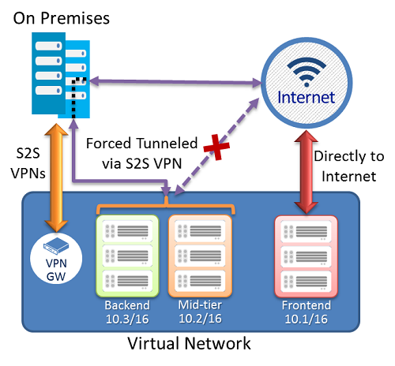
Forced Tunneling
Force internet-bound traffic from a Cloud application back through on-premises network via Site-to-Site VPN/ExpressRoute
Allows scenario for inspection and auditing of traffic
Can create a routing table to create a default route, then associate routing table to VNet subnets
Notes:
Forced Tunneling
You can now redirect or “force” all Internet-bound traffic that originates in a cloud application back through an on-premises network via a Site-to-Site VPN tunnel for inspection and auditing. This is a critical security capability for enterprise grade applications.
https://azure.microsoft.com/en-in/documentation/articles/vpn-gateway-about-forced-tunneling/
In the diagram it shows two subnets associated with the default route

Slide 54
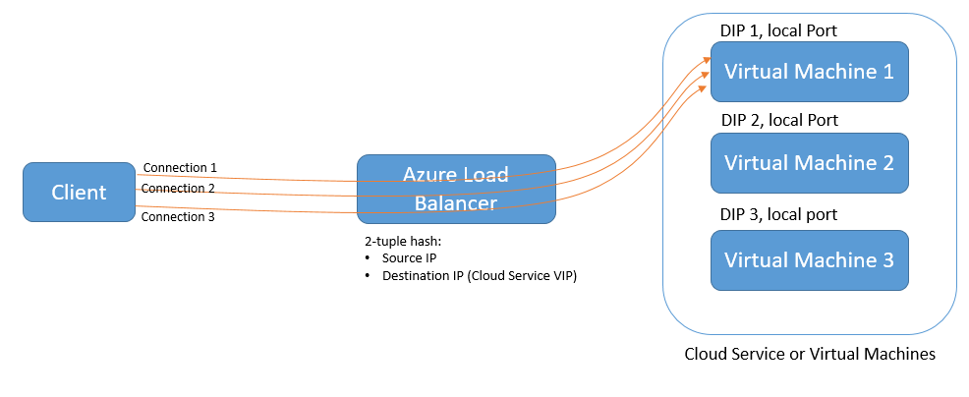
Source IP Affinity
Azure Load Balancer – new distribution mode = Source IP Affinity
Load balance traffic based on 2 or 3 tuple modes
Scenarios
Configure load balancer distribution to an endpoint on a VM via PowerShell/Service Management API
Configure load balancer distribution for your Load-Balanced Endpoint Sets via PowerShell/Service Management API.
Configure load balancer distribution for your Web/Worker roles via the Service model (.csdef file)
Notes:
Source IP Affinity
The Azure Load Balancer now supports a new distribution mode called Source IP Affinity (also known as session affinity or client IP affinity). You can now load balance traffic based on a 2-tuple (Source-IP, Destination-IP) or 3-tuple (Source-IP, Destination-IP and Protocol) distribution modes.
http://azure.microsoft.com/blog/2014/10/30/azure-load-balancer-new-distribution-mode/
For web and worker roles
http://msdn.microsoft.com/library/azure/ee758711.aspx

Slide 55
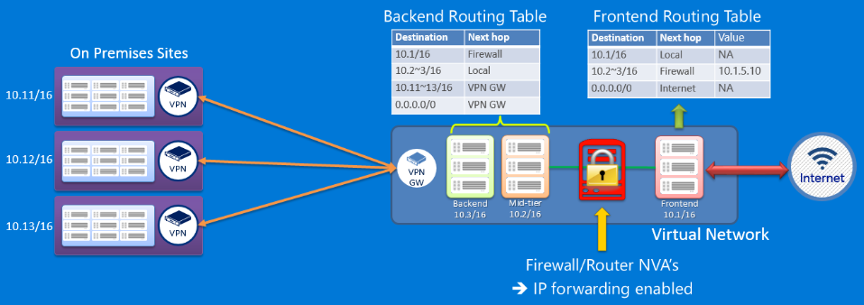
User Defined Routing
By default, Azure provides a route table based on your virtual network settings
Need for custom routing may include
Use of a virtual appliance in your Azure environment, ex. Firewall
Implementing a virtual NAT appliance to control traffic between your Azure virtual network and the Internet
BGP Route – if you are using ExpressRoute, you can enable BGP to propagate routes from your on-premises network to Azure
Ex. - All traffic directed to the mid-tier and backed subnets initiated from the front end subnet goes through a virtual firewall appliance
Notes:
With User Defined Routing, you can now define custom routes in Virtual Networks to control how traffic flows. Azure now allows customers to override the default static routing policy which enables a number of Virtual Appliance scenarios such as ‘NAT’ing, ‘Application firewall’, ‘Bring your own gateway’, ‘Intrusion protection systems’ and ‘Intrusion detection systems’. It will now be possible to run sophisticated network topologies in the cloud, which mirrors the setup in on-premises.
http://azure.microsoft.com/en-us/documentation/articles/virtual-networks-udr-overview/
How to Create Routes
https://azure.microsoft.com/en-in/documentation/articles/virtual-networks-udr-overview/

Slide 56
Module 4: IaaS Virtual Networking
Virtual Network Appliances

Slide 57
Virtual Network Appliances
Overview
VMs that perform specific network functions
Focus: Security (Firewall, IDS , IPS), Router/VPN, ADC (Application Delivery Controller), WAN Optimization
Typically Linux or FreeBSD-based platforms
1st and 3rd Party Appliances
Scenarios
IT Policy & Compliance – Consistency between on premises & Azure
Supplement/complement Azure capabilities
Azure Marketplace
Available through Azure Certified Program to ensure quality and simplify deployment
You can also bring your own appliance and license
ExpressRoute / Virtual Networks make Azure part of customer’s network driving demand for security, compliance, performance, scalability
1st Party
Appliances
3rd Party
Appliances
L7 Load Balancer
Cookie Session Affinity
SSL Offload
Future Opportunities
WAN Accelerator
WAF
Load Balancer
Intrusion Prevention
Bring Your Own Appliance
Notes:
The idea for virtual networking is to extend a customers network into Azure as easily as possible. On-premises, most customers are using IDP/IPS firewall devices and we would like to see these appear in the Azure marketplace (3rd party appliances) like Barracuda for example.
But, in cases where the customer wants everything to be ‘Azure’ and not a 3rd party, we have Azure Application Gateway

Slide 58

Azure Application Gateway
Azure-managed, first-party virtual appliances
HTTP routing based on app-level policies:
Cookie based session affinity
URL hash
Weight (load)
SSL termination and caching
Centralize certificate management
Scalable backend provisioning
Customer VMs
VM
Web1
Load Balancing
Cookie Affinity
App Gateway
VM
Web2
HTTP & HTTPS
VM
Web3
SSL Offload
Notes:
See TechReady21 – AZR200 - https://tr21.techreadytv.com/sessions/AZR200.aspx
General link - http://azure.microsoft.com/en-us/services/application-gateway/
Create a gateway tutorial https://azure.microsoft.com/en-us/documentation/articles/application-gateway-create-gateway/
Azure-managed, first-party virtual appliances – this is top priority for some customers. They don’t want to have to pay for a license to a 3rd party and they don’t want to have to figure out a whole new product interface. Microsofts goal is NOT to compete with the current partner eco-system, but to offer an additional choice to customers.
There are actually two versions of this gateway, one that supports the older model, PowerShell setup/creation and then a new one that support the new ARM model with creation via ARM.
HTTP routing based on app-level policies:
Cookie affinity
URL hash
Weight (load)
SSL termination and caching - A secure socket layer (SSL) connection uses a certificate for authentication before sending encrypted data from a client computer to the web server. SSL termination, a form of SSL offloading, shifts some of this responsibility from the web server to a different machine. SSL termination acts as the end of the line, or termination point, for an SSL connection. The process prepares the data for the server and organizes incoming connections in order to allow the web server to concentrate other tasks such as loading web pages. SSL termination allows servers with an SSL connection to handle a large volume of simultaneous connections, or sessions, and cookies. SSL termination also works to increase site and web application performance by increasing server speed. It ensures accuracy by performing decryption on a separate device. Centralize certificate management – by managing the SSL certificate at the App Gateway, this means you don’t have to distribute the certificate to all of the web servers.
Scalable backend provisioning

Slide 59
Application Gateway – LB Hierarchy
Azure Service | What | Example
Traffic Manager | Cross-region redirection & availability | http://news.com 🡺 apac.news.com 🡺 emea.news.com 🡺 us.news.com
SLB | In-region scalability & availability | emea.news.com AppGw1 AppGw2 AppGw2
Application Gateway | URL/content-based routing & load balancing | news.com/topnews news.com/sports news.com/images
VMs | Web Servers
Internet
Azure Traffic Manager (DNS Load Balancer)
SLB (L4 Load Balancer)
SLB (L4 Load Balancer)
Application
Gateway
Application
Gateway
Application
Gateway
Application
Gateway
VM
VM
VM
VM
VM
VM
VM
VM
Region 1
Region 2
Notes:
On this slide, the table on the left compares the different Azure services and how they would handle the routing and load balancing of incoming calls into Azure and the general use for the Service
SLB is the standard Azure Load Balancer you would have by creating a load balanced set
Over on the right, the scenario shows that the application gateway plugs in nicely with our current load balancing solutions. Here, you have two regions that are setup to use the ATM. Region 1 is behind the standard Azure SLB layer 4 load balancer and routes the traffic to 3 different application gateways. These gateways then have rules that will instruct the AG which server to send the incoming call to.

Slide 60
Module 04: IaaS Virtual Networking
Preview Features

Slide 61
Infrastructure Services Implementation Guidelines
Decisions:
What type of virtual network do you need to host your IT workload or infrastructure (cloud-only or cross-premises)?
For cross-premises virtual networks, how much address space do you need to host the subnets and virtual machines now and for reasonable expansion in the future?
Tasks:
Define the address space for the virtual network.
Define the set of subnets and the address space for each.
For cross-premises virtual networks, define the set of local network address spaces for the on-premises locations that the virtual machines in the virtual network need to reach.
Create the virtual network using your naming convention. You can use the Azure Portal https://portal.azure.com or the Azure Management Portal https://manage.windowsazure.com.
https://azure.microsoft.com/en-us/documentation/articles/virtual-machines-infrastructure-services-implementation-guidelines/

Slide 62
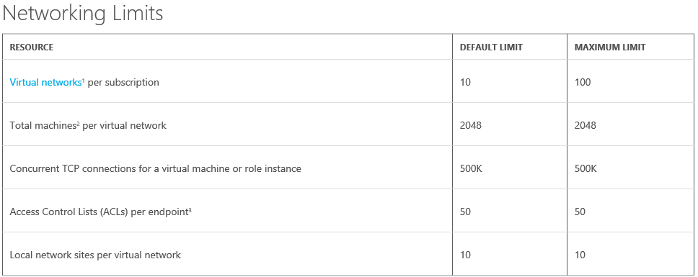
Azure Subscription and Service Limits, Quotas, and Constraints
https://azure.microsoft.com/en-us/documentation/articles/azure-subscription-service-limits/

Slide 63
Common issues / mistakes
Do not put static IP configuration inside the OS
Although we support Multiple VIPs per Virtual Network, you cannot create 2 endpoint with the same LocalPort using 2 different VIPs
VMs lose IPs when are deallocated, use static IP for your VMs
Machines in a virtual network lose the IP when all the instances are deallocated, use Reserved IP
VMs secondary NIC cannot be used for public facing
VMs requires Internet Access to contact license server (while using force tunneling). You can use custom routes in this scenario
http://blogs.msdn.com/b/mast/archive/2015/05/20/use-azure-custom-routes-to-enable-kms-activation-with-forced-tunneling.aspx
ILPIP do not persist – similar to VIP
Do not block (Allow) the IP address is 168.63.129.16. Microsoft Azure platform uses a static, publicly routable IPv4 address for a variety of administrative scenarios like ILB monitoring.

Slide 64
Common issues / mistakes
NSG : First matching NSG is applied (not most restrictive)
NSG: VM NSGs processed before subnet NSGs
Express Route - Forced routing works with ExpressRoute enabled VNETS by BGP advertisement of default route:
Windows Activation failures – be sure to setup Public Peering
Effectively disables RDP access to VIP Endpoint
Express Route - Billing begins with New-AzureDedicatedCircuit (not with connectivity)
Azure PowerShell Version obsolete, check or use available scripts to be up to date.
A region do not have the same services than other - Review Networking service availability in your region
http://azure.microsoft.com/en-us/regions/#services

Slide 65
Troubleshooting
Network standard practices
Remember OS Firewalls
Remember Limits
Enabling VPN Gateway logging for VNET connectivity insight on Azure side
http://blogs.technet.com/b/keithmayer/archive/2014/12/18/diagnose-azure-virtual-network-vpn-connectivity-issues-with-powershell.aspx
Check Service status: -> http://azure.microsoft.com/en-us/status/
Check Azure Incidents reported -> Management Services /OperationalLogs
Check and follow Azure support team blog http://blogs.msdn.com/b/mast/
Open a Support case

Slide 66
Module Knowledge Check

Slide 67
Answers – Module Knowledge Check

Slide 68


Slide 69
Classic and ARM Comparison
 | Classic | ARM
VM Container | Cloud Service | Resource Group + VNet
Region span | Single region | Multi-region
FQDN | Myapp.cloudapp.net | Optional -myDNS.region.cloudapp.azure.com
ILPIP | Optional - Supplied by Azure | Optional – supplied by Azure
VIP | Supplied by Azure | Optional – supplied by Azure
External Connectivity | Endpoints – RDP/SSH default | Inbound Security Rule – RDP by default
Virtual Network | Not required | Required
Azure DNS | Within Cloud Service | Within Virtual Network
API | REST / Azure Service Management | REST / Azure Resource Manager
Notes:
PIP – Private IP address – instance level

Slide 70
Microsoft Azure Provided DNS – Within a Cloud Service (Classic)
TestVM1
TestVM2
Who is TestVM2?
10.1.1.1
Who is TestVM2?
Who is TestVM2?
Notes:
Slide Objective
Overview of Microsoft Azure provided DNS.
Notes
No need to deploy a DNS server. Name resolution within the deployment boundary works
A malicious tenant cannot detect VMs in a deployment by name or IP address
The name resolution boundary is the same as the deployment boundary
Discovery is currently not supported
[EDITOR] TWB_Trevor:
09 October 2013 Kindly validate the factual accuracy of the last bullet, since it contains a reference to time.

Slide 71
Overview: Basic Connectivity in Microsoft Azure (Classic)
DNS Namespace & public IP
(yourService.cloudapp.net)
LB
Cloud Service
Access via internal IP address
Notes:
To understand how Microsoft Azure virtual networks work, you first need to understand the concept of how the machines can be accessed via the DNS namespace address. Although you have multiple machines that are load balanced, by referencing the DNS address from outside, the load balancer will take care of finding a machine to call.
Inside of the Cloud Service, machines can reference each other by internal IP addresses

Slide 72
Overview: Existing Connectivity in Microsoft Azure (Classic)
DNS Address
Load balanced endpoint. Stable VIP per service deployment
Single port per endpoint with protocols HTTP, HTTPS, TCP
Each individual VM can reserve a separate public IP address
VIP: DNS Address
LB
Internal IP Addresses
Instance-to-instance communication in Cloud Service
Supported Protocols: TCP
Port ranges supported
Communication boundary = Deployment boundary
Name Resolution
Internal IP Addresses
Microsoft Azure-provided DNS service for Cloud service-level name resolution
foo.cloudapp.net 🡪 VIP
Notes:
Slide Objective
This slide discusses connectivity options supported as of SDK1.6. This slide does not include information on any of the new features.
Notes
Cloud Service is assigned a VIP for a deployment slot—Production in the case of a VM (IaaS)
RDP and SSH ports are open by default
Need to define endpoints to open ports
Each individual VM can have a reserved public IP address (10/2/14)
Input endpoint is a port
Can be load balanced
If load balanced, endpoint is mapped across all role instances
Port mapping is supported
Internal endpoint enables inter-role-instance communication
Ports for inter-VM communication are closed by default—firewall rules need to be set up to open them
An internal endpoint needs to be defined for communication
Internal endpoints can be port ranges
DNS resolution is only
Only service-level name resolution is supported
Runtime APIs need to be used for instance name resolution
[EDITOR] TWB_Trevor:
08 October 2013 This bullet seems incomplete. Kindly update if required.

Slide 73
Internal IP Addresses (Classic)
Open by default with VMs (Firewalls are not)
Allows all IP traffic to flow
Open ICMPv4 port to ping
Can be used across Cloud Services within a single virtual network
Virtual Network
Cloud Service/Deployment
Cloud Service/Deployment 1
Cloud Service/Deployment 2
IP Traffic
Notes:
Slide Objective
Understand how and explain why internal endpoints are open by default.
Notes
Internal endpoints are an overhead for VMs and within a Cloud service, you can reference each machine by name, therefore using internal ip addresses is an open if you need it
All ports need to be open for all IP-based protocols
This has been done by default for VMs
Same can be done for PaaS by defining an internal endpoint with protocol = any
Allows all IP-based traffic to flow
Notable exceptions: UDP MCAST, Broadcast; GRE and IP-inIP encap traffic
If you are not using any sort of DNS, you can put multiple Cloud Services inside a single virtual network and reference machines by IP address
[EDITOR] TWB_Trevor:
08 October 2013 The content on this slide has been repeated- same as Notes Page 09. Kindly delete this content and replace it with information specific to this slide.

Slide 74
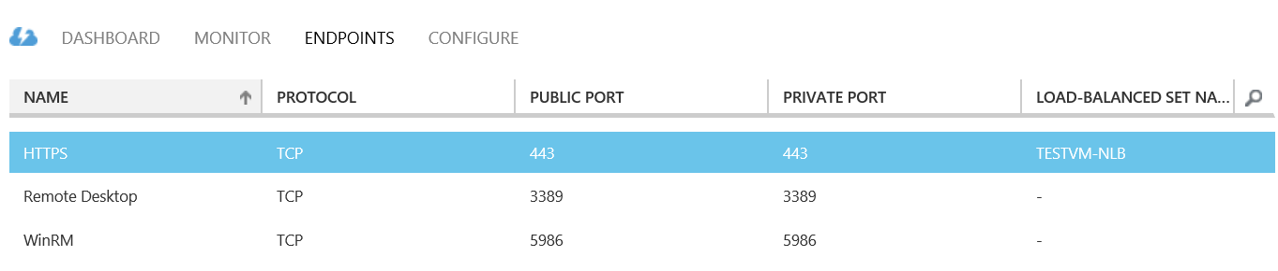
Virtual Machine Endpoints (Classic)
VMs can automatically communicate with other VMs in the same cloud service or virtual network
Endpoints are required to direct Internet or other virtual networks inbound network traffic to a VM
In the Azure Management Portal, endpoints are automatically created for:
Remote Desktop
Windows PowerShell Remoting
Secure Shell (SSH)
Each endpoint has a public port and a private port:
Public port: used by the Azure load balancer to listen for incoming traffic to the VM from the Internet
Private port: used by the VM to listen for incoming traffic to an application or service running on the VM
ACLs on an endpoint can restrict traffic based upon source IP address
Rules can allow or deny traffic from specific IPs and known IP address ranges
Rules are evaluated in order starting with the first rule and ending with the last rule
Rules should be ordered from least restrictive to most restrictive
If the virtual machine is in an Azure VNet, use Network Security Groups instead
Notes:
All virtual machines that you create in Azure can automatically communicate using a private network channel with other virtual machines in the same cloud service or virtual network. However, other resources on the Internet or other virtual networks require endpoints to handle the inbound network traffic to the virtual machine.
When you create a virtual machine in the Management Portal, you can create these endpoints, such as for Remote Desktop, Windows PowerShell Remoting, or Secure Shell (SSH). After you create the virtual machine, you can create additional endpoints as needed. You also can manage incoming traffic to the public port by configuring rules for the network access control list (ACL) of the endpoint. This article shows you how to do both of those tasks.
Each endpoint has a public port and a private port:
The private port is used internally by the virtual machine to listen for traffic on that endpoint.
The public port is used by the Azure load balancer to communicate with the virtual machine from external resources. After you create an endpoint, you can use the network access control list (ACL) to define rules that help isolate and control the incoming traffic on the public port.
Default values for the ports and protocol for these endpoints are provided when the endpoints are created through the Management Portal. For all other endpoints, you specify the ports and protocol when you create the endpoint. Resources can connect to an endpoint by using either the TCP or UDP protocol. The TCP protocol includes HTTP and HTTPS communication.
Important: Firewall configuration is done automatically for ports associated with Remote Desktop and Secure Shell (SSH), and in most cases for Windows PowerShell Remoting. For ports specified for all other endpoints, no configuration is done automatically to the firewall in the guest operating system. When you create an endpoint, you'll need to configure the appropriate ports in the firewall to allow the traffic you intend to route through the endpoint.
Create an Endpoint
If you have not already done so, sign in to the Azure Management Portal.
Click Virtual Machines, and then click the name of the virtual machine that you want to configure.
Click Endpoints. The Endpoints page lists all the current endpoints for the virtual machine.
In the taskbar, click Add.
On the Add an endpoint to a virtual machine page, choose the type of endpoint.
If you're creating a new endpoint that is not part of a load-balanced set or the first member in a new load-balanced set, choose Add a stand-alone endpoint, and then click the left arrow.
Otherwise, choose Add an endpoint to an existing load-balanced set, select the name of the load-balanced set, and then click the left arrow. On the Specify the details of the endpoint page, type a name for the endpoint in Name, and then click the check mark to create the endpoint.
On the Specify the details of the endpoint page, type a name for the endpoint in Name. You can also choose a network protocol name from the list, which will fill in initial values for the Protocol, Public Port, and Private Port.
For a customized endpoint, in Protocol, choose either TCP or UDP.
For customized ports, in Public Port, type the port number for the incoming traffic from the Internet. In Private Port, type the port number on which the virtual machine is listening. These port numbers can be different. Ensure that the firewall on the virtual machine has been configured to allow the traffic corresponding to the protocol (in step 7) and private port.
If this endpoint will be the first one in a load-balanced set, click Create a load-balanced set, and then click the right arrow. On the Configure the load-balanced set page, specify a load-balanced set name, a probe protocol and port, and the probe interval and number of probes sent. The Azure load balancer sends probes to the virtual machines in a load-balanced set to monitor their availability. The Azure load balancer does not forward traffic to virtual machines that do not respond to the probe. Click the right arrow.
Click the check mark to create the endpoint.
You will now see the endpoint listed on the Endpoints page.
Manage the ACL on an Endpoint
If you have not already done so, sign in to the Azure Management Portal.
Click Virtual Machines, and then click the name of the virtual machine that you want to configure.
Click Endpoints. The Endpoints page lists all endpoints for the virtual machine.
Select the appropriate endpoint from the list.
In the task bar, click Manage ACL. The Specify ACL details dialog box appears.
Use rows in the list to add, delete, or edit rules for an ACL and change their order. The Remote Subnet value is an IP address range for incoming traffic from the Internet that the Azure load balancer will either permit or deny based on the traffic's source IP address. You must specify the IP address range in CIDR format, also known as address prefix format. An example is 131.107.0.0/16

Slide 75
Azure Load Balancer (Classic)
Load Balancer
Cloud Service
VM
VM
VM
VM
Notes:
Slide Objective
Explain the Load Balancer and health probes.
Notes
Required for load balancing VMs based on health
If probes are not responded to, the instance will be taken out of load balancer rotation
This is not desirable in some cases as it does not take the app’s health into account
Custom probes offers the ability to probe an app directly for health. Custom probes are supported for TCP and HTTP
By using a custom health probe, you can keep the network load balancer from putting the machine into load balancer rotation until it is ready (by returning a non-200 http code)
For PaaS role instances running in a VM, we have a guest agent that performs many tasks, including responding to probes from the load balancer
[EDITOR] TWB_Trevor:
08 October 2013 The context of the last bullet is not clear. Are default probes or custom probes required to load balance VMs based on health? The bullet needs to be rephrased for clarity.

