Slide 1
Micro-clients
it's not just monolith vs services

Slide 2
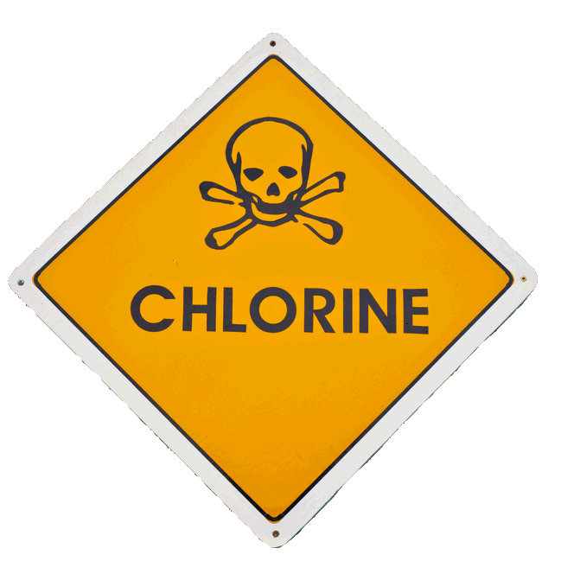
Standard caveo
These are my observations based on my experience
I’m not telling you to do anything, or that you are wrong
Ask lots of questions… please!

Slide 3

Everything is a trade-off
Things we will look at in this talk
Merges/branches
Versioning & compatibility between parts
Transferring state between parts
Latency & down-time
Security surface area
Documenting parts
Logging, tracing & debugging (specifically, remotely)
Communicating between teams
Dependencies of one product on another (impact on teams)

Slide 4

Monoliths
Merges/branches – weak
Versioning & compatibility between parts – strong
Transferring state between parts – strong
Latency & down-time – weak
Security surface area – can be strong
Documenting parts – high-effort
Logging, tracing & debugging – high-effort
Communicating between teams – high-effort
Dependencies of one product on another – weak

Slide 5
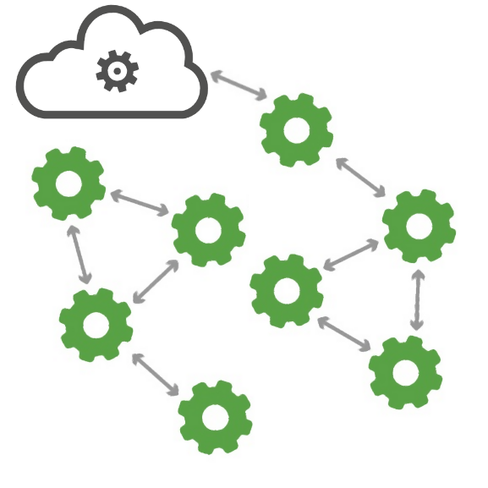
Microservices
Merges/branches – strong
Versioning & compatibility between parts – weak
Transferring state between parts – high-effort
Latency & down-time – can be strong
Security surface area – weak
Documenting parts – medium-effort
Logging, tracing & debugging – high-effort
Communicating between teams – medium-effort
Dependencies of one product on another – can be strong

Slide 6

Some of these don’t have a ‘strong’ option…
Can we change the trade-offs?
Documenting parts
Logging, tracing & debugging
Communicating between teams

Slide 7
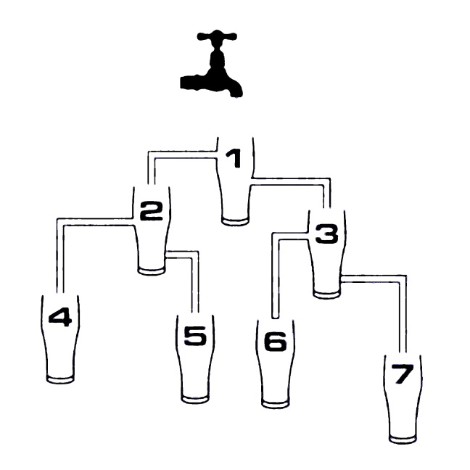
Hierarchical Broadcast Eventing
Parts we will be putting together
An additive hierarchy of message types, with a single base
A set of queues for each client
A routing engine
API endpoints to:
Register the events we want to receive
Broadcast any kind of event
Receive events for our client

Slide 8
Hierarchical Broadcast Eventing
Parts we will NOT be supporting
Having a specific target for any event
Custom events outside the hierarchy
Know who received our event

Slide 9
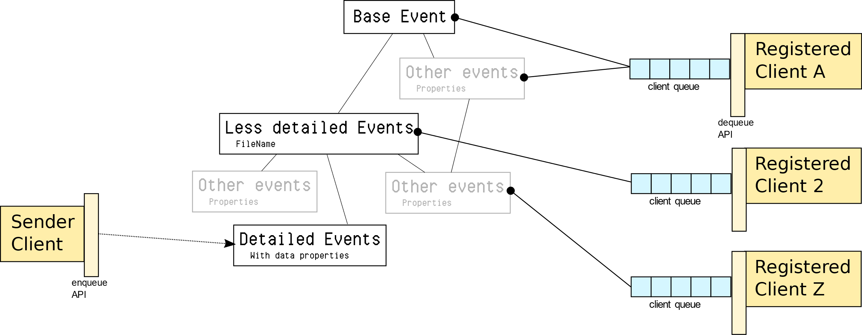
Overview

Slide 10
Sender broadcasts a message
The sender sends to part of the event hierarchy, not to another client

Slide 11





Router finds clients
The router walks up the tree toward the ‘base event’ type
At each point in the tree the router checks if any clients have registered for that event type

Slide 12


Clients get copies of event
A new copy of the event data is delivered to each client that is interested
Each client polls for events through the API

Slide 13
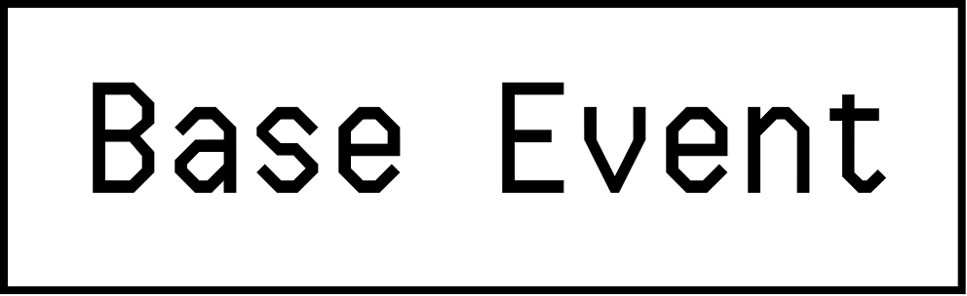
The event hierarchy
Our base event serves to anchor the type hierarchy.
It contains no message details.
Every event must be able to trace its parents back to the base event.

Slide 14
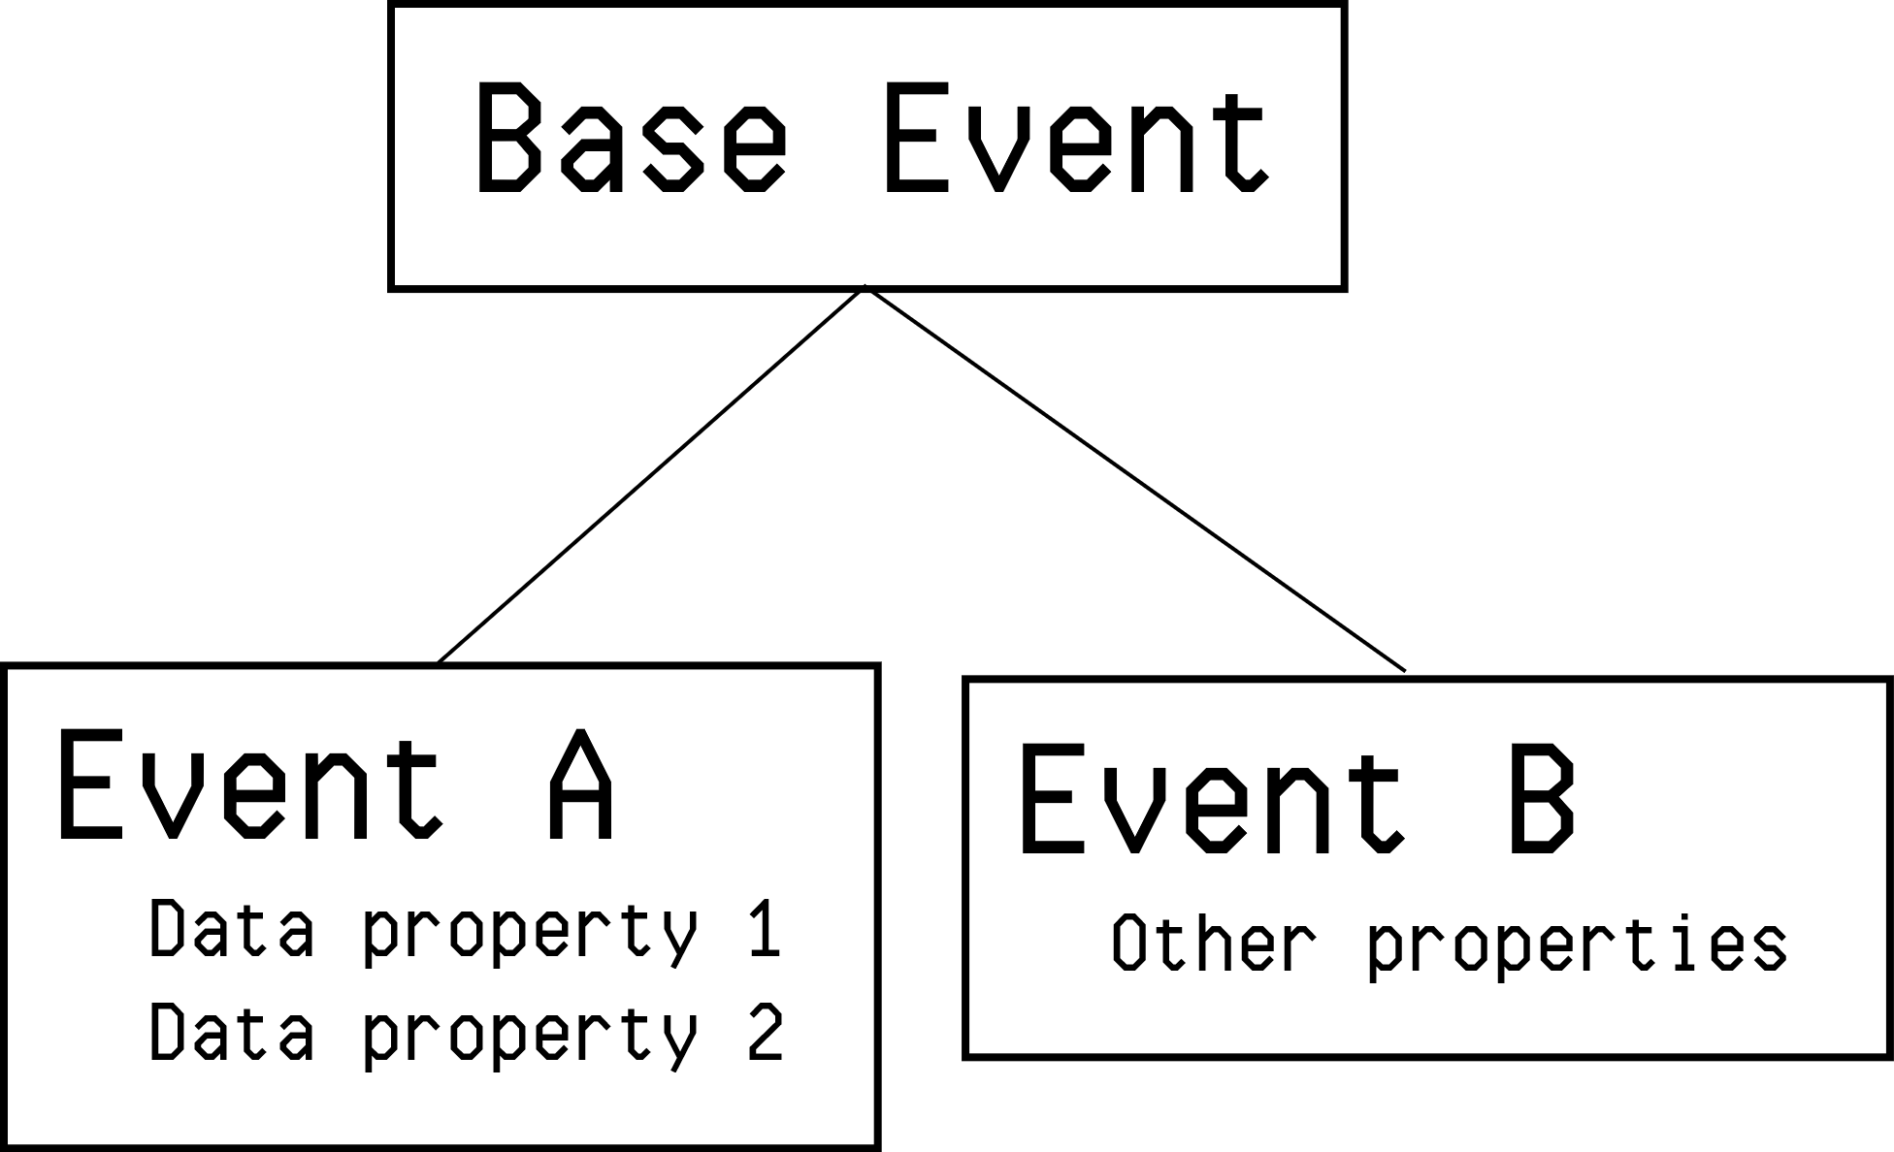
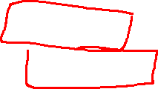
The event hierarchy
Each sub-type of event we add to our hierarchy is a specialisation of another one.
The tree of event types is a living part of our system, and we publish it. This is like the API surface of a service-orientated architecture.
However, events contain only data, and don’t express any behaviour

Slide 15
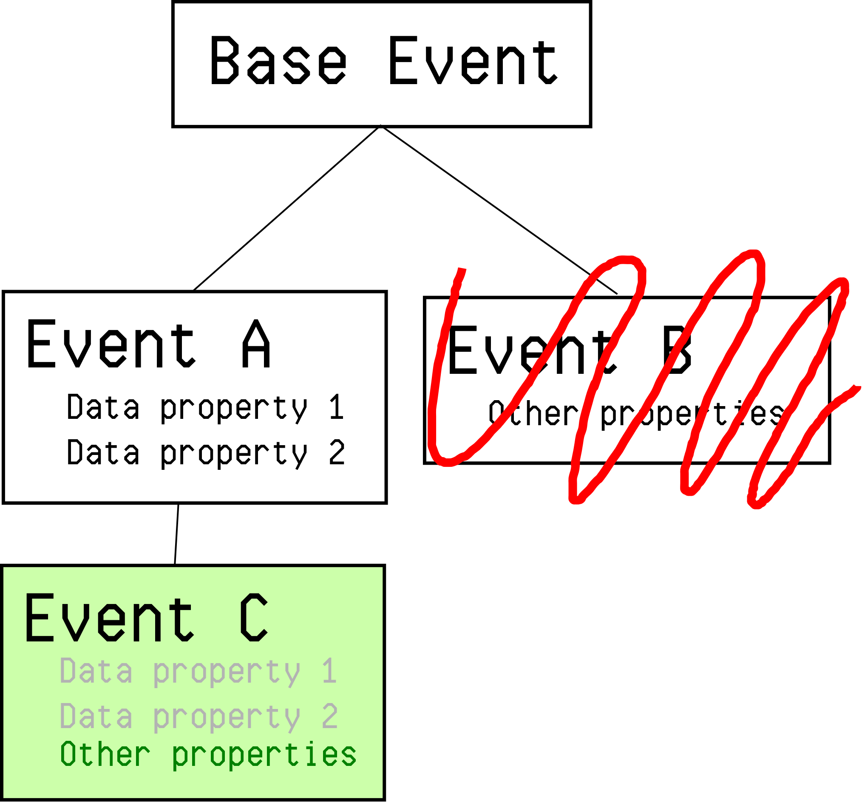
The event hierarchy
As this tree will be our public interface, we have some observations:
Adding new event types is cheap and easy
Adding new properties to existing types is a bit weird
Taking away properties or events is a breaking change

Slide 16
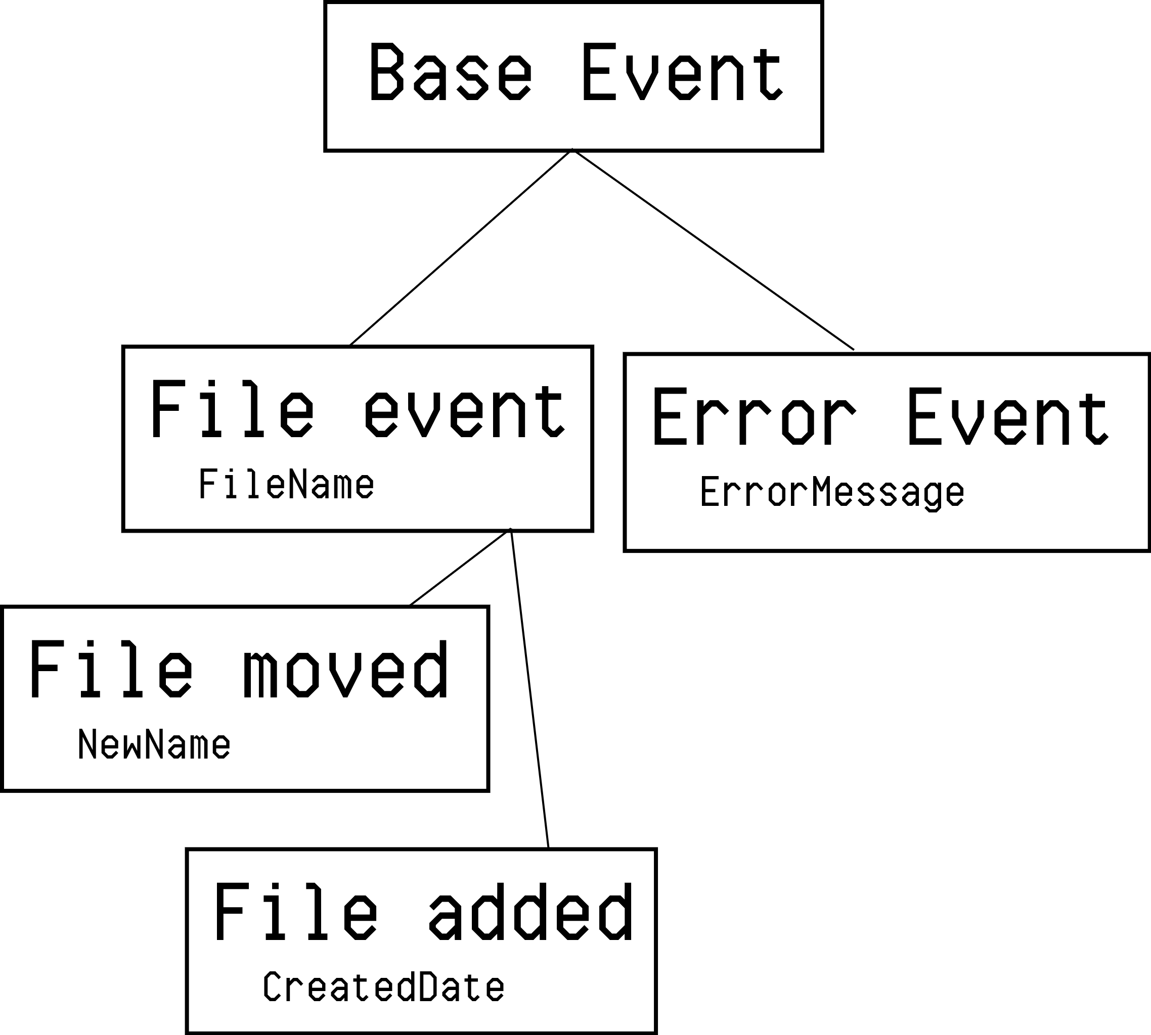
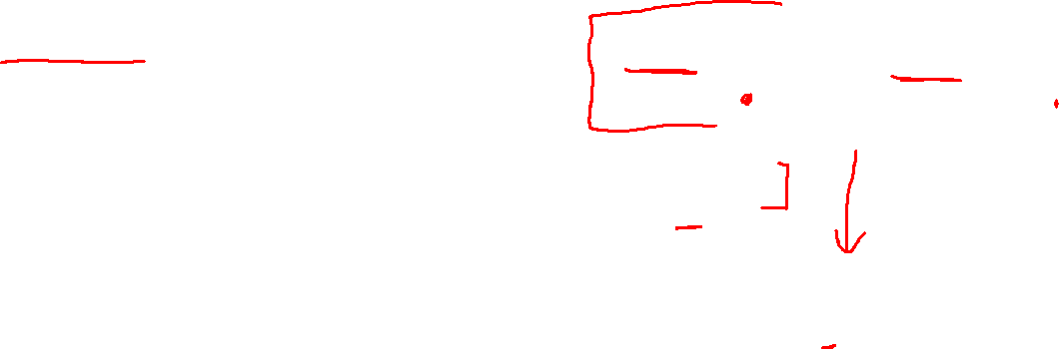
The event hierarchy
These observations lead to some good behaviours:
Lower level events should be ‘classifying’ and add as little as possible
Prefer adding a specialisation over making a big event type
Create new events rather than modify old ones

Slide 17
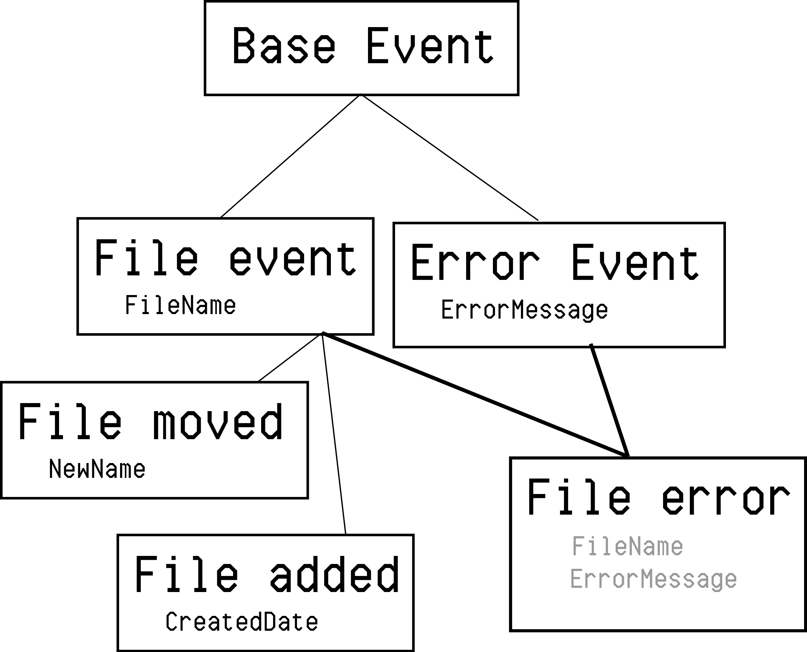
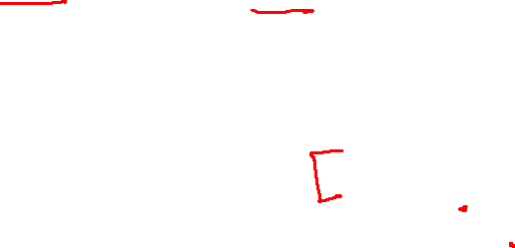
The event hierarchy
The hierarchy allows for multiple inheritance, which lets us have more than one ‘type’ per event

Slide 18

Back to what we were trying to achieve
Back to what we were trying to achieve
Documenting parts
Logging, tracing & debugging
Communicating between teams

Slide 19
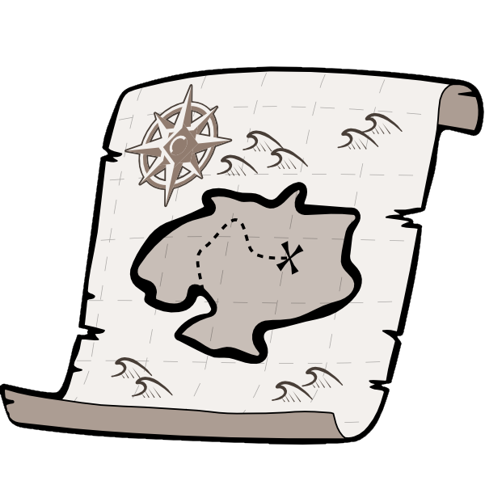
Documenting parts
Our core API asks all clients to register as they start
We always know:
What clients are active – or could be
What messages they send and receive
The API can be set-up to ask for name and purpose of each client, so we end up with a complete map of all components ‘free’

Slide 20

Logging, tracing & debugging
Logging comes almost free: Hook into the ‘base event’ and write to your log repository
You can also send ‘log’ typed events, so you don’t need log-gathering SDKs dotted around
Each event caught on the ‘base event’ still knows its sender and original type, so we get inter-component tracing for free
Event sequences causing failures can be captured from live systems and re-played on a debug environment (assuming you’re not relying on loads of external state)

Slide 21

Communicating between teams
The event hierarchy is our only surface area, and doesn’t encode any behaviour. It’s your contract between teams.
It’s good to keep in a repository or area separate from the clients
If a team needs to change the event hierarchy code, you need to alert the other teams
If your change doesn’t affect the events, you’re safe.

Slide 22

Other nice things
Load balancing and work distribution comes for free (it’s a queue-based system)
Always-on upgrades are quite simple by event specialisation and work-stealing
Monitoring queue lengths is an easy way to see problems and scaling issues
As long as you can call the API, you can mix any tech stacks together
Including user-interaction stages

Slide 23
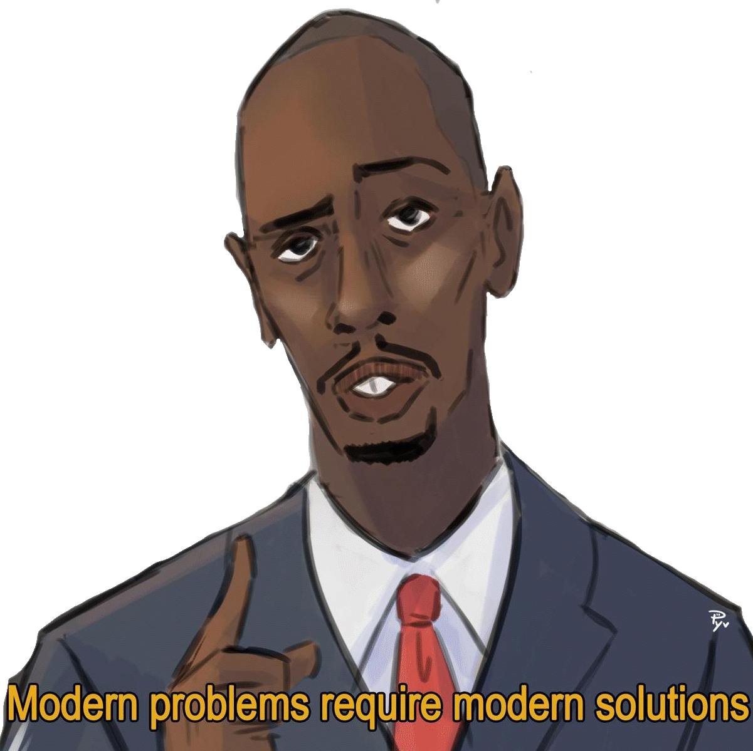
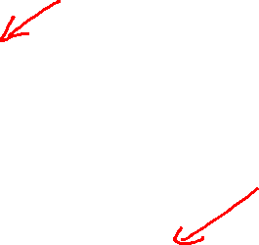
Does this work in real life?
7Digital (originally developed here)
World-wide music distribution, ingest, sales
Backs Samsung music, BBC, audible, and more
GoCompare
Used to integrate M&A sub-companies
Feeding multiple tech platforms into a single web-based product
Azure components, .Net, Python, C++, Ruby, Node.Js, 3rd party services

Slide 24
Hierarchical Broadcast Eventing
Merges/branches – medium
Versioning & compatibility between parts – medium
Transferring state between parts – medium
Latency & down-time – medium
Security surface area – strong
Documenting parts – low-effort
Logging, tracing & debugging – low-effort
Communicating between teams – low-effort
Dependencies of one product on another – can be strong

Slide 25
Questions?
Or observations, insults, clever wordplay, etc.
Blatant self promotion:
www.nuget.org/packages/...
BearBonesMessaging
SevenDigital.Messaging
Gasconade

