Slide 1



DEPARTMENT OF COMPUTER SCIENCE AND ENGINEERING
Major Project (COM-811) Presentation
B.Tech CSE 8th | Batch 2021-2025
PROJECT TITLE: MOPI - LOCAL SEMANTIC SEARCH
Team Members:
OpenCode Team
2. Name (Roll No)
3. Name (Roll No)
4. Name (Roll No)
Model Institute of Engineering & Technology (Autonomous)
Notes:
Presentation slide for courses, classes, lectures et al.

Slide 2

Table of Content
Introduction & Problem Statement
Project Objectives
Proposed Solution & Innovation
Methodology (Technology Stack)
System Architecture / Workflow
Implementation
Results / Outcomes
Conclusion
References

Slide 3
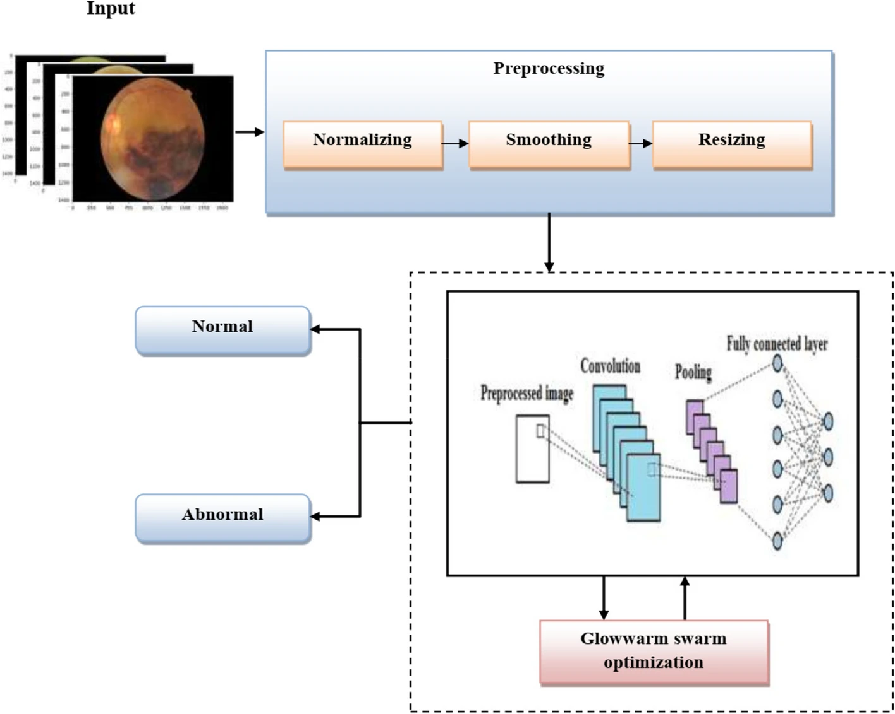
1. Introduction & Problem Statement
CNN Learning Cycle
Train on labeled fundus images.
Detect patterns from the images.
Compare predictions with actual results.
Improve accuracy by adjusting filters.
Why CNN?
Automatic Feature Learning [5]
Efficient Pattern Recognition [6]
Superior to FCNs and ANNs [6] [7]
Better for High-Dimensional Images [7]
Fig 1: CNN Work Flow [4]

Slide 4
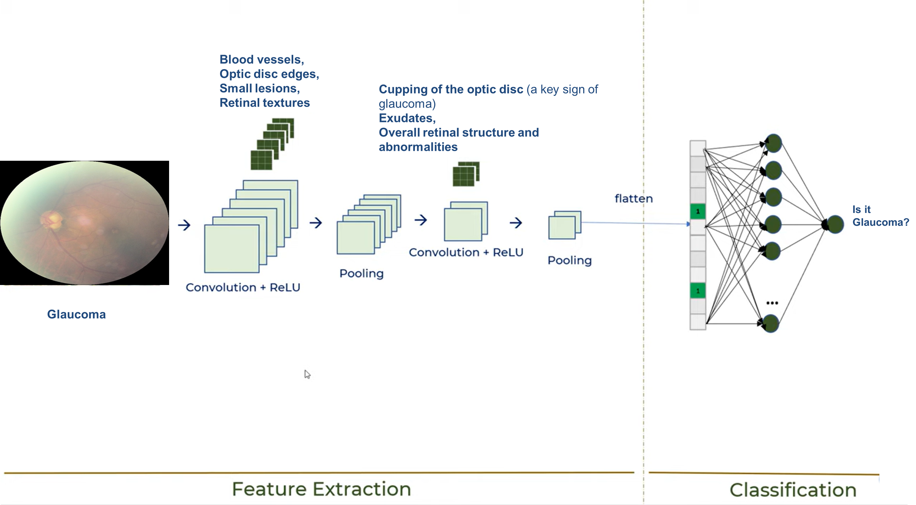
2. Project Objectives
Fig 2: CNN for Glucoma detection [8]

Slide 5
3. Proposed Solution & Innovation
Hybrid Retrieval Engine:** Combines the precision of Tantivy (BM25) with the recall of Vector Search (HNSW).
Reciprocal Rank Fusion (RRF):** A mathematically robust way to merge disparate search scores into a single ranked list.
Semantic Chunking:** Unlike naive fixed-size splitting, mopi understands file structure (paragraphs, headings) to preserve context.

Slide 6
4. Methodology (Technology Stack)
Language:** Rust (Performance, Memory Safety).
Deep Learning:** ONNX Runtime via **FastEmbed-RS**.
Lexical Index:** Tantivy.
Metadata:** SQLite.
Client/Server:** Unix Domain Sockets (IPC) with length-delimited binary framing.

Slide 7
5. System Architecture / Workflow

Slide 8
6. Implementation
Model Choice:** `all-MiniLM-L6-v2` (384 dimensions).
Optimization:
Quantization:** `INT8` weights for 4x size reduction.
Hardware Acceleration:** AVX-512 and SIMD utilization.
Concurrency:** Dedicated worker pools for extraction and embedding to prevent blocking the query path.

Slide 9
7. Results / Outcomes
Latency:
Query Embedding: **~15ms
Search & Fusion: **~15ms
Total Interactive Loop: **~35ms
UX:** Enabled a launcher-style GUI (`kiwi`) that updates semantically as the user types.
Accuracy:** Significant recall improvement over keyword-only systems for conceptual queries (e.g., "how to setup auth" finding `README.md`).

Slide 10
8. Conclusion
mopi** proves that high-quality semantic search does not require the cloud.
By optimizing the inference stack and using hybrid ranking, we provide a search experience that is both private and faster than remote alternatives.
Future:** Integration of cross-encoders for reranking and hardware-specific kernels (Metal/CUDA).

Slide 11
9. References
FastEmbed-RS:** [https://github.com/qdrant/fastembed](https://github.com/qdrant/fastembed)
Tantivy:** [https://github.com/quickwit-oss/tantivy](https://github.com/quickwit-oss/tantivy)
Marp CLI:** [https://marp.app/](https://marp.app/)
ONNX Runtime:** [https://onnxruntime.ai/](https://onnxruntime.ai/)

Slide 12
THANK YOU

