Slide 1
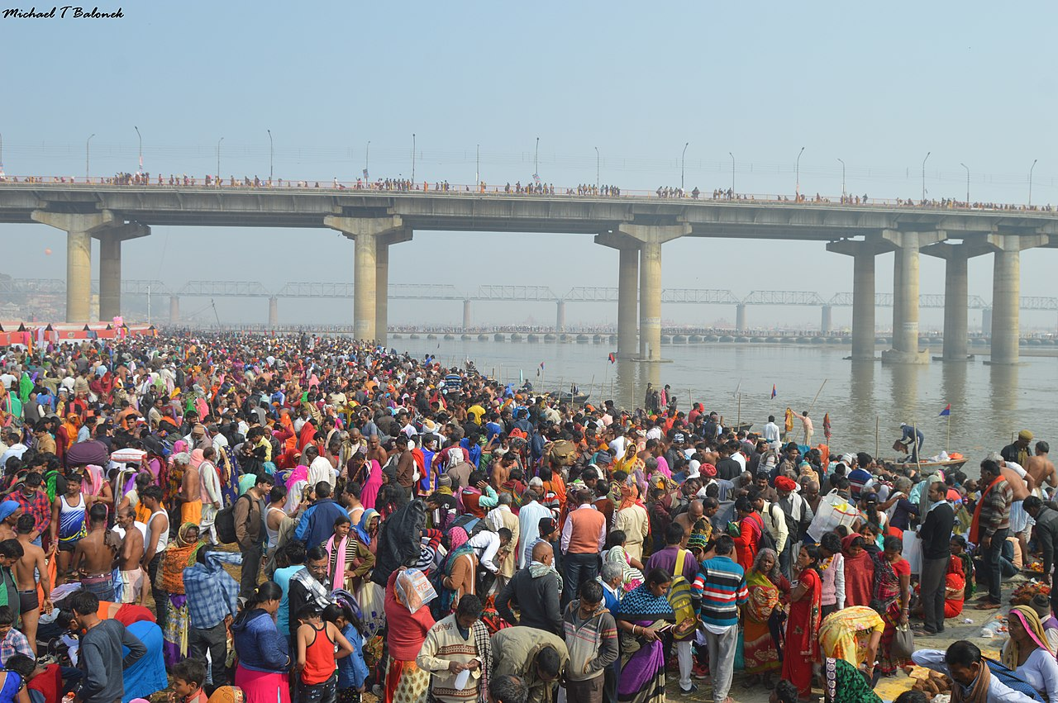
HACKATHON
PRAYAGRAJ
MAHAKUMBH
2025

Slide 2
Security, Surveillance, mobility and crowd management using emerging Tech Solution (Artificial Intelligence Solutions, Advance Analytics, Machine Learning, etc.)
Enhancing Mobility, Safety and Crowd Management at the Kumbh Mela Through Machine learning, Public Address systems, GIS, Predictive Analysis and Mass notification Service

Slide 3
Apache Kafka – High throughput video streams from multiple cameras
FFMPEG – Preprocessing tasks: Format conversion, resizing and frame extraction
TensorFlow/Pytorch – Deep learning frameworks for building and training Convolutional Neural Networks (CNNs) for person recognition.
NVIDIA GPUs: Accelerating CNN training and inference tasks with CUDA acceleration.
Apache Hadoop(HDFS) – For distributed storage of video data and processed features.
Apache HBase - For storing metadata related to videos, people and their paths.
Apache Spark – For distributed data processing and Analysis.
Elasticsearch and Kibana – For realtime monitoring and visualization of system metrics and alerts.

Slide 4
RESTful APIs – For communication with command centers
React Native or Flutter – For developing cross platform Mobile apps
Docker – For containerizing and orchestrating system components.
Serverless computing devices – For minimizing costs during periods of low activity

Slide 5
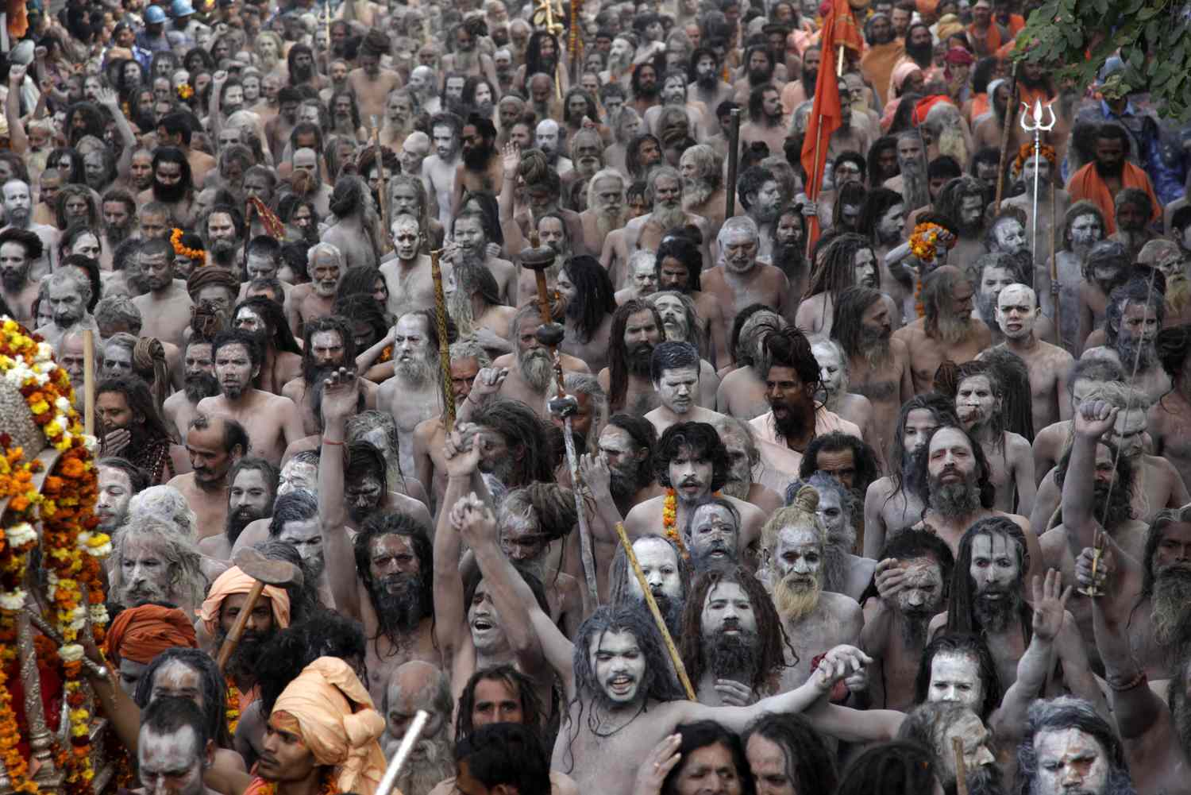

Slide 6

Ingestion
CCTV
Drone
Social Media
Hadoop

Slide 8
Workflow of model
Video Ingestion and Processing –
Video streams from multiple cameras is ingested using Apache Kafka.
Preprocessing tasks such as format conversion and frame extraction is done by FFMPEG.
Convolutional Neural Network for person recognition
CNN models are built and trained using TensorFlow or PyTorch.
NVIDIA GPUs are utilised for accelerating training and inference tasks.
Storage and Database Management –
Video data and processed features are stored in Apache Hadoop(HDFS)
Video and people Metadata is stored in Apache HBase.
Apache Parquet
Data Processing and Analysis
Apache Spark is used for distributed data processing and analysis
Real-Time Monitoring and Alerting
Apache Kafka streams are used for real-time processing of video streams
Elasticsearch and Kibana are employed for real-time monitoring and visualization of system metrics and alerts

Slide 9
Workflow of model
Command Centre communications
RESTful APIs are used for communication with command centers
Apache Kafka is utilised for Asynchronous communication
Mobile App Development
Cross-platform mobile apps are developed using Flutter and React Native.
Infrastructure Management
Cloud Infrastructure services are utilized for scalability and flexibility
Docker and Kubernetes are used for containerizing and orchestrating system components

Slide 10
Model Matching with the Theme
The proposed model aligns with the theme of handling a massive crowd scenario by efficiently processing video streams, performing real-time person recognition and providing insights for monitoring and analysis by leveraging advanced technologies such as deep learning, distributed computing and real time processing, the model addresses the complex requirements of managing large-scale video data and ensuring public safety in crowded environments.

Slide 11
Advantages of the model
Scalability-The model utilises distributed computing and cloud infrastructures to scale seamlessly with increasing data volume and processing demands,
Real-time Insights – By employing real-time processing and monitoring technologies, the model enables timely detection of critical events and issuance of alerts
Cost-Effectiveness: Utilizing serverless computing services and cost optimization strategies helps minimize operational costs during periods of low activity.
Cross-Platform Accessibility: The development of cross-platform mobile apps ensures accessibility to real-time data and alerts for command center personnel.

Slide 12
Possibility of the Implementation considering the Massive Crowd
The implementation of the proposed model is feasible considering the massive crowd scenario. The use of distributed computing technologies, deep learning frameworks, and scalable infrastructure allows for efficient processing and analysis of video data even in crowded environments with high throughput requirements.

Slide 13
Expertise within the Team
The project team comprises experts in software development, data engineering, machine learning, and cloud computing. The team possesses the necessary skills and experience to design, implement, and deploy the proposed solution effectively.

Slide 14
Implementation Requirements
Skilled development team with expertise in software development, machine learning, and cloud computing.
Access to necessary hardware resources, including GPUs for accelerated deep learning tasks.
Subscription to cloud service providers for infrastructure needs.
Development environment with access to required software tools and frameworks

Slide 15
Time Plan of the Actual Implementation (Deadline July 2024)
Requirements Gathering and Planning: March-April 2024
System Design and Architecture: April-May 2024
Development and Testing: May-June 2024
Deployment and Optimization: June-July 2024

Slide 16
Cost of the Implementation
The cost of implementation includes expenses related to cloud infrastructure, hardware resources, software licenses, and personnel. A detailed cost analysis will be conducted during the planning phase to estimate the total implementation cost accurately.

Slide 17
Scalability and Performance
The model is designed to be highly scalable, leveraging distributed computing and cloud infrastructure. It can handle increasing data volumes and processing demands efficiently, ensuring optimal performance even in scenarios with a massive crowd.

Slide 18
Deliverables Commitment of the Demonstration
Fully functional video processing and analysis system capable of real-time person recognition and monitoring.
Cross-platform mobile applications for accessing real-time data and alerts.
Comprehensive documentation covering system architecture, implementation details, and deployment instructions.
Demonstration of system performance, scalability, and real-time monitoring capabilities to stakeholders.

