Slide 1
Keyword Extraction from Scanned Academic Notices
MLLP MINI PROJECT · TASK 13
OCR + TF-IDF + KeyBERT, evaluated on 12 hand-labelled college notices
Karan Burgohain· Bikash Pradhan · Ayushmaan Nath ·
Notes:
Hello, we are [names]. Our project for the MLLP course is Task 13: keyword extraction from scanned academic notices. We built a pipeline that reads a scanned college notice with OCR and pulls out its most important keywords, using two methods, TF-IDF and KeyBERT, which we compare against keywords we labelled by hand. (about 20 seconds)

Slide 2
Problem: scanned notices can't be searched
The problem
Our objectives
Colleges post circulars as scanned images. A scan is just pixels: it cannot be searched, tagged or filtered, so students must open and read every notice to find the one they need.
Scan → text with OpenCV + Tesseract OCR
Extract keywords with TF-IDF and KeyBERT
Score both against hand-labelled keywords
Ship a usable web demo (Gradio)
Goal: turn every scanned notice into a short list of searchable keywords, and measure how good that list is.
Notes:
Colleges publish notices as scanned images. A scan is only pixels, so it can't be searched or tagged, and a student has to open every notice to find the one about fees or exams. Our objectives were four: convert scans to text with OCR, extract keywords with a statistical and a semantic method, evaluate both against hand-labelled keywords, and build a demo anyone can use. (about 30 seconds)

Slide 3
Dataset: 12 notices, 4 categories
3
3
3
3
Exam
Fee
Holiday
Event
timetable, results, practicals
tuition, hostel, scholarship
Christmas, winter, Guru Nanak Jayanti
tech fest, guest lecture, sports meet
Each notice has a letterhead, reference number, title, body and signatory. For every notice we hand-labelled 6–7 ground-truth keywords, e.g. end semester examination, hall ticket, exam fee.
Notes:
Our dataset is 12 scanned notices, three in each of four categories: exam, fee, holiday and event. Every notice has the same structure as a real circular: letterhead, reference number, title, body and signatory. For each one we wrote six to seven keywords by hand, the words a student would actually search for. These are our ground truth. (about 25 seconds)

Slide 4
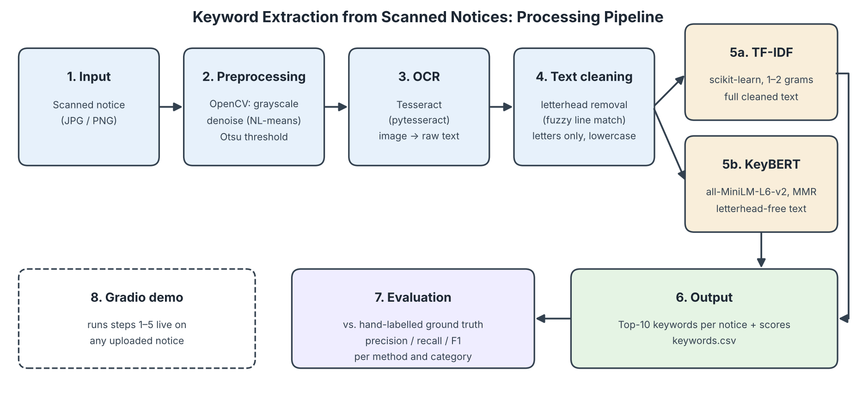
Pipeline: scan to keywords in six stages
Notes:
Here is the full pipeline. The scanned image is converted to grayscale, denoised and binarised with Otsu's threshold in OpenCV. Tesseract OCR turns it into text. We then clean the text: remove the letterhead and keep only lowercase letters. Two extractors run side by side: TF-IDF on the full text and KeyBERT on the letterhead-free text. The top ten keywords are saved and scored against our ground truth. The Gradio demo runs the same steps on any new upload. (about 40 seconds)

Slide 5
Models and tools
Stage | Model / library | What it does
Preprocessing | OpenCV | Grayscale, NL-means denoise, Otsu threshold
OCR | Tesseract (pytesseract) | Image → raw text
Statistical keywords | scikit-learn TF-IDF (1–2 grams) | Frequent in this notice, rare in others
Semantic keywords | KeyBERT + MMR (diversity 0.3) | Phrases closest in meaning to the notice
Embeddings | sentence-transformers/all-MiniLM-L6-v2 | 384-dim sentence vectors (Hugging Face)
Demo | Gradio | Upload a notice, see the keywords
Google Colab, CPU only. No training: every model is used pretrained.
Notes:
These are the models and tools we used. OpenCV for preprocessing and Tesseract for OCR. For keywords, TF-IDF from scikit-learn scores words that are frequent in one notice but rare across all notices. KeyBERT uses the MiniLM sentence-transformer from Hugging Face to embed the notice and every candidate phrase, and picks the phrases closest in meaning to the whole notice. MMR adds diversity so it doesn't return near-duplicates. Everything runs on a free Colab CPU, with no training. (about 35 seconds)

Slide 6
Key finding: KeyBERT was reading the letterhead
Before: full text
After: letterhead removed + MMR
eastern institute · bhubaneswar odisha · examination timetable · institute technology · eitm coe …
examination timetable · semester examinations · examination hall · end semester …
F1 0.261
F1 0.571
Lines in ≥50% of notices are letterhead. We remove them with fuzzy matching (85%), so OCR slips like "Copy ta" for "Copy to" are caught too.
Example: notice1.jpg
Notes:
This was our key finding. In our first run, KeyBERT scored only 0.26 F1, because its top phrases were the letterhead: eastern institute, bhubaneswar odisha. The letterhead appears on every notice, so the embedding model treats it as central. TF-IDF wasn't affected, because IDF already gives low weight to words that appear everywhere. Our fix: any line that appears in at least half the notices is letterhead, and we remove it with fuzzy matching, since Tesseract sometimes misreads a character. With that and MMR, KeyBERT's F1 more than doubled to 0.57. (about 40 seconds)

Slide 7
Results: precise TF-IDF vs. broader KeyBERT
Method | Precision | Recall | F1
TF-IDF | 0.671 | 0.535 | 0.587
KeyBERT (baseline) | 0.238 | 0.292 | 0.261
KeyBERT (final) | 0.502 | 0.676 | 0.571
Metric: phrases split into words (stopwords and digits removed), compared with the ground truth. Mean over 12 notices.
Notes:
Here are the overall results. TF-IDF has the best precision, 0.67: most of its keywords are correct. Final KeyBERT has the best recall, 0.68: it finds more of the true keywords, but includes more wrong ones. Their F1 scores are almost equal, 0.59 and 0.57. For the metric, we split each keyword list into words, remove stopwords and digits, and compare the word sets with our ground truth. (about 30 seconds)

Slide 8
By category: TF-IDF wins on exams
Exam: TF-IDF 0.63 vs KeyBERT 0.56
Fee, event: KeyBERT slightly ahead
Holiday: a tie
KeyBERT wins on 5 of 12 notices; per-notice F1 ranges 0.30–0.73.
Notes:
Broken down by category: TF-IDF is clearly better on exam notices, 0.63 against 0.56. KeyBERT is slightly ahead on fee and event notices, and the two tie on holidays. The grey bars show how badly the baseline KeyBERT did, especially on fee notices. Per notice the swings are big: KeyBERT wins on only 5 of 12, and F1 ranges from 0.30 to 0.73. With three notices per category, these are trends, not firm conclusions. (about 30 seconds)

Slide 9
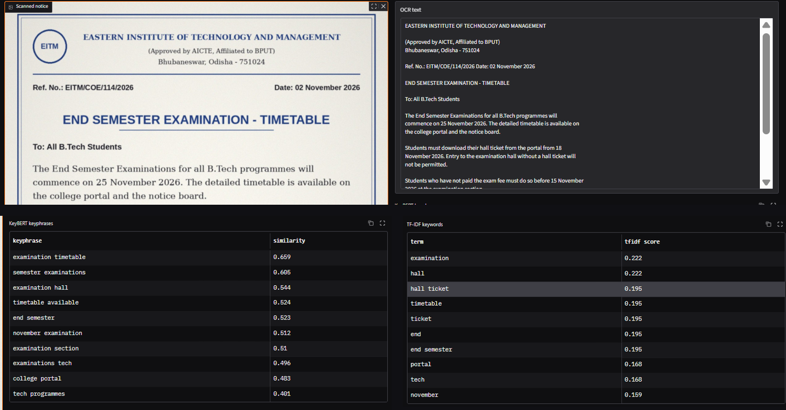
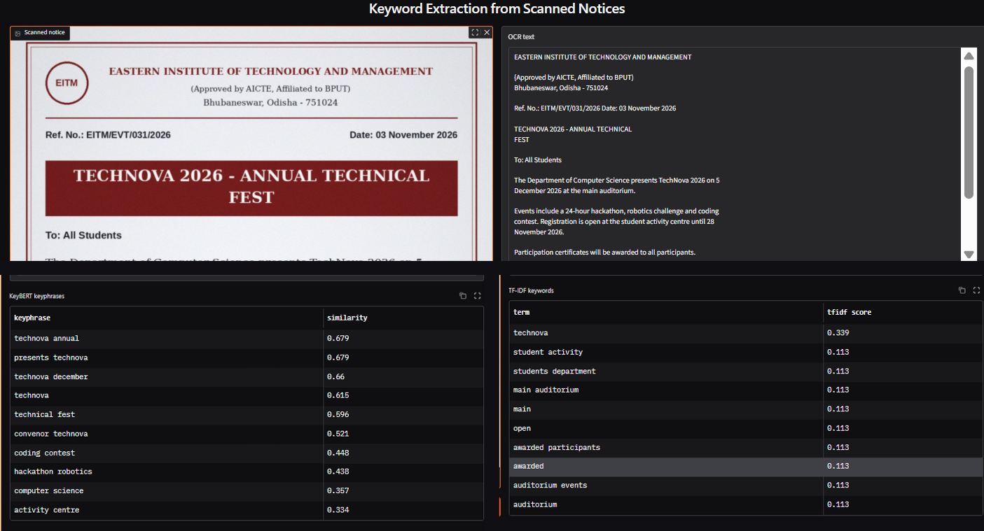
Demo: upload a notice, get its keywords
Exam notice: KeyBERT gives clean phrases; TF-IDF splits "hall ticket" into fragments.
Event notice: KeyBERT repeats "technova" 5×; TF-IDF ties 9 terms at 0.113.
Gradio app with a public gradio.live link
Notes:
Now the demo. [Switch to the Gradio app.] I upload a notice, here the end semester examination timetable, and click Submit. On the right is the OCR text. Below, KeyBERT returns phrases like examination timetable and examination hall with their similarity scores, and TF-IDF returns single terms like hall ticket and timetable with their weights. KeyBERT gives readable phrases, while TF-IDF splits them into fragments. [Now upload the TechNova event notice.] Here KeyBERT finds technical fest and hackathon, but repeats technova in five phrases, and TF-IDF gives nine terms the same score, so their order is arbitrary. (about 60 seconds)

Slide 10
Limitations and future scope
Limitations
Future scope
Only 12 notices from one institute
Clean digital scans, not phone photos
Dates and amounts are stripped out
Word-level metric is lenient
English only; no tables or columns
Extract dates and fees with NER / regex
Hybrid: TF-IDF candidates, KeyBERT ranking
Stronger MMR diversity to stop repeats
100+ real notices, with a test split
Hindi and Odia OCR + multilingual model
Biggest next step: keep dates and fee amounts, the facts students search for most.
Notes:
Our system has clear limits. The dataset is only 12 clean notices from one institute, so real phone photos would give more OCR errors. Our cleaning keeps only letters, so dates and fee amounts can never become keywords, even though they are often the most important facts. Our metric is lenient, and we only handle English. For future work: extract dates and amounts with named-entity recognition, combine TF-IDF and KeyBERT, raise the MMR diversity so KeyBERT stops repeating one word, test on a larger real dataset, and add Hindi and Odia support. (about 35 seconds)

Slide 11
Team and contributions
Name | Roll number | Contribution
Karan Burgohain | 2304024 | Coding, Implementation
Bikash Pradhan | 2304020 | Dataset , Report
Ayushmaan Nath | 2304019 | PPT , Presentation
Code, data and report: https://github.com/i-karanburagohain/keyword-extraction-scanned-doc
Thank you
Notes:
Finally, our team. [Each member says their name and what they did, one sentence each.] All the code, data, outputs and this report are in our GitHub repository. Thank you. (about 30 seconds)

