Slide 1


MindDocs AI
AI-Powered Document Intelligence Platform
Created by Shivraj

Slide 2
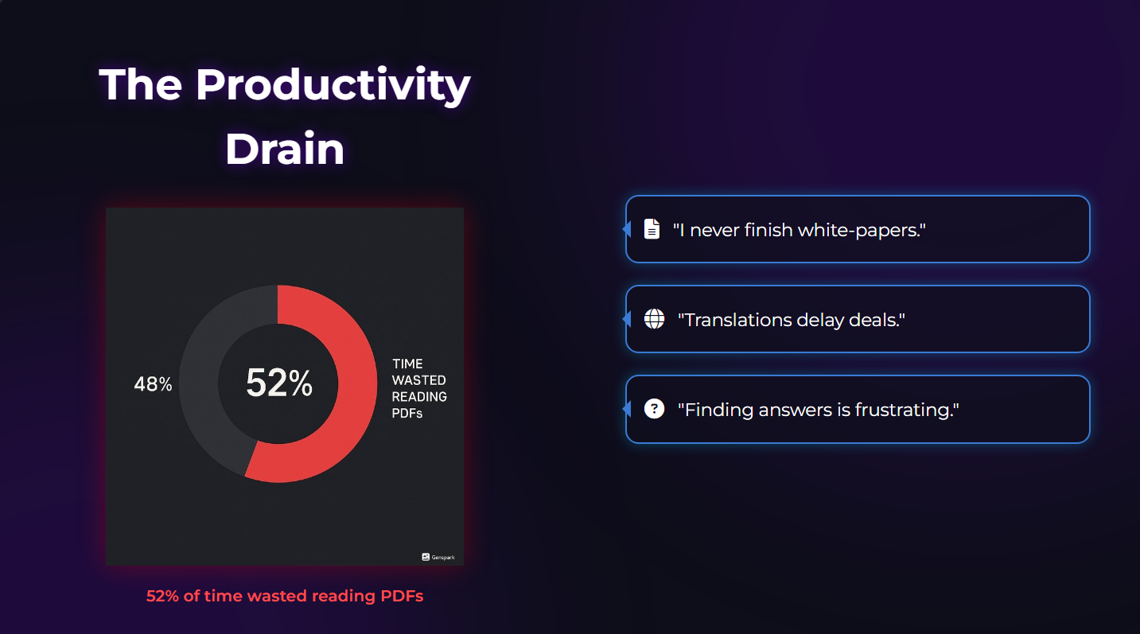
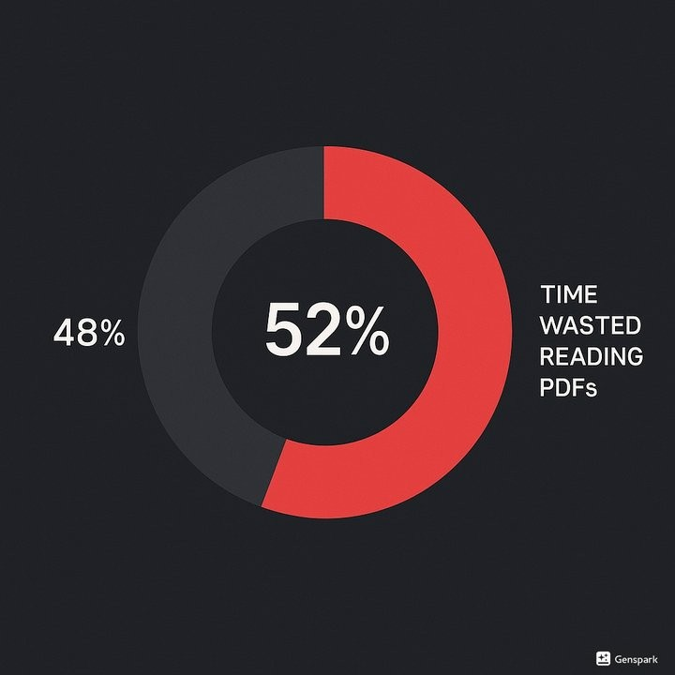



The Productivity Drain
"I never finish white-papers."
"Translations delay deals."
"Finding answers is frustrating."
52% of time wasted reading PDFs
Made with Genspark

Slide 3
One Platform, Instant Insights
💬
📑
📤
Upload
Any PDF document, no matter the size or complexity
Chat / Translate / Summarize
Interactive AI with TTS & multi- language support
Export / Listen
Save as PDF or use TTS playback for on-the-go learning

Slide 4

Why Users Love It
⏱
✅
Reliable Results
🌐
Multi-Language + TTS
Faster Reading
80%
>90%
Instant
From 10 minutes to just 2 minutes per document
Accuracy on summaries and question answering
Translate and listen to content on the go

Slide 5
Cloud-Native Architecture
React
Modern UI with Lottie animations and responsive design
FastAPI
Backend with Python 3.11 and async processing
LangChain RAG
+ Groq Llama-3 for high- performance inference
Azure Blob
FAISS
Secure storage for PDF documents with SAS URL access
Vector storage for high-performance similarity search

Slide 6


















Battle-Tested Stack
Layer
Tech Stack
React
UI
Lottie Animations
FastAPI
Backend
Python 3.11
Uvicorn
LangChain
AI
Groq Llama-3
Inference
HuggingFaceEmbeddings
Azure Blob
PDFs
Storage
FAISS
Vectors
Docker
DevOps
GitHub Actions
Azure Container Apps
Auto-Scale
Made with Genspark

Slide 7
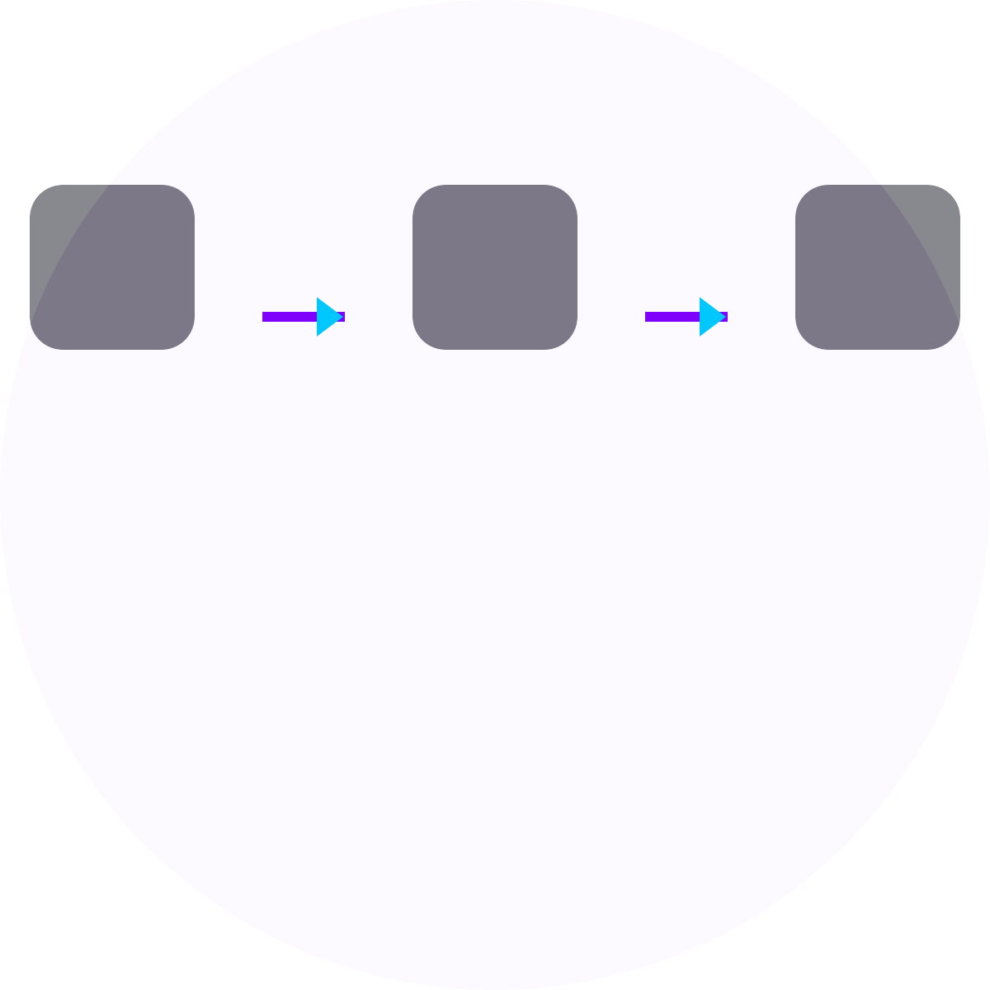
Chatbot & Memory
💬
🔍 🦙 📊
🔊
User Q
FAISS
Llama-3
Stream
TTS
Persistent memory using ConversationBufferMemory for continuous context
✨
⚡
🎯
Real-time token streaming & interactive voice playback
RAG-based accurate retrieval with context-aware responses

Slide 8
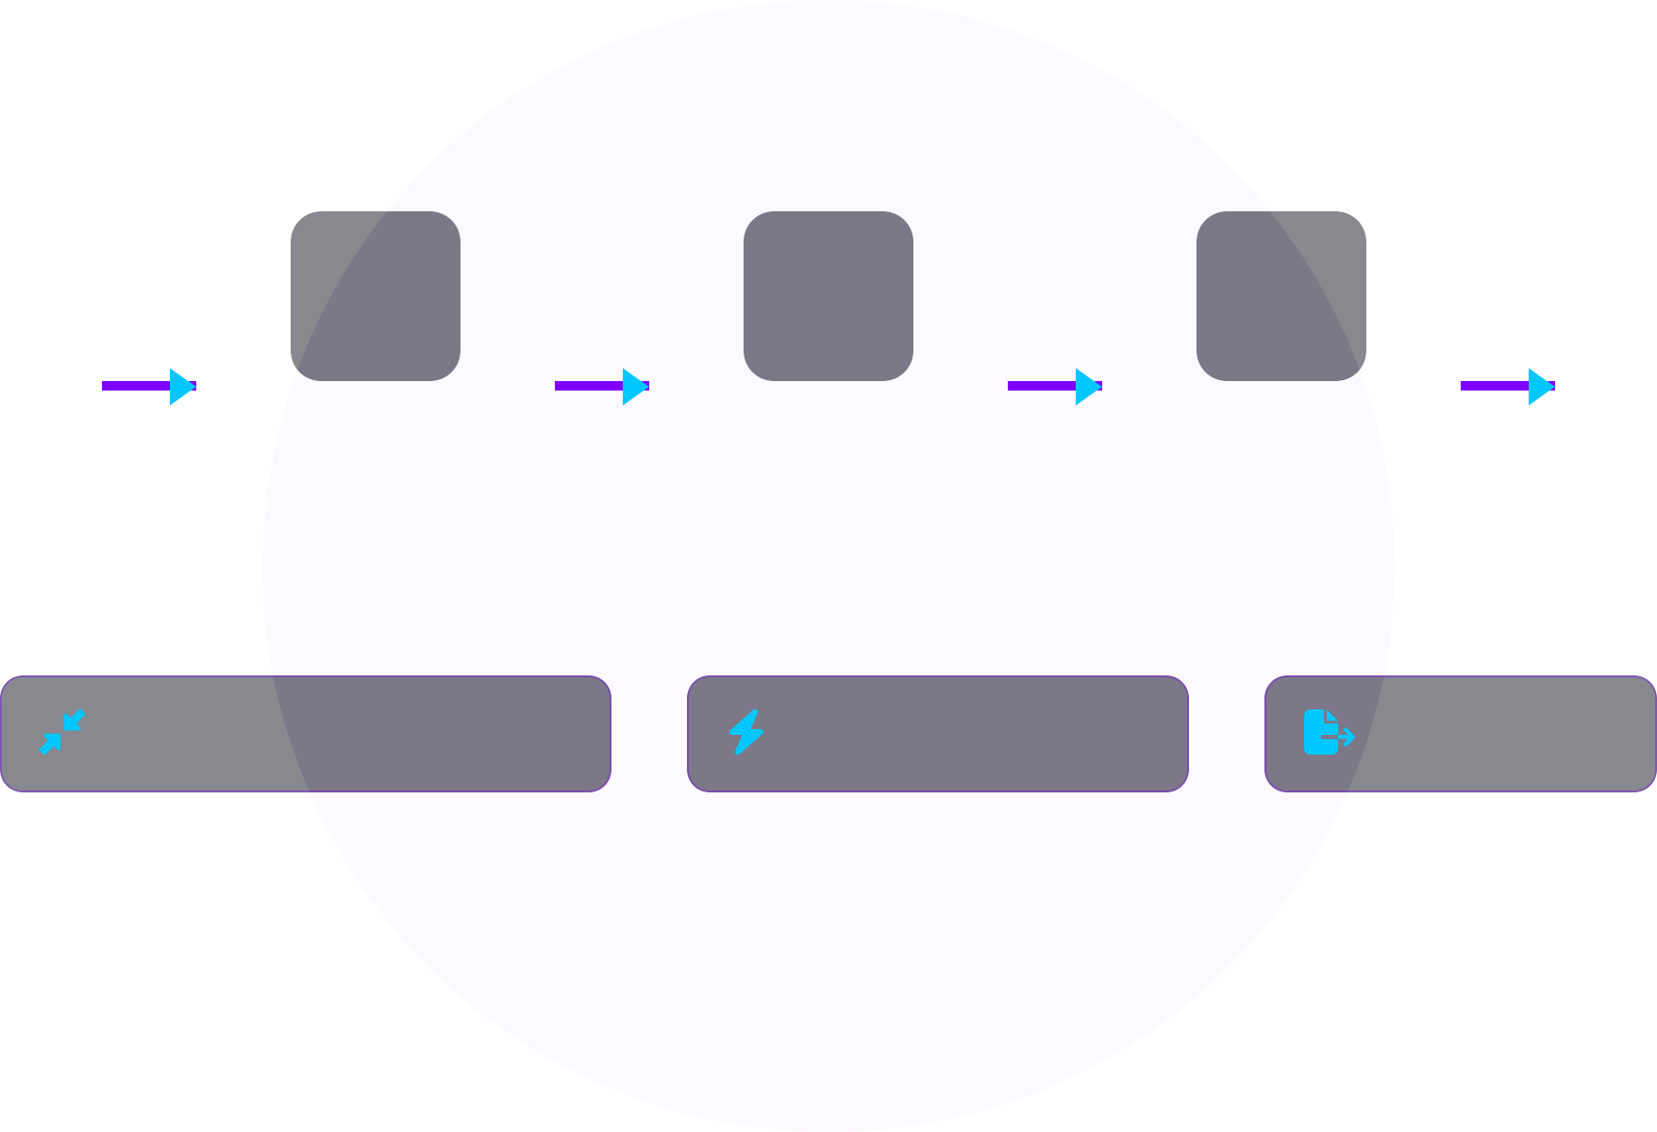
Summarization Flow
📄
🧩 🧠 📝
💾
PDF
Raw document input
Chunk & Embed
Break document into manageable sections
RAG Llama-3
Context-aware AI processing
Summary
Concise document overview
Export PDF
Save in shareable format
Custom compression ratios
Fast & token-efficient
Export as PDF

Slide 9
Translation Pipeline (Agentic)
PDF
Upload document for translation
📄
Extract & Chunk
Break document into processable segments
✂
Mistral-7B per chunk
Specialized translation processing for each segment
🧠
Merge
Combine translated segments maintaining document flow
🔄
Final Pass
Quality check and terminology standardization
✅
Output
Translated document ready for export
📝
🤖 Agentic Workflow
🌐 Domain Adaptation
HuggingFace Integration
🔌
Stepwise processing with intelligent decision-making at each stage for optimal translation quality
Specialized translations tailored to specific industries and technical terminology
Seamless connection to state-of-the-art language models via HuggingFace Endpoints
Made with Genspark

Slide 10


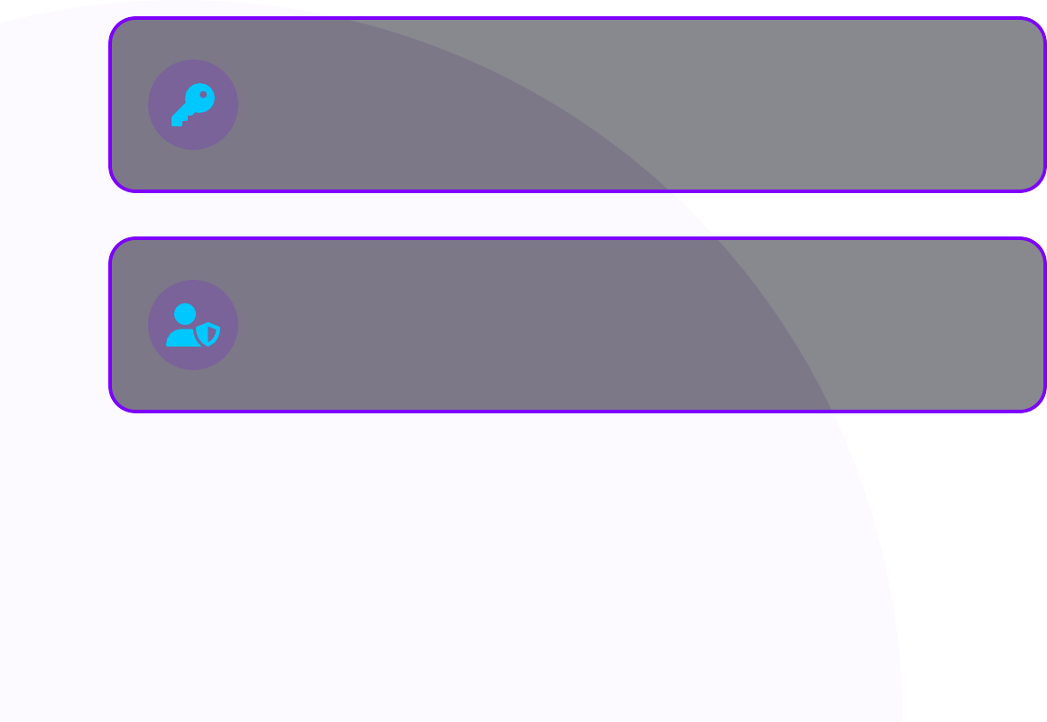


Security Features
CI/CD Pipeline
JWT + HTTPS
Secure authentication and encrypted communications
GitHub
Source code repository with version control
Azure Blob SAS URLs
Time-limited, secure access to document storage
Docker
Containerized application packaging
Role-based Access Control
Granular permissions system for document access
Azure Container Registry (ACR)
Private Docker image repository
Azure Container Apps
Auto-scaling serverless container platform

Slide 11

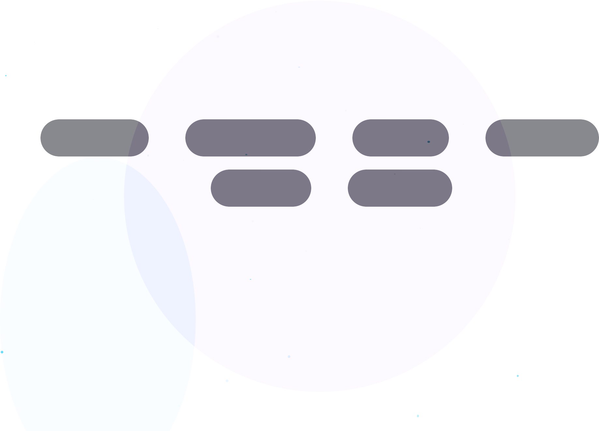

🚀 Live Demo
Uploading
→
Summarizing
→ Speaking
→
Chatting
→
Translating
→ Exporting
MindDocs live web app

Slide 12

Demo Highlights
📄
One-Click Summary
💬
Streaming Chat
+ TTS
🌐
Agentic Translation
📥
Save Results as PDF
Generate comprehensive document
summaries with instant PDF export
Real-time conversation with token streaming and
voice playback
Multi-language translation with domain-specific
adaptation
Export all interactions, summaries and translations with one
click

Slide 13
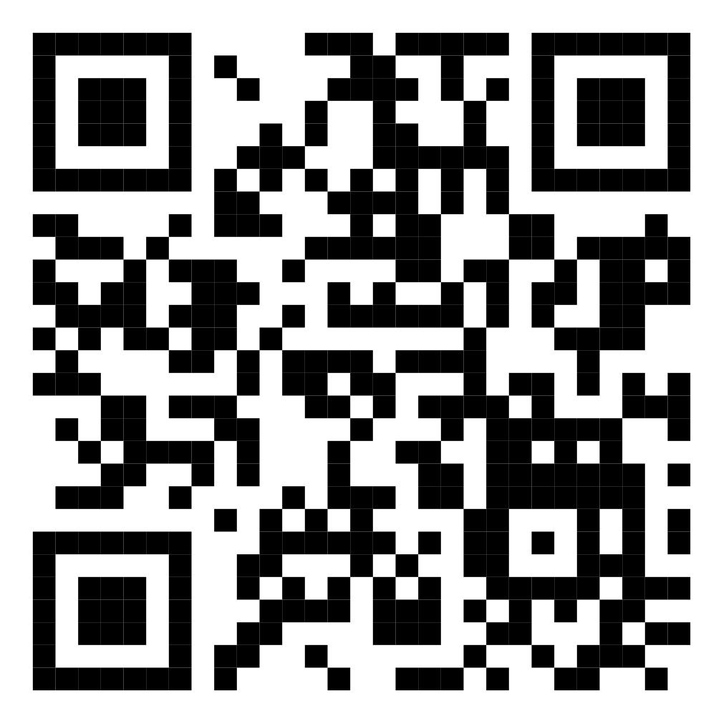

TThhaannkk YYoouu!!
Questions?
Powered by MindDocs AI

