Slide 1
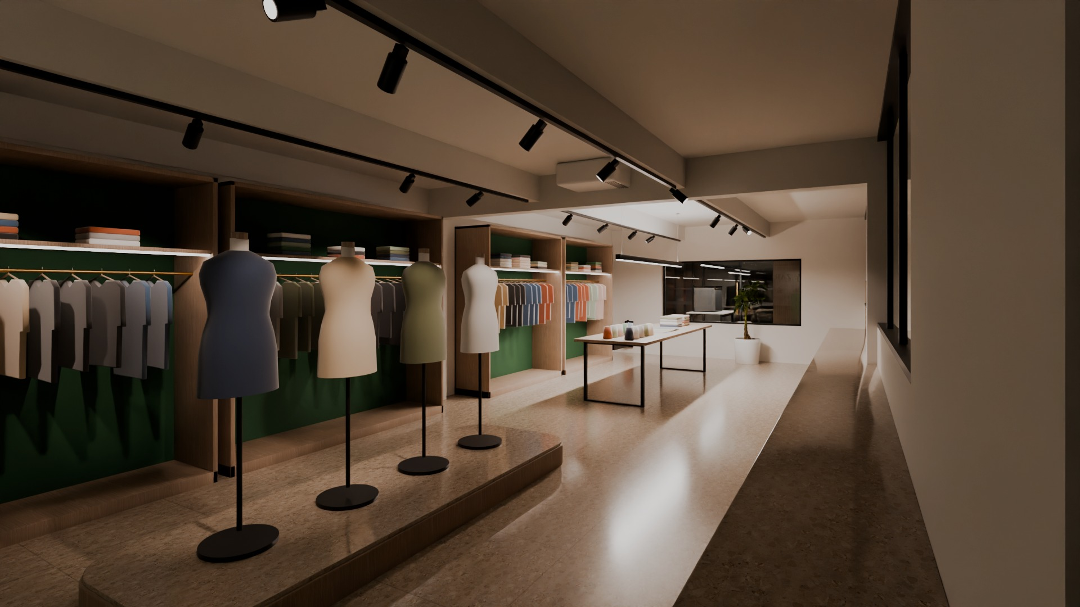



INTERIOR DESIGN PROPOSAL | GROUND FLOOR
Premium International Fashion Corporate Headquarters & Design Development Centre
Stage II Knitting Apparel Ltd. · Stage II Knitting Apparel Unit-1 · Zara Fashion
Holding 329/2, Ward 15, Vogra, Bason, Gazipur
Experience centre - Blender Cycles render of the project model
STAGE II KNITTING APPAREL / ZARA FASHION | Ground-floor corporate office - interior design proposal
01 / 18

Slide 2
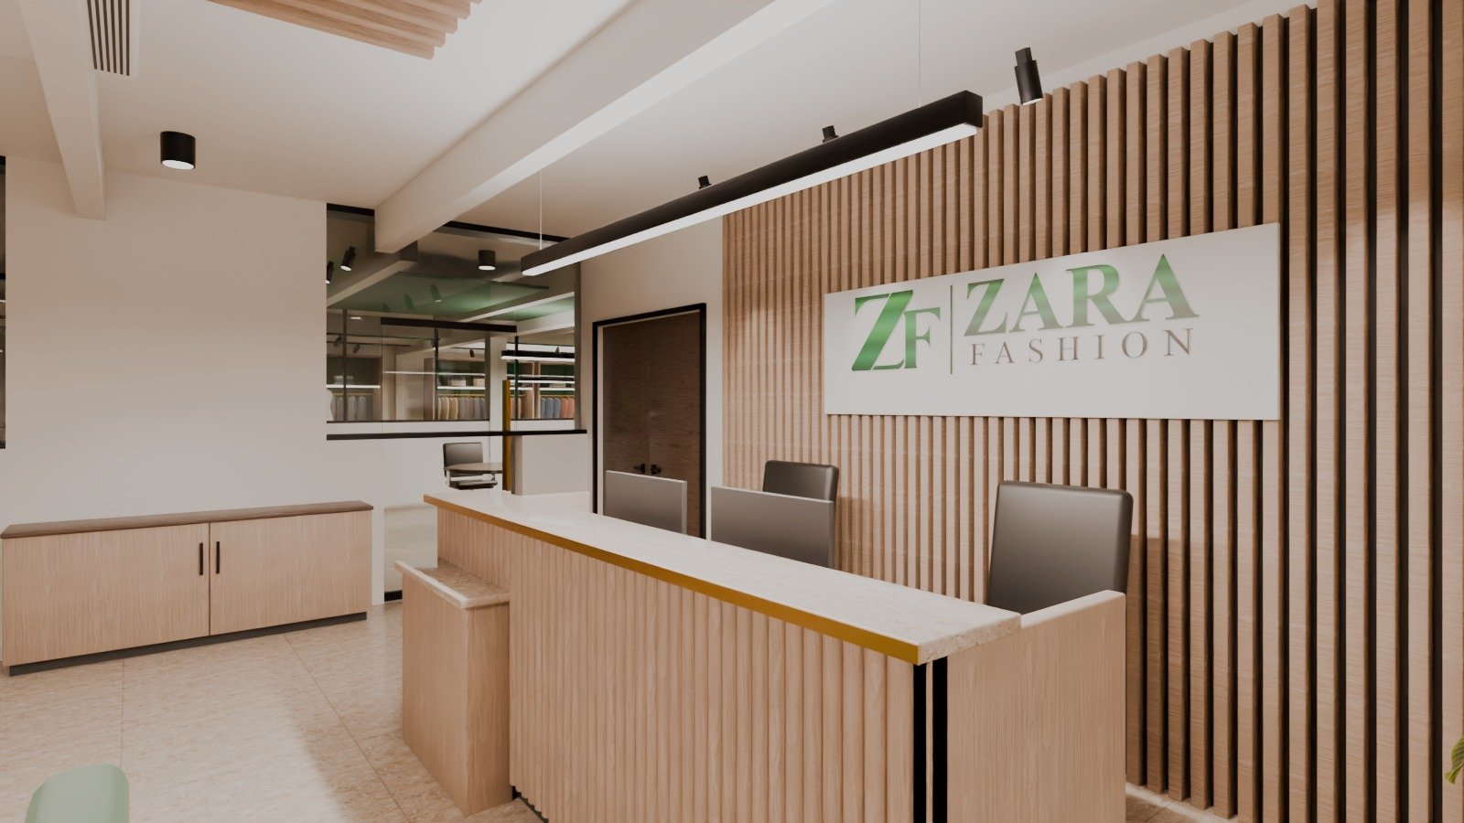
PROJECT VISION
One floor that tells the story from yarn to buyer-ready collection
The face of the company: a calm, premium headquarters where buyers meet the brand, management works in comfort and the design team turns trends into products - with no production on this floor.
- Visitor journey: lobby - reception - experience centre - boardroom
- Executive suite and administration beside the visitor zone
- Design wing, staff cafe, lounge / training and prayer rooms behind
34
54
rooms and zones designed
work seats incl. growth and guests
707 sft
75 / 75
experience centre at the heart
survey dimension checks passed
Reception desk and logo wall
STAGE II KNITTING APPAREL / ZARA FASHION | Ground-floor corporate office - interior design proposal
02 / 18

Slide 3
DESIGN PHILOSOPHY
Six principles behind every decision
01 Modernity
02 Functionality
03 Collaboration
Clean planes, slim black-aluminium glass, an exposed and painted structure - an honest contemporary shell.
Clear zoning: visitors, executives, administration, design development and staff support each have their place.
Team tables, a buyer presentation table, a sample-review counter and glass views between departments.
04 Creativity
05 Employee comfort
06 Professional image
Mood-board wall, fabric & trim library, 3D printing lab and display bays keep products and ideas visible.
Ergonomic 1400 mm desks, acoustic felt, 4000 K task light, staff cafe, lounge and prayer rooms.
The client's own logos and green, terrazzo, oak and walnut: a confident international brand presence.
STAGE II KNITTING APPAREL / ZARA FASHION | Ground-floor corporate office - interior design proposal
03 / 18

Slide 4
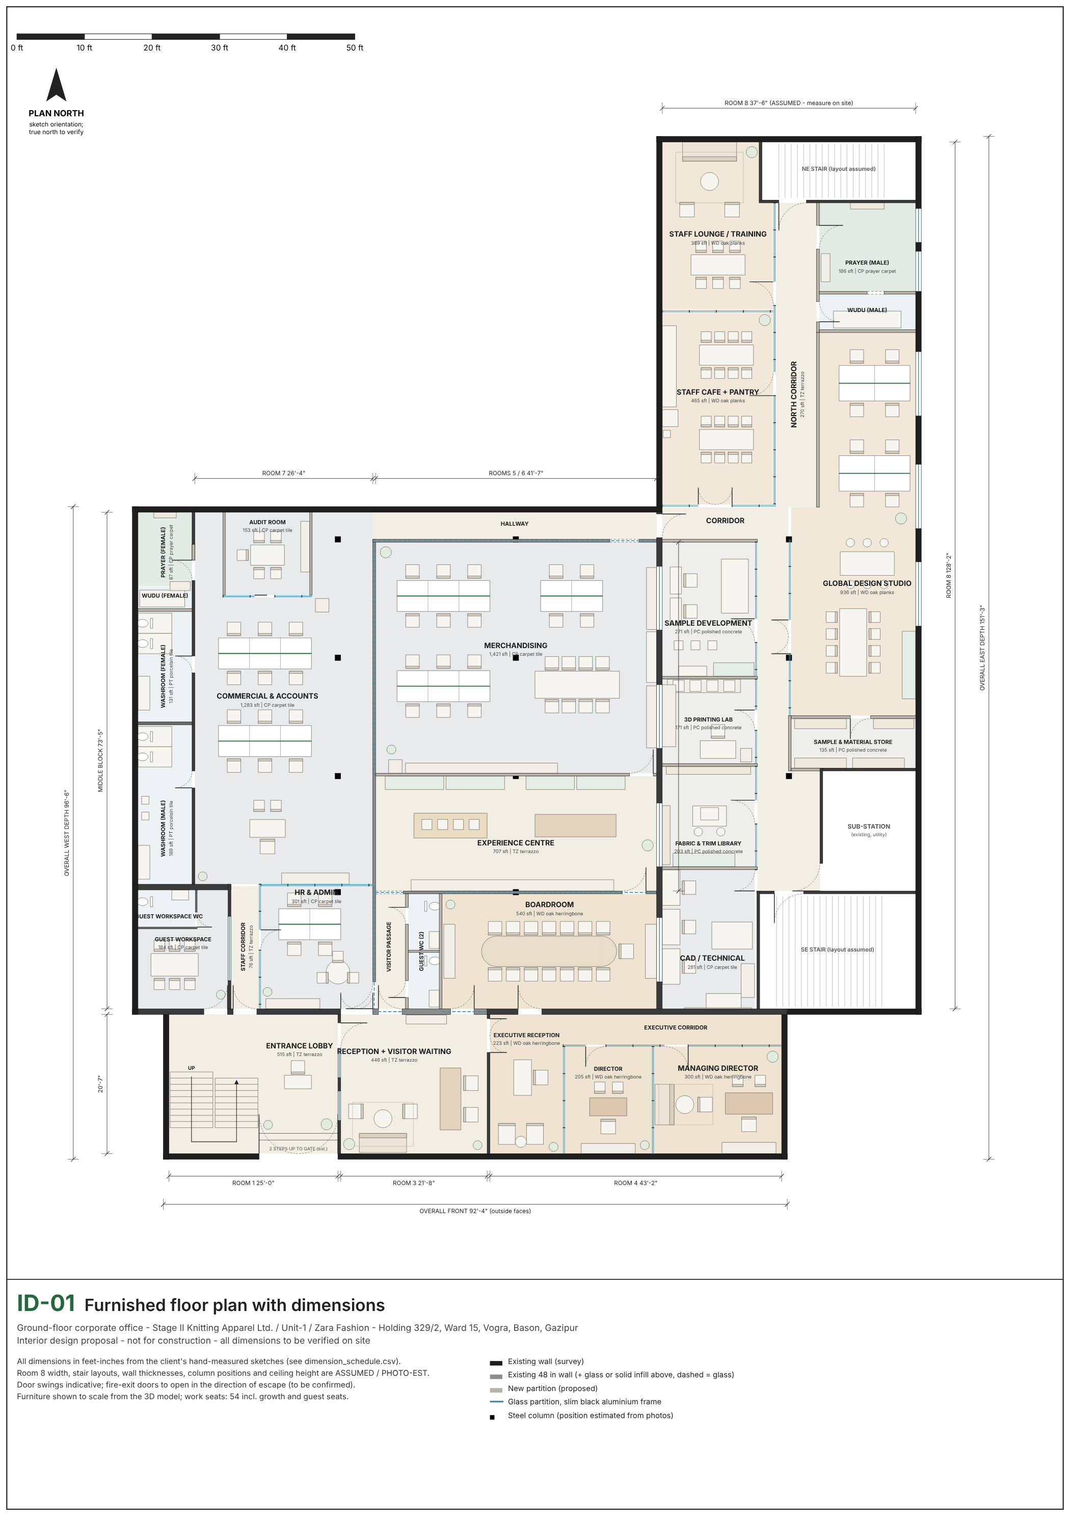
FLOOR PLAN
Furnished ground-floor layout
Overall 92'-4" front x 96'-6" (west) / 151'-3" (east) outside dimensions, from the client's hand-measured sketches. Fit-out zones total about 11,092 sft net.
Key dimension | Value | Status
Rooms 1 / 3 / 4 widths | 25'-0" / 21'-8" / 43'-2" | measured
Middle block depth | 73'-5" | derived
Rooms 5 + 6 width | 41'-7" | measured
Room 8 length / width | 128'-2" / 37'-6" | measured / assumed
Floor to deck | 9'-6" | photo estimate
Drawing set (A3): ID-01 furnished plan, ID-02 zoning, ID-03 ceiling + lighting, ID-04 power, data + fire. Geometry check: 75 of 75 model measurements match the survey values.
STAGE II KNITTING APPAREL / ZARA FASHION | Ground-floor corporate office - interior design proposal
04 / 18

Slide 5
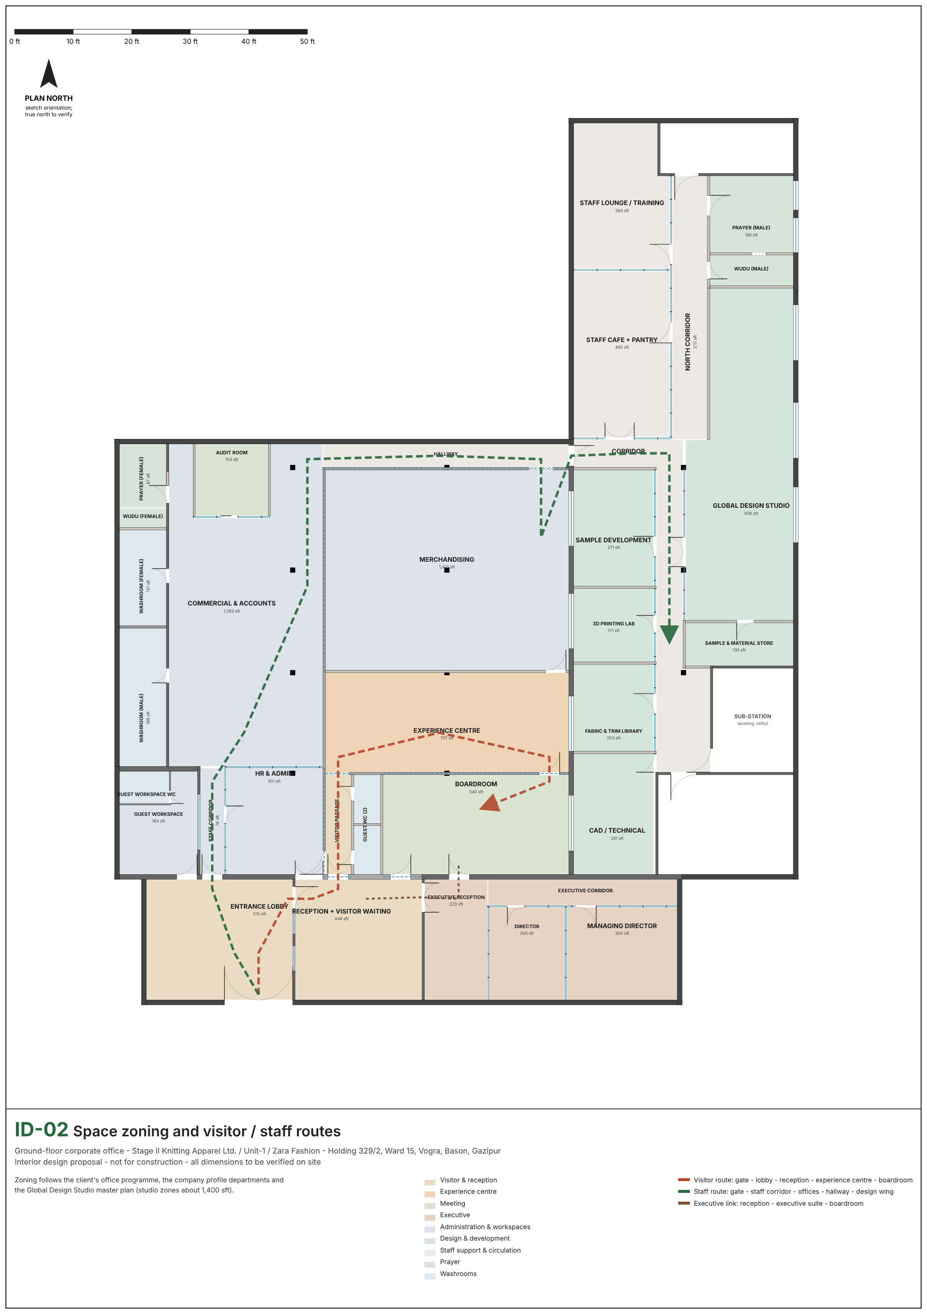
SPACE ZONING
Visitors in front, work in the middle, creation and care at the back
Red route: visitors. Green route: staff. Brown: executive link to the boardroom. Visitors never pass through the offices.
Zone | Net area
Visitor & reception | 1,036 sft
Experience centre | 707 sft
Meeting | 693 sft
Executive | 873 sft
Administration & workspaces | 3,265 sft
Design & development | 1,997 sft
Staff support & circulation | 1,704 sft
Prayer | 375 sft
Washrooms | 444 sft
STAGE II KNITTING APPAREL / ZARA FASHION | Ground-floor corporate office - interior design proposal
05 / 18

Slide 6
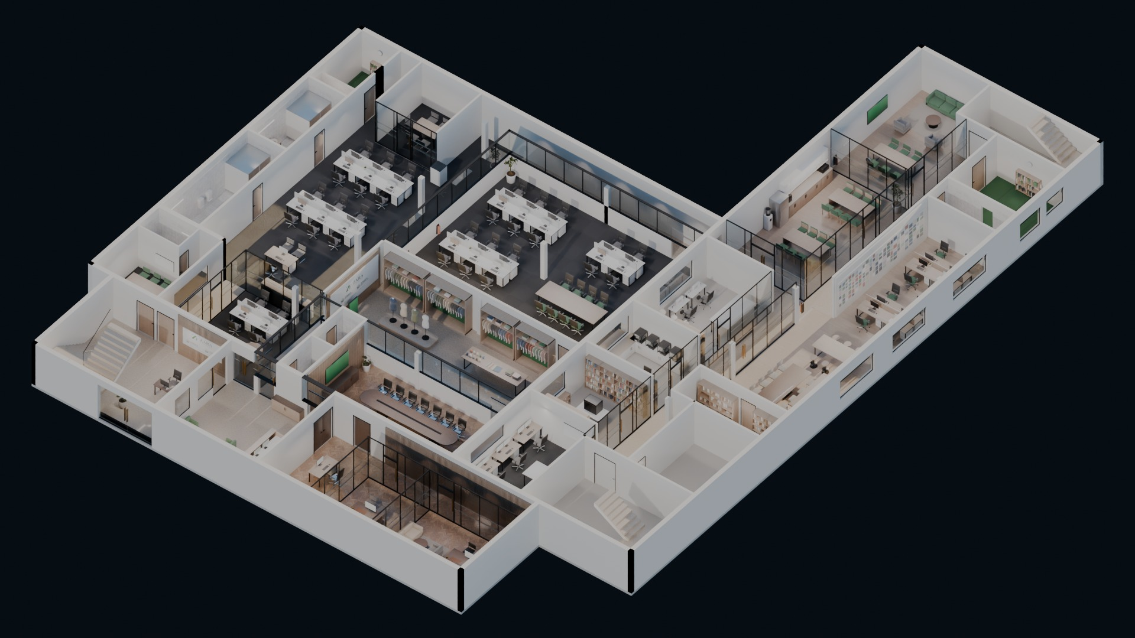
OVERALL 3D VIEW
The complete ground floor, furnished
Editable Blender model: every wall, partition, door, light and piece of furniture is a separate named object in named collections.
Overall isometric cut-away of the furnished floor - Blender Cycles render
STAGE II KNITTING APPAREL / ZARA FASHION | Ground-floor corporate office - interior design proposal
06 / 18

Slide 7
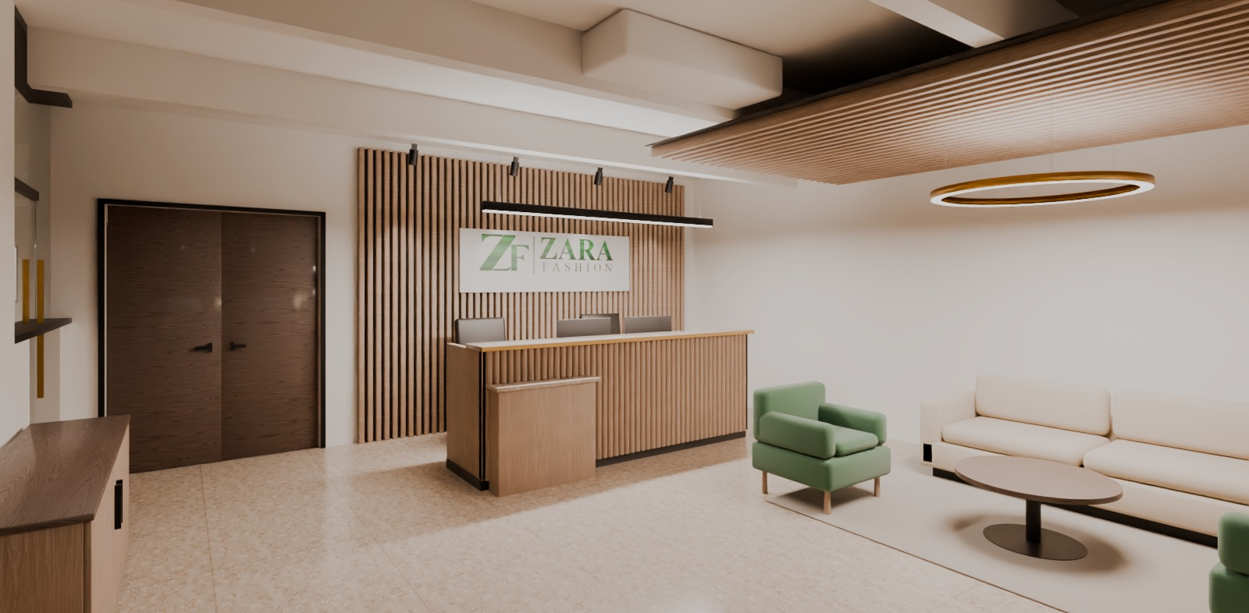
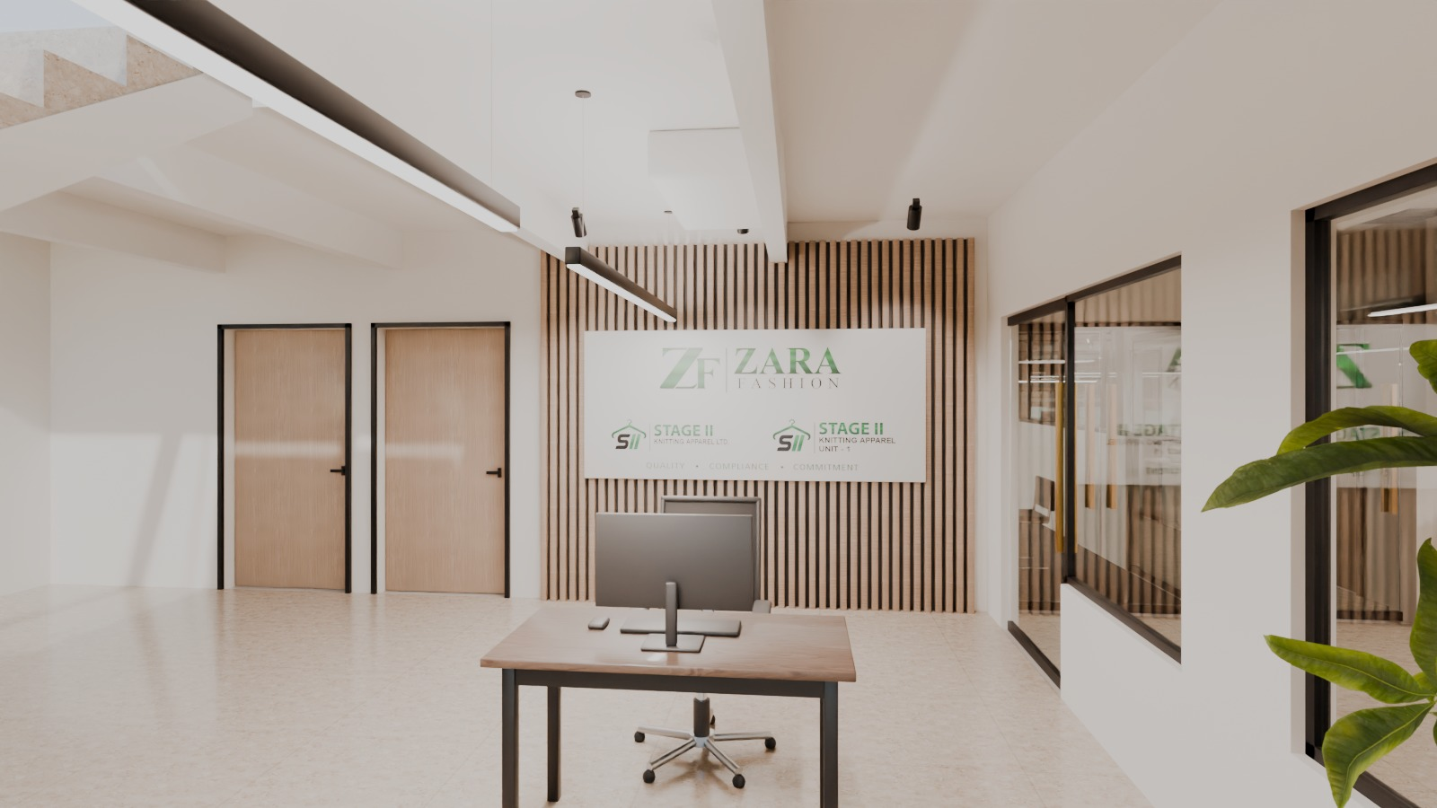
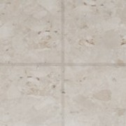
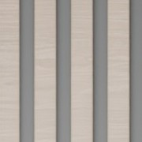
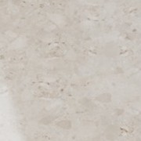

RECEPTION & ENTRANCE
A calm, branded welcome
Guests step down from the gate into a terrazzo lobby with a security desk and the group's three logos on an oak brand wall, then into a warm reception.
- Fluted white-oak counter, terrazzo ledge, accessible 760 mm section
- Backlit logo plate on a fluted oak wall
- Waiting lounge under an oak slat raft and a brass halo
- Glass between lobby and reception
Reception and visitor lounge
KEY FINISHES
TZ-01
WO-01
SS-01
MT-02
Terrazzo floor
White-oak slats
Quartz / terrazzo top
Brushed brass
Reception desk and logo wall
Entrance lobby - brand wall
STAGE II KNITTING APPAREL / ZARA FASHION | Ground-floor corporate office - interior design proposal
07 / 18

Slide 8
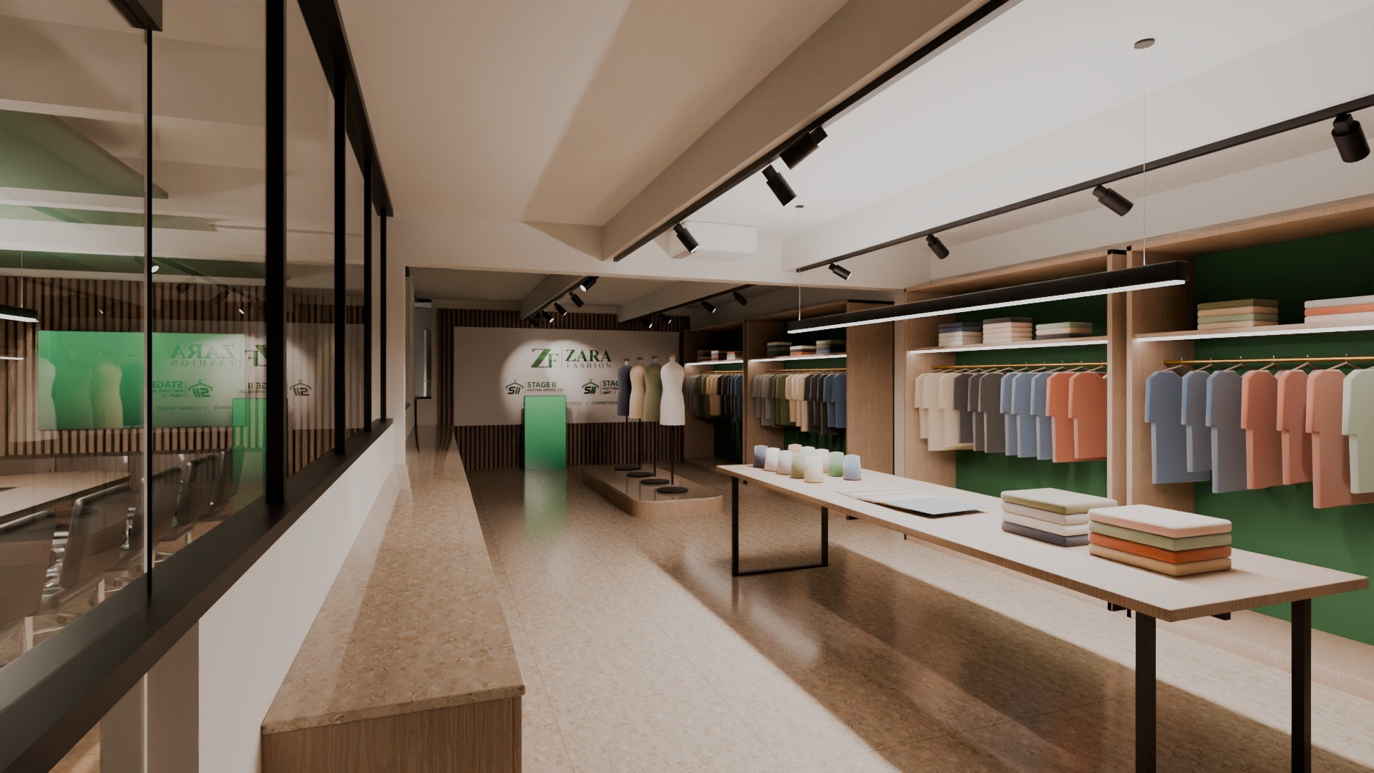
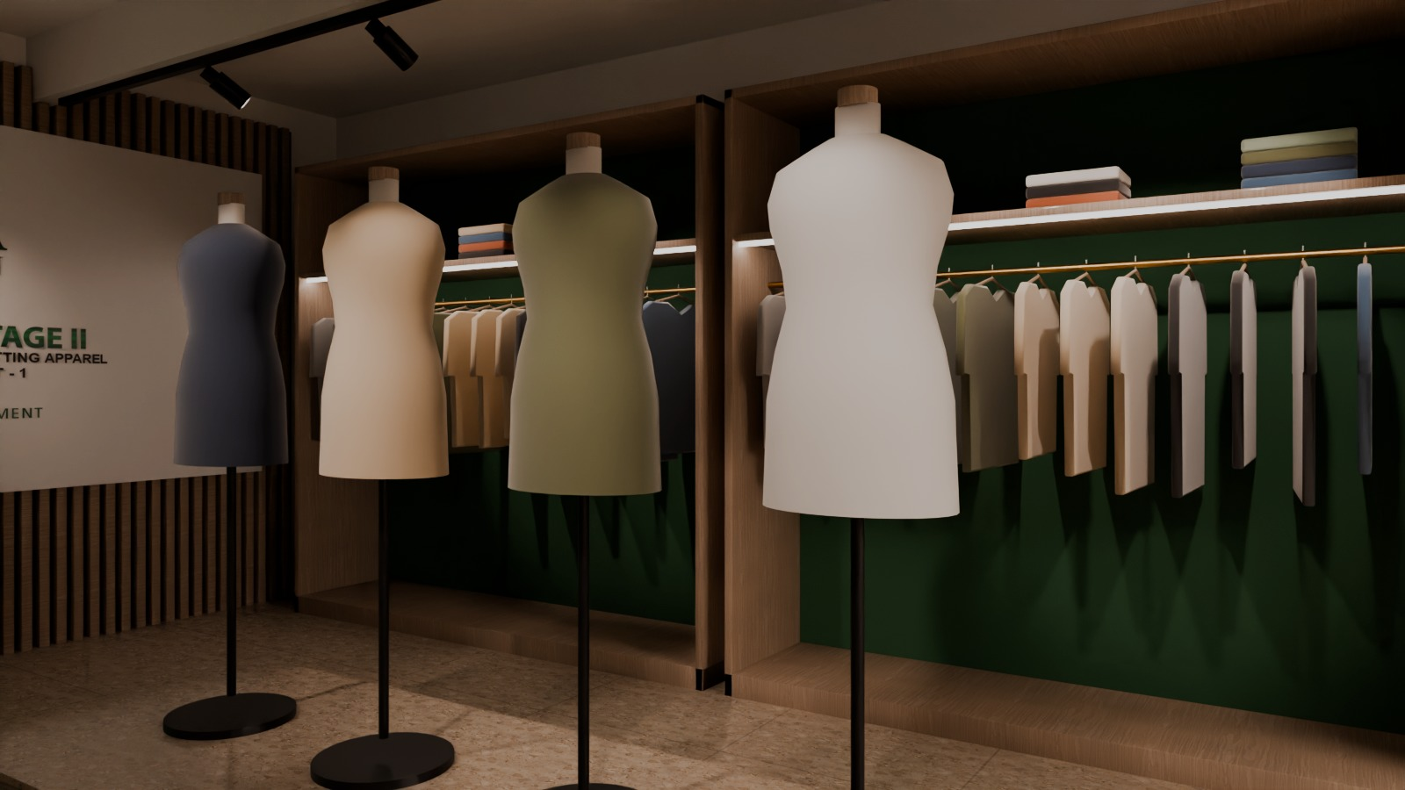

EXPERIENCE CENTRE
Where buyers meet the product
At the centre of the floor, between reception and boardroom, the experience centre tells the company story and shows the collection.
- Brand-story wall with the client's logos and tagline
- Four garment bays: deep green backs, brass rails, LED shelves
- Mannequin plinth and 'yarn to garment' touch table
- Track lights fixed to the existing beams
- Glass views into boardroom and fabric library
Experience centre
KEY FINISHES
TZ-01
PA-02
WO-01
MT-02
Terrazzo floor
Brand green
White-oak slats
Brushed brass
Experience centre - story wall
Display detail
STAGE II KNITTING APPAREL / ZARA FASHION | Ground-floor corporate office - interior design proposal
08 / 18

Slide 9
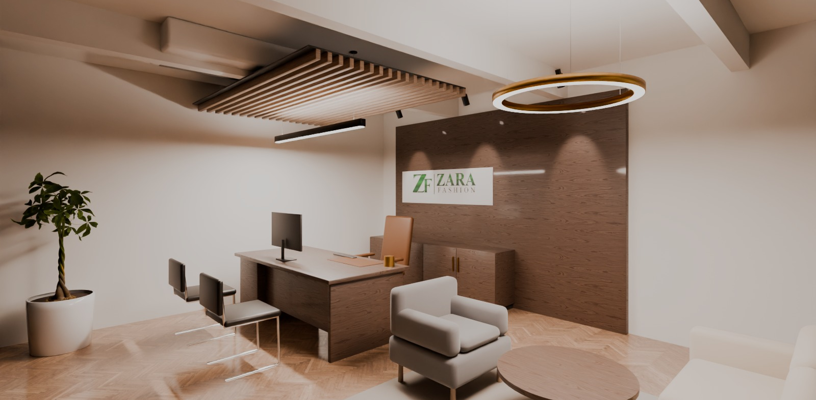
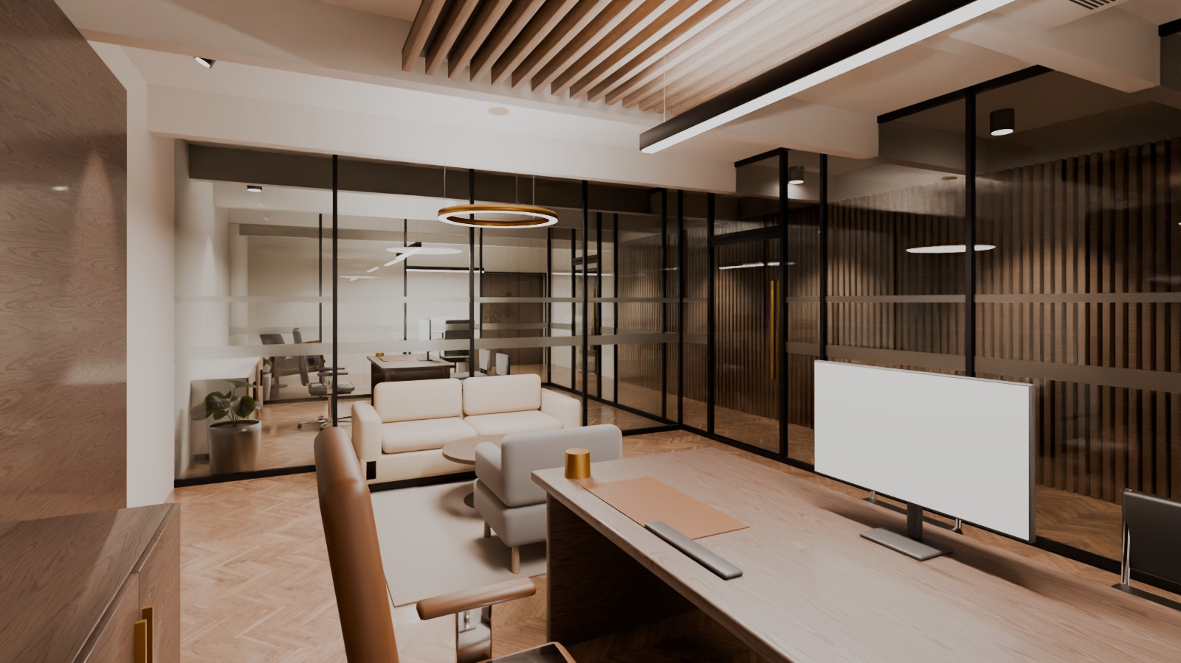
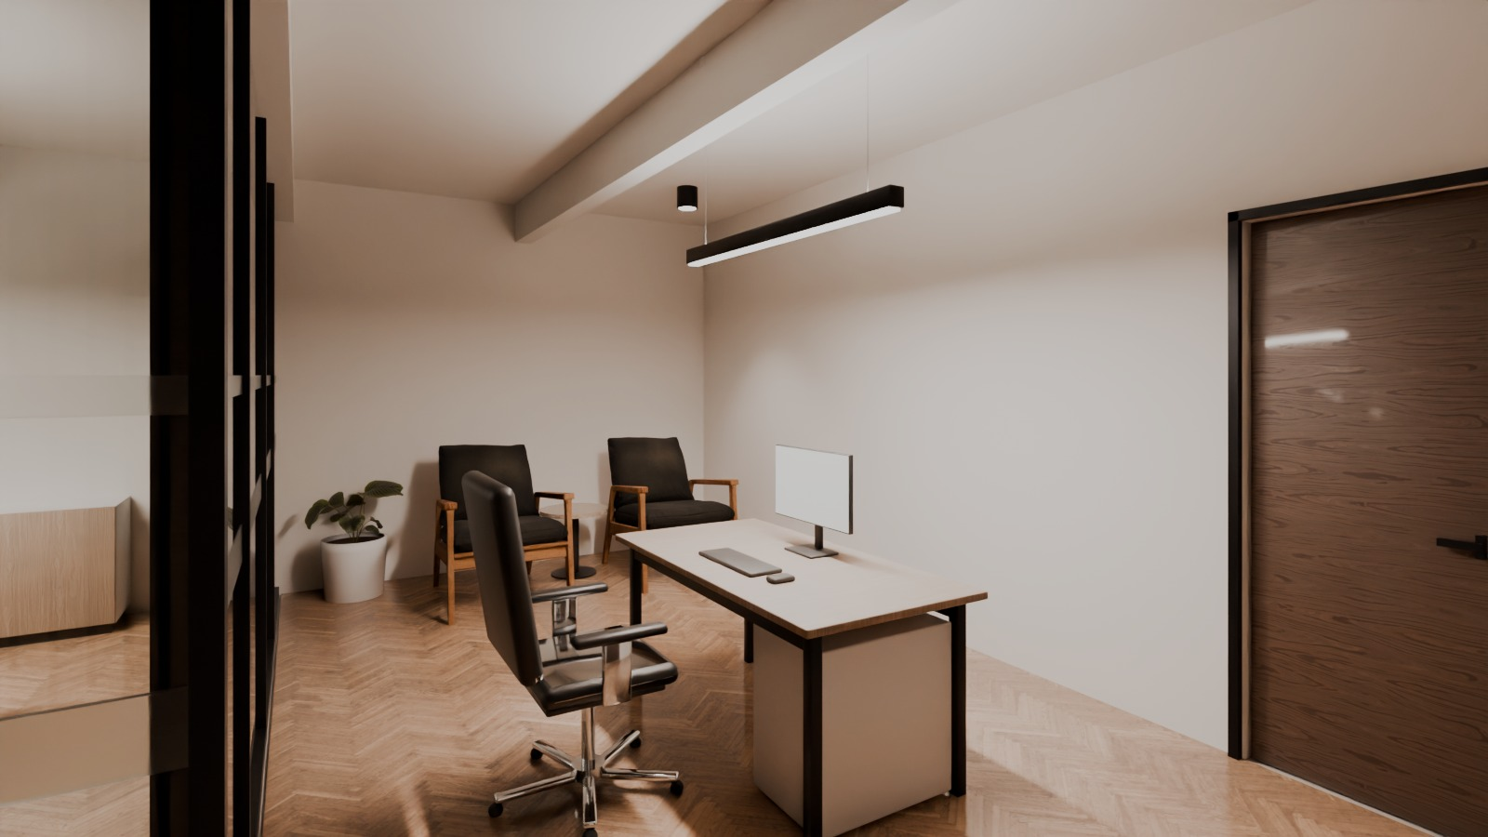
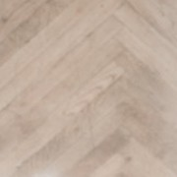
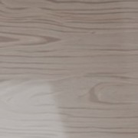


EXECUTIVE OFFICE
Managing Director's office
A quiet, warm executive suite next to the reception, reached through the PA and executive waiting area and a glass executive corridor.
- 2.1 m smoked-walnut desk, cognac leather chair
- Walnut feature wall with the company logo
- Lounge corner for informal meetings
- Oak herringbone floor, oak slat raft and halo light
- Direct link from the executive suite to the boardroom
MD office
KEY FINISHES
WD-01
WO-02
UP-02
UP-01
Oak herringbone
Smoked walnut
Cognac leather
Sand fabric
MD office - lounge corner
Executive reception (PA)
STAGE II KNITTING APPAREL / ZARA FASHION | Ground-floor corporate office - interior design proposal
09 / 18

Slide 10
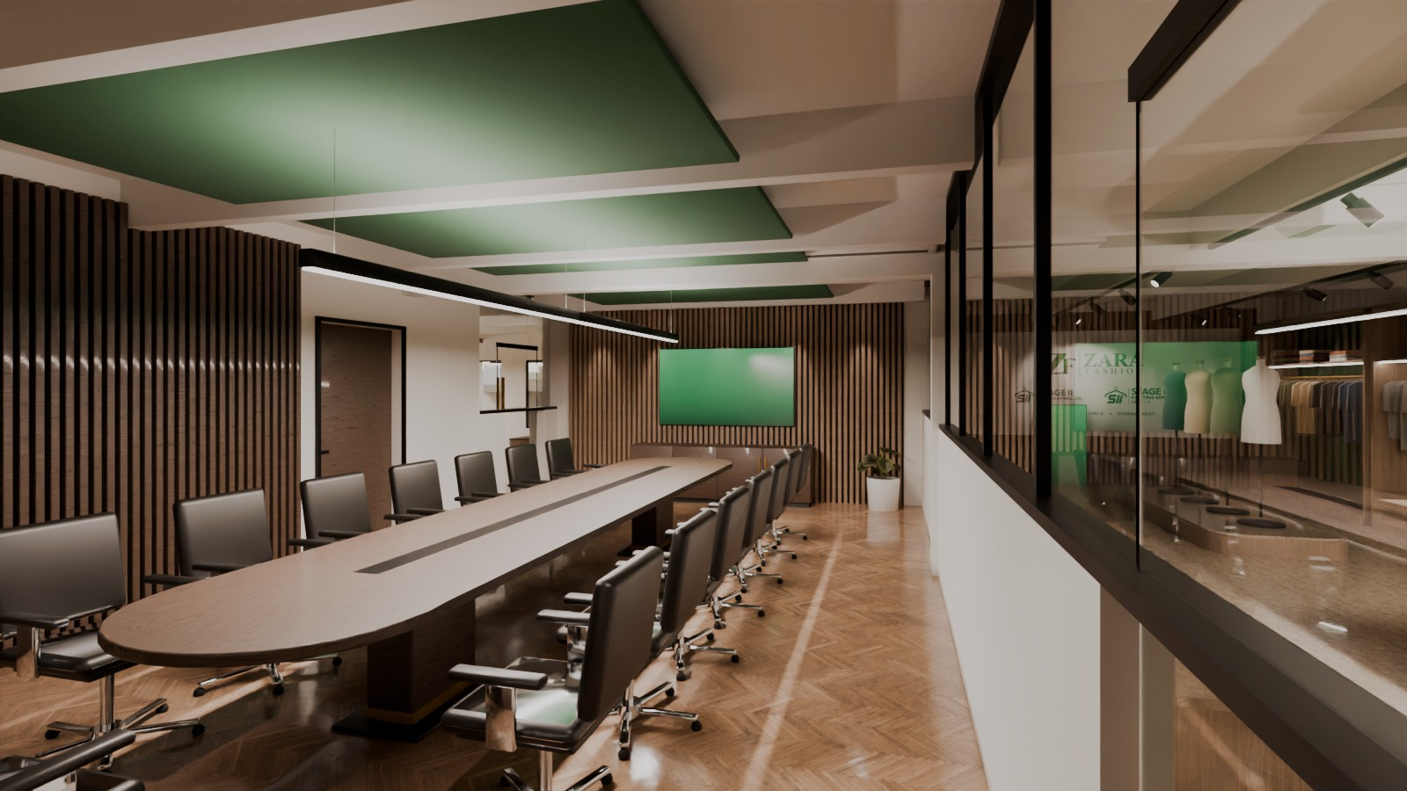
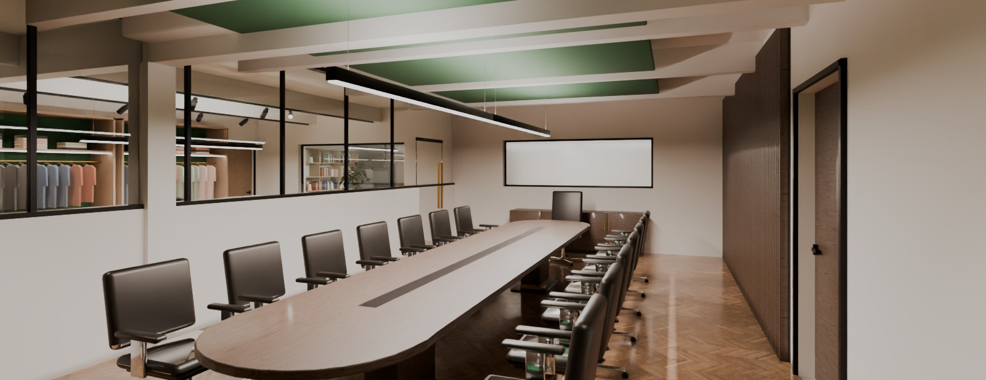

BOARDROOM
A boardroom for international buyers
Fifteen seats around a 6.1 m walnut table, between the reception, the executive suite and the experience centre.
- 86 in screen on an oak slat media wall
- Green felt acoustic rafts set between the existing beams
- Walnut acoustic slat wall, herringbone oak floor
- Power/data trough in the table; privacy curtains recommended on the glass
Boardroom
KEY FINISHES
WD-01
WO-02
AC-01
WO-01
Oak herringbone
Smoked walnut
Acoustic felt
White-oak slats
Boardroom - towards the experience centre
STAGE II KNITTING APPAREL / ZARA FASHION | Ground-floor corporate office - interior design proposal
10 / 18

Slide 11
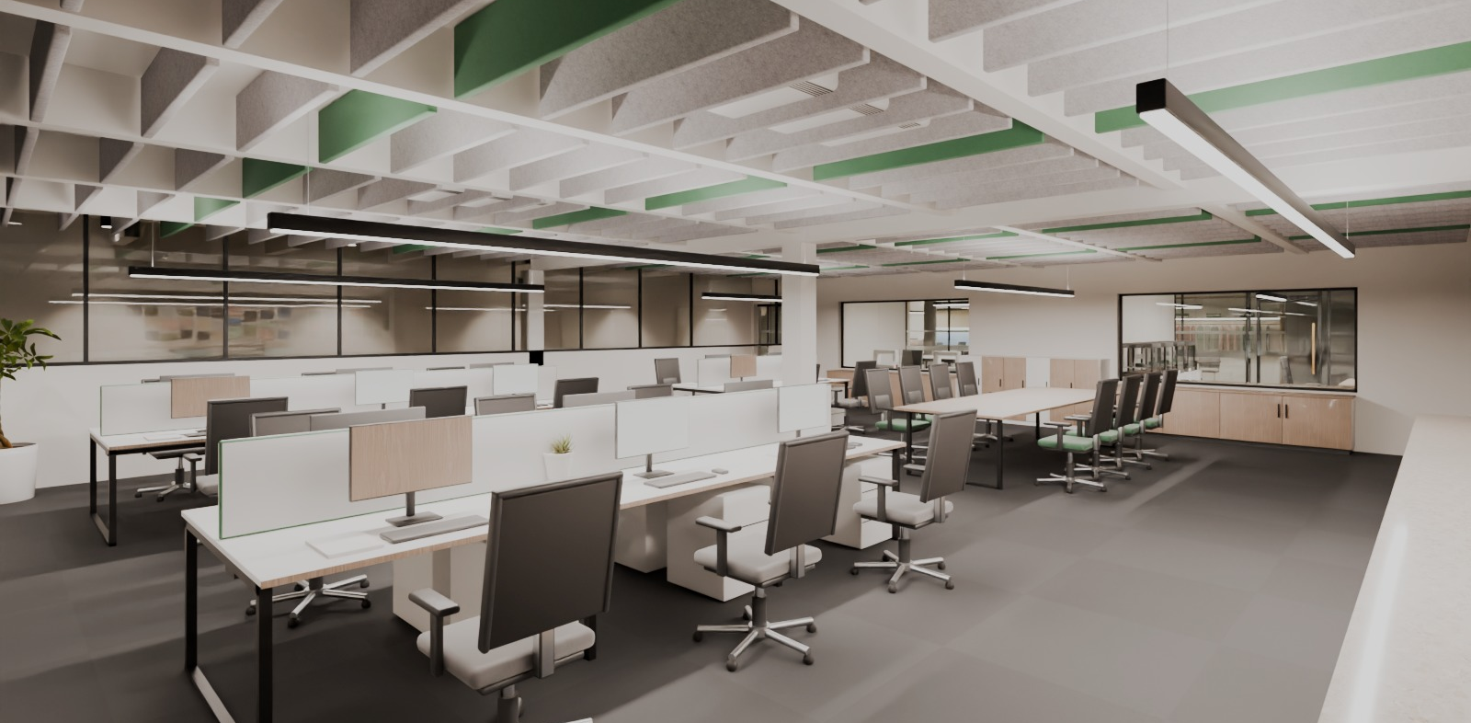
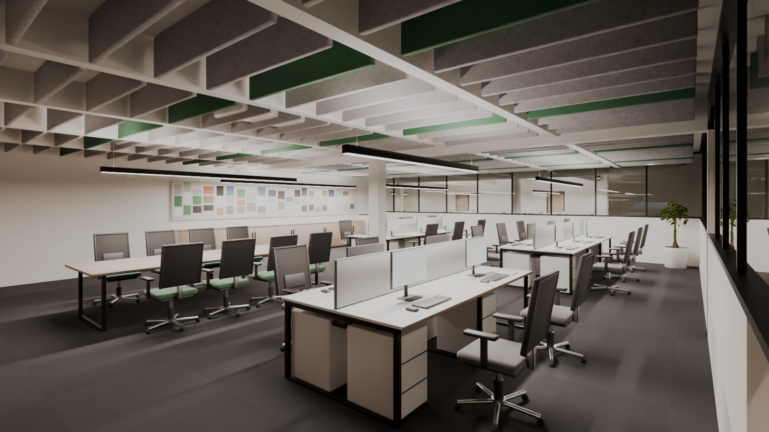
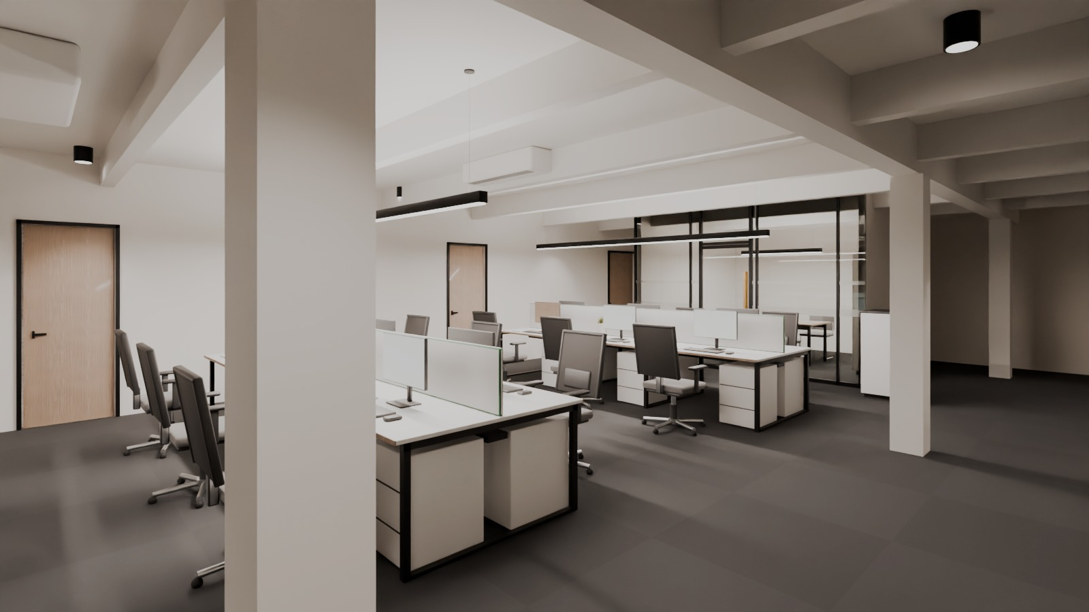
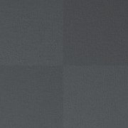


MAIN OFFICE
Workplaces that work
Merchandising, commercial & accounts and HR & admin share one desk family and one light and acoustic language.
- 48 dedicated workstations + 6 guest seats (about 50 % growth)
- 1400 x 700 mm bench desks, green felt screens, task chairs
- Team table and sample-review counter for merchandisers
- Felt baffles between the beams, 4000 K linear light
Merchandising open office
KEY FINISHES
CP-01
AC-01
UP-01
PA-01
Carpet tile
Acoustic felt
Green fabric
Warm white paint
Merchandising - team table
Commercial & accounts
STAGE II KNITTING APPAREL / ZARA FASHION | Ground-floor corporate office - interior design proposal
11 / 18

Slide 12
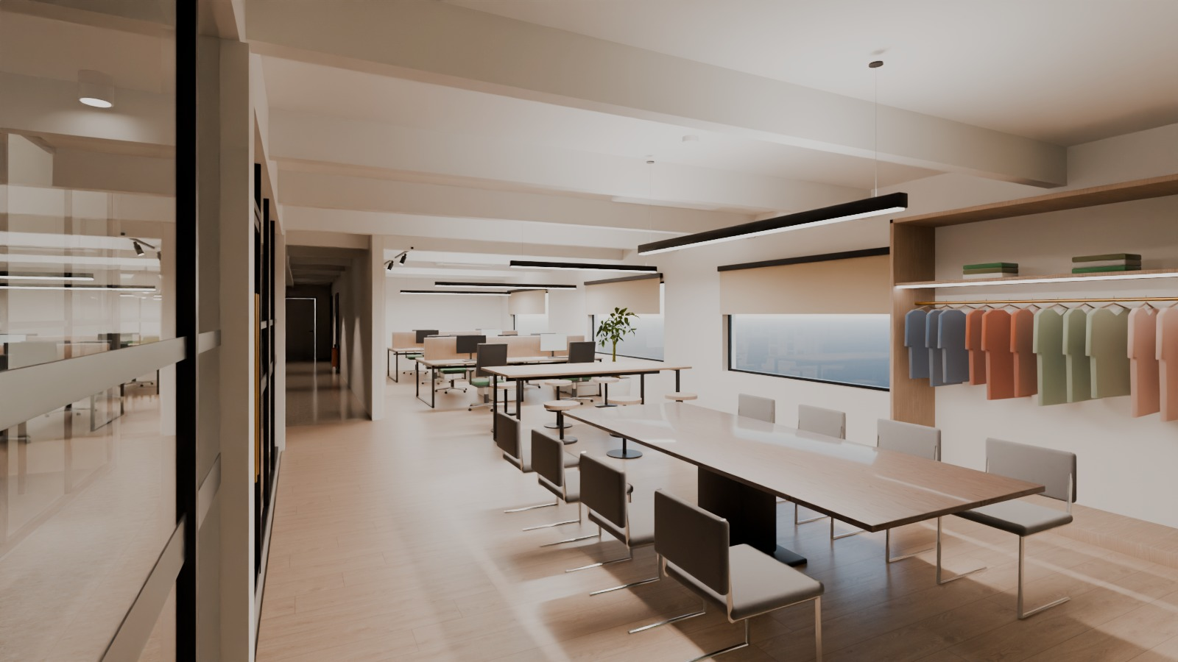
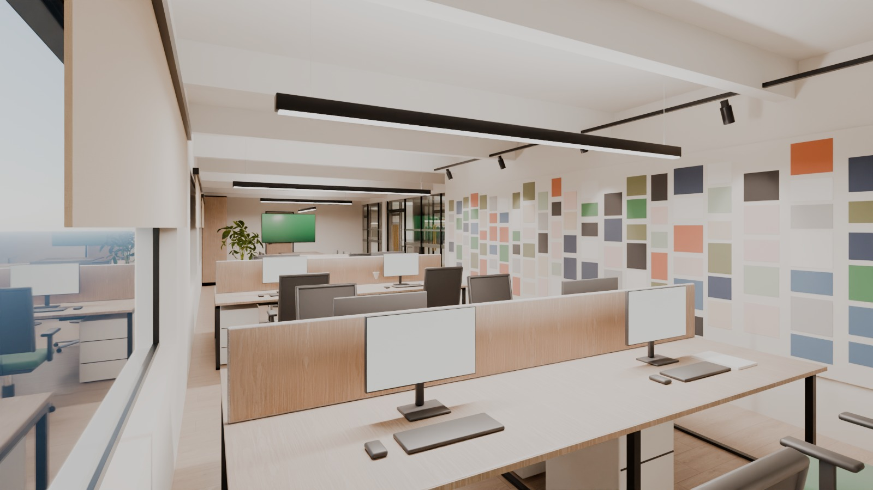
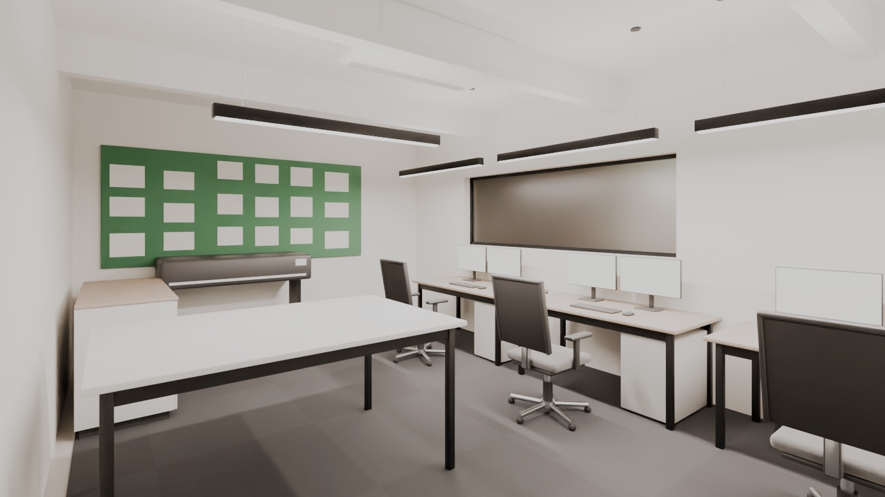
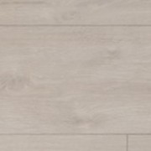
DESIGN STUDIO & CAD
The Global Design Studio
Zones from the master plan (about 1,400 sft): creative desks, trend wall, collection presentation, technical design, fabric library and storage.
- Designer desks at the east windows
- 7.4 m mood-board wall for trend research
- Buyer presentation table with 86 in screen
- CAD room with plotter; fabric & trim library with D65 booth
- 3D printing lab and sample room as office-grade support
Global Design Studio
KEY FINISHES
WD-02
UP-01
WO-02
PA-01
Oak-look plank
Green fabric
Smoked walnut
Warm white paint
Design studio - workstations + mood board
CAD / technical design
STAGE II KNITTING APPAREL / ZARA FASHION | Ground-floor corporate office - interior design proposal
12 / 18

Slide 13
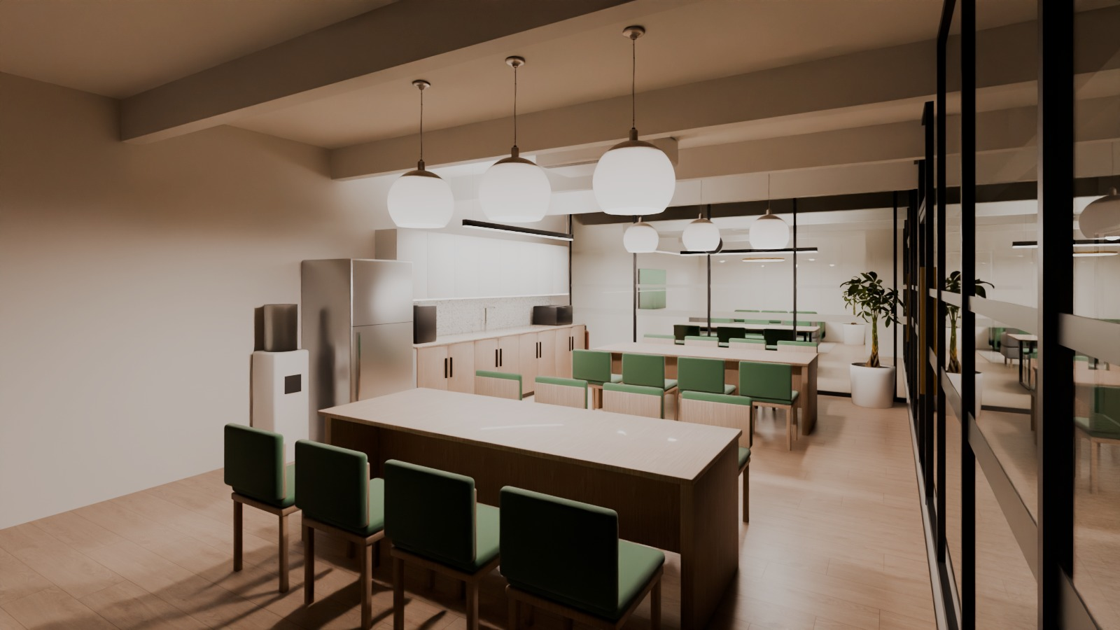
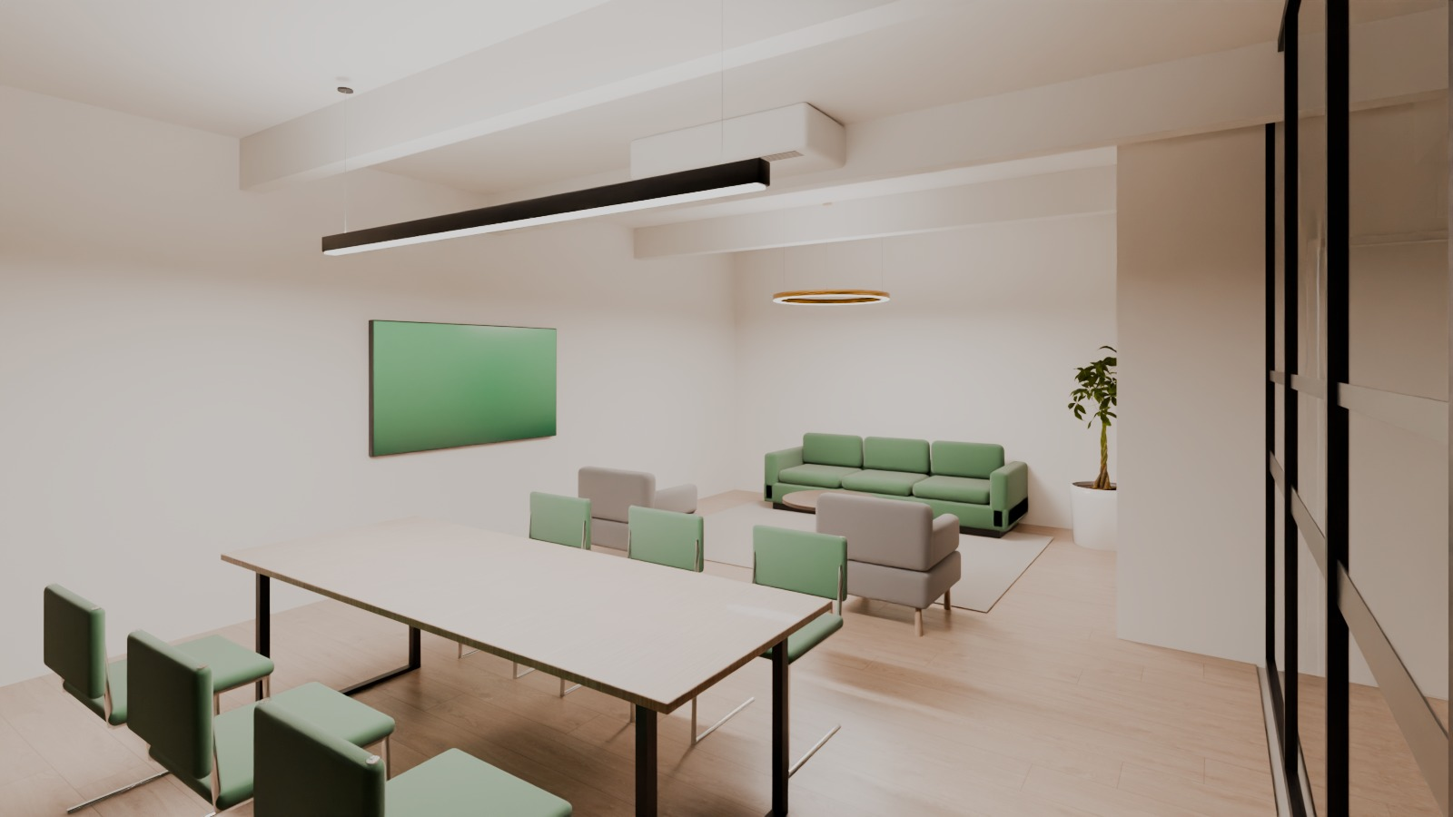
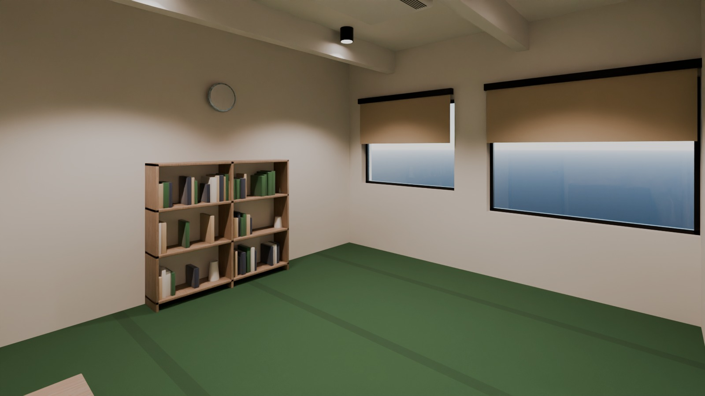
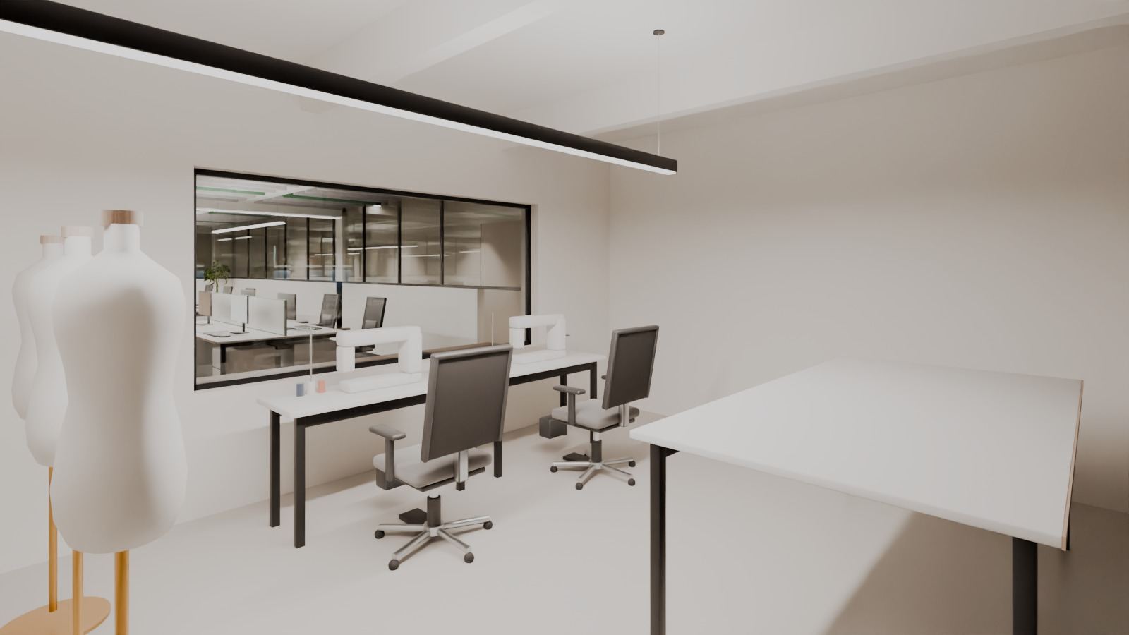
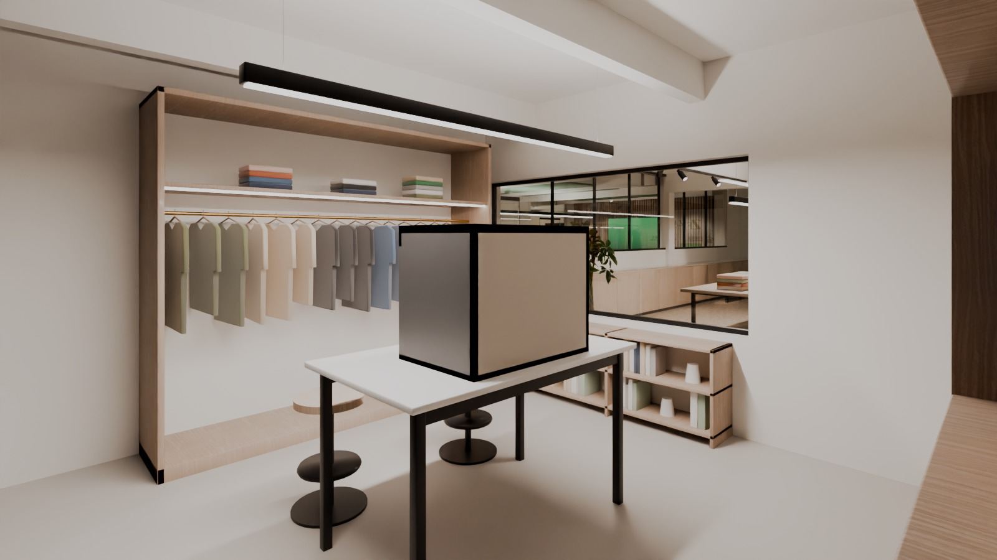
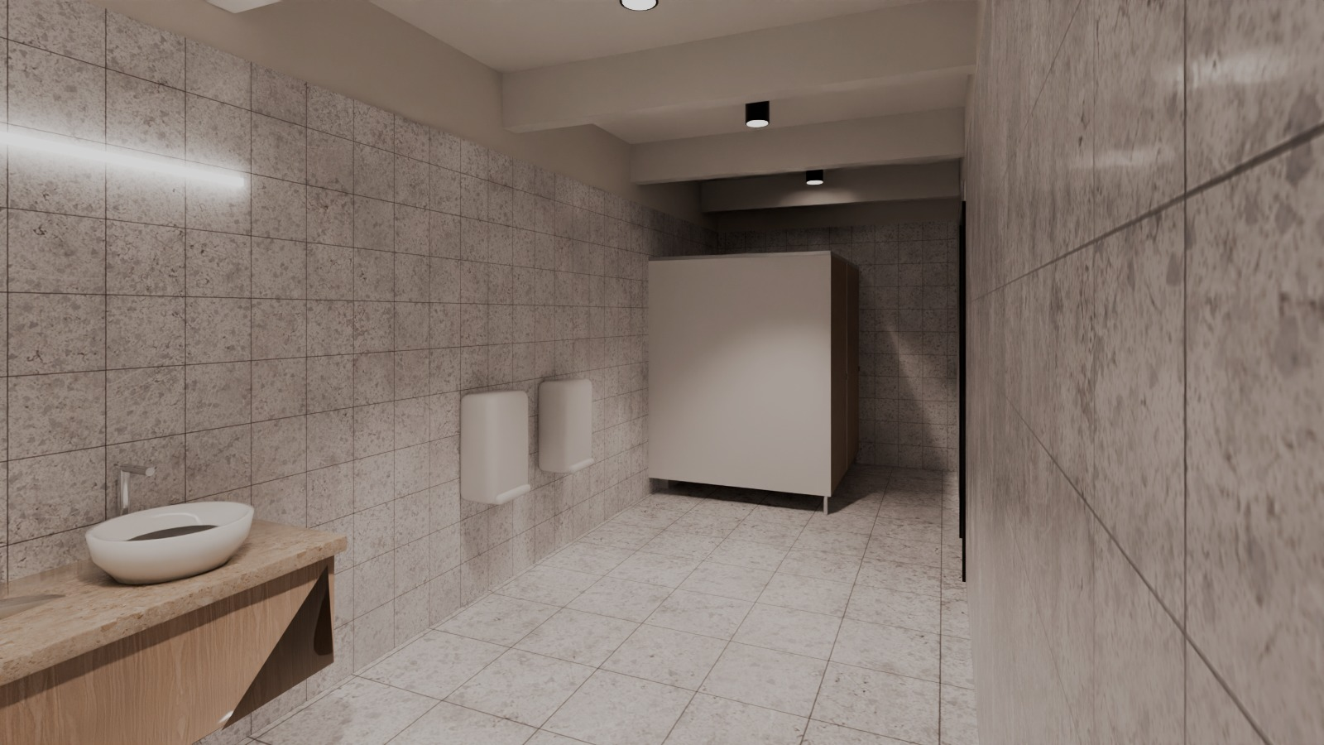
SUPPORT SPACES
Care for the people who make the product
Staff cafe + pantry
Lounge / training (multipurpose)
Prayer room (male)
Sample development
Fabric & trim library
Staff washroom
STAGE II KNITTING APPAREL / ZARA FASHION | Ground-floor corporate office - interior design proposal
13 / 18

Slide 14
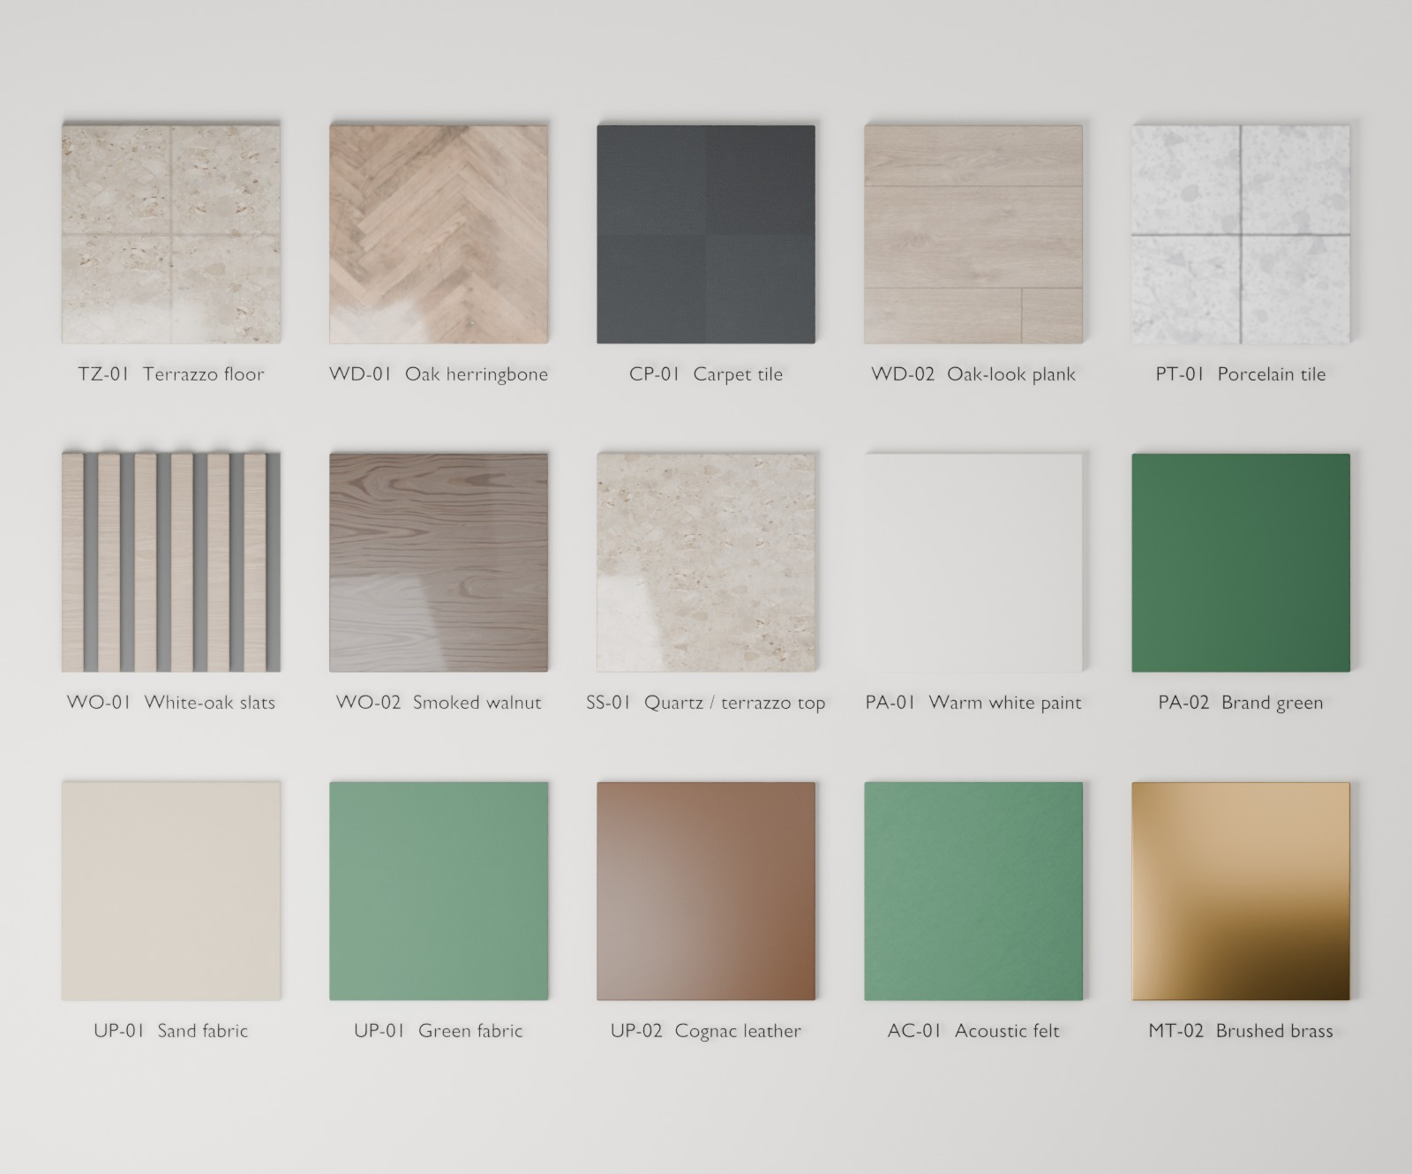
MATERIALS & FINISHES
A warm, durable palette
Code | Finish | Where
TZ-01 | Terrazzo-look porcelain, warm beige | visitor floors
WD-01 | Oak herringbone | boardroom, executive
CP-01 | Charcoal carpet tile | offices
WO-01 | White-oak slats on acoustic felt | feature walls
WO-02 | Smoked walnut veneer | executive furniture
PA-02 | Deep green from the logo | accents
GL-01 | 12 mm glass, black aluminium | partitions
MT-02 | Brushed brass | details
Specification concepts; final products by sample approval. Full schedule in 04_DOCUMENTATION.
Material board - the PBR materials of the model, rendered in Blender
STAGE II KNITTING APPAREL / ZARA FASHION | Ground-floor corporate office - interior design proposal
14 / 18

Slide 15
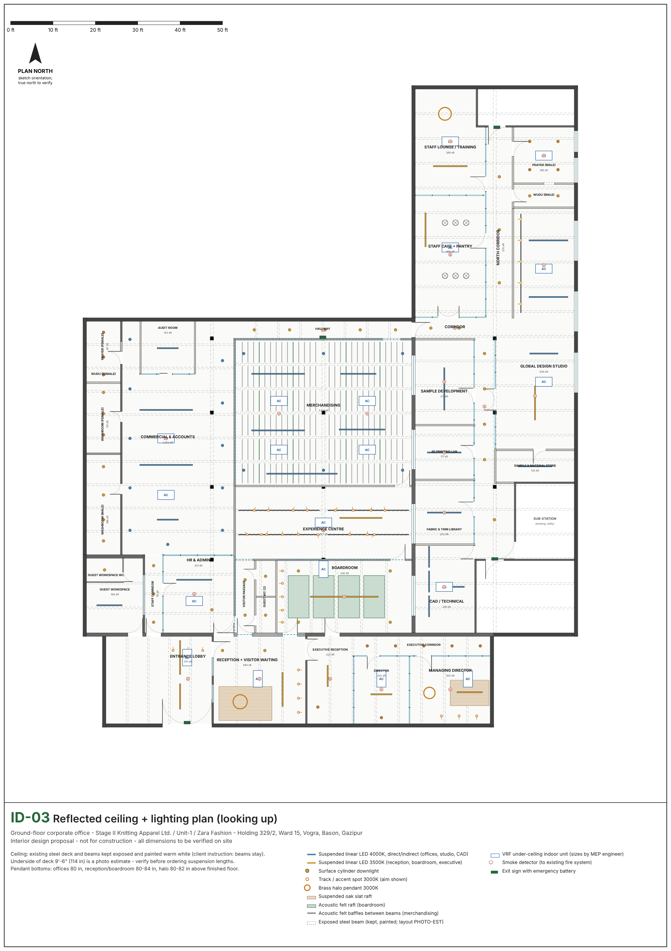
LIGHTING & CEILING
The beams stay - and do the work
- Existing steel deck and beams kept exposed, painted warm white
- Experience centre: track lights fixed to the beams
- Boardroom: green felt rafts between the beams; merchandising: felt baffles
- Reception and MD office: oak slat rafts below beam level
- 4000 K direct/indirect light over desks; 3000-3500 K in visitor and executive areas
- Accent spots on products and brand walls; halo pendants
Felt rafts between the beams - boardroom
STAGE II KNITTING APPAREL / ZARA FASHION | Ground-floor corporate office - interior design proposal
15 / 18

Slide 16
DESIGN BENEFITS
What the company gains
Operational efficiency
Professional image
Employee comfort
Departments placed by workflow: merchandising beside the experience centre and sample room, HR at the staff entrance, the studio next to CAD, library and samples.
A visitor sequence that presents the brand, the product and the management in one walk.
Ergonomic desks, acoustic control, daylight in the studio, cafe, lounge and prayer rooms.
Flexibility
Maintainability
Bench desks, a multipurpose lounge / training room, glass partitions and about 50 % seat growth.
Hard-wearing terrazzo and porcelain, replaceable carpet tiles, exposed services that stay accessible.
Global Design Studio
STAGE II KNITTING APPAREL / ZARA FASHION | Ground-floor corporate office - interior design proposal
16 / 18

Slide 17
IMPLEMENTATION CONSIDERATIONS
To confirm before construction
Item | What has to be confirmed
Site measurements | Floor-to-deck height, room 8 width, column positions and beam layout (currently estimated).
Structure | Lintels for the new openings D17, D20, D22 and the lobby-reception glass - structural engineer.
Fire & escape | Ground-floor exits of the NE / SE stairs; without them the walk to the main gate is about 220 ft from the lounge.
MEP | VRF cooling, fresh air for windowless rooms, exhausts (WCs, pantry, 3D lab), power/data, UPS, DB location.
Accessibility | Ramp or lift at the two entrance steps; one accessible WC (door at least 36 in).
Approvals & branding | Fire / building approvals as applicable; trademark check for 'Global Design Studio'; signage from original vector logos.
No budget or programme was supplied, so none is stated. Details: 04_DOCUMENTATION/technical_coordination_notes.md.
RECOMMENDED NEXT STEPS
01
02
03
04
Site measurement
Engineering reviews
Client decisions
Detailed design
Floor-to-deck height, room 8 width, columns and beams; then update the survey data, rebuild and re-verify the model.
Structural check of the new openings, fire strategy and exits, HVAC, power and data design.
Head count per department, interior budget, experience-centre content and approval of this layout.
Construction drawings, finish samples, furniture selection and bill of quantities after approval.
STAGE II KNITTING APPAREL / ZARA FASHION | Ground-floor corporate office - interior design proposal
17 / 18

Slide 18
CLOSING
Quality, compliance and commitment - built into the space.
A ground floor that welcomes buyers, supports management and gives the design team room to create - ready for detailed design once the open site measurements are confirmed.
Experience centre towards the brand-story wall - Blender Cycles render
STAGE II KNITTING APPAREL / ZARA FASHION | Ground-floor corporate office - interior design proposal
18 / 18

