Slide 1

Major Project Presentation on
“Landslide Detection using Deep Learning Model”
Submitted by:
Vineet Patel (202200530) Pratham Mir Dutraj (202200521)
Under the Supervision of
DEPARTMENT OF INFORMATION TECHNOLOGY SIKKIM MANIPAL INSTITUTE OF TECHNOLOGY
Majitar, Rangpo, East Sikkim-737136
Sonam Lhamu Bhutia
Assistant Professor

Slide 2

CONTENT
Sl.no | Title | Pg.no
1 | Abstract | 3
2 | Introduction | 4
3 | Literature Survey | 6
4 | Summary of Research Gap | 9
5 | Problem Definition | 10
6 | Objective | 11
7 | Solution Strategy | 12
8 | Methodology | 13
9 | Design & Devlopment | 16
10 | Result & Outcome | 20
11 | Limitation & Future Scope | 24
12 | Gant Chart | 25
13 | Reference | 26
14 | Acknowledgements | 27

Slide 3
ABSTRACT
Natural hazard that can seriously harm people, property, and infrastructure is landslides. In order to lower risks and assist disaster management teams, early detection is crucial. In this research, we used deep learning to create a landslide detection and segmentation model. The model employs an Attention U-Net design, which helps the network concentrate on crucial landslide locations while lowering background noise, and is trained on the Bijie Landslide Dataset.
To test the performance of the model, numerous measures were utilized, including Pixel Accuracy, Precision, Recall, F1-Score, and Dice Coefficient. The model is optimized using a combination of Binary Cross-Entropy (BCE) and Dice Loss to accommodate the dataset’s class imbalance.The outcomes demonstrate that the model has dependable segmentation performance and can accurately anticipate landslide masks.

Slide 4
INTRODUCTION
Landslides are dangerous movements of earth and rock that can damage property, obstruct highways, and put human lives at risk, which makes early diagnosis vitally crucial. Conventional detection techniques rely on manually analyzing satellite or ground photos, which is laborious, slow, and unsuitable for big or difficult-to-reach locations.
To solve this challenge, our project uses a deep learning strategy based on the Attention U-Net model to automatically locate and highlight landslide-affected locations in photos. The precise location of the landslide is displayed in a crisp segmentation mask produced by the model. Metrics including Precision, Recall, F1-Score, Dice Score, and Pixel Accuracy are used to assess its performance.
Overall, this technology provides a faster, more accurate, and more efficient option for landslide identification, helping in risk assessment and supporting disaster management teams.

Slide 5
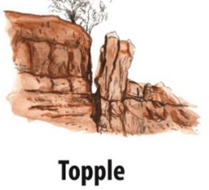
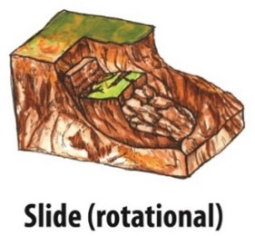
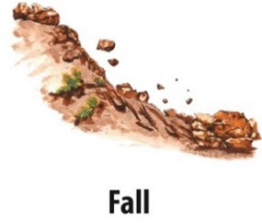
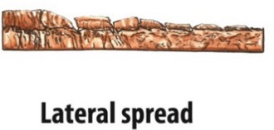
TYPES OF LANDSLIDE
Topple: Sudden free fall of rock/soil from steep slopes or cliffs.Very fast & destructive; accumulates as talus at slope base.
Slide: Forward tilting/rotation of rock or soil blocks.Often caused by undercutting, water seepage, or overhangs.
Lateral Spread: Horizontal movement of ground over weak/liquefied layers.Damages infrastructure in flat, waterlogged terrains.
Fall: Downslope movement along curved or planar slip surfaces.Triggered by rainfall, earthquakes, or human activity.

Slide 6
LITERATURE REVIEW
Author Name , Journal Name , Vol Page , Year : | Title of the Paper | Inference | Relevance with the present work / Motivation. | Research Gap
[1] S. R. Meena et al., Landslides, Vol. 19, 1209–1229 (2022) | Landslides | Used ML models and U-Net for landslide detection in the Himalayas. U-Net performed best with ~76% MCC. Adding DEM/topographic data helped differentiate terrain features. | Shows how U-Net–based image segmentation can detect natural hazards from satellite images. Useful because your work also uses CNN/U-Net and image-based classification. Demonstrates remote-sensing applications similar to environmental/agri-vision tasks. | Small dataset; limited generalization. DEM fusion didn’t always improve results → need better multimodal fusion. U-Net still early in landslide domain; needs large, diverse datasets.

Slide 7
LITERATURE REVIEW
Author Name , Journal Name , Vol Page , Year : | Title of the Paper | Inference | Relevance with the present work / Motivation. | Research Gap
[2] C. Fang et al., ,”Remote Sensing, vol. 14, 2022 | “Landslide detection using remote sensing techniques.” | Used LiDAR-derived terrain maps + a lightweight U-Net variant (LAU-Net). Accurately mapped ~1,900 historical landslides. Achieved high IoU (~82%) and F1 (~87%). | Shows how topography + deep learning improves detection. Demonstrates use of segmentation models beyond optical images (important for future remote-sensing projects). Good reference if integrating DEM/LiDAR in your work. | Requires high-resolution LiDAR → not available everywhere. Model may not generalize to new terrains without retraining. Focuses only on historical landslides, not real-time detection.

Slide 8
LITERATURE REVIEW
Author Name , Journal Name , Vol Page , Year : | Title of the Paper | Inference | Relevance with the present work / Motivation. | Research Gap
[3] L. P. Soares, H. C. Dias, and C. H. Grohmann, 2024, | Deep-learning-based landslide mapping,” “Multimedia Tools and Applications”, | Reviews deep-learning techniques (classification, detection, segmentation) used for landslide analysis. Highlights that DL outperforms traditional methods. Discusses frameworks, progress, and challenges in geospatial landslide research. | Gives strong background for DL + remote sensing tasks. Helps position your work within modern DL applications. Useful for citing overall progress and importance of DL-based segmentation (like your U-Net experience). | Lack of standardized datasets across regions. Deep models struggle with cross-regional generalization. Need better multi-sensor data fusion (optical + DEM + SAR). Real-time monitoring using DL still limited.

Slide 9
LITERATURE REVIEW
Author Name , Journal Name , Vol Page , Year : | Title of the Paper | Inference | Relevance with the present work / Motivation. | Research Gap
[4]Omid Ghorbanzadeh et al. , Remote Sensing , Vol. 11, Article 196 , 2019 | Evaluation of Different Machine Learning Methods and Deep-Learning CNNs for Landslide Detection | CNNs can detect landslides well, but do not always outperform traditional ML. Best accuracy was CNN with 16×16 window using only spectral data (mIOU = 78.26%). Topographic layers (slope, aspect) did not improve results. | Supports deep learning for landslide detection (same as your U-Net). Shows quality training data is crucial. Confirms spectral data alone works strongly. Highlights need for better architectures, which motivates your U-Net/Attention U-Net approach. | CNN design not standardized; performance varies a lot. Not enough labeled landslide datasets for strong training. Impact of DEM/topographic features unclear. Patch-based CNN struggles with irregular landslide shapes → motivates using U-Net.

Slide 10
LITERATURE REVIEW
Author Name , Journal Name , Vol Page , Year : | Title of the Paper | Inference | Relevance with the present work / Motivation. | Research Gap
[5]Guangchen Li, Kefeng Li, Guangyuan Zhang*, Ke Pan, Yuxuan Ding, Zhenfei Wang, Chen Fu, Zhenfang Zhu Scientific Reports (Nature) Vol. 15, Year 2025 Article 11852 | A landslide area segmentation method based on an improved UNet | The improved DEP-UNet (with Dilated Convolution + EMA Attention + Pag module) gives better accuracy than normal U-Net, improving mIoU, Precision, Recall and F1-score by ~2–3%. | Uses U-Net improvements, same as your U-Net / Attention U-Net project. Shows why attention modules and better skip connections increase segmentation accuracy. Proves that deep learning is effective for pixel-wise landslide mapping. Motivates improving your model with better feature extraction + better fusion. | Standard U-Net loses spatial info + has weak skip connections. Hard to capture multi-scale features of landslides. Need better feature extraction (context) + better attention. Existing models struggle with boundaries and fine details.

Slide 11
SUMMARY OF RESEARCH GAP
Large or remote locations cannot benefit from the slow and laborious nature of traditional landslide detection, which depends on specialists to visually examine satellite or ground photos.
Existing approaches struggle with accuracy, notably in identifying landslide zones from complicated backdrops, resulting to uneven findings.
There is a shortage of automated deep-learning-based segmentation algorithms that can swiftly and precisely pinpoint landslide-affected locations for speedier risk assessment and catastrophe response.

Slide 12
PROBLEM DEFINITION
Current landslide detection is slow, manual, and often inaccurate, struggling to identify landslide regions at the pixel level. A deep learning-based Attention U-Net model is required to accurately highlight impacted areas and help early risk assessment because current landslide detection is sluggish, manual, and frequently wrong, struggling to identify landslide regions at the pixel level.

Slide 13
OBJECTIVE
To create a deep-learning–based Attention U-Net model that reliably separates landslide zones in satellite data and analyzes its performance using important measures like Precision, Recall, F1-Score, Dice Score, and Pixel Accuracy.

Slide 14
SOLUTION STRATEGY
Use a deep learning method based on Attention U-Net Model that takes satellite images as input , uses attention gates to improve important landslide features , and output a pixel-level segmentation mask . This method helps focus on real landslide areas while cutting down on background noise and misclassification

Slide 15
METHODOLOGY
1. Dataset Collection
1.1 Used the Bijie Landslide Dataset containing satellite images and corresponding landslide masks.
1.2 Images include multiple channels (RGB, NDVI, slope, elevation).
2. Data Preprocessing
2.1 Normalize each channel between 0–1.
2.2 Split dataset into Landslide(770),Non-Landslide(2001) and Mask(770)
2.3 Trainset 85% 2357 images, Validation set 15% 416 images
3. Model Architecture
3.1 Attention U-net model is used
3.2 Helps reduce background noise and improves pixel-level segmentation.
4. Loss Function & Optimization
4.1 Used Binary Cross-Entropy (BCE) + Dice Loss for imbalance handling.
4.2 Dice Loss helps improve small landslide region detection.
4.3 Adam optimizer used for faster convergence.
5. Model Training & Evaluation
5.1 Trained for 45 epochs with batch size 8
5.2 Monitored and validated the model with the help of Performance Matric
6. Prediction & Visualization
6.1 Generated segmentation masks for validation images.
6.2 Compared input, ground truth, and predicted outputs.

Slide 16
DATASET DESCRIPTION
DATASETLINK: https://www.kaggle.com/datasets/hanstankman/bijie-landslidedataset
MAIN FOLDER NAME: bijie-lanslidedataset
TOTAL IMAGES: 3567
SUB GROUPS OF THE TOTAL IMAGES :
1.⁠ ⁠LANDSLIDE IMAGES : 770
2.⁠ ⁠LANDSLIDE MASKS : 770
3.⁠ ⁠NON-LANDSLIDE IMAGES : 2027
SUB FOLDER DETAILS :
Land slide_biji_dataset/
1.landslide/ image/ → landslide images
mask/ → ground-truth segmentation masks
mask pixels = white → landslide black → non-landslide
2. non-landslide/ image/ → normal terrain images (without masks)
For these images, we create a zero mask (all black)
IMAGE SIZE : 256 x 256 px

Slide 17
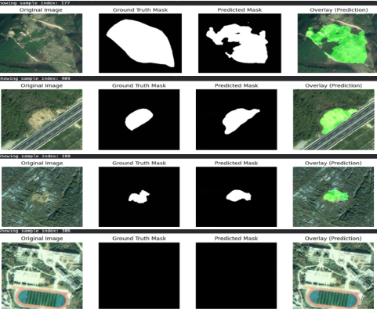
Orignal Image: The raw satellite image used as input for landslide segmentation.
Ground Truth Mask: The manually annotated mask indicating the actual landslide region.
Predict Mask: The segmentation mask generated by the trained Attention U-Net model.
Overlay Prediction: The predicted mask overlaid on the original image to visually compare model accuracy.
Fig_no:1.1 shows the comparison between the original satellite images, ground truth masks, and the landslide regions predicted by our model. The overlays highlight how accurately the model identifies and segments the landslide areas across different terrains.

Slide 18
DESIGN & DEVELOPMENT
1. The segmentation process used by the system is based on deep learning.
1.1 Input pictures (256×256) with 6 channels: R, G, B, NDVI(Normalize Difference Vegetation Index), Slope, Elevation.
1.2 Attention U-Net architecture developed with:
1.3 Encoder for feature extraction
1.4 Decoder for mask reconstruction
1.5 Attention Gates to emphasize landslide fetures.
1.6 A binary mask that distinguishes between landslide and non-landslide pixels is the output.
2. Model Design
2.1 TensorFlow/Keras was used in construction.
2.2 Convolution layers with ReLU activation.
2.3 Attention blocks combined with skip connections enhances feature concentration.
2.4 Class imbalance is addressed by the (Dice + BCE) Loss
2.5 Adam optimizer chosen for stable training.`
3.Dataset Processing & Preparation
3.1 Preprocessing includes:
i)NaN handling ii)Normalization of all channels,
3.2 Data was divided into two categories: validation (15%) and training (85%).
4. Development Steps
4.1 Implemented custom loss functions (Dice + BCE).
4.2 Precision, Recall, F1, Dice, and Pixel Accuracy are additional evaluation metrics.
4.3 Model trained for 45 epochs.
5. Production of Output
5.1 Pixel-level landslide segmentation masks are produced by the model.
5.2 The input, ground truth, and anticipated mask are visually compared.
5.3 Final masks are useful for hazard evaluation and early detection.

Slide 19
PSEUDOCODE/ALGORITHM
Landslide Segmentation Model Workflow
Input: RGB image (256×256) ; Output: Binary segmentation mask
Step 1: Data Preprocessing
1.1 Load landslide + non-landslide images.
1.2 Create masks (real masks for landslide, zero masks for non-landslide).
Step 2: Define Loss & Metrics
2.1 Loss: BCE + Dice Loss
2.2 Metrics: Precision, Recall, F1-Score, Dice Coefficient, Pixel Accuracy
Step 3: Build U-Net Architecture
3.1 Encoder: Conv → BatchNorm → ReLU → MaxPool
3.2 Attention Gates: refine skip connections
3.3 Decoder: Upsample → Concatenate → Conv blocks
3.4 Output: 1×1 Conv + Sigmoid for binary mask.
Step 4: Model Training
4.1 Optimizer: Adam (lr = 1e-4)
4.2 Train for 45 epochs, batch size 8
4.3 For each epoch:
Train on batches → compute loss
Validate → compute metrics
Save best model based on F1-Score
Step 5: Model Output
5.1 Predicted segmentation mask (landslide area)
5.2 Best model weights (best_unet.pth)
Extracts features and reduces spatial dimension.
Refine skip connections by filtering important encoder features before passing them to the decoder.
Rebuilds spatial resolution and predicts fine boundaries (“Rebuilding with Prediction”)
Produces a binary segmentation mask (landslide vs. background).

Slide 20
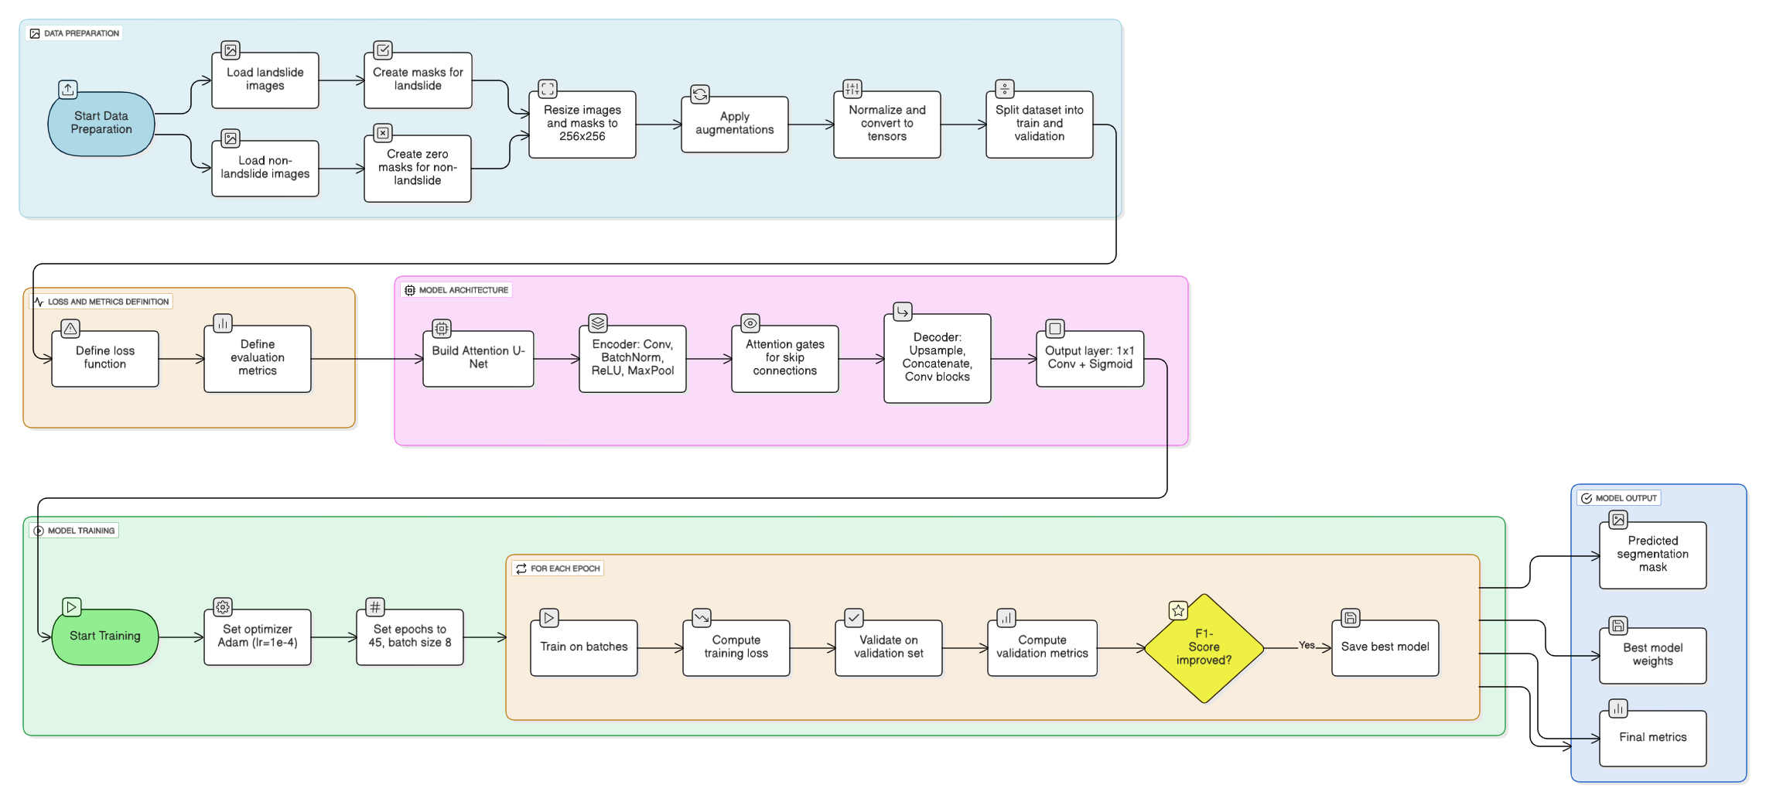
FLOW DIAGRAM FOR PSEUDO CODE
Fig.1 Flow diagram of the Pseudo code / algorithm

Slide 21
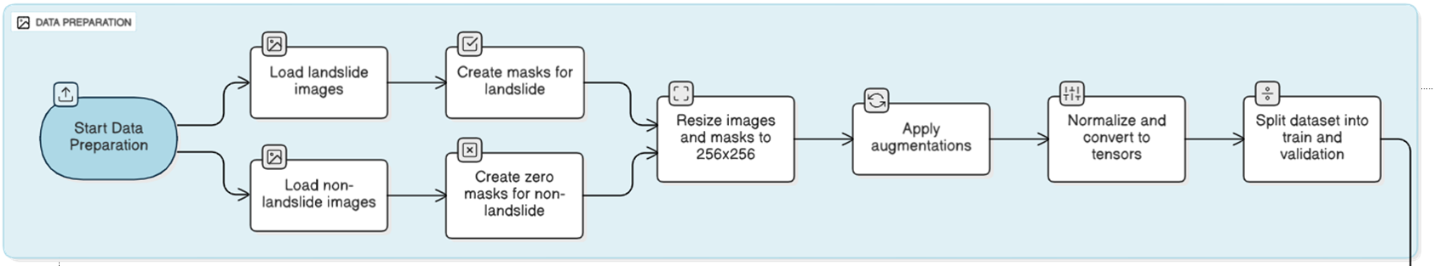
FLOW DIAGRAM FOR PSEUDO CODE

Slide 22
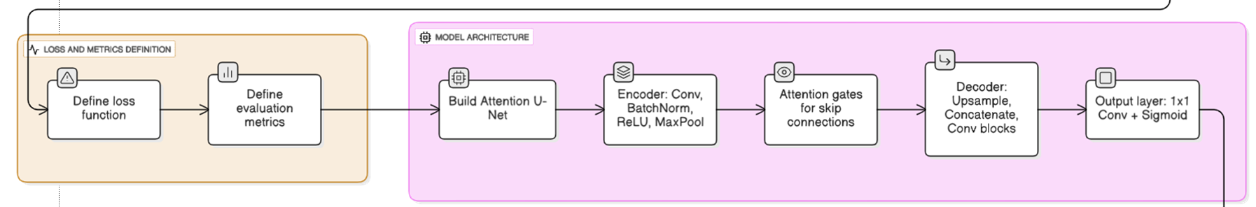
FLOW DIAGRAM FOR PSEUDO CODE

Slide 23
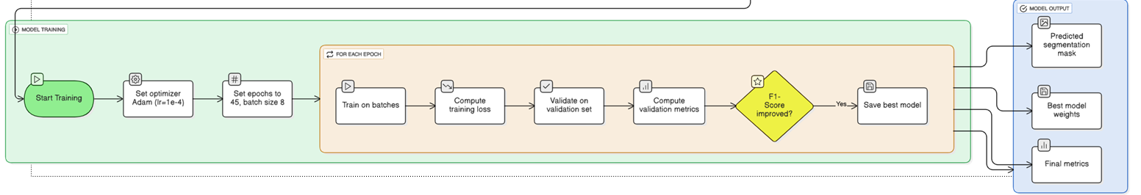
FLOW DIAGRAM FOR PSEUDO CODE

Slide 24
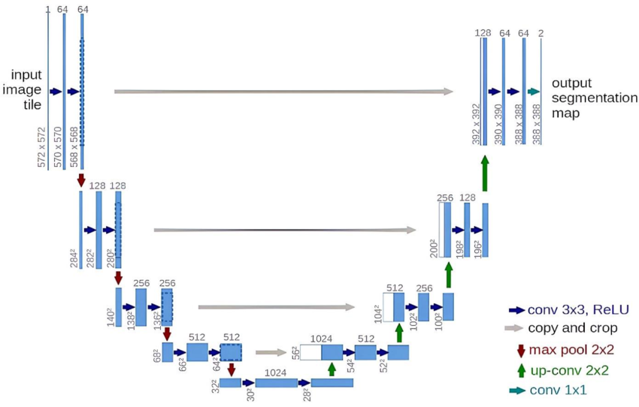
U-NET ARCHITECTURE FOR THE MODEL

Slide 25
DESCRIPTION OF THE GENERAL U-NET ARCHITECTURE
Input Image: The process starts with a 2D image. At this stage, the model does not know anything about the target regions.It only recives the raw image and start extravting useful visual patterns.
Encoder (Feature Extraction): The encoder is responsible for learning meaningful features from the input image. Each encoder block performs:
Two 3×3 Convolutions + ReLU → captures important patterns such as edges, textures, shapes, and intensity variations.
Max-Pooling (2×2) → reduces spatial size but increases feature depth, helping the model learn more complex and abstract features.
Bottleneck: This is the core part of the model where all extracted features are combined. Here, the model forms a deep understanding of:
Which regions appear consistent or stable?
which regions have patterns similar to the target region?
Decoder (Reconstruction & Localization): The decoder gradually rebuilds the image resolution and localizes the exact target region It performs:
Upsampling (×2) → increases spatial size
Skip Connections → bring back fine details lost during downsampling
Concatenation → merges encoder features with decoder features
3×3 Convolutions + ReLU → refine boundaries and restore spatial details
Output: A final 1×1 convolution reduces the feature maps to the number of output classes (usually 1 or 2).

Slide 26

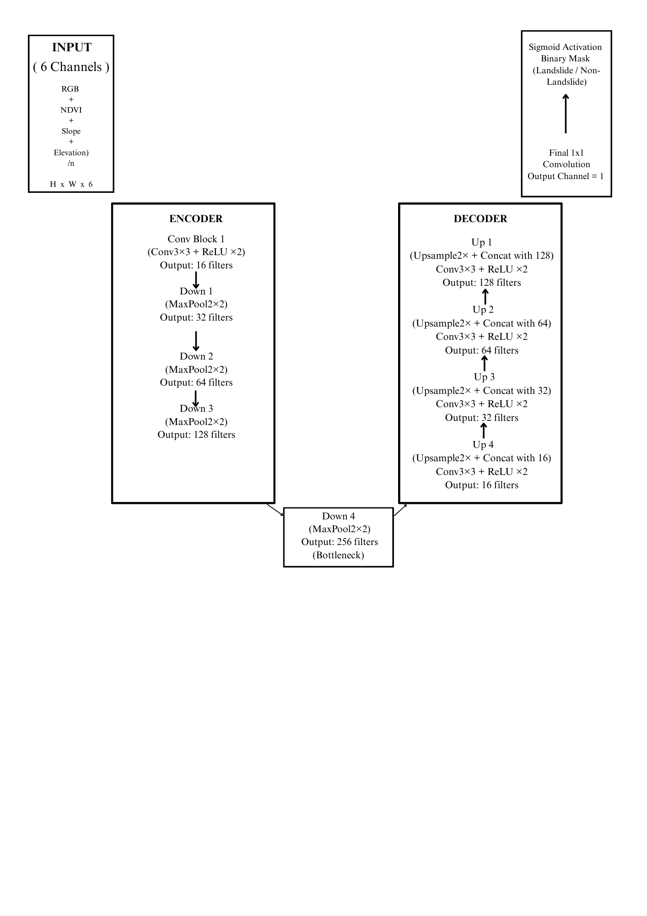
ATTENTION U-NET ARCHITECTURE FOR THE MODEL
Down Sampling
Up Sampling

Slide 27

DESCRIPTION OF ATTENTION U-NET ARCHITECTURE FOR THE MODEL
1. Input Image (H × W × 6):
Model takes 6 channels: RGB + NDVI + Slope + Elevation.
Extra channels help detect patterns like vegetation loss, slope steepness, and soil changes linked to landslides.
2. Encoder – Feature Extraction:
Gradually reduces image size while increasing feature depth.
Each block performs:
Two 3×3 Convolutions + ReLU → learns color changes, cracks, soil textures.
2×2 MaxPooling → captures larger terrain structures.
Filter progression:
16 → 32 → 64 → 128
3. Bottleneck Layer (Deep Feature Zone):
256 filters
Captures the most abstract features:
Bare soil exposure
Vegetation loss
Slope failure patterns
Debris texture indicators

Slide 28
DESCRIPTION OF ATTENTION U-NET ARCHITECTURE FOR THE MODEL
4. Decoder – Reconstruction:
Gradually restores image resolution.
Uses:
Upsampling ×2
Skip Connections to recover fine details
Concatenation with encoder features
3×3 Convolutions + ReLU
Filter progression:
128 → 64 → 32 → 16
Produces clean, sharp landslide boundaries.
5. Output Layer:
1×1 Convolution + Sigmoid
Generates a binary mask:
1 = Landslide pixel
0 = Non-landslide pixel

Slide 29
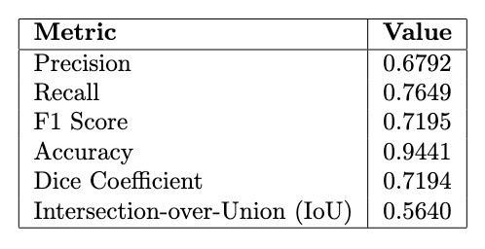
RESULT & OUTCOME
Aspect Evaluated | Observation / Discussion
Training Behavior | Training loss dropped steadily from 0.70 to 0.10, showing the model learned features effectively without instability.
Validation Behavior | Validation loss reduced from ~0.67 to ~0.19 across epochs, indicating that the model generalized well and avoided overfitting.
Precision Trend | Precision improved from ~0.26 in early epochs to peaks of ~0.72, meaning fewer false positives as training progressed.
Recall Trend | Recall reached as high as ~0.80, showing that the model became effective at detecting most landslide pixels.
F1-Score Performance | The best F1-score achieved was ~0.685, demonstrating a strong balance between precision and recall for this dataset.
Model Quality | Attention U-Net produced smoother boundaries and clearer segmentation compared to the vanilla U-Net version, especially in complex terrain.
Visual Evaluation | Overlay results showed that the model accurately highlighted landslide regions, especially where soil exposure or slope patterns were clear.
Table no. 1.1 : This table summarizes the model’s training and validation behavior, precision–recall trends, F1-score performance, and visual quality, showing how the Attention U-Net improved accuracy, reduced losses, and produced clearer landslide segmentation results.

Slide 30
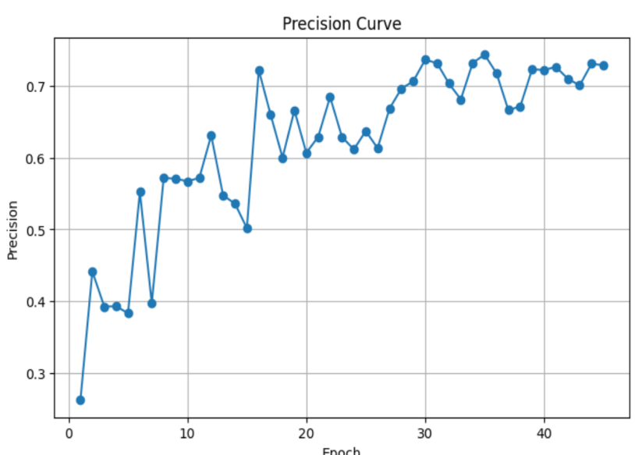
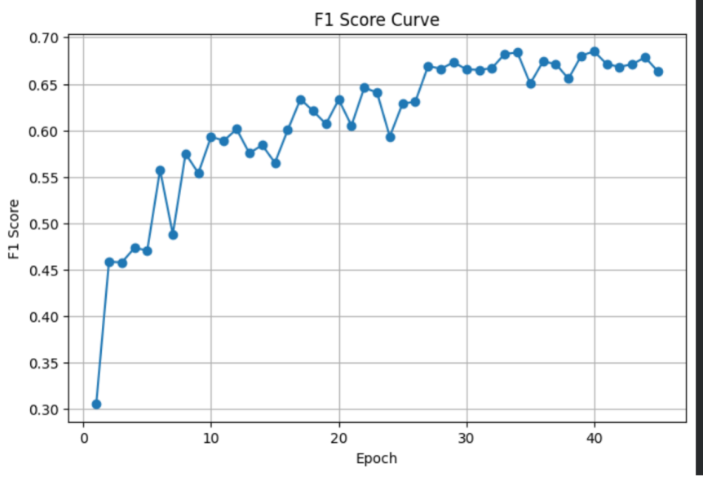
GRAPHICAL REPRESENTATION
Fig:5 Graphical representation of the Precision Curve: The precision steadily rises from about 0.28–0.35 in early epochs to roughly 0.70–0.73 by the end, with some mid-training oscillations; this shows the model progressively makes fewer false-positive pixel predictions as training proceeds, indicating improved confidence in predicted landslide pixels while still experiencing short-term variability during learning.
Fig: 5.22 Graphical representation of the F1 Score Curve F1 Score Curve: The F1 score climbs from ≈0.30 to ≈0.66–0.68 across epochs, following a generally smooth upward trend; this improvement reflects a balanced gain in both precision and recall over training, with the curve’s later plateau suggesting the model is approaching its best trade-off between false positives and false negatives

Slide 31
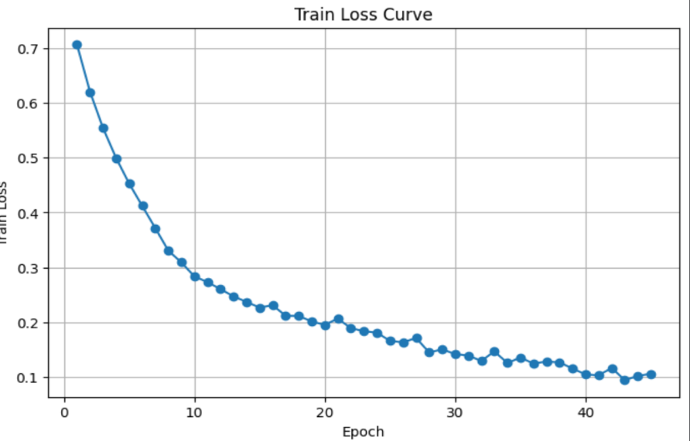
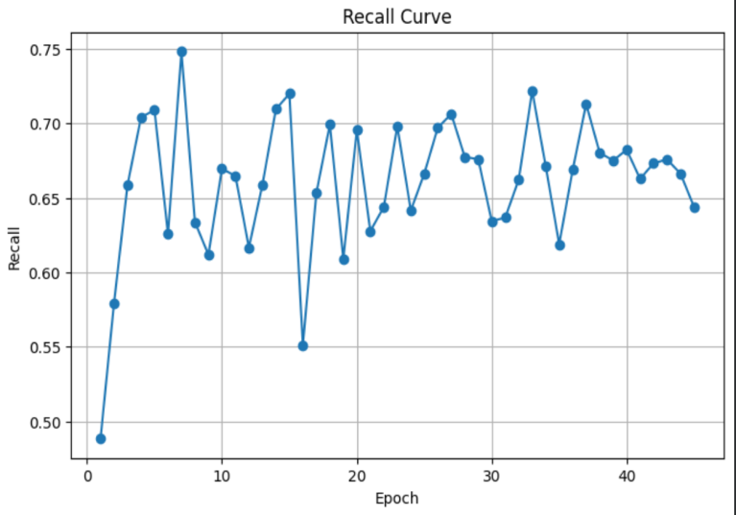
Fig: 5.5 Graphical representation of the Train Loss Curve: Train Loss Curve: Training loss decreases smoothly and monotonically from about 0.7 down to ~0.10 by the final epochs, showing consistent learning and weight updates; the gap between train and validation loss is small in later epochs, which supports that training is stable and the model is not severely overfitting.
Fig: 5.3 Graphical representation of the Recall Curve Recall Curve: Recall rises quickly in early epochs then fluctuates between about 0.55 and 0.72 throughout training, showing the model often succeeds in finding true landslide pixels but remains somewhat unstable in consistently capturing all positive pixels—this variability means the model sometimes trades off detection sensitivity for fewer false positives.

Slide 32
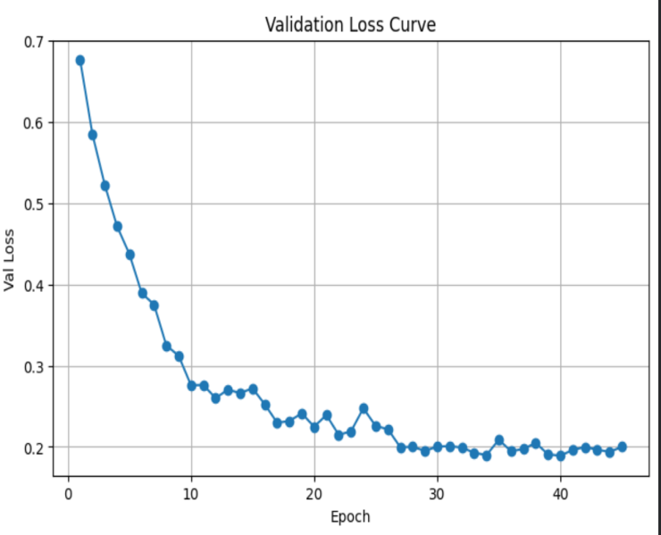
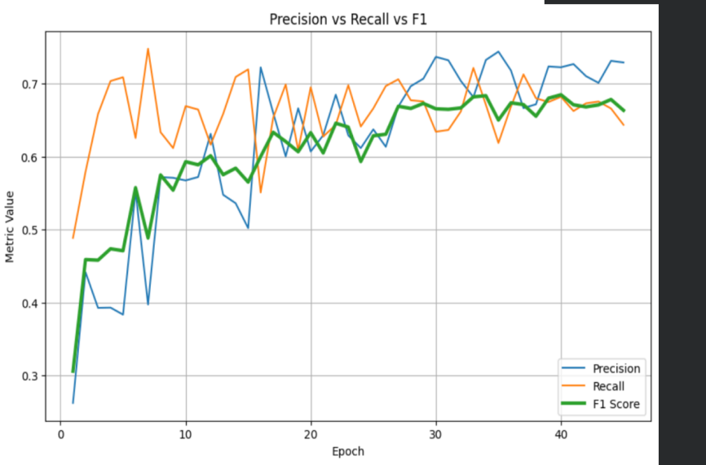
Fig: 5.4 Graphical representation of the Validation Loss Curve: Validation Loss Curve: Validation loss drops sharply from ~0.68 to ~0.25 within the first 10 epochs and then slowly declines and stabilizes around ~0.18–0.22, indicating rapid early learning and then steady convergence with no large late increases — a sign the model is generalizing well to unseen validation data rather than overfitting.
Fig: 5.6 compararive analysis Graphical representation of the Precision curve, F1 Score Curve and Recall : Precision vs Recall vs F1 Comparison Curve: The combined plot shows precision (blue), recall (orange) and F1 (green) beginning apart but converging toward ~0.65–0.72 in later epochs; this convergence indicates the model’s metrics are harmonizing (better balance between identifying true landslides and avoiding false alarms), with F1 tracking between precision and recall as the balanced summary metric

Slide 33
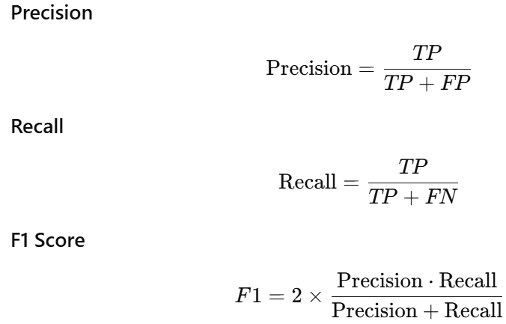
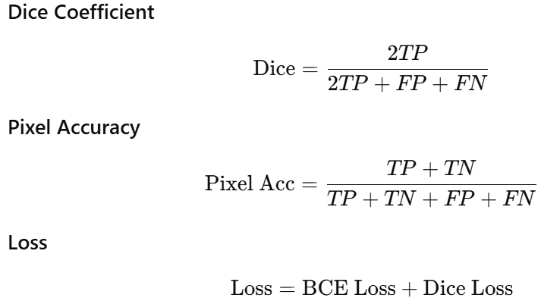
DISCUSSION
TP - True Postive
TN-True Negative
FP- False Positive
FN-False Negative

Slide 34
DISCUSSION
Precision
Precision tells how many of the pixels that the model predicted as object were actually correct.
It measures the model’s accuracy in positive predictions, meaning it shows how few false alarms the model makes.
Recall
Recall tells how many of the actual object pixels the model successfully detected.
It measures the model’s ability to find all relevant pixels without missing anything.
F1 Score
F1 Score gives a single value that balances both precision and recall.
It shows the overall performance of the model when one metric is high and the other is low.
Dice Coefficient
Dice score measures how much the model’s predicted mask overlaps with the ground-truth mask.
Higher Dice means the model’s segmentation is more accurate and similar to the real shape.
Pixel Accuracy
Pixel Accuracy shows the percentage of total pixels (object + background) that the model labeled correctly.
It reflects overall pixel-level correctness across the entire image.
Loss
Loss represents how much error the model is making while learning.
Lower loss means the model is improving and predicting closer to the ground truth.

Slide 35
LIMITATION & FUTURE SCOPE
Image Quality Dependency: Better preprocessing is required to handle lower-quality photographs because the model works well with clear, high-resolution images but struggles with fuzzy, dark, or low-resolution photos. Challenging Terrain Impact: Expanding training data to cover these difficult conditions increases accuracy since rocky, snowy, or heavily forested terrain might lead to misclassifications because of their visual resemblance to landslides. Training Data Diversity: The variety of landslide types in the training set determines how effective the model is, highlighting the significance of including more varied landslide events and surroundings for improved generalization. Computational Resource Needs:High-performance GPUs are necessary for fast predictions, rendering the model slow on low-end devices, which calls for optimization to lower computing needs and allow deployment on resource-limited hardware. Surface-Only Detection Limitations:Detection is limited to visible landslides on the surface, so incorporating additional data sources is crucial to find early warning indications and subsurface movements not recorded by the model.

Slide 36
GANTT CHART
ACTIVITY | TIMEFRAME
 | Aug 2025 |  |  | Sep 2025 |  | Oct 2025 |  |  | Nov 2025 |  |  |  | Dec 2025
Literature Survey
Problem defination and solution startergy
Data collection
Implementation
Testing and Validation
Documentation
Activity Proposed
Activity Completed

Slide 37
REFFERENCES
[1] S. R. Meena, L. P. Soares, C. H. Grohmann, C. van Westen, K. Bhuyan, R. P. Singh, M. Floris, and F. Catani, “Landslides,” Landslides, vol. 19, pp. 1209–1229, 2022, doi: 10.1007/s10346-022-01861-3.
[2] C. Fang et al., “Landslide detection using remote sensing techniques,” Remote Sensing, vol. 14, 2022, doi: 10.3390/su142416311.
[3] L. P. Soares, H. C. Dias, and C. H. Grohmann, “Deep-learning-based landslide mapping,” Multimedia Tools and Applications, 2024, doi: 10.1007/s11042-024-19454-8. [4] G. Li, K. Li, G. Zhang, K. Pan, Y. Ding, Z. Wang, C. Fu, and Z. Zhu, “A landslide area segmentation method based on an improved UNet,” Scientific Reports, vol. 15, p. 11852, 2025, doi: 10.1038/s41598-025-94039-5. [5] O. Ghorbanzadeh, T. Blaschke, K. Gholamnia, S. R. Meena, D. Tiede, and J. Aryal, “Evaluation of Different Machine Learning Methods and Deep-Learning Convolutional Neural Networks for Landslide Detection,” Remote Sensing, vol. 11, no. 196, pp. 1–21, 2019, doi: 10.3390/rs11020196.

Slide 38
ACKNOWLEDGEMENT
We sincerely thank everyone who supported us throughout our Major Project, “Landslide Detection using Deep Learning Models.” Our heartfelt gratitude goes to Mrs. Sonam Lhamu Bhutia for her constant guidance, encouragement, and valuable suggestions, which shaped our work from start to finish.
We are deeply thankful to Dr. Biswaraj Sen, Head of the IT Department, SMIT, for providing a positive academic environment and continuous support. We also appreciate the Project Coordinators and all faculty and staff of the IT Department for their help, direction, and encouragement throughout the project.
We gratefully acknowledge the constructive feedback from both internal and external examiners, which helped us refine our work.
Finally, we thank everyone who directly or indirectly contributed to the successful completion of this project.

Slide 39
THANK YOU

