Slide 1

Major Project Synopsis Presentation on
“Landslide Detection using Deep Learning Model”
Submitted by:
Vineet Patel (202200530) Pratham Mir Dutraj (202200521)
Under the Supervision of
DEPARTMENT OF INFORMATION TECHNOLOGY SIKKIM MANIPAL INSTITUTE OF TECHNOLOGY
Majitar, Rangpo, East Sikkim-737136
Sonam Lhamu Bhutia
Assistant Professor

Slide 2

CONTENT
sno | Title
1. | Abstract
2. | Introduction
3. | Types Of Landslide
4. | Literature Survey
5. | Problem Definition
6. | Objective
7. | Solution Strategy
8. | Methodology
9. | Dataset Description
10 | Hardware and Software Requirements
11. | Gantt Chart
12. | References

Slide 3
ABSTRACT
Landslides are highly destructive natural disasters that threaten lives, infrastructure, and the environment. This project implements a deep learning-based approach for landslide classification using a .noy format dataset containing remote sensing and terrain features. A Convolutional Neural Network (CNN) model was trained and evaluated, with performance measured through accuracy, precision, recall, and F1-score. The results highlight the effectiveness of deep learning in improving landslide classification and supporting early warning systems.

Slide 4
INTRODUCTION
Landslides are destructive hazards causing loss of life, property damage, and environmental disruption.
Triggers include rainfall, earthquakes, deforestation, and urbanization in hilly regions.
Traditional survey methods are slow, labor-intensive, and unsuitable for large-scale analysis.
Deep learning (CNN) with remote sensing & terrain data provides scalable and accurate classification.
This project uses .npy geospatial data + CNN, evaluated with Accuracy, Precision, Recall, and F1-score.

Slide 5
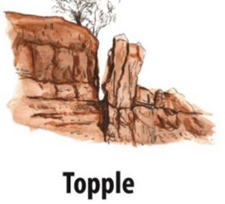
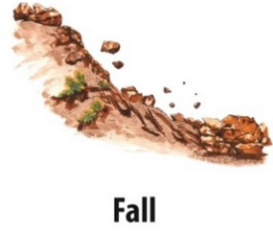
TYPES OF LANDSLIDE
Forward tilting/rotation of rock or soil blocks.
Often caused by undercutting, water seepage, or overhangs.
Sudden free fall of rock/soil from steep slopes or cliffs.
Very fast & destructive; accumulates as talus at slope base.

Slide 6
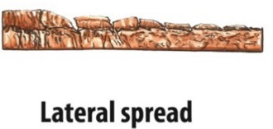
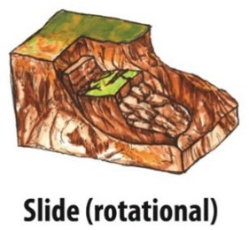
Horizontal movement of ground over weak/liquefied layers.
Damages infrastructure in flat, waterlogged terrains.
Downslope movement along curved or planar slip surfaces.
Triggered by rainfall, earthquakes, or human activity.

Slide 7
LITERATURE REVIEW
Author Name, Journal Name, Vol, Page, Year | Title of the Paper | Inference | Relevance with the present work /Motivation | Research Gap
Author Name, Journal Name, Vol, Page, Year : (1) Payal Varangaonkar, S.V. Rode, Multimedia Tools and Applications, 2024 | Landslide Prediction with Severity Analysis Using Efficient Computer Vision and Soft Computing Algorithms | The paper proposes a novel framework integrating preprocessing, dynamic feature extraction, and classification methods (ANN, SVM) to predict landslides and analyze severity from hyperspectral RS data. A dataset of 2713 samples from Goa and Maharashtra was developed for evaluation. | Relevant as it emphasizes ML driven prediction and classification for real-time landslide monitoring, similar to our work’s focus on classification-based forecasting. | Indian landslide datasets remain scarce, limiting scalability. Existing methods still rely heavily on handcrafted features and lack robust deep learning–based classification approaches, which may restrict generalization across diverse terrains..

Slide 8
Author Name, Journal Name, Vol, Page, Year | Title of the Paper | Inference | Relevance with the present work /Motivation | Research Gap
Author Name, Journal Name, Vol, Page, Year : (2) Y. Alimohammadlou, Landslide Process and Impacts, Vol. ? Page ?, 2013 | Landslide process and impacts: A proposed classification | Landslide impacts can be grouped into general and particular categories. | Understanding this impact-based classification helps frame the importance of categorizing landslides not just by type, but also by the nature of their consequences. It motivates considering consequences in your own work. | What constitutes “general” vs. “particular” impacts isn’t fully detailed; lacks definitions and examples.

Slide 9
PROBLEM DEFINITION
To automatically classify whether a given region (satellite image / geospatial data / soil data) is landslide-prone or not
To probe if AI models predict the likelihood of landslide occurrence based on terrain, soil, rainfall, and vegetation features
To check how accurate is manual classification, and how can AI improve on it in terms of speed and reliability

Slide 10
OBJECTIVE
To develop a deep learning-based binary classification model capable of distinguishing between landslide and non-landslide images.
To preprocess and prepare the landslide dataset by resizing, normalizing, and augmenting images for efficient training and testing.
To implement a suitable Convolutional Neural Network (CNN) architecture for automated feature extraction and classification of landslide imagery.
To evaluate the trained model using standard performance metrics such as accuracy, precision, recall, F1-score, and confusion matrix.

Slide 11
SOLUTION STRATEGY
Automated Classification – Use labeled landslide & non-landslide images with CNNs for binary classification.
Data Preprocessing – Resize, normalize, and augment images to improve model performance.
Multi-Feature Integration – Combine imagery with geospatial features (slope, soil, vegetation) for richer learning.
Higher Accuracy – Evaluate with accuracy, precision, recall, F1; outperform manual methods in speed & consistency.

Slide 12
METHODOLOGY
1.Problem Definition
Detect landslides from satellite/ground images
Formulated as a binary classification problem
2. Dataset Collection
Gather labeled images (landslide / non-landslide)
3. Preprocessing
Resize images to fixed size
Normalize pixel values
Data augmentation (rotation, flipping, cropping)
4. CNN Model
Pretrained CNN (ResNet50, EfficientNet)
ViT
5. Training & Validation
Steps: input image, Forward Pass, Loss Calculation, Backpropagation, Repeat
After every epoch, model is tested on validation set
6. Evaluation
Metrics: Accuracy, Precision, Recall, F1-Score
Ensures robustness of model
7. Outcome
Automated system for landslide detection
Supports hazard monitoring & risk management

Slide 13
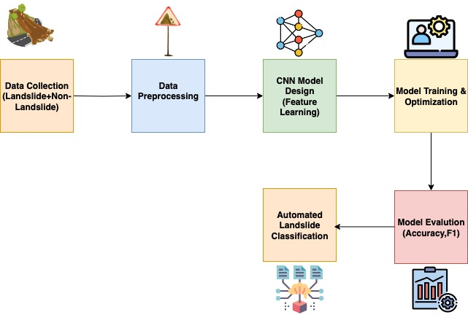
Fig.2
Block diagram of methodology

Slide 14
DATASET DESCRIPTION
DATASET LINK : https://www.kaggle.com/datasets/gauravduttakiit/classification-for-landslide-detection
DATASET NAME : Classification for Landslide
(Total number of images present in this folder: 12,544)
Total Size 4.93 GB
IMAGE SIZE :
Each image is standardized to 256 × 256

Slide 15
HARDWARE & SOFTWARE REQUIREMENTS
Hardware Requirements
Processor (CPU): Intel/AMD , with support for GPU acceleration
GPU: High performance GPU (e.g., NVIDIA and RYZEN ); integrated GPU sufficient for basic tasks.
RAM: 8 GB (min), 16 GB or more (recommended for handling large HDF5 datasets smoothly).
Storage: 256 GB SSD (min), with cloud storage integration (e.g., Google Drive).
Software Requirements
Operating System: Windows, Linux-based (e.g., Google Colab). Programming
Environment Libraries & Frameworks: Python (installed via Colab).
Machine Learning: TensorFlow (for CNN models), architecture U-Net NumPy, Pandas, Matplotlib.
Image Processing: h5py (for HDF5 handling), glob (for file management). Data Handling & Visualization: Matplotlib .
IDE / Tools: Google Colab, with Google Drive mounting for data access.
Package Manager: pip (for installing TensorFlow and Matplotlib).
Version Control: Git/Github

Slide 16
GANTT CHART
ACTIVITY | TIMEFRAME
 | Aug 2025 | Sep 2025 |  | Oct 2025 | Nov-Dec 2025
Literature Survey
Problem defination and solution startergy
Data collection and preprocessing
Devlopment of Model
Testing and Validation
Documentation
Not Completed
Completed

Slide 17
REFERENCES
(1)Varangaonkar, P., & Rode, S. V. (2024). Landslide prediction with severity analysis using efficient computer vision and soft computing algorithms. Multimedia Tools and Applications. DOI: 10.1007/s11042-024-19454-8
(2) Y. Alimohammadlou, Landslide Process and Impacts, (2013 ).Landslide process and impacts: A proposed classification DOI: 10.3390/su142416311

Slide 18
THANK YOU

