Slide 1
KERNELGUARD
Adaptive eBPF-Driven Behavioral Malware Detection Using Real-Time Kernel Telemetry and Graph Learning
KERNELGUARD
1

Slide 2


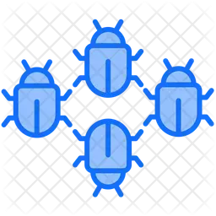
MOTIVATION
Malware Has Outgrown Static Defenses
Modern attacks execute in memory, encrypt data in seconds, and mutate their own code — defeating byte-pattern matching before an analyst ever sees a file.
Fileless Malware
Ransomware
Polymorphic Malware
Runs in-memory only
Seconds to encrypt
Rewrites its own code
Runs entirely within a process's address space — no binary ever touches disk for a scanner to catch.
Encrypts user data within seconds of execution, leaving no window for signature-based response.
Regenerates its code structure on every infection, defeating hash- and byte-pattern detectors.
Signature-based and static analysis pipelines are structurally unable to keep pace with this rate of mutation.
KERNELGUARD
2

Slide 3



RELATED WORK
Runtime Monitoring Trades Off Observability vs. Overhead
Kernel-Module Sensors
User-Space Hooking
High overhead
Blind spots
Full system-call interposition gives rich telemetry, but requires intrusive kernel patches and introduces non-trivial latency.
Lightweight to deploy, but blind to any activity that bypasses instrumented libraries or invokes syscalls directly.
eBPF tools (Falco, Tracee, Sysdig) prove the middle ground works — sandboxed, verifiable kernel programs with minimal per-event overhead. But most still rely on shallow rule-based or statistical scoring over individual events, not the deeper relational structure among system entities.
KERNELGUARD
3

Slide 4



OUR APPROACH
Introducing KernelGuard
An adaptive malware detection framework combining low-overhead eBPF kernel telemetry with hybrid graph-temporal representation learning.
01
02
03
Unified Kernel Telemetry
Hybrid GNN + Temporal Transformer
Adaptive, Interpretable Risk Scoring
Continuous, low-overhead collection via kprobes, tracepoints, LSM hooks, and XDP/TC — zero kernel modification, zero application instrumentation.
Sliding-window behavioral graphs jointly encoded to learn structural entity relationships and their evolution over time.
Reasons over syscall semantics and process lineage; explains every alert and recalibrates from analyst feedback.
KERNELGUARD
4

Slide 5
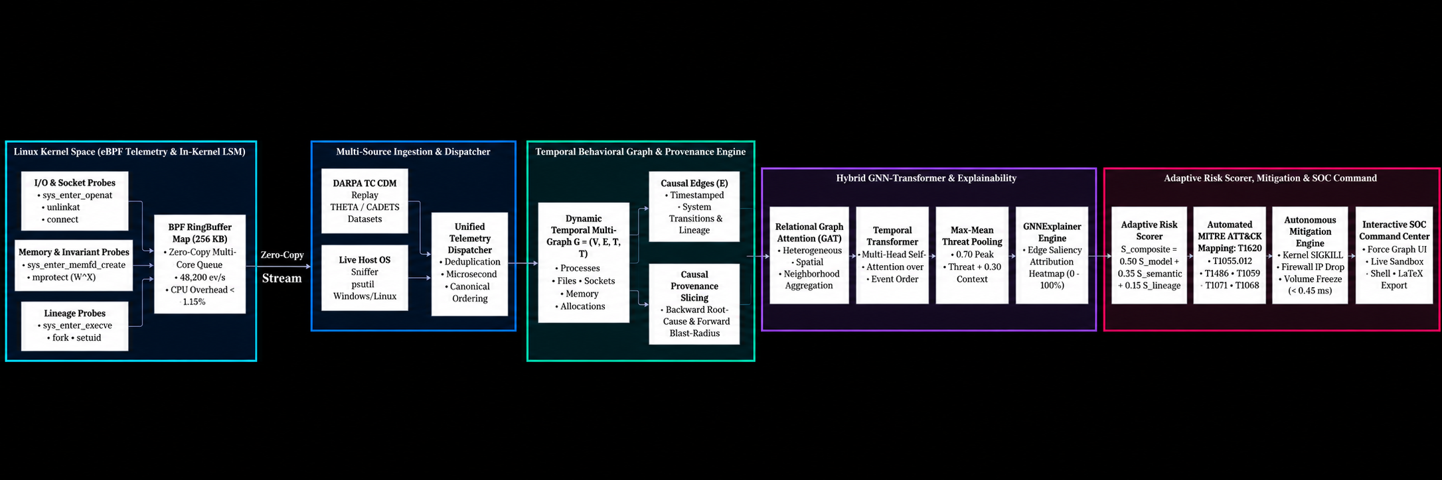


SYSTEM DESIGN
System Architecture
Reproduced from the project README — five stages, kernel telemetry to autonomous response.
1. Kernel Telemetry
2. Ingestion & Dispatch
3. Behavioral Graph
4. GNN + Transformer
5. Risk & Response
48,200 ev/s
< 1.15%
< 0.45 ms
Ring-buffer throughput
Kernel CPU overhead
Autonomous mitigation latency
Figures as labeled in the README's own architecture diagram, above. Full stage-by-stage walkthrough on the next slide →
KERNELGUARD
5

Slide 6


SYSTEM DESIGN
Architecture Explained, Stage by Stage
1 · Kernel Telemetry
Lineage probes (execve, fork, setuid), memory-invariant probes (memfd_create, mprotect) and I/O/socket probes (openat, unlinkat, connect) run in-kernel via eBPF and stream into a 256 KB zero-copy ring buffer built for multi-core throughput.
2 · Ingestion & Dispatch
A unified dispatcher merges the kernel ring-buffer stream with a live host-OS sniffer and replayed DARPA Transparent Computing datasets, de-duplicating events into one microsecond-ordered timeline.
3 · Behavioral Graph & Provenance
Events assemble into a dynamic temporal multi-graph of processes, files, sockets and memory. Causal provenance slicing traces backward to the root cause or forward to the full blast radius of any flagged node.
4 · Hybrid GNN-Transformer & Explainability
A Relational Graph Attention Network models spatial relationships between entities while a Temporal Transformer captures event order; max-mean pooling preserves sharp threat signals, and GNNExplainer renders an edge-saliency heatmap for every decision.
5 · Adaptive Risk Scoring & Response
A composite risk score blends model confidence with syscall-semantic and process-lineage signals, maps to MITRE ATT&CK techniques, and can trigger autonomous mitigation — process termination, IP blocks, volume freezes — surfaced live on the SOC dashboard.
Diagram & pipeline: github.com/i-mAshura/eBPF_KernelGuard (README)
KERNELGUARD
6

Slide 7


SYSTEM DESIGN
Four eBPF Hook Families, One Telemetry Layer
kprobes / kretprobes
Tracepoints
Instrument process- and memory-management functions: creation, termination, memory mapping, page-permission changes.
Capture system-call entry/exit and scheduler context-switch events with stable kernel ABI guarantees.
LSM Hooks
XDP / TC Hooks
Intercept privilege transitions, capability checks and file-access decisions at the exact point policy is enforced.
Capture network packet metadata at the earliest point in the receive/transmit path.
All four probe families write structured records into a shared per-CPU ring buffer — the high-throughput channel to user space.
KERNELGUARD
7

Slide 8
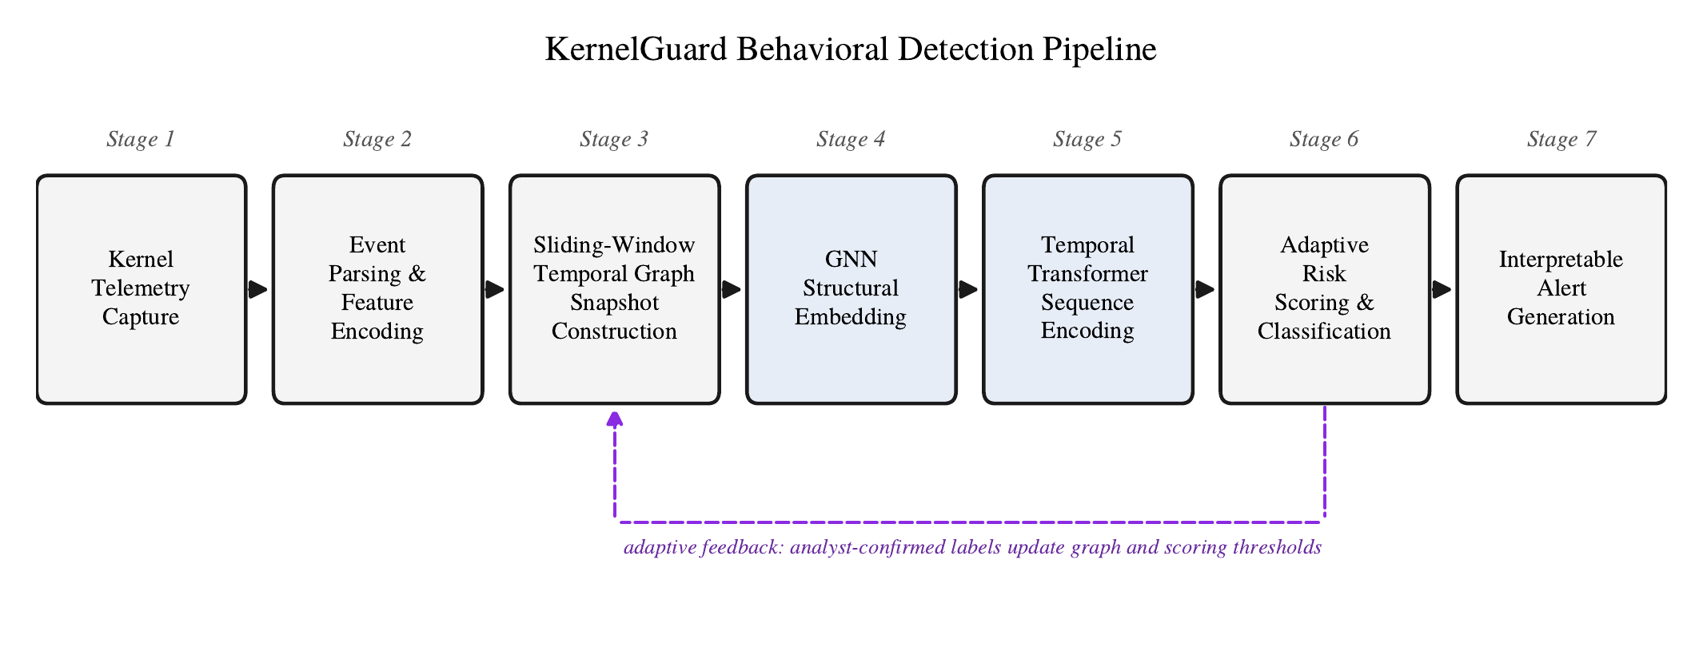
METHODOLOGY
End-to-End Detection Pipeline
Seven stages, kernel telemetry to interpretable alert — with a closed adaptive-feedback loop.
Analyst-confirmed labels continuously update the graph constructor and scoring thresholds.
KERNELGUARD
8

Slide 9
METHODOLOGY
Hybrid Graph Neural Network + Temporal Transformer
Structural Embedding (per snapshot)
Temporal Encoding (across snapshots)
A multi-layer Graph Attention Network aggregates each entity's neighborhood — processes, files, sockets, memory regions — into a learned embedding, weighting neighbors by attention rather than uniformly.
An attention-weighted readout compresses each window into a single graph-level vector zₜ. The full snapshot sequence z₁…zₜ passes through a Transformer applying multi-head self-attention, capturing long-range dependencies a single snapshot cannot see. A feed-forward head outputs a benign/malicious decision and malware-family estimate, trained end-to-end with weighted cross-entropy.
Ablation result: removing either component costs accuracy — structural and temporal modeling are complementary, not redundant.
KERNELGUARD
9

Slide 10


METHODOLOGY
Adaptive Risk Scoring & Explainability
Rₜ = β₁·P(malicious | zₜ) + β₂·Syscall-Semantic Score + β₃·Process-Lineage Score
Calibration weights β₁, β₂, β₃ initialize from validation-set optimization and adapt online from analyst feedback.
Syscall Semantics
Process Lineage
Explainability
Deviation from a per-process-image argument-distribution baseline flags anomalous behavior.
Anomalous ancestor–descendant relationships surface privilege abuse and living-off-the-land activity.
Attention weights and subgraph attribution show the analyst exactly which nodes and edges drove the score.
KERNELGUARD
10

Slide 11


EVALUATION
Experimental Setup
Dataset
Baselines Compared
Linux kernel 6.5 with eBPF/BTF, bare-metal and virtualized hosts
Labeled benign workloads: developer, office-productivity, server-admin tasks
Six malicious categories, vendor-consensus labeled: Ransomware · Fileless · Polymorphic · Rootkits · Trojans · Cryptominers
Temporal train/val/test split — no leakage between sessions of the same binary family
Test split is held out, zero-day style: no training-time family variant
Operational systems: Falco & Tracee (rule-based eBPF), Sysdig (statistical), Auditd + ML, ClamAV (signature)
Architecture ablations: GNN-only (no Transformer), LSTM syscall-sequence model
Feature baseline: Random Forest on handcrafted statistical features
Overhead reference: LiME + Volatility offline memory forensics
KERNELGUARD
11

Slide 12
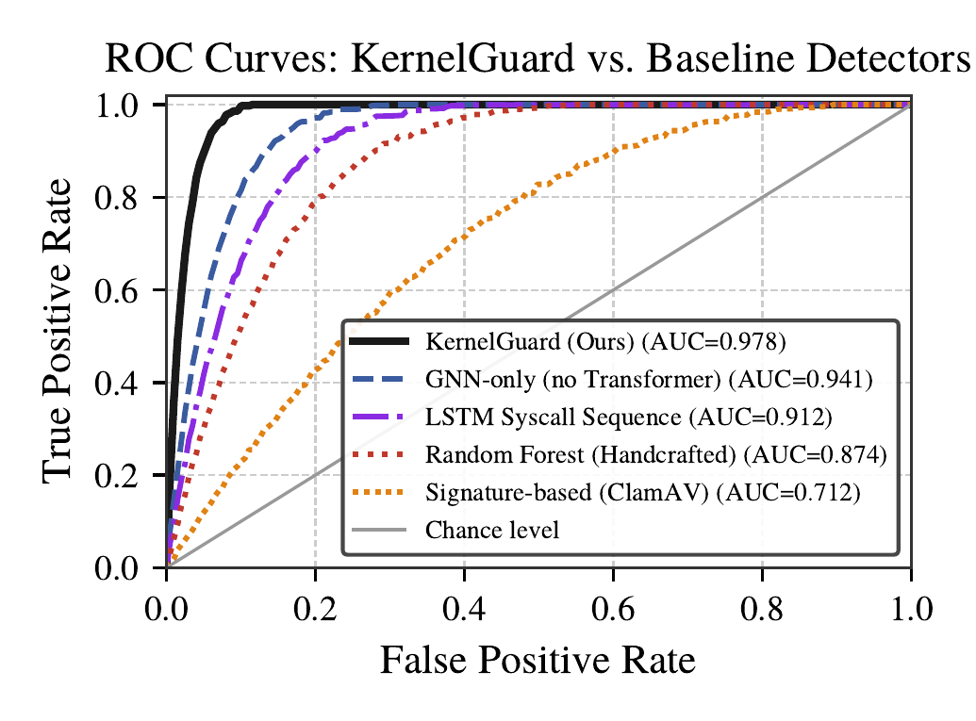
RESULTS
Overall Detection Performance
Highest accuracy, precision, recall, F1 and AUC-ROC among all compared systems.
97.4%
Method | Acc | F1 | AUC
KernelGuard (Ours) | 97.4 | 96.9 | 0.978
GNN-only | 94.5 | 93.4 | 0.941
LSTM Sequence | 91.6 | 90.0 | 0.912
Auditd + ML | 90.3 | 88.7 | 0.897
Random Forest | 87.9 | 85.8 | 0.874
ClamAV (Signature) | 71.2 | 66.9 | 0.712
Accuracy
96.9%
F1-Score
0.978
AUC-ROC
+6.0 pts accuracy over the strongest operational baseline (Auditd + ML). GNN-only ablation trails by 2.9 pts, LSTM-only by 5.8 pts — both components matter.
KERNELGUARD
12

Slide 13
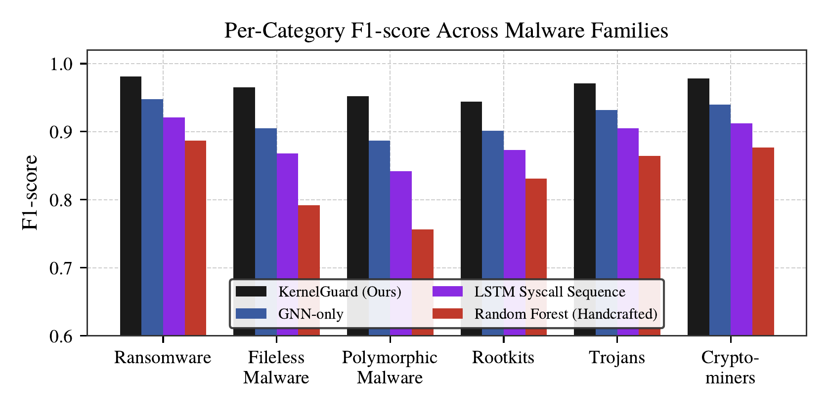
RESULTS
Behavioral Modeling Wins Where Static Signals Fail
Per-category F1-score across six malware families.
+19.6 pts
+17.2 pts
+11.3 pts
Polymorphic malware F1 gain over Random Forest
Fileless malware F1 gain over Random Forest
Rootkit F1 gain — the hardest category to separate from legit admin activity
KERNELGUARD
13

Slide 14
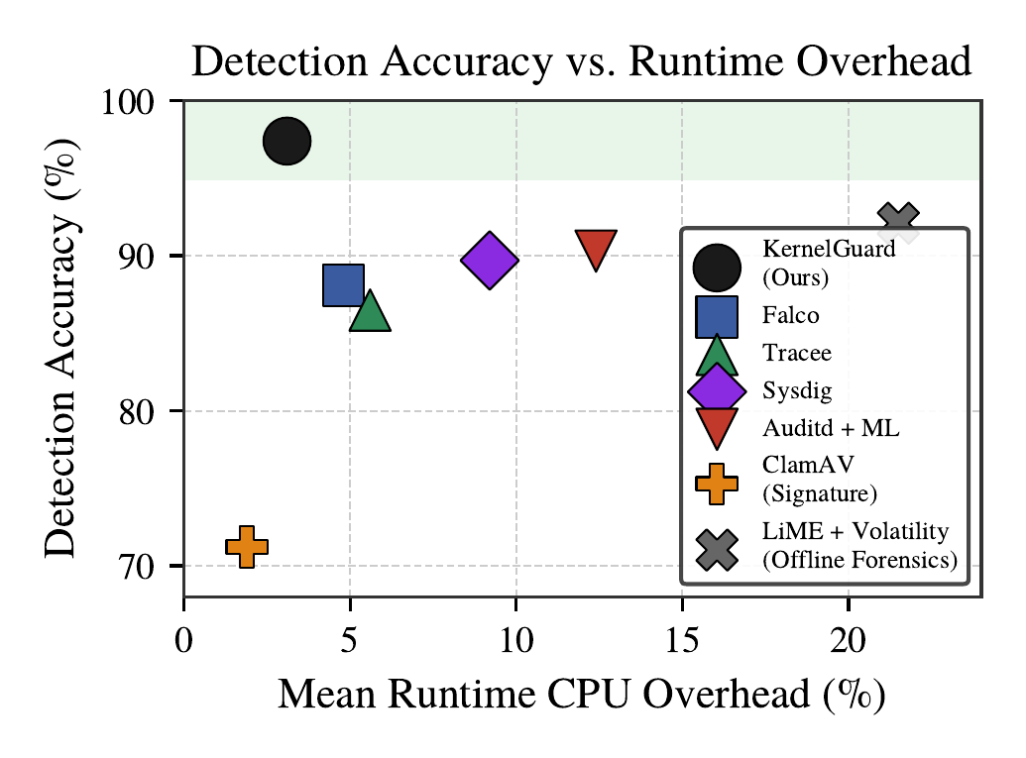

RESULTS
High Accuracy Without the Overhead
Runtime CPU overhead vs. detection accuracy — KernelGuard occupies the most favorable region.
3.1%
Mean CPU overhead — lower than every learned baseline except ClamAV
8.4 ms
Inference latency per sliding window
6×
Lower overhead than the offline LiME + Volatility forensics pipeline, at higher accuracy
KERNELGUARD
14

Slide 15
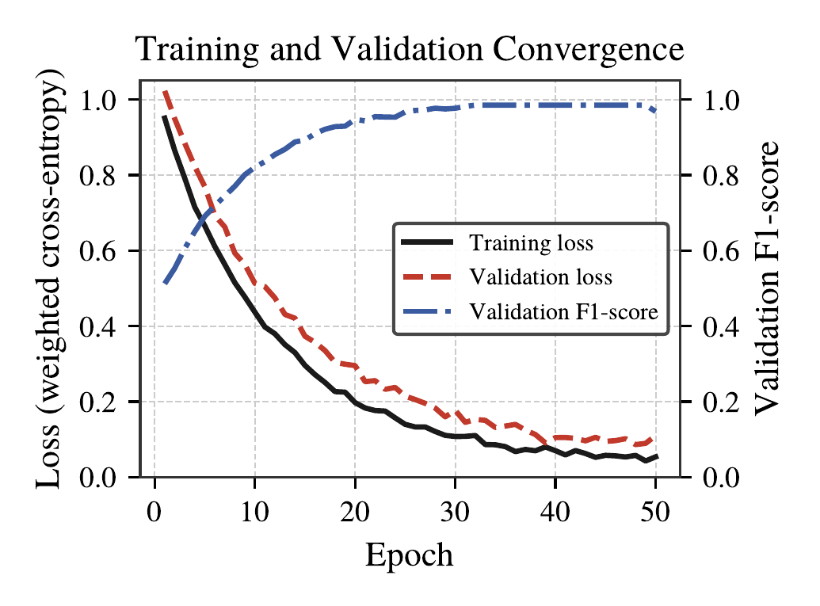

RESULTS
Training Convergence
Training/validation loss and validation F1-score across 50 epochs.
Limited overfitting
Validation loss tracks closely behind training loss under the weighted cross-entropy objective.
Early stopping at ~epoch 30
Validation F1-score stabilizes after roughly 30 epochs — the point used for all reported results.
KERNELGUARD
15

Slide 16

WRAP-UP
Conclusion & Future Work
What KernelGuard Delivers
Future Work
Kernel-level telemetry via eBPF, with zero kernel modification or application instrumentation
Temporal behavioral graphs jointly modeled by a hybrid GNN + Temporal Transformer
Adaptive, feedback-driven risk scoring with subgraph-level explainability for SOC analysts
Highest accuracy, precision, recall, F1 and AUC-ROC among all compared systems — at overhead competitive with the lightest rule-based monitors
Longitudinal production deployment to measure the adaptive feedback loop's effect on false-positive reduction over time
Cross-host graph correlation to detect lateral-movement campaigns invisible to single-host telemetry
Lightweight integrity-measurement signals to improve rootkit detection against privilege abuse that mimics legitimate administration
KERNELGUARD
16

Slide 17
Thank You
KERNELGUARD
17

