Slide 1
How We Build Software Here
A plain-language walkthrough, using the Tetris demo project as the real example

Slide 2
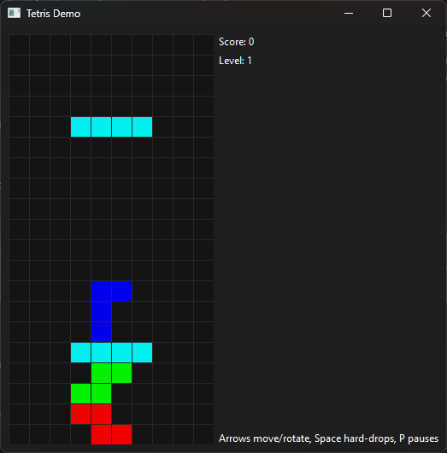
What We Built
A small, single-player Tetris game — not the point of the exercise. The game is just a real, working example to walk through the process on.
What actually matters here is everything that happened around the code: how the project was set up, reviewed, and shipped.

Slide 3
1. Starting a New Project
Every project starts as an empty folder on GitHub — nothing exists yet, not even a "main" version to compare changes against.
The very first save (called a "commit") goes directly onto the main version, just to get something there to build on.
After that one exception, every future change goes through a review process before it's allowed to join the main version.

Slide 4
2. Starting from a Shared Rulebook
New projects don't start from a blank page — they copy a shared template: a rulebook for how the team works, plus a set of automated checks.
Copying it isn't blind trust. Each project adapts the template to its own needs.
We even caught a mistake in the template itself: an old habit (a separate "findings log" file) the team had already replaced with something better on other projects, just not yet updated in the shared copy.
Lesson: a shared rulebook is a starting point, not gospel. Check it against how things are actually done today, and fix it when it's fallen behind.

Slide 5
3. Building Safely, on a Side Copy
All real work happens on a "branch" — a parallel, private copy of the project.
Nothing on that copy affects the real version until it's explicitly approved and merged in.
Before asking anyone to look at it, the work is tested locally first, using the exact same checks a robot reviewer will run later.

Slide 6
4. Asking for Review
A "Pull Request" is a formal request: please review this change before it becomes permanent.
Four automated checks have to pass: a style check, a security scan, the automated tests, and a basic "does it actually run" check.
An AI reviewer reads every change too, and leaves comments just like a human reviewer would.

Slide 7
5. The Review Loop
The first automated review found 7 issues — including one real bug: keyboard controls silently did nothing until you clicked the game window.
Every issue gets fixed, or gets a stated reason for not fixing it. Nothing is silently ignored.
A second review caught an outdated instruction left over from the shared rulebook.
A third review caught a genuine crash: following the setup instructions exactly as written would have failed with an error.
Each fix gets written down in a running notes file, so the same mistake doesn't get made twice on a future project.

Slide 8
Important: Quality Control Takes Time
Writing the actual game code took well under an hour.
Getting it fully reviewed and ready to merge took considerably longer — three rounds of review, each with a built-in wait (the AI reviewer's free plan allows one full review per hour).
This is normal, not a failure. Every single round caught something real.
Don't measure a task by "time to write the code" alone. Reviewing and fixing is just as much a part of the work, and it can take longer than the writing itself.

Slide 9
6. Merging — and Keeping the Trail
Once everything passes, the side copy is merged into the real version.
The side-copy branch is deliberately not deleted afterward.
Keeping it costs almost nothing, and it leaves a clear trail of exactly what changed and when, for later reference.

Slide 10
7. Marking a Version
Once a milestone is reached, it gets a version number — like v0.1.0 — attached to that exact point in the project's history.
This project's numbering: the first number is for breaking changes, the second for new features, the third for small fixes.
No automatic publishing happens when a version is marked here. It's purely a label: "this is what the project looked like at this point."

Slide 11
This Document Followed the Same Process
Even this write-up went through a side branch, a review, and a merge — no shortcut for "it's just documentation."

Slide 12
Glossary
Repo — the project's whole folder of files plus its complete history.
Branch — a private, parallel copy of the project used for one change at a time.
Commit — a saved snapshot of a set of changes, with a note on what and why.
Pull Request (PR) — a request to review and merge one branch's changes into another.
Merge — folding an approved branch's changes into the main version for good.
Tag — a permanent label marking one exact point in the project's history.
CI (Continuous Integration) — automated checks that run on every proposed change.
Linter / security scanner — tools that check code for style issues or risky patterns without running it.
CodeRabbit — the AI tool that automatically reviews every change and leaves comments, similar to a human reviewer.
Rate limit — a cap on how often a service can be used in a stretch of time.

