Slide 1
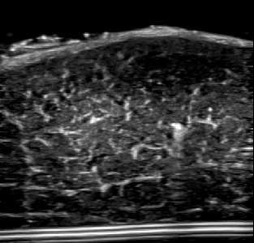

Binary Method
Needle
Needle
Shadow
Noise
Histogram Method

