Slide 1
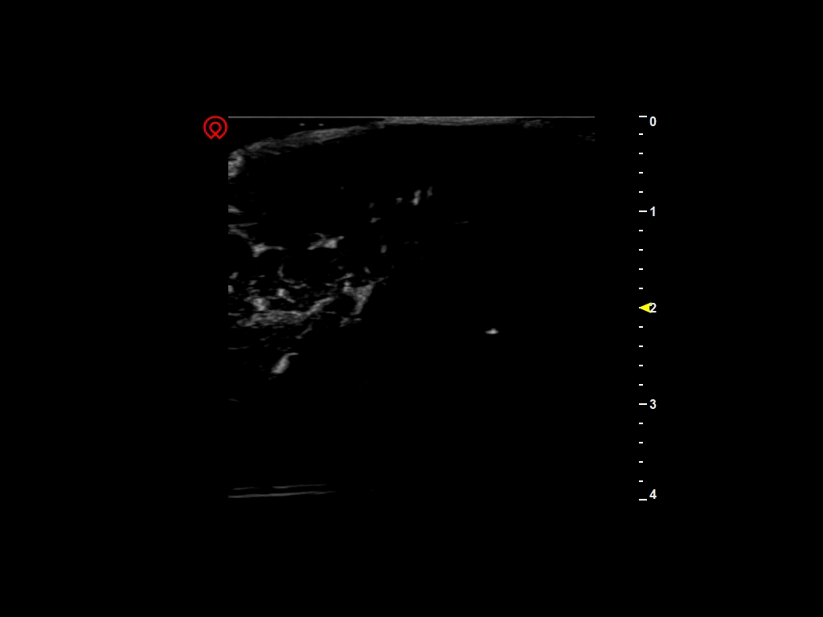
Binary Method
Needle
Needle
Histogram Method

