Slide 1
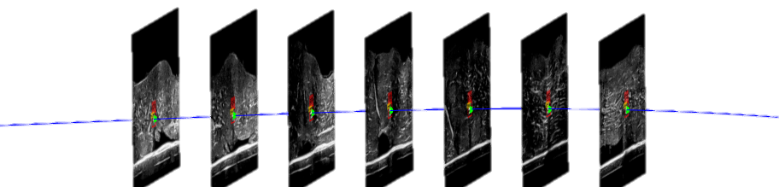
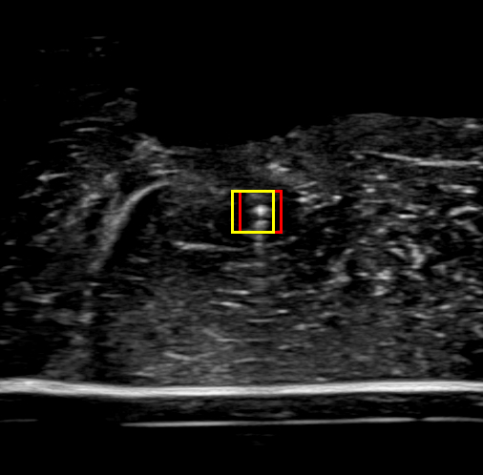
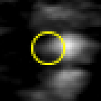
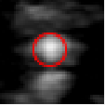





($x_{previous},y_{previous},z_{previous},{∆x}_{previous}$,$∆y_{previous}$,$∆z_{previous}$)
Prediction
($x_{prediction},y_{prediction},z_{prediction}$)
($I_{x_prediction}, I_{y_prediction}$)
Update
($I_{x_update}$,$I_{y_update}$)
($x_{m},y_{m},z_{m} ,{∆x}_{m},∆y_{m},∆z_{m}$)
($x_{c},y_{c},z_{c},{∆x}_{c}$,$∆y_{c}$,$∆z_{c}$)

