Slide 1
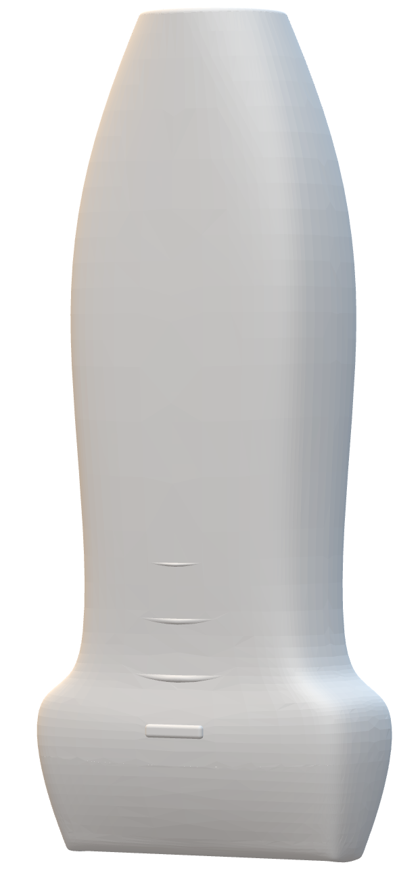
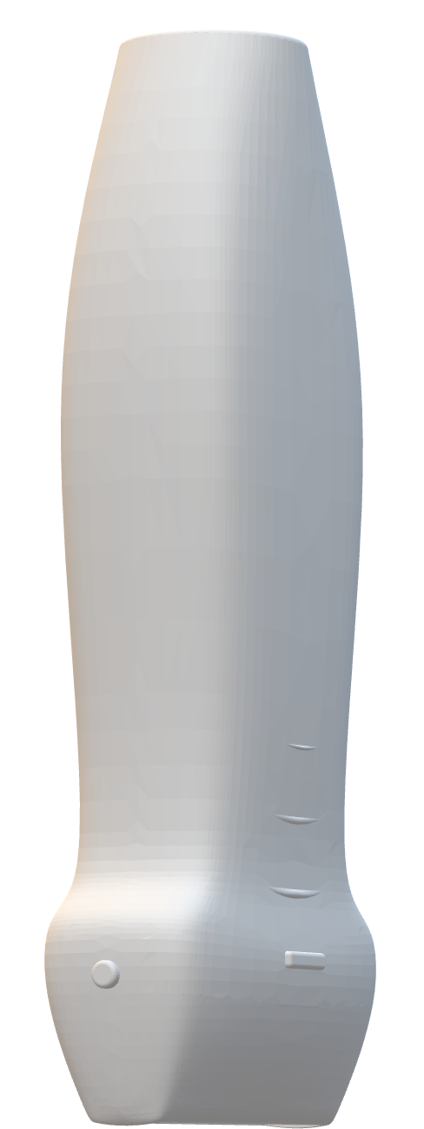
US Probe
Needle
Sagittal US Image
Transverse US Image

