Slide 1

QURU (Question Guru)
Members: Mohammad Usama & Muhammad Ahzam
Supervisor: Dr. Abdul Rehman Gilal
Co-supervisor: Miss Shafaq

Slide 2
Agenda
Problem Statement
Solution
Literature Review
Scope
Methodology
Dataset
Architecture
Challenges
Gantt Chart
Demo

Slide 3
Problem Statement
Instructors are involved in various activities
Such as teaching, management responsibilities, student counselling and their self-development
Spending Hours in making Questions papers for quizzes or exams
Keeping the busy scheduling in view, teachers could greatly be benefitted from an Automated Question Answering System

Slide 4
Solution
QURU
It will take content from you as input, and will give you questions and answers as output
Content
(Input)
QURU
(System)
Q/A
(Output)

Slide 5
Literature Review

Slide 6
Scope
Initially we are planning to create for only one Subject
Blockchain
We are intending to generate factual questions only
Example:
Content: Since 1934 , the sale of Federal Duck Stamps has generated $670million, and helped to purchase or lease 5,200,000 acres ( 8,100 sq mi ; 21,000 km2 ) of habitat .
Question: How much money has been generated due to the Duck Stamp act ?
Answer: $670 million

Slide 7
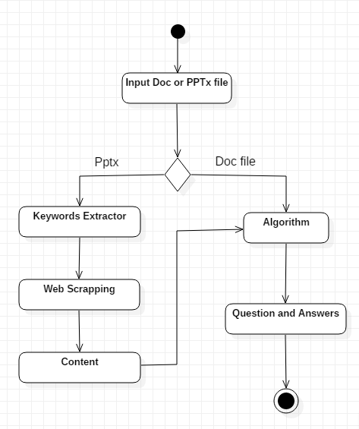
Methodology
Extracting content from slide.
PPTx (Python Library).
Extracting Keywords.
RAKE (NLP).
Web Scrapping.
Beautiful Soap.
For MCQs Distractors:
WordToVec.

Slide 8
DATASET
Name | Question Source | Paragraphs | Answerable Questions (Pair) | Un-Answerable Questions | F1 Score
SQuAD 1.1 | Crowd Source | 536 | 107,785 | 0 | 86%
SQuAD 2.0 | Crowd Source | 536 | 107,785 | 50,000 | 66%

Slide 9

System Architecture

Slide 10
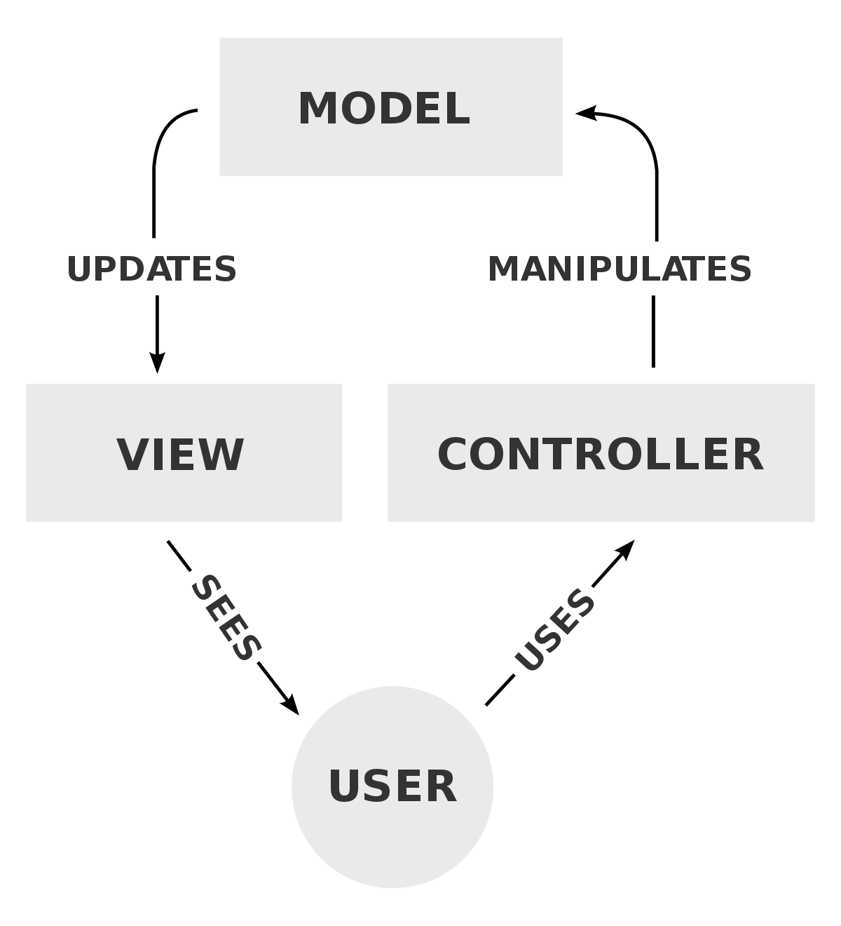
DETAIL ARCHITECTURE

Slide 11
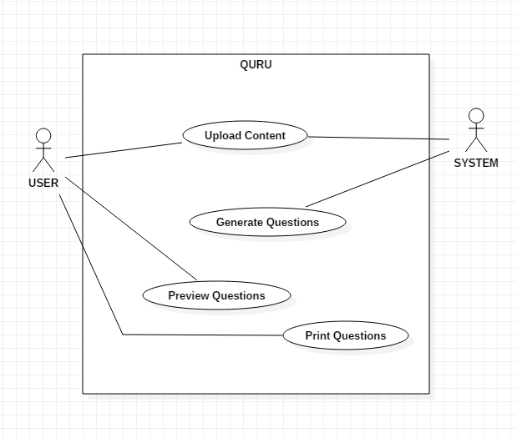
Use Case: Upload Content Generate Questions Preview Questions Print Questions.

Slide 12
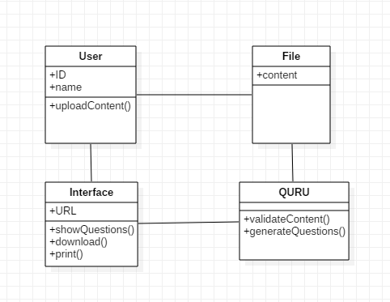
Class Diagram

Slide 13
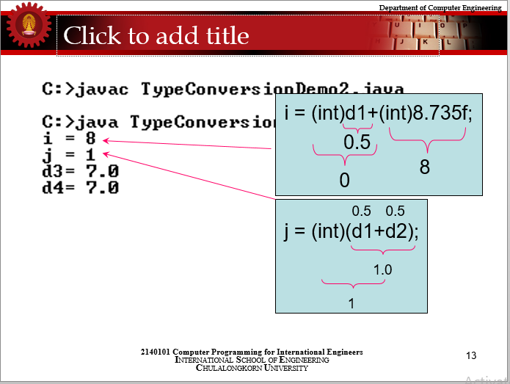
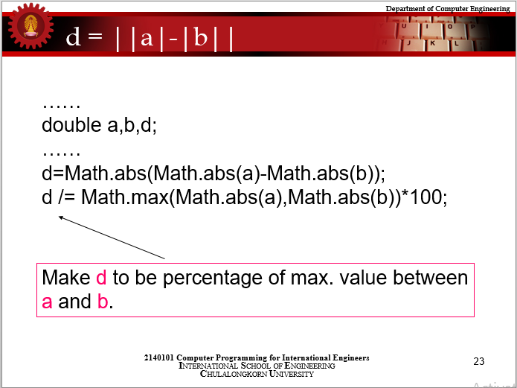
Challenges.

Slide 14
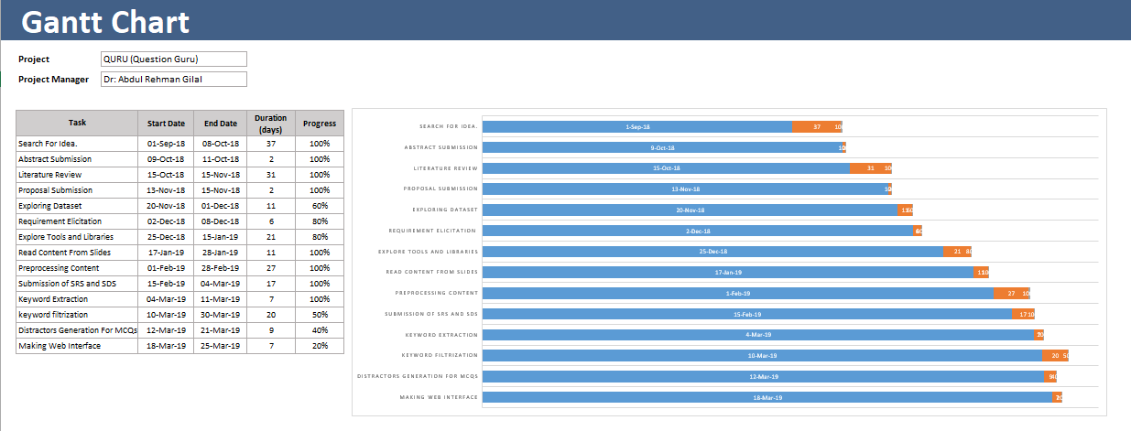
Gantt Chart

Slide 15
DEMO

