Slide 1
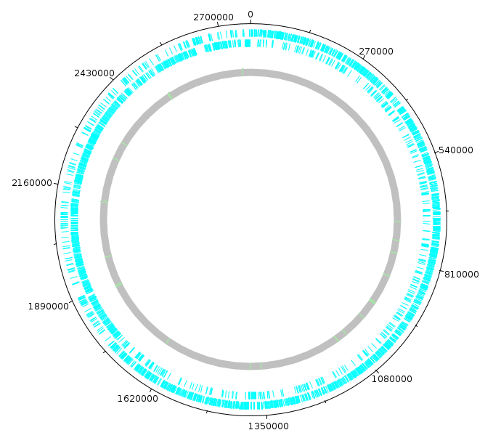
E. FAECIUM
What genes are essential for
growth in human serum?
By: Ina Odén Österbo

Slide 2
E. Faecium
Commensal in gastrointestinal tract
Usually doesn’t affect us
Hospitalized immunocompromized patients
Blood stream infections
Antibiotic resistance
Goal: Which genes? Targets?

Slide 3
What are my conclusions?
Article
Chromosome: 2 773 588 nt (2 765 010 nt)
Plasmid contigs: 7 (6)
Diff. exp. genes: 16.5% (27.8%)
Essential genes: Nucleotide biosynthesis
Carbohydrate biosynthesis
& transportation
(Nucl. biosynth.
& Carb. metab.)
Present in closely
related species: Yes

Slide 4
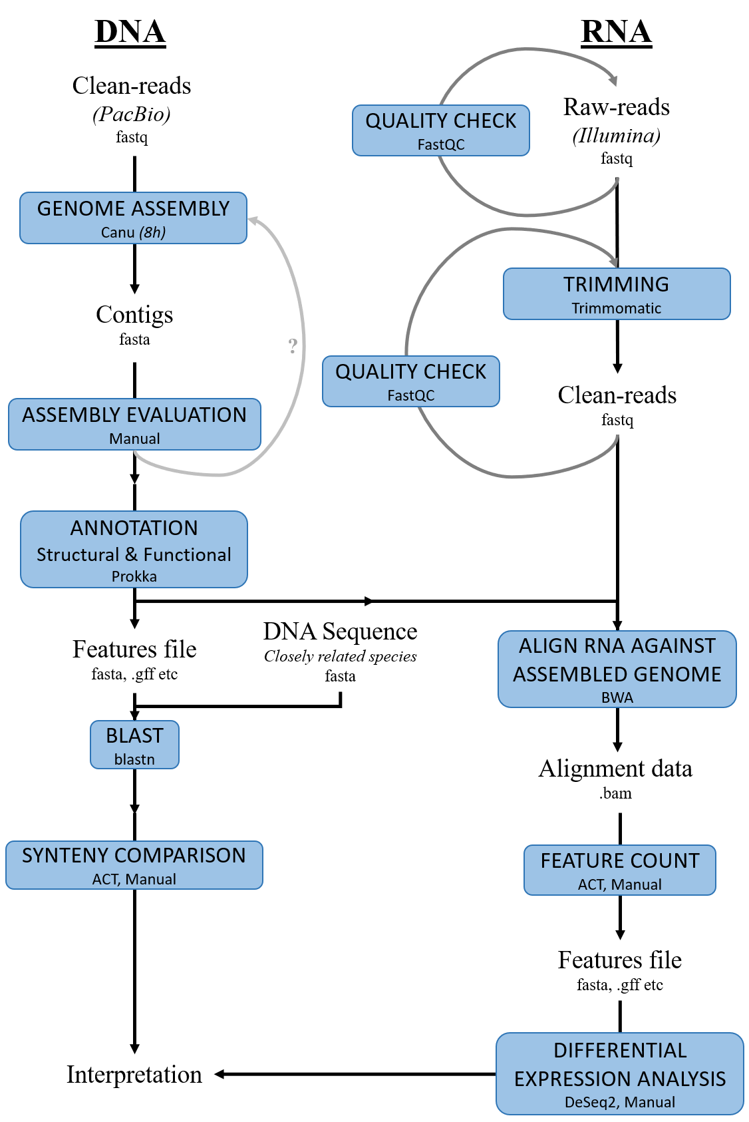
1.
2.

Slide 5
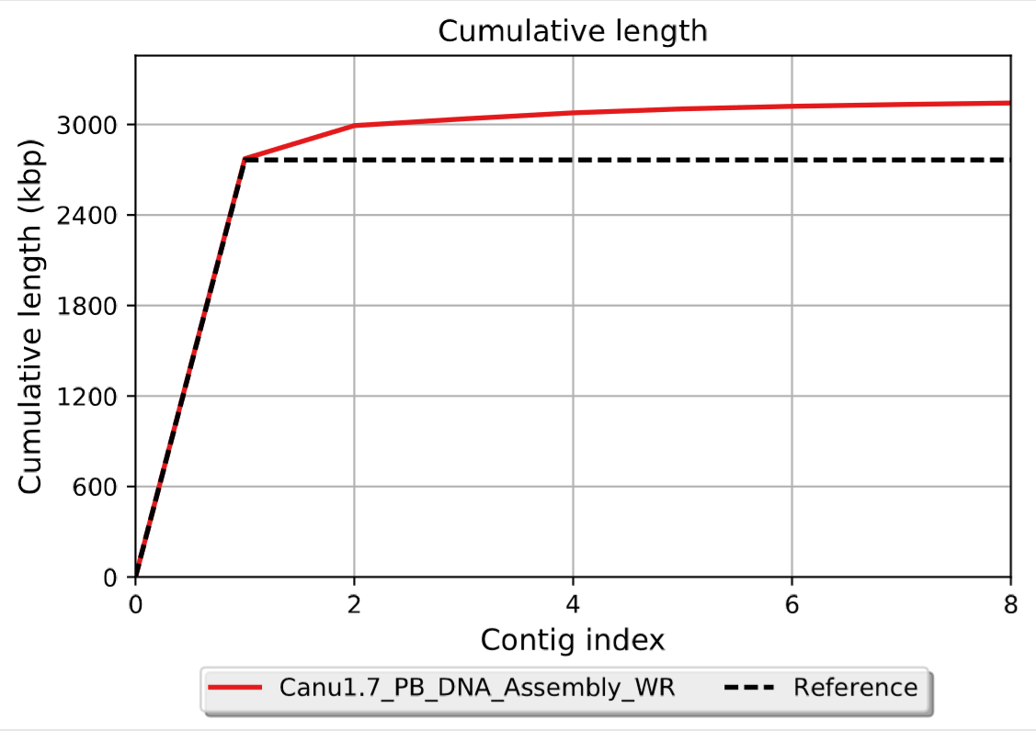
The assembly...
Total:
3.1 Mbp
N50= 2 773 588 nt
1 contig:
Entire chromosome

Slide 6
2.

Slide 7
Differential expression
Before RNA-seq: BHI or Serum (x3)
Transcription units: 3 208 (3217)
Differentially expressed: 496 (860)
padj < 0.001
log 2 fold change <-2 or >2

Slide 8
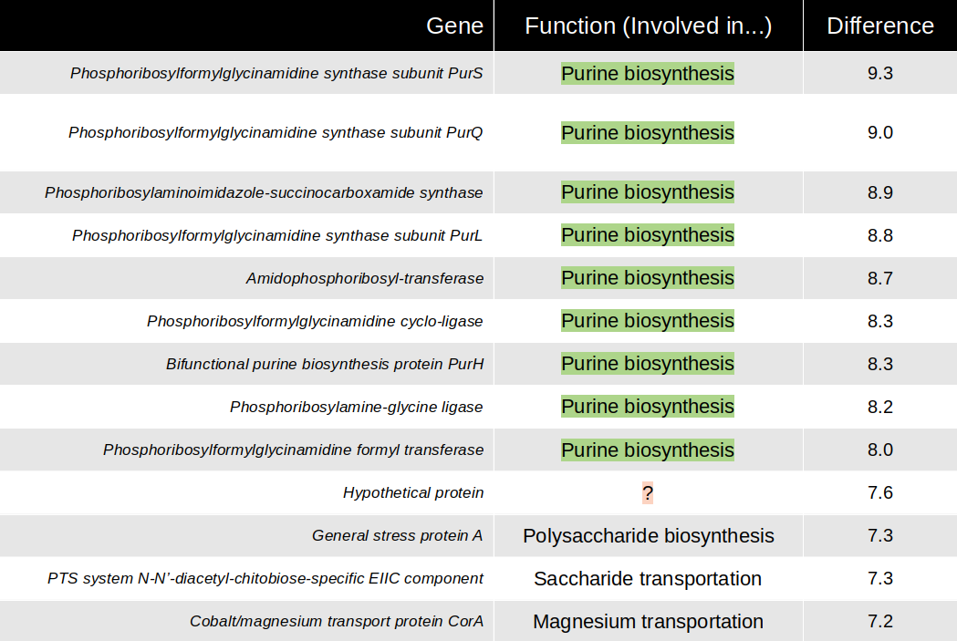
So what were the differentially expressed genes?
log2Fold
Change
Gene product
Serum > BHI

Slide 9
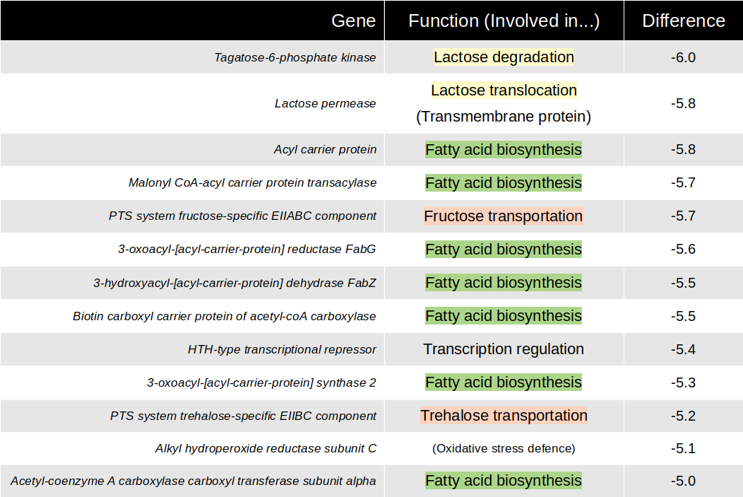
So what were the differentially expressed genes?
log2Fold
Change
Gene product
Serum < BHI

Slide 10
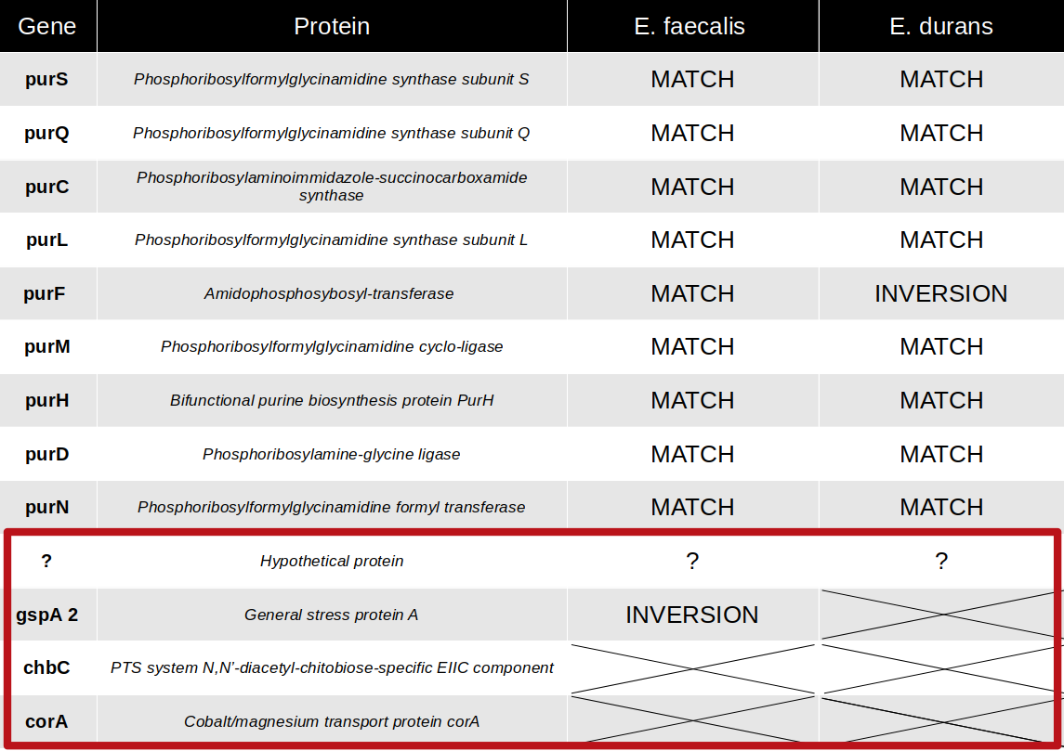
E. faecalis & E. durans

Slide 11
A summary…
ACT……………….
Essential genes → purine-biosynthesis proteins & carbohydrate metabolism
Blood stream → Upregulated
Targets for treatment?
My results (mostly) agree with what the authors of the article found…

Slide 12
Thank you for listening!
Questions?

Slide 13
This is in case someone asks a foreseen question

Slide 14
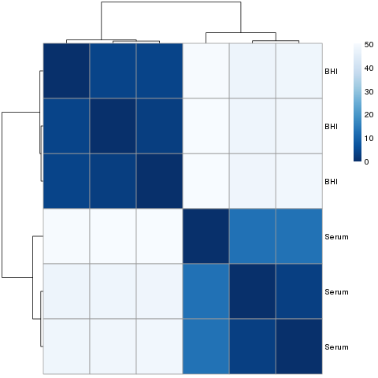
Were there any differences between the within-group replicates?
Yes!
One weird-ish-looking serum replicate.

Slide 15
How did I do the functional annotation?
I should’ve done it using EggNOGmapper...
I didn’t.

Slide 16
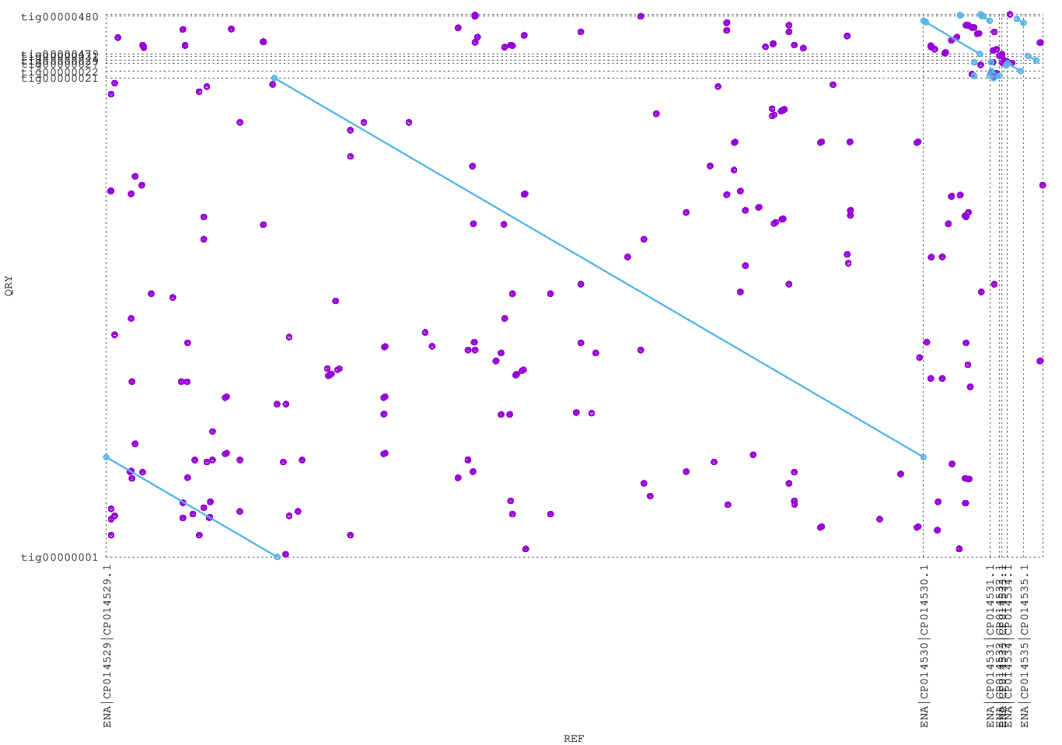
Did I use some other software to look at the assembly?
Indeed I did! – MUMmerplot

Slide 17
If I had more time, what would I have done?
Tn-seq! (Important part of the article)
Mariner-based transposon mutant library
Class of interspersed repeats
(non-adjacent)
Insertion in gene
→ change in survival etc?

