Slide 1
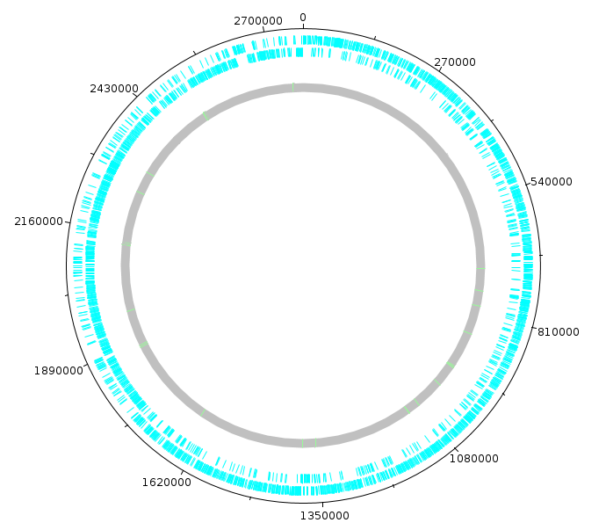
E. FAECIUM
What genes are essential for growth in human serum?
By: Ina Odén Österbo

Slide 2
What are my conclusions?
Article
Chromosome | 2 773 588 nt
Plasmids | 7
Differentially expressed genes | 16.5 %
Essential genes | Nucleotide biosynthesis & carbohydrate biosynthesis -and transportation
Present in closely related species? | Yes!
Chromosome | 2 765 010 nt
Plasmids | 6
Differentially expressed genes | 27.8 %
Essential genes | Nucleotide biosynthesis & Carbohydrate metabolism

Slide 3
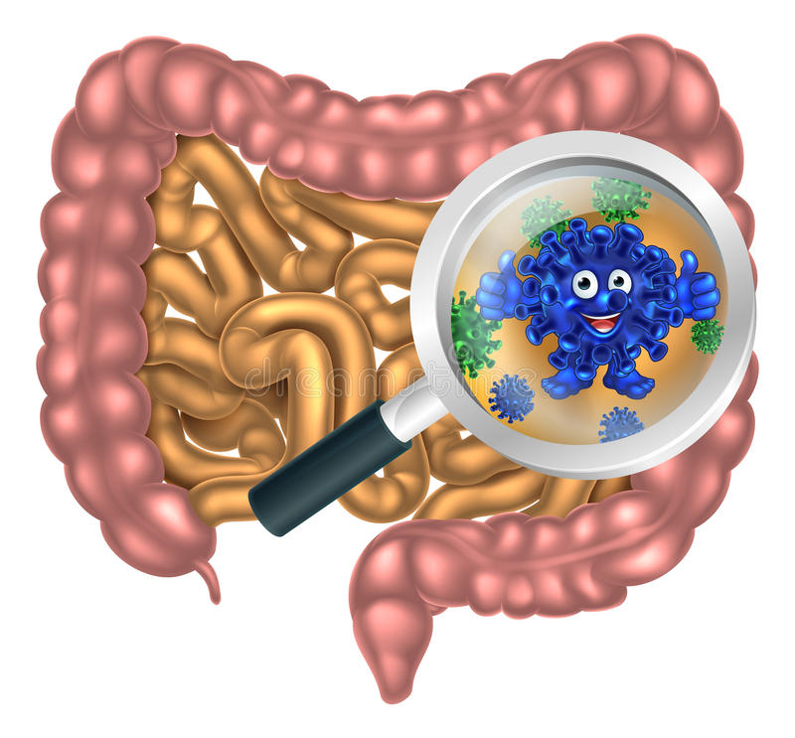
* Commensal in gastrointestinal tract
* Usually doesn’t affect us
* Hospitalized immunocompromized patients
* Blood stream infections
* Antibiotic resistance
* Goal: Which genes? Targets?

Slide 4
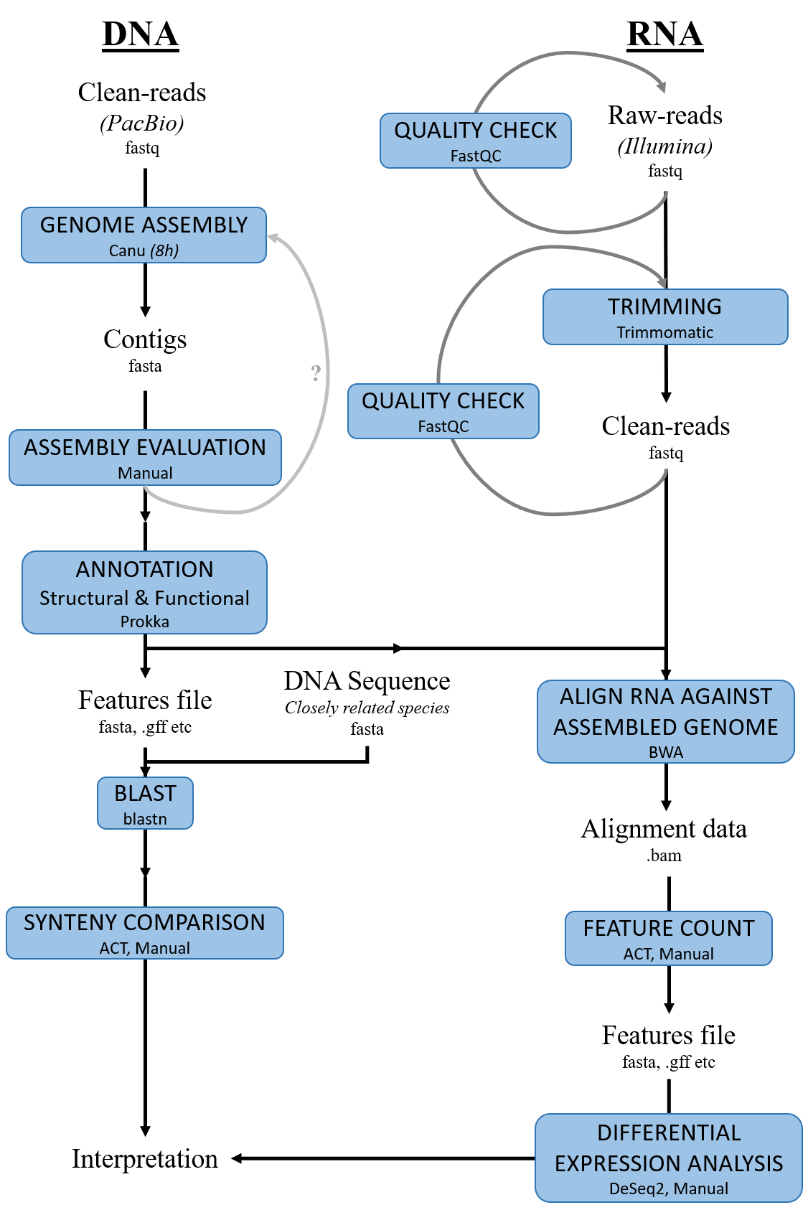
1.
2.

Slide 5
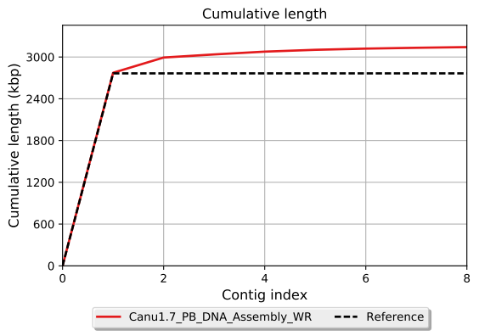
The assembly...
* 8 contigs
* Total: 3.1 Mbp
* 1 contig: Entire chromosome
* 7 other contigs – plasmids

Slide 6
1.
2.

Slide 7
Differential expression
* Annotation
* RNA mapping
* Transcription units: 3 208
* Differentially expressed: 496

Slide 8
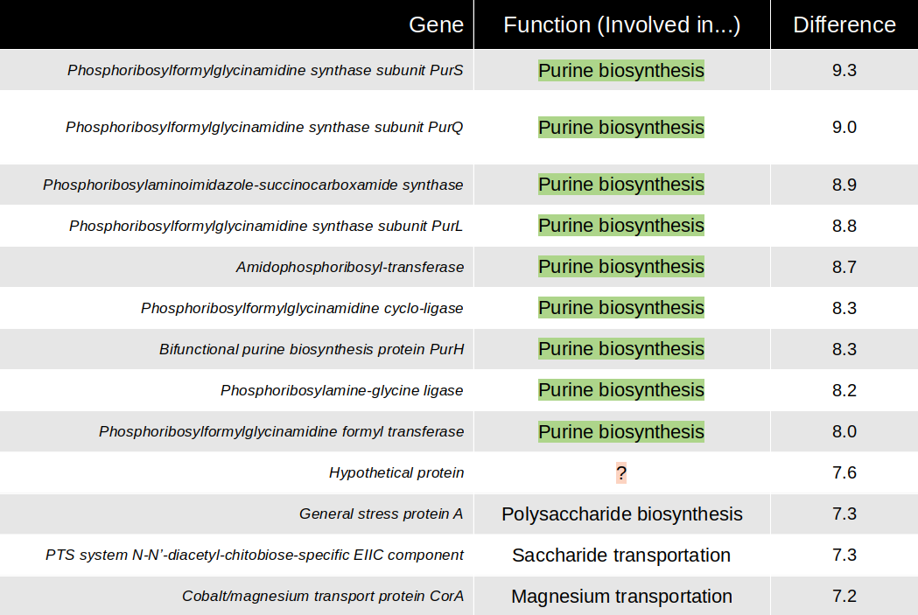
So what were the differentially expressed genes?
Before RNA-seq: BHI or Serum (x3)
Serum > BHI

Slide 9
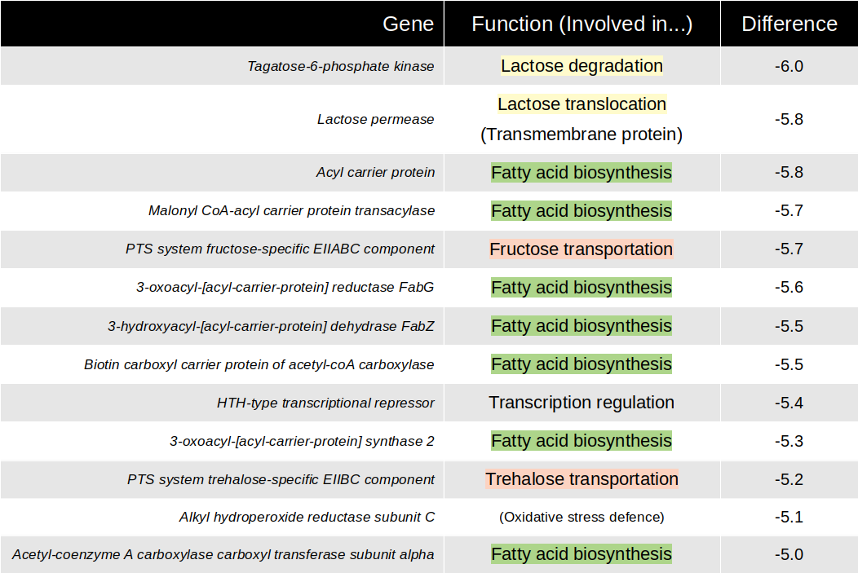
So what were the differentially expressed genes?
Before RNA-seq: BHI or Serum (x3)
Serum < BHI

Slide 10
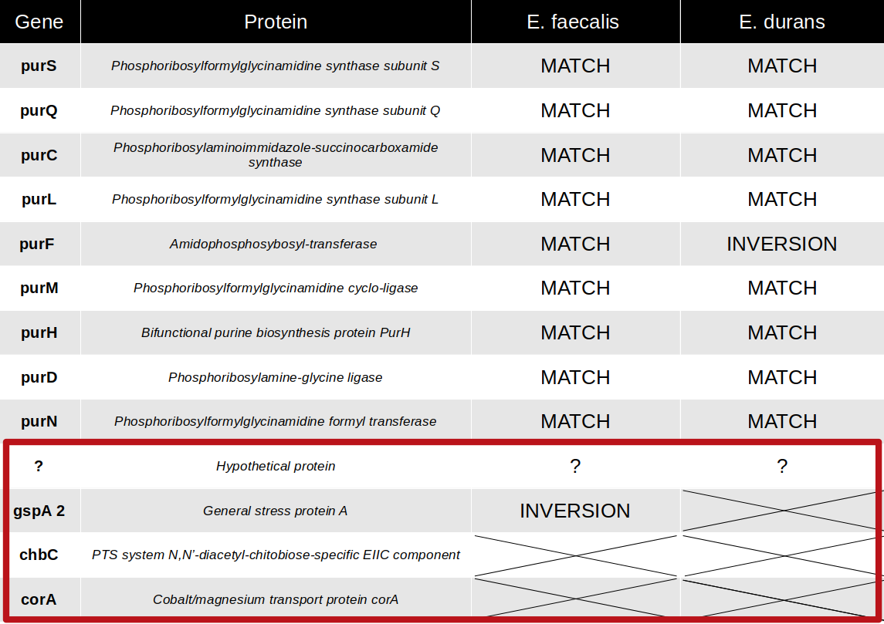

Slide 11
My conclusions
* Artemis…. Is not my friend.
* Essential genes → purine-biosynthesis proteins & carbohydrate metabolism
* Blood stream → Upregulated
* Targets for treatment?
* My results (mostly) agree with what the authors of the article found…
- Differences → questions

Slide 12
Thank you for listening!
Questions?

